Slide 1
Direct Donation System
Donate unconditionally
Smit Vijay Shah
shah.smi@husky.neu.edu
INFO 5100 – Application Engineering & Development
Final Individual Project

Slide 2
Problem Statement

Slide 3
Problem Statement
Donating money instead of goods to poor people.
Research shows that when people donate some goods to poor people the probability of them using it is very less and the probability of them exchanging it for money is very high. This research has clearly outlined that poor people needs money for their betterment.
Research also clearly outlines that the percentage of people using the money for bad usage is very less and are using it to improve their life.
Another statistic’s shows that for every donated amount by donors around 95% of that amount gets used up in management, infrastructure, transportation and various other departments for making those money/goods reach to poor people. So, around 5% is what actually donated to poor people of the entire donation. This ratios is very high.
(The objective of this project topic is not to justify the political/moral correctness of donating directly to the poorest people, but try to build such system to prove it will work technically)
[Reference: http://www.ted.com/talks/joy_sun_should_you_donate_differently]

Slide 4
Solution

Slide 5
Solution
Donating Money – Donate money instead of goods to poor people (Let them decide what is better for them)
Mobile Money - Transferring virtual money to persons registered mobile number (This will remove bureaucracy in charity by eliminating majority of the department like transportation, infrastructure and management where money gets utilized.)
Location verification – Verify the user’s location, surrounding and house condition to identify whether a person is actually poor or not.
User authentication –Mobile number(UserName), password and pin to authenticate a user during transfer/withdrawal to overcome fraudulent usage.
Support – Block account for any future transaction if a user reports loss/misuse of mobile/information. (This will eliminate misuse)

Slide 6
Scope

Slide 7
Scope
System cover entire world
Donor donates money to World Enterprise
Field Experts at County level is responsible for creating various registration drive in entire country and validating poor people information
Field Agents is responsible for visiting a place and registering poor people with personnel information, house condition, house GPS co-ordinates, providing mobile, number and creating their account.
Country Admin registers various sites
Finance team at World level:
Donates money to Poor People
Transfers money to Registered Sites.
Poor People can:
Transfer money to another person
Transfer money to registered site
Withdraw money from registered site
Generating Donation and Transaction reports
Generating UserAccount logs

Slide 8
Assumptions

Slide 9
Assumptions
All transaction are in USD $
Unique International ID is considered which is used while registering poor person
Only 1 member can register per family
Unique mobile numbers are linked to a person, which will be used as their username
Validating persons information with actual proof when person visits registered site for withdrawing money
Donation is made based on person age and number of family members
Field Agents have GPS device to enter a persons house location co-ordinates

Slide 10
Assumptions
Auto Donation
Individual
if Age >= 18 && Age <= 25 $500
if Age >= 26 && Age <= 40 $600
if Age >= 41 && Age <= 55 $700
if Age >= 56 $800
Family Member
if nos = 0 $0
if nos >= 1 && nos <= 2 $400
if nos >= 3 && nos <= 5 $800
if nos >= 6 $1000

Slide 11
Roles

Slide 12
Roles
World Admin
Donor
Poor People
Finance
Support
Country Admin
Field Experts
Field Agents
Registered Site Admin
Registered Site Agent

Slide 13
Object Model

Slide 14
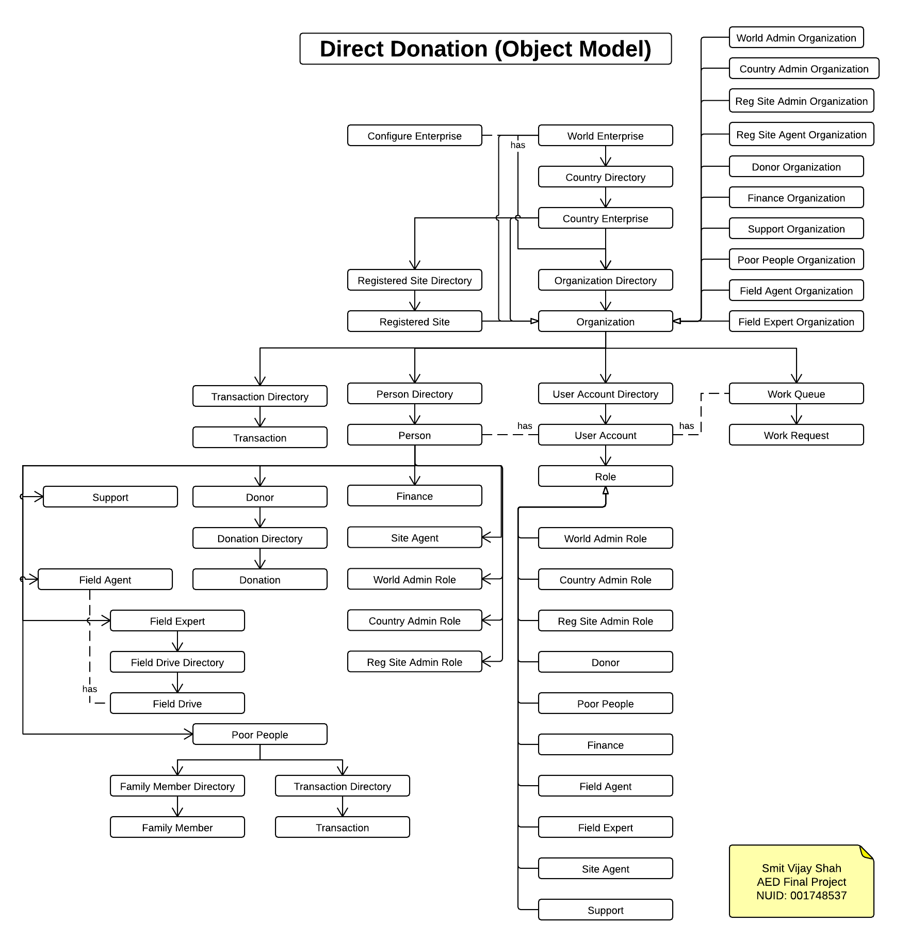

Slide 15
Responsibilities

Slide 16
World Admin
Manages World Enterprise and its organization
Manages users and user accounts of
World Admin
Finance
Support
Donor
Manages Country Enterprise
Add New Country
Creates Country Admin
Checks entire Transactions

Slide 17
Donor
Registers
Donates money
Checks entire transaction
Checks overall donation received and donation made

Slide 18
Finance
Checks entire transaction
Transfer money (Manual / Auto)
Virtual to Poor People
Real to Registered Site

Slide 19
Support
Validates user
Activate/Pending/De-Activate poor persons account in case of any reports made by them

Slide 20
Country Admin
Manages Country Enterprise and its organization
Manages users and user accounts of
Country Admin
Field Experts
Field Agents
Manages Registered Site Enterprise
Add New Site
Creates Site Admin
Checks entire Transactions

Slide 21
Field Expert
Create various field drives
Assigns Field Agents to drive
Approve/Dis-Approve a poor person based on it information and housing condition

Slide 22
Field Agent
Visits fields
Registers poor person to the system (Enters entire details of the person like personal information, family member information and house information)
Once person is activated, assigns mobile and number, creates account for use

Slide 23
Registered Site Admin
Manages Registered Site Enterprise and its organization
Manages users and user accounts of
Registered Site Admin
Registered Site Agents
Checks entire Transactions

Slide 24
Registered Site Agent
Verifies person visited for cash withdrawal
Provides money

Slide 25
Poor People
Updates PIN for transaction
Transfers money to
Another person
Registered Site for purchase of some goods
Withdraws money from Registered Sites

Slide 26
Thank You

