Slide 1
BIRLA VISHVAKARMA MAHAVIDYALAYA (Engineering College) (An Autonomous Institution) Information Technology Department AY: 2022 -23 4IT31 – Project I
Brain tumor detection
Guide: Group Members:
DR. zankhana shah Sneh Shah (19IT431)
Akshay kathiriya (19IT440)
Anchal singh (20IT606)

Slide 2
Outline of the presentation
Objective
Scope
Introduction
Literature Survey
ER diagram/Use-case diagram/Sequence diagram/DFDs
Description of Modules & Functionalities
Results/Screenshots
Demonstration

Slide 3
OBJECTIVE
To study Machine Learning and Deep Learning Algorithms which are useful in brain tumor detection
To study Image pre-processing and feature extraction algorithms
To achieve more accuracy than existing models
Pinpoint the major focus on the research.

Slide 4
SCOPE
Our Proposed model can easily classify MR image uploaded by the user in malignant or benign.
The MR picture should be taken from upward of the brain. Model is trained on particular type of MR images which are taken from particular angle of the brain.
Model can be used after image is taken in machine.
Image should be clean and with less noise.
Model does not provide live detection of tumor in MR scan.

Slide 5
INTRODUCTION
The central nervous system (CNS), which is made up of the brain and spinal column, regulates all essential bodily processes. These processes include voice, movement, and thought. This implies that a person's mental processes, speech, or movement might be affected when a tumor arises in the CNS.
According to the International Association of Cancer Registries (IARC), about 24,000 people pass away each year as a result of brain tumors.
The usual method to detect brain tumor is Magnetic Resonance Imaging (MRI) scans. Our proposed methodology will identify the tumor from MR image by using Machine Learning algorithm. Our system will identify tumor very fast and efficiently

Slide 6
Literature survey
Sr No | Literature | Results (Accuracy) | Findings
1 | Brain Tumor Detection Using Machine Learning in MR Images, Dept. of Computer Science Engineering Integral University Lucknow https://ieeexplore.ieee.org/document/9509695 Publish Year: 2021 | Three Features No Dropout => 92.17 % Two Features No Dropout => 89.06 % Three Features With Dropout => 89.25 % Two Features With Dropout => 91.91% | Didn’t use algorithm like PCA or WT for pre-processing or feature extraction. CNN can achieve better accuracy. Achieved more accuracy than previous paper they have studied.
2 | Brain Tumour Classification Based on Deep Convolutional Neural Networks, Electronic and Electrical Communication Department, Faculty of Electronic Engineering, Menoufia University https://ieeexplore.ieee.org/document/9480637 Publish Year: 2021 | CNN With Splitting Ratio 70:30 => 94.14% CNN With Splitting Ratio 80:20 => 96.05% | Used dataset is raw and resolution of image is not stable & quality is not high. Accuracy can be increased with another available dataset
3 | Deep Learning for Brain Tumor Classification from MRI Images, Department of Computer Science and Engineering The North Cap University Gurugram, Haryana, India. https://ieeexplore.ieee.org/document/9702609 Publish Year: 2021 | SVM => 71.34% RFC => 72.78% VGG-16 =>96.3% Inception_V3 => 93.4% ResNet => 99.7% | Didn’t use algorithm like PCA or WT for pre-processing or feature extraction SVM accuracy can be increased

Slide 7
Sr No | Literature | Results (Accuracy) | Findings
4 | Multiclass Brain Tumor Classification Using Convolutional Neural Network and Support Vector Machine, Department of Computer Sciences University of Engineering and Technology Taxila, Pakistan https://ieeexplore.ieee.org/document/9526262 Publish Year: 2021 | ResNet => 97.8% GoogleNet => 97.4% ResNet-18 + SVM => 98% GoogleNet + SVM => 97.6% | Have studied some ResNet and GoogleNet models, that achieved higher accuracy
5 | Survey on Brain Tumor Detection using Machine Learning and Deep Learning ,ME CSE. Panimalar Engineering College Chennai,India. https://ieeexplore.ieee.org/document/9457019 Publish Year: 2021 | SVM => 98% KBFC => 97% FPCNN => 99% ST => 100% | Applied many Algorithms of ML and DL Most accurate model

Slide 8
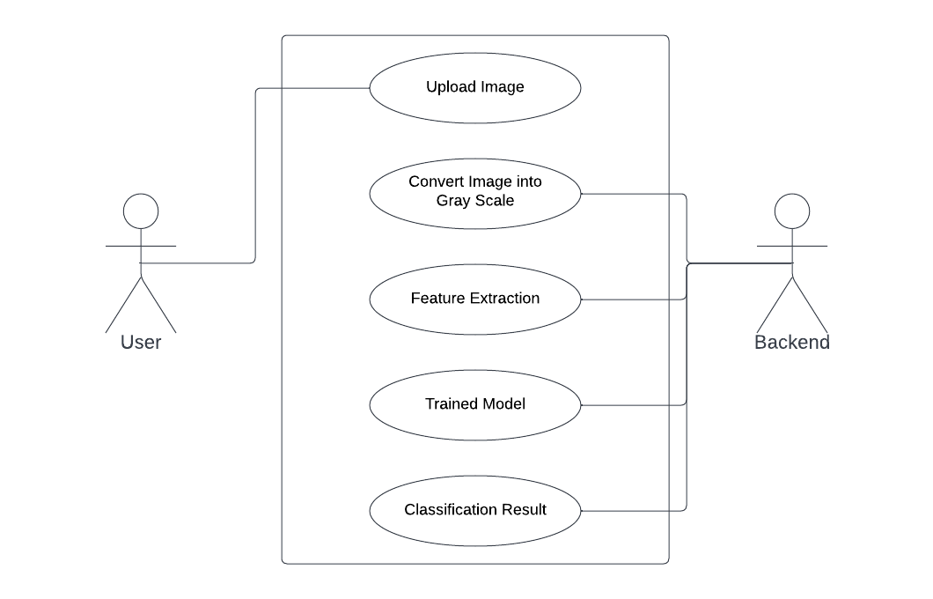
Use-case diagram

Slide 9
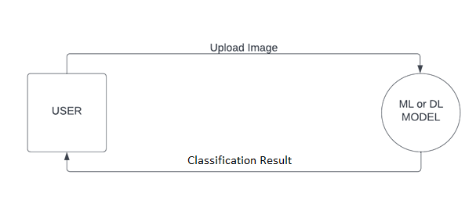
Data flow diagram
level 0

Slide 10
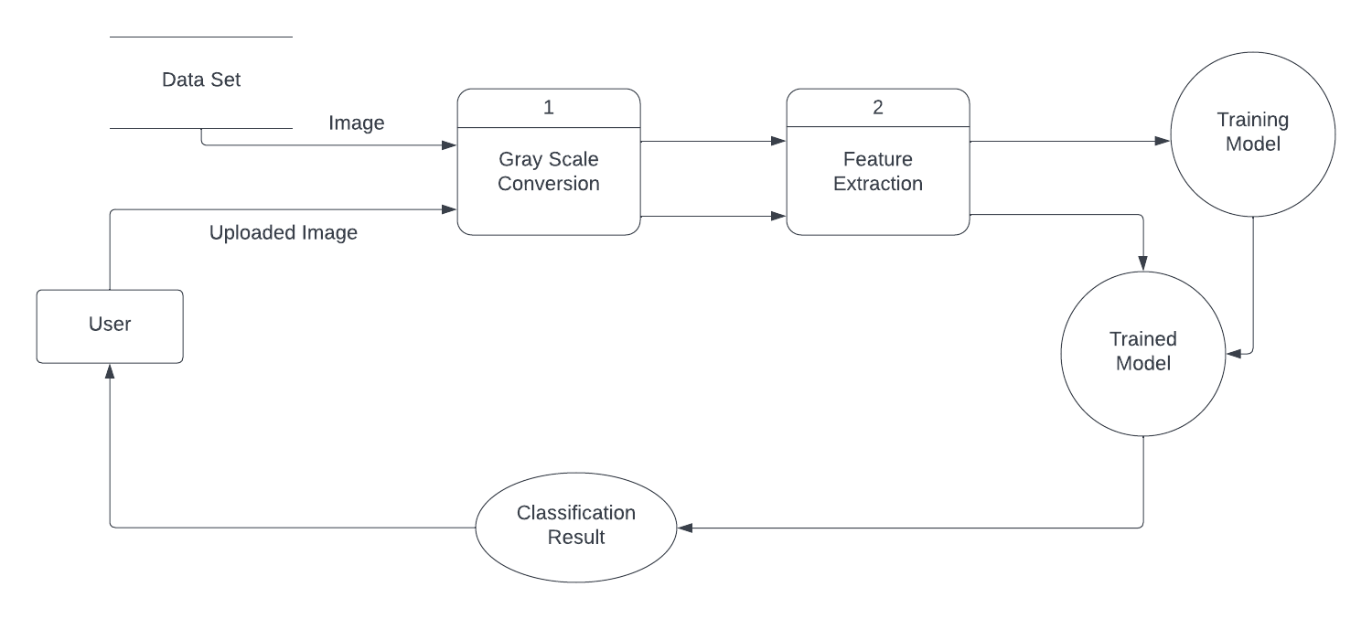
Level-1

Slide 11
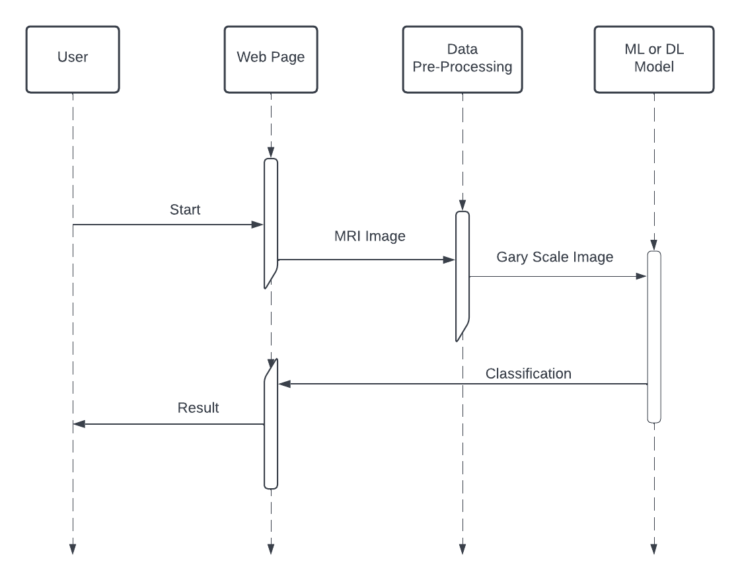
Sequence Diagram

Slide 12
Project Modules
Data Collection
Data Pre-processing
Feature Extraction
Classification
Deployment

Slide 13
Data Collection
Sr No | Dataset | Survey
1 | Kaggle | 3000 Images Labelled Images
2 | Figshare | 766 Images In the form of Access Database
3 | Github | 4-Class Classification 2870 Training Images Mixed type of images Probably hard to achieve high accuracy
4 | Github | 253 Images Labelled images

Slide 14
IMAGE PREPROCESSING
Data Pre-processing is most essential step for any ML or DL model. It directly affects the accuracy of the model. So clean and suitable data for the model is needed.
Dataset images size is not fixed. To feed the image as input to model, we have to normalize the size of the image in terms of the pixels. So as per the various methods we have resized the images to 64 x 64 for DWT and PCA, 128 x 128 for CNN and 256 x 256 for central tendency method.
Also, the images pixels are in 3-dimensions as RGB so we converted the image in grey scale. This process converted image into 2-dimension from 3-dimension. This would reduce computation time and training time of the model.

Slide 15
FEATURE EXTRACTION
Feature extraction helps to reduce the amount of redundant data from the data set.
In the end, the reduction of the data helps to build the model with less machine effort and also increases the speed of learning and generalization steps in the machine learning process.
Techniques used in Feature Extraction:
Discrete Wavelet Transform (DWT)
Principal Component Analysis (PCA)
Central Moments

Slide 16
DISCRETE WAVELET TRANSFORM (DWT)
The discrete wavelet transform has a huge number of applications in science, engineering, mathematics and computer science. Most notably, it is used for signal coding, to represent a discrete signal in a more redundant form, often as a preconditioning for data compression
Discrete wavelet transform is widely used in feature extraction step because it reduces the dimension accurately that we can extract main features

Slide 17
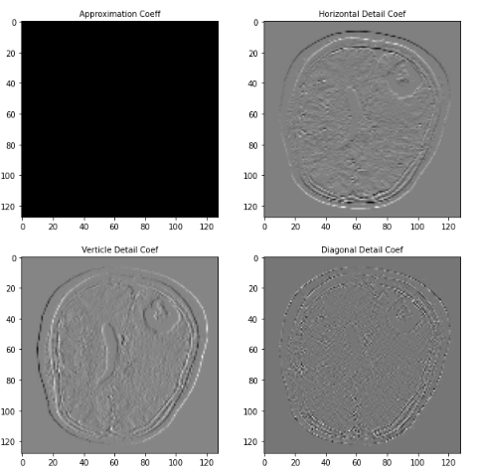
DISCRETE WAVELET TRANSFORM (DWT)
When we apply DWT on any image, image will decompose in two parts i) Low pass Decomposition filter and ii) High pass Decomposition filter.
Then again both decomposed in two-two parts. After second decomposition we get four coefficients
i) Approximation Coef.
ii) Horizontal Detailed Coef.
iii) Vertical Detailed Coef.
iv) Diagonal Detailed Coef.

Slide 18
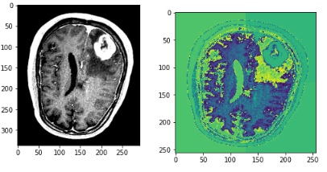
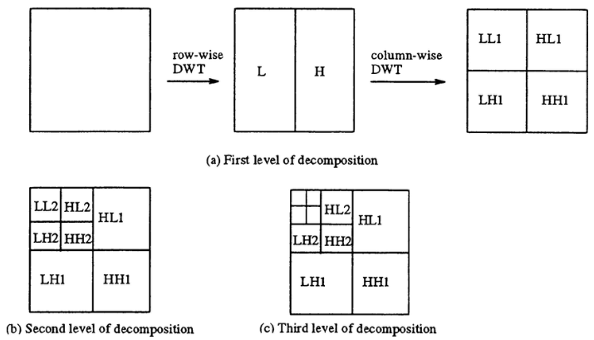
DISCRETE WAVELET TRANSFROM (DWT)
Images Before and After applying the DWT
Different level of decomposition

Slide 19
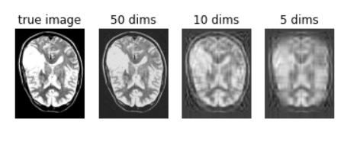
PRINCIPAL COMPONENT ANALYSIS
Principal Component Analysis (PCA) is a linear dimensionality reduction technique (algorithm) that transform a set of correlated variables (p) into a smaller k (k<p) number of uncorrelated variables called principal components while keeping as much of the variability in the original data as possible.
We have checked image by applying various k value and stay with k=50 as it is giving accuracy of 97.50% which is better then other k values.
Image after applying various dimensions in PCA.

Slide 20
CENTRAL MOMENTS
Technique of data reduction
In this method we have taken the image size of 256 x 256 and segment it into 16 x 16 window. Central moments of each window stored in the metrics. This method helps to reduce the data significantly and make the training faster.
Lossy Data Reduction

Slide 21
CLASSIFICATION
Process of categorizing a given set of data into classes
Classify the tumor in malignant and benign categories
Algorithms we have used:
Support Vector Machine (SVM)
Convolutional Neural Network (CNN)

Slide 22

SUPPORT VECTOR MACHINE (SVM)
Support Vector Machine is one of the most popular techniques for classification.
SVM creates best line or hyperplane to segregate n-dimensional datasets.
SVM selects the most extreme points to set the hyperplane. Points which are used to measure maximum distance or to find maximum margin are support vectors.

Slide 23
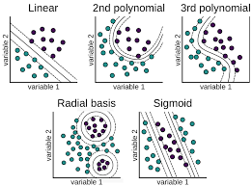
SUPPORT VECTOR MACHINE
We can use various kernels in SVM to fit best hyperplane and achieve more accuracy. In this research paper we have used three different kernels:
i) Linear
ii) Polynomial
iii) Radial Basis Function (RBF)

Slide 24
CONVOLUTION NEURAL NETWORK (CNN)
Convolutional Neural Networks (ConvNets or CNNs) are a category of Neural Networks that have proven very effective in areas such as image recognition and classification. ConvNets have been successful in identifying faces, objects and traffic signs apart from powering vision in robots and self driving cars.
1. Convolution
2. Non Linearity (ReLU)
3. Pooling or Sub Sampling
4. Classification (Fully Connected Layer)

Slide 25

Convolution
Extract Features
The filter interacts with image and perform dot products
Matrix generated by dot product and image matrix is called Feature Map

Slide 26
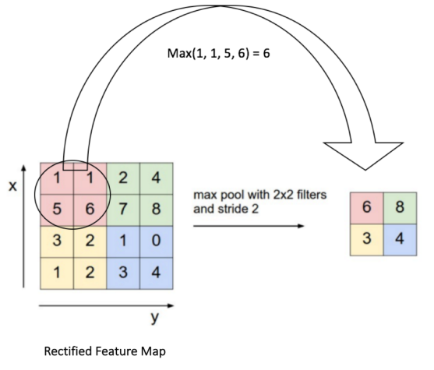
Pooling
Pooling layers are used to reduce the dimensions of the feature maps. Thus, it reduces the number of parameters to learn and the amount of computation performed in the network
Types of Pooling Layers:
Max Pooling
Average Pooling

Slide 27
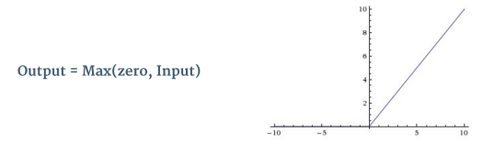
ReLU (Rectified Linear Unit)
ReLU is an element wise operation (applied per pixel) and replaces all negative pixel values in the feature map by zero.
The purpose of ReLU is to introduce non-linearity in our ConvNet, since most of the real-world data is non-linear and we would want our ConvNet to learn non-linear data

Slide 28
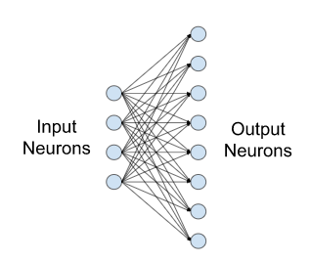
Fully Connected Layer (Dense Layer)
Also known as linear layers
That connect every input neuron to every output neuron and are commonly used in neural networks
We can use different activation functions on Dense layer

Slide 29
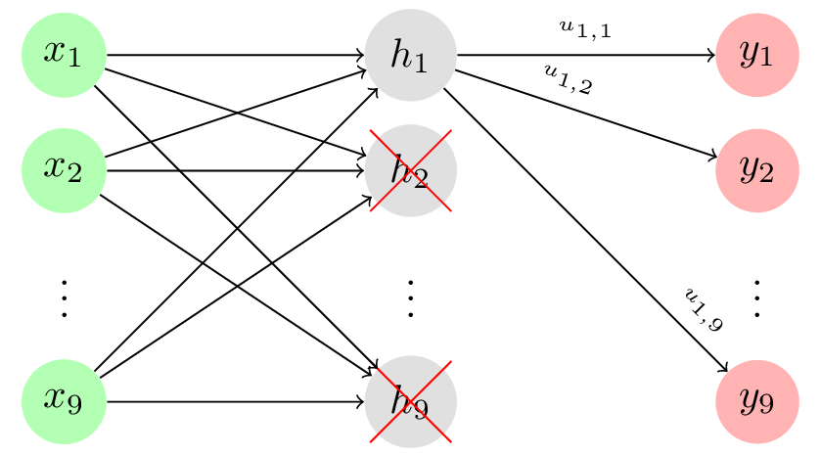
Dropout Layer
The Dropout layer randomly sets input units to 0 with a frequency of rate at each step during training time
It is used to prevent overfitting
We can provide rate to dropout layer to customize it as per our model

Slide 30
DEPLOYMENT
We have made simple UI using Streamlit library in python
Streamlit is an open-source Python library that makes it easy to create and share beautiful, custom web apps for machine learning and data science. In just a few minutes you can build and deploy powerful data apps
Streamlit provides easy APIs for different widgets of the webpage. We can code front end and back end both in one file. We don’t have to maintain numbers of file for front and back end

Slide 31
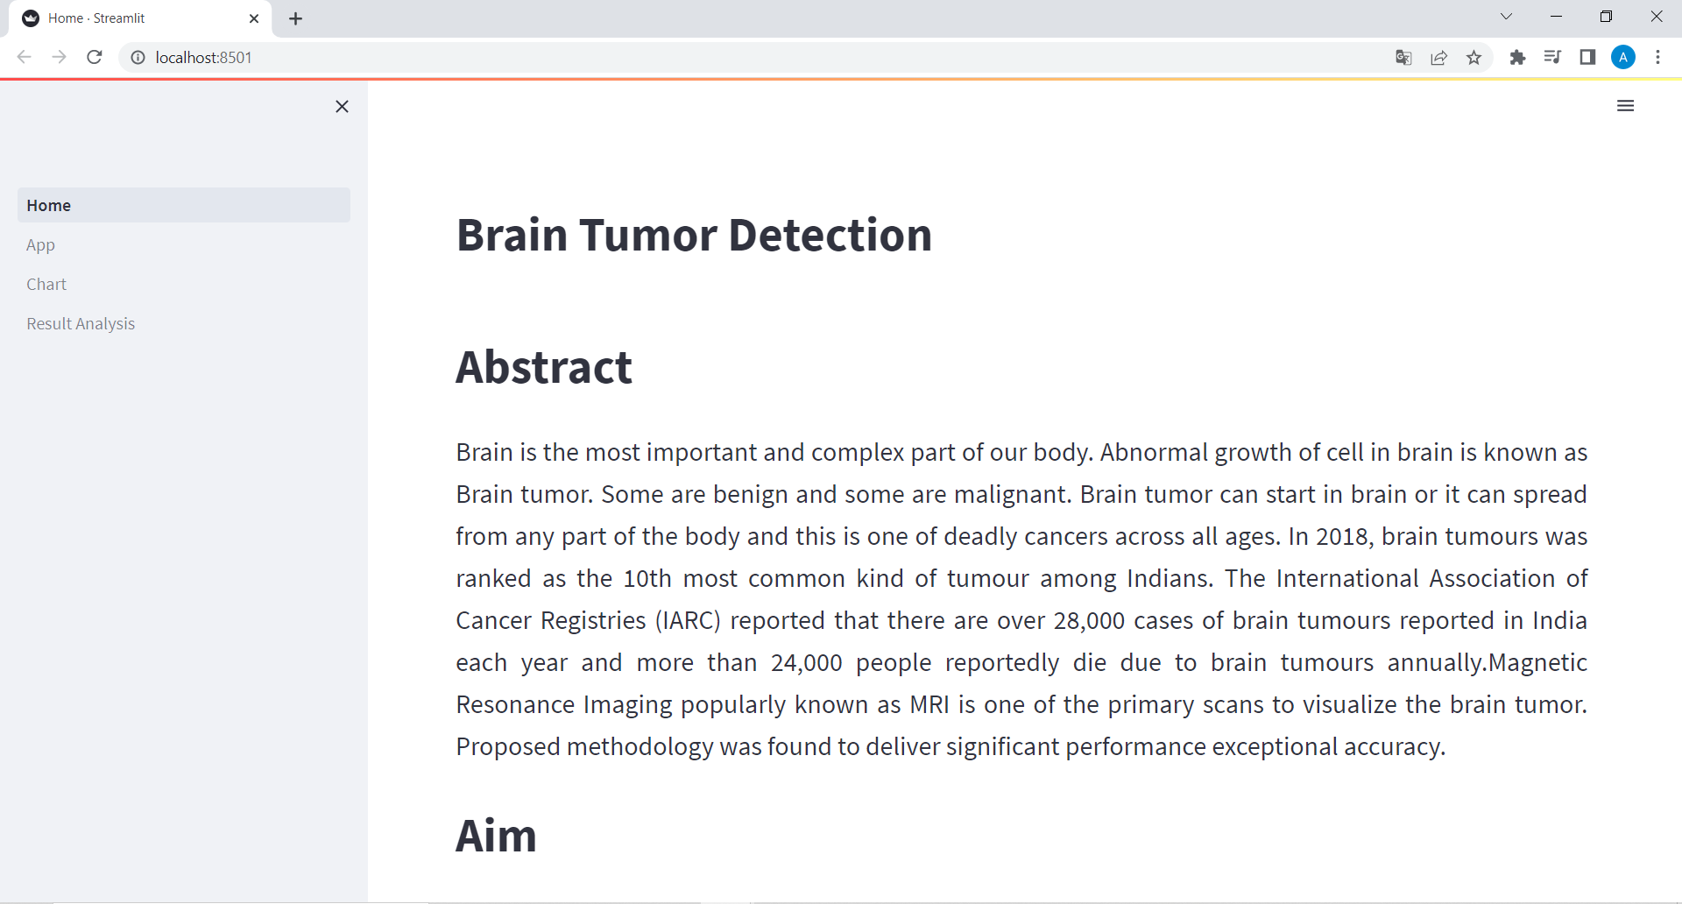
USER INTERFACE (UI)

Slide 32
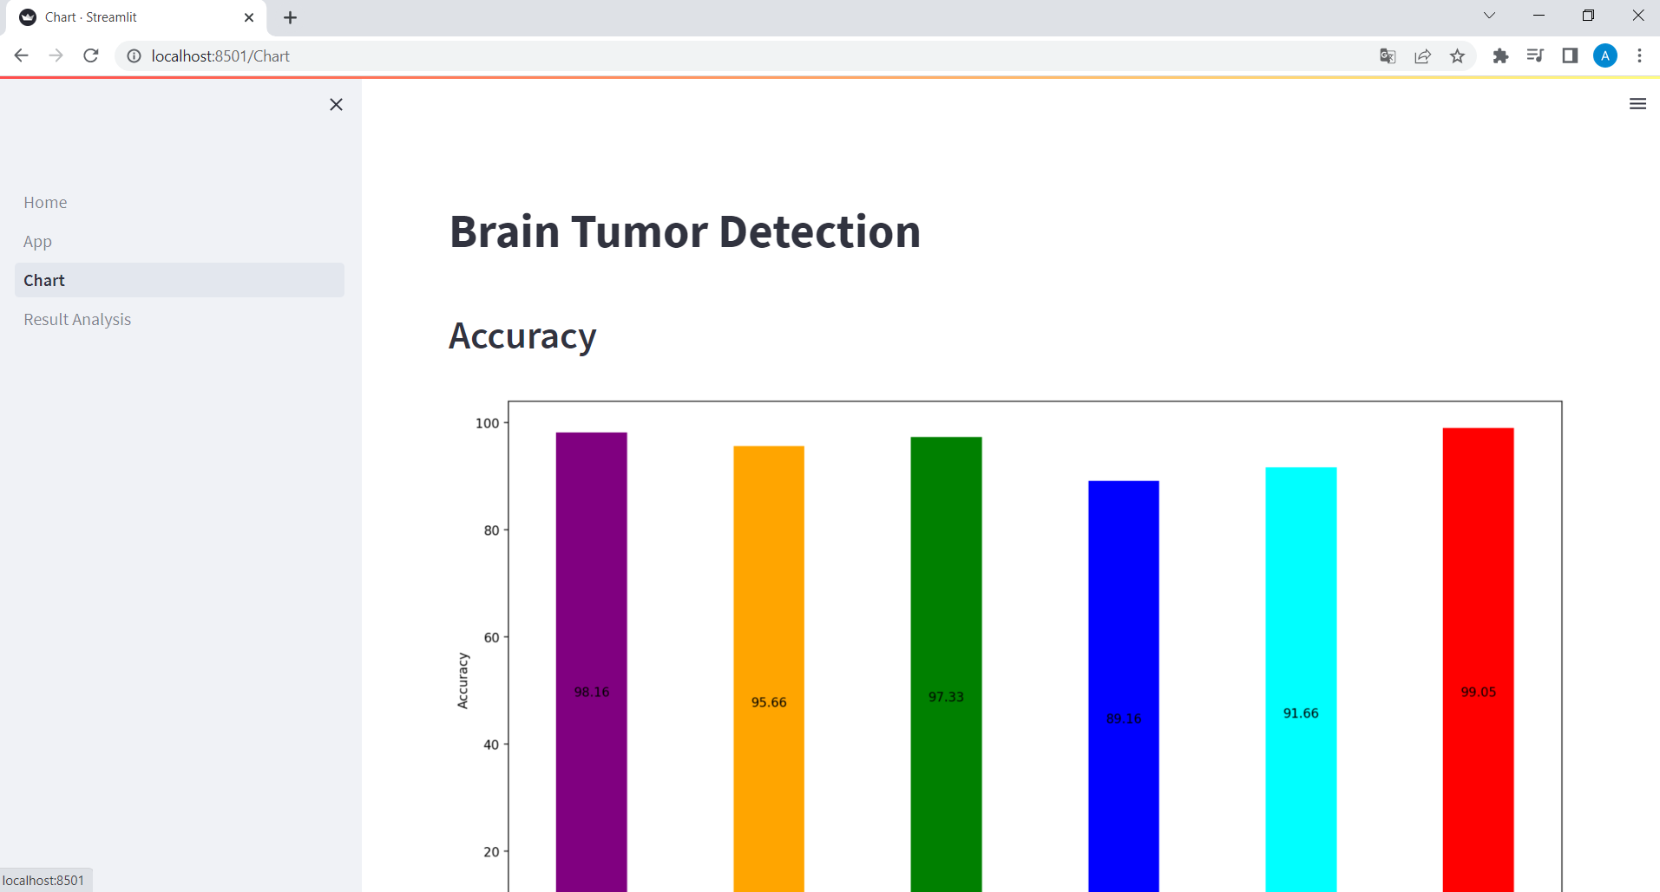
USER INTERFACE (UI)

Slide 33
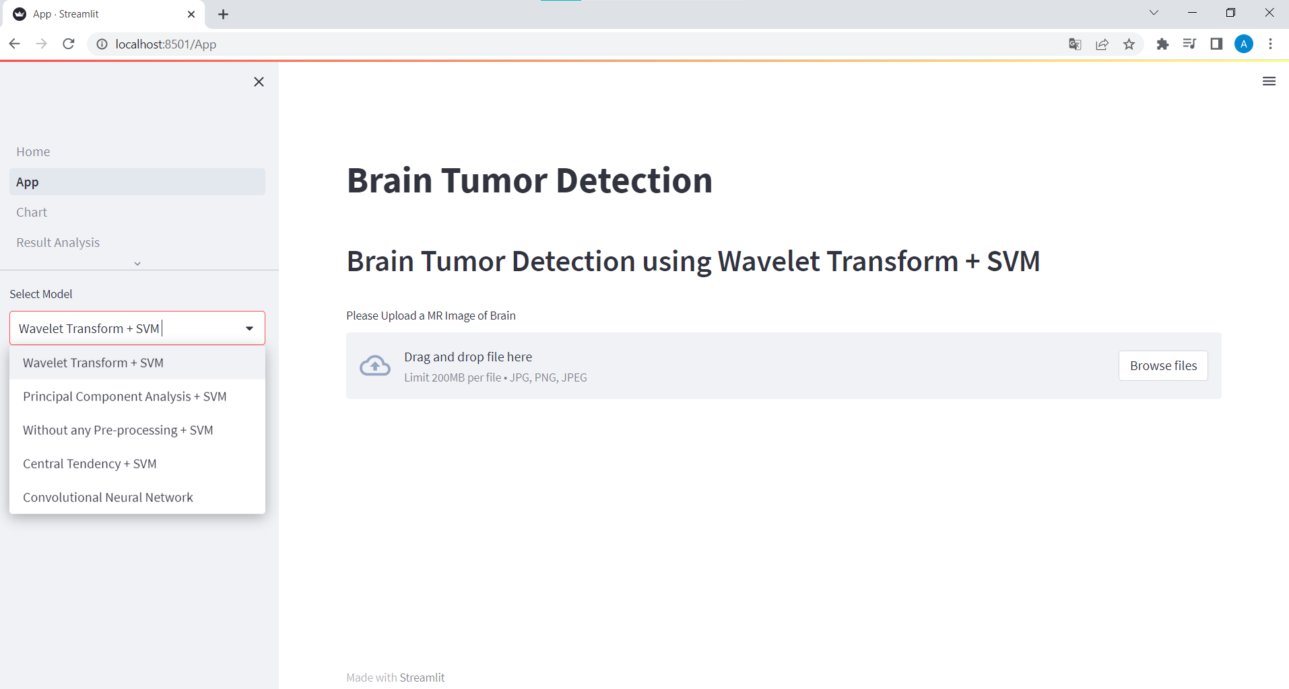
USER INTERFACE (UI)

Slide 34
RESULT ANALYSIS (70:30 Split)
Model | Kernel | Accuracy | Precision | Recall
DWT + SVM | Linear | 95.55% | 95.97% | 96.34%
 | Polynomial | 96.88 | 97.54 | 96.75%
 | RBF | 96.44 | 96.19 | 97.36
Without feature extraction + SVM | Linear | 93.88 | 95.32 | 92.57
 | Polynomial | 92.11 | 96.11 | 88.23
 | RBF | 95.44 | 96.45 | 94.52
PCA + SVM | Linear | 94.22 | 97.01 | 91.54
 | Polynomial | 92.66 | 96.25 | 89.15
 | RBF | 96.88 | 97.37 | 96.52
Central Tendency + SVM (128x128) | Linear | 79.44 | 82.21 | 79.71
 | Polynomial | 82.88 | 94.25 | 73.22
 | RBF | 85.11 | 87.31 | 85.19
Central Tendency + SVM (256x256) | Linear | 88.33 | 90.75 | 87.62
 | Polynomial | 89.88 | 96.31 | 84.87
 | RBF | 87.55 | 90.96 | 85.80
CNN | - | 98.13 | 97.33 | 98.2

Slide 35
RESULT ANALYSIS (80:20 Split)
Model | Kernel | Accuracy | Precision | Recall
DWT + SVM | Linear | 96.5% | 96.8% | 97.08%
 | Polynomial | 98.16 | 98.53 | 98.25%
 | RBF | 97.33 | 97.11 | 98.25
Without feature extraction + SVM | Linear | 94.66 | 95.75 | 93.91
 | Polynomial | 94.33 | 96.36 | 92.65
 | RBF | 95.66 | 96.10 | 95.48
PCA + SVM | Linear | 95.33 | 97.07 | 94.02
 | Polynomial | 94.33 | 96.71 | 92.45
 | RBF | 97.33 | 97.40 | 97.84
Central Tendency + SVM (128x128) | Linear | 80.5 | 85.31 | 79.59
 | Polynomial | 89.16 | 95.72 | 84.83
 | RBF | 87.5 | 89.64 | 88.33
Central Tendency + SVM (256x256) | Linear | 89.66 | 93.76 | 87.75
 | Polynomial | 91.66 | 97.41 | 87.75
 | RBF | 89.16 | 91.61 | 89.21
CNN | - | 99.05 | 98.33 | 99.1

Slide 36
CONCLUSION
The proposed methodology outperforms other methodologies under consideration. The accuracy of feature extraction using Discrete Wavelet Transform and classification using SVM is higher than that of the studied model.
PCA and central tendency are lossy data reduction techniques, they do not provide the expected accuracy.
We have achieved more than 99% accuracy using CNN, which is better than the models studied for this research

Slide 37
FUTURE WORK
To Study GoogleNet and ResNet algorithms
Try to achieve accuracy near 100%
Deploy model in a way that it can be used in live detection

Slide 38
REFERENCES
R. Jahan and M. M. Tripathi, "Brain Tumor Detection Using Machine Learning in MR Im- ages," 2021 10th IEEE International Conference on Communication Systems and Network Technologies (CSNT), 2021, pp. 664-668, doi: 10.1109/CSNT51715.2021.9509695.
H. Kibriya, M. Masood, M. Nawaz, R. Rafique and S. Rehman, "Multiclass Brain Tumor Classification Using Convolutional Neural Network and Support Vector Machine," 2021 Mohammad Ali Jinnah University International Conference on Computing (MAJICC), 2021, pp. 1-4, doi: 10.1109/MAJICC53071.2021.9526262.
S. Arora and M. Sharma, "Deep Learning for Brain Tumor Classification from MRI Im- ages," 2021 Sixth International Conference on Image Information Processing (ICIIP), 2021, pp. 409-412,doi: 10.1109/ICIIP53038.2021.9702609.
S. A. El-Feshawy, W. Saad, M. Shokair and M. Dessouky, "Brain Tumor Classification Based on Deep Convolutional Neural Networks," 2021 International Conference on Elec- tronic Engineering (ICEEM), 2021, pp. 1-5, doi: 10.1109/ICEEM52022.2021.9480637.
P Gokila Brindha, M Kavinraj, P Manivasakam and P Prasanth “Brain tumor detection from MRI images using deep learning techniques” https://iopscience.iop.org/arti- cle/10.1088/1757-899X/1055/1/012115/pdf

Slide 39
Yongli Zhang "Support Vector Machine Classification Algorithm and Its Application"
Mahmoud Ayyoub,Ghaith Husari, Omar Darwish, Alabed Ahmad, 2012/04/03,"Machine learning approach for brain tumor detection" DO:10.1145/2222444.2222467, ACM Interna- tional Conference Proceeding Series
https://www.researchgate.net/figure/Three-levels-of-decomposition-in-2D-DWT_fig3_220540085
https://www.javatpoint.com/machine-learning-support-vector-machine-algorithm
https://www.r-bloggers.com/2019/10/support-vector-machines-with-the-mlr-package/
https://ujjwalkarn.me/2016/08/11/intuitive-explanation-convnets/
https://ujjwalkarn.me/2016/08/11/intuitive-explanation-convnets/
https://livebook.manning.com/book/machine-learning-for-mortals-mere-and-oth- erwise/chapter-6/148

Slide 40


