Slide 1
Introducing “LIDL – The Wellness Zone ”
Disclaimer: This presentation contains reconstructed project examples for portfolio purposes.
No confidential client data, proprietary insights, or sensitive materials are included.
A Strategic Partnership with Wellness Space Brands
Dublin, Ireland
Date: XY, XYWZ

Slide 2
Table of contents
01
Market Problem Overview
02
Why Collaborate with “Wellness space Brands”?
03
What’s in it for LIDL Customers?
04
Implementation Plan
Revenue Estimations
05
06
Implementation challenges
07
Marketing promotions
08
What’s in it for LIDL?

Slide 3
Market Problem Overview
01
Addressing the Growing Wellness Challenges

Slide 4
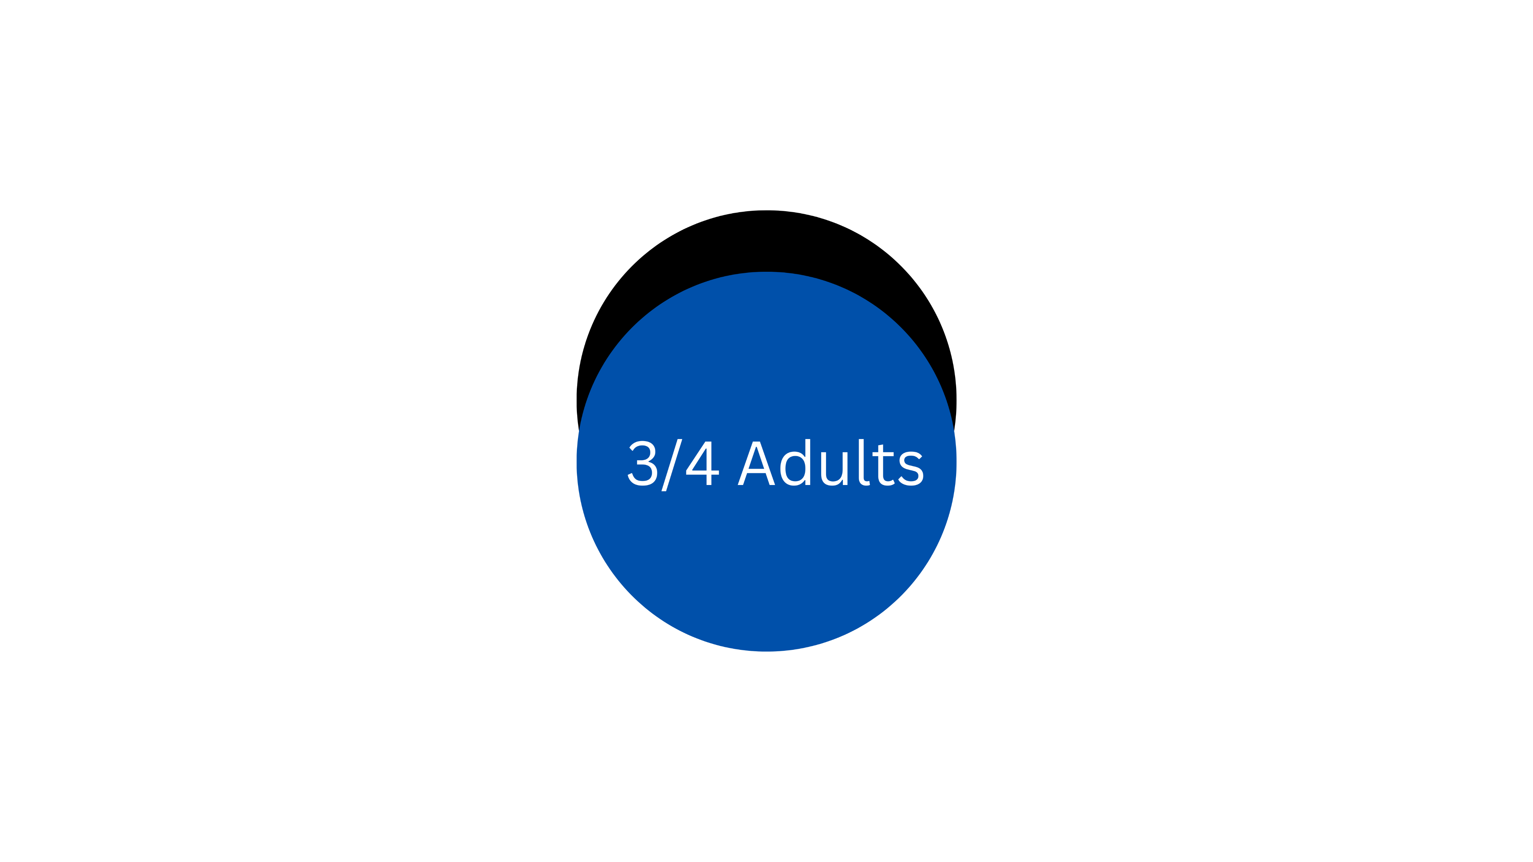
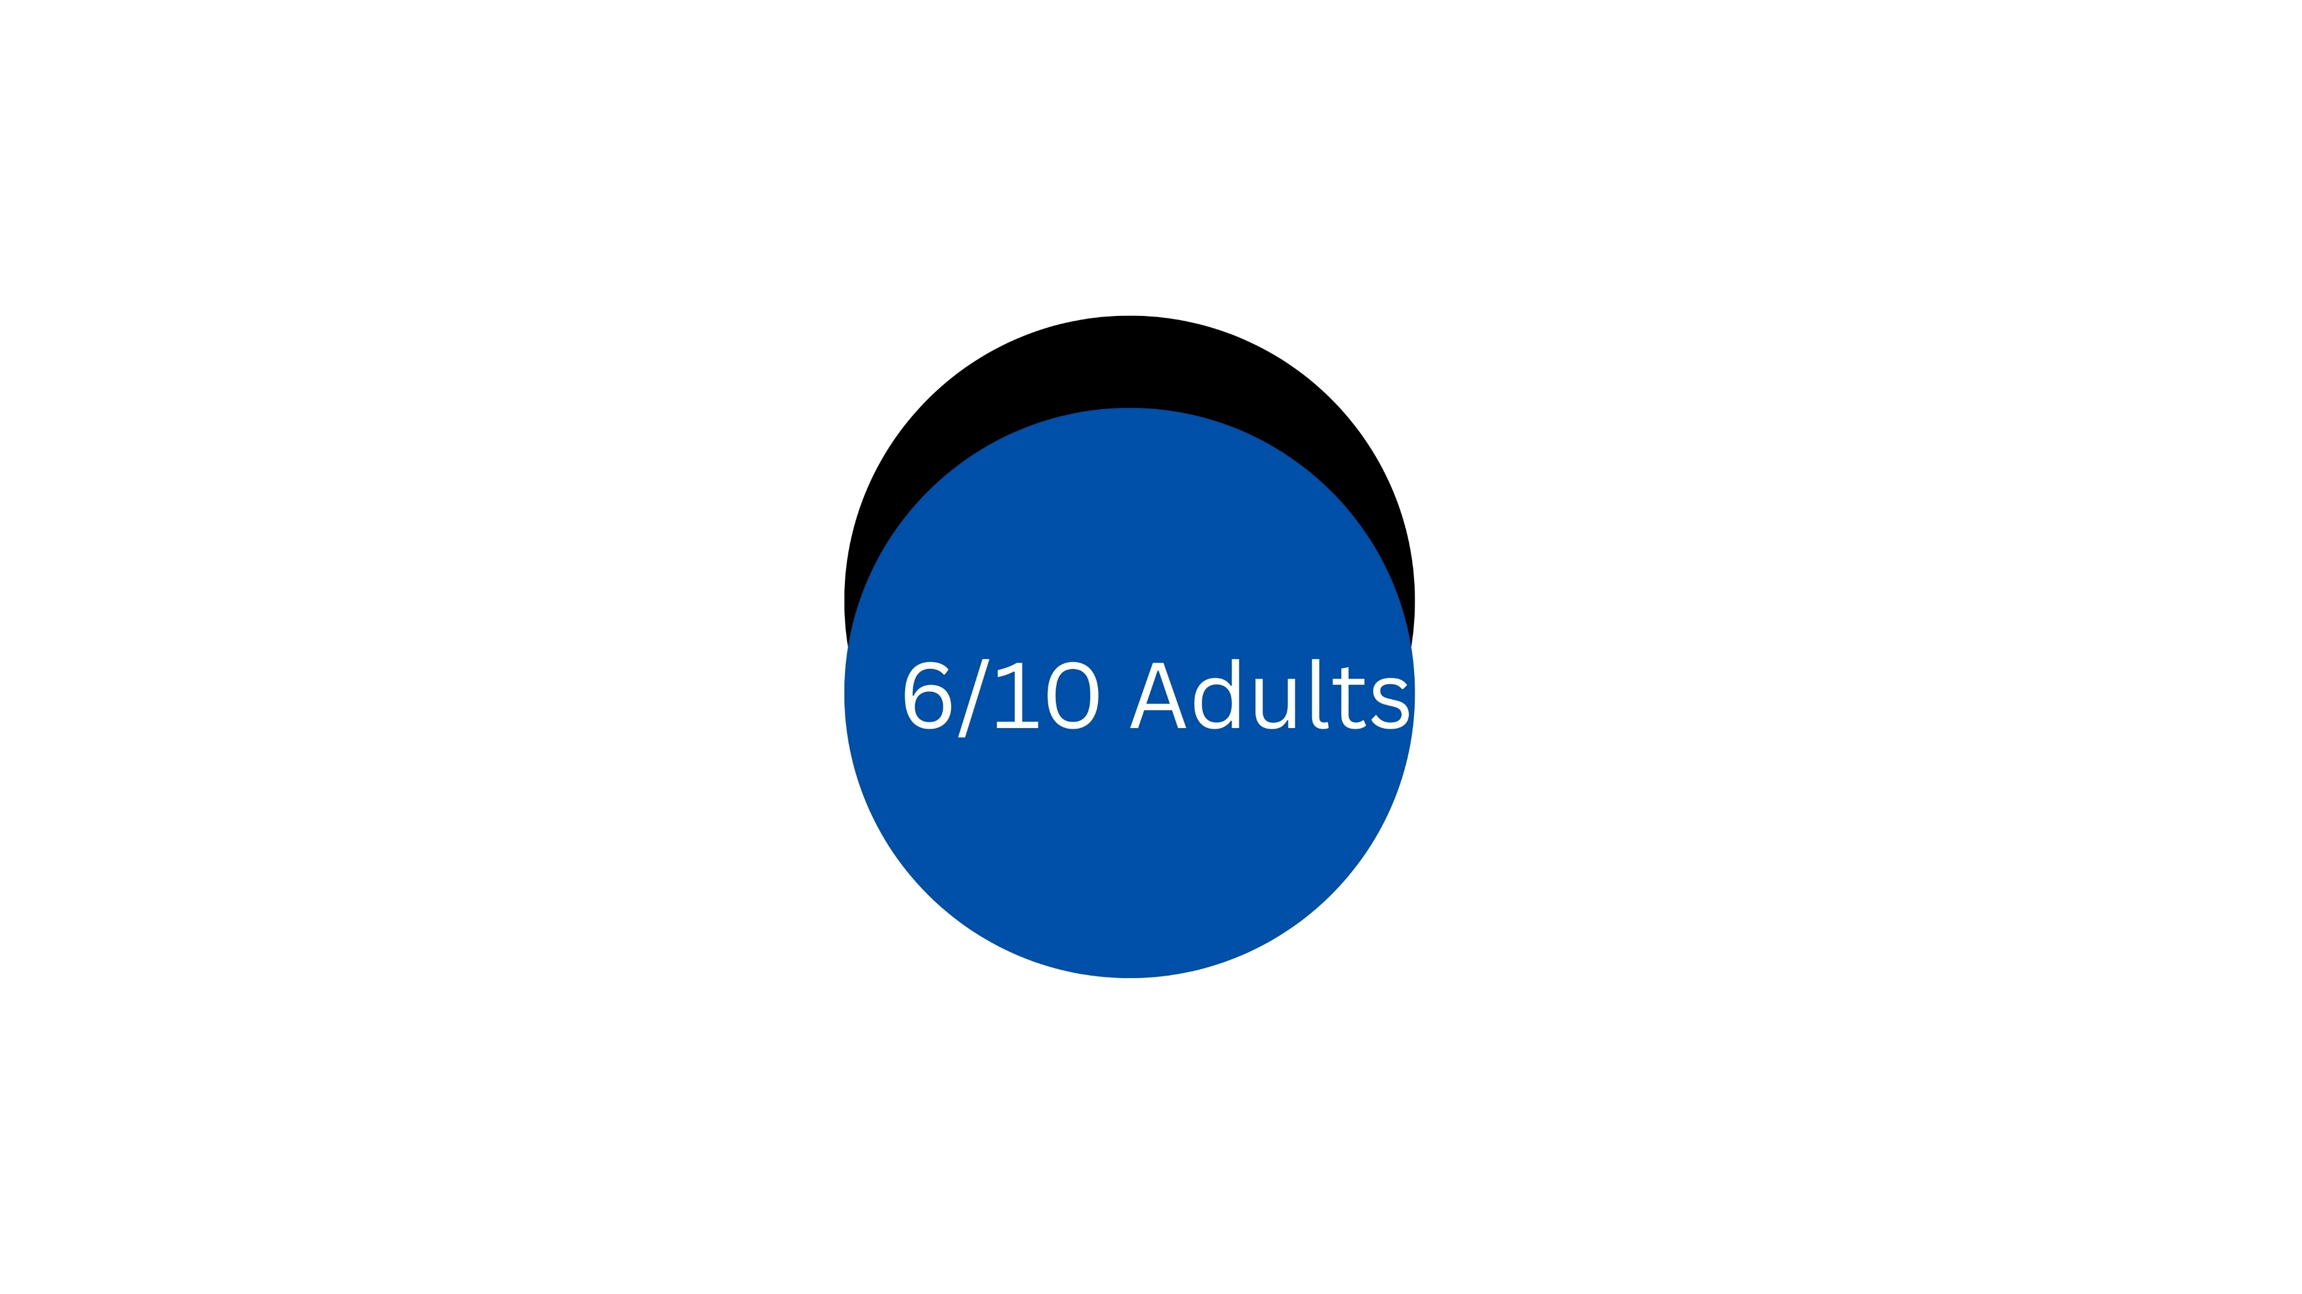
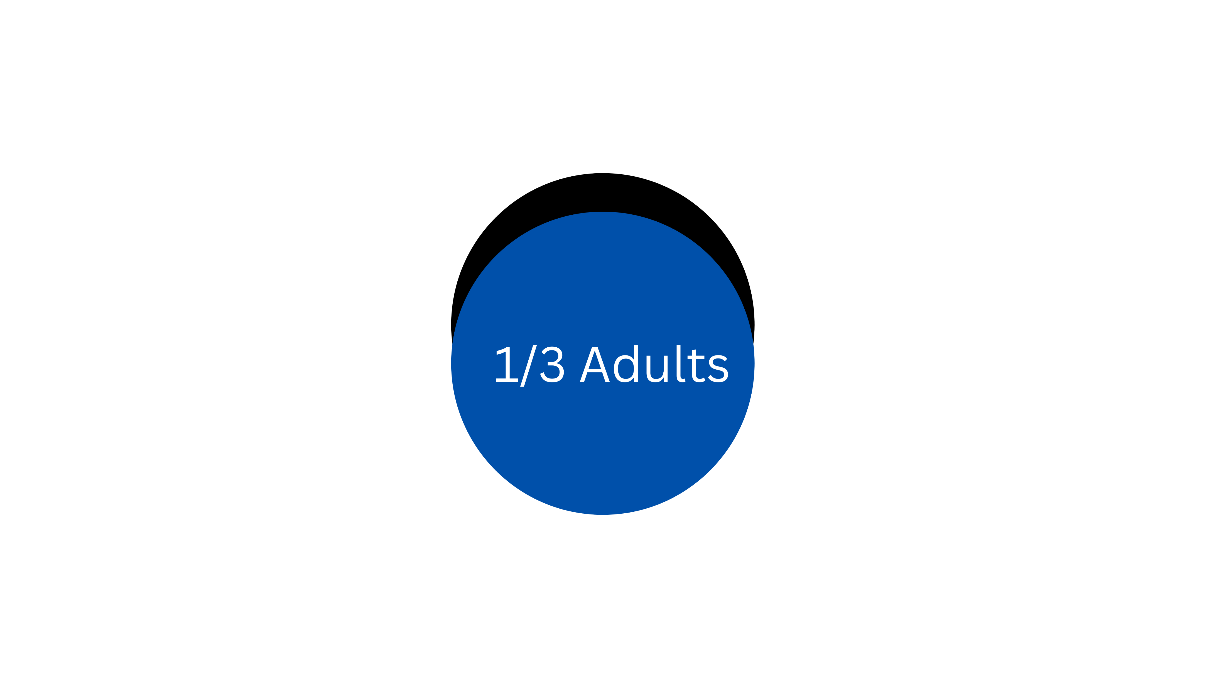
“What Does the Research Say?”
Anxiety Issues
1 in 5 adults experience anxiety daily, significantly impacting their ability to function
Women report anxiety at higher rates, with 82% experiencing it more frequently compared to men
Key factors: Negative thinking patterns | Family history | Poor dietary habits | Alcohol
Sleep Deprivation
This can be either chronic or severe which can further cause serious health conditions
Chronic issue can further cause HBP, Depression, Higher Mortality, Obesity
Key factors: Work schedule | Sleeping environment & quality | Personal lifestyle choices
Stress
Work responsibilities, Financial challenges, Health related concerns, Family issues
The highest levels of stress are reported by individuals aged 45-54, with a majority being women
Key factors: Life-changing events | Emotional imbalance | Environmental factors
4

Slide 5
Why Collaborate with “Wellness space Brands”?
02
Innovative Products with Immersive Mental Wellness Experiences

Slide 6
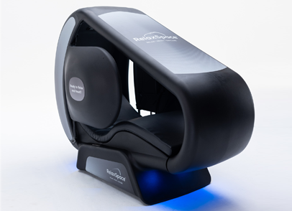
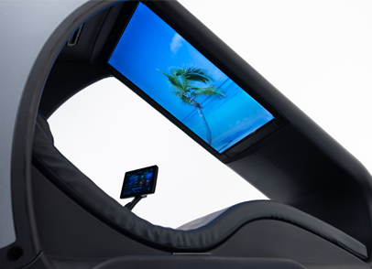
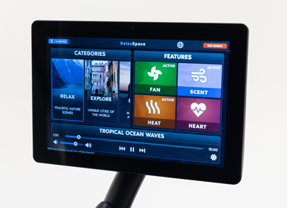
Introducing RelaxSpace Wellness Pods
Innovative Design
The product offers a free and relaxed atmosphere, free of unnecessary complications
This unique experience aims to spark curiosity and heighten awareness among customers.
Immersive Experience
Engaging videos featuring soothing nature soundscapes from around the globe are enhanced with scent infusions
The experience is further enriched by guided meditation and breathing exercises
Easy to Control & Manage
Monitor relaxation levels during each breathing exercise to assess stress levels effectively
Built-in heated seats provide added comfort by alleviating body soreness
https://www.youtube.com/watch?v=u26csSEcawQ&t=1s https://wellnessspace.com/

Slide 7
What’s in it for LIDL Customers?
03
Customer Benefits and Added Value for LIDL

Slide 8
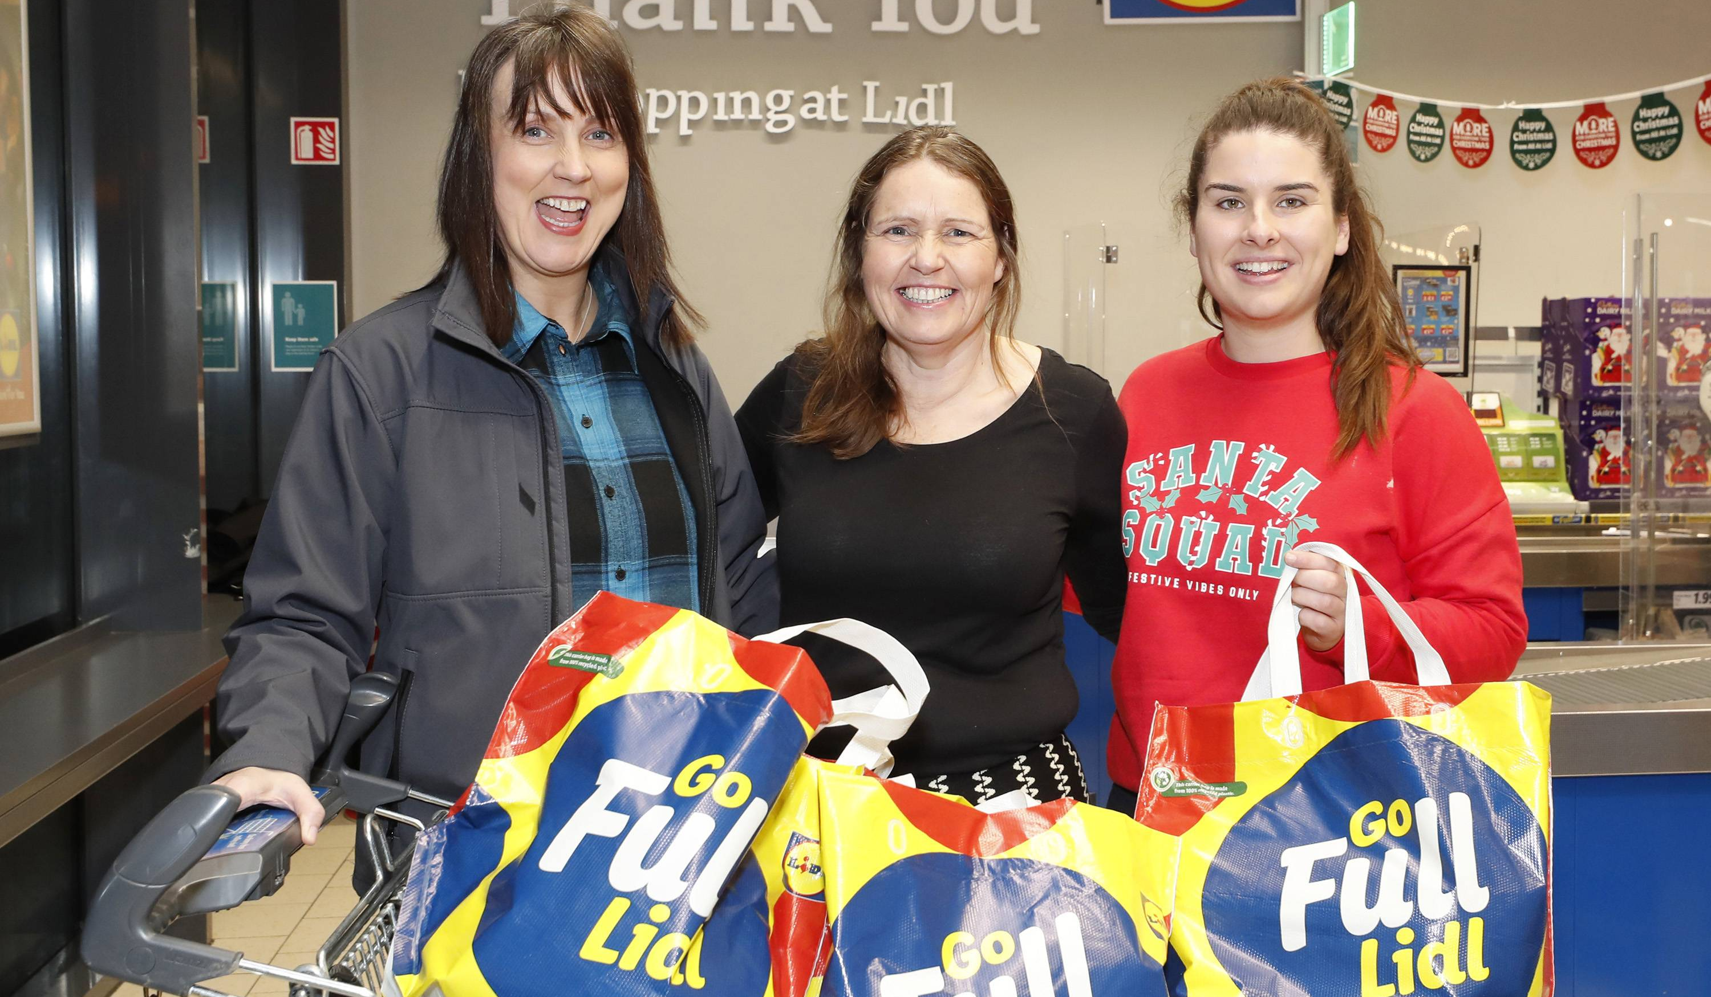
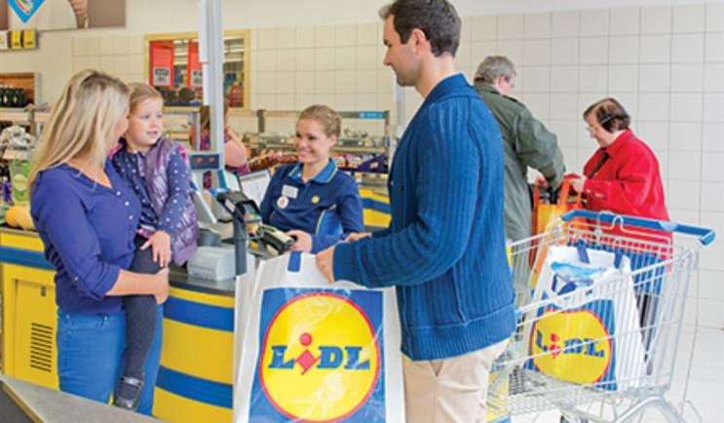
Customers can enjoy this unique experience at selected LIDL stores, accompanied by friends and family.
Our goal is to simplify customers' lives by offering an experience that extends beyond routine grocery shopping.
This initiative encourages repeat visits, transforming the store into a destination for relaxation and wellness
Customers can take advantage of this service before or after their grocery shopping, making it a seamless part of their routine
It also provides a perfect opportunity to unwind after work, helping them recharge before heading home
Regular visits will promote better mental and physical well-being, fostering awareness of a healthier lifestyle
Just 15 minutes of relaxation can have a profound and positive impact on their daily lives
8

Slide 9
Implementation Plan
04
Transform LIDL's brand perception and create impact on customer’s life

Slide 10
The Four Step Plan
Objective
Our goal is to transform LIDL’s brand perception while positively impacting the lives of its customers. This initiative has the potential to be a game-changer, redefining customer engagement and well-being. A key focus will be identifying the right demographics to test the market acceptance of this pilot project.
01
02
03
04
Explore Partnership Goals
Clearly define the roles and responsibilities for WSB and LIDL
Collaborate on the design and development of a comprehensive wellness plan
Integrate offerings
Develop wellness kits that seamlessly complement LIDL's existing product offerings
Strategize the creation of dedicated "Wellness Zones" within stores
Rollout & Marketing Plans
Launch marketing campaigns through the LIDL app and in-store promotions
Conduct live in-store engagement activities to showcase the benefits of the wellness offerings
Feedback & Optimization
Analyze customer engagement data and identify emerging requirements
Introduce innovative wellness programs to continuously enhance and expand the initiative

Slide 11
Revenue Estimations
05
Assessing the revenue potential and growth opportunities for this initiative

Slide 12
Estimated Revenue Per Store
Key metrics | Avg. Session time per customer | Avg. Price per session | Customers opting for sessions / day | Total Revenue per store / annum
Store 1 – Galway | ~15 mins | €7 | ~13 | €32,760
Store 2 – Cavan | ~15 mins | €8 | ~7 | €20,160
Store 3 – Dublin | ~15 mins | €7 | ~17 | €42,840
Store 4 – Cork | ~15 mins | €7 | ~15 | €37,800
Store 5 – Offaly | ~15 mins | €8 | ~9 | €25,920
Gross Total |  |  |  | €1,59,480
Pilot Program for Enhanced Revenue Models
Subscription options for multiple sessions
App-exclusive deals paired with healthy snacks or food products

Slide 13
Implementation challenges
06
Potential Challenges in Implementing This Project

Slide 14
Key challenges
01 Regulatory & Compliance
02 Customer Adoption
Customers may fail to perceive tangible benefits in their lives, potentially leading to dissatisfaction or even legal challenges against the company.
There could be limited or no initial response to the “Wellness Zone,” which might delay or halt plans to expand the initiative to additional locations.
03 Operational Issues
04 Lack of Support from WSB
The initiative requires additional manpower and trained staff. Poor management or lack of skilled personnel could result in negative customer experiences.
Dependence on WSB’s support poses a risk. A lack of cooperation or availability from the brand may hinder the success of this initiative.

Slide 15
Marketing promotions
07
Key Steps to Develop an Effective Marketing Plan for the New Initiative

Slide 16

Customer Journey Funnel
Awareness - Campaign Launch The goal is to activate in-store promotions and build awareness of LIDL's unique offerings
Customer Engagement & Interaction
Introduce a range of health and wellness Irish brands, integrated into the wellness experience zone to enhance the in-store experience
Conversion
Set an estimated target conversion rate of 10% to 12% daily, with an anticipated gradual increase each month as awareness and engagement grow
Building Long-term Relationships
Foster customer loyalty through ongoing engagement and innovative offerings, encouraging valuable feedback and shaping future expectations

Slide 17
What’s in it for LIDL?
08
LIDL's Progress Over the Last 3–5 Years

Slide 18

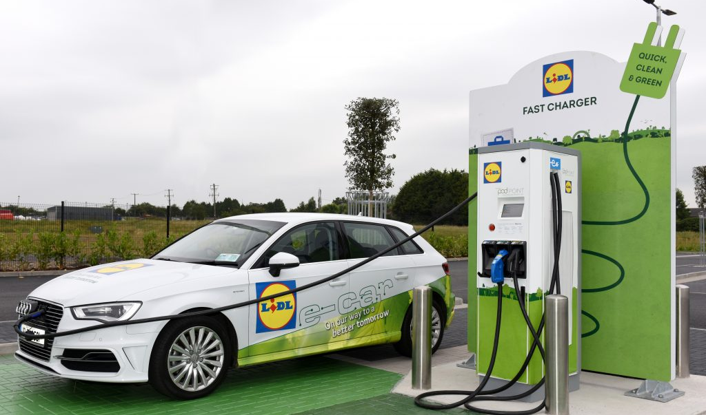
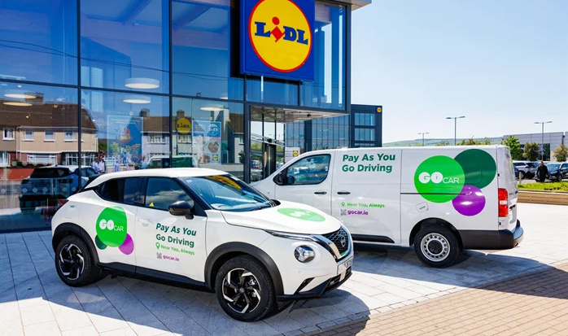
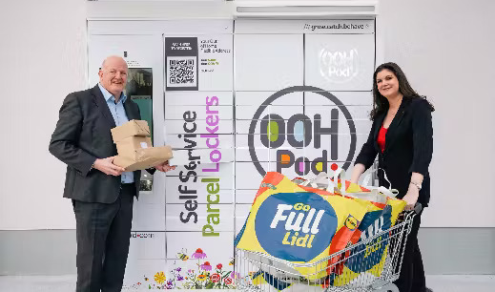
LIDL's Current Momentum and Future Opportunities
Electric Vehicle Charging Points
Steady growth with ~72 charging stations operational
Utilized over 53,711 times in the past year, highlighting strong customer adoption
GoCar - PAYG
Convenient car and van-sharing services available at 50 locations
Approximately 6,000 customers have benefited from this offering to date
OOHPod - Parcel Lockers
24/7 accessible parcel lockers designed for maximum convenience
Subscription plan: €8.85/month for up to three 48-hour access sessions
Proposed Collaboration - WSB
Driving increased footfall and fostering deeper engagement with the brand
Positively impacting thousands of lives while elevating the overall customer experience

Slide 19
Thank you
Open for questions!

Slide 21
Appendix 1 - List of Irish brands to consider it for further consideration to blend it with the overall concept of Wellness Zone
One nutrition – Superfoods and Wellness products https://www.onenutrition.ie/
BiaSol – Granola and Oat Based healthy snacking products https://www.biasol.ie/
Good4U – SuperGreens and Seeds, Salad toppers & Sprouts
https://good4u.co/ Solaris Botanicals – Different types of teas to heal different parts of the body https://solarisbotanicals.com/

Slide 22
Appendix – 2 – Source/References
Slide 4 –
https://www.aware.ie/national-survey-2023/#:~:text=Anxiety%20rates%20also%20appear%20to,most%20likely%20to%20be%20affected
https://www.mentalhealthireland.ie/research/
https://www.breakingnews.ie/ireland/more-than-a-third-of-people-in-ireland-stressed-in-daily-lives-1680209.html#:~:text=More%20than%20a%20third%20of%20people%20in%20Ireland%20say%20they,age%20group%20feeling%20the%20strain.
Slide 12 –
https://eire.fandom.com/wiki/List_of_Irish_counties_by_population
Slide 18 –
https://www.lidl.ie/c/electric-vehicle-charging-points/s10020571
https://www.oohpod.com/blog/lidl-joins-forces-with-oohpod
https://www.lidl.ie/c/go-car/s10027539

