Slide 1
Deep Learning Model Credit Card Transaction Fraud Check
Shahtab Khandakar

Slide 2

01
Design Guidelines Inference to process live data points for the model to be able to say if a particular credit card transaction is fraudulent or not
01 -> Data Preparation
Collect and process transaction data for model training
Train, test and validate datasets are located in Kaggle Hub
02 -> Model Selection
Choose architectures like FNN, CNN, RNN etc relevant to the data
A Feedforward Neural Network model is used for this use case
03 -> Feature Engineering
Identify and create relevant features to improve model accuracy
Five columns from the CSV file is used for in_features (X) and one last column for label (y)
04 -> Model creation and evaluation
Evaluate and utilize metrics for model accuracy
05 -> Realtime analysis
Deploy model for continuous monitoring of transactions in real-time

Slide 3
03
Dataset source
Obtained custom data from a vendor and uploaded following datasets to
my own space in Kaggle Hub
train.csv ( 600,000 rows)
test.csv (200,000 rows)
validate.csv (200,000 rows)
Kaggle Hub location:
https://www.kaggle.com/datasets/shahtabkhandakar/credit-card-fraud-detection
Full and completed code of the notebook:
https://colab.research.google.com/drive/14Z0tF5AOLTWHTeoeCJjk9DGZtvFqDcm1?usp=sharing

Slide 4
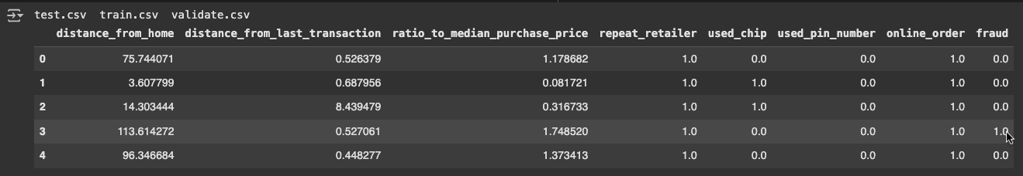
04
The CSV data that is used to train the model contains the following fields: (each row in the csv file) distance_from_home - The distance from home where the transaction happened. distance_from_last_transaction - The distance from the last transaction that happened. ratio_to_median_purchase_price - The ratio of purchased price compared to median purchase price. repeat_retailer - If it's from a retailer that already has been purchased from before. used_chip - If the credit card chip was used. used_pin_number - If the PIN number was used. online_order - If it was an online order. fraud - If the transaction is fraudulent.
A few sample training data from train.csv file

Slide 5
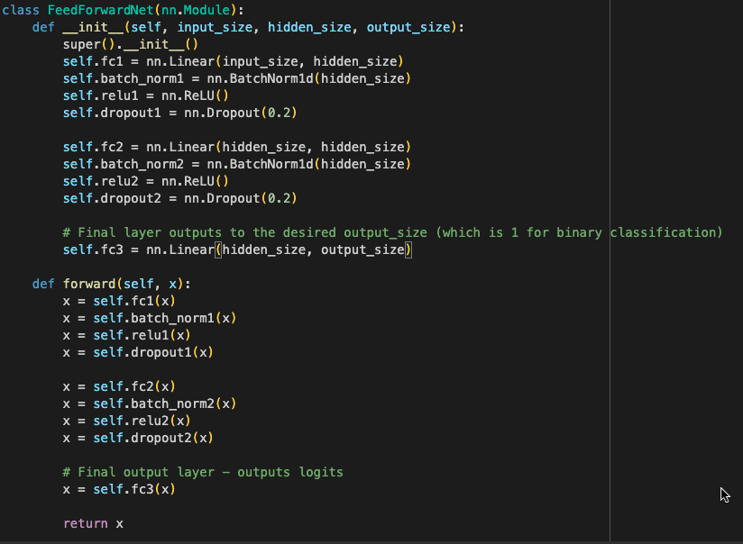
05
Simple Feedforward Neural Network Model (3 fully connected layers)

Slide 6
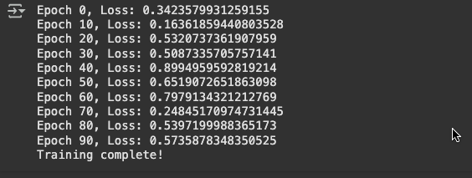
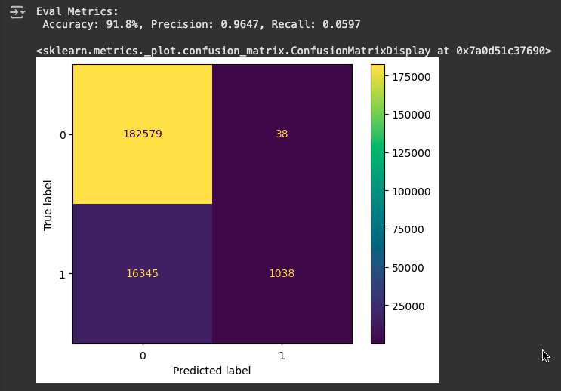
06
Train model Results obtained for Loss and confusion matrix

Slide 7
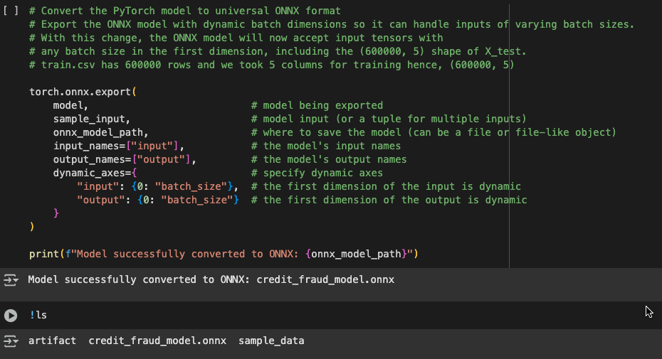
07
Save model in ONNX format for future inference
ONNX is a universal format where the essential operations of a deep learning model written differently with
different deep learning libraries are standardized, enabling us to interchangeably use different deep
learning libraries.

Slide 8
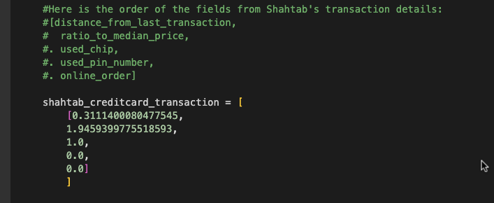

08
Inferencing with the trained and saved model to see if certain transaction is fraudulent
prediction = sess.run(
[output_name],
{input_name: scaler.transform(shahtab_creditcard_transaction).astype(np.float32)}
)
The prediction would be either TRUE (fraudulent) or FALSE ( not fraudulent)
Result:

