Slide 1
Web Page Performance Test
Synchrony Bank
Notes:
Myself Shahul Shaik, I am here to represent my company Trimble.com

Slide 2
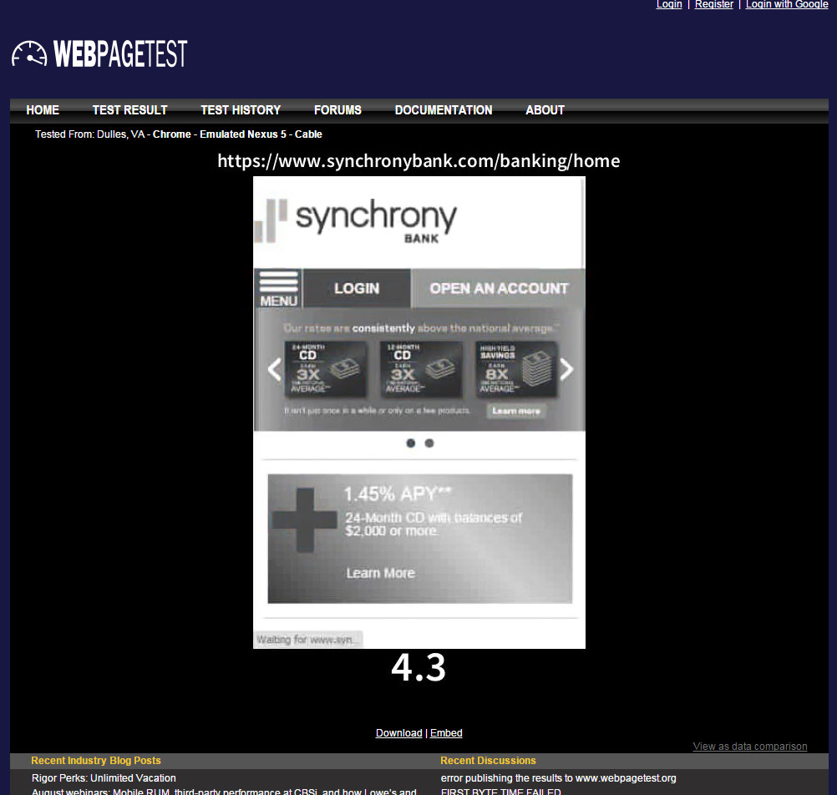
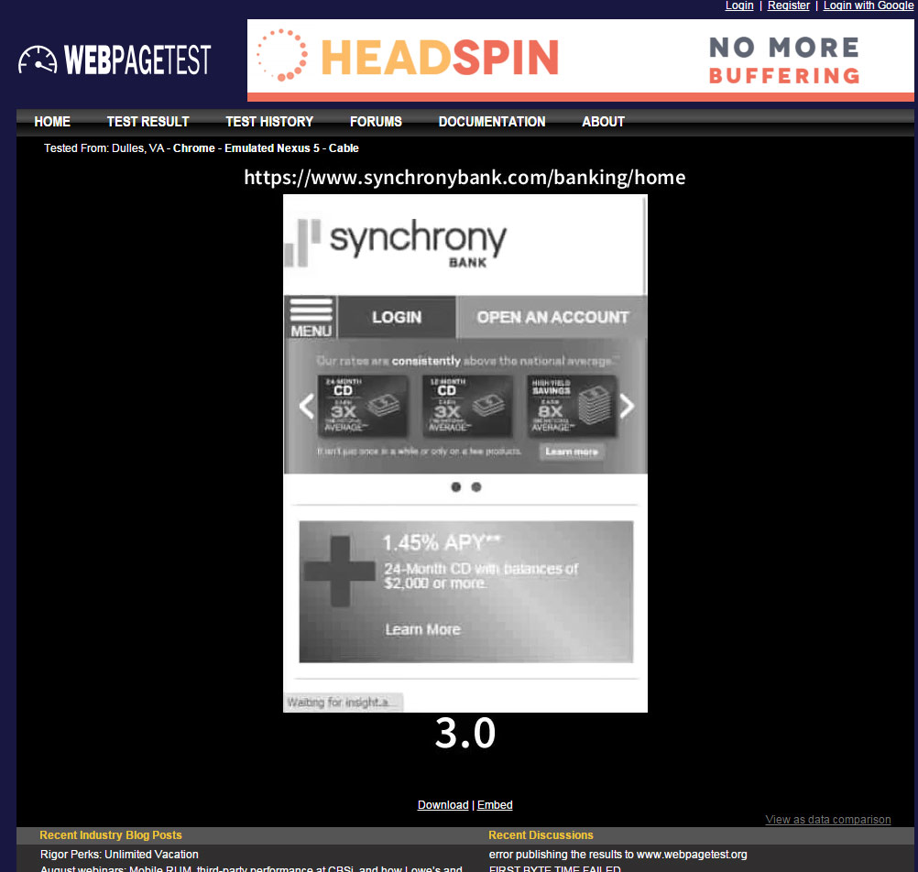

First & Repeat View
First View
Repeat View

Slide 3

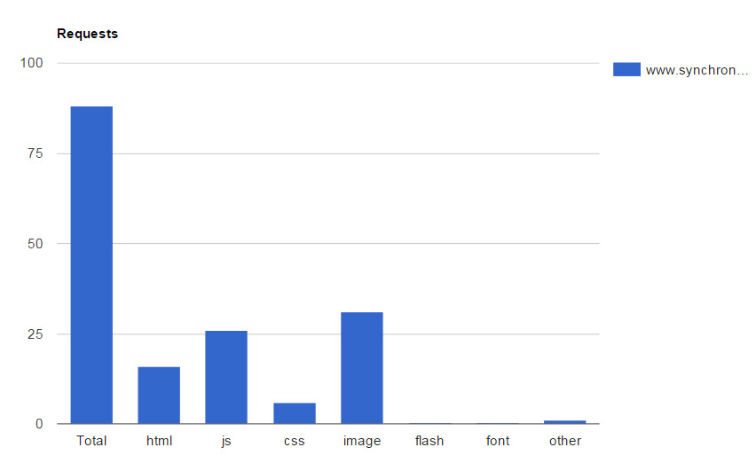
Contents Breakdown

Slide 4
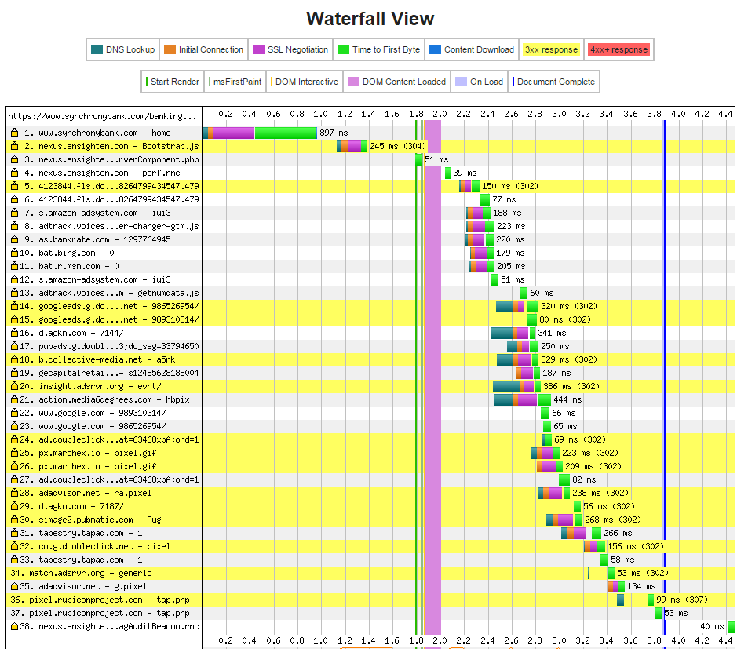
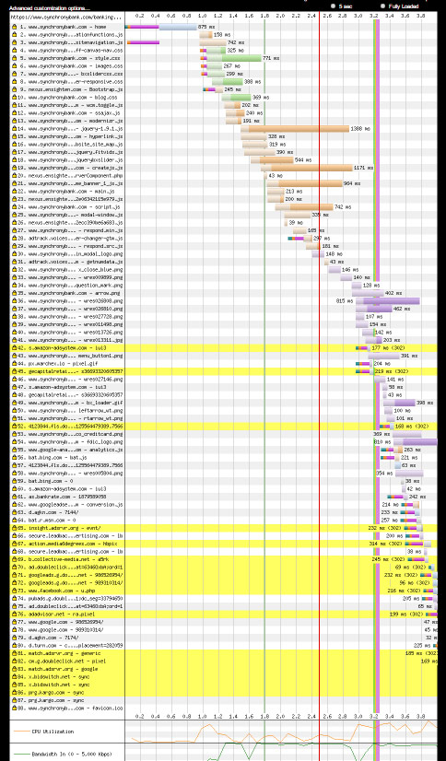
Waterfall View

Slide 5
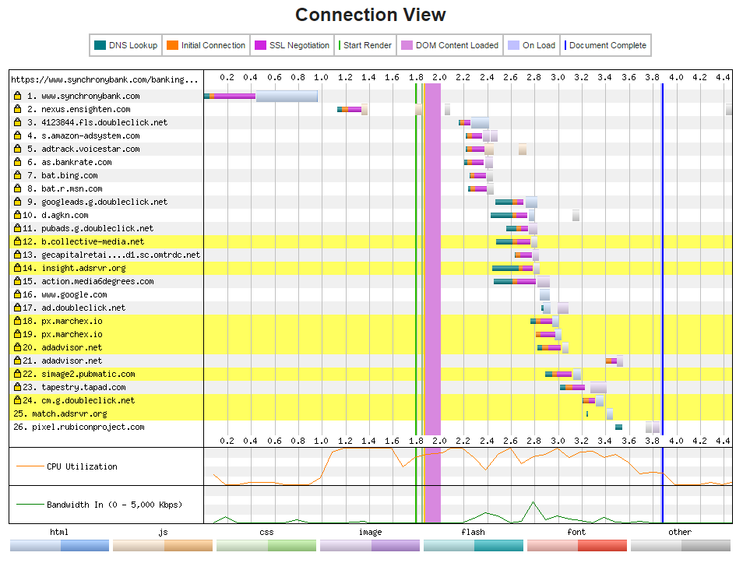
Connection View

