Slide 1

NEXUS HACKATHON 2026
AI-Powered Resume Analyzer
& Interview Assistant
Intelligent recruitment • Skill matching • Personalized interviews
TEAM NO: 52
TEAM NAME: VishVerse
Presented by Vidhi Shah & Shaili Rudani
“Analyze. Match. Identify. Interview. Hire Smarter.”
A recruiter-focused AI assistant for faster, consistent and explainable candidate screening.
Nexus Hackathon 2026 • Tridyatech Limited
01

Slide 2
01 • PROBLEM
The Recruitment Screening Problem
Recruiters often receive hundreds of resumes for a single opening, making manual screening slow and difficult.
01
02
03
TIME
CONSISTENCY
HIDDEN SKILLS
Manual review consumes recruiter effort.
Different candidates may be evaluated differently.
Relevant skills can be buried in projects, certifications or experience.
04
SKILL GAPS
05
INTERVIEW PREP
06
COMPARISON
JD-to-resume comparison is difficult to do manually.
Personalized questions take additional time to create.
Ranking candidates objectively can be challenging.
Our problem: How can AI automate initial screening while keeping matching fast, consistent and explainable?
Nexus Hackathon 2026 • Tridyatech Limited
02

Slide 3
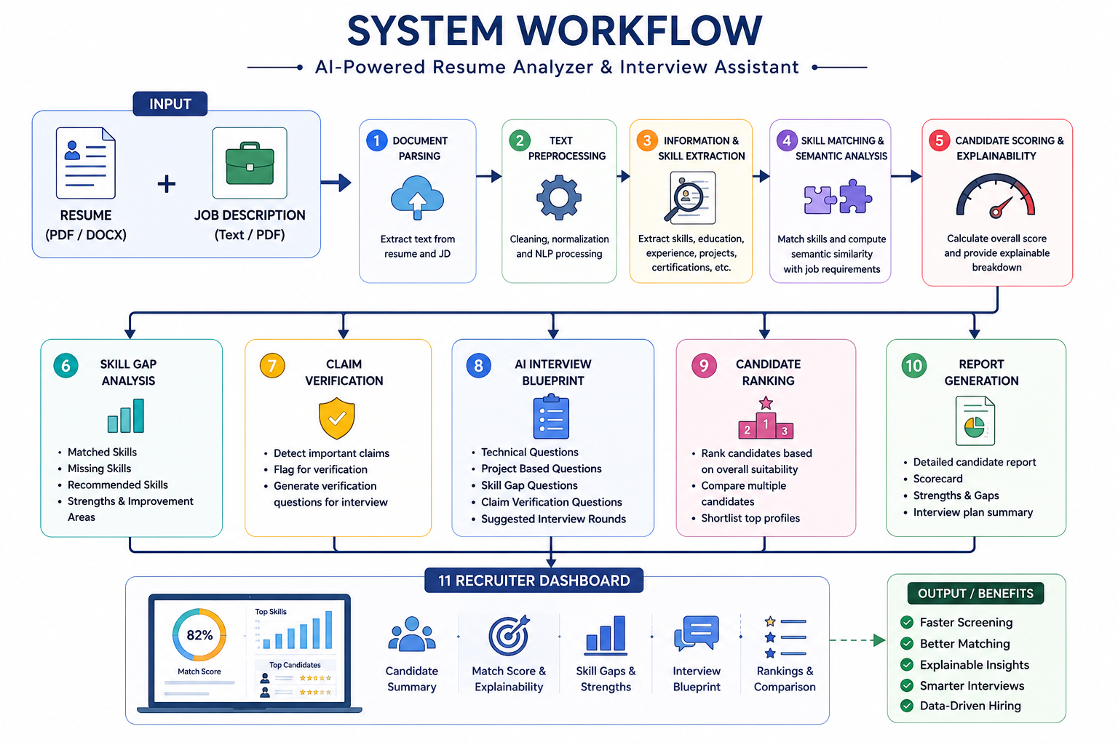
02 • SOLUTION
Proposed Solution
A recruiter-focused AI assistant accepts one JD and multiple resumes, extracts job-relevant skills, scores and ranks candidates, identifies gaps, and prepares personalized interview questions.
01
02
03
04
05
06
07
Skill gaps
Interview
Rank
Upload
→
Analyze
→
Match
→
Score
→
→
→
Resume + JD
Skill + semantic
Explainable score
Tailored questions
Rank & compare candidates
Extract profile
Matched vs missing
Nexus Hackathon 2026 • Tridyatech Limited
03

Slide 4
03 • FEATURES
Key Features
01
AI Resume Analysis
02
Job–Candidate Matching
Skills • education • experience • projects • certifications
Skill matching + semantic similarity
03
Explainable Candidate Scoring
04
Skill Gap Analysis
Overall compatibility + factors behind the score
Matching skills • missing skills • improvement areas
05
Personalized Interview Assistant
06
Candidate Ranking
Resume • JD • projects • skill gaps
Rank candidates and revisit saved analysis sessions
Value: from simply screening resumes → to providing actionable insights for better hiring decisions.
Nexus Hackathon 2026 • Tridyatech Limited
04

Slide 5
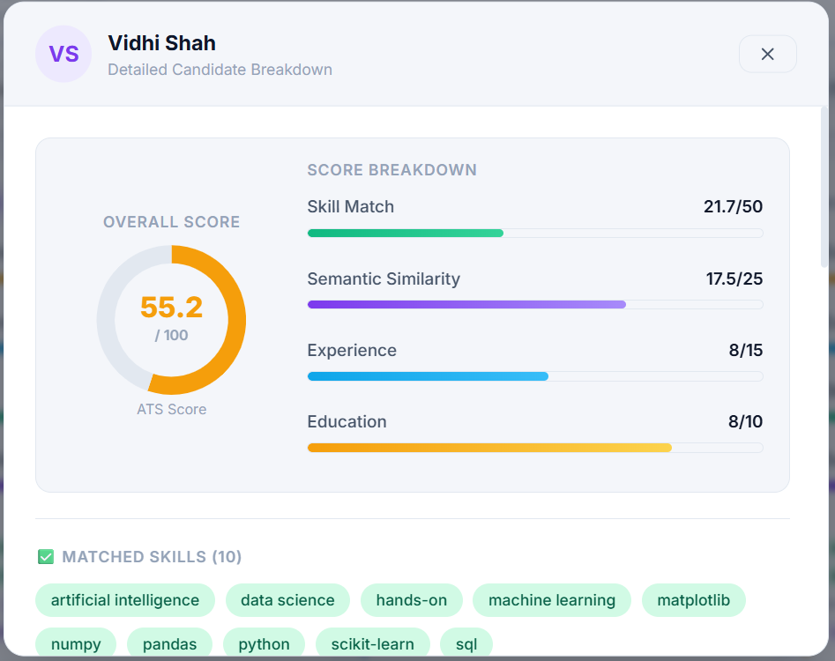
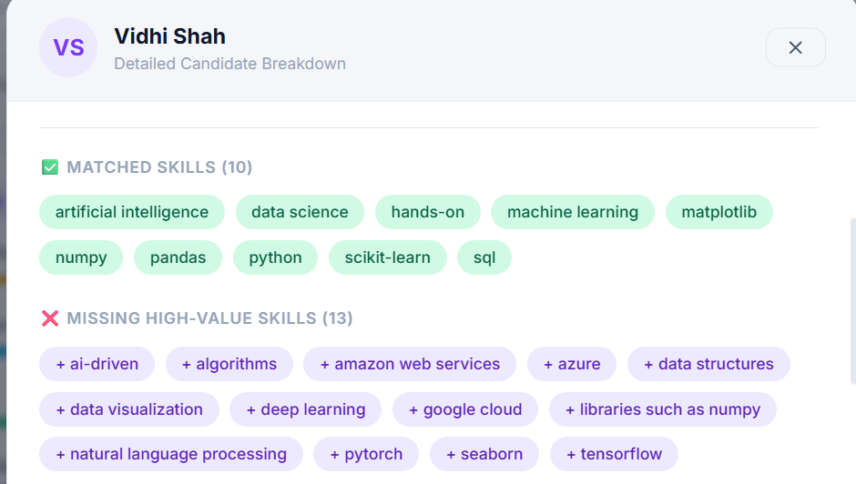
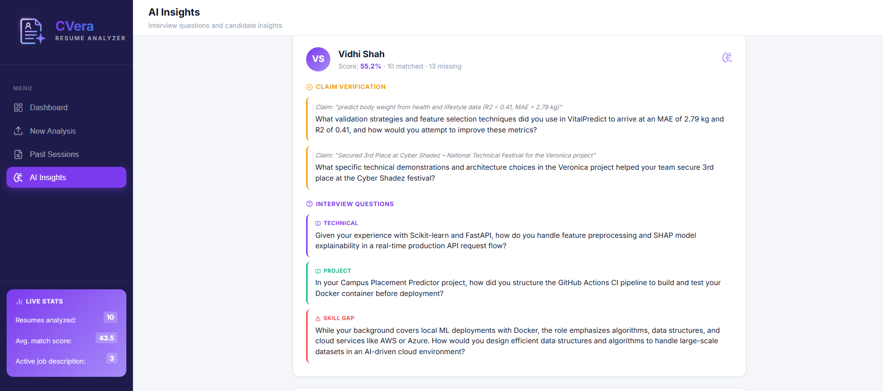
04 • DIFFERENTIATORS
What Differentiates the Project
01
Explainable AI
02
Resume Claim Verification
03
AI Interview Blueprint
Not just “82% match” — the system shows why: skills, semantic match, strengths and gaps.
Important claims are turned into interview questions to verify them.
Technical + project + skill-gap + verification questions are tailored to each candidate.
Explainable scoring
Interview + skill-gap intelligence
Recruiter-facing output
Nexus Hackathon 2026 • Tridyatech Limited
05

Slide 6

05 • WORKFLOW
System Workflow
The complete pipeline from uploaded documents to a recruiter-ready candidate profile.
Nexus Hackathon 2026 • Tridyatech Limited
06

Slide 7
06 • AI PIPELINE
AI & NLP Approach
1
Text extraction
2
Information extraction
PDF/DOCX → raw text
Skills, education, experience, projects & certifications
3
Skill normalization
4
Skill + context matching
Standardize different names for the same skill
Compare required skills with candidate skills and usage/context
5
Explainable scoring
6
Gemini interview insights
Matched skills ÷ total JD skills × 100
Technical, project, skill-gap & claim-verification questions
Extract → Normalize → Match → Score → Explain → Generate
AI-assisted screening — final hiring decisions remain with the recruiter.
Nexus Hackathon 2026 • Tridyatech Limited
07

Slide 8
07 • SCORING
Explainable Candidate Scoring
Simple enough to audit, clear enough for a recruiter to explain.
WHY THE SCORE IS EXPLAINABLE
MATCH SCORE
Matched skills
Skills found in both JD and resume
Score =
Matched JD skills
÷ Total JD skills
× 100
Missing skills
JD skills not found in the resume
Normalization
Synonyms / abbreviations map to canonical skills
Example: 8 / 10 = 80%
Recruiter control
Supports screening; recruiter makes the final decision
Nexus Hackathon 2026 • Tridyatech Limited
08

Slide 9
08 • INTERVIEW INTELLIGENCE
Intelligent Interview & Skill Gap Analysis
Gemini turns candidate-specific evidence into an interview-ready question set.
TECHNICAL
PROJECT
Based on skills that match the JD
Based on projects and past work
SKILL-GAP
CLAIM VERIFICATION
Targets missing JD skills
Targets quantified or important resume claims
Resume + JD + missing skills → structured JSON → recruiter-friendly interview UI
Nexus Hackathon 2026 • Tridyatech Limited
09

Slide 10
09 • TECHNOLOGY
Technologies & Tools
Lightweight POC architecture: React UI → FastAPI backend → parsing + skill engine + Gemini → SQLite.
Frontend
React + Vite + Vanilla CSS • Upload, dashboard, Past Sessions, AI Insights
Backend
FastAPI + Python • REST APIs, orchestration, persistence
Document parsing
pdfplumber / PyMuPDF • Extract text from PDF resumes and JDs
Skill engine
skills.json + normalization • Synonyms, canonical skills, noise filtering
AI layer
Google Gemini API • gemini-2.5-flash • Structured interview insights
Database
SQLite • JD sessions, candidates, scores, skills, insights
Nexus Hackathon 2026 • Tridyatech Limited
10

Slide 11
10 • IMPACT
Expected Outcome
Candidate Analysis
Actionable Insights
Interview Intelligence
Recruiter Dashboard
• Overall match score
• Candidate strengths
• Technical questions
• Candidate ranking
• Matching & missing skills
• Skill gaps
• Project-based questions
• Side-by-side comparison
• Skill match evidence
• Claims requiring verification
• Skill-gap questions
• Score breakdown
• Project & experience analysis
• AI-generated resume summary
• Verification questions
• Skill-gap visualization
• Education & certification analysis
• Personalized interview blueprint
Reduce manual screening → Improve candidate matching → Enable personalized interviews → Support better hiring decisions
Nexus Hackathon 2026 • Tridyatech Limited
11

Slide 12
11 • RESPONSIBLE AI
Assumptions, Challenges & Limitations
Assumptions
Challenges
Our Approach
• PDF/DOCX resumes
• Resume format variability
• AI as an assistant
• Clearly defined JD requirements
• Skill names & abbreviations
• Focus on job-relevant qualifications
• Context-sensitive abbreviations (e.g., R, C, AI)
• Initial focus on English
• Transparent scoring
• Candidate information assumed accurate
• Gemini reliability / API availability
• Explainable results
• Initial screening, not final hiring
• Skill dictionary coverage and niche skills
• Recruiter-controlled decisions
Principle: use AI as an assistant — not as the final decision-maker.
Nexus Hackathon 2026 • Tridyatech Limited
12

Slide 13
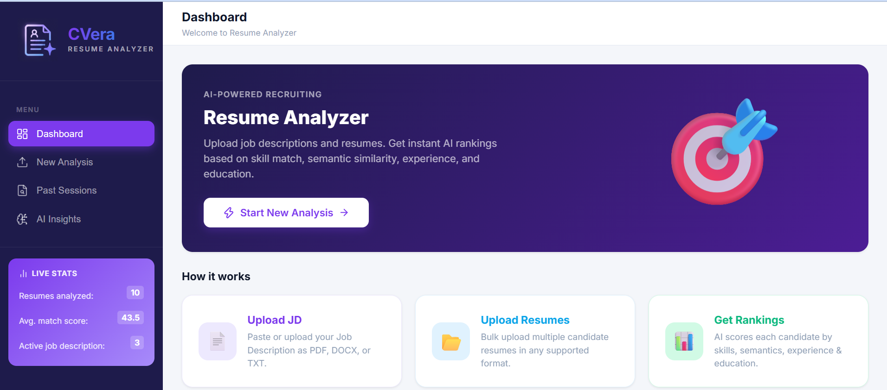
13 • OUTPUT
Recruiter Dashboard
One dashboard brings together suitability, strengths, gaps, interview insights and ranking.
Nexus Hackathon 2026 • Tridyatech Limited
14

Slide 14
14 • FUTURE
Future Scope & Conclusion
OCR for scanned resumes
Weighted scoring
ATS + Calendar integration
Real-time voice-based interviews
Follow-up questions based on candidate responses
Analyze resumes in multiple languages
Production database
Multi-language resumes
Responsible AI
Track hiring trends and candidate performance
Connect with existing Applicant Tracking Systems
Improve fairness, privacy and bias detection
Faster hiring. Better matching. Smarter interviews.
AI-assisted screening • Explainable insights • Recruiter remains the decision-maker
Nexus Hackathon 2026 • Tridyatech Limited
15

Slide 15
NEXUS HACKATHON 2026
THANK YOU
AI-Powered Resume Analyzer & Interview Assistant
Analyze • Match • Identify • Interview • Hire Smarter
Vidhi Shah & Shaili • Tridyatech Limited
Recruitment intelligence, designed for human decisions.
18

