Slide 1
Vaccine Distribution System
Team Members
Dharmik Bharatbhai Harkhani(001029591)
Santosh Krishnan(001029708)
Vineet Samir Shah(001020429 )

Slide 2
Problem Statement
In past a few years, we have encountered some severe diseases and these diseases spreads exponentially. Hence, vaccination distribution management has to be more effective.
The application aims to design, develop and implement a vaccine distribution, which will enable real time access to availability of vaccines at National, State and local levels and proper accounting of vaccines, thus ensuring safe and non-wastage of vaccines.

Slide 3
Which issue it has solved?
The application solves various issues:
Generating vaccine as per the need
Prevent Vaccine Wastage.
Real Time display of data.
Can easily recall vaccines.

Slide 4
Solution
We must record vaccine distribution to improve the efficiency, reduce the wastage of vaccine and deliver vaccine according to its demand.
Such an application will benefit Pharmaceutical Companies, Hospitals and clinics and patients ensuring more efficient Distribution system.

Slide 5
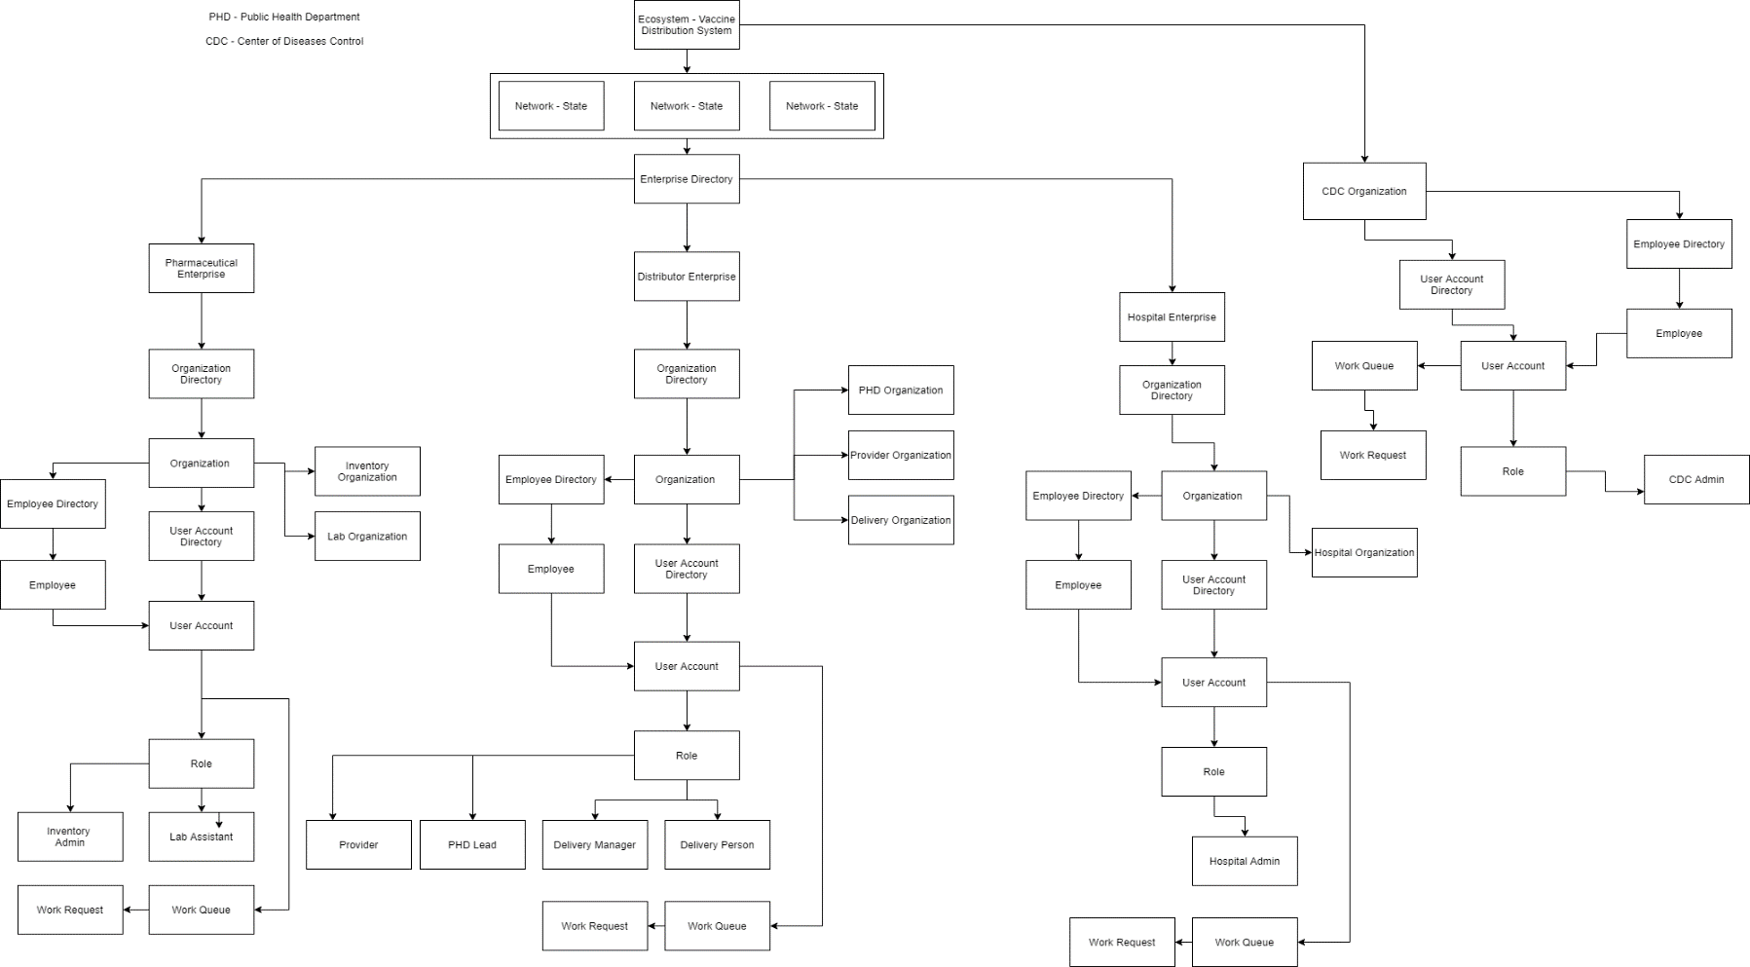
Eco-System Architecture Diagram

Slide 6
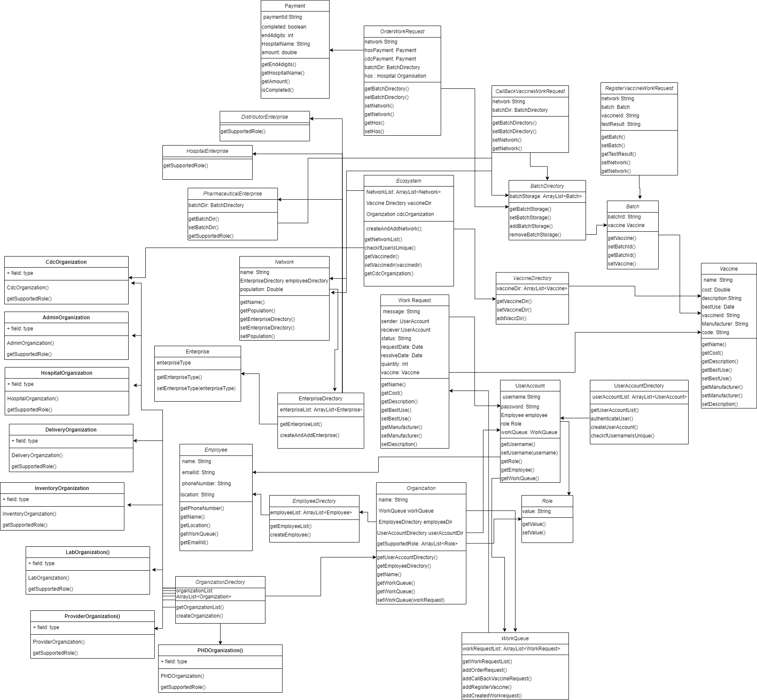
UML Diagram

Slide 7
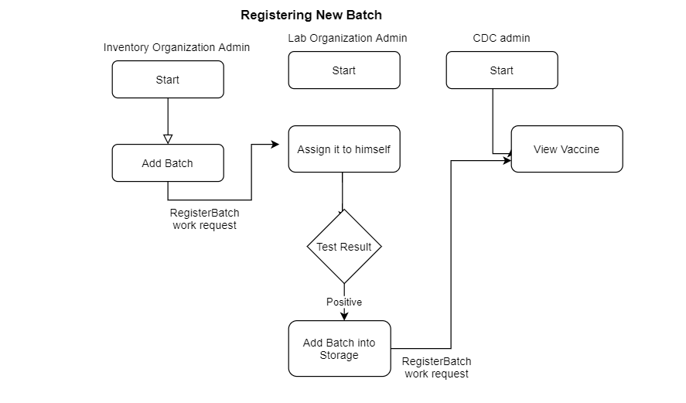
Work Flow

Slide 8
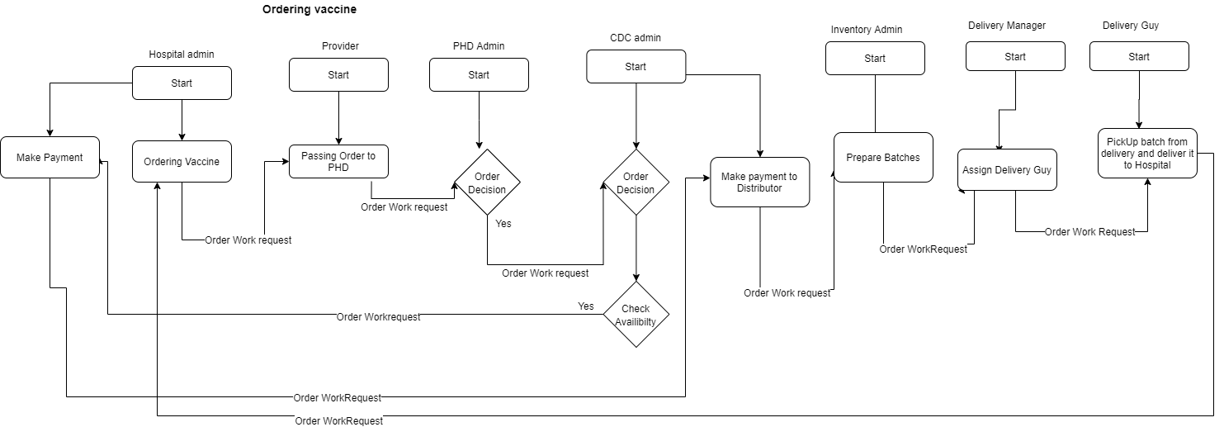
Work Flow

Slide 9
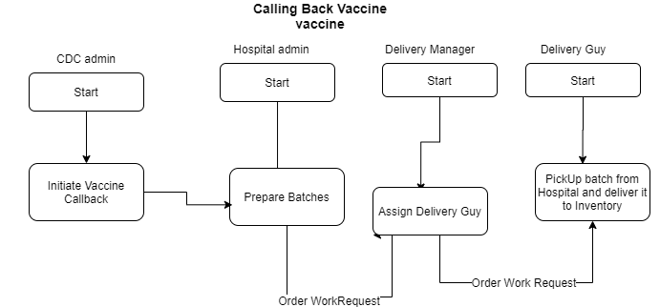
Work Flow

Slide 10
Roles
Roles
System Admin
System Admin is capable to create and manage CDC Admin, Enterprise and Network.
CDC Admin
Center for Disease Control Administrator manages Population of the network, manages vaccines and vaccine orders. Moreover, CDC Admin can call back vaccines that are delivered to hospitals.
Hospital Admin
Hospital Admin can create a vaccine order request and can also keep a track of vaccines which are called back. Moreover, Hospital admin, also records the payment for the vaccines which are requested.
PHD Lead
Public Health Department Lead gets the request for the vaccine request approval from the provider.
Provider
Provider gets the vaccine request from the hospital and after verification, the provider forwards that request to the PHD lead.

Slide 11
Roles
Roles
Inventory Manager
Inventory Manager gets the request from the Center for Disease Control Department regarding the Vaccine request. Inventory Manager is also capable in creating and managing Vaccine Batches.
Lab Assistant
Lab Assistant gets the request from the Inventory manager to test the vaccine and pass the vaccine request to the delivery manager if the vaccine is approved for delivery
Delivery Manager
Delivery manager gets the request from the Inventory Organization, which is then assigned to a particular delivery guy for the vaccine delivery.
Delivery Person
Delivery Person can confirm the assigned delivery and confirm the status after the order is delivered.

Slide 12
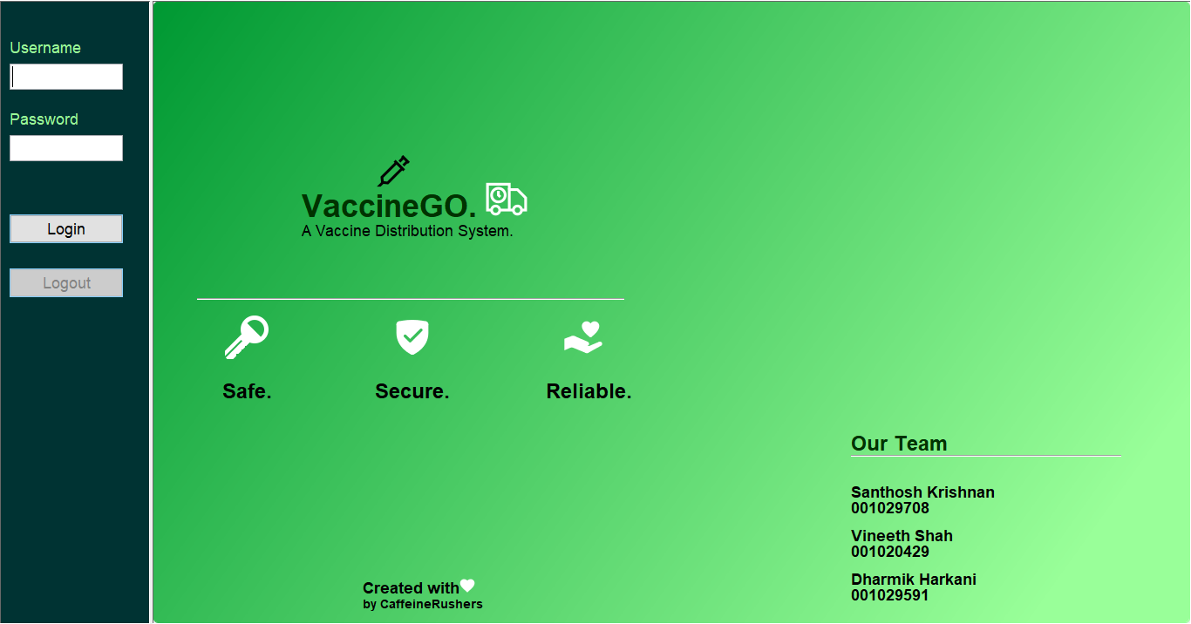
Snapshots

Slide 13
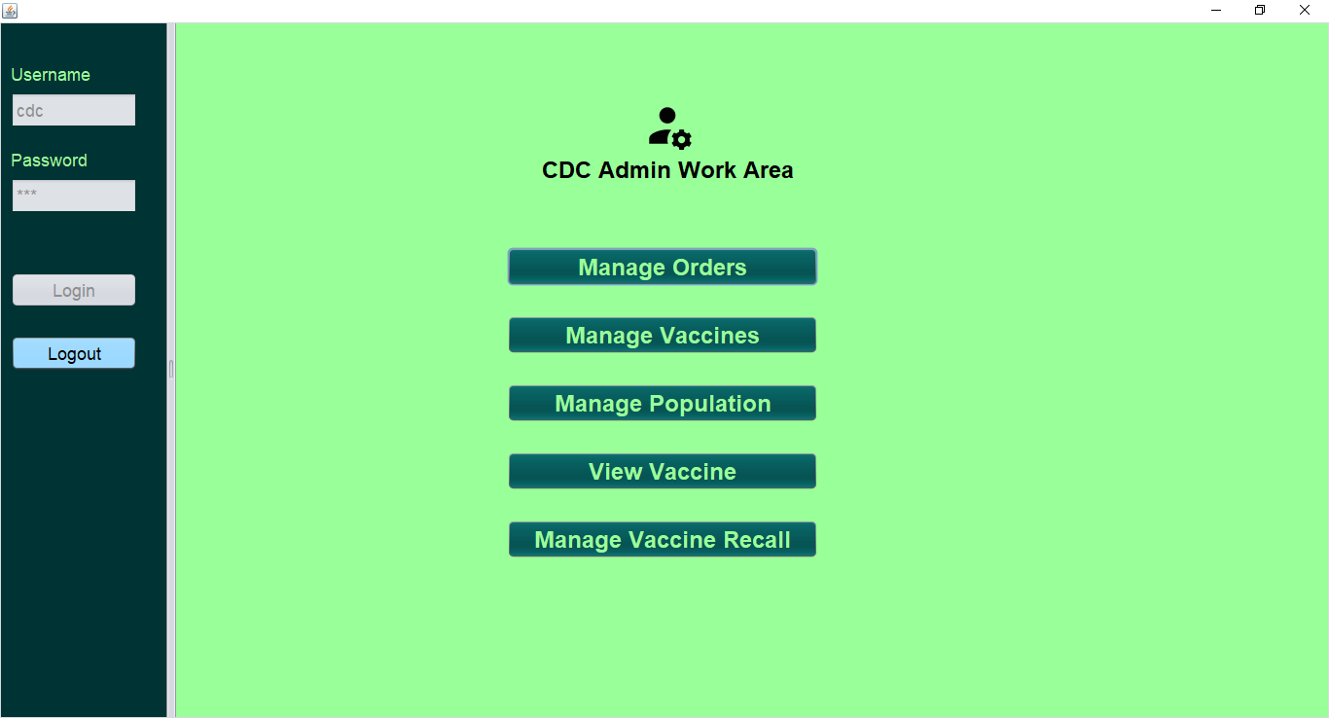
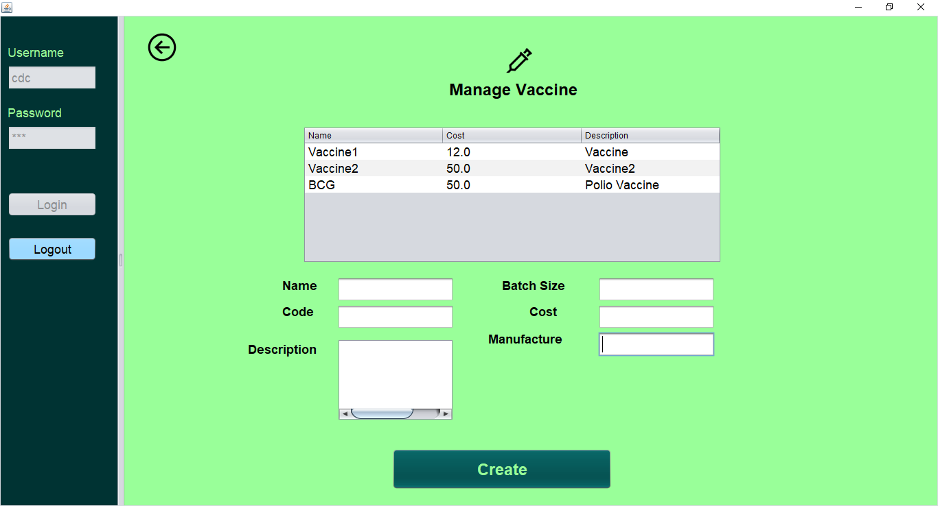
CDC Admin Work Area
Manage Vaccine

Slide 14
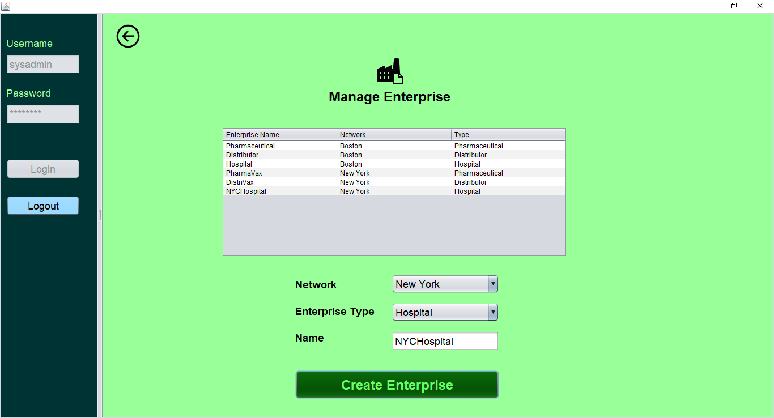
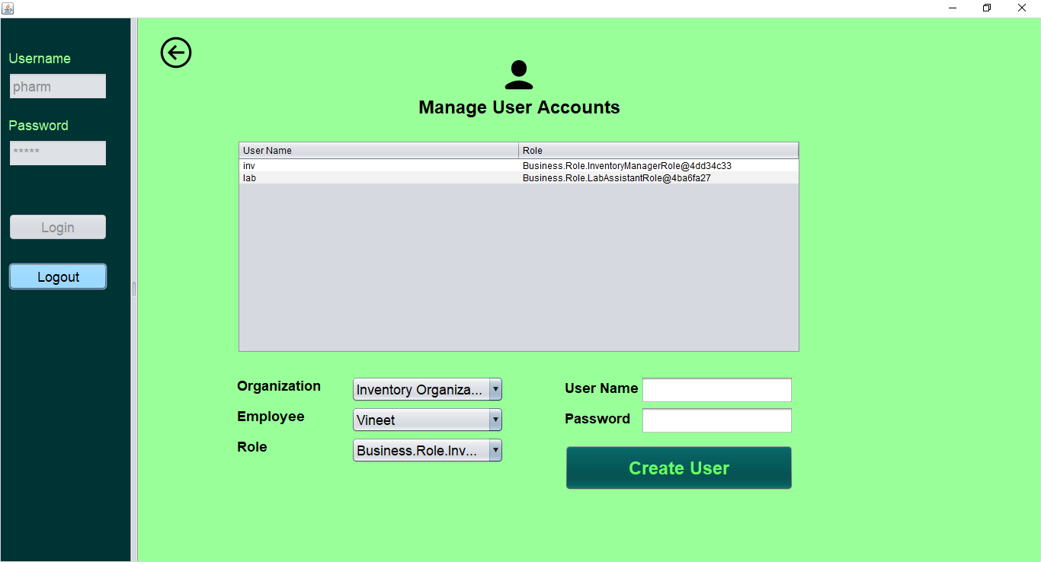
Manage Enterprise
Manage User Account

Slide 15
Thank You!

