Slide 1
Where do I move into in Seattle?
By Viyang Shah

Slide 2
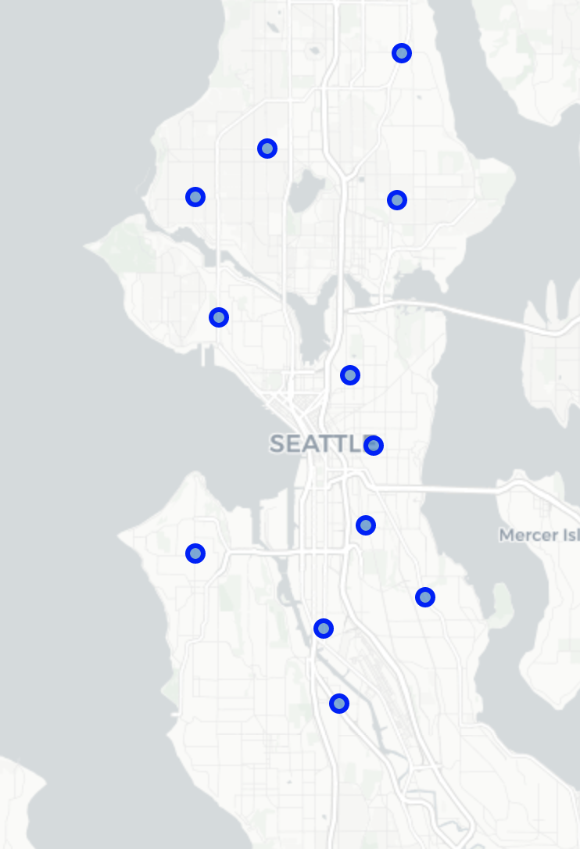
Problem
For people moving to Seattle, how can we find a good neighborhood to move into?
Is there a neighborhood that has places unlike any other?
Is rent there affordable?
Factors considered: average rent and uniqueness of venues in a set of 12 popular neighborhoods.

Slide 3
Data acquisition and use
Twelve neighborhoods considered, as listed: West Seattle, Beacon Hill, Ravenna, Columbia City, Ballard, Interbay, South Park, Central District, Georgetown, Lake City, Greenwood, and Capitol Hill.
Website used to acquire neighborhood names and average rent.
Foursquare API used to query venues at these neighborhoods (within a 500-meter radius), their category and their location.

Slide 4
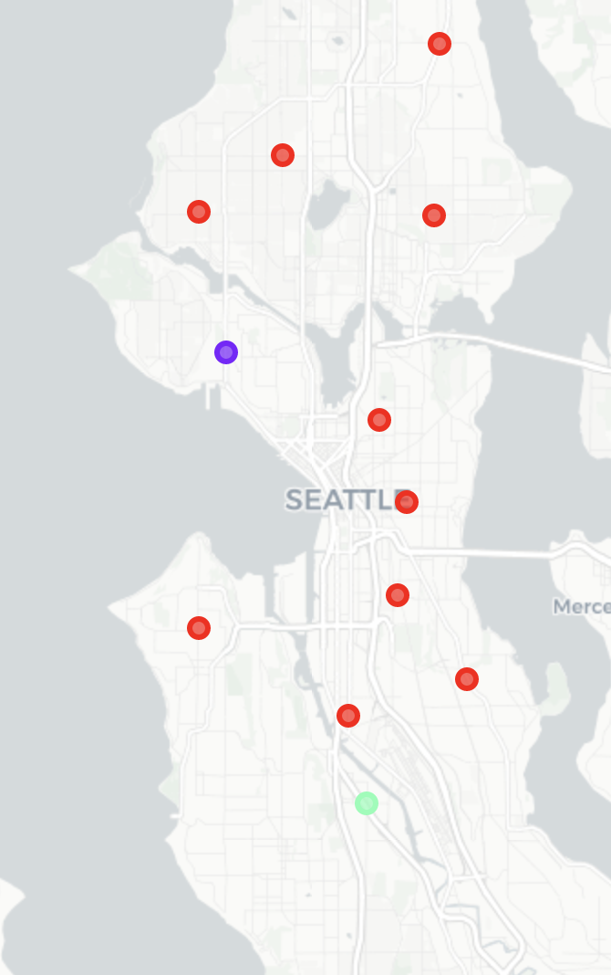
K-means clustering using k = 3
Clustering algorithm sorts two neighborhoods into their individual clusters, and the rest in a big cluster.
Common venues such as coffee shops and bars cause the big cluster.

Slide 5
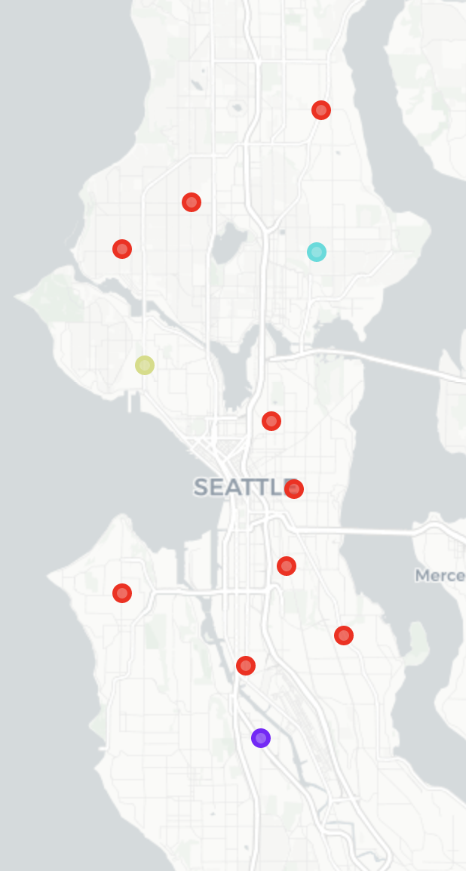
K-means clustering using k = 4
Another unique neighborhood singled out.
Increasing cluster number might cause overfitting.

Slide 6
Results

Slide 7
Adding more clusters does not separate the neighborhoods in clusters of multiple sizes, but it singles out unique neighborhoods that have less venues in common with others.
South Park in Seattle is unique, but the rent there is too high.
Interbay and Ravenna are recognized as unique neighborhoods with affordable rent.

Slide 8
Conclusion
The two neighborhoods I would consider moving into are Interbay and Ravenna.
The K-means clustering algorithm works to single out unique items if very few items are considered.
More data can be involved to better the model, and to make it historically accurate, dynamic data can be used.

