Slide 1

SkyCast
An Android weather app with charts, favorites and offline support
CS533 Personal Project · Project Report
Reza Shahwaz
https://github.com/shahwazreza/SkyCast-CS533-Solo-Project
Notes:
Introduce SkyCast: a weather app built for the CS533 solo project, following the SDLC.

Slide 2
SkyCast: Components
Current weather, a 7-day forecast and charts for any city, using the free Open-Meteo API (no key, no account). Built in Java on the course's Android build setup.
3
3
3
2,366
Activities
Fragments
Charts
Lines of Java
Main, Search, Settings
Today, Forecast, Favorites
24-hour, high/low, rain
25 classes, 9 layouts
required: 2
required: 1
required: data visualization
13 automated tests
Notes:
The assignment asks for two activities, a fragment and data visualization. SkyCast has three of each. All weather data comes from the free Open-Meteo API.

Slide 3
Developed using Waterfall Method
Analysis
Oct 7
Design
Oct 7
Development
Oct 8
Testing
Oct 10
Implementation
Oct 10
Evaluation
Oct 10
Requirements, use cases
Alternatives, diagrams, wireframes
25 classes, done a day early
Unit, instrumented, manual
Real device, fix issues
Report and submission
Why Waterfall
Fixed requirements
The assignment defines the required components up front.
Short, fixed deadline
Five days leaves no room for repeated full iterations.
Matches the report
Each phase maps to a section of this report.
Notes:
Waterfall fits: the requirements were fixed by the assignment, the deadline was short, and the report sections match the phases. A defect found in testing loops back to development before moving on.

Slide 4
Objectives:
Accurate weather
Current conditions and a 7-day forecast for any city the user searches for.
1
Visual data
Three charts: 24-hour temperature, 7-day high/low, and chance of rain.
2
Favorites
Save cities and switch between them in one tap.
3
Works offline
Shows the last saved forecast when there is no internet.
4
Follow the SDLC
Document each phase in this report.
5
Notes:
Objectives guide what the app must do; stakeholders show who it serves.

Slide 5
15 functional requirements, 13 built
Must
Should
Could
FR-01 Current conditions for the selected city
FR-02 24-hour temperature line chart
FR-03 7-day high/low line chart
FR-04 7-day chance-of-rain bar chart
FR-05 7-day daily list
FR-06 Search cities by name
FR-13 Clear error and empty-state messages
FR-07 Save or unsave the current city
FR-08 Favorites list: tap to open, delete
FR-09 °F + mph or °C + km/h, remembered
FR-10 Reopen on the last city viewed
FR-11 Pull-to-refresh and Refresh button
FR-12 Offline: last saved forecast
FR-14 Nearest city from location
FR-15 Daily weather notification
Stretch goals, not built: moved to future work
Notes:
Must and Should requirements are all implemented. The two Could items are stretch goals, moved to future work.

Slide 6
Nine non-functional requirements
Performance
Weather appears within 3 seconds
Responsiveness
Network and database work off the UI thread
Reliability
No crash offline, on API errors or rotation
1
4
7
Usability
Every feature within 2 taps of Today
Compatibility
Android 6.0 (API 23)+, portrait and landscape
Security & privacy
HTTPS only, no key or account, 2 permissions
2
5
8
Maintainability
data / ui / view / util packages, classes commented
Accessibility
Content descriptions, sp text, labeled charts
Storage
One cached forecast per city, replaced on refresh
3
6
9
Notes:
Each NFR has a way to measure it, which feeds the test plan.

Slide 7
Platform and UI
Decision | Chosen | Alternatives | Why chosen (pros) | Trade-off (cons)
Platform | Native Android, Java | Kotlin; Flutter; React Native | Matches the course's working build; full access to Android APIs | More boilerplate than Kotlin; Android only
UI toolkit | XML layouts, support library 23.0.1 | Jetpack Compose; AndroidX + Material | Fragments are required; builds with Android Gradle Plugin 3.1 | Older widgets and styling
Navigation | TabLayout + ViewPager | Bottom navigation; Navigation component | Available in design library 23.0.1; swipe between tabs | Bottom navigation isn't available at this version
Weather data | Open-Meteo API | OpenWeatherMap; WeatherAPI.com | Free, HTTPS, no API key or account; forecast and city search | Depends on a third-party service staying free
Notes:
Every choice here was shaped by one constraint: the build setup is copied from a working course project, so no new libraries.

Slide 8
Data and charts
Decision | Chosen | Alternatives | Why chosen (pros) | Trade-off (cons)
Networking | HttpURLConnection + org.json | Retrofit + Gson; Volley; OkHttp | Built into Android; no new dependencies | URLs and JSON parsing written by hand
Storage | SQLiteOpenHelper + SharedPreferences | Room; Firebase; plain files | Built in; works offline; no account or setup | Hand-written SQL and cursor code
Charts | Custom Canvas view (SimpleChartView) | MPAndroidChart; GraphView | No library allowed; full control of look and labels | No zoom or tap-for-value; more code to test
Background work | AsyncTask | Thread + Handler; Executors; RxJava | Part of API 23; results arrive on the UI thread | Deprecated in later Android; must cancel by hand
Notes:
Without new dependencies, networking, storage and charts are written with what Android provides. More code, but no setup risk and full control.

Slide 9
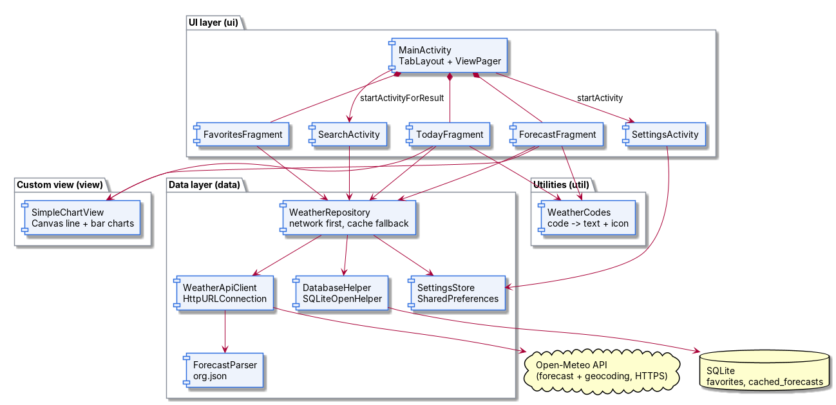
System diagram
Notes:
Activities and fragments only talk to WeatherRepository. The repository tries the network first and falls back to the SQLite cache.

Slide 10
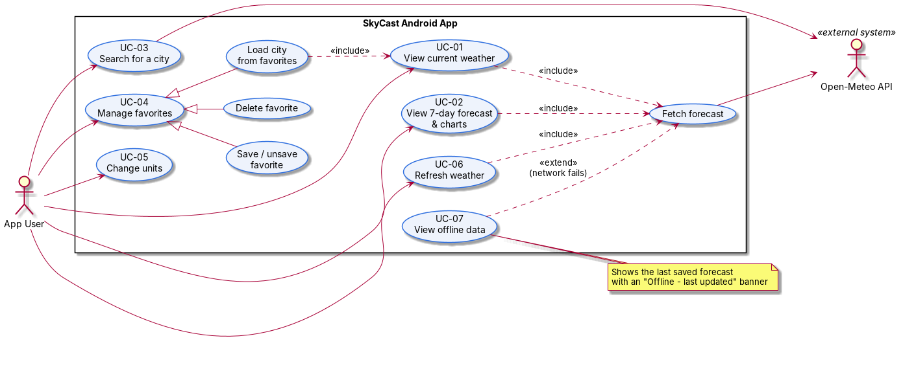
Use cases
Notes:
UC-01, 02 and 06 include Fetch forecast. UC-07, offline data, extends it when the network fails.

Slide 11
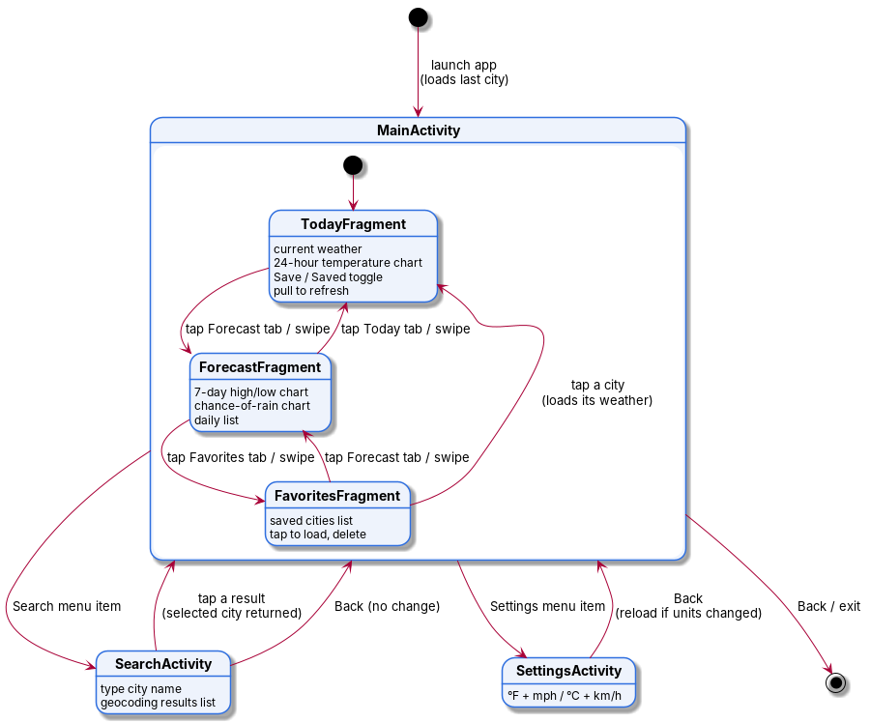
Screen flow
Notes:
MainActivity hosts the three fragments. Search returns a city with startActivityForResult; Settings triggers a reload if units changed.

Slide 12
Risks, trade-offs and limits
Item | Type | Impact | Solution or decision
Open-Meteo outage or slow network | Risk | No fresh weather | Network first with SQLite cache fallback; 10-second timeouts; clear message
Fixed old toolchain (AGP 3.1, API 23) | Constraint | No modern libraries | Wrote networking, storage and charts by hand; kept the build identical to a working project
AsyncTask deprecated in later Android | Trade-off | Future maintenance | Fine on API 23; replace with Executors when upgrading
Cache only covers cities already loaded | Limit | New city offline shows an error | Message says there's no internet; cache refreshes on every successful load
Emoji weather icons vary by phone | Limit | Icons look different per device | Text description shown with every icon
Custom charts are static | Trade-off | No zoom or tap-for-value | Values printed on the 7-day charts; daily list shows exact numbers
Notes:
The main risk, depending on a free API, is covered by the offline cache. The rest are accepted trade-offs of the fixed toolchain.

Slide 13




2,366 lines of Java in four packages
ui
MainActivity, SearchActivity, SettingsActivity, TodayFragment, ForecastFragment, FavoritesFragment, WeatherFragment, adapters, ItemDivider
1,245 lines
11 classes
data
WeatherRepository, WeatherApiClient, ForecastParser, DatabaseHelper, SettingsStore, models (City, Forecast, DailyForecast…)
615 lines
10 classes
view
SimpleChartView: custom line and bar charts drawn with Canvas
339 lines
1 class
util
WeatherCodes (WMO code → text + icon), Formatters, Units
167 lines
3 classes
Notes:
Code is split by responsibility. ui is the largest because it holds all three activities, three fragments and their adapters.

Slide 14
Key code: network first, cache fallback
// WeatherRepository.java
public WeatherResult loadForecast(City city, String units) {
try {
String json = WeatherApiClient.get(
WeatherApiClient.buildForecastUrl(
city.getLatitude(), city.getLongitude(), units));
Forecast forecast =
ForecastParser.parseForecast(json, units);
long now = System.currentTimeMillis();
database.saveForecast(city.getId(), json, units, now);
return new WeatherResult(city, forecast, json,
false, now, 0);
}
catch (IOException | JSONException e) {
return loadCachedForecast(city); // offline fallback
}
}
1. Download
HttpURLConnection, 10 s timeouts, runs in an AsyncTask off the UI thread.
2. Parse and cache
org.json builds the Forecast; the raw JSON replaces the city's cache row.
3. Fall back
On failure, the cached JSON is parsed instead and the offline banner shows its time.
Notes:
This one method delivers FR-12 (offline) and NFR-03 (no crash). Any network or parsing failure falls through to the cache.

Slide 15
Key code: chart axes that pick their own scale
// SimpleChartView.java
// rounds a raw gridline step to 1, 2, 5 or 10 x 10^n
static double niceStep(double rawStep) {
if (rawStep <= 0 || Double.isNaN(rawStep))
return 1;
double magnitude =
Math.pow(10, Math.floor(Math.log10(rawStep)));
double fraction = rawStep / magnitude;
double nice = (fraction <= 1) ? 1 : (fraction <= 2) ? 2 :
(fraction <= 5) ? 5 : 10;
return Math.max(1, nice * magnitude);
}
// converts a data value to a y coordinate in the plot
private static float toY(double value, double min,
double max, float top, float plotHeight) {
return (float) (top + plotHeight *
(1 - (value - min) / (max - min)));
}
Scales to any view
Every size is computed in onDraw from the view's width and height, in dp and sp.
Readable labels
X-labels that would overlap are skipped; high/low values print above and below their lines.
Handles gaps
Missing (NaN) values leave a break in the line instead of a wrong point.
Notes:
SimpleChartView rounds the gridline step to 1, 2, 5 or 10 times a power of ten, so the y-axis always reads cleanly whatever the temperatures are.

Slide 16
Test cases:
ID | Req. | Steps | Expected result | Result
TC-01 | FR-01, 10 | Install and open the app fresh | Cape Girardeau weather with every field filled | Pass
TC-02 | FR-02 | Look at the Today tab | 24-hour temperature chart with readable labels | Pass
TC-03 | FR-03–05 | Open the Forecast tab | High/low chart, rain chart and 7-day list | Pass
TC-04 | FR-06 | Search "Paris", tap Paris, France | Today tab shows Paris weather | Pass
TC-05 | FR-13 | Search with an empty box, then "xyzxyz" | "Please enter a city name", then "No cities found" | Pass
TC-06 | FR-07, 08 | Save Paris, open Favorites, tap it, delete it, tap Undo | Paris listed, opens on tap, removed, then restored | Pass
TC-07 | FR-09 | Choose °C and km/h in Settings, go back, restart | Weather reloads in °C; setting kept after restart | Pass
Notes:
Fill in the Result column after running each case on the device.

Slide 17
Test cases:
ID | Req. | Steps | Expected result | Result
TC-08 | FR-10 | View Paris, close the app fully, reopen | Paris shows, not Cape Girardeau | Pass
TC-09 | FR-11 | Pull down on Today; tap Refresh | Data reloads and the "Updated" time changes | Pass
TC-10 | FR-12, NFR-03 | Load a city, turn on airplane mode, reopen | Cached weather with the offline banner, no crash | Pass
TC-11 | FR-13 | Airplane mode, search any city | "No internet connection", no crash | Pass
TC-12 | NFR-03, 05 | Rotate on every screen | Layout adjusts, data stays, no crash | Pass
TC-13 | NFR-01 | Time the load on Wi-Fi | Weather appears in under 3 seconds | Pass
TC-14 | NFR-02 | Tap around while weather loads | No freeze or "App not responding" | Pass
Notes:
These cover the remaining functional requirements and the measurable NFRs.

Slide 18
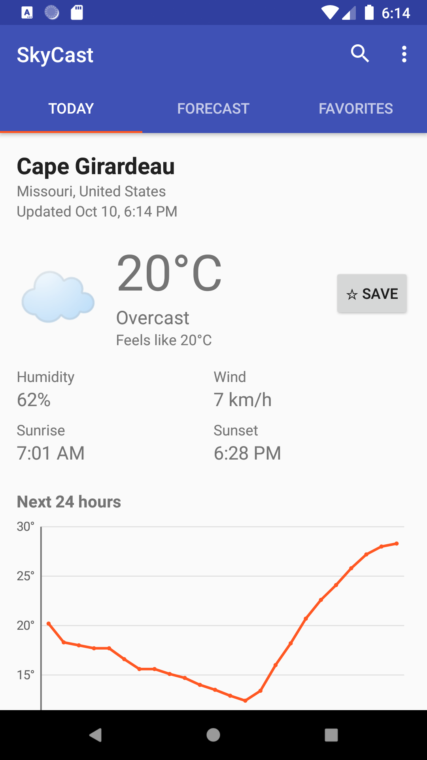
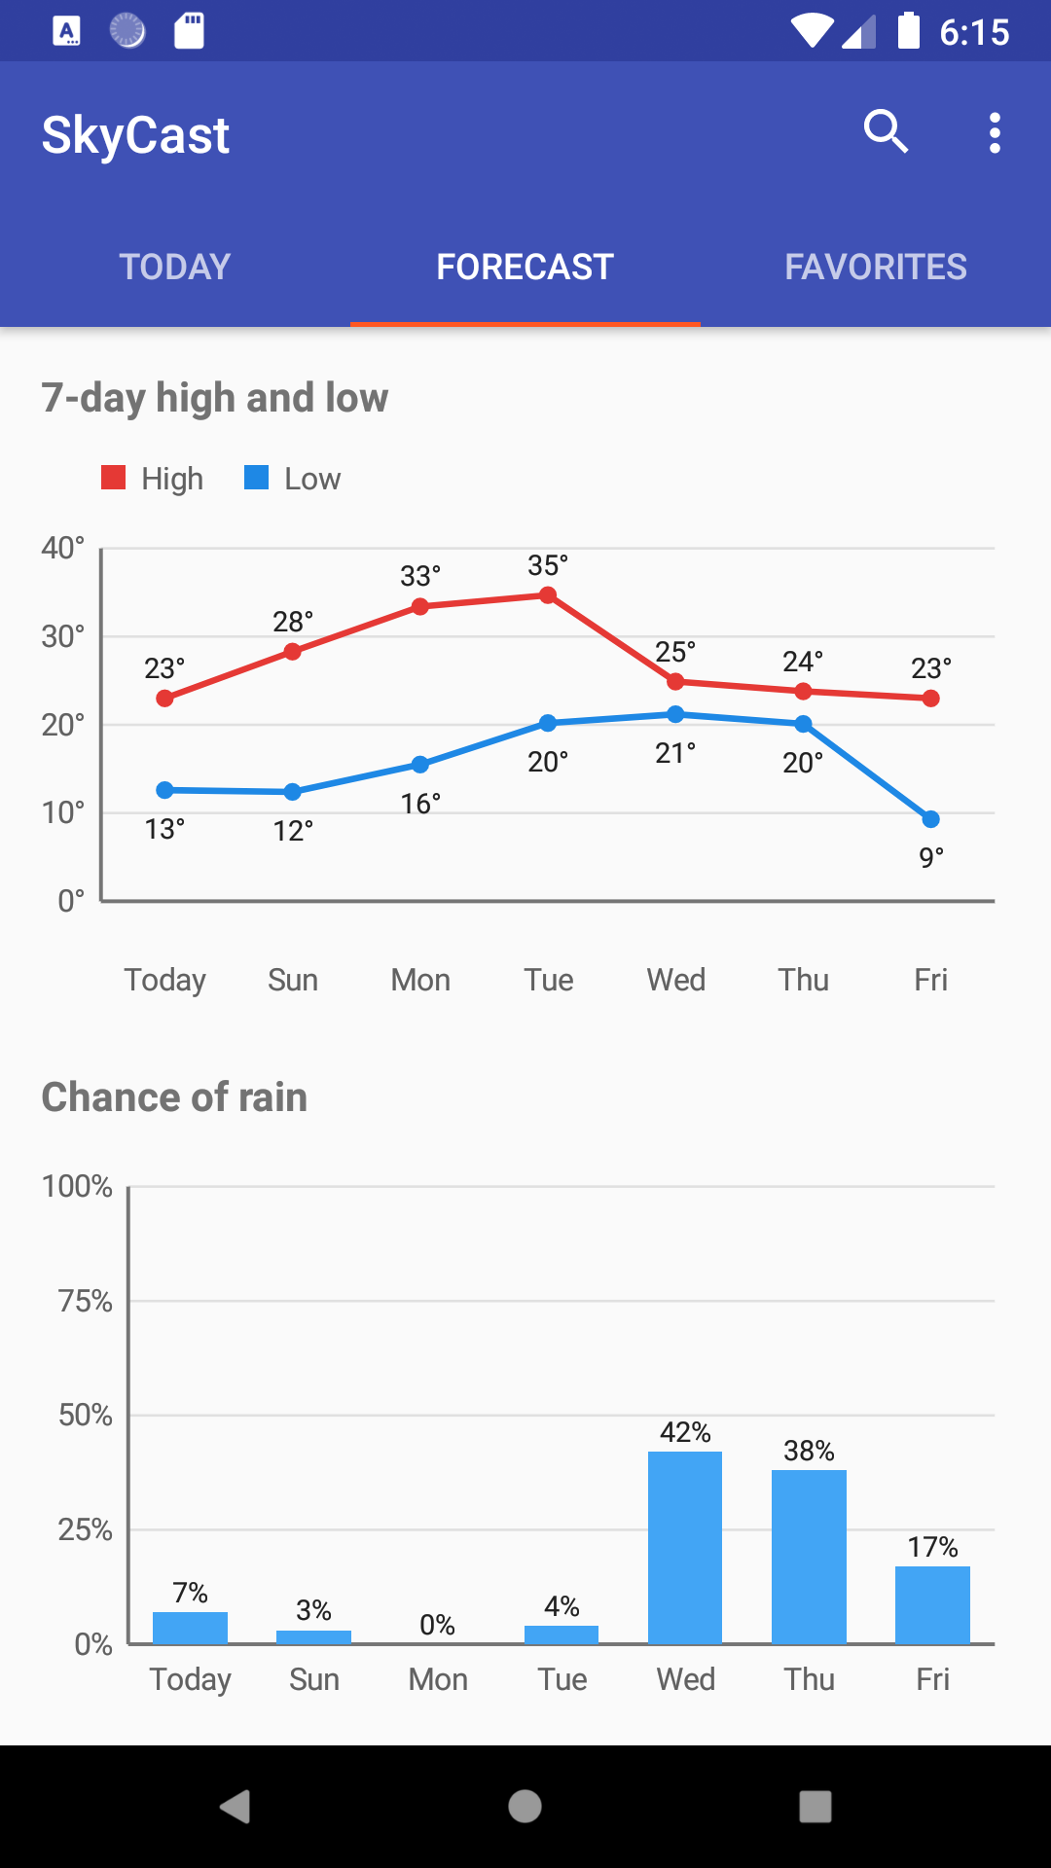
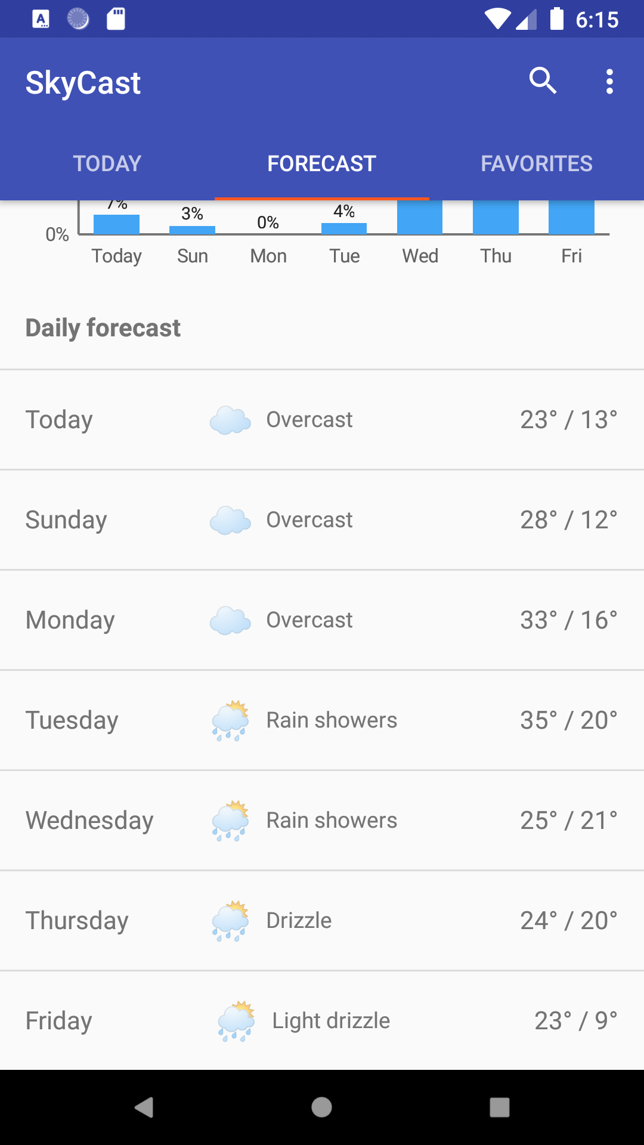
SkyCast running on a device:
1
1
Today tab
Current weather and 24-hour chart
Forecast tab
High/low chart, rain chart
Forecast tab
7 Day Weather View
Notes:
Replace each dashed frame with a screenshot from the phone (portrait). Keep the captions.

Slide 19
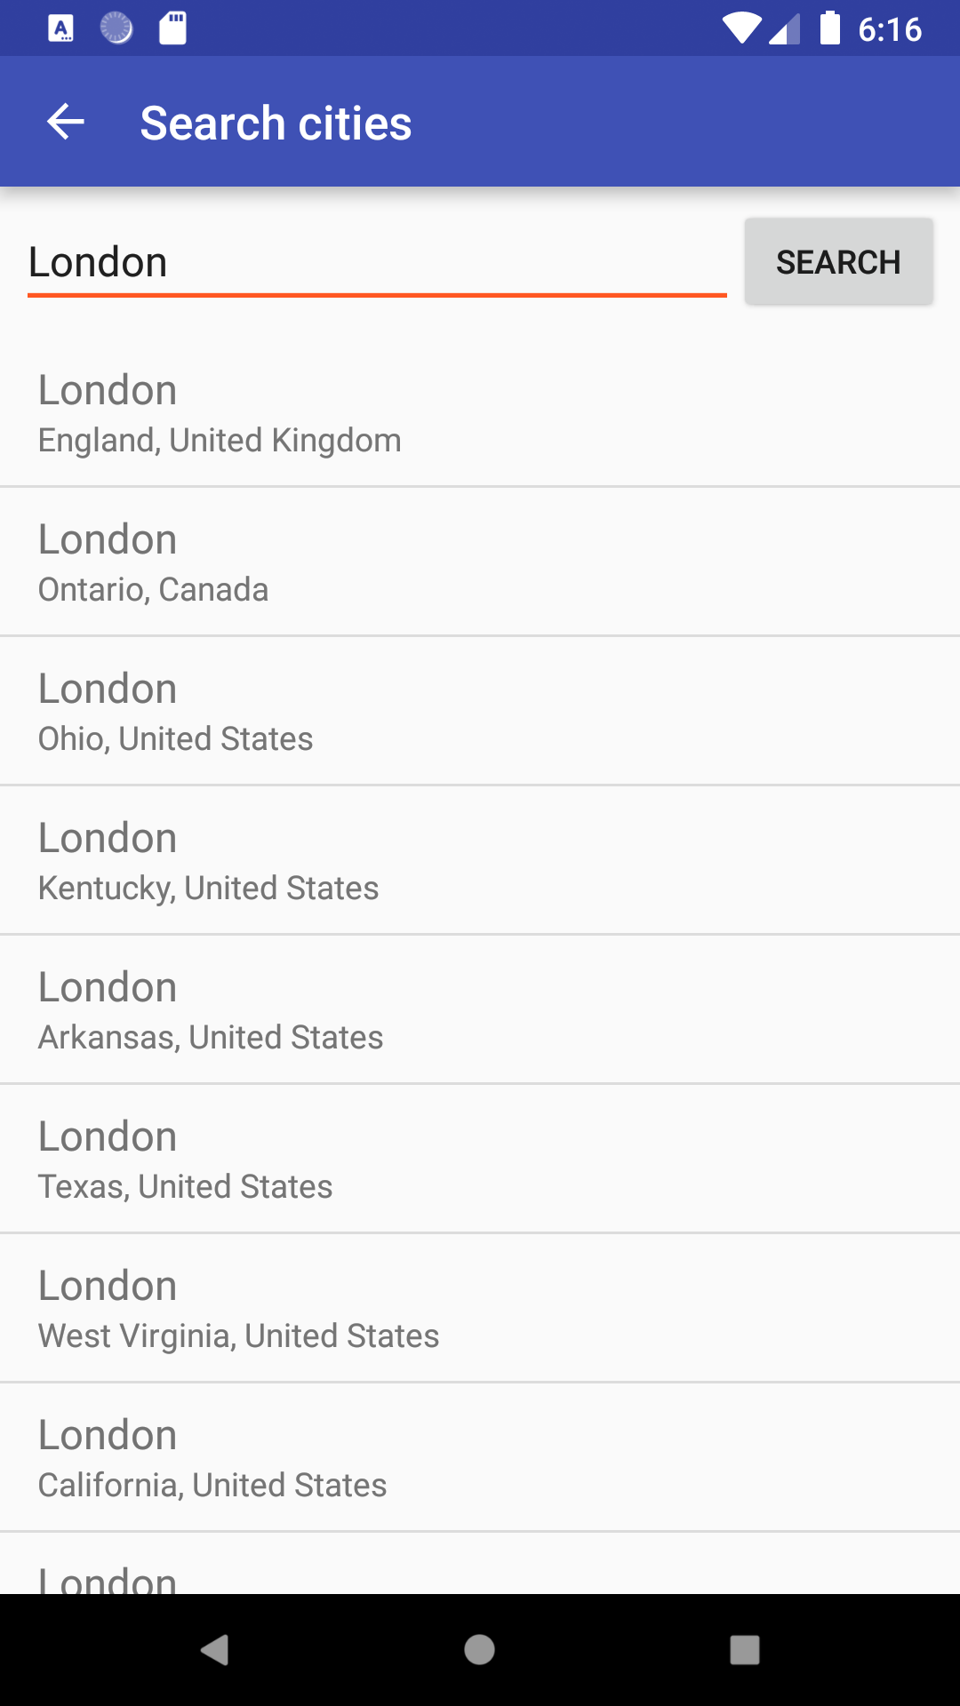
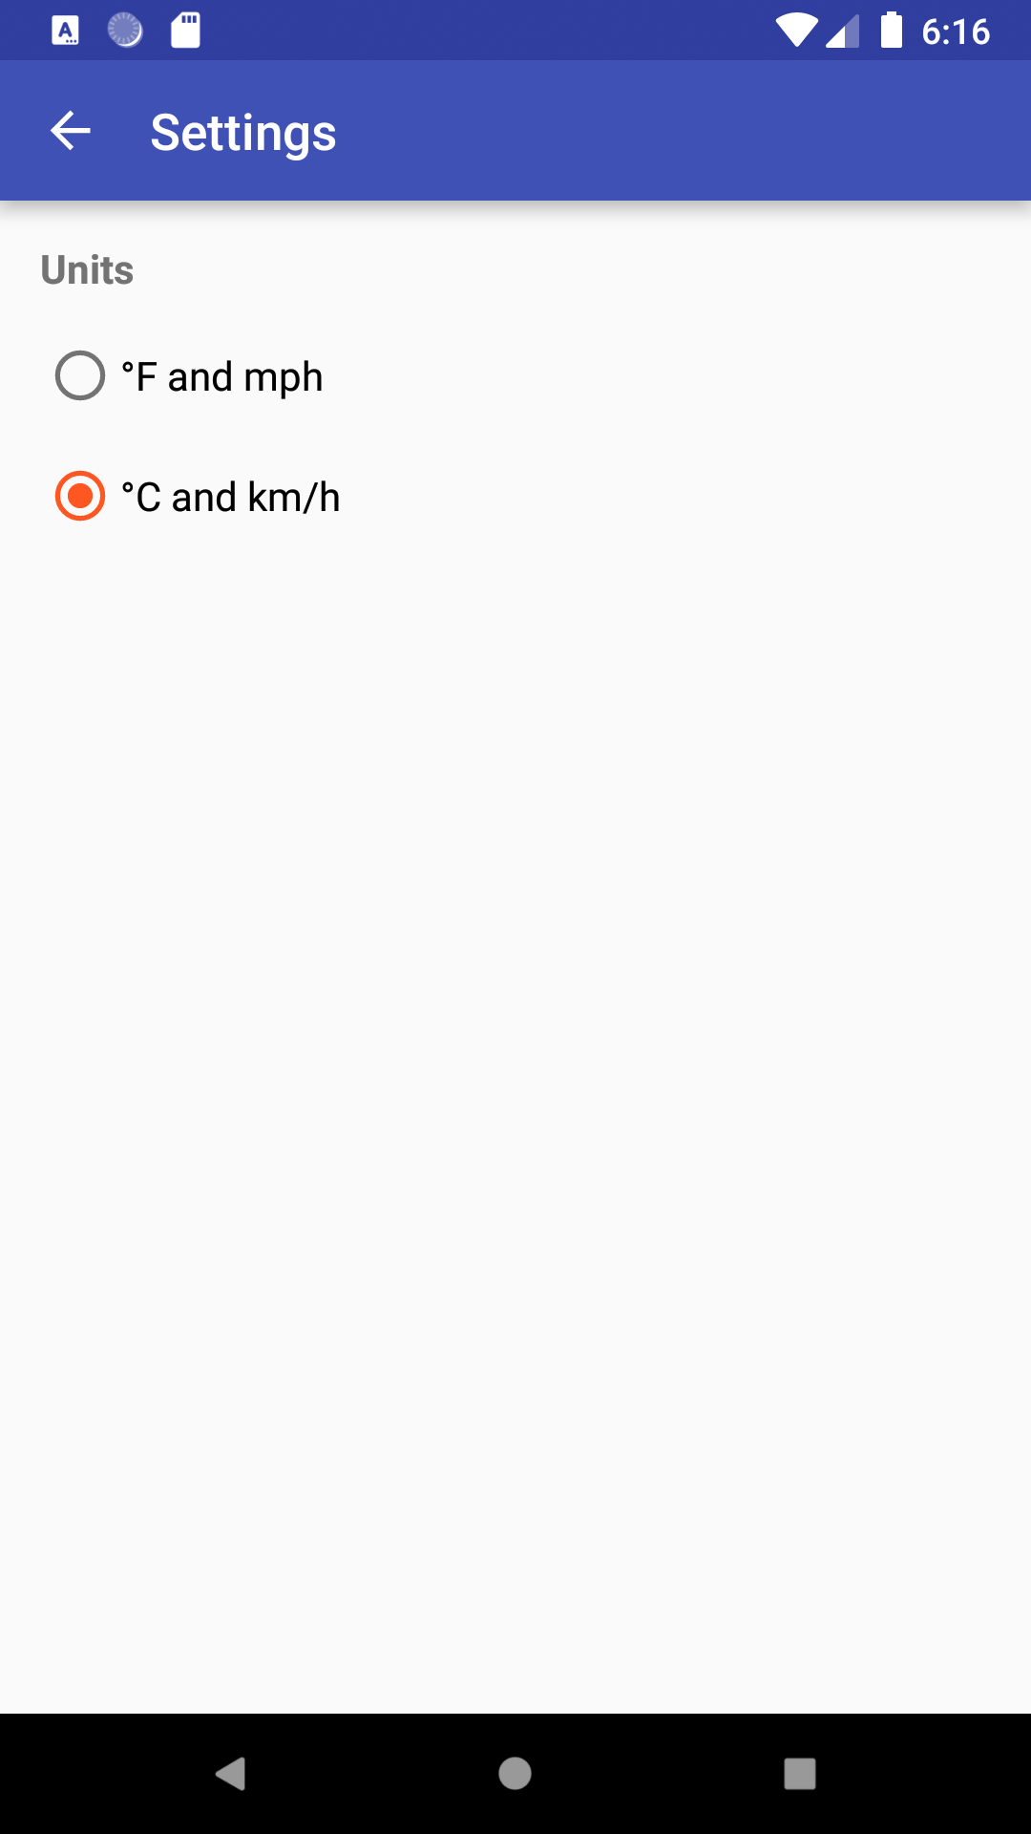
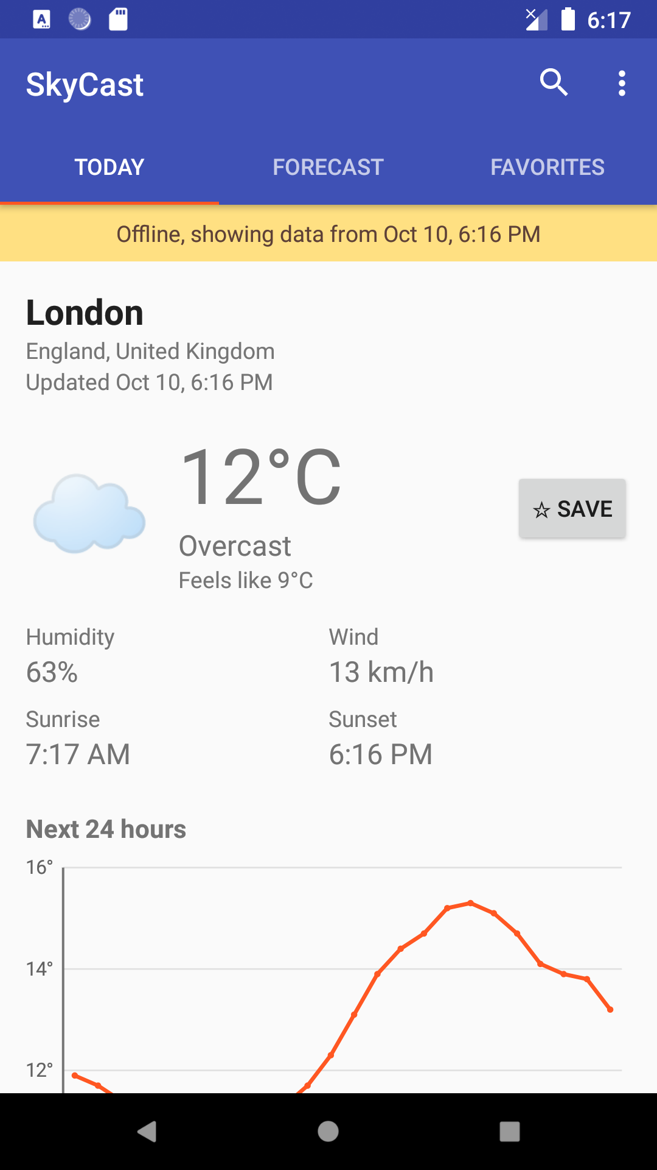
SkyCast running on a device:
Search
Results for a city name
Settings
°F + mph or °C + km/h
Offline
Cached forecast with the offline banner
Notes:
Replace each dashed frame with a screenshot from the phone (portrait). Keep the captions.

Slide 20
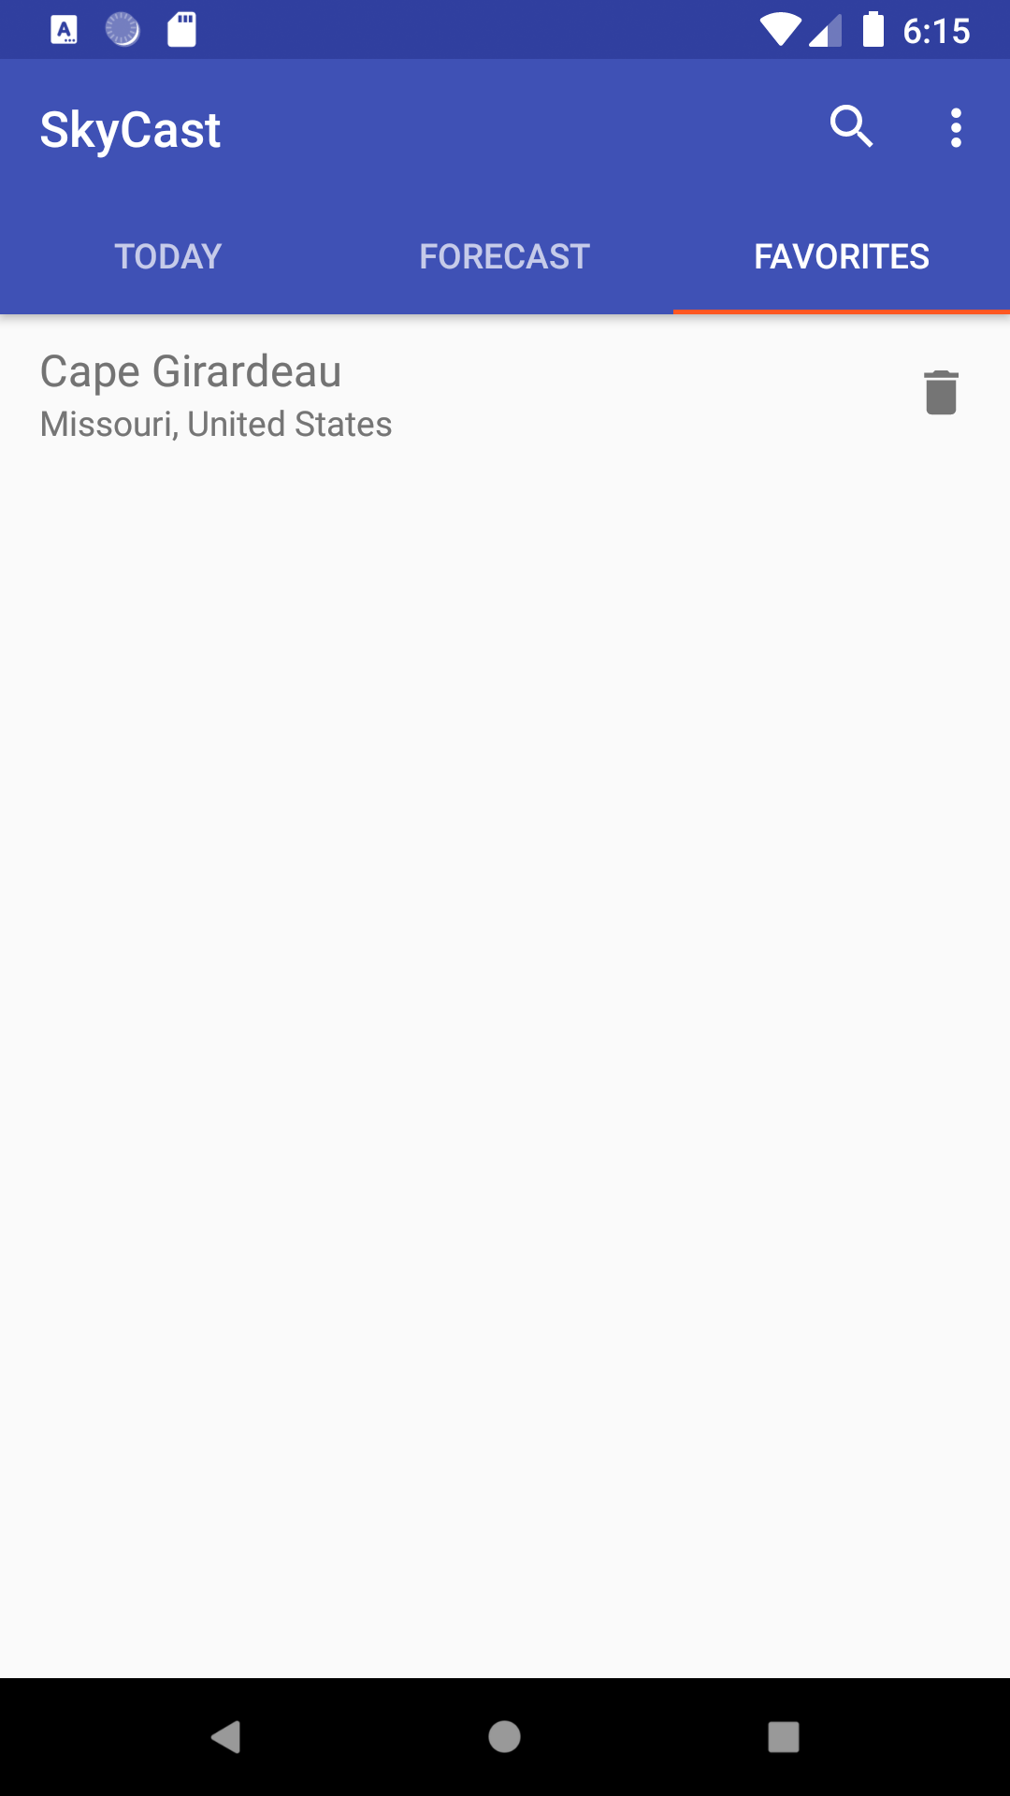
SkyCast running on a device:
Favorites
Favorite cities
Notes:
Replace each dashed frame with a screenshot from the phone (portrait). Keep the captions.

Slide 21
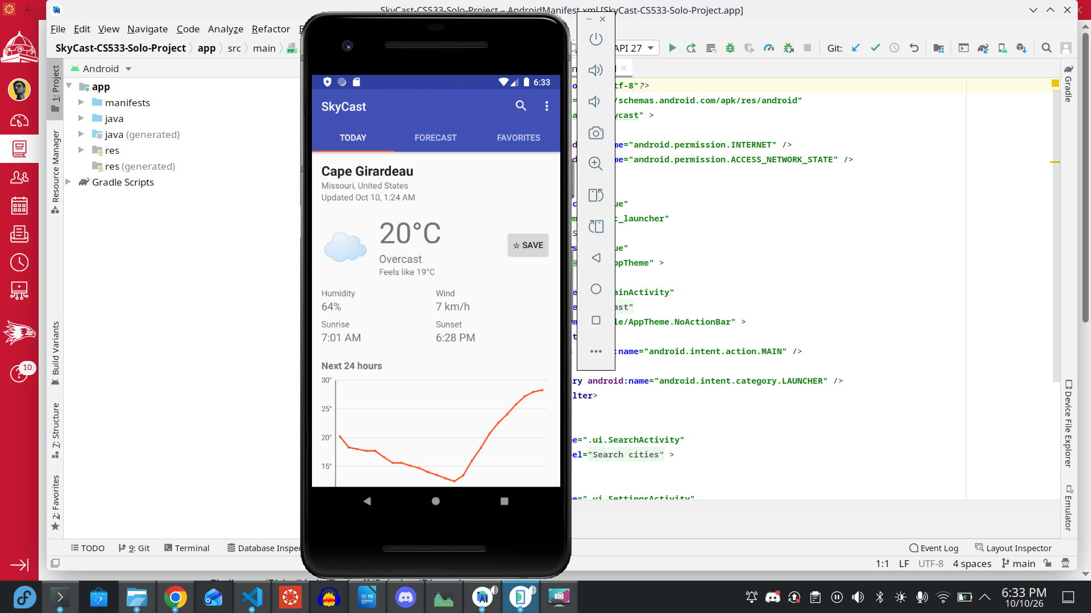
SkyCast Running on Emulator

Slide 22






Future work
Current location
Find the nearest city from GPS (FR-14).
Daily notification
Morning summary of the day's weather (FR-15).
Home-screen widget
Current temperature without opening the app.
Interactive charts
Tap a point for its value; hourly detail for each day.
Weather alerts
Warn about storms, heat or freezing temperatures.
Modernize the stack
AndroidX, Room and Executors in place of deprecated AsyncTask.
Notes:
The first two are the unbuilt stretch requirements. The last one would modernize the code if the course toolchain allowed it.

Slide 23
Thank you
Disclaimer: Artificial Intelligence was used in order to design some aspects of this presentation. While the idea and execution are completely mine, AI helped me outline, design, and complete this presentation.

