Slide 1
BnbLens
Leveraging Data Analytics and AI for Optimized Airbnb Recommendations
Team Members:
Smit Chandi
Yaksh Shah
Introduction to Data Management and Processing

Slide 2
INTRODUCTION
Have you ever spent hours scrolling through Airbnb listings, struggling to find the perfect stay?
What if data could do this work for you?
Absolutely! We wanted to solve the exact problem of spending hours scrolling through Airbnb listings, trying to find the perfect stay. So, we focused on analyzing Airbnb listings to uncover key insights and trends in the rental market. By leveraging data, we’ve created a personalized recommendation system that simplifies the decision-making process for travelers and helps hosts optimize their offerings. Using statistical analysis, data visualization, and machine learning, we provide tailored suggestions based on user preferences, ensuring a seamless and informed experience for both renters and hosts. With data doing the work, finding the perfect stay becomes effortless and efficient.

Slide 3
Goal:
To develop a professional dashboard for visualizing and deriving key insights that can enhance both user and host experiences. This dashboard will provide a simple, intuitive method for accessing property metadata, which can reveal patterns to help deliver more personalized suggestions, offers, and discounts.
To develop an Airbnb Recommendation System through a chatbot that suggests properties based on the user's textual input. This approach streamlines the process by eliminating the need to manually sift through individual listings and apply filters sequentially.

Slide 4
Objective:
User-Centric Recommendations:
Create an intuitive recommendation system integrated with a chatbot that provides property suggestions based on users’ textual input, simplifying the search process.
Host-Centric Insights: Develop actionable insights for hosts, such as optimizing pricing, amenities, and listing strategies to enhance booking rates and guest satisfaction.
Dashboard for Visualization: Build a professional dashboard to visualize Airbnb data, uncover trends, and derive actionable insights for both users and hosts.
Enhanced Experience: Improve decision-making for travelers and optimize host performance by leveraging statistical analysis, machine learning, and data visualization.
Efficiency and Accessibility: Provide a seamless and efficient way for users to explore personalized offers, discounts, and property recommendations without manual filtering.

Slide 5
Data Collection and Preparation:
Gather detailed Airbnb data, including property metadata (e.g., price, location, amenities, reviews,
ratings).
Clean and preprocess data by addressing missing values, inconsistencies, and outliers.
Exploratory Data Analysis (EDA):
Analyze the data to uncover key trends, such as popular property features, optimal pricing strategies,
and booking patterns.
Visualize findings using charts, graphs, and interactive elements to make insights accessible.
Recommendation System:
Develop a chatbot-powered recommendation system using natural language processing (NLP) to
interpret user input and suggest properties.
Implement machine learning models (e.g., collaborative filtering, content-based filtering) to provide
personalized property recommendations.
Scope:

Slide 6
Dashboard Development:
Create a user-friendly dashboard for visualizing trends, patterns, and insights derived from Airbnb data.
Include features like search filters, trend analysis, and key metrics for hosts and users.
Host Optimization Tools:
Provide hosts with insights on pricing, amenities, and listing strategies based on data patterns.
Design tools or reports to help hosts improve their listings and maximize bookings.
Performance Evaluation:
Test and evaluate the recommendation system and dashboard using metrics like accuracy, user satisfaction, and system efficiency.
Use feedback from users and hosts to refine and improve the system.
User Feedback and Iteration:
Gather feedback from both users and hosts to continuously improve the chatbot, dashboard, and insights provided.
Ensure that the system evolves to meet changing user preferences and market trends.

Slide 7
Literature Review
Zillow's Optimized Search Operation:
One notable example of existing work is Zillow's optimized search system, which employs a hybrid search technique to streamline property searches. Unlike traditional filtering methods where users apply filters sequentially (e.g., location, price, size), Zillow's approach allows users to search directly using natural language queries. This system leverages a combination of natural language processing (NLP) and machine learning algorithms to interpret user input and deliver relevant property results instantly. By bypassing the need for step-by-step filtering, this technique enhances user experience by making the search process faster and more intuitive
Relevance to Our Project:
Zillow’s hybrid search model demonstrates the potential of using NLP-powered search mechanisms for simplifying decision-making in property selection. Inspired by this, our project integrates a similar concept into the Airbnb Recommendation System, where a chatbot uses user-generated textual input to suggest personalized listings. This approach eliminates the need for users to manually filter listings, providing a seamless and efficient experience. Our work builds upon this idea by focusing on Airbnb's unique rental market and incorporating additional features like data visualization and host insights.

Slide 8
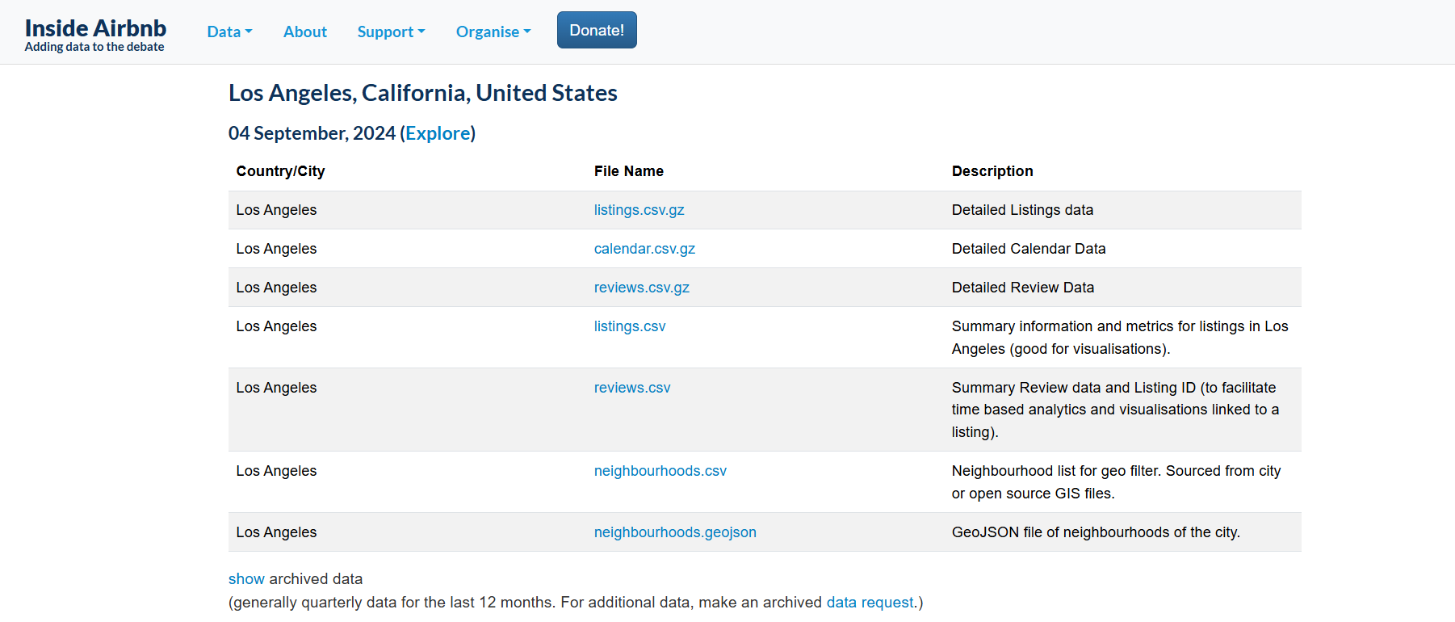
Methodology
The Initial Step:
Conduct research to identify a relevant topic and gather data for analysis.
Listings Dataset used:
Los Angeles
Oakland
San Diego
San Francisco
Inside Airbnb: https://insideairbnb.com/get-the-data/

Slide 9
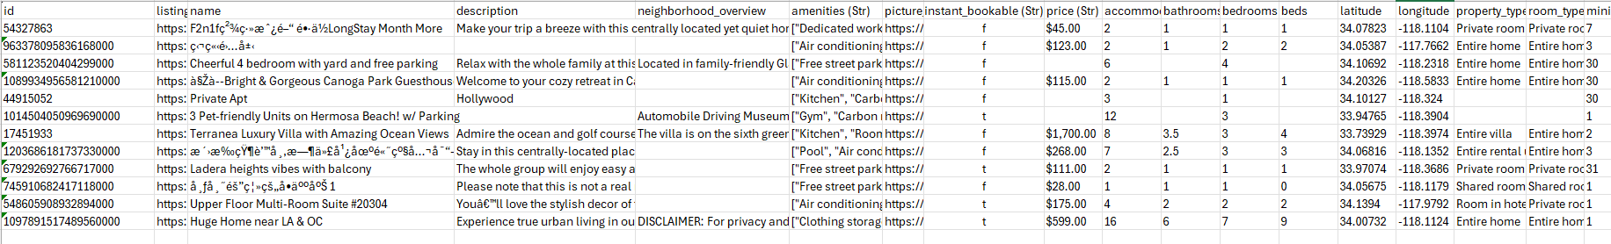

Data Preprocessing:
This step involves a systematic approach to Extracting, Transforming, and Loading (ETL) data to ensure it is clean, organized, and ready for analysis.
Extraction: Inside Airbnb
Extracted Data
Data that is cluttered, untidy, noisy, inconsistent, non-continuous, totally messed up, flawed, and cannot be relied upon is known as unhealthy data.
The data we extracted was extremely unhealthy.

Slide 10

Transformation:
The model preparation, recommendation and analysis rely heavily on data; even a minor flaw can lead to irrelevant output. Therefore, data transformation was one of the most crucial and effective steps in the entire project workflow.
The raw dataset initially contained 58 distinct features, which could have posed significant challenges.
Feature selection was extremely essential to eliminate irrelevant features, thus mitigating the risk of the curse of dimensionality and ensuring more efficient analysis.

Slide 11
Addressing challenges with unhealthy data:
ID: Addressed inconsistency and large sized data (up to 17 digits).
Gibberish Data: Designed and implemented a well-formed regular expression to clean irregular entries.
Amenities: Processed strings of lists using ast.literal_eval for accurate evaluation.
Instant Bookable: Converted string values to boolean for proper classification.
Price: Managed irregular string formats through regular expressions, followed by type conversion for consistency.
Updated the data types for each feature to ensure relevance and accuracy.

Slide 12

The data is now organized, structured, consistent, relevant, and clean, making it ready for analysis.
But, wait—what if a new property gets listed tomorrow?
Will the analysis dashboard automatically incorporate it?
Is the data static or dynamic?
Is the ETL process region-specific, or is it generalized to form a comprehensive ETL pipeline?

Slide 13
Loading:
To enable real-time access and dynamic updates, the dataset is first processed through normalization, a step that organizes the data into a structured format by removing redundancies and ensuring logical relationships between tables.
This normalized data is then inserted into a PostgreSQL database, which serves as a robust and scalable system for managing structured data. By employing primary keys, foreign keys, and constraints during this process, the database maintains data integrity, ensuring consistency, accuracy, and reliability across all records.
The database is seamlessly connected to an analysis dashboard, which dynamically fetches data in real-time to deliver actionable insights through visualizations like graphs, charts, and metrics. This integrated approach ensures a streamlined flow from data normalization to actionable intelligence while preserving the quality and reliability of the underlying data.

Slide 14
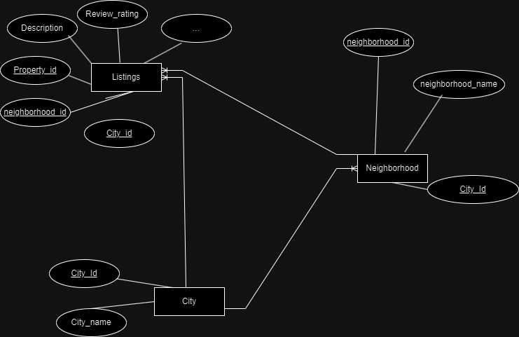
ER Diagram

Slide 15
Code Generalization:
This marks the transition from an ETL process to a fully automated ETL pipeline. The region-specific code was refined into a generalized framework, enabling the creation of a pipeline that automates the extraction, preprocessing/transformation, and loading of data into the database seamlessly.

Slide 16



Data Analysis:
Power BI
https://tinyurl.com/Airbnb-Listings-Analysis

Slide 17
Search Techniques
Syntactic Search:
It refers to a method of information retrieval that focuses on matching the exact structure, arrangement, and sequence of words or phrases within a dataset, query, or document. It emphasizes the surface-level structure of the text rather than its meaning, context, or intent.
In syntactic search, the system looks for exact or near-exact matches between the query and the stored data, often ignoring the deeper relationships between words. This type of search relies on rules and patterns in the syntax or grammar of the language used in the dataset.
Key Characteristics of Syntactic Search:
Exact Phrase Matching: Retrieves documents with exact keyword or phrase matches without interpreting their meaning.
Rule-Based Pattern Recognition: Follows strict patterns like word order and punctuation, ideal for precise queries.
No Semantic Understanding: Does not consider synonyms or context (e.g., treats "car" and "automobile" as different).

Slide 18
Semantic Search:
Semantic search is an advanced information retrieval technique that focuses on understanding the meaning and context behind a user's query rather than simply matching keywords. By leveraging natural language processing (NLP), machine learning, and knowledge graphs, semantic search systems can interpret user intent and provide more relevant and contextually appropriate results.
Key Characteristics of Semantic Search:
Contextual Understanding Semantic search systems interpret the context of a query, allowing them to understand relationships between words, phrases, and concepts. Example: A search for "Apple stock" returns financial information about the tech company, while "Apple fruit" returns nutritional facts about the fruit.
Synonym Recognition Unlike syntactic search, semantic search recognizes synonyms and related terms. It knows that “car” and “automobile” refer to the same concept. Example: A query for "buy a car" may return results containing "purchase a vehicle."

Slide 19
3. Entity Linking and Disambiguation Semantic search links terms to specific entities (people, places, or things) and resolves ambiguities. Example: A query for "Paris" could refer to Paris, France, or Paris Hilton, and semantic search differentiates based on context.
4. User Intent Detection It identifies the intent behind the query, whether it's informational, transactional, or navigational, and adjusts the results accordingly. Example: Searching for "how to bake a cake" returns instructional content, while "buy a cake" shows e-commerce websites.

Slide 20
Hybrid Search:
Hybrid search is an advanced search methodology that combines the strengths of syntactic search (keyword-based) and semantic search (context-based) to deliver more accurate, relevant, and comprehensive search results. By leveraging both exact keyword matching and context-aware understanding, hybrid search systems can retrieve precise information while considering the meaning and intent behind a user’s query.
Key Characteristics of Hybrid Search:
1. Combines Exact Matching and Contextual Understanding:
Hybrid search merges the benefits of keyword-based searches (high precision) with the contextual and conceptual insights of semantic search (high recall).
Example: A search for "affordable hotels in Paris" retrieves results containing both exact phrases like "affordable hotels" and contextually relevant options like "budget accommodations" or "cheap stays.“
2. Enhanced Relevance
By integrating syntactic and semantic approaches, hybrid search improves the relevance of results by ensuring they match both the exact terms and the user’s intent.
3. Broader Coverage
Hybrid search systems can retrieve documents that would be missed by either syntactic or semantic search alone, providing a broader and more inclusive result set.

Slide 21
BM25:
BM25 (Best Matching 25) is a ranking function used by search engines to estimate the relevance of documents to a given search query. It belongs to the family of bag-of-words (BoW) retrieval functions and is an extension of the traditional TF-IDF (Term Frequency-Inverse Document Frequency) model. BM25 addresses some of the limitations of TF-IDF, making it one of the most popular and effective ranking algorithms for information retrieval systems.
Although BM25 itself is not a word vectorization technique like Word2Vec or BERT, it plays a crucial role in vectorizing text documents in a sparse format. This sparse representation can then be used in search engines, text retrieval systems, and hybrid search models.
BM25 accounts for how often a term appears in a document. Unlike traditional TF-IDF, it uses a saturation function that limits the impact of very high term frequencies. This prevents excessively long documents from dominating the relevance score.

Slide 22
Pinecone:
Pinecone is a fully managed vector database designed for building and scaling AI-powered applications. It enables fast, accurate, and efficient similarity search and ranking of vector embeddings generated by machine learning models. Pinecone is a critical tool for applications involving semantic search, recommendation systems, personalization, natural language processing (NLP), and computer vision.
Key Concepts of Pinecone:
Vector Embeddings Vector embeddings are numeric representations of data points (e.g., text, images, audio) in a multi-dimensional space. Pinecone is designed to store and query these embeddings efficiently, enabling high-performance similarity searches.
Similarity Search Pinecone performs similarity searches by finding data points in the vector space that are closest to a query vector. Common distance metrics include:
Cosine Similarity
Euclidean Distance
Dot Product
Indexing Pinecone indexes vector embeddings to optimize search and retrieval. Unlike traditional databases, Pinecone is optimized for high-dimensional vector data, offering millisecond response times for queries across millions or even billions of vectors.

Slide 23
Inserting Data to Pinecone
Gemini Flash Model
Generate description of each property
Insert Data into pinecone

Slide 24
Application Overview
Gemini Flash Model
Now take user prompts what user wants
Get Summarized User Query
Fetch relevant properties and display it

Slide 25


Slide 26
References
https://zillow.mediaroom.com/2023-01-26-Zillows-new-AI-powered-natural-language-search-is-a-first-in-real-estate
https://insideairbnb.com/
Stephen Robertson and Hugo Zaragoza. 2009. The Probabilistic Relevance Framework: BM25 and Beyond. Found. Trends Inf. Retr. 3, 4 (April 2009), 333–389. https://doi.org/10.1561/150000001
https://huggingface.co/sentence-transformers/multi-qa-mpnet-base-dot-v1

Slide 27
References
https://docs.pinecone.io/guides/data/understanding-hybrid-search
https://www.youtube.com/watch?v=CK0ExcCWDP4&t=2193s
https://harshadsuryawanshi.medium.com/exploring-airbnb-listings-with-semantic-search-a-qdrant-and-llm-powered-approach-a65cd170f710
https://www.youtube.com/watch?v=5e5vHc4U30o

