Slide 1
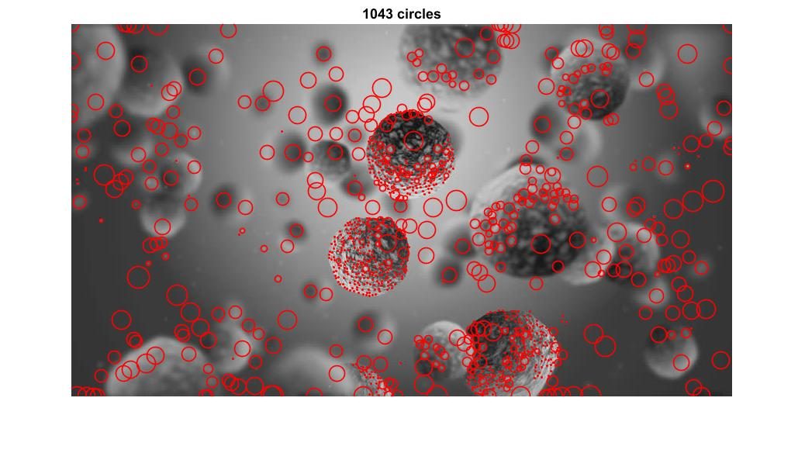
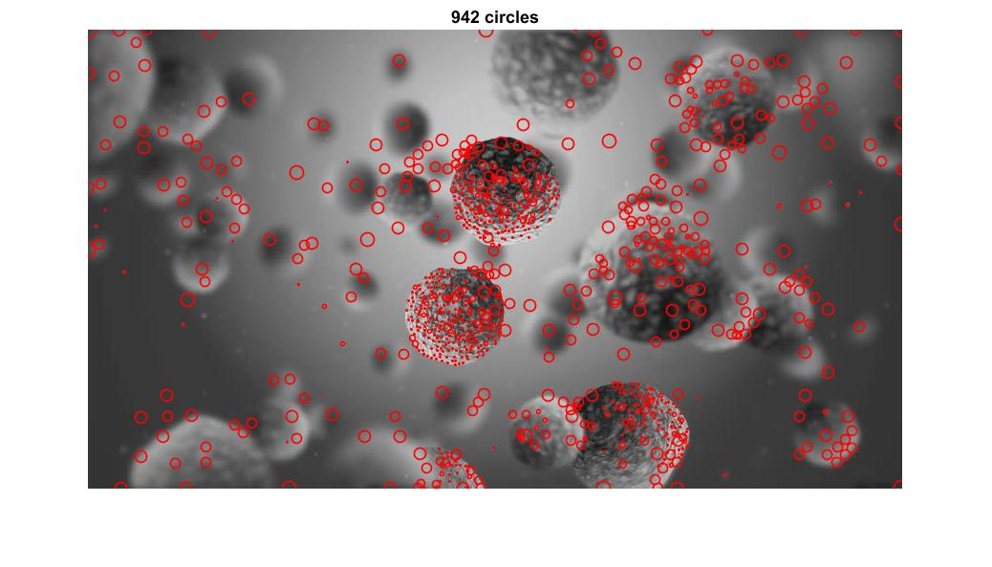
Increasing Kernel Size:
Running Time = 6.33s
Downsizing Image:
Running Time = 0.34s

Slide 2
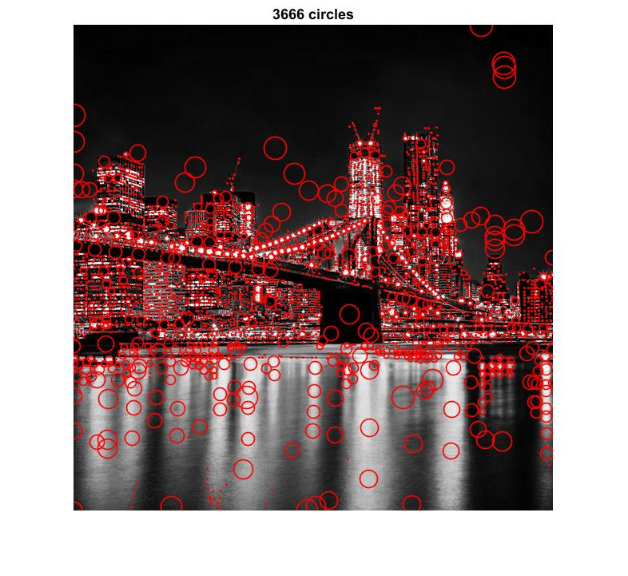
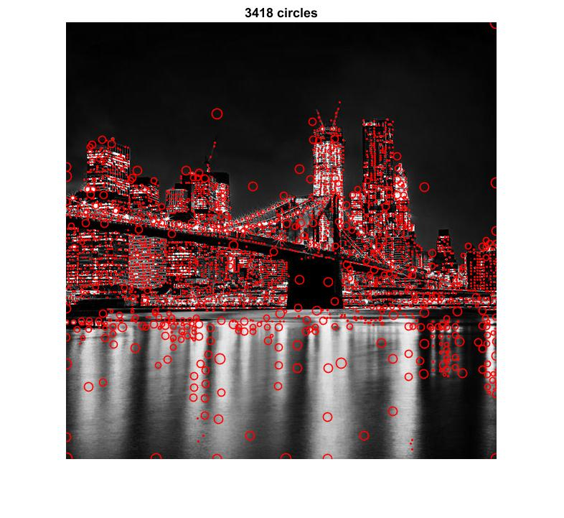
Increasing Kernel Size:
Running Time = 5.48s
Downsizing Image:
Running Time = 0.34s

Slide 3
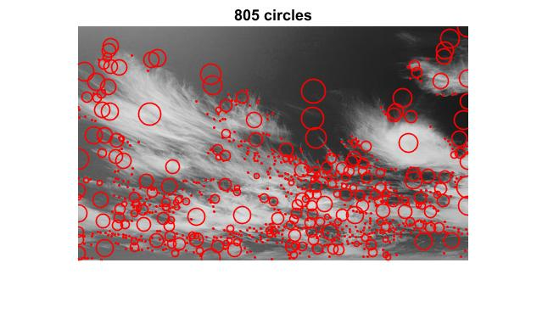
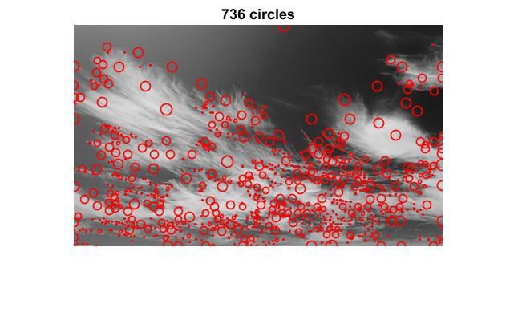
Increasing Kernel Size:
Running Time = 2.29s
Downsizing Image:
Running Time = 0.23s

Slide 4
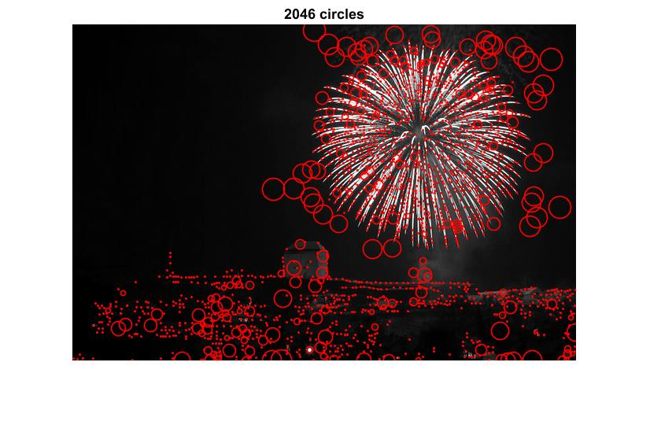
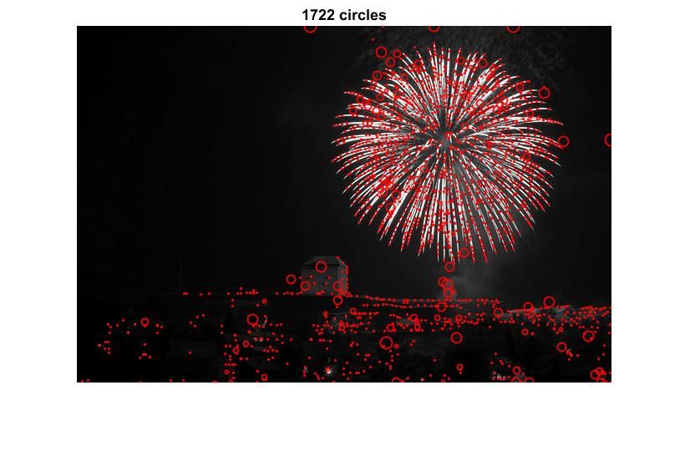
Increasing Kernel Size:
Running Time = 4.32s
Downsizing Image:
Running Time = 0.29s

Slide 5
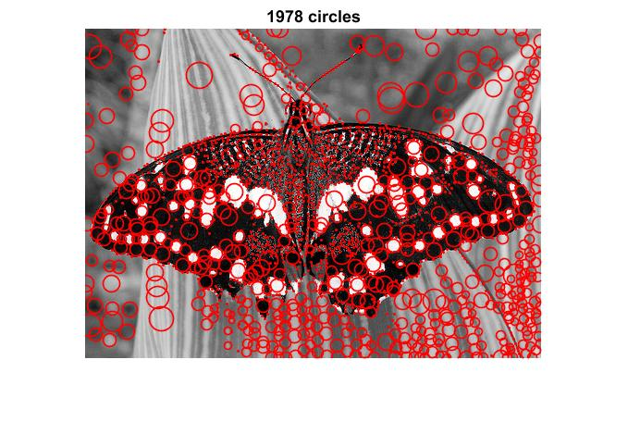
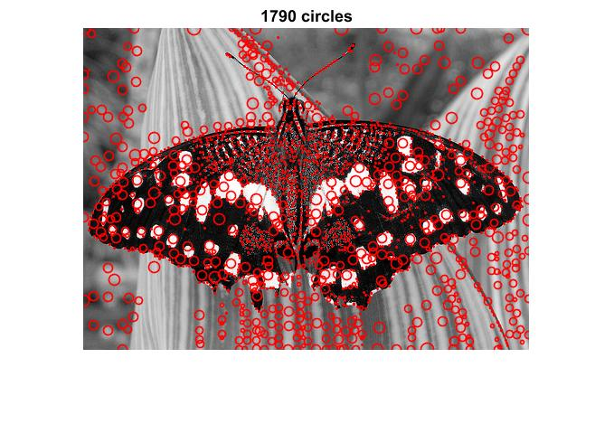
Increasing Kernel Size:
Running Time = 2.86s
Downsizing Image:
Running Time = 0.33s

Slide 6
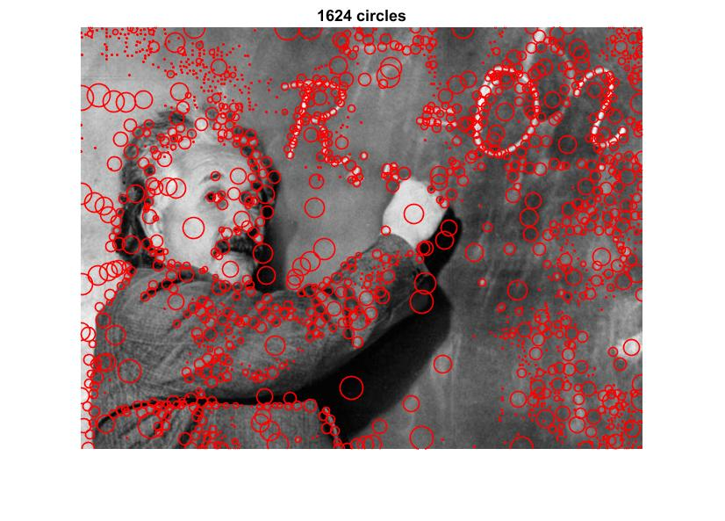
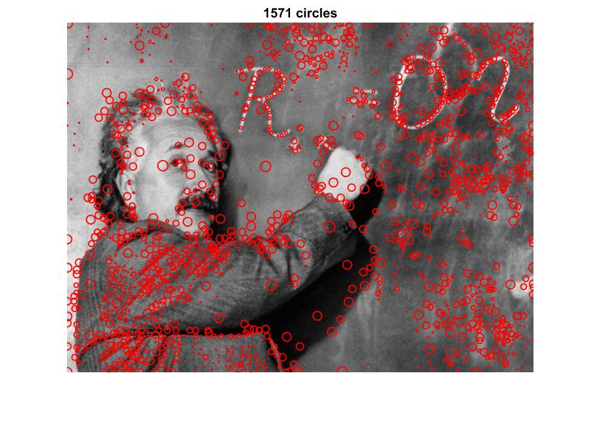
Increasing Kernel Size:
Running Time = 4.66s
Downsizing Image:
Running Time = 0.28s

Slide 7
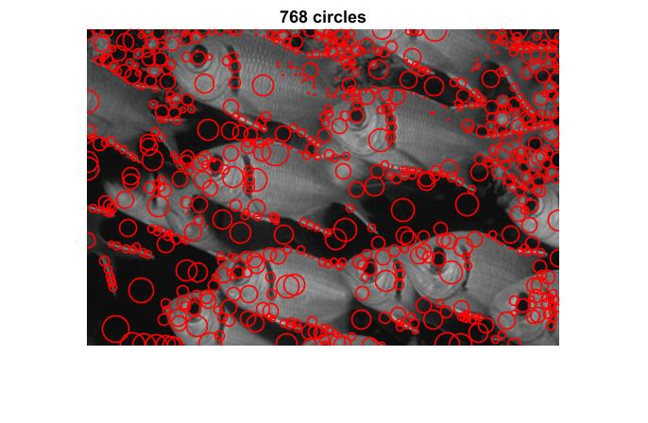
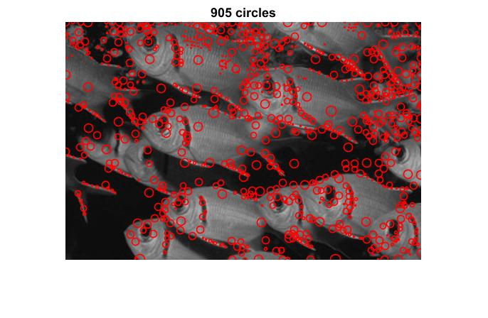
Increasing Kernel Size:
Running Time = 3.07s
Downsizing Image:
Running Time = 0.18s

Slide 8
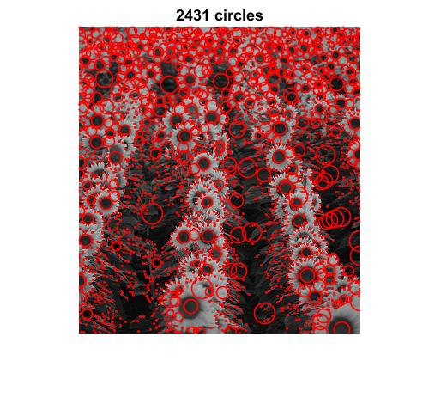
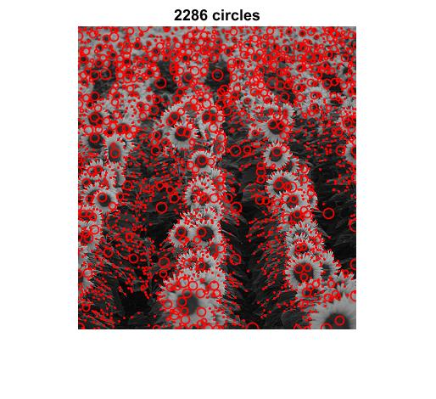
Increasing Kernel Size:
Running Time = 2.11s
Downsizing Image:
Running Time = 0.13s

Slide 9
Comparison of running times
As we can see from the running times stated that downsizing an image and then filtering it is much faster than increasing the kernel size.
Therefore downsizing an image is more Downsizing Image.

Slide 10
Parameter choosing
I played around with the values of sigma, threshold, K(multiplication factor) and number of levels in the code.
I found sigma = 0.5, K = √2 and number of levels = 15 to give the best results for me in both the methods.
Threshold = 0.01 gave me the best results in the Increasing kernel size method.
Threshold = 0.03 gave me the best results in the Downsizing method.
I have tried sigma = 1, threshold = 0.1, K =2 and No of levels = 10, but the above values gave me the best results.
All the values were chosen based on the results I got by trial and error with multiple values.

