Slide 1

Design Practice in Turbo-machinery
P M V Subbarao
Professor
Mechanical Engineering Department
A Wise Sequence of Creating a New Machine…….

Slide 2
Two Major Levels of Creation
Develop a new Idea based on Ideal Fluid Conditions – A generalized Procedure.
Modify the design details for Real Fluid Conditions.

Slide 3
Basic Rules for Design of An Ideal Turbo-machine
Enumerate the details of source or demand.
Calculate Specific speed and identify the fundamental concept of operation.
X₁ (Impulse)+X₂(Reaction)+(1-X₁-X₂)(centrifugal)
Y₁ (Radial)+(1-Y₁ )(Axial)
Design of Flow Path using Conservation of rothalpy.
Design blade cascade using conservation of mass and momentum.
Design of Radial Geometry using Radial Equilibrium Theory.
A design of an Ideal Machine…..
Real Performance will be lower ……

Slide 4
Basic Rules for Design of A Real Turbo-machine
More customized rules along with the general rules.
Customized rules are specific to application:
Power consumption Vs Power Generation.
Radial Vs Axial.
Incompressible flow Vs Compressible.
In Reality:
Design analysis of A Real Machine is an Exclusive Scientific Art.
Define and evaluate a series of correction factors.

Slide 5
Basic Steps in Design of Hydro Power Plants
P M V Subbarao
Professor
Mechanical Engineering Department
A Hydro Power Harvester…….

Slide 6
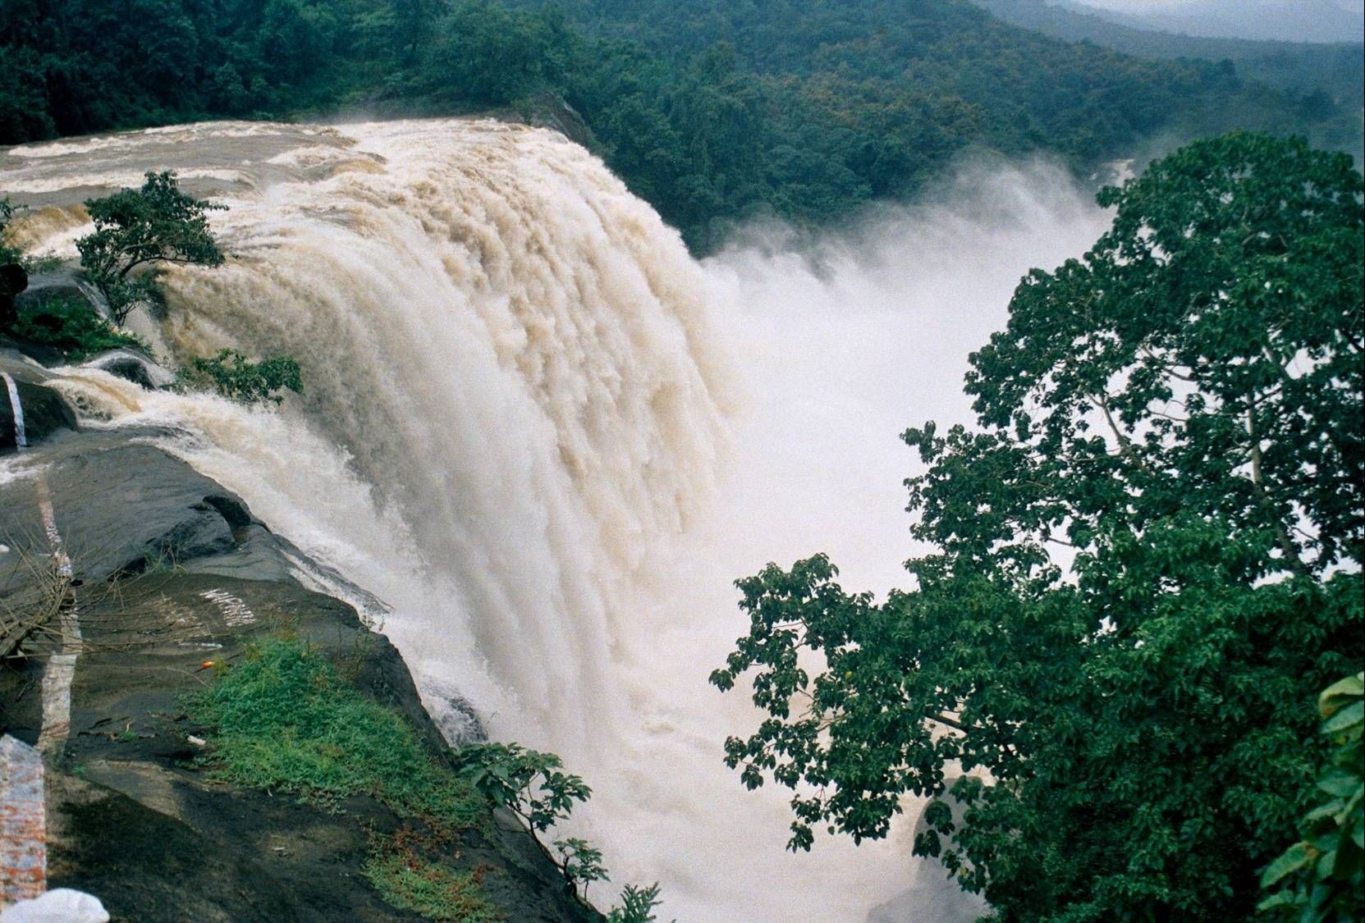
A Two-Way Welfare for the Globe

Slide 7
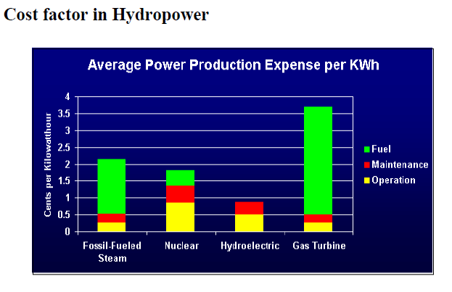

Slide 8
Varieties of Hydro Resources Available in Nature…
Each Resource is naturally fit in the classification?
Any modification of the resource is required for better harvesting of resource?

Slide 9

The Size of A Power Project
A Macro Power Project : > 100 MW.
A Small Power Project : 5 MW to 25 MW.
A Mini Power Project : 500 kW to 2 MW.
A Micro Power Project : 50 kW to 200 kW.
A Pico Power Project : < 30 kW.

Slide 10
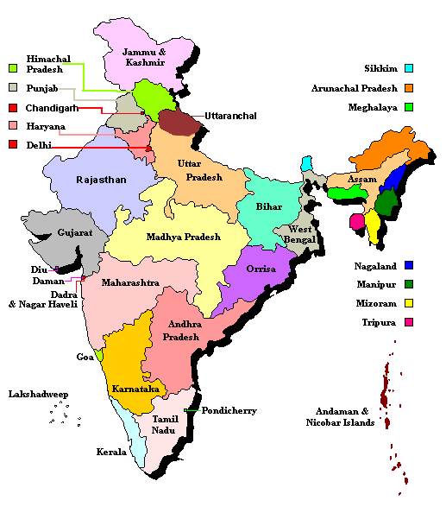
Geographical Description of India

Slide 11
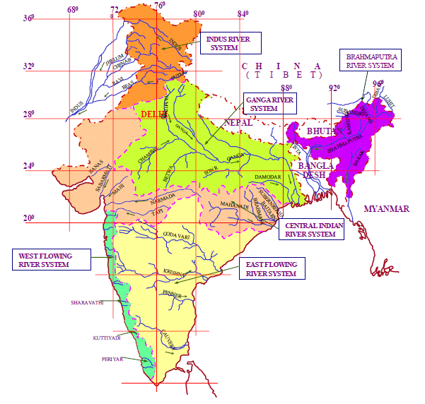
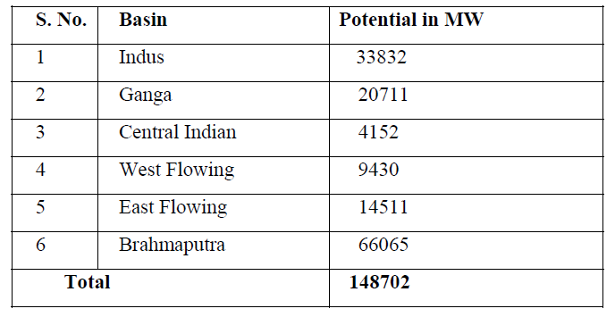
Hydrological Description of India

Slide 12
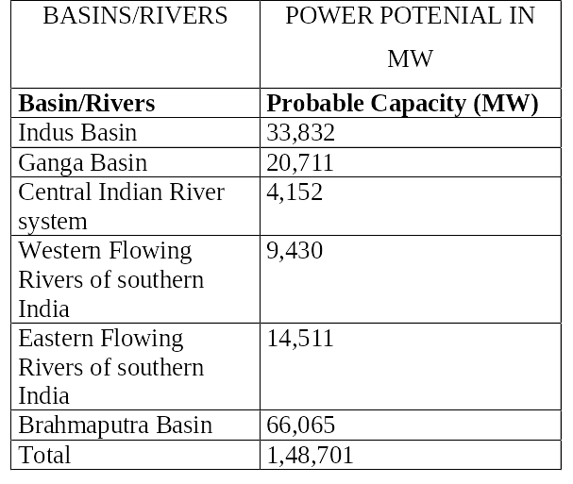
MACRO -HYDRO-POWER POTENTIAL IN INDIA
India is blessed with immense amount of hydro-electric potential and ranks 5th in terms of exploitable hydro-potential on global scenario.

Slide 13
List Of Hydro Electric Power Stations In The Country With Station Capacity Above 25 MW as On 30 June 2013
REGION/ | NO.OF STATIONS | NO.OF UNITS | CAPACITY (MW)
Northern | 61 | 206 | 15523.25
Western | 28 | 101 | 7392.00
Southern | 67 | 240 | 11387.45
Eastern | 18 | 65 | 4078.70
North Eastern | 10 | 29 | 1242.00
All India (Total) | 184 | 606 | 39623.40

Slide 14
More Details of Macro Hydro Power Plants
STATION | NO. OF UNITS X SIZE (MW) | CAPACITY (MW)
Bhakra – l hydro electric power station | 5*108 | 540.00
Bhakra – r hydro electric power station | 5*157 | 785.00
Ganguwal hydro electric power station | 1*29.25+2*24.2 | 77.65
Kotla hydro electric power station | 1*29.25+2*24.2 | 77.65
Dehar hydro electric power station | 6*165 | 990.00
Pong hydro electric power station | 6*66 | 396.00

Slide 15
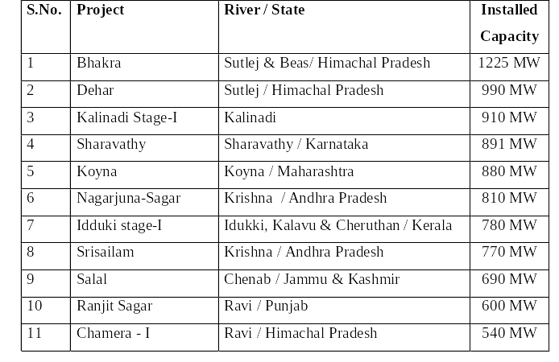
MACRO HYDRO-POWER PROJECTS IN INDIA

Slide 16
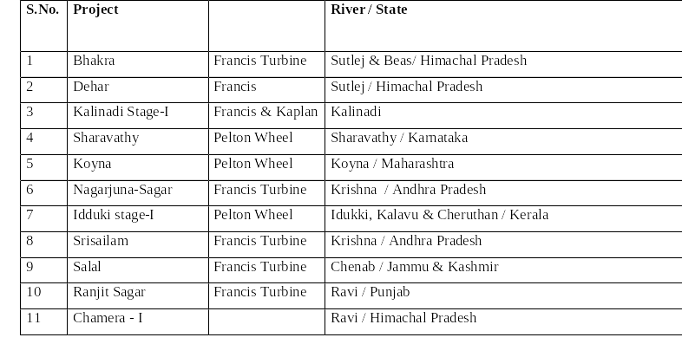
MAJOR HYDRO-POWER PROJECTS IN INDIA

Slide 17
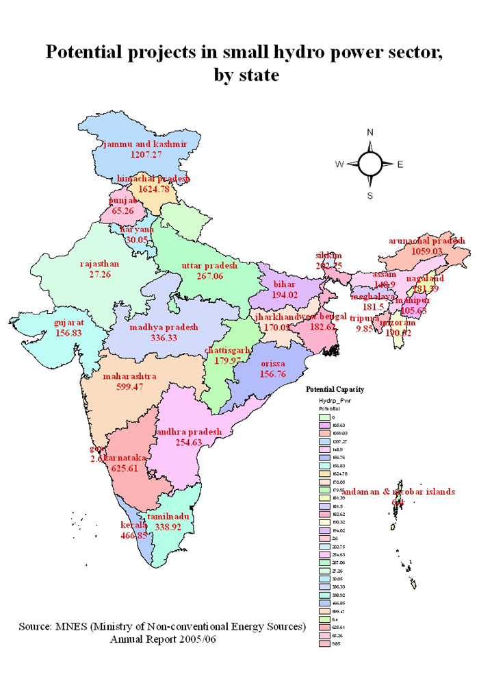
Small Hydro Map of India

Slide 18
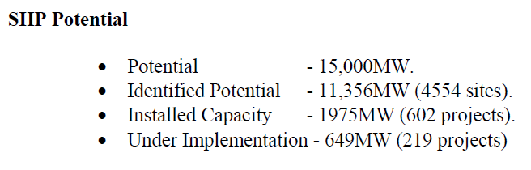
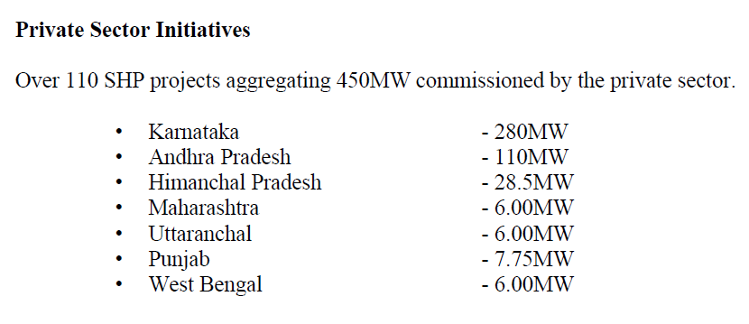

Slide 19
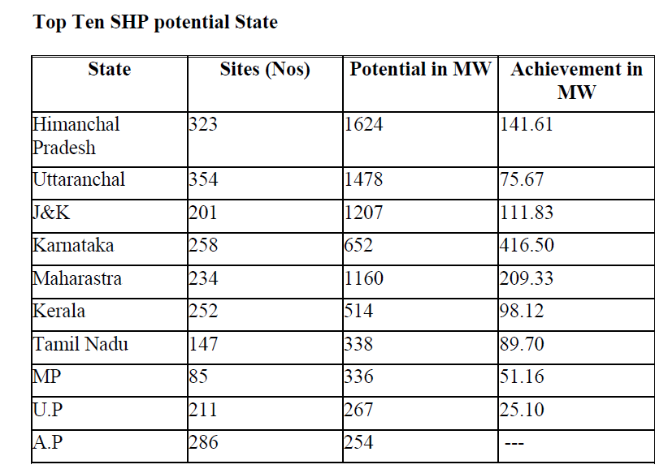

Slide 20
Methodology of HEPP Development
Site Survey: Hydrological & geological Survey.
Estimation of Potential
Regulations & Environmental Concerns
Feasible Supply
Turbine Selection
Costing and Payback.

