Slide 1
What is Dictionary?
A dictionary is a collection which is unordered, changeable and indexed. In Python dictionaries are written with curly brackets, and they have keys and values.

Slide 2
Why Dictionary?
List = [“Bob, 25, “Dev”, “New York”, “bob@gmail.com”]
Can store data but cannot extract information.
Name?
Age?
Job?
City?
Email?

Slide 3
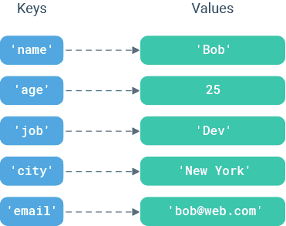
How dictionary works?

Slide 4
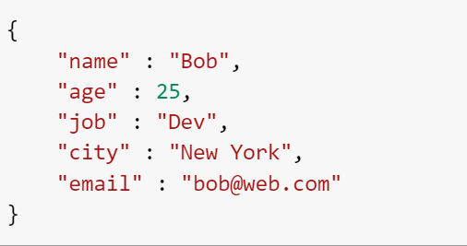
How to achieve this?

Slide 5
List VS Dictionary
List | Dictionary
Referred with a numeric index | Map key to values
Ordered | Unordered
[ ] | { }
Usually for same data type | Handle different types of data

Slide 6

What data types are supported as keys?
Integer
Float
String
Boolean
Tuples

Slide 7
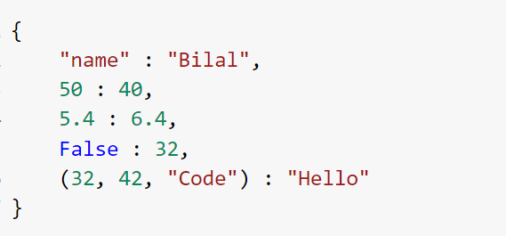
Example

Slide 8
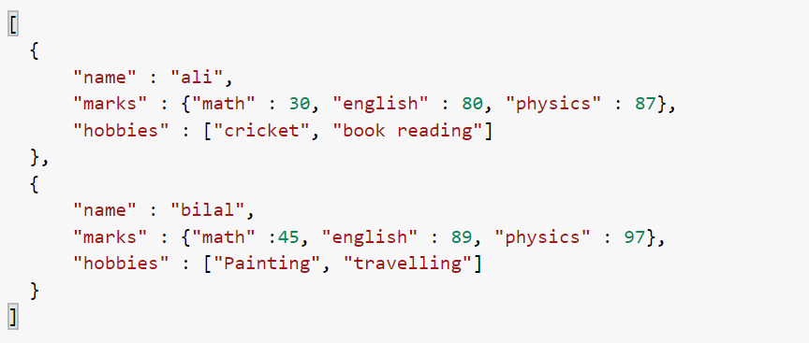
Task
Create a application to store student data. Output>

