Slide 1
Python Modules & Upwork Market
By rauf ur rahim

Slide 2
We will cover
Selenium
Pyqt5
Upwork Market
Selling your skills

Slide 3

Selenium Python

Slide 4
Why, What, How ?
Why?
Need for Automatic Web Application Testing

Slide 5
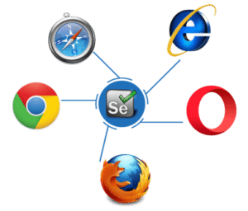
What
Selenium is an open source tool which is used for automating the tests carried out on web browsers

Slide 6
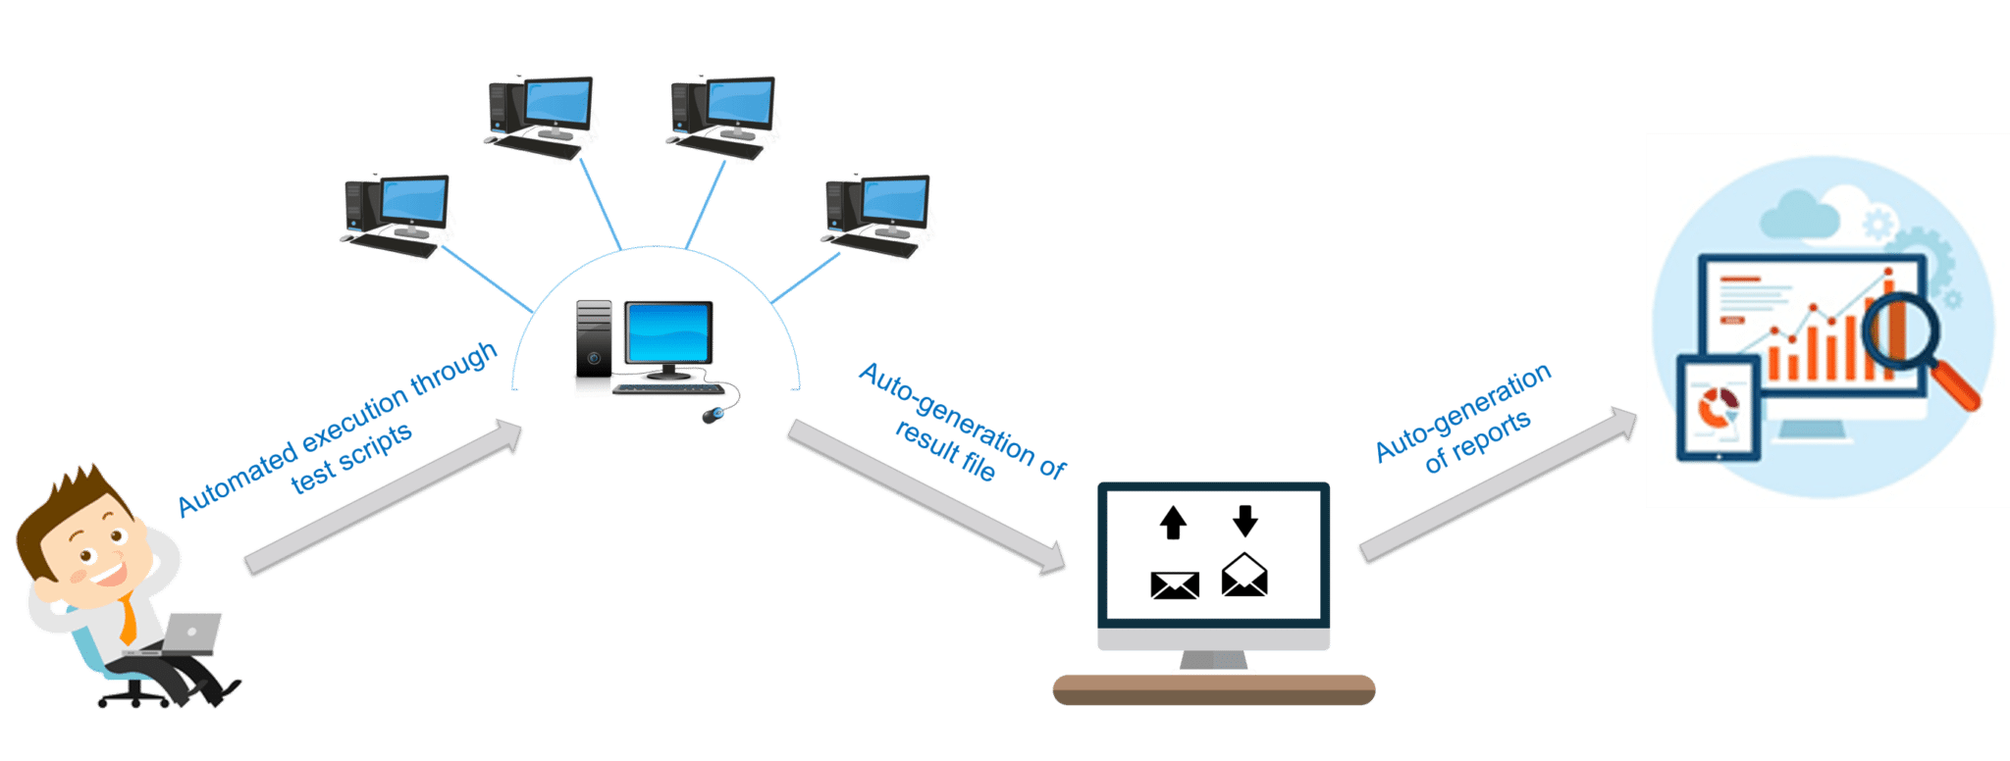
How?

Slide 7
Let’s code
Import Libraries first
from selenium import webdriver
from selenium.webdriver.common.keys import Keys

Slide 8
Credidentials
user_name = "YOUR EMAILID"
password = "YOUR PASSWORD"

Slide 9
driver = webdriver.Firefox()
driver.get("https://www.facebook.com")

Slide 10
element = driver.find_element_by_id("email")
element.send_keys(user_name)
element = driver.find_element_by_id("pass")
element.send_keys(password)

Slide 11
element.send_keys(Keys.RETURN)
element.close()

Slide 12
from selenium import webdriver
from selenium.webdriver.common.keys import Keys
user_name = "YOUR EMAILID"
password = "YOUR PASSWORD"
driver = webdriver.Firefox()
driver.get("https://www.facebook.com")
element = driver.find_element_by_id("email")
element.send_keys(user_name)
element = driver.find_element_by_id("pass")
element.send_keys(password)
element.send_keys(Keys.RETURN)
element.close()

Slide 14
Pyqt5
Graphical Interface for Python
Desktop Application

Slide 15
1: Install Module
Pip install pyqt5
Pip install pyqt5-tools

Slide 16
2: Go for designer.exe file
import site
print (site.getsitepackages())
['C:\\Python36', 'C:\\Python36\\lib\\site-packages']
pyqt5-tools => designer.exe

Slide 17
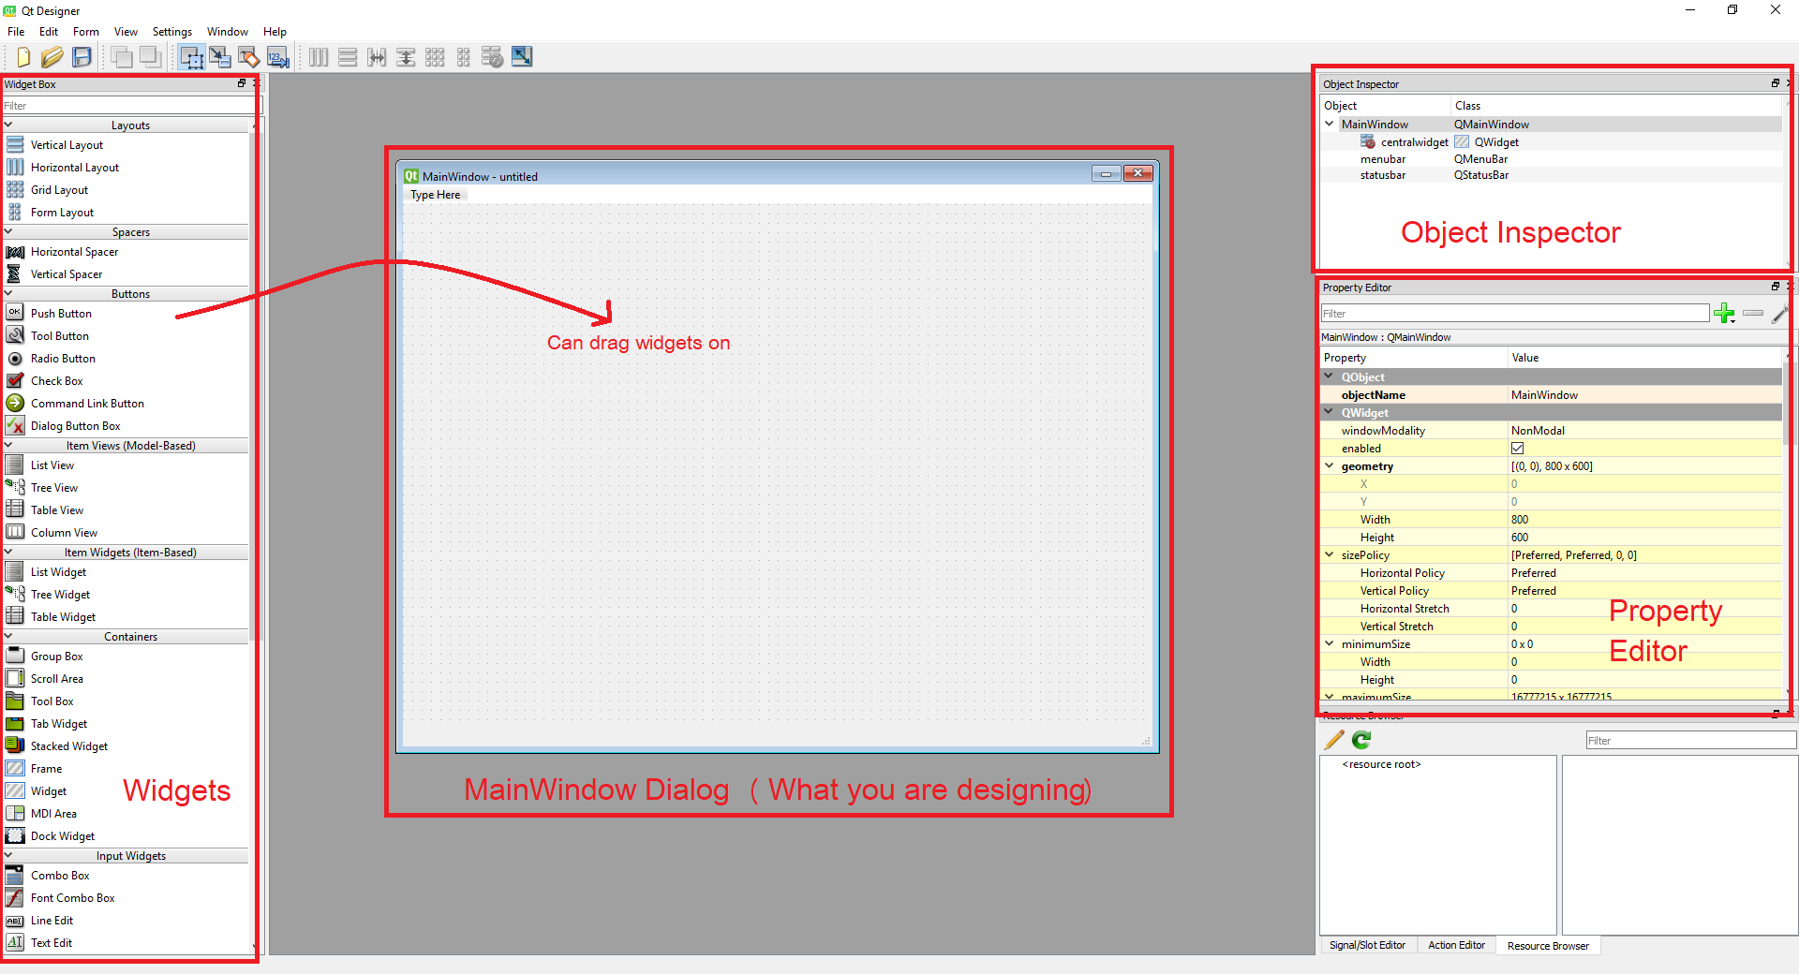
3: Start Designing your interface

Slide 18
4: Convert GUI into Python File
import sys
import os
print (os.path.dirname(sys.executable))
C:/Users/Rauf/Anaconda3/Scripts
pyuic5 -x "C:\Users\Rauf\Desktop\mycode.ui" –o "C:\Users\Rauf\Desktop\mycode.py"

Slide 19
5: Create Functionalities and Run File
Get the ID of widget
For example:
self.pushButton.clicked.connect(self.showForm)
def showForm (self):
val1 = int(self.lineEdit.text())
val2 = int(self.lineEdit_2.text())
print(val1+val2)

Slide 20
Must Watch
https://www.youtube.com/watch?v=ksW59gYEl6Q
https://nitratine.net/blog/post/python-guis-with-pyqt/

Slide 21
Upwork
Section # 1: Tips
Section # 2: Invisible Questions
Section # 3: Samples of Proposals

Slide 22
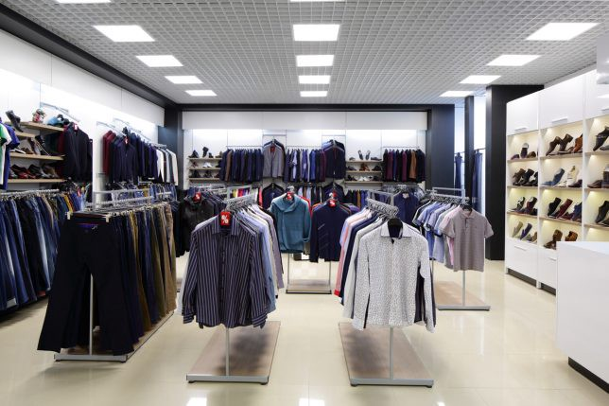
Tip #1: Start your proposal with a “Decompression Zone”
Notes:
Summer loan sale

Slide 23
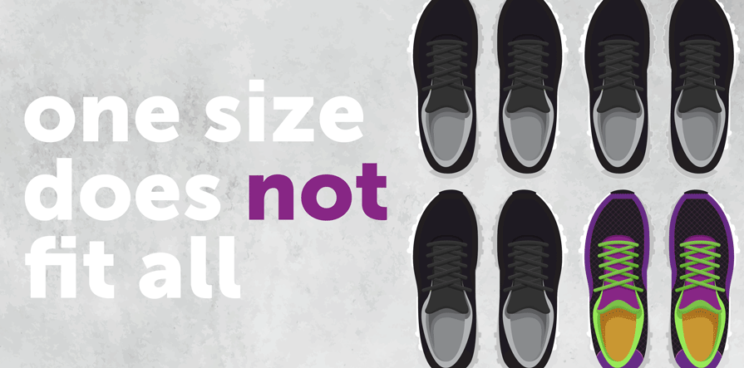
Tip #2: Avoid the “Hybrid Proposal”
Notes:
Bata shoes

Slide 24

Tip #3: Offer a helpful suggestion right in your cover letter
Notes:
Suggestion should not irritate client or create trouble for them

Slide 25

Tip #3: Offer a helpful suggestion right in your cover letter

Slide 26
Tip #4: Don’t bury the lead
Long story, Less Pratical
Short story, More Pratical
Kya kr rhi ho baby doll soney ki? Kesa raat aaj ka din? Thak gya ho ga mela baby? Kuch khaya? Kuch khhaa k sona haan…. U know na how much care I do… tmharey liye asmaan se chand aur taarey b torr k la skta hun… :’( Have a sweet dream.. Bye bye !!! | Foodpanda rider will be at ur place in 10 mints. I request you to eat before sleeping.
Don’t tell
Just Show
Notes:
Long stories burn lead even it is helpful…

Slide 27
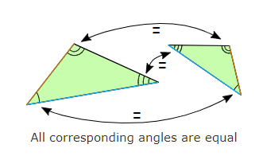
Tip #5: Show an example of similar work (even if you’re brand-new)
Notes:
show even if you don’t have work

Slide 28
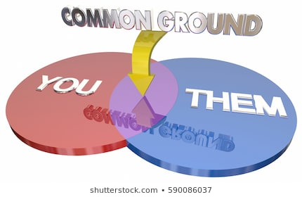
Tip #6: Find common ground

Slide 29
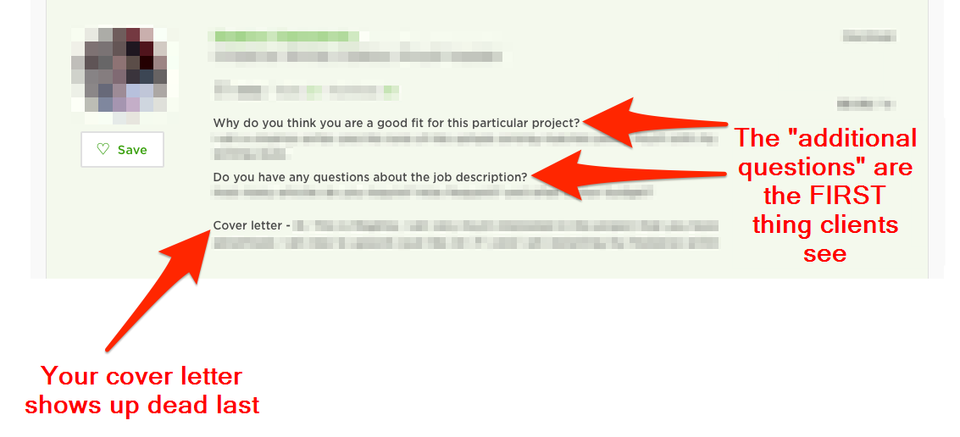
Tip 7#: Become a screening question “smuggler”

Slide 30
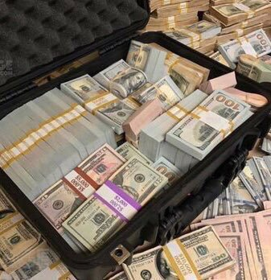

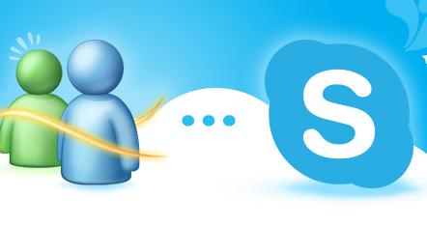
Tip #8: End your cover letter with a Call To Action

Slide 31
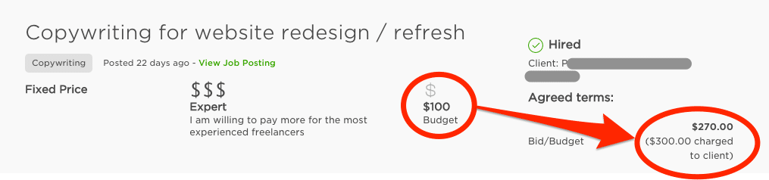
Tip #9: Don’t sell yourself short
Notes:
Client’s afraid of over-paying… visit client’s profile if he is willing to pay extra then don’t bid too low

Slide 32

Tip #10: Use the client’s name

Slide 33

Tip # 11: Don’t be a widow
Notes:
Us rizk se maut achi jis se aati ho perwaaz me kotahi

Slide 34

Tip # 12: One word = 1 Year
Notes:
100 years life… Capture the client’s attention fast… news paper

Slide 35

Additional Tip: Threat your Client
Notes:
Why you? Why not other?

Slide 36
Sample
Hi Client’s Name, I just read your requirements and I find it interesting. As far as I understand, you need…… (Re-write client’s requirement with more detail, 1-2 lines) and you need an expert of….. (1 line)
I developed similar project for my client who approached me on LinkedIn……
2-4 lines what I already have done related to it for other client
One paragraph indirectly big claims (Since I, myself is a ___ expert or _____ lover)
Mostly big mistakes that other people do
Since I am a consultant as well, please share more detail of your work with me so that I can help you and give more advance suggestions.
Call to action: Will you be available for 5 mint call on skype or chat? Let’s solve your problem.
Best Wishes

Slide 37
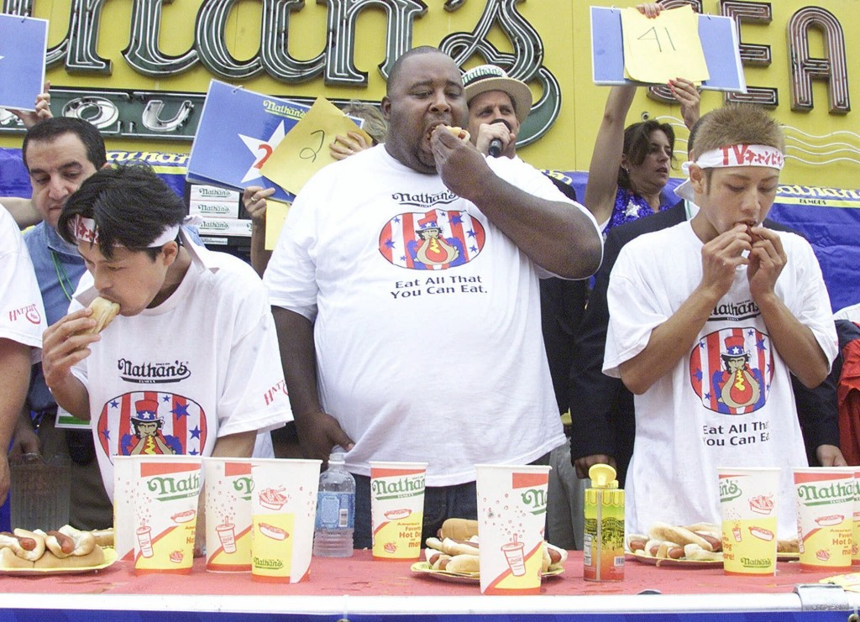
Play Strategically

Slide 38
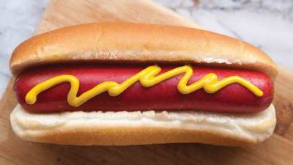

Slide 39
Cover Letters # 1
Hi, I am a well-reputed Machine Learning Engineer
I did my BS-Computer Engineering from COMSATS Lhr and B.Eng Systems Engineering from Lancaster university UK. I completed my Masters in Electrical Engineering from FAST having specialization in Artificial Intelligence.
I have worked for more than 3 years in AI field. I worked as Head of AI at JeM POS UK pvt limited. My core responsibilities were developing AI strategies, road-maps, competitor’s analysis and leading my department. Beside these I were responsible of finding best deep learning algorithms and fine tune them to achieve state-of-the-art accuracy.
Other than industry, I worked as Research Assistant in FAST University on HEC funded projects. On achieving best accuracy my work has been published in numerous journal papers having good impact factor.

Slide 40
My core area is:
Data Science Solution
Deep Learning
Machine Learning
Natural Language Processing
Computer Vision
I am looking forward to you to discuss more about your project.
Best Wishes

Slide 41
The structure of this proposal goes something like this:
This is what I have done.
This is how many years of experience I have.
Me, me, me.

Slide 42
Cover Letter # 2
Hi John,
I read your requirements and find it a great work for humanity. As far as I understand, you need to develop and test algorithms specifically for healthcare. The other thing you need is a complete road map for your lab to automate it through AI. For this purpose you need a person combo of two; AI product Management and AI Engineering.
I developed similar project for my client who approached me on LinkedIn. First, I analyzed main drivers and pain points of my client and then I build a complete road map on the basis of competitors’ analysis. This includes Online Symptom Checking, Doctor Recommendation, Healthcare Data Security and other modules. I used Convolutional Neural Networks to recognize symptom out of an image and used regression for recommendation and prediction.
Being a son of a doctor and an AI expert, I found a biggest mistake that other developers do, is they do not know the actual dependency of data input variables over output. Consequently, system do not provide as much accuracy as needed for a patient to trust.

Slide 43
Let me help you to plan automation for your lab that will be helpful in cost reduction and make your system more trust-worthy. Please share more detail of your work with me so that I can help you and give more advance suggestions.
Will you be available for 5 mint call on skype or chat? Let’s solve your problem.
Best Wishes

Slide 44
Can you Please count how much times ‘I’ and ‘You’ is used?
I = 8
You = 8

