Slide 1
Python Revision Class
By rauf ur rahim

Slide 2
Topics to cover
Conditions (if else)
Lists
Loops (for & while)
Dictionaries

Slide 3
Announcement
Quiz on coming Sunday
Python A smarter way to learn
1 – 40 Chapters

Slide 4
Data Types
What will be printed at each line?
print(type(True))
print(type(5))
print(type(5.0))
print(type(‘True’))

Slide 5
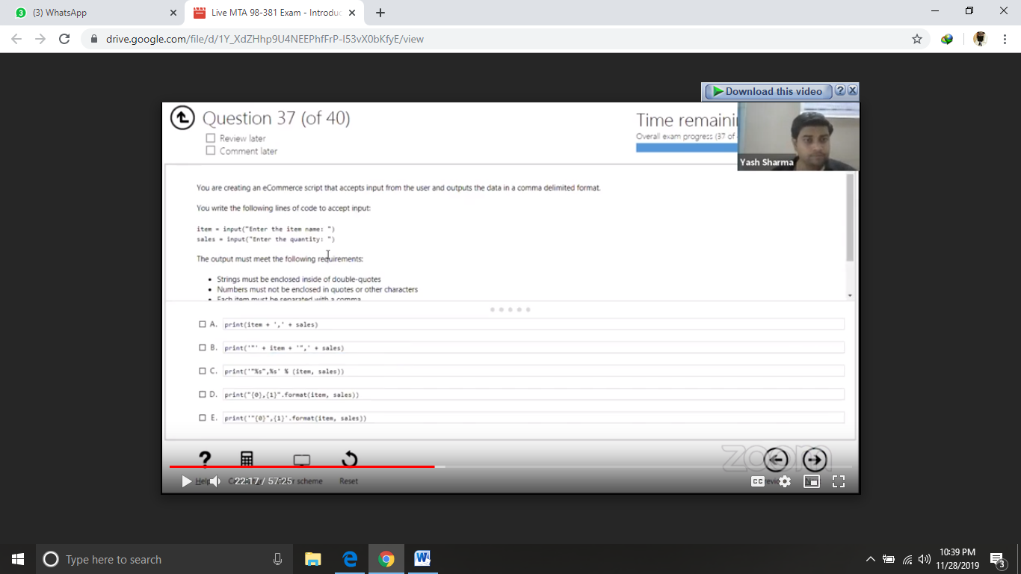

Slide 6
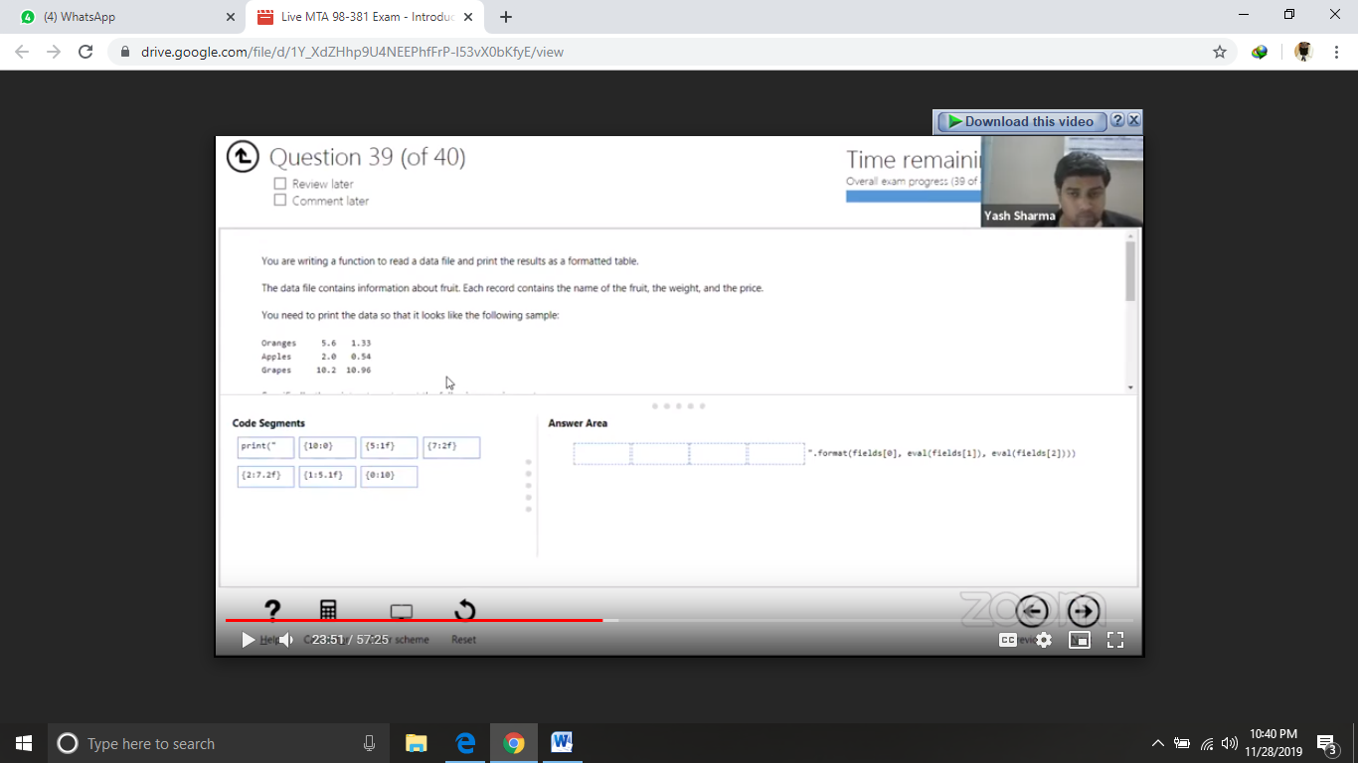

Slide 7
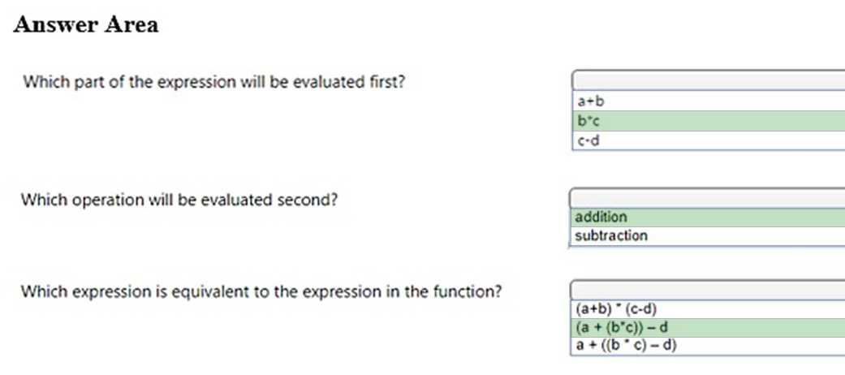
Value = a + b * c – d

Slide 8
Evaluate the following Python arithmetic expression:
3
13
15
69

Slide 9
You are creating a function that manipulates a number. The function has the following requirements:
A float is passed into the function
The function must take the absolute value of the float
Any decimal points after the integer must be removed
A. math.fmod(x)
B. math.frexp(x)
C. math.floor(x)
D. math.ceil(x)
E. math.fabs(x)
Answer: CE
Explanation:
math.floor(x) returns the largest integer less than or equal to x.
math.fabs(x) returns the absolute value of x.

Slide 10
You are writing code that generates a random integer with a minimum value of 5 and a maximum value of 11.
Which two functions should you use? Each correct answer presents a complete solution. (Choose two.)
A. random.randint(5, 12)
B. random.randint(5, 11)
C. random.randrange(5, 12, 1)
D. random.randrange(5, 11, 1)

Slide 11
What is if else?

Slide 12
Understand the flow of if else
If the condition is true
Print statement executed, program continues to next statement
If the condition is false
Print statement ignored, program continues
Only one command runs at a time (if , elif, else)

Slide 13
Example
Username = input(‘Enter Username: ’)
Password = input(‘Enter password’)
If username == ‘admin’ & password ==‘123’
Print(‘Login Successful’)
Else:
Print(‘Try again’)
print(‘End of program’)

Slide 14
Example
Username = input(‘Enter Username: ’)
Password = input(‘Enter password’)
If username == ‘admin’ & password ==‘123’
Print(‘Login Successful’)
Else:
Print(‘Try again’)
print(‘End of program’)

Slide 15
Indentation
if name == ‘Rauf ur Rahim’
Print (‘PIAIC’)
Print(‘Islamabad Batch 3’)
Print(Bahria University)
else
print(‘Name not Found’)

Slide 16
Indentation
if name == ‘Rauf ur Rahim’
Print(‘PIAIC Islamabad Batch 3’)
if class == ‘9AM’
print(‘Class 1’)
elif class == ’12PM’
print(‘Class 2’)
else
print(‘Class 3 or 4’)
else
print(‘Name not Found’)

Slide 17
Name = Rauf ur Rahim, Class = 12PM
if name == ‘Rauf ur Rahim’
Print(‘PIAIC Islamabad Batch 3’)
if class == ‘9AM’
print(‘Class 1’)
elif class == ’12PM’
print(‘Class 2’)
else
print(‘Class 3 or 4’)
else
print(‘Name not Found’)

Slide 18
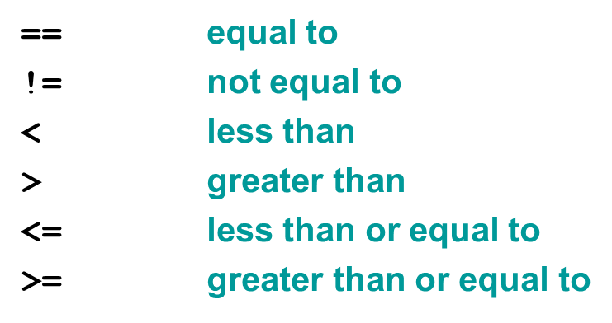
Boolean Expression

Slide 19
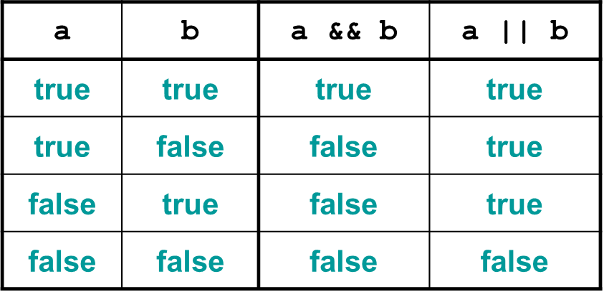
Truth Table

Slide 20
Task # 1
Write a program that receives marks from user and check the grade.
Marks greater than equal to 90 then A grade
Marks between 80 to 90, B grade
Marks between 70 to 80, C grade
Marks between 60 to 70, D grade
Marks less than equal to 60 then E grade

Slide 21
Solution
grade = input(‘Enter Grade Marks: ’)
if ( grade >= 90 ) print("A“) elif ( grade >= 80 ) print(“B“) elif ( grade >= 70 ) print(“C“) elif ( grade >= 60 ) print(“D“) else print(“E“)

Slide 22
Task # 2
The ABC Video company needs a way to determine the cost that a customer will pay for renting a DVD. The cost is dependent on the time of day the DVD is returned. However, there are also special rates on Thursdays and Sundays. The fee structure is shown in the following list:
The cost is $1.59 per night.
If the DVD is returned after 8 PM, the customer will be charged an extra day.
IF DVD is scratched charge 1$ Extra
If the video is rented on a Sunday, the customer gets 30% off for as long as they keep the video
If DVD is scratched charge 2$ Extra
If the video is rented on a Thursday, the customer gets 50% off for as long as they keep the video

Slide 23
Solution

Slide 24
What is List?
A list (also called an array in other programming languages) is a tool that can be used to store multiple pieces of information at once. It can also be defined as a variable containing multiple other variables.
fruit = ["apple", "banana", "cherry", "orange"]

Slide 25
Understand the working / Indexing of List
Positive Indexing
fruit = ["apple", "banana", "cherry", "orange", "kiwi", "melon", "mango"]
0
1
2
3
4
5
6

Slide 26
Understand the working / Indexing of List
Negative Indexing
fruit = ["apple", "banana", "cherry", "orange", "kiwi", "melon", "mango"]
-7
-6
-5
-4
-3
-2
-1

Slide 27
Understand the working / Indexing of List
Positive & Negative Indexing (Forward)
fruit = ["apple", "banana", "cherry", "orange", "kiwi", "melon", "mango"]
Fruit [ 1 : 5] == fruit [ -6 : -2]
Fruit [ -7 : 5 : 1]
0
1
2
3
4
5
6
-7
-6
-5
-4
-3
-2
-1

Slide 28
Understand the working / Indexing of List
Positive & Negative Indexing (Backward)
fruit = ["apple", "banana", "cherry", "orange", "kiwi", "melon", "mango"]
Rules to remember:
Left to right => Positive Increment
Right to left => Negative Increment
0
1
2
3
4
5
6
-7
-6
-5
-4
-3
-2
-1

Slide 29
Increment
Fruit [ -7 : 5 : 1 ]
List Name
Starting Point
Ending Point
Increment

Slide 30
Understand the working / Indexing of List
Positive & Negative Indexing (Backward)
fruit = ["apple", "banana", "cherry", "orange", "kiwi", "melon", "mango"]
Fruit [ 4 : -7 : 1]
Fruit [ 4 : -7 : -1]
Fruit [ -3 : 0 : -1]
0
1
2
3
4
5
6
-7
-6
-5
-4
-3
-2
-1

Slide 31
Task # 1
A list named employees contains 12 employee names, the last five being company management. You need to slice the list to display all employees excluding management.
Which two code segments should you use? Each correct answer presents a complete solution. (Choose two.)
employees [1:-4]
employees [:-5]
employees [1:-5]
employees [0:-4]
employees [0:-5]

Slide 32
Employee = [E1,E2, E3, E4, E5, E6, E7, M1, M2, M3, M4, M5]
employees [1:-4]

Slide 33
Employee = [E1,E2, E3, E4, E5, E6, E7, M1, M2, M3, M4, M5]
employees [:-5]

Slide 34
Employee = [E1,E2, E3, E4, E5, E6, E7, M1, M2, M3, M4, M5]
employees [1:-5]

Slide 35
Employee = [E1,E2, E3, E4, E5, E6, E7, M1, M2, M3, M4, M5]
employees [0:-5]

Slide 36
Task
What is the output of following:
list1 = [1,2]
list2 = [4,5]
list3 = list1 + list2
list3 = list3 * 2
print( list3 )

Slide 37
What is For Loop?
For loop is used to iterate same lines of code
Multiple times
Starting , ending , increments

Slide 38
Understand the Iterations of For Loop
for i in range ( 1 , 10 , 2)
print ( i * 2 )
Output
i = 1 , i * 2 = 2
i = 3 , i * 2 = 6
i = 5 , i * 2 = 10
i = 7 , i * 2 = 14
i = 9 , i * 2 = 18

Slide 39
Nest For Loop
i = 1
for i in range ( 1 , 5)
for j in range ( 0 , 3 )
print ( i * j , end=‘ ’ )
print(‘/n’)
Output:
j= 0
i * j = 0
0

Slide 40
Nest For Loop
i = 1
for i in range ( 1 , 5)
for j in range ( 0 , 3 )
print ( i * j , end=‘ ’ )
print(‘/n’)
Output:
j= 0
j = 1
i * j = 0
i*j = 1
0
1

Slide 41
Nest For Loop
i = 1
for i in range ( 1 , 5)
for j in range ( 0 , 3 )
print ( i * j , end=‘ ’ )
print(‘/n’)
Output:
j= 0
j = 1
j = 2
i * j = 0
i*j = 1
i*j = 2
0
1
2

Slide 42
Nest For Loop
i = 2
for i in range ( 1 , 5)
for j in range ( 0 , 3 )
print ( i * j , end=‘ ’ )
print(‘/n’)
Output:
j= 0
i * j = 0
0
1
2
0

Slide 43
Nest For Loop
i = 2
for i in range ( 1 , 5)
for j in range ( 0 , 3 )
print ( i * j , end=‘ ’ )
print(‘/n’)
Output:
j= 0
j = 1
i * j = 0
i*j = 2
0
1
2
0
2

Slide 44
Nest For Loop
i = 2
for i in range ( 1 , 5)
for j in range ( 0 , 3 )
print ( i * j , end=‘ ’ )
print(‘/n’)
Output:
j= 0
j = 1
j = 2
i * j = 0
i*j = 2
i*j = 4
0
1
2
0
2
4

Slide 45
Nest For Loop
i = 3
for i in range ( 1 , 5)
for j in range ( 0 , 3 )
print ( i * j , end=‘ ’ )
print(‘/n’)
Output:
j= 0
i * j = 0
0
1
2
0
2
4
0

Slide 46
Nest For Loop
i = 3
for i in range ( 1 , 5)
for j in range ( 0 , 3 )
print ( i * j , end=‘ ’ )
print(‘/n’)
Output:
j= 0
j = 1
i * j = 0
i*j = 3
0
1
2
0
2
4
0
3

Slide 47
Nest For Loop
i = 3
for i in range ( 1 , 5)
for j in range ( 0 , 3 )
print ( i * j , end=‘ ’ )
print(‘/n’)
Output:
j= 0
j = 1
j = 2
i * j = 0
i*j = 3
i*j = 6
0
1
2
0
2
4
0
3
6

Slide 48
Final Output
0 1 2
0 2 4
0 3 6
0 4 8

Slide 49
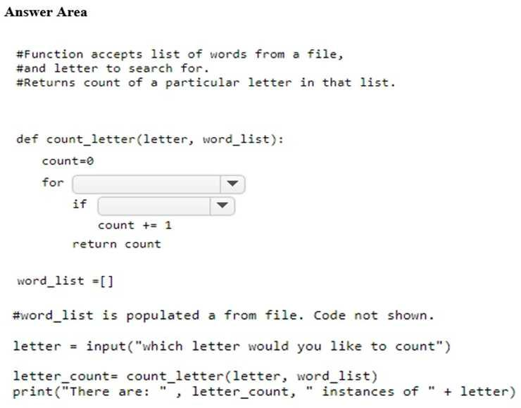

Slide 50
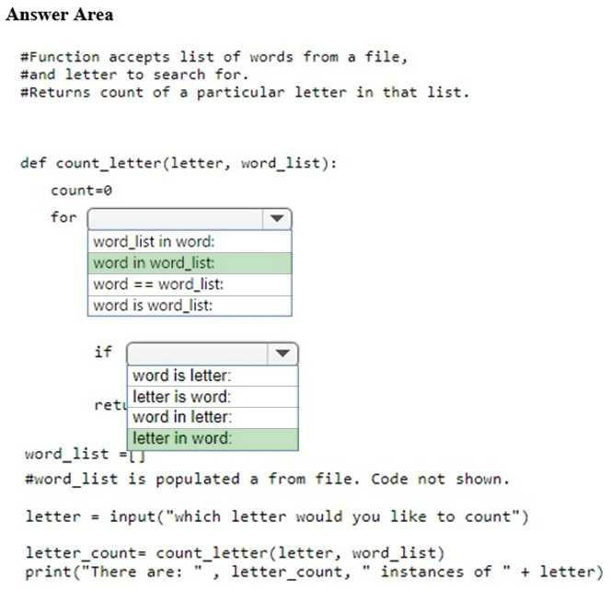

Slide 51
What is while Loop?
The while loop is used when we don't know the number of times it will repeat.
If that number is infinite, or the Boolean condition of the loop never gets set to False, then it will run forever. This is why it's an infinite loop.

Slide 52
Understand the Iterations of while Loop
if <some_condition>
do some task
while <some_condition>
keeping doing some task

Slide 53
1. sach = False
2. Counter = 0
3. While (sach != True):
4. if counter == 10:
5. sach = True
6. counter+=1
7. print(‘Yuiiiiiiiiiiiii….’)
8. print(‘Total liter= ’ + str(counter))

Slide 54
Task # 1
Take a list of 10 numbers ( 0 to 9)
Use while loop to find number 6 in list
If found print index else keep finding…

Slide 55
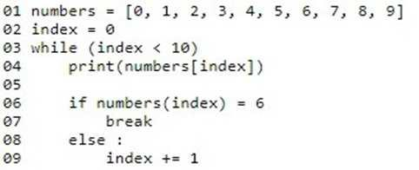
Solution

