Slide 1
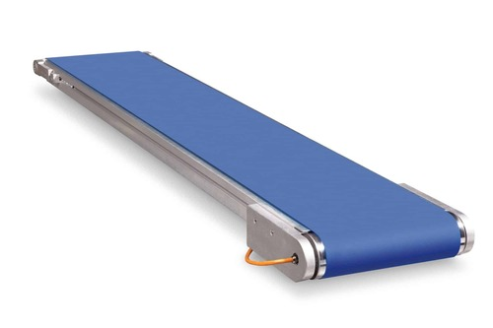
Smart chromatic sorting system using PLC automation
Presented by:
  Shahzad Meer (BSMTEF2022M042)
  Samat Zahra (BSMTEF2022M024)
  Fareeha (BSMTEF2022M037)
  Mutte Ur Rehman (BSMTEF2022M028)
  Supervised by:
  Arqam razzaq
  Department of Mechatronics Engineering
  University of Chakwal

Slide 2

Introduction
Our Project Focus:
The main focus of our project is to integrate computer vision, PLC control, conveyor automation, and robotic arm operation into a single intelligent system for automatic chromatic sorting in industrial applications.
In this system:
Objects move on the conveyor belt.
A mobile camera captures the object image.
The system identifies the object color through image processing.
The PLC receives the detection signal.
The robotic arm performs pick-and-place operation.
The object is sorted into the correct bin automatically.

Slide 3
Statement
Existing Limitations
Human errors
Slow sorting
High labor cost
Low efficiency
Limited automation
Research Gap
Need smart PLC automation
Limited camera-based sorting systems
Lack of low-cost intelligent solutions
Need better accuracy and flexibility

Slide 4
Project Objectives
Main Objectives
Smart automated sorting
PLC-based control system
Mobile camera detection
reduce human effort
Improve accuracy and speed
conveyor and robotic arm integration
Real-time industrial automation

Slide 5
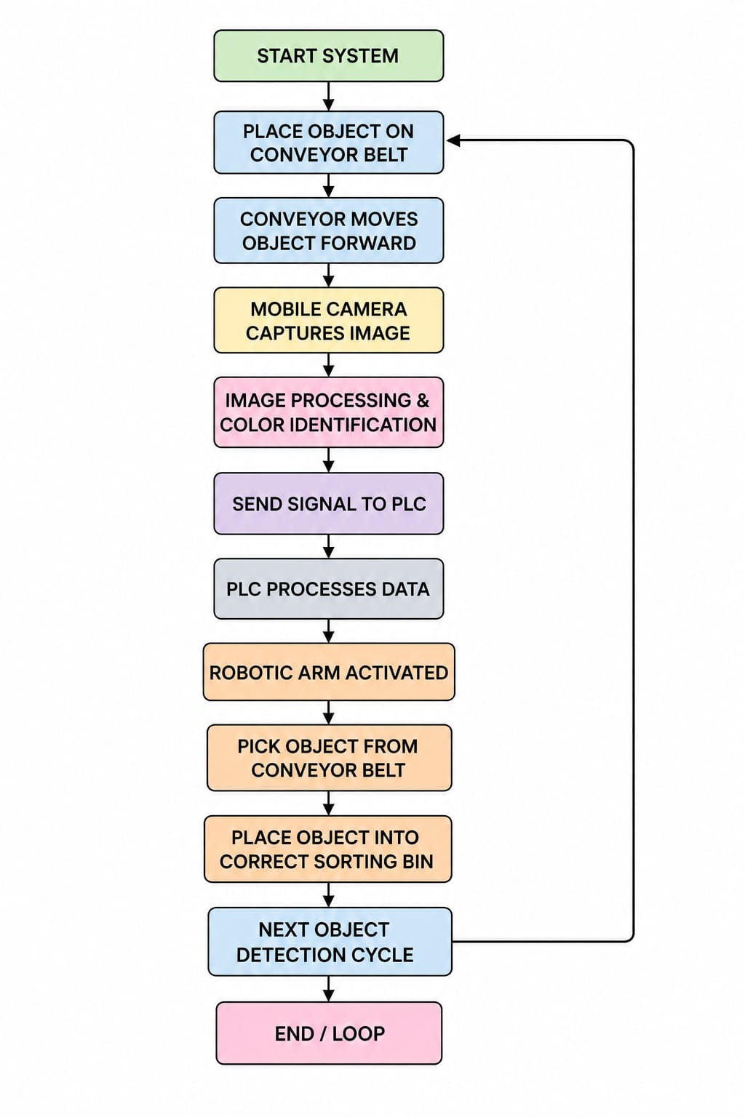
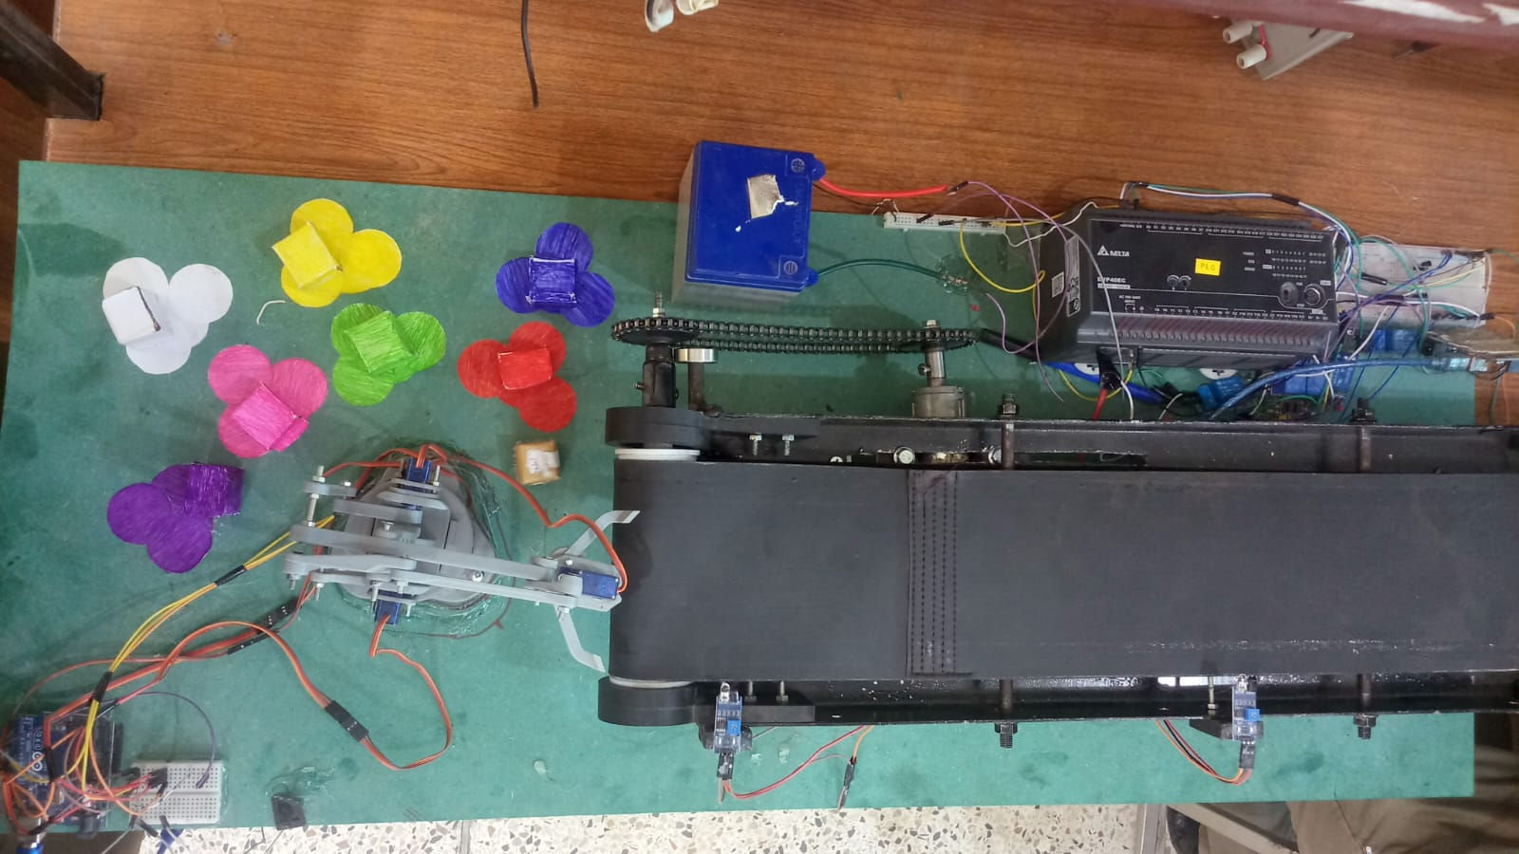
Flow Chat

Slide 6
Working Principle
Object is placed on the conveyor belt
Conveyor moves the object automatically
Mobile camera captures object image
Image processing detects object color
Detection data is sent to PLC
PLC analyzes and processes the signal
PLC controls robotic arm movement
Robotic arm picks the object
Object is placed in the respective sorting bin
Process repeats continuously for automatic sorting

Slide 7
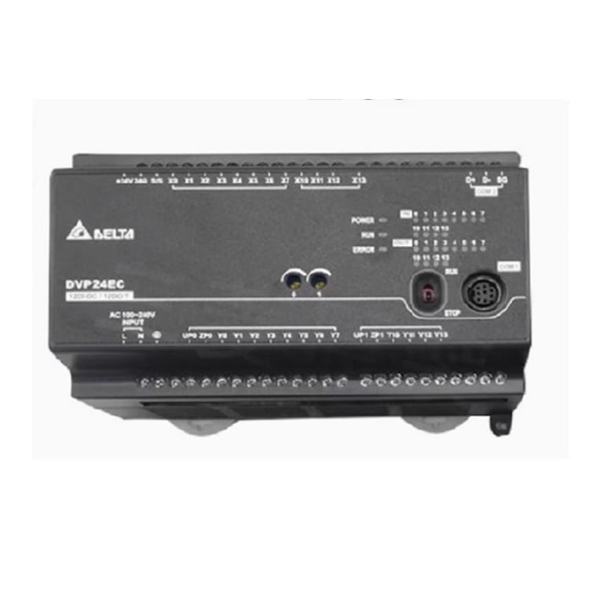
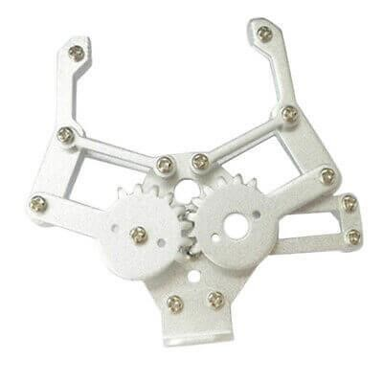
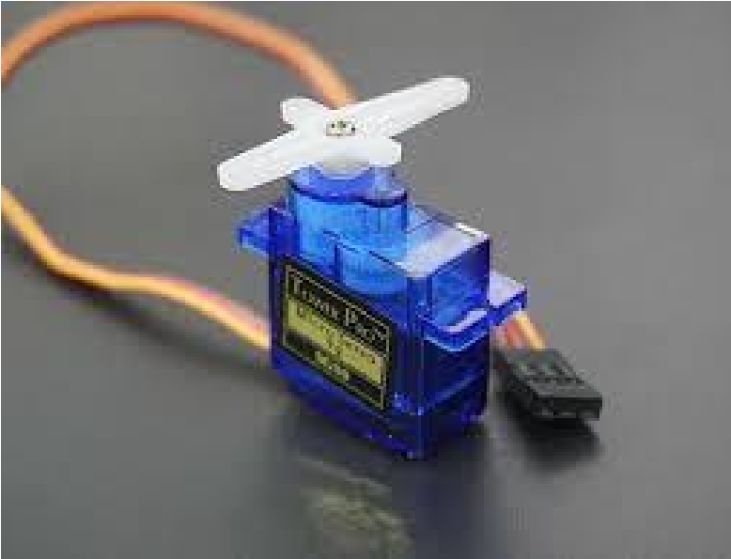
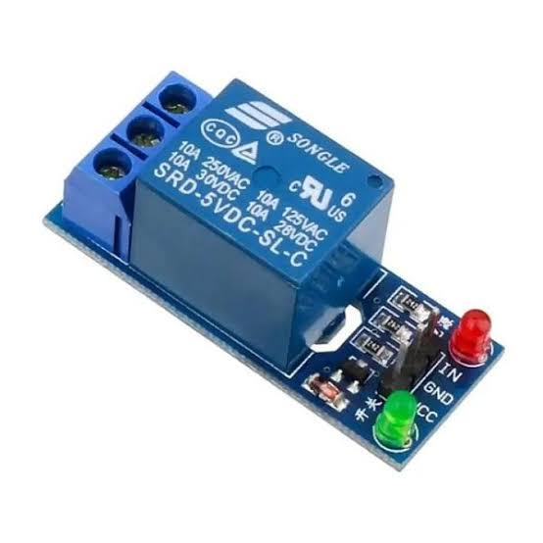
Hardware Selection & Assembly
PLC → Main control unit
Mobile Camera → Object color detection
Conveyor Belt → Object movement
DC Motor → Drives conveyor
Robotic Arm → Pick-and-place operation
Servo Motors → Arm movement control
Motor Driver → Motor interfacing
Power Supply → Provides electrical power
Relay Module → Switching control
Sorting Bins → Store sorted objects

Slide 8
Implementation And Testing
Hardware setup and wiring were completed successfully
PLC was programmed using ladder logic for automation control
Conveyor belt movement was tested for smooth operation
Mobile Camera accurately detected different object colors
Robotic arm successfully performed pick-and-place operations
Communication between PLC, sensors, and motors was verified
System was tested under real-time sorting conditions

Slide 9
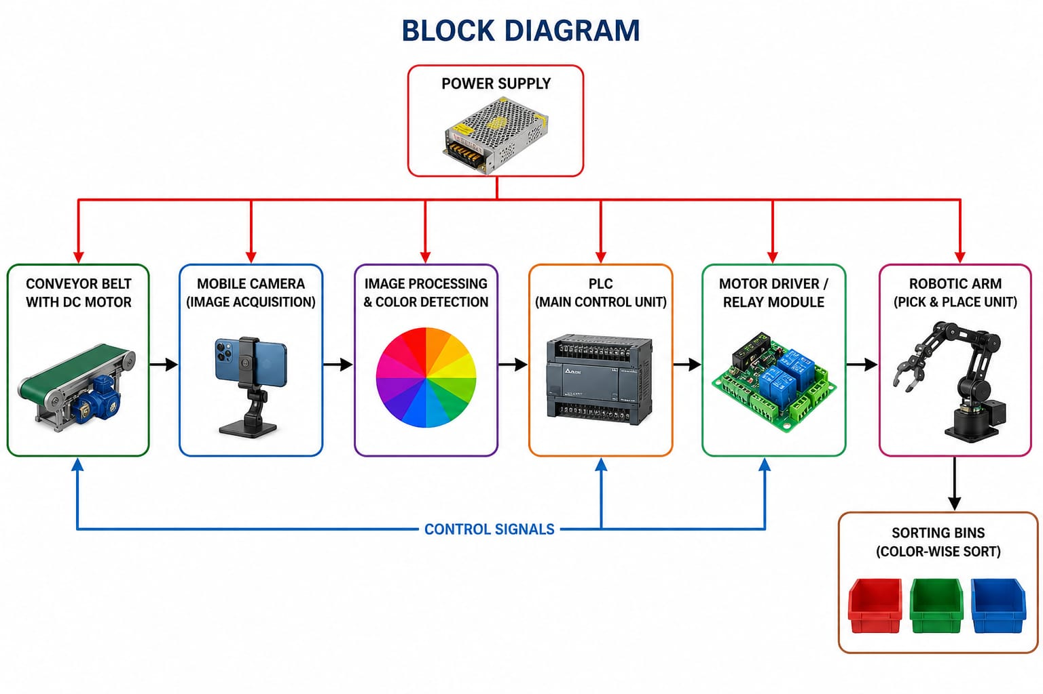
Block Diagram

Slide 10
Real time value
The Smart Chromatic Sorting System provides real-time automatic object sorting using mobile camera vision and PLC automation. It improves industrial efficiency, reduces human effort, increases sorting accuracy, and supports smart manufacturing applications.

Slide 11


Software Architecture
Delta ISPSOFT is used for PLC programming, monitoring, and automation control in the project.
Arduino IDE is used for programming and controlling Arduino-based hardware components.
Python is used for image processing and color detection using the mobile camera.

Slide 12
Project Integration
Integration of mobile camera, PLC, Arduino, and robotic arm
Python used for image processing and color detection
PLC controls conveyor and sorting operation
Proper synchronization ensures smooth real-time performance

Slide 13
Challenges and Solutions
Challenge | Solution
Color detection accuracy | Image processing with mobile camera
Plc and robotic arm synchronization | Optimized PLC programming
Conveyor speed control | Controlled motor operation
Hardware interfacing | Proper system integration
Communication issues | Correct baud rate configuration used
Outcomes
Accurate automatic sorting achieved
Successful PLC and image processing integration
Reduced human effort and errors
Improved industrial efficiency and automation

Slide 14
Experimental Testing and Results
Tests Performed
Tested with multiple colored objects
Verified camera-based color detection
Checked PLC and robotic arm synchronization
Performed real-time sorting trials
Results Achieved
Stable autonomous flight
Successful waypoint navigation
Reliable obstacle detection
Accurate payload deployment

Slide 15
Applications of the Project
Industrial automation
Manufacturing industries
Packaging systems
Food processing industries
Recycling systems
Warehouse automation
Logistics and distribution centers
Quality control systems
Smart factories

Slide 16
Conclusion
The Smart Chromatic Sorting System using PLC Automation provides an efficient and reliable solution for automatic color-based object sorting. By integrating a mobile camera, image processing, PLC control, conveyor belt, and robotic arm, the system achieves accurate real-time sorting with reduced human effort. The project improves industrial efficiency, accuracy, and automation, making it suitable for modern smart manufacturing applications.

Slide 17
Future Work
The future scope of this project includes the integration of Artificial Intelligence (AI), Machine Learning, IoT, and SCADA systems to enhance automation and sorting accuracy. In future, the system can be upgraded to detect object shape, size, and material using advanced computer vision techniques. The project can also be implemented in large-scale industries with faster conveyor systems and more efficient robotic arms. Remote monitoring, cloud-based analytics, and smart manufacturing technologies can further improve industrial productivity and system performance.

Slide 18


