Slide 1
Smart Chromatic Sorting System Using PLC Automation
Presented by
Shahzad Meer BSMTEF2022M042
Mutee Ur Rehman BSMTEF2022M028
Fareeha BSMTEF2022M037
Samat Zahra BSMTEF2022M024
Supervisor: Engr. Arqum Razzaq

Slide 2
Introduction
The idea of the PLC-based Automatic Color Sorting System comes from the need to improve efficiency and accuracy in industrial material handling processes.
In many industries, products of different colors need to be separated for packaging, quality control, or further processing.
This system is applicable in industries such as manufacturing, packaging, food processing, recycling, and quality inspection lines, etc.
It performs automatic detection and sorting of objects based on color using sensors, machine vision, and controlled actuators.

Slide 3
Literature Review
Previous research shows that PLC-based chromatic sorting systems improve automation by integrating sensors, conveyor belts, and robotic mechanisms to achieve accurate and reliable sorting. Vision-based techniques using Raspberry Pi and cameras enable real-timecolor detection, reducing human involvement and errors. The integration of robotic arms for pick-and-place operations enhances system efficiency and flexibility. Communication modules such as RS485 ensure smooth coordination between PLCs and controllers. Overall, these studies confirm that smart chromatic sorting systems are effective solutions for modern industrial automation

Slide 4
Problem Statement
Manual color sorting is slow, labor-intensive, error-prone, inconsistent, costly, and unsuitable for continuous industrial production, therefore there is a need of automatic color sorting.
.

Slide 5
Objectives
Automate color-based sorting to reduce human effort and errors
Achieve fast and accurate sorting using PLC, sensors, and camera vision
Integrate conveyor, camera, and robotic arm for coordinated industrial automation

Slide 6
Methodology
PLC
Optoisolator
RS485
Raspbery Pi B+
Arduino UNO
IR Sensor
IR Sensor
Pi Camera
IR Sensor
Conveyor Belt
Robotic Arm
DC Motor
Motor Driver

Slide 7
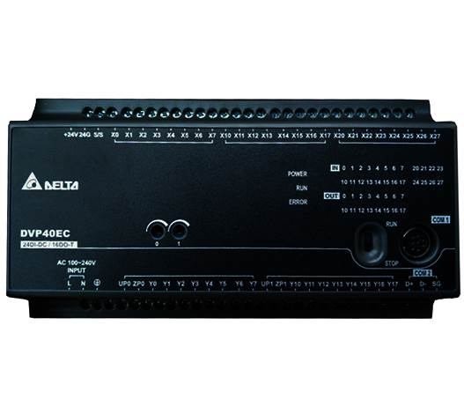
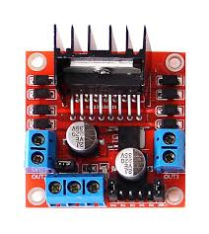
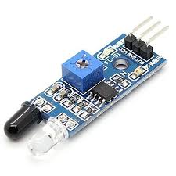
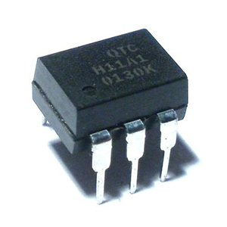
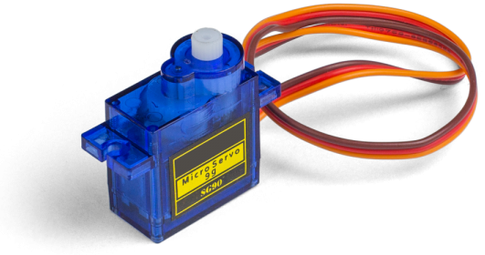
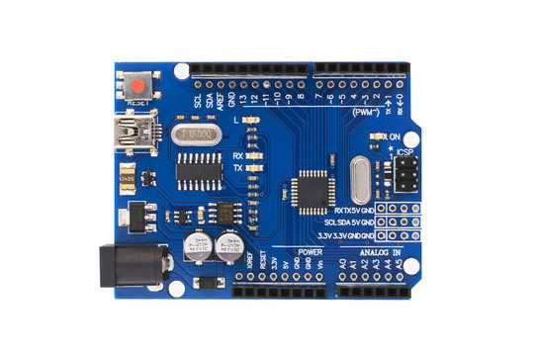
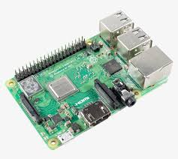
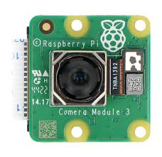
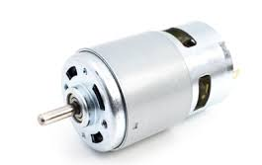
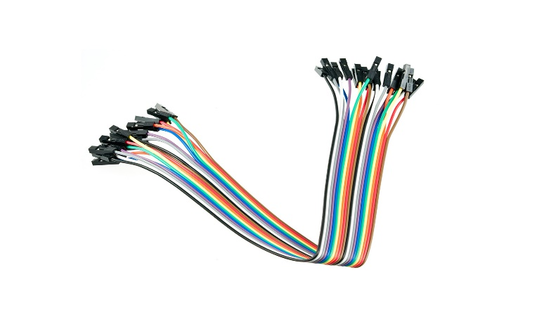
Components

Slide 8
Softwares
SolidWorks – Conveyor belt and mechanical design
Delta PLC Programming Software – PLC ladder logic programming
Arduino IDE – Programming the robotic arm
Python / OpenCV – Camera color detection on Raspberry Pi

Slide 9
Interfacing
IR sensors
Optoisolators
PLC input
PLC
Motor
PLC
RS485
Raspberry Pi
PLC
Arduino UNO

Slide 10
Current Progress
All components have been gathered
Conveyor belt designed in SolidWorks
Research papers and references have been studied
Initial testing: color detection using Python and laptop camera
Interfacing plan prepared
Overall project completion: 50%

Slide 11
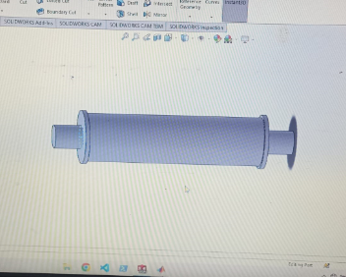
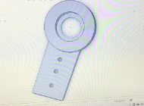
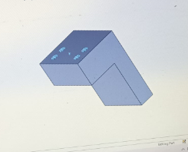
SolidWorks Design

Slide 12
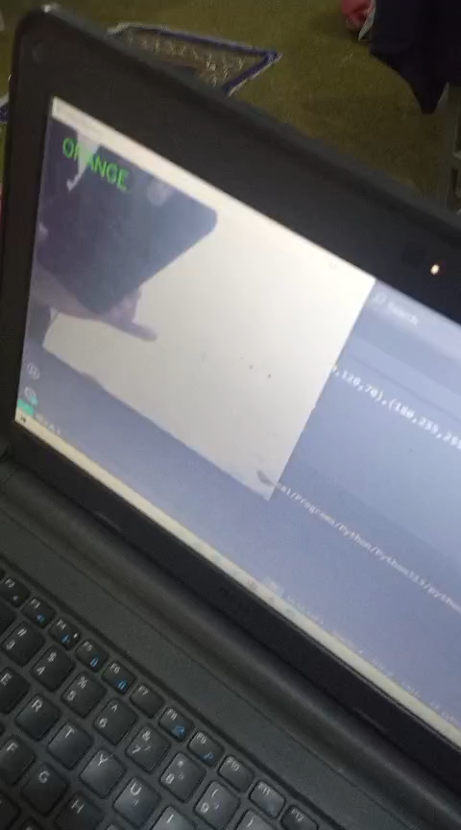
Initial Testing

Slide 13
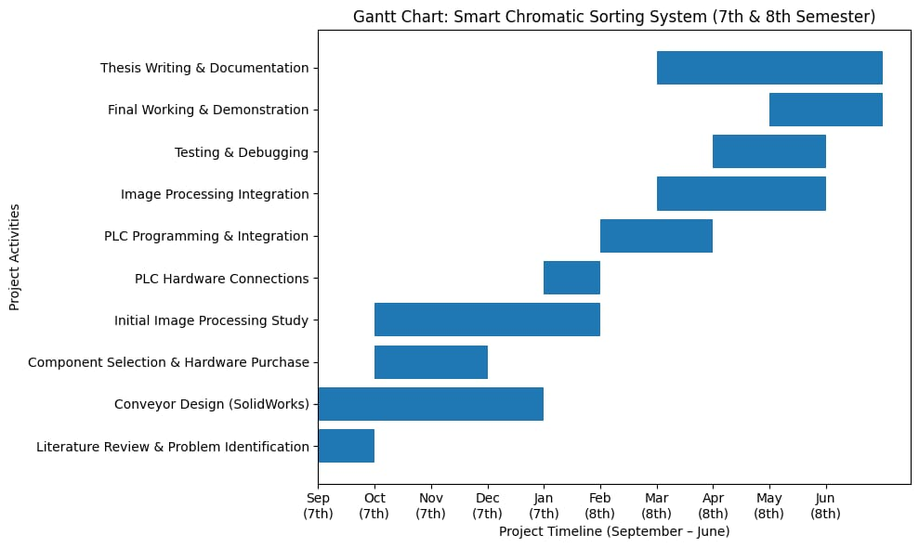
Timeline

Slide 14
Conclusion
Uses a PLC as the central controller for the entire system
Sorts objects automatically based on detected color
IR sensors ensure accurate object detection and positioning
Raspberry Pi with camera performs reliable color detection
Arduino-controlled robotic arm handles precise sorting
Reduces human involvement and manual errors
Improves speed, accuracy, and overall productivity

Slide 15
References
Building an Educational Automated MechatronicsBased Sorting System
Authors: Benjamin Jackvony & Musa Jouaneh
Published: 15 July 2024 Link (open access):
https://www.mdpi.com/2673-4052/5/3/18 2)
Fruit Sorting Automation; Cartesian Robot and Conveyor Design
Authors: Mustafa Ayyıldız, Yusuf Kenan Çiftçi, Kubilay Kilecioğlu & Ömer Faruk Arslan
Published: July 31, 2024 Link (open access / DOI):
https://doi.org/10.29130/dubited.1400615 3)

Slide 16
References
Implementing a Vision‑ Based ROS Package for Reliable Part Localization andDisplacement from Conveyor Belts
Authors: Eber L. Gouveia, John G. Lyons & Declan M. Devine
Published: 30 September 2024 Link (open access): https://www.mdpi.com/2504-4494/8/5/218

