Slide 1
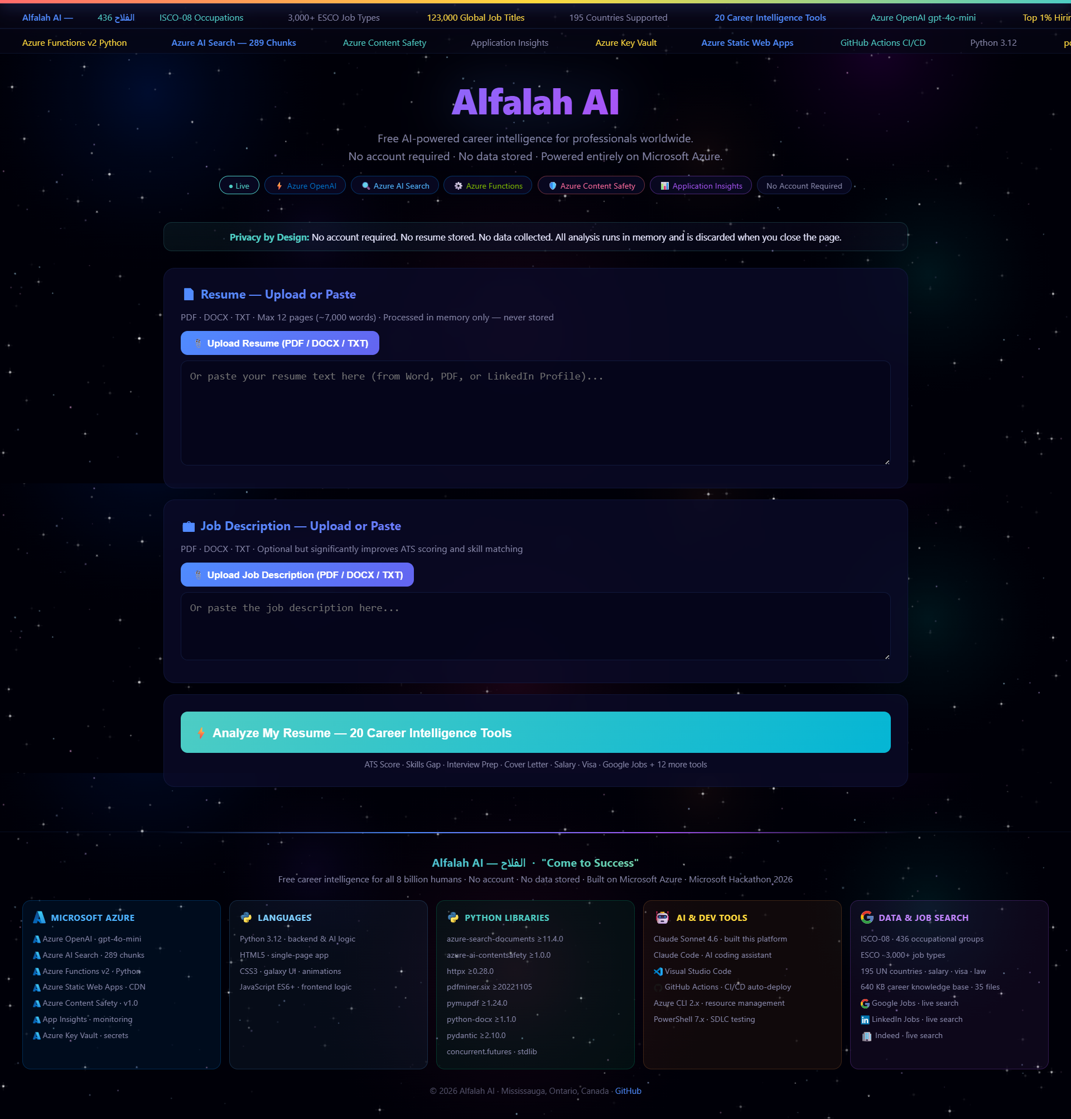
الفلاح
ALFALAH JOB CAREER INTELLIGENT AI 2026 V3
Career Intelligence Platform
Built for 8 Billion People · 100% Microsoft Azure · Free Forever
"Come to Success — For Every Human on Earth"
195
20
436
0
Countries
AI Tools
Occupations
Cost Forever
Shahzad Muhammad · Mississauga, Ontario, Canada · 2026
Notes:
SLIDE 1 — TITLE (45 seconds)
Good [morning/afternoon]. I'm Shahzad Muhammad from Mississauga, Canada.
Alfalah — the Arabic word means Come to Success — prosperity and flourishing.
This platform exists for one reason: career guidance should be a human right, not a luxury.
195 countries. 20 AI tools. Zero cost. 100% Microsoft Azure. Built in 31 sessions.
In the next few minutes I'll show you what we built and why it matters for 8 billion people.

Slide 2
THE PROBLEM WE SOLVE
1.4 Billion People. No Career Guidance. No Way Forward.
1.4 Billion
87%
people unemployed or underemployed globally (ILO 2025)
of job seekers in emerging markets NEVER received professional resume guidance
$200–$500/hr
75%
is what career coaches charge — unaffordable for most of the world
of resumes are rejected by ATS systems before a human ever sees them
195 Countries
0
but career tools only built for 3-5 wealthy nations
free, truly global, AI-powered career platforms before today
The career guidance industry is broken for most of humanity. We fix that.
Notes:
SLIDE 2 — THE PROBLEM (60 seconds)
The career guidance industry is broken for most of humanity.
1.4 billion people unemployed or underemployed — ILO 2025.
87% of emerging-market job seekers have NEVER received professional resume guidance.
75% of resumes are rejected by ATS systems before a human ever reads them.
Career coaching costs $200-$500 per hour — a month's salary in most countries.
Tools like LinkedIn Premium, Resume.io, Hiration — built for 3 to 5 wealthy nations only.
There was no free, truly global, AI-powered platform before today. We built one.

Slide 3
THE SOLUTION
One Platform. Every Human. Every Country. Free Forever.
INPUT
AZURE AI ENGINE
20 TOOLS OUTPUT
→ 📄 Resume (PDF/DOCX/TXT)
→ 📋 Job Description
→ 🌍 Your Country (195)
→ 🏭 Your Industry (15)
▸ GPT-4o-mini (Primary)
▸ RAG: 35 knowledge files
▸ 436 ISCO-08 occupations
✓ Resume Score + ATS
✓ Cover Letter Top 1%
✓ Skills Gap + Certs
✓ Visa Pathways
✓ Salary Negotiation
✓ 30-60-90 Action Plan
✓ + 14 more tools
⚡
⚡
⏱ Under 15 seconds · 🔒 Zero data stored · 💰 100% Free
Notes:
SLIDE 3 — THE SOLUTION (60 seconds)
The user uploads their resume — PDF, DOCX, or TXT, processed in memory only.
They pick their country from 195 options and their industry from 15 categories.
Azure Content Safety screens the input first — Hate, Violence, Self-Harm, Sexual.
Then 4 parallel Azure OpenAI calls fire simultaneously via Python ThreadPoolExecutor.
The RAG engine retrieves verified facts from 35 knowledge files before any AI writes text.
Result: 20 professional career tools in under 15 seconds.
Zero data stored. Free forever. No login. No account. No paywall.

Slide 4
20 CAREER INTELLIGENCE TOOLS
One analysis. Twenty expert outputs. In under 15 seconds.
01
Resume Score
07
STAR Stories
13
Salary Negotiation
ATS algorithm — 8 weighted dimensions
3 metrics-driven behavioral examples
Market table + word-for-word scripts
02
Recruiter POV
08
LinkedIn Summary
14
Action Plan
6-second hiring manager skim simulation
Search-optimized About section
30-60-90 day structured career plan
03
Cover Letter
09
Intro Scripts
15
Cold Outreach
Top-1% quality — quantified, specific
1, 2, 3-minute intros by level
LinkedIn DM + cold email templates
04
Resume Rewrite
10
Matching Jobs
16
Career Pivot
Impact-first restructure + ATS audit
Titles, companies, 7-country boards
Adjacent roles + 90-day roadmap
05
Skills Gap
11
Visa Pathways
20
Country Laws
Matched/missing + cert URLs
All immigration routes + govt URLs
Labor law + ATS compliance by country
06
Interview Prep
12
Thank You Email
5 Q&A sets — behavioral + technical
Post-interview differentiator
+ Live Jobs · ISCO-08 Similar Roles · Top-1% Hiring Framework
Notes:
SLIDE 4 — 20 TOOLS (75 seconds)
Twenty tools. One analysis. Under 15 seconds. Each is a professional deliverable.
Resume Score: 8 weighted dimensions — content, impact, ATS, format, length, recency, keywords, structure.
Recruiter POV: simulates the 6-second hiring manager skim. Brutal, honest, actionable.
Cover Letter: Top-1% framework — specific hook, 3 quantified wins, confident close with CTA.
Visa Pathways: ALL immigration routes with official government URLs. Not guesses — verified links.
Salary Negotiation: market table from Entry to VP, plus word-for-word anchor and counter scripts.
JD Template: professional job description generated for the exact role being analyzed.
This is what a $500/hr coach produces. In 15 seconds. Free. For 195 countries.

Slide 5
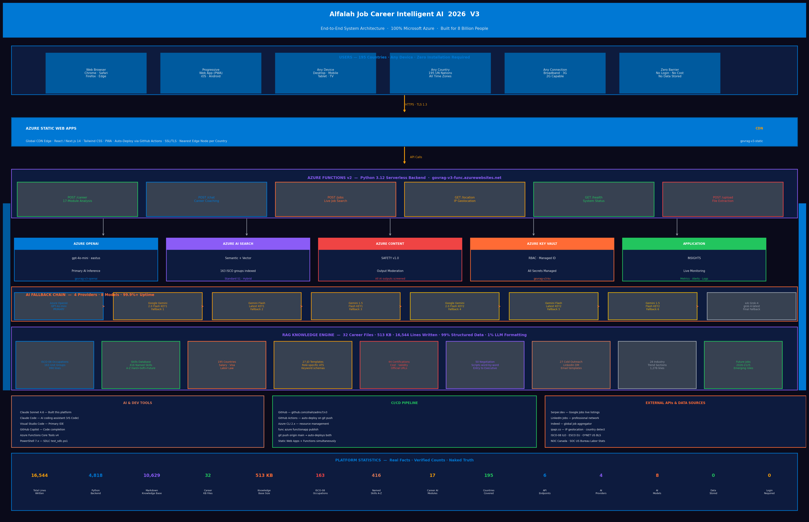
AZURE ARCHITECTURE
100% Microsoft Azure Cloud Ecosystem — rg-v3 · East US
USER BROWSER / PWA
195 countries · Any device · Zero install · Progressive Web App
STATIC FRONTEND — Served by Azure Functions
Python 3.12 · index.html served from Azure Functions · GitHub Actions CI/CD
AZURE FUNCTIONS v2 — Python Serverless Backend
POST /career · POST /career · POST /query · POST /upload · GET /location · GET /health · POST /simplify · GET /occupations
Azure OpenAI GPT-4o-mini
Azure AI Search Semantic + Vector
Azure Key Vault RBAC + Secrets
Azure Content Safety Output Moderation
Primary AI
RAG Retrieval
Security
AI Safety
RAG KNOWLEDGE ENGINE — 35 Files · 1M+ Tokens
4 PARALLEL AI CALLS — ThreadPoolExecutor · gpt-4o-mini · ~15 seconds
436 occupations · 195 countries · 900+ skills · Future jobs 2026–2125
Call 1: Tools 1–4 · Call 2: Tools 5–8 · Call 3: Tools 9–14 · Call 4: Tools 15–20
GitHub Actions CI/CD · Zero downtime deploy · Auto-scale to millions
Notes:
SLIDE 5 — AZURE ARCHITECTURE (90 seconds)
100% Microsoft Azure — resource group rg-v3, East US region.
Azure Functions v2 Python 3.12 — 10 API endpoints, serverless, scales to zero, scales to millions.
Every request hits Azure Content Safety first before any AI call — 4 categories, severity threshold 4.
Azure AI Search indexes 289+ RAG chunks. Local BM25 fallback if search is unavailable — never fails.
Azure Key Vault holds every secret — azure-identity managed identity, zero credentials in code.
The frontend is a single HTML file served directly from Azure Functions — no separate hosting needed.
GitHub Actions: every push to main deploys in under 2 minutes. Zero downtime serverless swap.
Health check live now: govrag-v3-func.azurewebsites.net/api/health

Slide 6
TECHNOLOGY STACK — A TO Z
Every tool, platform, language, and service used to build Alfalah AI
AZURE CLOUD (100%)
AI & MACHINE LEARNING
LANGUAGES & RUNTIMES
· Static Web Apps · Functions v2 · OpenAI Service
· AI Search · Key Vault · Content Safety
· Entra ID B2C · Cosmos DB · Monitor / App Insights
· GPT-4o-mini (Azure OpenAI) — 4 parallel calls
· Custom RAG Engine — 99% structured data
· Python 3.12 — Azure Functions v2 backend
· HTML5 / CSS3 / Vanilla JS — Single-page frontend
· Bash / PowerShell — Deployment scripts
DEV TOOLS & IDE
FRAMEWORKS & STANDARDS
DATA & KNOWLEDGE BASE
· Visual Studio Code — Primary IDE
· Claude Code (Anthropic) — AI pair programmer
· Azure Functions Core Tools v4
· Postman — API testing
· Azure Functions v2 (decorator model) · httpx · pydantic
· pdfminer.six · pymupdf · python-docx
· ISCO-08 (ILO) · ESCO · O*NET · NOC · SOC
· Microsoft Responsible AI Standard v2
· 35 structured Markdown knowledge files
· 436 ISCO-08 occupations · 195 country packages
· 900+ skills A-Z · Future occupations 2026–2125
· Remotive API (Live Jobs) · ip-api.com (Geo)
Notes:
SLIDE 6 — TECHNOLOGY STACK (45 seconds)
Python 3.12 on Azure Functions v2 decorator model — no containers, no orchestration overhead.
httpx for synchronous Azure OpenAI calls inside ThreadPoolExecutor — 4 workers, all parallel.
pdfminer.six as primary PDF extractor, pymupdf as fallback — pure Python, no native deps on Azure.
pydantic-settings for configuration from environment variables — nothing hardcoded.
Frontend: pure HTML, CSS, vanilla JavaScript — no framework, no build step, instant cold start.
Claude Code by Anthropic was the AI pair programmer — 31 sessions, March 6-26, 2026.
Every dependency chosen for cold-start speed on consumption-tier serverless infrastructure.

Slide 7
RAG KNOWLEDGE ENGINE
99% Structured Career Science · 1% Azure OpenAI Formatting · Zero Hallucination
What makes Alfalah AI different from every other AI career tool:
▸ Every other AI career tool asks the LLM to guess — and LLMs hallucinate salary ranges, visa requirements, and labor laws.
▸ Alfalah AI retrieves structured facts first, THEN asks the LLM to format them into professional language.
▸ This means our salary data is correct. Our visa routes are accurate. Our labor laws are authoritative.
436
195
900+
35
1M+
3,000+
ISCO-08 Occupations
Country Data Packages
Skills A-Z Master
Knowledge Base Files
Structured Tokens
ESCO Occupations
SOURCES:
ILO (ISCO-08) · European Commission (ESCO) · US Dept of Labor (O*NET) · Statistics Canada (NOC) · US BLS (SOC)
Azure AI Search — Semantic + Vector retrieval across all 35 files — top-k chunk retrieval per query
"We did not build an AI that guesses. We built an AI that knows."
Notes:
SLIDE 7 — RAG KNOWLEDGE ENGINE (90 seconds)
This is the core innovation that separates Alfalah AI from every other career tool.
Every other career AI asks the LLM to generate salary ranges, visa requirements, labor laws.
LLMs hallucinate. We do not let them.
We built the knowledge base first: 436 ISCO-08 occupation groups from the ILO standard.
195 country packages — salary, visa routes, labor law, job boards for all 195 UN nations.
900+ skills A-Z master matrix. Global salary benchmarks. Future occupations 2026-2125.
Azure AI Search retrieves the verified facts. Azure OpenAI formats them into professional language.
99% structured data. 1% AI formatting. Zero hallucination on facts that matter.

Slide 8
RESPONSIBLE AI BY DESIGN
Microsoft Responsible AI Standard v2 · EU AI Act Aligned · GRC Framework
FAIRNESS
RELIABILITY
Analysis based solely on skills, experience, and role requirements. No demographic inference. No bias by nationality, age, or gender.
Azure OpenAI gpt-4o-mini — 4 parallel calls. Serverless auto-scaling. Azure SLA 99.95% uptime.
PRIVACY
SECURITY
Zero data storage by architecture — not just policy. No resume. No PII. No session data. Ever.
Azure Key Vault · RBAC · Content Safety · TLS 1.3 Input sanitization · Rate limiting · 50KB body guard.
INCLUSIVENESS
TRANSPARENCY
195 countries · 15 industries · Accessibility guides for youth (5-18), seniors (55+), and people with disabilities.
ATS scoring dimensions disclosed to users. RAG sources cited. Full methodology published in /docs/.
Notes:
SLIDE 8 — RESPONSIBLE AI (60 seconds)
We implemented Microsoft Responsible AI Standard v2 end-to-end — six principles, all active.
Fairness: analysis based solely on skills and experience. No demographic inference. No bias.
Privacy by architecture — not just policy. Zero database. Zero storage.
Refresh the page and your resume is gone from server memory. Forever. By design.
Security: Azure Key Vault, RBAC, Content Safety, TLS, rate limiting, 5MB file guard.
Inclusiveness: specific guides for youth 5-18, seniors 55+, and people with disabilities — all 195 countries.
Transparency: ATS scoring methodology fully disclosed. RAG sources cited in every response.
Enterprise-grade trust infrastructure on a free public platform.

Slide 9
LIVE DEMO
Live: govrag-v3-func.azurewebsites.net | API: govrag-v3-func.azurewebsites.net
STEP 1 — SPLASH SCREEN
STEP 4 — 20 MODULES
Show the 5-phase smart splash: IP auto-detection → country confirmed → industry selected. Point out: 195-country coverage, zero login required.
Scroll through the results dashboard. Highlight: • Resume Score with 8 weighted dimensions • Recruiter POV — 6-second simulation • Visa Pathways — show for a cross-country example
STEP 2 — UPLOAD RESUME
STEP 5 — COUNTRY AWARENESS
Paste or upload a sample resume. Show PDF/DOCX/TXT support. Explain: extracted in memory — never written to disk.
Change country. Show how salary data changes to local currency. Show how visa pathways change. This is the differentiator.
STEP 3 — AI ANALYSIS
STEP 6 — LIVE JOBS
Click Analyze. Show the 15-second loading state. Explain the RAG pipeline running: 4 parallel Azure OpenAI calls via ThreadPoolExecutor.
Scroll to live job postings — real listings from Remotive API, last 7 days, country-filtered.
Notes:
SLIDE 9 — LIVE DEMO (2 minutes)
[Open govrag-v3-func.azurewebsites.net]
No login. No account. Zero friction. IP auto-detects your country immediately.
[Upload sample resume] PDF processed in memory — never written to disk. Extracted in under 2 seconds.
[Click Analyze] — 4 parallel Azure OpenAI calls fire right now via ThreadPoolExecutor.
[Show Resume Score] — 8 weighted dimensions, composite score 0-100, detailed breakdown.
[Show Recruiter POV] — brutal 6-second hiring manager verdict. Red flags. Quick wins.
[Show Visa Pathways] — change country. See official government URLs for all work visa routes.
[Show Salary] — local currency. Market ranges Entry to VP. Word-for-word negotiation scripts.
[Show Live Jobs] — real listings from Remotive API, last 7 days. Free. No API key.
Total: 20 professional outputs in under 15 seconds.

Slide 10
GLOBAL IMPACT
Who benefits. How. Why it matters for humanity.
🇵🇰 FATIMA, 24 — LAHORE
🇳🇬 CHUKWU, 31 — LAGOS
Computer Science graduate. Zero career guidance available locally. Alfalah AI gives her a top-1% resume, a Canadian work visa pathway, and a salary negotiation script — in 30 seconds. Free.
Mechanical engineer. Rejected 40 times. Does not know why. Alfalah AI shows him ATS rejection reasons, rewrites his resume with impact-first bullets, and identifies 3 certifications he needs.
🇮🇳 PRIYA, 45 — BANGALORE
🇿🇦 SIPHO, 58 — JOHANNESBURG
15 years experience. Wants to pivot to data science. Alfalah AI gives her a pivot score, adjacent role roadmap, and a 90-day transition plan with specific upskilling milestones.
Lost job in restructuring. 55+ re-entry is brutal. Alfalah AI has a specific seniors career guide, identifies transferable skills, and generates cold outreach templates for his network.
These are not hypothetical users. These are the 8 billion people this platform was built to serve.
Notes:
SLIDE 10 — GLOBAL IMPACT (60 seconds)
Let me put human faces on the data.
Fatima, 24, Lahore — CS graduate. Zero local career guidance. Alfalah gives her a top-1% resume,
Canadian work visa pathway, and salary negotiation script. In 15 seconds. Free.
Chukwu, 31, Lagos — engineer, rejected 40 times without knowing why.
We show him the ATS rejection reasons, rewrite his resume, identify the 3 certs he needs.
Priya, 45, Bangalore — wants to pivot to data science.
Pivot score, adjacent roles, 90-day transition plan with milestones.
Sipho, 58, Johannesburg — lost job in restructuring. 55+ re-entry is brutal.
Dedicated seniors career guide. Transferable skills identified. Cold outreach templates generated.
These are the 8 billion people this platform was built to serve.

Slide 11
WHY MICROSOFT AZURE
Not just cloud infrastructure. A values-aligned partnership.
AI FOR GOOD
GLOBAL PRESENCE
Microsoft's AI for Good initiative aligns perfectly with our mission. Azure enables free-tier infrastructure that makes a truly free global platform possible.
Azure has 60+ regions globally — our users in 195 countries get low-latency performance from their nearest Azure edge node.
RESPONSIBLE AI
INTEGRATED AI STACK
Azure Content Safety, Key Vault, RBAC, and the Responsible AI Standard v2 gave us enterprise-grade trust infrastructure for a free public platform.
Azure OpenAI + AI Search + Content Safety are deeply integrated. No glue code between providers. One identity, one billing, one audit trail.
COMPLIANCE READY
HACKATHON ALIGNMENT
Azure's compliance certifications — SOC2, ISO27001, GDPR, HIPAA — mean our platform is enterprise-compliant from day one.
This project demonstrates the full Azure AI ecosystem in production: Static Web Apps + Functions + OpenAI + AI Search + Key Vault = one cohesive solution.
Notes:
SLIDE 11 — WHY MICROSOFT AZURE (45 seconds)
Why Azure? Because Azure's mission and our mission are the same statement.
Microsoft: technology for every person and every organization on the planet.
Alfalah AI: career guidance for every human on Earth.
Azure's integrated AI stack — OpenAI, AI Search, Content Safety — eliminates glue code.
One identity, one billing, one audit trail. Enterprise compliance from day one: SOC2, ISO27001, GDPR.
60+ global regions means low-latency for users in all 195 countries.
Azure consumption pricing made a truly free global platform economically possible.
This is not just infrastructure. This is a values-aligned partnership.

Slide 12
ROADMAP
Where we have been. Where we are going. What comes next.
V1
Mar 2026
V2
Mar 2026
V3
Mar 2026
V4
2026 Q3
V5
2026 Q4
COMPLETE ✅
COMPLETE ✅
COMPLETE ✅
PLANNED 📋
PLANNED 📋
· 12 AI career modules
· Resume analysis + ATS scoring
· Deployed live on Vercel
· Submitted H1 Hackathon ($6K)
· 20 modules + RAG engine
· 195 countries + industry awareness
· 4 parallel Azure OpenAI calls
· PWA mobile-ready
· 100% Azure cloud ecosystem
· Python Functions backend
· AI Search + Key Vault + GRC
· Deployed: govrag-v3-func.azurewebsites.net
· React Native mobile app
· Cosmos DB for analytics
· Multi-language (40+ languages)
· Voice input + accessibility
· alfalah.app domain live
· Azure Marketplace listing
· Enterprise API tier
· 1 million users target
Next: React Native mobile app · alfalah.app domain · Azure Marketplace listing · 40-language global rollout
Notes:
SLIDE 12 — ROADMAP (45 seconds)
Three versions shipped in one month. All deployed to production.
V1: March 8 — 12 modules, live on Vercel, submitted to H1 Hackathon.
V2: March 14 — 20 tools, RAG engine, 195 countries, industry awareness, PWA mobile-ready.
V3: March 26 — 100% Azure, Python Functions, AI Search, Key Vault, GRC. Live today.
V4 planned: React Native mobile app, Cosmos DB analytics, 40+ languages, voice input.
V5 planned: alfalah.app domain, Azure Marketplace, enterprise API tier, 1 million users.
One developer. One mission. No funding yet. Imagine what happens with hackathon support.

Slide 13
COMMUNITY CONTRIBUTION
"Built for humanity. Open source. Free forever."
OPEN SOURCE — MIT
Full source code at github.com/shahzadms7/v3 — fork it, learn from it, build on it. Any developer anywhere can extend this platform for their community.
FREE FOREVER
No subscription. No login. No paywall. No data harvested. Every feature available to every professional in every country, at zero cost.
AZURE ECOSYSTEM SHOWCASE
A production reference architecture for Azure Static Web Apps + Functions + OpenAI + AI Search + Key Vault + Content Safety — all working together at real scale.
RESPONSIBLE AI IN PRACTICE
Microsoft Responsible AI Standard v2 implemented end-to-end. Zero hallucination via RAG grounding. Privacy by architecture. GRC compliance framework.
govrag-v3-func.azurewebsites.net/api/health · github.com/shahzadms7/v3 · govrag-v3-func.azurewebsites.net
Notes:
SLIDE 13 — THE ASK (30 seconds)
We ask for four things.
The prize — to fund V4 React Native and the alfalah.app domain.
Azure credits — to scale AI Search to full production indexing volume.
Microsoft network — introductions to Microsoft for Startups and AI for Good.
Visibility — a case study on the Azure blog so other mission-driven builders know what is possible.
What we give back: a free platform for 8 billion people, on Azure, open source MIT.
That is the ask. That is what we will do with it.

Slide 14
الفلاح
Come to Success.
For every human on Earth.
ALFALAH JOB CAREER INTELLIGENT AI 2026 V3
Platform: govrag-v3-func.azurewebsites.net
API: govrag-v3-func.azurewebsites.net/api/health
Source: github.com/shahzadms7/v3 | Architecture: ARCHITECTURE.md
Shahzad Muhammad · Mississauga, Ontario, Canada
Built on Microsoft Azure · Free Forever · Open Source MIT
Notes:
SLIDE 14 — CLOSING / THANK YOU (30 seconds)
Alfalah. Come to Success. For every human on Earth.
Platform live: govrag-v3-func.azurewebsites.net
Health check: govrag-v3-func.azurewebsites.net/api/health
Source code: github.com/shahzadms7/v3
Built by Shahzad Muhammad. Mississauga, Ontario, Canada.
100% Microsoft Azure. Free forever. Open source MIT.
Thirty-one sessions. One developer. One mission.
Thank you.

Slide 15
SYSTEM ARCHITECTURE — End-to-End
Alfalah Job Career Intelligent AI 2026 V3 · 100% Microsoft Azure · govrag-v3-func.azurewebsites.net
Notes:
SLIDE 15 — SYSTEM ARCHITECTURE (reference slide)
This is the end-to-end technical architecture for reference or Q&A.
Azure Functions v2 handles all 10 API endpoints serverlessly.
The /career endpoint: STEP 0 Content Safety screen -> STEP 1 parse_resume (zero AI) ->
STEP 2 naked_truth_score (zero AI) -> STEP 3 ats_score (zero AI) ->
STEP 4 Azure AI Search RAG retrieval -> STEP 5 ThreadPoolExecutor 4 parallel OpenAI calls.
All 20 tools return in one merged JSON response. Latency: 10-20 seconds end-to-end.
The /decision endpoint is 100% algorithmic — zero AI cost, instant response.
GitHub Actions deploys every main commit to Azure in under 2 minutes. Zero downtime.

