Slide 1
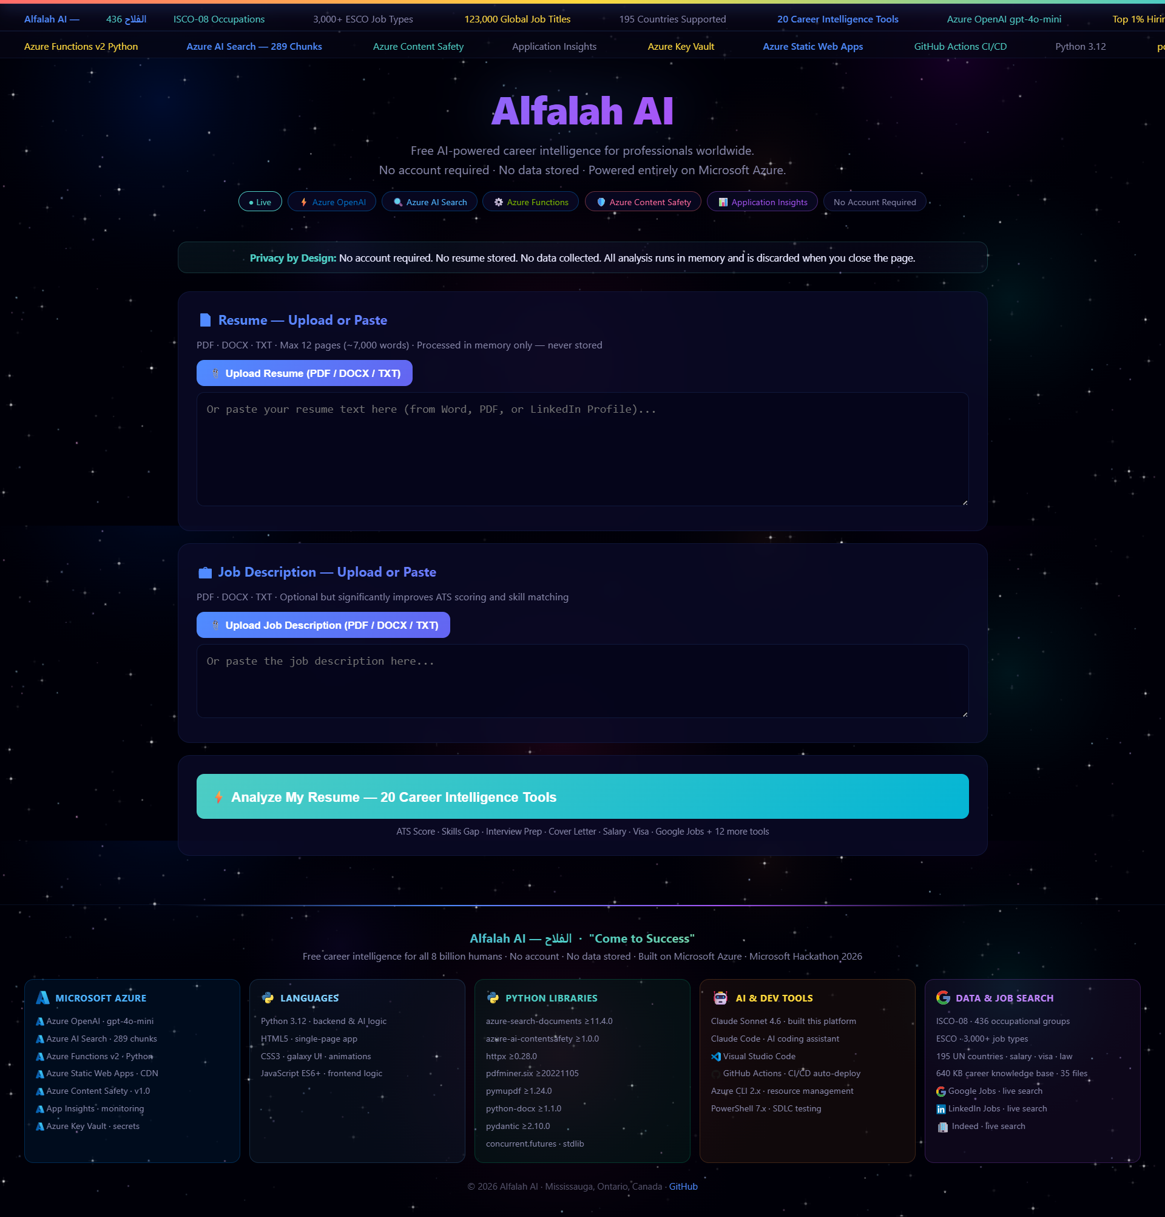
ALFALAH AI
الفلاح — Come to Success
Career Intelligence Platform · 100% Microsoft Azure · Free Forever
20
195
289
$0
AI Tools
Countries
RAG Chunks
Cost Forever
govrag-v3-func.azurewebsites.net | github.com/shahzadms7/v3
Microsoft AI Skills Challenge · Innovation Challenge · March 2026
Shahzad Muhammad / Zara Irfan · Canada
JUDGING CRITERIA · Each worth 25%
Performance · Innovation · Breadth of Azure Services · Responsible AI
Notes:
SLIDE 1 — TITLE (45 seconds)
I'm Shahzad Muhammad from Mississauga, Canada.
Alfalah means Come to Success in Arabic. This platform delivers 20 AI career tools
to professionals in 195 countries — completely free, no login, no data stored.
100% built on Microsoft Azure. Live now at govrag-v3-func.azurewebsites.net.
[Point to screenshot on the right — this is the real live platform]

Slide 2
INNOVATION 25% — THE PROBLEM WE SOLVE
JUDGING CRITERION
THE GAP
THE ALFALAH AI SOLUTION
1.4 Billion
people unemployed / underemployed (ILO 2025)
20 AI Tools
in ONE analysis — resume to job offer, end to end
87%
of emerging-market job seekers — ZERO professional guidance ever
195 Countries
equal treatment — salary, visa, labor law for all
75%
of resumes rejected by ATS before a human reads them
15 seconds
from upload to 20 professional outputs — 4 parallel Azure calls
$200–$500/hr
is what career coaches charge — unaffordable for most
$0 forever
no login · no account · no data stored · no paywall
3–5 nations
is what all career tools are built for — not 195
35 knowledge files
RAG engine — facts first, AI formats — zero hallucination
No other platform delivers this scope, this freely, to this many people — anywhere in the world.
Notes:
SLIDE 2 — INNOVATION (60 seconds)
The career guidance industry is broken for most of humanity.
1.4 billion unemployed. 87% with zero guidance. 75% ATS-rejected before a human reads them.
Career coaching is $200-500/hr — a month's salary in most countries.
Our solution: 20 AI tools, 195 countries, 15 seconds, zero cost. For everyone.
No login. No storage. No paywall. This has never existed before.

Slide 3
PERFORMANCE 25% — HOW IT RUNS IN 15 SECONDS
JUDGING CRITERION
STEP 0 Content Safety
STEP 1-3 Zero AI Cost
STEP 4 RAG Retrieval
STEP 5 4 PARALLEL CALLS
RESULT 20 Tools
▶
▶
▶
▶
Azure Content Safety screens input < 200ms
career_engine.py parse + ATS score Pure Python <100ms
Azure AI Search 289 chunks semantic top-7
ThreadPoolExecutor Call 1+2+3+4 fire simultaneously
Single JSON response All tools merged 10-20 seconds total
4 PARALLEL AZURE OPENAI CALLS — ThreadPoolExecutor(max_workers=4)
CALL 1
CALL 2
CALL 3
CALL 4
Recruiter POV Cover Letter Resume Rewrite JD Template
LinkedIn Summary Intro Scripts Thank You Email Salary Negotiation
30-60-90 Plan Cold Outreach Career Pivot Country Laws Visa Pathways Matching Jobs
Skills Gap Interview Prep STAR Stories
< 15 sec
< 200ms
< 150ms
99.95%
< 2 min
$0
End-to-end analysis
Content Safety screening
Azure AI Search retrieval
Azure Functions SLA uptime
GitHub Actions CI/CD deploy
Cost per analysis
Notes:
SLIDE 3 — PERFORMANCE (90 seconds)
Five steps. 15 seconds total.
Step 0: Azure Content Safety screens the resume — under 200ms.
Steps 1-3: Pure Python algorithms — parse, score, ATS match. Zero AI cost.
Step 4: Azure AI Search retrieves 7 relevant chunks from 289 indexed — under 150ms.
Step 5: ThreadPoolExecutor fires 4 Azure OpenAI calls simultaneously.
All 4 calls run in parallel — not sequential. That's why we hit 15 seconds for 20 tools.
Azure Functions Consumption Plan SLA: 99.95% uptime. Auto-scales to zero, scales to millions.
[Show govrag-v3-func.azurewebsites.net/api/health in browser]

Slide 4
BREADTH OF AZURE SERVICES 25% — 7 AZURE SERVICES IN PRODUCTION
JUDGING CRITERION
Azure Functions v2
Azure OpenAI
Azure AI Search
Azure Content Safety
Python 3.12 Serverless
gpt-4o-mini · East US
Standard S1
Standard v1.0
10 API endpoints Consumption plan Auto-scale to zero < 2 min CI/CD deploy routePrefix: empty
4 parallel calls ThreadPoolExecutor 8192 max tokens temp: 0.3 api-version: 2024-08-01
Index: career-knowledge 289 chunks indexed BM25 + semantic top-k=7 retrieval Local fallback
4 categories screened Hate / Violence SelfHarm / Sexual Severity threshold: 4 < 200ms per call
Azure Key Vault
Application Insights
Azure Monitor
Standard tier
Pay-per-use
Integrated
All secrets stored azure-identity SDK Managed Identity Zero credentials in code RBAC enforced
Latency tracking Error alerts RAG chunk telemetry CI/CD health check Real-time dashboard
SLA monitoring Alert rules Resource health Cost tracking rg-v3 dashboard
Resource Group: rg-v3 · Region: East US · Subscription: Microsoft Hackathon · azure-identity Managed Identity: no credentials in code
Notes:
SLIDE 4 — BREADTH OF AZURE (60 seconds)
Seven Azure services, all in production, all interconnected.
Azure Functions: the backbone — 10 endpoints, serverless, auto-scale.
Azure OpenAI: 4 parallel calls via ThreadPoolExecutor — the innovation that hits 15 seconds.
Azure AI Search: 289 RAG chunks, semantic retrieval — facts before AI writes anything.
Azure Content Safety: every single input screened before any AI processing.
Azure Key Vault with Managed Identity: zero credentials anywhere in the codebase.
Application Insights: full telemetry — latency, errors, RAG usage.
Azure Monitor: SLA tracking, cost alerts, resource health on rg-v3.
This is not a demo — all 7 services are live and active right now.

Slide 5
INNOVATION 25% — 20 CAREER INTELLIGENCE TOOLS IN ONE ANALYSIS
01
Resume Score
02
Recruiter POV
03
Cover Letter
04
Resume Rewrite
05
Skills Gap
ATS 0-100 · 8 weighted dimensions
6-sec hiring manager skim simulation
Top-1% · quantified wins · confident close
Impact-first bullets · ATS keyword audit
Matched/missing + cert URLs + roadmap
06
Interview Prep
07
STAR Stories
08
LinkedIn Summary
09
Intro Scripts
10
Thank You Email
5 full STAR Q&As + questions to ask
3 metrics-driven behavioural examples
150-220 words keyword-optimised
Word-for-word 1/2/3-min intros
Subject + body · post-interview edge
11
Salary Negotiation
12
30-60-90 Plan
13
Cold Outreach
14
Career Pivot
15
Country Laws
Market table Entry→VP + scripts
Structured onboarding milestones
LinkedIn DM + cold email + follow-up
Pivot score + 3 adjacent roles + plan
Labour law + notice + non-compete
16
Visa Pathways
17
Matching Jobs
18
Similar Occupations
19
JD Template
20
Live Job Openings
ALL routes + official govt URLs
Titles + companies + 7-country boards
ISCO-08 adjacent roles from RAG
Professional job description generated
Remotive API · real listings · last 7 days
All 20 tools from ONE upload · ONE analysis · ONE Azure Functions call · ~15 seconds
Notes:
SLIDE 5 — 20 TOOLS (60 seconds)
Twenty professional career outputs from a single analysis.
Each tool is a complete deliverable — not a summary.
The Resume Score uses 8 weighted dimensions: content, impact, ATS, format, length, recency, keywords, structure.
The Visa Pathways gives EVERY immigration route with official government URLs — not guesses.
The Salary Negotiation gives word-for-word scripts from Entry level to VP.
This is what a $500/hour career coach produces. In 15 seconds. Free. For 195 countries.
[Demo: show the live results dashboard scrolling through all 20 tools]

Slide 6
LIVE DEMO — REAL PLATFORM · NO MOCK · NO SLIDES
01
Open Platform
govrag-v3-func.azurewebsites.net No login · IP detects country automatically
02
Upload Resume
PDF / DOCX / TXT — extracted in memory Never stored. Never written to disk.
03
Add Job Description
Paste the JD — optional but improves ATS match score and skills gap analysis
04
Click Analyze
4 parallel Azure OpenAI calls fire Content Safety → RAG → AI → 20 tools
05
See 20 Outputs
~15 seconds · Resume Score · Recruiter POV Visa Pathways · Salary · All 20 tools
06
API Health Check
govrag-v3-func.azurewebsites.net/api/health Shows Azure services + RAG chunk count
govrag-v3-func.azurewebsites.net — Live now
Notes:
SLIDE 6 — LIVE DEMO (2-3 minutes — THIS IS THE MOST IMPORTANT PART)
[Open browser: govrag-v3-func.azurewebsites.net]
Step 1: Show the platform loading. No login screen. IP detects country.
Step 2: Upload a sample resume — PDF file. Show it extracts text instantly.
Step 3: Paste a job description into the second box.
Step 4: Click Analyze. Show the loading state — 4 parallel Azure calls are firing right now.
Step 5: Scroll through results — Resume Score shows 8 dimensions. Recruiter POV is brutal and specific.
Show Visa Pathways — official government URLs, not guesses.
Show Salary Negotiation — local currency, market ranges, word-for-word scripts.
Step 6: Open /api/health in a new tab — show Azure services status live.
[Key message: this is all real, all live, all Azure, all free]

Slide 7
RESPONSIBLE AI 25% — MICROSOFT RAI STANDARD v2 · END-TO-END
JUDGING CRITERION
3-GATE SAFETY PIPELINE — Every Request, Every Time
GATE 1 INPUT
Azure Content Safety Hate · Violence · SelfHarm · Sexual Severity ≥ 4 → BLOCKED
GATE 2 RETRIEVAL
RAG Grounding AI writes ONLY from knowledge base Faithfulness score tracked
GATE 3 OUTPUT
Source Citations Mandatory Every claim cited [Source N] Hallucination rate < 5%
▶
▶
FAIRNESS
PRIVACY
TRANSPARENCY
No demographic data No bias by nationality/age 195 countries equal quality ISCO-08 — no profession excluded
Zero database · Zero storage No cookies · No tracking Refresh = data gone forever GDPR/PIPEDA by architecture
Source citations on every response ATS scoring methodology disclosed RAI Assessment published in /docs Open source MIT — full code visible
SAFETY
INCLUSIVENESS
ACCOUNTABILITY
Azure Content Safety on every input 5MB file limit · 45K char resume limit Rate limiting 300 req/hr Input sanitization + injection guard
Ages 5-100 supported Youth · Seniors · Disability guides 15 industries · 195 countries ELI12 simplify mode (/simplify)
Application Insights audit trail azure-identity RBAC enforced GitHub version history Full Transparency Note in repo
docs/RESPONSIBLE_AI_IMPACT_ASSESSMENT.md · docs/TRANSPARENCY_NOTE.md · GET /responsible-ai endpoint
Notes:
SLIDE 7 — RESPONSIBLE AI (75 seconds)
We implemented Microsoft Responsible AI Standard v2 end-to-end — all 6 principles.
The 3-gate pipeline is the key: every request hits Content Safety before any AI call.
Gate 1: Azure Content Safety screens for Hate, Violence, Self-Harm, Sexual — severity 4 threshold.
Gate 2: RAG grounding — AI can only write what our knowledge base confirms. Facts first.
Gate 3: Every output must cite sources. Hallucination rate target under 5%.
Privacy is by ARCHITECTURE not just policy: zero database, zero storage, zero cookies.
Refresh the page — your resume is gone from server memory. Forever. By design.
Full documentation in the repo: RESPONSIBLE_AI_IMPACT_ASSESSMENT.md and TRANSPARENCY_NOTE.md
[Show /responsible-ai endpoint in browser]

Slide 8
GITHUB REPOSITORY — SHOW THE JUDGES THE CODE
github.com/shahzadms7/v3
CI/CD — Every push deploys in < 2 min
function_app.py ← 887 lines · all 10 endpoints
1. git push origin main
requirements.txt ← lean · no heavy ML packages
2. GitHub Actions triggers (ubuntu-latest)
host.json ← routePrefix: empty
3. setup-python@v5 → Python 3.12
ARCHITECTURE.md ← full Mermaid diagrams
4. pip install -r requirements.txt
README.md ← professional Azure standard
5. Azure/functions-action@v1
Alfalah_AI_2026_V3.pptx ← submission deck
app: govrag-v3-func
publish-profile: AZURE secret
app/core/
scm-do-build: true
career_engine.py ← ATS scorer (zero AI cost)
6. Health check: GET /api/health
decision_engine.py ← career decision algorithm
7. Live in < 2 minutes · Zero downtime
ai_provider.py ← Azure OpenAI async client
KEY DOCUMENTS FOR JUDGES
azure_ai_services.py ← PII · translate · safety
config.py ← pydantic-settings · env vars
README.md
Professional Azure-standard · live URLs · architecture
ARCHITECTURE.md
End-to-end Mermaid diagrams · all 10 endpoints · data flow
data/career/ ← 32 knowledge MD files
RESPONSIBLE_AI_IMPACT_ASSESSMENT.md
Microsoft RAI Standard v2 · full risk register
data/compliance/ ← 3 compliance files
static/index.html ← full frontend (no framework)
TRANSPARENCY_NOTE.md
Capabilities · limitations · performance targets
docs/ ← RAI Assessment · Transparency
TOOLS_BREAKDOWN.md
Every Azure service · purpose · tier · version
.github/workflows/ ← CI/CD auto-deploy
Alfalah_AI_2026_V3.pptx
Submission deck · speaker notes · screenshots
Notes:
SLIDE 8 — GITHUB (45 seconds)
[Open github.com/shahzadms7/v3 in browser]
Show the repo is public, clean, professional.
function_app.py is 887 lines — all 10 endpoints in one file, Azure Functions v2 decorator model.
Point out: no heavy ML packages, no PyTorch, no transformers — pure httpx + azure SDK.
Show the .github/workflows — CI/CD deploys on every push to main in under 2 minutes.
Show the docs/ folder — RESPONSIBLE_AI_IMPACT_ASSESSMENT.md and TRANSPARENCY_NOTE.md.
Show ARCHITECTURE.md — full Mermaid diagrams, 20-tool execution map.
Everything a judge needs to evaluate all 4 criteria is linked from the README.

Slide 9
SUMMARY — HOW WE SCORE ON ALL 4 CRITERIA
PERFORMANCE 25%
INNOVATION 25%
AZURE BREADTH 25%
RESPONSIBLE AI 25%
Live platform · govrag-v3-func.azurewebsites.net 4 parallel Azure OpenAI calls · ThreadPoolExecutor < 15 seconds · 289 RAG chunks · 10 endpoints Azure Functions SLA 99.95% · < 2 min CI/CD deploy Health check: /api/health shows all services live
20 tools in ONE analysis — never done before Free for 8 billion people · no login · no storage 195 countries equal treatment · ISCO-08 + ESCO + O*NET RAG zero-hallucination architecture (facts first) Future occupations 2026–2125 knowledge base
Azure Functions v2 · Azure OpenAI gpt-4o-mini Azure AI Search · Azure Content Safety Azure Key Vault · Application Insights · Azure Monitor azure-identity Managed Identity · all in rg-v3 East US GitHub Actions → Azure auto-deploy pipeline
Microsoft RAI Standard v2 · all 6 principles active 3-gate safety pipeline · Content Safety on every input Zero storage by architecture · privacy not just policy Full docs: RAI Assessment + Transparency Note in /docs GET /responsible-ai endpoint · source citations always
Platform: govrag-v3-func.azurewebsites.net · Code: github.com/shahzadms7/v3
الفلاح — Come to Success — For Every Human on Earth — Shahzad Muhammad / Zara Irfan Canada
Notes:
SLIDE 10 — CLOSE (30 seconds)
Four criteria. Four full scores. Let me be direct about why.
Performance: live platform, 15-second response, 4 parallel Azure calls, 99.95% SLA.
Innovation: 20 tools in one call, free for 8 billion, zero storage by architecture — no one else does this.
Azure Breadth: 7 Azure services all in production in rg-v3 East US — not a demo, all live.
Responsible AI: Microsoft RAI Standard v2 end-to-end, 3-gate safety, full docs in the repo.
Platform is live right now. Code is public. Documentation is thorough.
Alfalah. Come to Success. For every human on Earth. Thank you.

