Slide 1

Proposal Defense
Team
Ashar Zafar (20F-0240)
Shahzaib Shafiq (20F-0317)
Ehsan Akhtar (20F-0312)
Supervisor
Sir Tahir Farooq

Slide 2

LOGO

Slide 3
Team/Company Name:
NexusInnovations
Project Name/Title:
Student Support and Navigation System

Slide 4
Outline
Problem Statement
Project Introduction
Need for Project
Modules detail ( may be more than 1 slide)
Comparison with other projects if applicable
Architecture Diagram
Tools and Technologies
References if any

Slide 5
Problem Statement
The current system lacks a central platform to help students. Our app aims to assist new students with tasks like finding their classes, buying/selling items, navigating through the campus, getting help from seniors and much more all in one place. There's a need for a single application to handle these tasks.

Slide 6
Project Introduction
"Student Support and Navigation Application" (SSNA) is a mobile app designed to help new students adjust to campus life. It offers features like chatting with seniors, bus schedules, a marketplace, a campus map, a timetable manager, contacts, a complaint system, hostel info, and much more. It helps new students find classes, talk to seniors, and get assistance.

Slide 7
Need for project
The current system lacks a one-stop platform to support students. Our app is designed to help new students with essential tasks such as locating their classes, trading items, campus navigation, seeking guidance from seniors, and more, all in a single app. There's a clear need for a project like ours to provide a solution for these tasks that can be used on the go.

Slide 8
Student Module
Timetable information + reminders
Senior guidance
Buses routes
Marketplace
Lost and Found
Suggestion/Complaint
Faculty contacts
Campus announcements
Courses Information
Outdoor Map navigation

Slide 9
Admin Module
Update Timetable information
Approve seniors
Update Buses routes
Approve Marketplace Items
Approve Lost and Found
Approve Suggestion/Complaint
Campus announcements

Slide 10
Related Projects
Griffith Application
UCSF Mobile (University of California, San Francisco)
NAUGO (Northern Arizona University)
CSUN (California State University, Northridge)
CSUSM (California State University, San Marcos)

Slide 11


Comparison
Features | SSNA | Other Apps
Campus Navigation
Timetable Management
Bus Route Management
Marketplace
Campus Notifications

Slide 12
High Level Features
Timetable Management
Chat Module
Buses routes
Marketplace
Suggestion/Complaint
Faculty Contact Details
Campus Notifications

Slide 13






Tools/Technologies/Environment

Slide 14
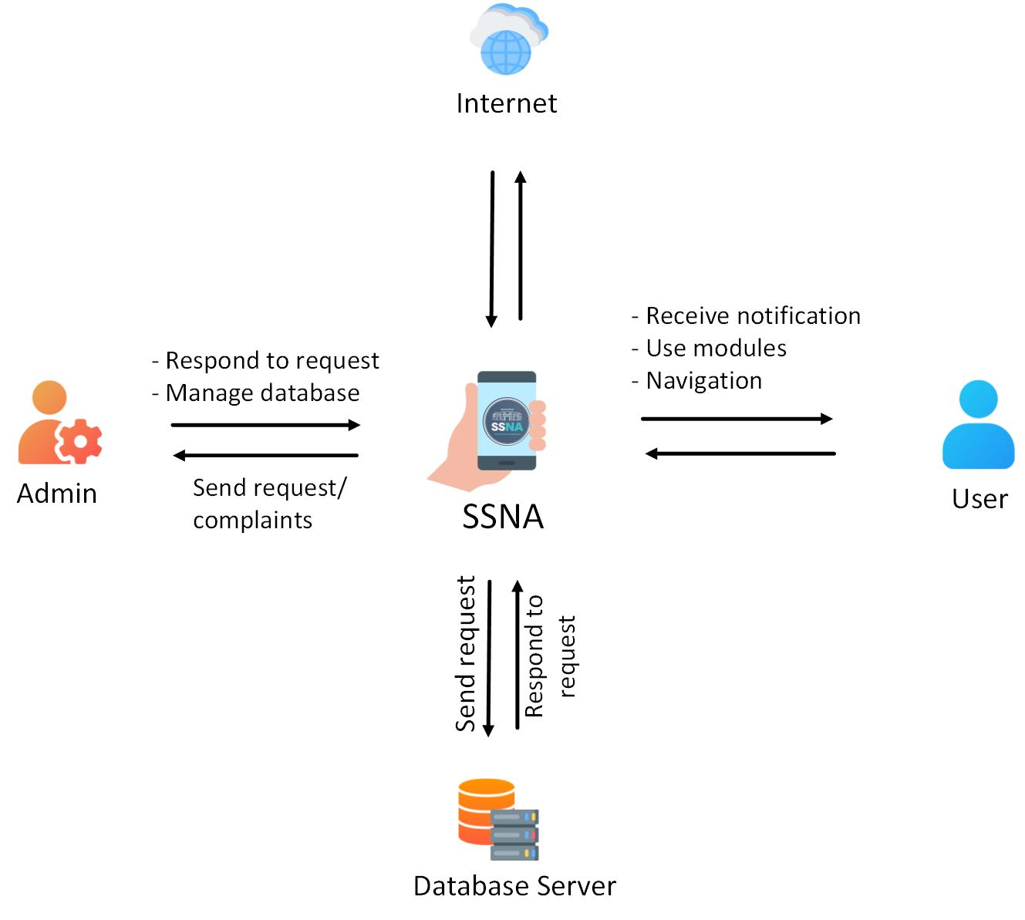
High Level System Diagram

