Slide 1
Embedded electronic engineering A: Real-time systems seminar
Multi-core partitioned scheduling
By Shahzaib Waseem

Slide 2
Agenda
Motivation
Task allocation
Partitioned EDF
Uppaal implementation
Remarks

Slide 3
Motivation
The switch from single-core to multi-core systems
Better task scheduling
Lesser task starvation
Partitioned scheduling implies:
Permanent task assignment
Each core has its own ready-queue and scheduling algorithm

Slide 4
Task allocation: best fit example
200 KB
220 KB free
Task 1
Core 1
Task 2
215 KB
238 KB free
Core 2
Task 3
220 KB
202 KB free
Core 3
Task 4
230 KB
250 KB free
Core 4

Slide 5
Partitioned EDF
Each core runs EDF scheduling algorithm
Earliest deadline first
Preemptive scheduling
Higher priority = earlier deadline task

Slide 6
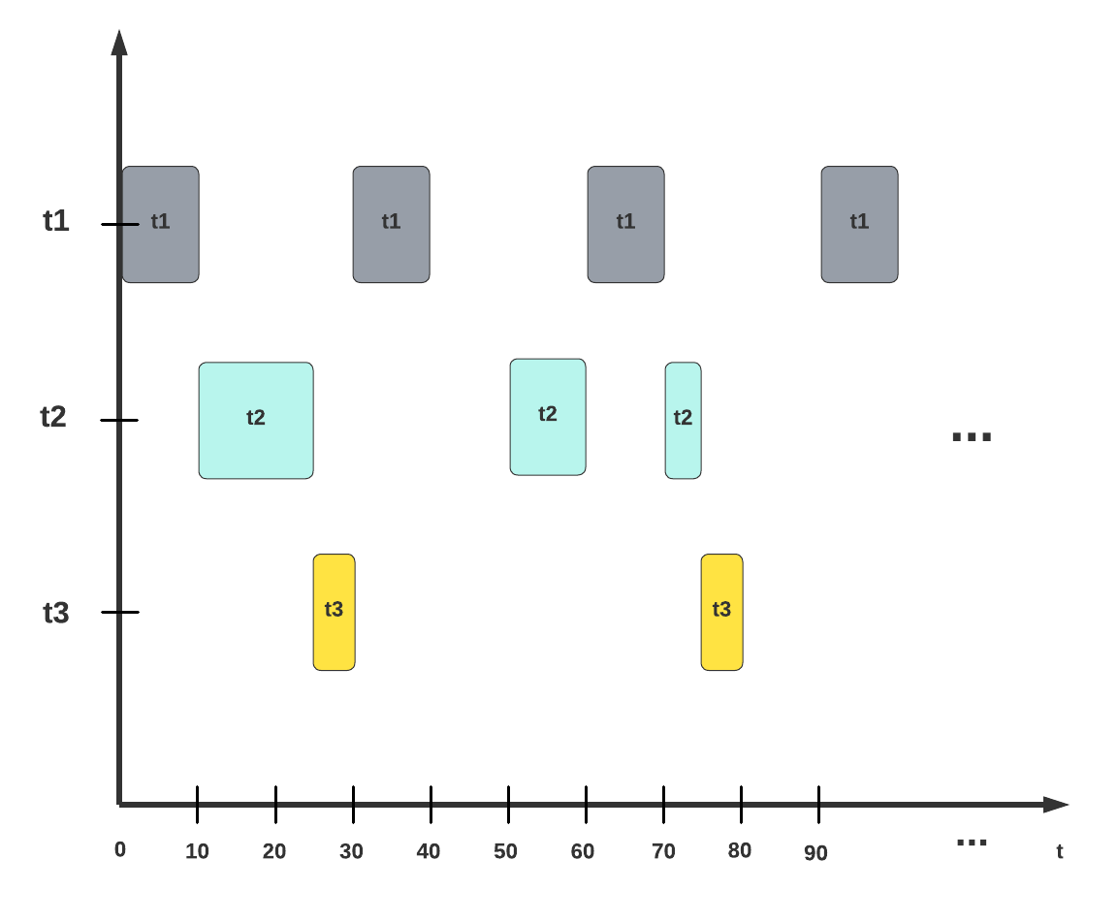
Partitioned EDF

Slide 7
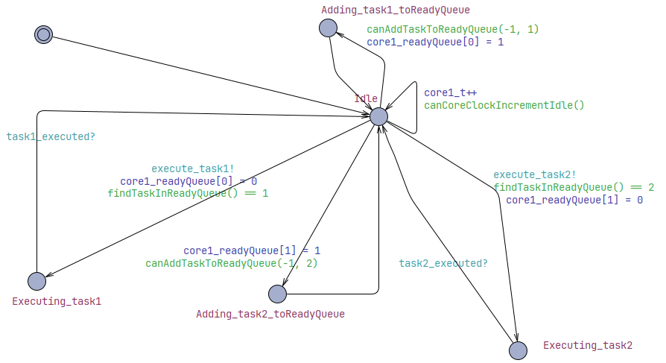
Uppaal implementation: Core

Slide 8
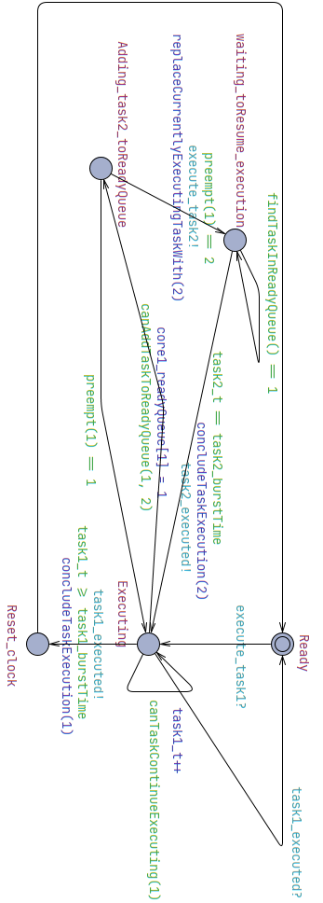
Uppaal implementation: Task 1

Slide 9
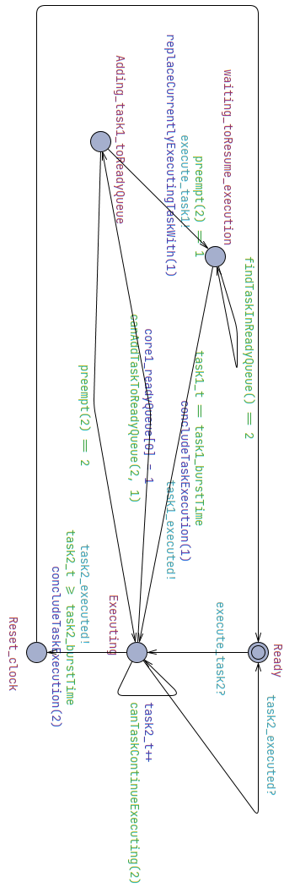
Uppaal implementation: Task 2

Slide 10
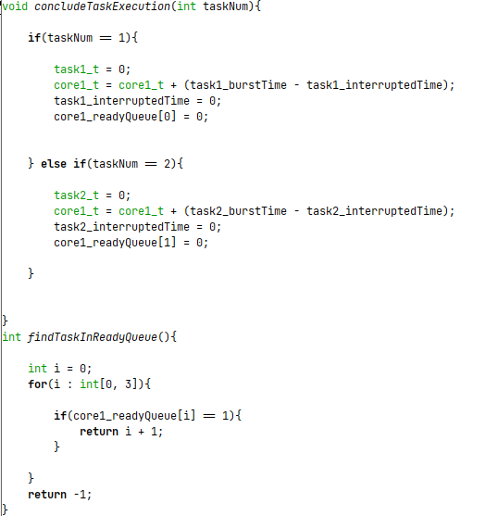
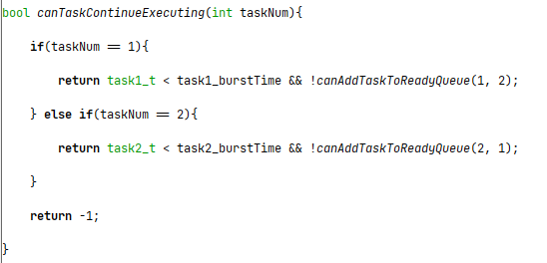
Uppaal implementation: code

Slide 11
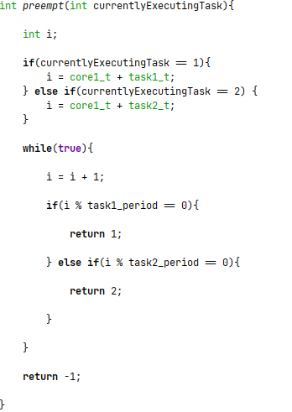
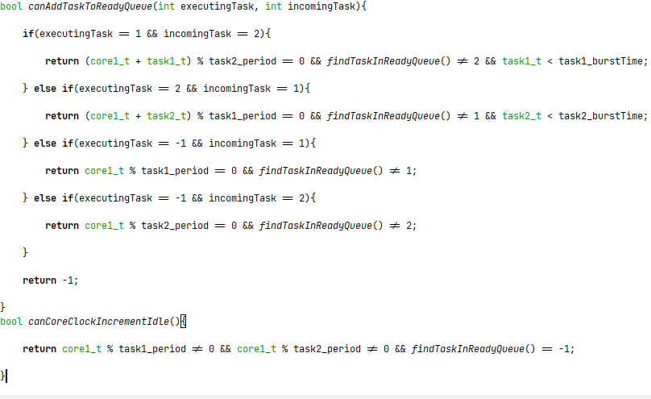
Uppaal implementation: code

Slide 12
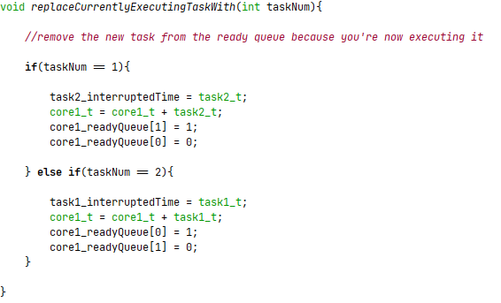
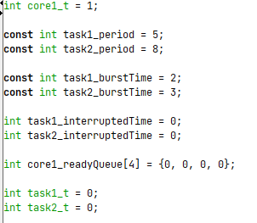
Uppaal implementation: code

Slide 13
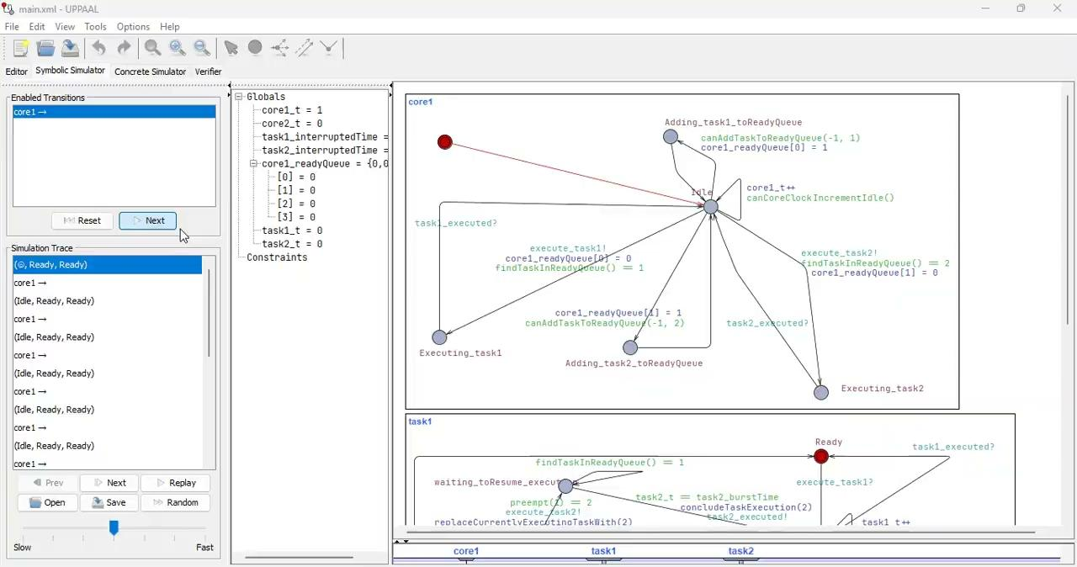
Uppaal implementation: simulation
 | Task 1 | Task 2
Period | 5 | 8
Burst Time | 2 | 3

Slide 14
Remarks
Potential improvements:
Using clocks and invariants
Handling more than 2 tasks

