Slide 1

SoC Now
A tool for making customized SoC using No Code
An open source No Cost tool for creating customized SoC using No Code

Slide 2
Group SE-07 Members
Shazaib (18B-050-SE-A)
Talha Ahmed (18B-024-SE-B)
Syeda Fizza Jaffery (18B-133-SE-B)
Almas Ibrahim (18B-088-SE-B)
Muhammad Shahzaib (18B-016-SE-B)

Slide 3


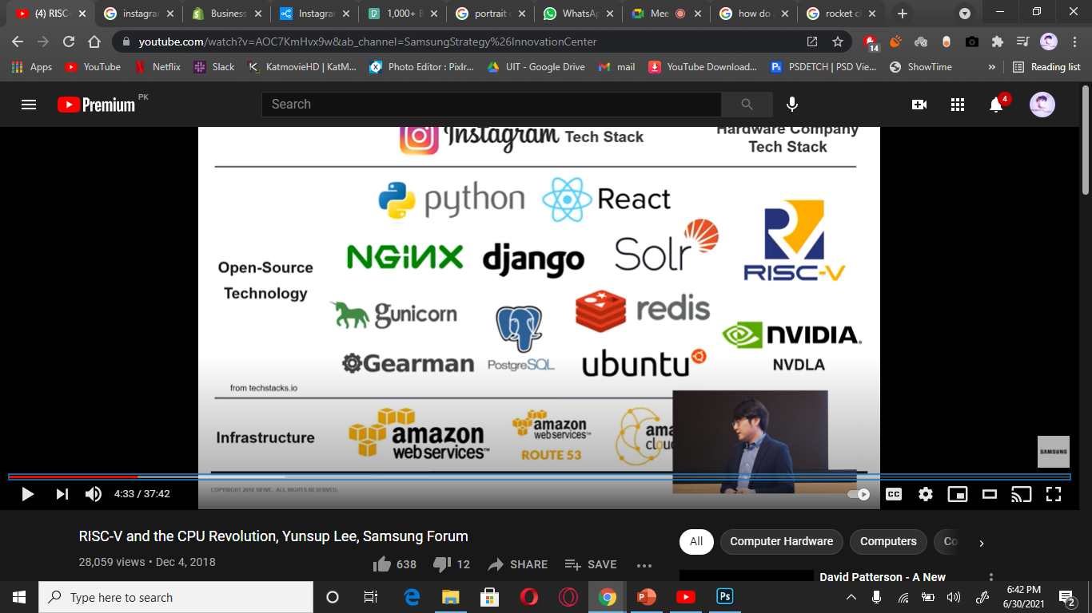
Problem Statement
Designing a System on Chip from scratch takes months for designers to complete.
Sometimes years to design an efficient one.
Testing and verifying the System on Chip is another dimension of stress.
Only Computer and Hardware Engineers used to design by use of Low-Level Hardware Descriptive Languages (HDLs).
How Instagram turn into a $1B acquisition with only 13 employees
Re-use of Code (Frameworks, Libraries, APIs)
Hardware Tech Stack
???

Slide 4

Proposed Solution
Our software will code a System on Chip.
It will provide Re usable components to Open Source.
High Level approaches will be used by using CHISEL (Constructing Hardware in Scala Embedded Language).
Our Software will provide a GUI Interface to configure the specifications of System on Chip.
Based on Configuration, SoC can be generated by No Code approach.

Slide 5
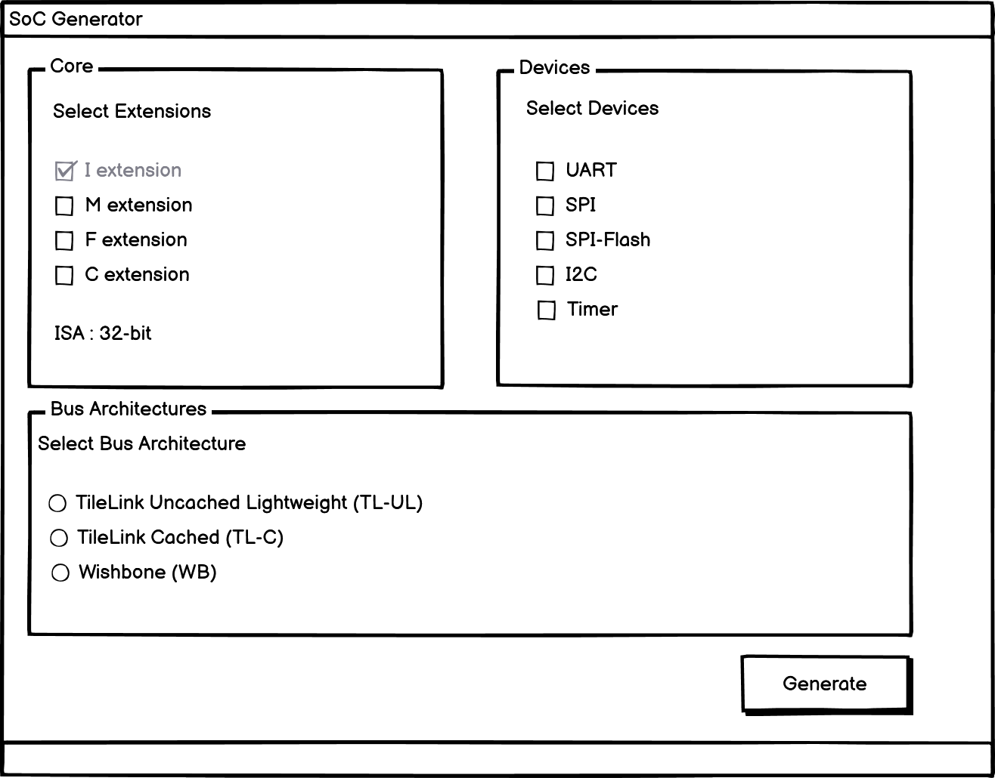
Scope
Our Software will provide the options to configure the SoC.
Core parameters will be of selecting minimum 1 or maximum all 3 extensions.
Devices can be selected, minimum 1 or maximum all 5.
Bus Architecture can be selected only 1.

Slide 6
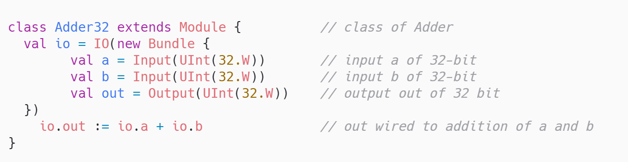
Hardware Design with Software Paradigm
OBJECT ORIENTED APPROACH TO DEVELOP HARDWARE
The Object of this class “Adder32” can be used anywhere to implement an Adder operation between two inputs.
This class provides Re-usability
We can use object of this class to use its functionality anywhere.

Slide 7
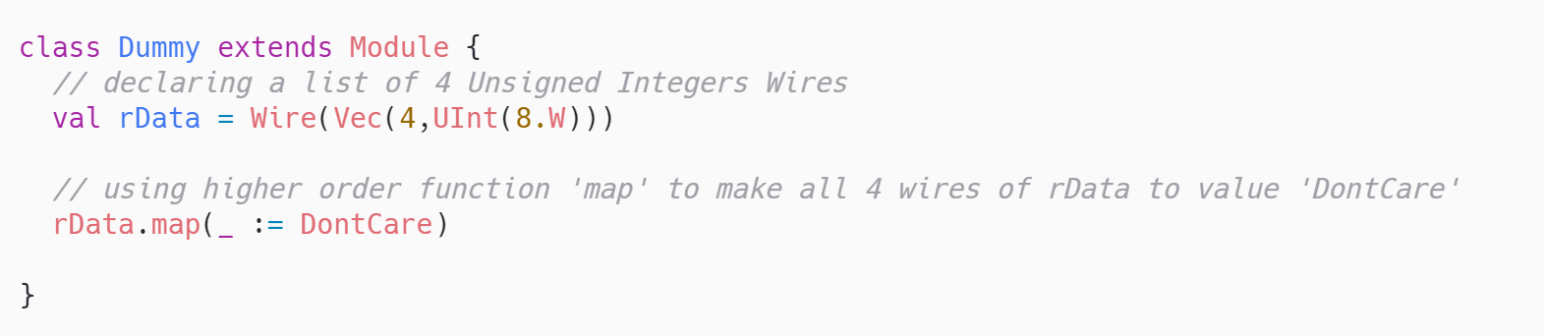
Hardware Design with Software Paradigm
FUNCTIONAL PROGRAMMING APPROACH TO DEVELOP HARDWARE
A list (Vector) having 4 wires (pins), which are further wired to a specific value (DontCare) by use of higher order functions of Functional Programming.

Slide 8
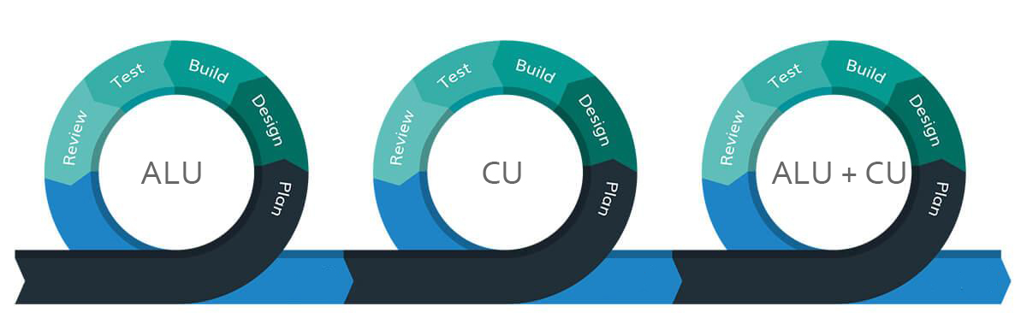
Agile Methodology of CHISEL
In order to develop a core or a complete System on Chip.
The development is done by following the Agile Methodology.
Arithmetic Logic Unit
Control Unit
Arithmetic Logic Unit
+
Control Unit

Slide 9
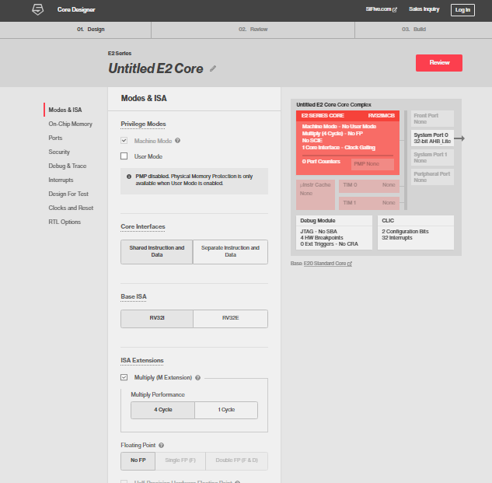
Previous Work
Similar Work is done by SiFive Company (Paid Product). $$$
They have a Parameterized GUI for generating an SoC of your specs.
But this is a paid feature and entirely close sourced.
Another Free Open-Source alternative is Rocket Chip.
But It is not implementable on FPGA.
Ours will be a minimal version of something like this, but open sourced.

Slide 10
Comparison of SiFive, Rocket-Chip and Our Software
Si-Five (Paid Product) | Rocket-Chip (Free Open Source) | Our Software (FREE)
M extension (✔️) | M extension (✔️) | M extension (✔️)
F extension (✔️) | F extension (✔️) | F extension (✔️)
C extension (✔️) | C extension (✔️) | C extension (✔️)
Bus Protocol (✔️) | Bus Protocol (Partially) | Bus Protocol (✔️)
FPGA implemented (✔️) | FPGA Implemented (❌) | FPGA Implemented (✔️)

Slide 11
Parameters to Generate the System on Chip
Core having 32-bit Architecture (RV-32i)
Containing a Multiplier with it. (M extension)
RV-32im
Supporting Compressed Instructions. (C extension)
RV-32ic
RV32imc
Containing either a Floating-Point Unit (F extension)
RV-32if
RV-32icf
RV-32imf
All of them
RV-32imcf

Slide 12
Parameters to Generate the System on Chip
Peripherals to connect with Core:
Universal Asynchronous Receiver Transmitter (UART)
Serial Peripheral Interface (SPI)
SPI-Flash
Inter Integrated Circuit (I2C)
Timer
Bus Architecture with which Core will communicate with Peripherals:
TileLink Uncached Lightweight (TL-UL)
TileLink Cached (TL-C)
Wishbone (WB)

Slide 13
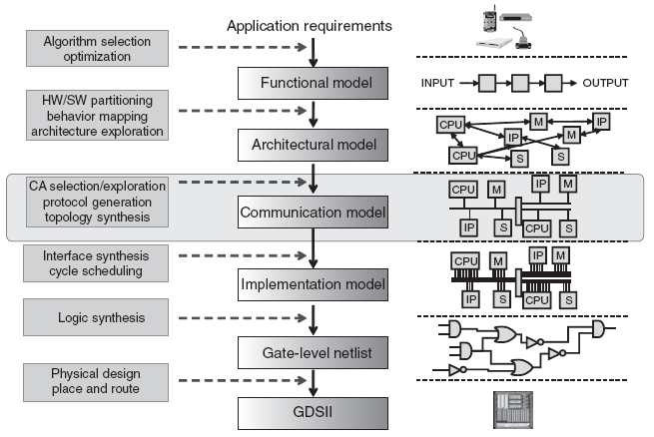
Design Flow
Bit Stream
Santos, Luiz & Rigo, Sandro & Azevedo, Rodolfo & Araujo, Guido. (2011). Electronic System Level Design. 10.1007/978-1-4020-9940-3_1.

Slide 14
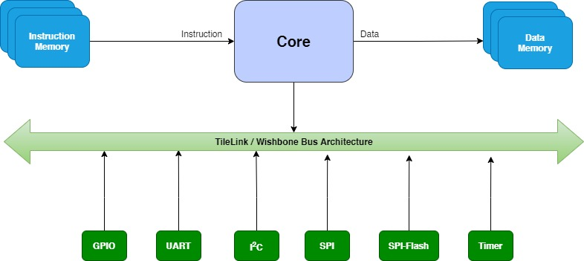
Block Diagram

Slide 15
Suggested Supervisor
Engr. Farhan Ahmed Karim
Senior Lecturer Department of Computer Science UIT
Software Team Lead MERL-PAKISTAN
PhD Scholar FTSM, The National University of Malaysia

Slide 16

THIS PROJECT IS FUNDED BY
Group Members
Shazaib (Research Intern)
Talha Ahmed (Research Intern)
Syeda Fizza Jaffery (Research Intern)
Almas Ibrahim (Research Intern)
Muhammad Shahzaib (Research Intern)
FOR OPEN-SOURCE COMMUNITY

Slide 17
Methodology
The main features of this project include:
Designing a Core for the SoC, having ALU, CU, Instruction and Data Memories, Pipelines.
Designing Peripherals(UART, SPI…), chosen by the User.
Interconnecting the Peripherals with the core with a Bus Architecture.
The output of this project will be source code of the designed/generated hardware of Specification taken as input by the User. The source code will be in HDL i.e. Verilog, CHISEL

