Slide 1
THE PROBLEM IN NUMBERS
$577M
Trafigura nickel fraud, 2023 forged warehouse
receipts on collateral that was never there
~$10B
China fraudulent trade-financing exposed, 2014
forged docs and repeated invoices for one shipment
£29.4M
Stenn supply-chain finance fund losses, 2019
inflated invoices and phantom invoices
65/65
end-to-end tests passing on our working prototype
SilkFlow AI
Explainable AI credit scoring and on-chain escrow settlement for cross-border SME trade finance
2026 Shenzhen International FinTech Competition AI Track (International)
Direction F positioning: agent-driven settlement with real on-chain escrow logic
Team CoreTech Innovation · Nawabshah, Sindh, Pakistan · English submission ·
Sources: Reuters / FT / WSJ / GTR reporting details on later slides
Notes:
[0:00-0:30] Introduce team and one-line hook: real frauds cost billions; small exporters can't get finance; we built a working answer in three weeks.

Slide 2
SILKFLOW AI
The Multi-Billion Trade Finance Trust Gap
Document fraud and duplicated paper have cost the industry billions and the same mechanisms lock small exporters out of finance today.
$577M
TRAFIGURA · 2023
Forged warehouse receipts secured multi-billion lending against nickel that had already been secretly re-sold.
~$10B
CHINA · 2014
Forged documents and one shipment invoiced repeatedly across banks exposed by credit defaults in 2014.
£29.4M
STENN · 2019
Inflated and phantom invoices drained a £115m supply-chain finance fund run by a fraud ring.
Why the same frauds keep working and small exporters keep losing:
• Paper trust invoices, packing lists and bills of lading are verified by eye, so forged or duplicated documents slip through.
• Black-box credit , lenders see a verdict, never the reasons; exporters with clean records are still rejected without explanation.
• Payment-vs-delivery deadlock, neither side dares to move first: advances vanish, goods ship un-paid.
• Editable evidence , logs can be rewritten after the fact, so decisions cannot be proven to a counterparty or regulator.
SilkFlow AI | FinTechathon 2026
Notes:
[0:30-1:15] Three documented cases — all verified public reporting. Stress: same mechanisms (paper trust, opaque credit, payment-vs-delivery, editable logs) still lock SMEs out today.

Slide 3
SILKFLOW AI
Our Solution: SilkFlow AI
Score it. Explain it. Settle it. Prove it one closed loop for cross-border SME trade, running today.
1 SCORE IT , automatically
The document checker cross-validates invoice, packing-list and shipment fields; a passed check triggers credit scoring instantly. XGBoost + Isolation Forest over 16 engineered features flag anomalous trades before money moves.
2 EXPLAIN IT , no black box
SHAP attributes every score to named factors — buyer payment history, on-time rate, country risk, FX volatility. Borderline cases escalate to a human reviewer with the reasons attached; the LLM only ever explains.
3 SETTLE IT , on-chain escrow
Buyer funds lock into a Solidity escrow contract, not to the seller. Release requires verified shipment and delivery events; a dispute freezes the money instead of losing it. Payment and delivery are cryptographically linked.
4 PROVE IT , tamper-evident
Every check, score, decision and release appends a SHA-256 hash-chained audit entry. One click re-verifies the full chain edit any historical record and verification turns red immediately.
One platform, three portals exporter, buyer, reviewer/admin with authorization enforced in the backend, not just hidden in the UI.
SilkFlow AI | FinTechathon 2026 l
Notes:
[1:15-2:00] Four pillars map 1:1 to the four failure modes on the previous slide. Say: this is a closed loop, not a feature list.

Slide 4
SILKFLOW AI
How The System Decides: One Score, Five Signals
16 engineered features feed an explainable ensemble every input is a trade-finance risk factor, not a generic profile.
Document integrity
Invoice, packing list and shipment fields are cross-checked. A failed check stops the order before scoring.
Buyer payment history
How the buyer has actually paid on previous trades in the system weighted as a top SHAP factor.
On-time track record
Delivery and settlement punctuality of both counterparties feeds directly into the score.
Country & FX risk
Jurisdiction risk and currency-volatility features capture macro exposure of the specific trade.
Anomaly guard
Isolation Forest isolates the most unusual 2.5% of trades size, pattern or behaviour outliers.
Score 0–100 → risk band: low = agent may proceed , medium = hold for review , high / anomaly = escalate to a human. Models recommend; policy and people control the money.
Every explanation on screen is a real SHAP attribution from the scored model shown per order, not marketing copy.
SilkFlow AI | FinTechathon 2026
Notes:
[2:00-2:45] Emphasise every feature is a trade-finance risk factor. Say the model recommends but never moves money — policy and humans do.

Slide 5
SILKFLOW AI
Trade Lifecycle: Draft To Settled Every Step Guardrailed
The agent automates the routine hops; hard policy and humans keep the risky ones.
1 Order + documents
2 Automated document check
3 Auto credit score + SHAP
4 Agent: approve / hold / escalate
5 Buyer funds escrow on-chain
6 Shipment + delivery verified
7 Release · refund · split
Dispute at any point
freezes funds in contract
Guardrails on every hop
• The LLM never computes a number and never authorises money movement deterministic Python computes, backend policy enforces.
• Cash-flow forecasts and gap alerts are plain arithmetic over scheduled receipts and payments no AI guessing on financial figures.
• Policy limits force high-risk, anomalous or borderline trades into the human reviewer queue an agent can never self-approve those.
• Each step writes an audit entry the moment it happens, hash-chained with SHA-256 the trail is produced by the flow, not assembled afterwards.
SilkFlow AI | FinTechathon 2026
Notes:
[2:45-3:30] Walk the flow once, quickly. Land the guardrail line: LLM explains, deterministic code computes, policy authorises, chain proves.

Slide 6
SILKFLOW AI
Three Roles, One Integrated Platform
Built around real trade-finance stakeholders exporter, buyer, reviewer/admin each with its own portal.
EXPORTER (SELLER)
• Create a trade and upload docs in seconds
• Document check , instant auto credit score with SHAP reasons
• Deterministic weekly cash-flow forecast
• Cash-gap alerts and what-if scenarios for late payments
• Financing offers matched to the risk band
• SME copilot answers in plain English, fully cited
BUYER
• Sees full trade terms, document status and the credit score before committing money
• Funds go into the escrow smart contract not to the seller
• Release only on verified shipment + delivery events
• A dispute freezes the funds instead of losing them
• Inbox and alerts for every pending action
REVIEWER / ADMIN
• Live feed of every agent decision across the book
• Case queue of escalations human releases, refunds or splits
• One-click audit hash-chain verification and live tamper demo
• Model governance: honest holdout metrics, versions, drift
• Portfolio reports and user RBAC administration
Same backend, role-scoped APIs: a seller never sees another seller's orders; the reviewer console is authorization-enforced, not menu-hidden.
SilkFlow AI | FinTechathon 2026
Notes:
[3:30-4:00] One sentence per role; note backend-enforced authorization (maps to the unauthorized-operations judging item).

Slide 7
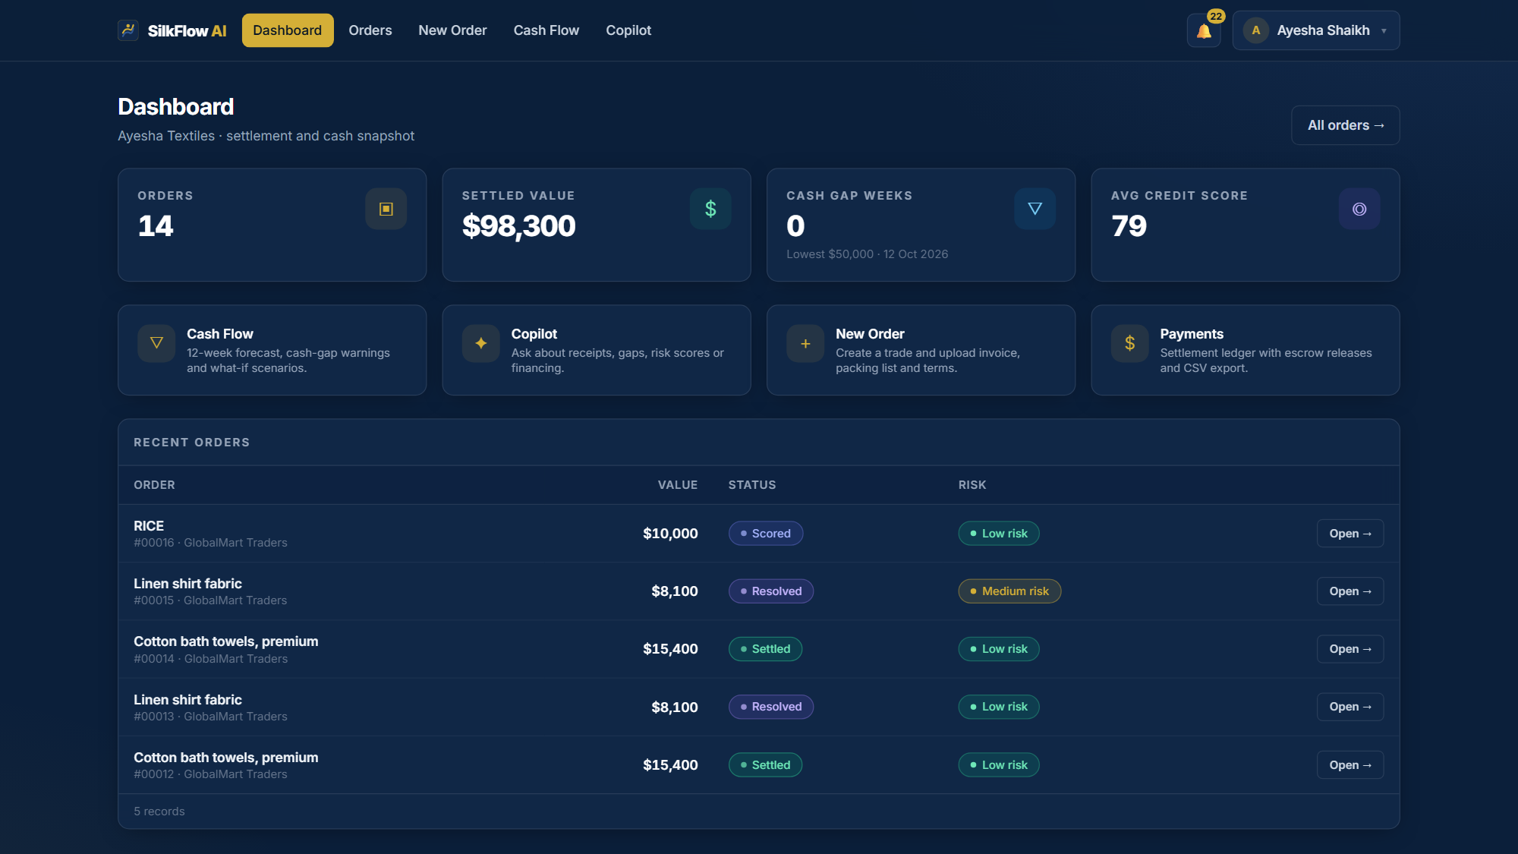
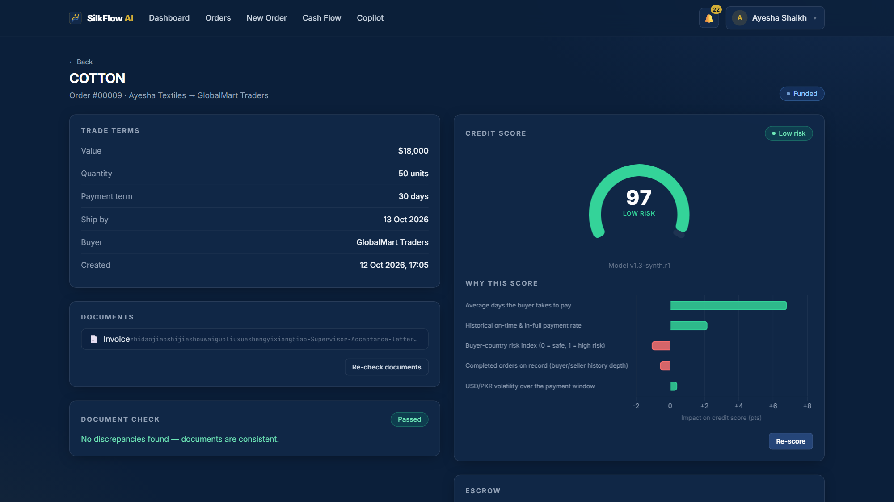
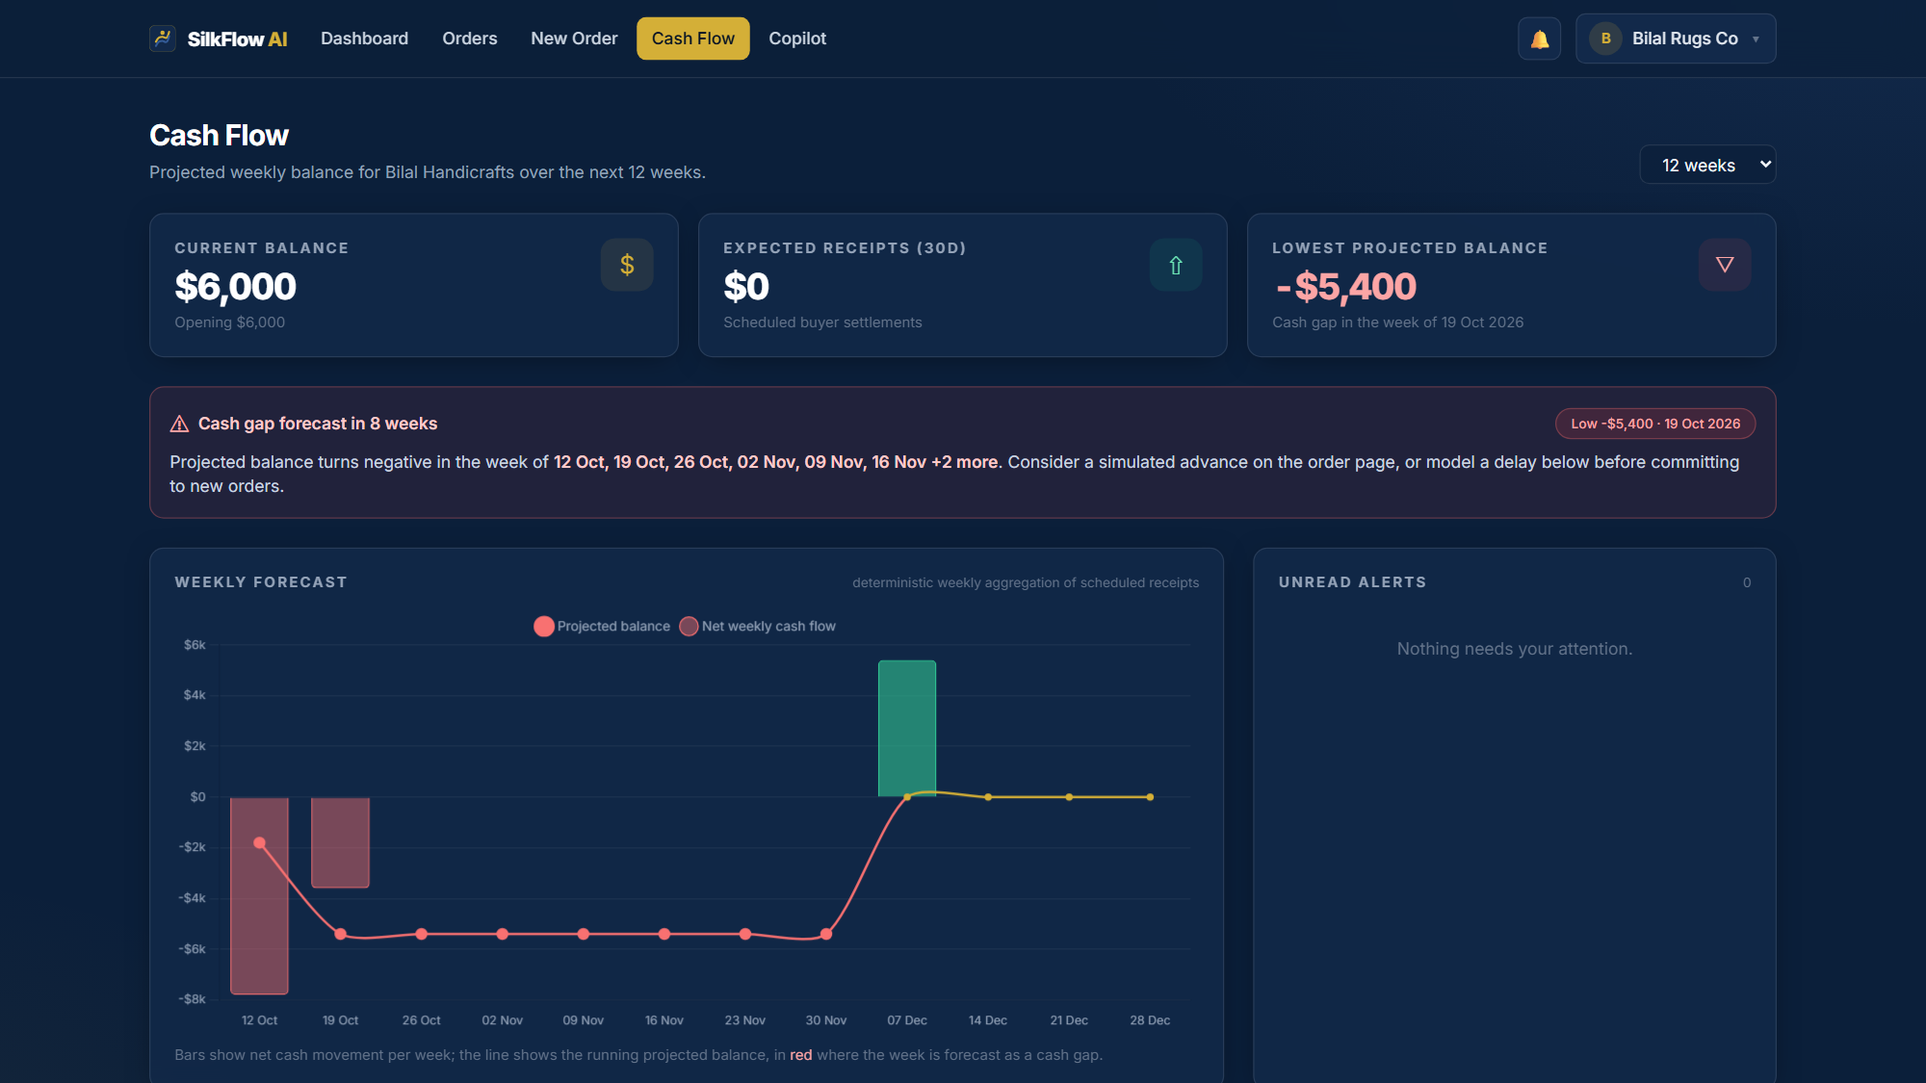
SILKFLOW AI
Product Screens 1/2 , The Exporter Portal
Live screens captured from the running local build no mockups, no design comps.
Exporter dashboard
Live orders, scores, escrow status and alerts at a glance for the seller's home portal.
Auto-scoring with reasons
Order #9 scored 96.7 automatically after the passed check — SHAP shows which factors moved it.
Cash-flow gap detection
Deterministic forecast exposes a −$5,400 gap over 8 flagged weeks; alerts fire and what-if sliders test late payments.
Financing offers shown alongside scores are label-as-simulated bank products matched to the risk band; all demo data is synthetic and labeled inside the app the UI never pretends to be production.
SilkFlow AI | FinTechathon 2026
Notes:
[4:00-4:45] Screenshots from the running build. Point at order 96.7 auto-score and the -5,400 gap; mention labels on synthetic/simulated data.

Slide 8
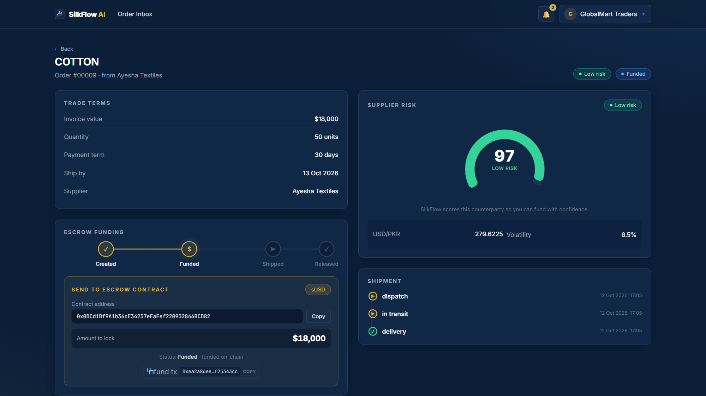
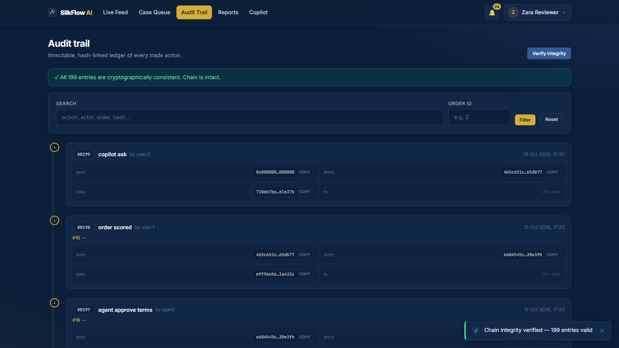
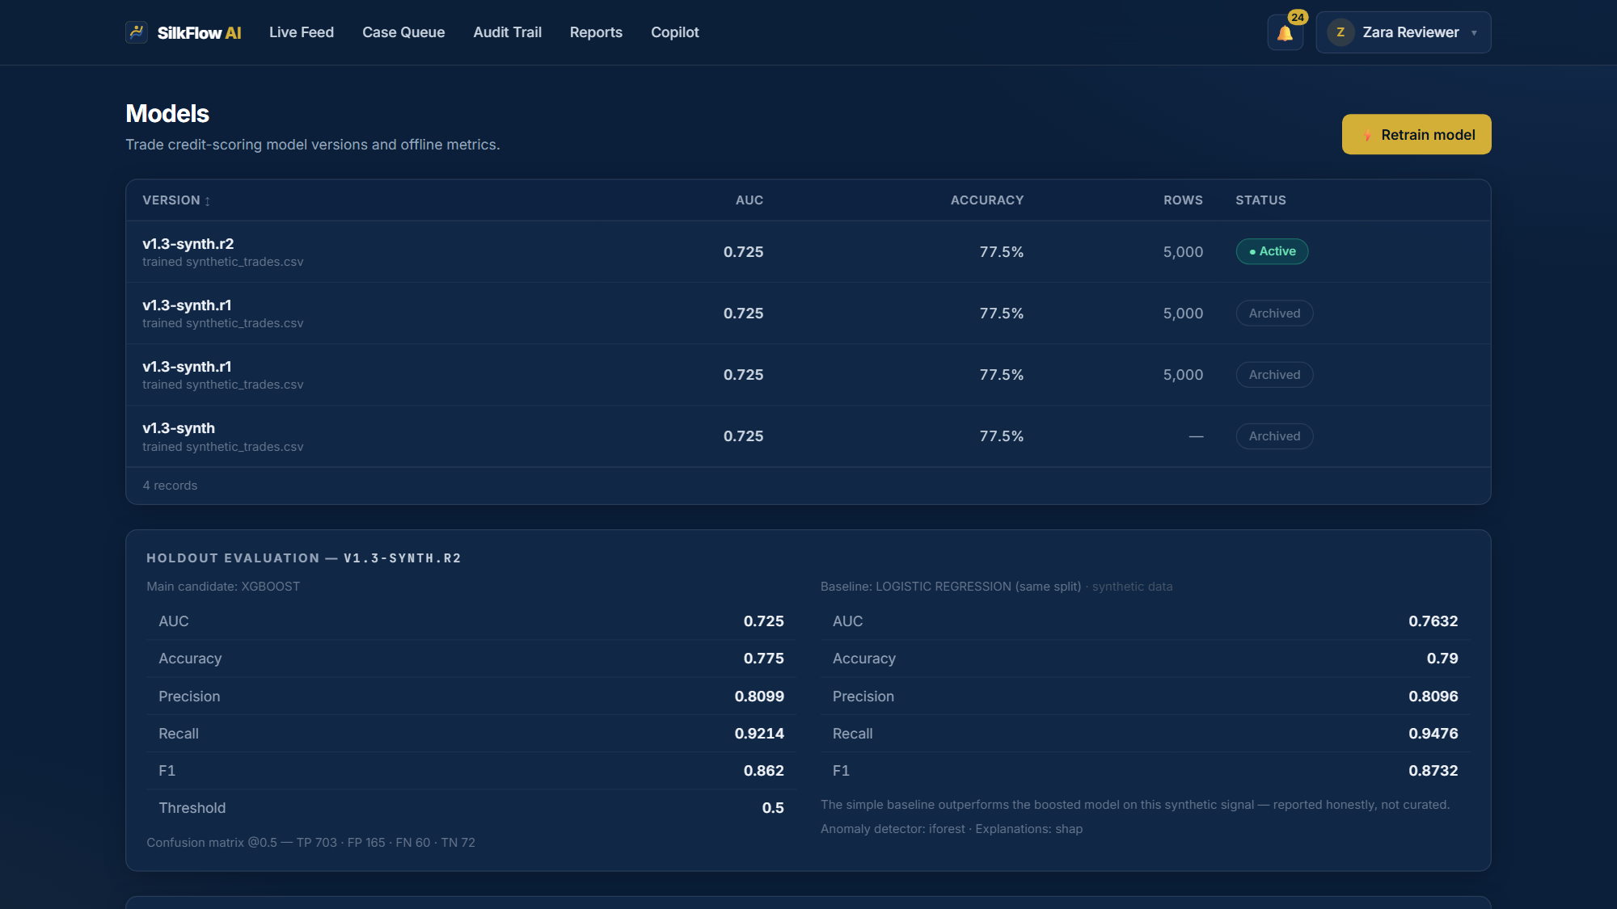
SILKFLOW AI
Product Screens 2/2 , Buyer, Reviewer & Admin
The trust side of the platform: money control, tamper evidence and model governance.
Buyer escrow view
Buyer funds sit in the smart contract; release is linked to verified delivery, disputes freeze the money.
Audit trail verified
199 hash-chained entries pass one-click integrity verification; any edit to history turns the chain red.
Honest model governance
The admin panel publishes the uncomfortable truth: the simple baseline outperforms XGBoost on our holdout.
Judging weights security at 30% our answer is architectural: the LLM explains, deterministic code computes, policy authorises, and the hash chain proves what happened.
SilkFlow AI | FinTechathon 2026
Notes:
[4:45-5:15] Trust side: escrow view, 199-entry verified chain, and the honest metrics panel where the baseline beats our XGBoost — we ship that truth in the UI.

Slide 9
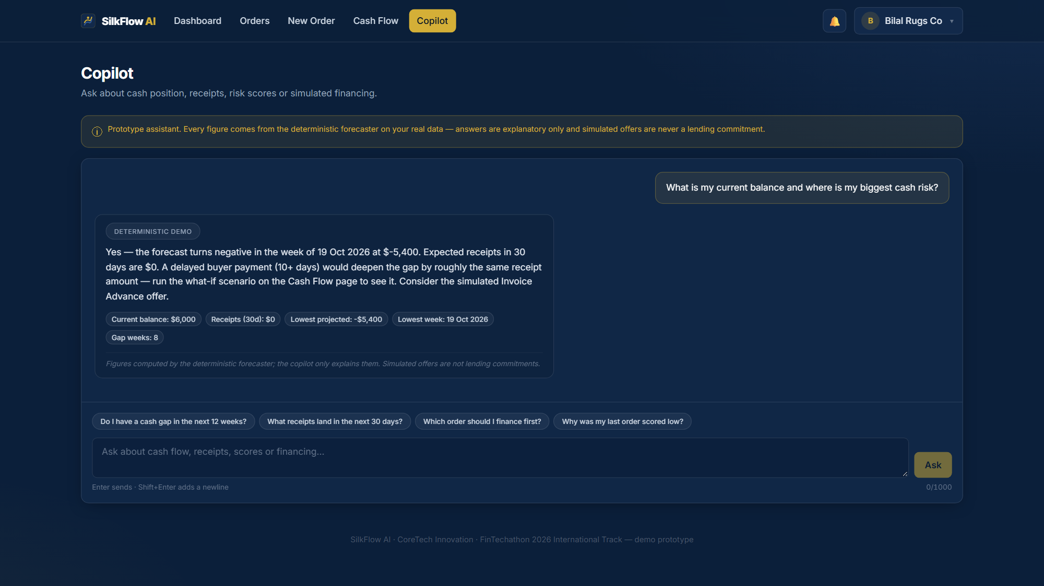
SILKFLOW AI
The SME Copilot And The Fences Around It
Conversational access to your own business data with math and money taken out of the LLM's hands entirely.
1 The LLM never computes a number
Every figure comes from the deterministic engine and is cited in the answer. Hallucinated numbers are structurally impossible.
2 The LLM never authorises money
Escrow actions require an authenticated role plus backend policy checks; prose can never trigger a transfer.
3 Grounded or silent
Answers are grounded in the caller's own scoped data; if the data does not exist, the copilot says so.
4 Honest labelling
Demo mode shows a visible badge; synthetic data and simulated offers are labeled in the interface.
Right: live copilot answering a seller's cash-gap question — cited figures and the demo-mode badge are visible in the capture.
SilkFlow AI | FinTechathon 2026 l
Notes:
[5:15-5:45] Judges' injection/inducement concern answered structurally: no numeric or money authority in the LLM path at all.

Slide 10
SILKFLOW AI
On-Chain Escrow The Agent-Settlement Story
An AI agent moving money through a smart contract with hard policy limits and total honesty about scope.
Contract mechanics
• Buyer's stablecoin deposit is locked in SilkEscrow never sent to the seller
• Release requires the verified policy: shipment event AND delivery event
• A dispute freezes funds; a human decision then releases, refunds or splits
• High risk band blocks auto-release regardless of model confidence
• Every state transition is written to the append-only hash-chained audit
Real deployed artifacts
SilkEscrow 0x0DCd1Bf9A1b36cE34237eEaFef220932846BCD82
MockStable 0xA51c1fc2f0D1a1b8494Ed1FE312d7C3a78Ed91C0
Compiled and deployed on a local Hardhat chain; the backend talks JSON-RPC through a lightweight client.
38/38 contract tests · 65/65 end-to-end tests executed against the live chain with escrow flows included.
Scope honesty (a design principle, not a disclaimer)
Everything runs on a dev chain with unlocked standard Hardhat accounts no private keys, no real funds, no mainnet claims. Deploying the identical contracts to a public testnet with verifiable transaction hashes is the first roadmap item after the hackathon.
SilkFlow AI | FinTechathon 2026
Notes:
[5:45-6:30] Direction-F story: agent + wallet + policy. Be explicit: local Hardhat chain today, public-testnet hashes is roadmap item 1. Honesty is the differentiator.

Slide 11
SILKFLOW AI
Security By Architecture Not By Prompt
Each attack class the rubric scores is closed in code, not by hoping the model behaves.
Unauthorized operations
Every endpoint enforces role and order-ownership in the backend; cross-role access fails with 403 — hiding menus is never the control.
Prompt injection
User text is treated as data: it cannot trigger tools, queries or money movement, and the copilot has no write capability at all.
Induced transfers / hallucination
The LLM physically cannot authorise or compute a payment: deterministic Python computes, backend policy authorises, humans escalate.
Information theft
Data access is scope-filtered per role and per business; no secrets in logs; dev accounts only — zero real keys exist to steal.
Abuse controls
Rate limiting on auth and copilot, idempotency keys on payment-side calls, validation and pagination on every listing.
Tamper evidence
SHA-256 hash-chained audit: any after-the-fact DB edit breaks verification instantly — even for a DBA with full access.
All of the above is exercised by the automated test suite results on the next slide.
SilkFlow AI | FinTechathon 2026
Notes:
[6:30-7:00] Map each card to a scored security threat class; all exercised by automated tests.

Slide 12
SILKFLOW AI
Verification Evidence Measured, Not Claimed
Every number here comes from automated runs reproducible from the submitted source.
65/65
end-to-end API tests green against the running stack and live chain
38/38
Hardhat contract tests: fund, release, dispute, refund, split
199
hash-chained audit entries verified consistent in one click
1,000
held-out synthetic trades scoring both models on identical data
Honest metrics as policy the part most teams hide
On the same holdout, the logistic baseline scores AUC 0.763 and the XGBoost model 0.725 and the product UI itself publishes the baseline's win. Training data is 5,000 labeled synthetic trades, the bank offers are simulated, and logistics events are mocked: each labeled in the interface.
A system that must be trusted with money should never need curated numbers to look good.
SilkFlow AI | FinTechathon 2026
Notes:
[7:00-7:30] Offer the reproduction path from the source submission. Pause on the honest-metrics box — this is where we differentiate.

Slide 13
SILKFLOW AI
Why SilkFlow Wins Against Legacy Practice
Not AI for its own sake each line removes a failure mode that produced the real-world frauds.
Legacy trade-finance practice | SilkFlow AI
Paper documents verified by eye forged or duplicated receipts pass | Every document field cross-checked, then an anomaly model screens the trade
Opaque relationship-based credit verdicts | Explainable score SHAP shows each factor's exact impact
Advance payment or open credit one side carries all risk | Escrow contract: money moves only when delivery is verified
Weeks of manual back-and-forth per deal | Minutes: check → score → offer → fund demonstrated live
Editable spreadsheets and logs as evidence | SHA-256 hash-chained audit, re-verified with one click
Demo metrics cherry-picked to flatter the model | Honest holdout comparison published inside the product UI
SilkFlow AI | FinTechathon 2026
Notes:
[7:30-8:00] Read three rows max (paper, escrow, evidence); let the table speak.

Slide 14
SILKFLOW AI
Would SilkFlow Have Caught These Frauds?
Each real fraud mechanism mapped to a specific control that exists in our build and is covered by tests.
Trafigura forged receipts
Fake warehouse receipts pledged the same goods to multiple lenders ($577M).
Controls that bite: field-level document cross-check blocks inconsistent papers before scoring; funding only enters escrow after verification; disputes freeze rather than drain.
China 2014 , duplicate paper
One shipment invoiced repeatedly across banks; ~$10B of fraudulent financing exposed.
Controls that bite: every escrow funding binds to a single verified order record; Isolation Forest flags trades far outside a counterparty's normal size and pattern; duplicates route to the human queue.
Stenn , inflated invoices
Inflated and phantom invoices drained a £115m supply-chain fund (£29.4M lost).
Controls that bite: score keyed to the buyer's real payment history; oversized trades fail the anomaly screen; release still requires a verified delivery event.
The bar is not perfect fraud prevention it is verifiable documents, money linked to delivery, and evidence no one can rewrite afterwards.
SilkFlow AI | FinTechathon 2026
Notes:
[8:00-8:30] Quick 1-2-3 mapping; repeat the honest bar: verification, linkage, immutable evidence — not magic.

Slide 15
SILKFLOW AI
Roadmap , From Hackathon Build To Pilot
Honest sequencing: what is real today, and what replaces the synthetic parts next.
PHASE 1 · TODAY
Three live portals · auto document check · scoring with SHAP reasons · escrow on local Hardhat chain · 65/65 E2E and 38/38 contract tests green · narrated 4:56 demo.
PHASE 2 · 1–3 MONTHS
Public testnet: same SilkEscrow contracts deployed with faucet-funded test stablecoin, producing verifiable transaction hashes the missing piece for full on-chain judging.
PHASE 3 · 3–9 MONTHS
Real data: replace synthetic features with live FX rates and real logistics tracking; retrain scoring on genuine repayment outcomes instead of simulated history.
PHASE 4 · 9–18 MONTHS
Pilot: bank or trade-finance insurer integration, multi-currency escrow, KYC/AML data sources, and model governance for periodic retraining and drift checks.
SilkFlow AI | FinTechathon 2026 — AI Track International
Notes:
[8:30-9:00] Phase 2 (public testnet) is the ask-critical step; say we want judges' guidance to get there correctly.

Slide 16
SILKFLOW AI
Team & What We Ask For
Five people, one working prototype and three things we hope to gain from the finals.
SilkFlow AI every number measured, every decision explained, every action provable.
Shahzaib Shaikh
Team Lead(AI & Backend)
Sufyan Arain
ML / Data
Aleeza Memon
API / Doc & Pitch
Urooj Fatima
Front-end / UX
What we are asking the judges and mentors for
1. Trade-finance mentorship validate our escrow policy limits and document checks against real bank practice.
2. Compliance guidance map the audit chain and RBAC to the regulatory requirements an on-chain agent must meet.
3. Pilot pathway a small real exporter cohort to retrain the credit model on genuine repayment data.
Submission package: technical documentation · defense deck (≤10 min) · 4:56 narrated demo video · source code · security self-assessment · test evidence.
SilkFlow AI | FinTechathon 2026
Notes:
[9:00-9:30] Close on the tagline, make the three asks explicit, thank the panel. Leave team roster for Q&A.

