Slide 1
Fundamentals of the Analysis of Algorithm Efficiency

Slide 2
Analysis of Algorithms
Analysis of algorithms means to investigate an algorithm’s efficiency with respect to resources: running time and memory space.
  Time efficiency: how fast an algorithm runs.
  Space efficiency: the space an algorithm requires.

Slide 3
Analysis Framework
Measuring an input’s size
Measuring running time
Orders of growth (of the algorithm’s efficiency function)
Worst-base, best-case and average efficiency

Slide 4
Measuring Input Sizes
Efficiency is define as a function of input size.
Input size depends on the problem.
  Example 1, what is the input size of the problem of sorting n numbers?
  Example 2, what is the input size of adding two n by n matrices?

Slide 5
Units for Measuring Running Time
Measure the running time using standard unit of time measurements, such as seconds, minutes?
  Depends on the speed of the computer.
count the number of times each of an algorithm’s operations is executed.
  Difficult and unnecessary
count the number of times an algorithm’s basic operation is executed.
  Basic operation: the most important operation of the algorithm, the operation contributing the most to the total running time.
  For example, the basic operation is usually the most time-consuming operation in the algorithm’s innermost loop.

Slide 6
Input Size and Basic Operation Examples
Problem | Input size measure | Basic operation
Search for a key in a list of n items | Number of items in list, n | Key comparison
Add two n by n matrices | Dimensions of matrices, n | addition
Polynomial Evaluation | Order of the polynomial | multiplication

Slide 7
Theoretical Analysis of Time Efficiency
Time efficiency is analyzed by determining the number of repetitions of the basic operation as a function of input size.
Assuming C(n) = (1/2)n(n-1),
how much longer will the algorithm run if we double the input size?
input size
The efficiency analysis framework ignores the multiplicative constants of C(n) and focuses on the orders of growth of the C(n).
T(n) ≈ c_{op}C (n)
running time
execution time
for the basic operation
Number of times the basic operation is executed

Slide 8
Why do we care about the order of growth of an algorithm’s efficiency function, i.e., the total number of basic operations?
Examples
  GCD( 60, 24):
  Euclid’s algorithm?
  Consecutive Integer Counting?
  GCD( 31415, 14142):
  Euclid’s algorithm?
  Consecutive Integer Counting?
We care about how fast the efficiency function grows as n gets greater.

Slide 9
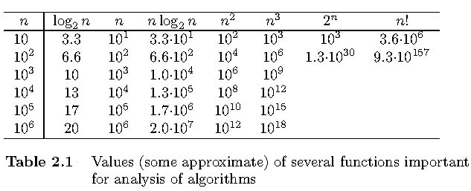
Orders of Growth
Exponential-growth functions
Orders of growth:
consider only the leading term of a formula
ignore the constant coefficient.

Slide 10
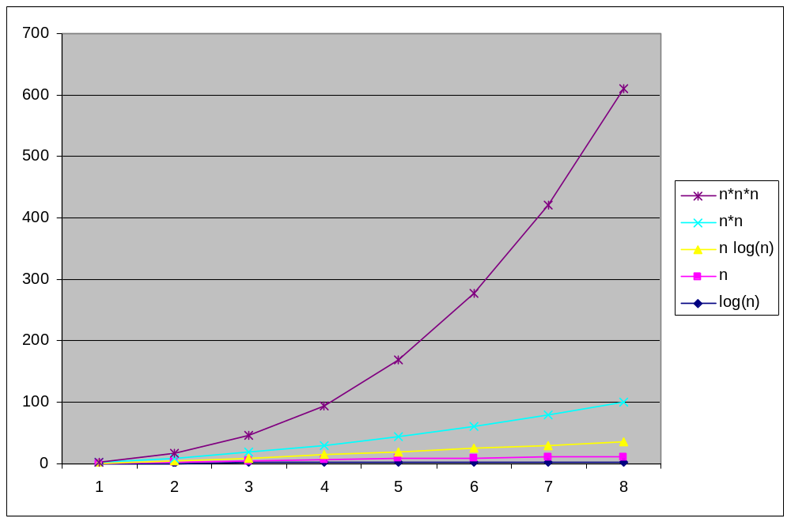

Slide 11
Worst-Case, Best-Case, and Average-Case Efficiency
Algorithm efficiency depends on the input size n
For some algorithms efficiency depends on type of input.
  Example: Sequential Search
    Problem: Given a list of n elements and a search key K, find an element equal to K, if any.
    Algorithm: Scan the list and compare its successive elements with K until either a matching element is found (successful search) of the list is exhausted (unsuccessful search)
Given a sequential search problem of an input size of n,
what kind of input would make the running time the longest?
How many key comparisons?

Slide 12
Sequential Search Algorithm
ALGORITHM SequentialSearch(A[0..n-1], K)
//Searches for a given value in a given array by sequential search
//Input: An array A[0..n-1] and a search key K
//Output: Returns the index of the first element of A that matches K or –1 if there are no matching elements
i ←0
while i < n and A[i] ‡ K do
i ← i + 1
if i < n //A[I] = K
return i
else
return -1

Slide 13
Worst-Case, Best-Case, and Average-Case Efficiency
Worst case Efficiency
  Efficiency (# of times the basic operation will be executed) for the worst case input of size n.
  The algorithm runs the longest among all possible inputs of size n.
Best case
  Efficiency (# of times the basic operation will be executed) for the best case input of size n.
  The algorithm runs the fastest among all possible inputs of size n.
Average case:
  Efficiency (#of times the basic operation will be executed) for a typical/random input of size n.
  NOT the average of worst and best case
  How to find the average case efficiency?

Slide 14
Summary of the Analysis Framework
Both time and space efficiencies are measured as functions of input size.
Time efficiency is measured by counting the number of basic operations executed in the algorithm. The space efficiency is measured by the number of extra memory units consumed.
The framework’s primary interest lies in the order of growth of the algorithm’s running time (space) as its input size goes infinity.
The efficiencies of some algorithms may differ significantly for inputs of the same size. For these algorithms, we need to distinguish between the worst-case, best-case and average case efficiencies.

Slide 15
Asymptotic Growth Rate
Three notations used to compare orders of growth of an algorithm’s basic operation count
  O(g(n)): class of functions f(n) that grow no faster than g(n)
  Ω(g(n)): class of functions f(n) that grow at least as fast as g(n)
  Θ (g(n)): class of functions f(n) that grow at same rate as g(n)

Slide 16
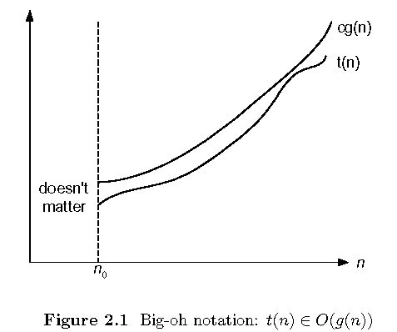
O-notation
back

Slide 17
O-notation
Formal definition
  A function t(n) is said to be in O(g(n)), denoted t(n) ∈O(g(n)), if t(n) is bounded above by some constant multiple of g(n) for all large n, i.e., if there exist some positive constant c and some nonnegative integer n₀ such that
  t(n) ≤ cg(n) for all n ≥ n₀
Exercises: prove the following using the above definition
  10n² ∈ O(n²)
  10n² + 2n ∈ O(n²)
  100n + 5 ∈ O(n²)
  5n+20 ∈ O(n)

Slide 18
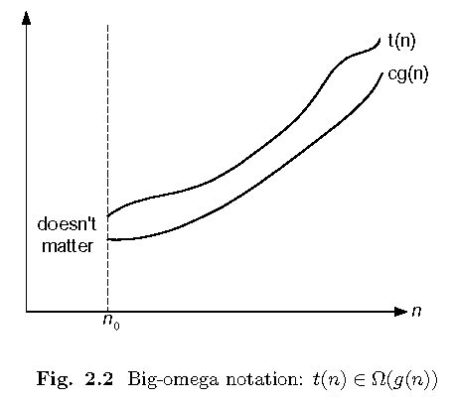
Ω-notation
back

Slide 19
Ω-notation
Formal definition
  A function t(n) is said to be in Ω(g(n)), denoted t(n) ∈ Ω(g(n)), if t(n) is bounded below by some constant multiple of g(n) for all large n, i.e., if there exist some positive constant c and some nonnegative integer n₀ such that
  t(n) ≥ cg(n) for all n ≥ n₀
Exercises: prove the following using the above definition
  10n² ∈ Ω(n²)
  10n² + 2n ∈ Ω(n²)
  10n³ ∈ Ω(n²)

Slide 20
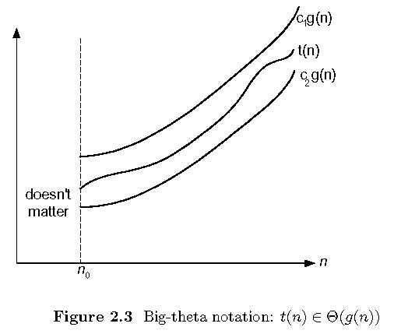
Θ-notation
back

Slide 21
Θ-notation
Formal definition
  A function t(n) is said to be in Θ(g(n)), denoted t(n) ∈ Θ(g(n)), if t(n) is bounded both above and below by some positive constant multiples of g(n) for all large n, i.e., if there exist some positive constant c₁ and c₂ and some nonnegative integer n₀ such that
  c₂ g(n) ≤ t(n) ≤ c₁ g(n) for all n ≥ n₀
Exercises: prove the following using the above definition
  10n² ∈ Θ(n²)
  10n² + 2n ∈ Θ(n²)
  (1/2)n(n-1) ∈ Θ(n²)

Slide 22
>=
Ω(g(n)), functions that grow at least as fast as g(n)
=
Θ(g(n)), functions that grow at the same rate as g(n)
g(n)
<=
O(g(n)), functions that grow no faster than g(n)

Slide 23
Theorem
If t₁(n) ∈ O(g₁(n)) and t₂(n) ∈ O(g₂(n)), then
t₁(n) + t₂(n) ∈ O(max{g₁(n), g₂(n)}).
  The analogous assertions are true for the Ω-notation and Θ-notation.
Implication: The algorithm’s overall efficiency will be determined by the part with a larger order of growth, I.e., its least efficient part.
  For example,
    5n² + 3nlogn ∈ O(n²)

Slide 24
Using Limits for Comparing Orders of Growth
0 order of growth of T(n) < order of growth of g(n)
lim_{n→∞} T(n)/g(n) =
c>0 order of growth of T(n) = order of growth of g(n)
∞ order of growth of T(n) > order of growth of g(n)
Examples:
10n vs. 2n²
n(n+1)/2 vs. n²
log_{b} n vs. log_{c} n

Slide 25
L’Hôpital’s rule
If
lim_{n→∞} f(n) = lim_{n→∞} g(n) = ∞
The derivatives f ´, g ´ exist,
Then
f(n)
g(n)
f ´(n)
g ´(n)
lim
n→∞
=
lim
n→∞
Example: log₂n vs. n

Slide 26
Summary of How to Establish Orders of Growth of an Algorithm’s Basic Operation Count
Method 1: Using limits.
  L’Hôpital’s rule
Method 2: Using the theorem.
Method 3: Using the definitions of O-, Ω-, and Θ-notation.

Slide 27
Basic Efficiency classes
The time efficiencies of a large number of algorithms fall into only a few classes.
fast
1 | constant
log n | logarithmic
n | linear
n log n | n log n
n² | quadratic
n³ | cubic
2^{n} | exponential
n! | factorial
High time efficiency
slow
low time efficiency

Slide 28
Homework 1

Slide 29
Time Efficiency of Nonrecursive Algorithms
Example: Finding the largest element in a given array
Algorithm MaxElement (A[0..n-1])
//Determines the value of the largest element in a given array
//Input: An array A[0..n-1] of real numbers
//Output: The value of the largest element in A
maxval ← A[0]
for i ← 1 to n-1 do
if A[i] > maxval
maxval ← A[i]
return maxval

Slide 30
Time Efficiency of Nonrecursive Algorithms
Steps in mathematical analysis of nonrecursive algorithms:
Decide on parameter n indicating input size
Identify algorithm’s basic operation
Check whether the number of times the basic operation is executed depends only on the input size n. If it also depends on the type of input, investigate worst, average, and best case efficiency separately.
Set up summation for C(n) reflecting the number of times the algorithm’s basic operation is executed.
Simplify summation using standard formulas (see Appendix A)

Slide 31
Example: Element uniqueness problem
Algorithm UniqueElements (A[0..n-1])
//Checks whether all the elements in a given array are distinct
//Input: An array A[0..n-1]
//Output: Returns true if all the elements in A are distinct and false otherwise
for i ← 0 to n - 2 do
for j ← i + 1 to n – 1 do
if A[i] = A[j] return false
return true

Slide 32
Example: Matrix multiplication
Algorithm MatrixMultiplication(A[0..n-1, 0..n-1], B[0..n-1, 0..n-1] )
//Multiplies two square matrices of order n by the definition-based algorithm
//Input: two n-by-n matrices A and B
//Output: Matrix C = AB
for i ← 0 to n - 1 do
for j ← 0 to n – 1 do
C[i, j] ← 0.0
for k ← 0 to n – 1 do
C[i, j] ← C[i, j] + A[i, k] * B[k, j]
return C
M(n) ∈ Θ (n³)

Slide 33
Example: Find the number of binary digits in the binary representation of a positive decimal integer
Algorithm Binary(n)
//Input: A positive decimal integer n (stored in binary form in the computer)
//Output: The number of binary digits in n’s binary representation
count ← 0
while n >= 1 do //or while n > 0 do
count ← count + 1
n ← ⎣n/2⎦
return count
C(n) ∈ Θ (⎣ log₂n ⎦ +1)

Slide 34
Example: Find the number of binary digits in the binary representation of a positive decimal integer
Algorithm Binary(n)
//Input: A positive decimal integer n (stored in binary form in the computer)
//Output: The number of binary digits in n’s binary representation
count ← 1
while n > 1 do
count ← count + 1
n ← ⎣n/2⎦
return count

Slide 35
Mathematical Analysis of Recursive Algorithms
Recursive evaluation of n!
Recursive solution to the Towers of Hanoi puzzle
Recursive solution to the number of binary digits problem

Slide 36
Example Recursive evaluation of n ! (1)
Iterative Definition
Recursive definition
  Algorithm F(n)
  F(n) = 1 if n = 0
  n * (n-1) * (n-2)… 3 * 2 * 1 if n > 0
  F(n) = 1 if n = 0
  n * F(n-1) if n > 0
  if n=0
  return 1 //base case
    else
    return F (n -1) * n //general case

Slide 37
Example Recursive evaluation of n ! (2)
Two Recurrences
  The one for the factorial function value: F(n)
  The one for number of multiplications to compute n!, M(n)
  F(n) = F(n – 1) * n for every n > 0
  F(0) = 1
  M(n) = M(n – 1) + 1 for every n > 0
  M(0) = 0
M(n) ∈ Θ (n)

Slide 38
Steps in Mathematical Analysis of Recursive Algorithms
Decide on parameter n indicating input size
Identify algorithm’s basic operation
Determine worst, average, and best case for input of size n
Set up a recurrence relation and initial condition(s) for C(n)-the number of times the basic operation will be executed for an input of size n (alternatively count recursive calls).
Solve the recurrence or estimate the order of magnitude of the solution (see Appendix B)

Slide 39
The Towers of Hanoi Puzzle
Recurrence Relations
  Denote the total number of moving as M(n)
Succinctness vs. efficiency
  M(n) = 2M(n – 1) + 1 for every n > 0
  M(1) = 1
M(n) ∈ Θ (2^{n})
Be careful with recursive algorithms because their succinctness mask their inefficiency.

Slide 40
Example: Find the number of binary digits in the binary representation of a positive decimal integer (A recursive solution)
Algorithm Binary(n)
//Input: A positive decimal integer n (stored in binary form in the computer)
//Output: The number of binary digits in n’s binary representation
if n = 1 //The binary representation of n contains only one bit.
return 1
else //The binary representation of n contains more than one bit.
return BinRec( ⎣n/2⎦) + 1

Slide 41
Smoothness Rule
Let f(n) be a nonnegative function defined on the set of natural numbers. f(n) is call smooth if it is eventually nondecreasing and
  f(2n) ∈ Θ (f(n))
  Functions that do not grow too fast, including logn, n, nlogn, and n^{α} where α>=0 are smooth.
Smoothness rule
let T(n) be an eventually nondecreasing function and f(n) be a smooth function. If
T(n) ∈ Θ (f(n)) for values of n that are powers of b,
where b>=2, then
T(n) ∈ Θ (f(n)) for any n.

Slide 42
Important Recurrence Types
Decrease-by-one recurrences
  A decrease-by-one algorithm solves a problem by exploiting a relationship between a given instance of size n and a smaller size n – 1.
  Example: n!
  The recurrence equation for investigating the time efficiency of such algorithms typically has the form
  T(n) = T(n-1) + f(n)
Decrease-by-a-constant-factor recurrences
  A decrease-by-a-constant algorithm solves a problem by dividing its given instance of size n into several smaller instances of size n/b, solving each of them recursively, and then, if necessary, combining the solutions to the smaller instances into a solution to the given instance.
  Example: binary search.
  The recurrence equation for investigating the time efficiency of such algorithms typically has the form
    T(n) = aT(n/b) + f (n)

Slide 43
Decrease-by-one Recurrences
One (constant) operation reduces problem size by one.
    T(n) = T(n-1) + c T(1) = d
    Solution:
A pass through input reduces problem size by one.
    T(n) = T(n-1) + c n T(1) = d
    Solution:
T(n) = (n-1)c + d linear
T(n) = [n(n+1)/2 – 1] c + d quadratic

Slide 44
Decrease-by-a-constant-factor recurrences – The Master Theorem
T(n) = aT(n/b) + f (n), where f (n) ∈ Θ(n^{k}) , k>=0
a < b^{k} T(n) ∈ Θ(n^{k})
a = b^{k} T(n) ∈ Θ(n^{k} log n )
a > b^{k} T(n) ∈ Θ(n^{log b a})
Examples:
  T(n) = T(n/2) + 1
  T(n) = 2T(n/2) + n
  T(n) = 3 T(n/2) + n
Θ(logn)
Θ(nlogn)
Θ(n^{log}₂³)

Slide 45
Homework 2

