Slide 1
Design and Analysis of Algorithm
Course Code: CSC301
Pre-Requisites: CSC211-Data Structures and Algorithms
Lecture Hours/Week: 03
Instructor: Dr. Rasool Bukhsh
Catalogue Description:

Slide 2
The Role of Algorithms in Computing
What are algorithms?
Why is the study of algorithms worthwhile?
What is the role of algorithms relative to other technologies used in computers?

Slide 3
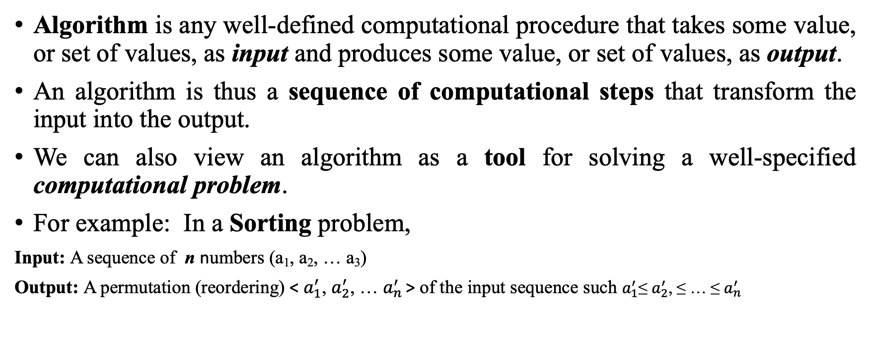
Algorithm (Informally)
Algorithm is any well-defined computational procedure that takes some value, or set of values, as input and produces some value, or set of values, as output.
An algorithm is thus a sequence of computational steps that transform the input into the output.
We can also view an algorithm as a tool for solving a well-specified computational problem.
For example: In a Sorting problem,
Input: A sequence of n numbers (a₁, a₂, … a₃)
Output: A permutation (reordering) < $a_{1}^{′}$, $a_{2}^{′}$, … $a_{n}^{′}$ > of the input sequence such $a_{1}^{′}$≤ $a_{2}^{′}$, ≤ … ≤ $a_{n}^{′}$

Slide 4
What kind of Problems are Solved ?
The Human Genome Project
Internet enables people all around the world to quickly access and retrieve large amounts of information
Privacy and Personal Information – Electronic commerce
Linear Programming
A political candidate may want to determine where to spend money buying campaign advertising in order to maximize the chances of winning an election
An Internet service provider may wish to determine where to place additional resources in order to serve its customers more effectively
An airline may wish to assign crews to flights in the least expensive way possible, making sure that each flight is covered and that government regulations regarding crew scheduling are met

Slide 5
Challanges
Data Structures
Hard Problems
Parallelism
Programming
Hardware
Suppose computers were infinitely fast and computer memory was free. Would you have any reason to study algorithms?
YES – Termination and correct output
Implementation to be within the bounds of good software engineering practice
Of course, computers may be fast, but they are not infinitely fast

Slide 6
Efficiency
Insertion Sort- c₁n²
Merge Sort- c₂nlgn; lgn=log₂n
c_{1<}c₂
c₁n² =c₁n.n
c₂nlgn = c₂n.lgn
Example:
Insert Sort’s n Merg Sort’s lgn,
If n=1000 then lgn=10. What about millions ?

Slide 7
Algorithms and Other Technoglies
Overall performance also affected by;
Advanced computer architectures and fabrication technologies,
Easy-to-use, intuitive,
Graphical user interfaces (GUIs),
Object-oriented systems,
Integrated Web technologies, and
Fast networking, both wired and wireless.

Slide 8
Bubble Sort
14 | 33 | 27 | 35 | 10
14 | 27 | 33 | 10 | 35
14 | 27 | 10 | 33 | 35
14 | 33 | 27 | 35 | 10
14 | 27 | 33 | 10 | 35
14 | 27 | 10 | 33 | 35
14 | 33 | 27 | 35 | 10
14 | 27 | 33 | 10 | 35
14 | 27 | 10 | 33 | 35
14 | 27 | 33 | 35 | 10
14 | 10 | 27 | 33 | 35
14 | 27 | 33 | 10 | 35
14 | 27 | 33 | 35 | 10
14 | 27 | 10 | 33 | 35
14 | 27 | 33 | 35 | 10
14 | 27 | 33 | 10 | 35
14 | 10 | 27 | 33 | 35
10 | 14 | 27 | 33 | 35
Do you know any othe Sorting Algorithm ?
How about Merge Sort ?
Which one you prefer and WHY ?

Slide 9
Merge Sort
14 | 33 | 27 | 10 | 35 | 19 | 42 | 44
Commentary: Merge sort keeps on dividing the list into equal halves until it can no more be divided. By definition, if it is only one element in the list, it is sorted. Then, merge sort combines the smaller sorted lists keeping the new list sorted too.
Step 1 − if it is only one element in the list it is already sorted, return.
Step 2 − divide the list recursively into two halves until it can no more be divided.
Step 3 − merge the smaller lists into new list in sorted order.
14 | 33 | 27 | 10
35 | 19 | 42 | 44
14 | 33
27 | 10
35 | 19
42 | 44
14
33
27
10
35
19
42
44
14 | 33
10 | 27
19 | 35
42 | 44
10 | 14 | 27 | 33
19 | 35 | 42 | 44
10 | 14 | 19 | 27 | 33 | 35 | 42 | 44

Slide 10
Merge Sort Complexity
Divide-and-Conqure algorithm
Divide the unsorted array into n subarrays, each containing one element.
Repeatedly merge subarrays to produce new sorted subarrays until there is only one subarray remaining.
Complexity
Divide: This step involves splitting the array into two halves. This operation takes O(1) time as it only involves calculating the midpoint of the array.
Conquer: This step involves recursively sorting the subarrays. The recursive call is made twice for each level of recursion, so the time complexity of this step is O(log n).
Merge: This step involves merging the subarrays. In the worst case, each element of the array is compared once, so the time complexity of this step is O(n).
Overall time complexity of the Merge sort algorithm is O(n log n)
Python Merge Sort Implementation
def merge_sort(arr): if len(arr) > 1:
mid = len(arr) // 2
left_half = arr[:mid]
right_half = arr[mid:]
merge_sort(left_half)
merge_sort(right_half)
i = j = k = 0
while i < len(left_half) and j < len(right_half):
if left_half[i] < right_half[j]:
arr[k] = left_half[i]
i += 1
else:
arr[k] = right_half[j]
j += 1
k += 1
while i < len(left_half):
arr[k] = left_half[i]
i += 1 k += 1
while j < len(right_half):
arr[k] = right_half[j]
j += 1
k += 1

Slide 11
Example: Working of Merge Sort Algorithm
Given array: [38, 27, 43, 3, 9, 82, 10]
Subarrays: [38, 27, 43, 3] and [9, 82, 10]
Subarrays into four subarrays: [38, 27], [43, 3], [9], [82, 10]
Sort and merge the subarrays
Sort and merge [38] and [27] to get [27, 38]
Sort and merge [43] and [3] to get [3, 43]
Don't need to sort [9] and [82, 10] because they already contain only one element.
Merge the two sorted subarrays [27, 38] and [3, 43] into subarray [3, 27, 38, 43]
Merge the two sorted subarrays [3, 27, 38, 43] and [9, 10, 82] into subarray [3, 9, 10, 27, 38, 43, 82]
Merge sort algorithm has a worst-case time complexity of O(n log n)

Slide 12
Notes
The time complexity of the merge_sort function is the sum of the time complexity of each line of code.
The first two lines of code have a time complexity of O(1) each, since they involve simple arithmetic operations and array slicing.
The next two lines of code involve creating two new subarrays, left_half and right_half. The time complexity of creating left_half is O(mid), where mid is the index of the midpoint of the input array arr. The time complexity of creating right_half is O(n-mid), since it involves copying the remaining elements of arr into a new subarray. Therefore, the time complexity of these two lines of code is O(n).
The next two lines of code recursively call the merge_sort function on left_half and right_half, with each recursive call operating on a subarray of half the size of the original array. This results in a time complexity of O(log n) for each recursive call.
The next three lines of code initialize three variables i, j, and k to 0, so they have a time complexity of O(1).
The next while loop iterates over the two subarrays left_half and right_half and merges them into a single sorted array. The loop runs n times, where n is the length of the input array arr. Therefore, the time complexity of this loop is O(n).
Inside the loop, the time complexity of each operation is O(1), since they involve simple arithmetic operations and array indexing.
The last two while loops handle the case where one subarray has more elements than the other. Each loop runs n-mid times, so the time complexity of each loop is O(n-mid).
Therefore, the overall time complexity of the merge_sort function is O(n log n), which is the sum of the time complexity of each line of code.
Algorithm with Complexity
def merge_sort(arr):
if len(arr) > 1: # O(1)
mid = len(arr) // 2 # O(1)
left_half = arr[:mid] # O(mid)
right_half = arr[mid:] # O(n-mid)
merge_sort(left_half) # O(log n)
merge_sort(right_half) # O(log n)
i = j = k = 0 # O(1)
while i < len(left_half) and j < len(right_half): # O(n)
if left_half[i] < right_half[j]: # O(1)
arr[k] = left_half[i] # O(1)
i += 1 # O(1)
else:
arr[k] = right_half[j] # O(1)
j += 1 # O(1)
k += 1 # O(1)
while i < len(left_half): # O(n-mid)
arr[k] = left_half[i] # O(1)
i += 1 # O(1)
k += 1 # O(1)
while j < len(right_half): # O(n-mid)
arr[k] = right_half[j] # O(1)
j += 1 # O(1)
k += 1 # O(1)

Slide 13
Example
Sorting array=10 million numbers
Computer A: 10B Inst./sec. – InsertionSort – 2n²
Computer B: 10M Inst./sec. – MergeSort – 50nlgn
For A;
For B;
2.(10⁷)²
^{___________________ =}20,000 sec.
10¹⁰ Inst./Sec.
50.10⁷lg10⁷
___________________ =116 sec.
10⁷ Inst./Sec.

Slide 14
Take Home Assignment: Play with ☺
Suppose we are comparing implementations of insertion sort and merge sort on the same machine. For inputs of size n, insertion sort runs in 8n² steps, while merge sort runs in 64n lg n steps. For which values of n does insertion sort beat merge sort?
What is the smallest value of n such that an algorithm whose running time is 100n² runs faster than an algorithm whose running time is 2^{n} on the same machine?
Problem 1.1

Slide 15
Questions ?
How many sorting algorithms are there ? - Few are there
Which one to chose ? -Depends e.g.; scenario, type, requirement
Why to chose specific algorithm? –To solve prob.+Efficient
Open Discussion

Slide 16
Complexity Analysis ?
Asymptotic analysis of an algorithm - defining the mathematical boundation/framing of its run-time performance (computing the running time of any operation in mathematical units of computation.)
Using asymptotic analysis, we can very well conclude the best case, average case, and worst case scenario of an algorithm.
Asymptotic analysis is input bound i.e., if there's no input to the algorithm, it is concluded to work in a constant time. Other than the "input" all other factors are considered constant.
f(n) and g(n^2) – What if n=1 and n>=2 ?
Best Case − Minimum time required for program execution.
Average Case − Average time required for program execution.
Worst Case − Maximum time required for program execution

Slide 17
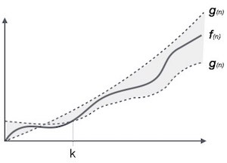
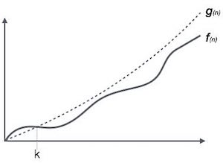
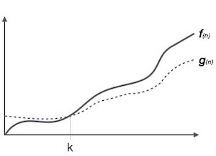
Asymptotic Notations
Big Oh Notation
Ο(f(n)) = { g(n) : there exists c > 0 and n₀ such that f(n) ≤ c.g(n) for all n > n₀. }
Big Omega Notation
Ω(f(n)) ≥ { g(n) : there exists c > 0 and n₀ such that g(n) ≤ c.f(n) for all n > n₀. }
Theta Notation
θ(f(n)) = { g(n) if and only if g(n) = Ο(f(n)) and g(n) = Ω(f(n)) for all n > n₀. }

Slide 18
Common Asympotatic Notations
constant | Ο(1)
logarithmic | Ο(log n)
linear | Ο(n)
n log n | Ο(n log n)
quadratic | Ο(n²)
cubic | Ο(n³)
polynomial | n^{Ο(1)}
exponential | 2^{Ο(n)}

