Slide 1
Heaps
Definition:
A heap is a binary tree with the following conditions:
Shape requirement: it is essentially complete:
Parental dominance requirement: The key at each node is ≥ keys(for max-heap) at its children
Examples
All its levels are full except possibly the last level, where only some rightmost leaves may be missing.
…

Slide 2
Heaps and Heapsort
Not only is the heap structure useful for heapsort, but it also makes an efficient priority queue.
Heapsort
  In place
  O(nlogn)
A priority queue is the ADT for maintaining a set S of elements, each with an associated value called a key/priority. It supports the following operations:
  find element with highest priority
  delete element with highest priority
  insert element with assigned priority

Slide 3
Properties of Heaps (1)
9
Heap and its array representation.
  Conceptually, we can think of a heap as a binary tree.
  But in practice, it is easier and more efficient to implement a heap using an array.
    Store the BFS traversal of the heap’s elements in position 1 through n, leaving H[0] unused.
Relationships between indexes of parents and children.
5
3
1
4
2
1 2 3 4 5 6
9 5 3 1 4 2
PARENT(i) LEFT(i) RIGHT(i)
return ⎣i/2⎦
return 2i
return 2i+1

Slide 4
Properties of Heaps (2)
Max-heap property and min-heap property
  Max-heap: for every node other than root, A[PARENT(i)] >= A(i)
  Min-heap: for every node other than root, A[PARENT(i)] <= A(i)
The root has the largest key (for a max-heap)
The subtree rooted at any node of a heap is also a heap
Given a heap with n nodes, the height of the heap,
h = log n .
- Height of a node: the number of edges on the longest simple downward path from the node to a leaf.
- Height of a tree: the height of its root.
- level of a node: A node’s level + its height = h, the tree’s height.

Slide 5
Bottom-up Heap construction
Build an essentially complete binary tree by inserting n keys in the given order.
Heapify a series of trees
  Starting with the last (rightmost) parental node, heapify/fix the subtree rooted at it: if the parental dominance condition does not hold for the key at this node:
    exchange its key K with the key of its larger child
    Heapify/fix the subtree rooted at it (now in the child’s position)
  Proceed to do the same for the node’s immediate predecessor.
  Stops after this is done for the tree’s root.
Example: 4 1 3 2 16 9 10 14 8 7→ 16 14 10 8 7 9 3 2 4 1

Slide 6
Bottom-up heap construction algorithm(A Recursive version)
ALGORITHM HeapBottomUp(H[1..n])
//Constructs a heap from the elements
//of a given array by the bottom-up algorithm
//Input: An array H[1..n] of orderable items
//Output: A heap H[1..n]
for i ← ⎣n/2⎦ downto 1 do
MaxHeapify(H, i)
Given a heap of n nodes, what’s
the index of the last parent?
⎣n/2⎦
ALGORITHM MaxHeapify(H, i)
l ← LEFT(i)
r ← RIGHT(i)
if l <= n and H[l] > H[i]
then largest ← l
else largest ← i
if r <= n and H[r] > H[largest]
then largest ← r
if largest ≠ i
then exchange H[i] ←→H[largest]
MaxHeapify(H, largest)
// if left child exists and > H[i]
// if R child exists and > H[largest]
// heapify the subtree

Slide 7
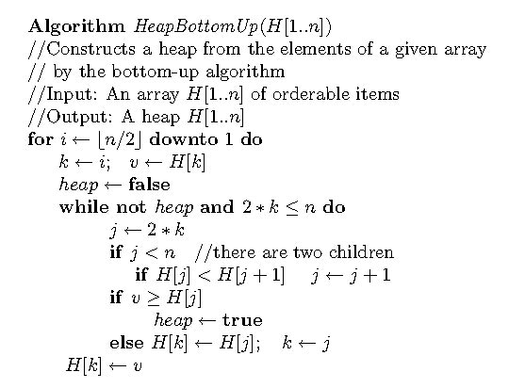
Bottom-up heap construction algorithm(An Iterative version)
// from the last parent down to 1, heapify the subtree rooted at i
// k: the root of the subtree to be heapified; v: the key of the root
// if not a heap yet and the left child exists
// find the larger child, j: its index.
// if the key of the root > that of the larger child, done.
// exchange the key with the key of the larger child
// again, k: the root of the subtree to be heapified; v: the key of the root

Slide 8
Worst-Case Efficiency
Worst case:
a full tree; each key on a certain level will travel to the leaf.
  Fix a subtree rooted at height j: 2j comparisons
  Fix a subtree rooted at level i : comparisons
    A node’s level + its height = h, the tree’s height.
  Total for heap construction phase:
2(h-i)
h-1
Σ
2(h-i) 2^{i} = 2 ( n – lg (n + 1)) = Θ(n)
i=0
# nodes at level i

Slide 9
Bottom-up vs. Top-down Heap Construction
Bottom-up: Put everything in the array and then heapify/fix the trees in a bottom-up way.
Top-down: Heaps can be constructed by successively inserting elements (see the next slide) into an (initially) empty heap.

Slide 10
Insertion of a New Element
The algorithm
  Insert element at the last position in heap.
  Compare with its parent, and exchange them if it violates the parental dominance condition.
  Continue comparing the new element with nodes up the tree until the parental dominance condition is satisfied.
Example 1: add 10 to a heap: 9 6 8 2 5 7
Efficiency:
  Inserting one new element to a heap with n-1 nodes requires no more comparisons than the heap’s height
Example 2: Use the top-down method to build a heap for numbers 2 9 7 6 5 8
Questions
  What is the efficiency for a top-down heap construction algorithm for a heap of size n?
  Which one is better, a bottom-up or a top-down heap construction?
h ∈ O(logn)

Slide 11
Root Deletion
The root of a heap can be deleted and the heap fixed up as follows:
Exchange the root with the last leaf
Decrease the heap’s size by 1
Heapify the smaller tree in exactly the same way we did it in MaxHeapify().
It can’t make key comparison more than twice the heap’s height
Efficiency:
Example: 9 8 6 2 5 1
2h ∈ Θ(logn)
Notes:
.

Slide 12
Heapsort Algorithm
The algorithm
  (Heap construction) Build heap for a given array (either bottom-up or top-down)
  (Maximum deletion ) Apply the root-deletion operation n-1 times to the remaining heap until heap contains just one node.
An example: 2 9 7 6 5 8

Slide 13
Analysis of Heapsort
Recall algorithm:
    Bottom-up heap construction
    Root deletion
    Repeat 2 until heap contains just one node.
Θ(n)
Θ(log n)
n – 1 times
Total: Θ(n) + Θ( n log n) = Θ(n log n)
Note: this is the worst case. Average case also Θ(n log n).

Slide 14
Problem Reduction
Problem Reduction
  If you need to solve a problem, reduce it to another problem that you know how to solve.
Linear programming
  A problem of optimizing a linear function of several variables subject to constraints in the form of linear equations and linear inequalities.
  Formally,
    Maximize(or minimize) c₁x₁+ …C_{n}x_{n}
    Subject to a_{i1}x₁+…+ a_{in}x_{n} ≤ (or ≥ or =) b_{i}, for i=1…n
    x₁ ≥ 0, …, x_{n} ≥ 0
Reduction to graph problems

Slide 15
Linear Programming—Example 1: Investment Problem
Scenario
  A university endowment needs to invest $100million
  Three types of investment:
    Stocks (expected interest: 10%)
    Bonds (expected interest: 7%)
    Cash (expected interest: 3%)
Constraints
  The investment in stocks is no more than 1/3 of the money invested in bonds
  At least 25% of the total amount invested in stocks and bonds must be invested in cash
Objective:
  An investment that maximizes the return

Slide 16
Example 1 (cont’)
Maximize 0.10x + 0.07y + 0.03z
subject to x + y + z = 100
x ≤(1/3)y
z ≥ 0.25(x + y)
x ≥ 0, y ≥ 0, z ≥ 0

Slide 17
Linear Programming—Example 2 : Election Problem
Objective:
  Figure out the minimum amount of money that you need to spend in order to win
    50,000 urban votes
    100,000 suburban votes
    25,000 rural votes
Scenario:
  A politician that tries to win an election.
  Three types of areas of the district:
    urban (100,000 voters),
    suburban (200,000 voters), and
    rural(50,000 voters).
  Primary issues:
    Building more roads
    Gun control
    Farm subsidies
    Gasoline tax
  Advertisement fee
    For every $1,000…
constraints:
Policy | Urban | Suburban | rural
Build roads | -2 | 5 | 3
Gun control | 8 | 2 | -5
Farm subsidies | 0 | 0 | 10
Gasoline tax | 10 | 0 | -2

Slide 18
Example 2 (cont’)
x: the number of thousand of dollars spent on advertising on building roads
y: the number of thousand of dollars spent on advertising on gun control
z: the number of thousand of dollars spent on advertising on farm subsidies
w: the number of thousand of dollars spent on advertising on gasoline taxes
Maximize x + y + z + w
subject to –2x + 8y + 0z + 10w ≥ 50
5x + 2y + 0z + 0w ≥ 100
3x – 5y + 10z - 2w ≥ 25
x, y, z, w ≥ 0

Slide 19
Linear Programming—Example 3: Knapsack Problem (Continuous/Fraction Version)
Scenario
Given n items:
  weights: w₁ w₂ … w_{n}
  values: v₁ v₂ … v_{n}
  a knapsack of capacity W
Constraints
  Any fraction of any item can be put into the knapsack.
  All the items must fit into the knapsack.
Objective:
  Find the most valuable subset of the items

Slide 20
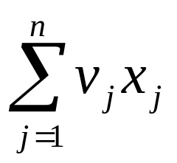
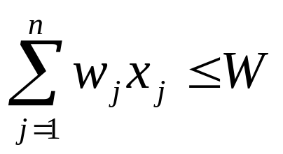
Example 3 (cont’)
Maximize
subject to
0 ≤ x_{j} ≤ 1 for j = 1,…, n.

Slide 21
Linear Programming—Example 3: Knapsack Problem (Discrete Version)
Scenario
Given n items:
  weights: w₁ w₂ … w_{n}
  values: v₁ v₂ … v_{n}
  a knapsack of capacity W
Constraints
  an item can either be put into the knapsack in its entirely or not be put into the knapsack.
  All the items must fit into the knapsack.
Objective:
  Find the most valuable subset of the items

Slide 22
Example 3 (cont’)
Maximize
subject to
x_{j} ∈ {0,1} for j = 1,…, n.

Slide 23
Algorithms for Linear Programming
Simplex algorithm: exponential time.
Ellipsoid algorithm: polynomial time.
Interior-point methods: polynomial time.
Integer linear programming problem
  no polynomial solution.
  requires the variables to be integers.

Slide 24
Reduction to Graph Problems
River-crossing puzzle
Star Gazing

