Slide 1
Chapter 4: Threads

Slide 2
Threads
a Thread of execution is the smallest sequence of programmed instructions that can be managed independently by a scheduler
Thread- a light-weight process executing in the address space of the process
Thread – a separately schedulable sequential execution stream within a process
Multiple threads can run in same address space
Why threads?
  Process creation is expensive
  Context switch is more expensive
  Hard to implement IPC

Slide 3
Threads…
Single-threaded Process
Multiplethreaded Process
Threads of
Execution
Single instruction stream
Multiple instruction stream
Common
Address Space

Slide 4
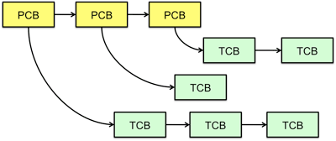
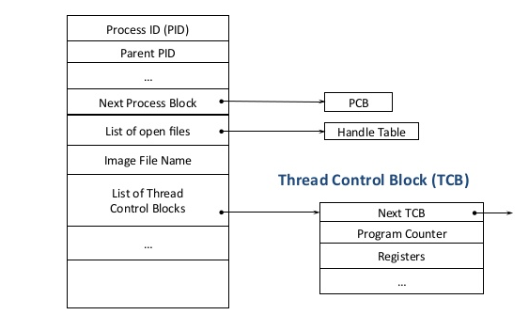
Threads…
Thread-control-block

Slide 5

Single and Multithreaded Processes

Slide 6
Motivation
Most modern applications are multithreaded
Threads run within application
Multiple tasks with the application can be implemented by separate threads
  Update display
  Fetch data
  Spell checking
  Answer a network request
Process creation is heavy-weight while thread creation is light-weight
Can simplify code, increase efficiency

Slide 7

Multithreaded Server Architecture

Slide 8
Benefits
Responsiveness – may allow continued execution if part of process is blocked, especially important for user interfaces
Resource Sharing – threads share resources of process, easier than shared memory or message passing
Economy – cheaper than process creation, thread switching lower overhead than context switching
Scalability – process can take advantage of multiprocessor architectures

Slide 9
Multicore Programming
Multicore or multiprocessor systems putting pressure on programmers, challenges include:
  Dividing activities
  Balance
  Data splitting
  Data dependency
  Testing and debugging
Parallelism implies a system can perform more than one task simultaneously
Concurrency supports more than one task making progress
  Single processor / core, scheduler providing concurrency

Slide 10
Multicore Programming (Cont.)
Types of parallelism
  Data parallelism – distributes subsets of the same data across multiple cores, same operation on each
  Task parallelism – distributing threads across cores, each thread performing unique operation

Slide 11


Concurrency vs. Parallelism
Concurrent execution on single-core system:
Parallelism on a multi-core system:

Slide 12

Amdahl’s Law
Identifies performance gains from adding additional cores to an application that has both serial and parallel components
S is serial portion
N processing cores
That is, if application is 75% parallel / 25% serial, moving from 1 to 2 cores results in speedup of 1.6 times
As N approaches infinity, speedup approaches 1 / S
Serial portion of an application has disproportionate effect on performance gained by adding additional cores

Slide 13
User Threads and Kernel Threads
User threads - management done by user-level threads library
Three primary thread libraries:
  POSIX Pthreads
  Windows threads
  Java threads
Kernel threads - Supported by the Kernel
Examples – virtually all general purpose operating systems, including:
  Windows
  Solaris
  Linux
  Tru64 UNIX
  Mac OS X

Slide 14
Multithreading Models
Many-to-One
One-to-One
Many-to-Many

Slide 15

Many-to-One
Many user-level threads mapped to single kernel thread
One thread blocking causes all to block
Multiple threads may not run in parallel on multicore system because only one may be in kernel at a time
Scheduling is fair among processes
Few systems currently use this model
Examples:
  Solaris Green Threads
  GNU Portable Threads

Slide 16

One-to-One
Each user-level thread maps to kernel thread
Creating a user-level thread creates a kernel thread
More concurrency than many-to-one
Number of threads per process sometimes restricted due to overhead
Scheduling is not fair
Examples
  Windows
  Linux
  Solaris 9 and later

Slide 17

Many-to-Many Model
Allows many user level threads to be mapped to many kernel threads
Allows the operating system to create a sufficient number of kernel threads
Solaris prior to version 9
Windows with the ThreadFiber package

Slide 18

Two-level Model
Similar to M:M, except that it allows a user thread to be bound to kernel thread
Examples
  IRIX
  HP-UX
  Tru64 UNIX
  Solaris 8 and earlier

