Slide 1
Chapter 7: Deadlocks

Slide 2
Outline
Basics of Deadlock
Characteristics of Deadlock
  Necessary conditions
  Resource Allocation Graph
Methods for Handling Deadlocks

Slide 3
Basic Concept of Deadlock
Multiple processes but limited resources
Resources can be used in mutually exclusive way
Each process utilizes a resource as follows:
  request
  use
  release

Slide 4
Basic Concept of Deadlock …
A process may require multiple resources at a time
When a process requests a resource and if its resource is not available then the process will wait until the resource gets available
A waiting process may never come out of the waiting state
This state is called deadlock

Slide 5
Basic Concept of Deadlock …
  Two process: Pi and Pj
Use two resources: Printer and Disk
  Pi first reads the disk and then prints it
  Pj first requests the printer and then reads the document
Pi
Available Resources
OS
Requests for Disk
Disk
Requests for Printer
Printer
Requests for Pritner
Requests for Disk
Pj

Slide 6
Basic Concept of Deadlock …
System consists of resources
Resource types R₁, R₂, . . ., R_{m}
    CPU cycles, memory space, I/O devices
Each resource type R_{i} has W_{i} instances
  If R1= Processor and W1=3 then it means there are 3 processors in the system

Slide 7
Basic Concept of Deadlock …
Deadlock can be defined as the permanent blocking of a set of processes that compete for system resources
A set of processes is in a deadlocked state when every process in the set is waiting for an event that can be caused only by another process in the set

Slide 8
Deadlock Characterization
Deadlock can arise if four conditions hold simultaneously.
Mutual exclusion: only one process at a time can use a resource
Hold and wait: a process holding at least one resource is waiting to acquire additional resources held by other processes
No preemption: a resource can be released only voluntarily by the process holding it, after that process has completed its task
Circular wait: there exists a set {P₁, …, P_{n}} of waiting processes such that P₁ is waiting for a resource that is held by P₂, P₂ is waiting for a resource that is held by P₃, …, P_{n–1} is waiting for a resource that is held by P_{n}, and P_{n} is waiting for a resource that is held by P₁.

Slide 9
Deadlock Characterization …
Two Processes: Pi and Pj
  Pi Disk
  Pj Printer
  Pi Printer
  Pj Disk

Slide 10
Deadlock Characterization …
Each can be used only by one process at a time
Each process holds one resource and waiting for the other
OS cannot preempt a resource
Circular waiting condition is satisfied
Pi
Pj

Slide 11
Resource-Allocation Graph
A tool to characterize the deadlock state in the system
Represents the system state
complete information about resources and processes and their current state
  Resource type
  Instances of each resource type
  Processes
  Allocated and free resources
  Allocated resources to each process

Slide 12
Resource-Allocation Graph
OS continuously updates the resource allocation graph as the system state is changed

Slide 13
Resource-Allocation Graph
A set of vertices V and a set of edges E.
V is partitioned into two types:
  P = {P₁, P₂, …, P_{n}}, the set consisting of all the processes in the system
  R = {R₁, R₂, …, R_{m}}, the set consisting of all resource types in the system
request edge – directed edge P_{i} → R_{j}
assignment edge – directed edge R_{j} → P_{i}

Slide 14
Resource-Allocation Graph (Cont.)
Process
Resource Type with 2 instances
P_{i} requests instance of R_{j}
P_{i} is holding an instance of R_{j}
. .
P_{i}
. .
R_{j}
P_{i}
. .
R_{j}

Slide 15

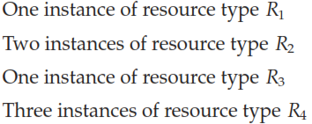
Example (RAG)

Slide 16
Example of a Resource Allocation Graph
R1
.
R3
.
P1
P2
P3
R2
. .
R4
. . .

Slide 17
Resource Allocation Graph …
Resource allocation graph can be used to determine whether a system is in deadlock state or not
No cycle in RAG means no deadlcok
Single instance system
  If there is a cycle in resource allocation graph then system is in deadlocked state
Multiple instances system
  a cycle in resource allocation graph means there is a possibility of deadlock

Slide 18

Resource Allocation Graph With A Deadlock

Slide 19

Graph With A Cycle But No Deadlock

Slide 20
Basic Facts
If graph contains no cycles ⇒ no deadlock
If graph contains a cycle ⇒
  if only one instance per resource type, then deadlock
  if several instances per resource type, possibility of deadlock

Slide 21
Methods for Handling Deadlocks
Ensure that the system will never enter a deadlock state
Allow the system to enter a deadlock state and then recover
Ignore the problem and pretend that deadlocks never occur in the system; used by most operating systems, including UNIX

Slide 22
Methods for Handling Deadlocks …
It can be ensured that deadlock never occurs using one of the following techniques
  deadlock prevention
  deadlock avoidance

Slide 23
Deadlock Prevention
Restrain the ways request can be made
Mutual Exclusion – not required for sharable resources (e.g., read-only files); must hold for non-sharable resources
Hold and Wait – must guarantee that whenever a process requests a resource, it does not hold any other resources
  allow process to request resources only when the process has none allocated to it.
  Require process to request and be allocated all its resources before it begins execution
  Low resource utilization; starvation possible

Slide 24
Deadlock Prevention (Cont.)
No Preemption –
  If a process that is holding some resources requests another resource that cannot be immediately allocated to it, then all resources currently being held are released
  Preempted resources are added to the list of resources for which the process is waiting
  Process will be restarted only when it can regain its old resources, as well as the new ones that it is requesting
Circular Wait – impose a total ordering of all resource types, and require that each process requests resources in an increasing order of enumeration

Slide 25
Deadlock Prevention (Cont.)
Resources: R1, R2, R3 and R4
Processes: P1, P2 and P3
R1 1, R2 2, R3 3, R4 4
P1
P3
P2

Slide 26
Chapter 7: Deadlocks
(Lecture 2)

Slide 27
Outline
Summary of the previous lecture
Deadlock avoidance
Deadlock detection and recover

Slide 28
Summary of the previous lecture
Basic concept of deadlock
Deadlock characterization
  necessary conditions
  resource allocation graph
Handling deadlocks
Deadlock prevention

Slide 29
Deadlock Avoidance …
A way to ensure that system never enters in deadlocked state
System enters in deadlock state when the OS makes a resource allocation that it should not.
OS checks whether a resource allocation can cause a deadlock?
  If No, allocate the resource
  If yes, make the process to wait

Slide 30
Deadlock Avoidance …
Requires that the system has some additional a priori information
available
  each process declare the maximum number of resources of each type that it may need
  hard to know in general purpose systems

Slide 31
Safe State
System is in safe state if there exists a sequence <P₁, P₂, …, P_{n}> of ALL the processes in the systems such that for each P_{i}, the resources that P_{i} can still request can be satisfied by currently available resources + resources held by all the P_{j}, with j < i

Slide 32
Safe State …
Total resource: 16
Processes: P1, P2, P3, P4
Maximum requirements:
  P1→ 8, P2→ 6, P3→10, P4→6
Current allocation:
  P1→ 3, P2→ 3, P3→4, P4→3
Future requirements:
  P1← 5, P2← 3, P3←6, P4←3

Slide 33
Safe State …
  Current Allocation: P1→ 3, P2→ 3, P3→4, P4→3
  Future Need: P1← 5, P2← 3, P3←6, P4←3
Available Resources
3
P2 is safe
<P2, P1, P3, P4> is a safe sequence
Available Resources
3 + will be released by P2 = 6
P1 is safe
Available Resources
6 + will be released by P1 = 9
P3 is safe
Available Resources
9 + will be released by P3 = 13
P4 is safe

Slide 34
Safe State …
If a system is in safe state ⇒ no deadlocks
If a system is in unsafe state ⇒ possibility of deadlock

Slide 35
Avoidance Algorithms
Single instance of a resource type
  Use a resource-allocation graph
Multiple instances of a resource type
  Use the banker’s algorithm

Slide 36
Resource-Allocation Graph Scheme
Processes declare the maximum needs
  some are allocated and remaining it may require
Claim edge is added in RAG
  Claim edge P_{i} → R_{j} indicated that process P_{j} may request resource R_{j}; represented by a dashed line

Slide 37
Resource-Allocation Graph Scheme …
When a process requests a resource
  Claim edge is converted to an assignment edge
If, after converting the claim edge into assignment
  no cycle → means system is safe and resource is assigned
  if cycle is completed → system is unsafe and process waits

Slide 38

Resource-Allocation Graph
P2 requests R2
System is unsafe and P2 process will wait

Slide 39
Resource-Allocation Graph
P1 requests R2
System is safe and R2 is allocated to P1

Slide 40
Banker’s Algorithm
Multiple instances
  processes must declare the maximum need
When a process makes a request for some resources, Banker’s algorithm decides whether the resources should be allocated or not
Works in two phases
  1st phase: check validity of request and availability of resources
  2nd phase: tests system safety

Slide 41


Data Structures for the Banker’s Algorithm
Let n = number of processes, and m = number of resources types.
Available: Vector of length m.
  Available = total – allocated
  If available [j] = k, there are k instances of resource type R_{j} available

Slide 42






Data Structures for the Banker’s Algorithm
Max: n x m matrix.
  If Max [i,j] = k, then process P_{i} may request at most k instances of resource type R_{j}
R1 R2 . . . Rm
P1
P2
.
.
.
.
Pn
.
.
.
.
.
.
.
.
.
.
.
.
Max=m=
Max[2,4]=2 means P2 may require 2 instances of R4

Slide 43






Data Structures for the Banker’s Algorithm
Allocation: n x m matrix.
  If Allocation[i,j] = k then P_{i} is currently allocated k instances of R_{j}
R1 R2 . . . Rm
P1
P2
.
.
.
.
Pn
Allocation=a=
.
.
.
.
.
.
.
.
.
.
.
.
Allocation[2,4]=2 means 2 instances of R4 are allocated to P2

Slide 44






Data Structures for the Banker’s Algorithm
Need: n x m matrix.
  If Need[i,j] = k, then P_{i} may need k more instances of R_{j} to complete its task
  Need [i,j] = Max[i,j] – Allocation [i,j]
R1 R2 . . . Rm
P1
P2
.
.
.
.
Pn
Need=n=
.
.
.
.
.
.
.
.
.
.
.
.

Slide 45
Resource-Request Algorithm for Process P_{i}
Request_{i} = request vector for process P_{i}. If Request_{i} [j] = k then process P_{i} wants k instances of resource type R_{j}
  1. If Request_{i} ≤ Need_{i} go to step 2. Otherwise, raise error condition, since process has exceeded its maximum claim
  2. If Request_{i} ≤ Available, go to step 3. Otherwise P_{i} must wait, since resources are not available
  3. Pretend to allocate requested resources to P_{i} by modifying the state as follows:
      Available = Available – Request_{i};
      Allocation_{i} = Allocation_{i} + Request_{i};
      Need_{i} = Need_{i} – Request_{i};

Slide 46
Safety Algorithm
1. Let Work and Finish be vectors of length m and n, respectively. Initialize:
      Work = Available
      Finish [i] = false for i = 0, 1, …, n- 1
2. Find an i such that both:
  (a) Finish [i] = false
  (b) Need_{i} ≤ Work
  If no such i exists, go to step 4
3. Work = Work + Allocation_{i}
Finish[i] = true
go to step 2
4. If Finish [i] == true for all i, then the system is in a safe state

Slide 47
Banker’s Algorithm…
Final decision
    If safe ⇒ the resources are allocated to P_{i}
    If unsafe ⇒ P_{i} must wait, and the old resource-allocation state is restored

Slide 48
Example of Banker’s Algorithm
5 processes P₀ through P₄;
3 resource types:
A (10 instances), B (5instances), and C (7 instances)
Current system state:
Allocation Max Available
A B C A B C A B C
P₀ 0 1 0 7 5 3 3 3 2
P₁ 2 0 0 3 2 2
P₂ 3 0 2 9 0 2
P₃ 2 1 1 2 2 2
P₄ 0 0 2 4 3 3
0 1 0
7 5 3
3 3 2
2 0 0
3 2 2

Slide 49
Example (Cont.)
The content of the matrix Need is defined to be Max – Allocation
Need
A B C
P₀ 7 4 3
P₁ 1 2 2
P₂ 6 0 0
P₃ 0 1 1
P₄ 4 3 1
7 5 3 – 0 1 0= 7 4 3
3 2 2 – 2 0 0= 1 2 2

Slide 50
Example (Cont.)
Suppose, P1 requests (1,0,2) i.e. Request1=(1,0,2)
Request 1≤ Need1
Request 1≤ Available
Allocation Need Available
A B C A B C A B C
P₀ 0 1 0 7 4 3 2 3 0
P₁ 3 0 2 0 2 0
P₂ 3 0 2 6 0 0
P₃ 2 1 1 0 1 1
P₄ 0 0 2 4 3 1
(1,0,2) ≤ (1,2,2) ⇒ true
(1,0,2) ≤ (3,2,2) ⇒ true
(3,3,2)-(1,0,2)
=(2,3,0)
(2,0,0)+(1,0,2)
=(3,0,2)
(1,2,2)-(1,0,2)
=(0,2,0)

Slide 51
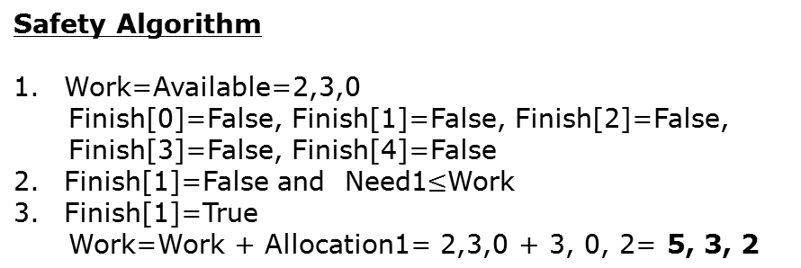
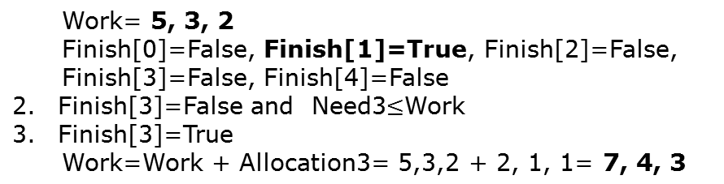
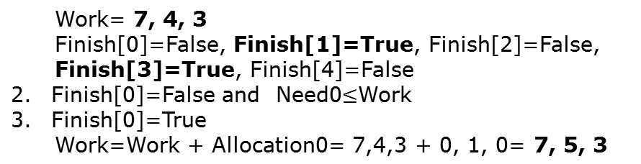
Example (Cont.)
Need
A B C
P₀ 7 4 3
P₁ 0 2 0
P₂ 6 0 0
P₃ 0 1 1
P₄ 4 3 1
P1 is safe
P3 is safe
P0 is safe
P2 is safe
P4 is safe
<P1, P3, P0, P2, P4>

Slide 52
Deadlock Detection
Allow system to enter deadlock state
Detection algorithm
Recovery scheme

Slide 53
Single Instance of Each Resource Type
Maintains wait-for graph
  Nodes are processes
  P_{i} → P_{j} if P_{i} is waiting for P_{j}
  can be extracted from RAG
If there is a cycle in Wait-for graph then it means the system is in deadlocked state
  OS executes some recovery scheme
OS periodically invokes this algorithm

Slide 54

Resource-Allocation Graph and Wait-for Graph
Resource-Allocation Graph
Corresponding wait-for graph

Slide 55
Several Instances of a Resource Type
Available: A vector of length m indicates the number of available resources of each type
Allocation: An n x m matrix defines the number of resources of each type currently allocated to each process
Request: An n x m matrix indicates the current request of each process. If Request [i][j] = k, then process P_{i} is requesting k more instances of resource type R_{j}.

Slide 56
Detection Algorithm
1. Let Work and Finish be vectors of length m and n, respectively Initialize:
  (a) Work = Available
  (b) For i = 1,2, …, n, if Allocation_{i} ≠ 0, then
  Finish[i] = false; otherwise, Finish[i] = true
2. Find an index i such that both:
  (a) Finish[i] == false
  (b) Request_{i} ≤ Work
  If no such i exists, go to step 4
3. Work = Work + Allocation_{i}
Finish[i] = true
go to step 2
4. If Finish[i] == false, for some i, 1 ≤ i ≤ n, then the system is in deadlock state. Moreover, if Finish[i] == false, then P_{i} is deadlocked

Slide 57
Example of Detection Algorithm
Five processes P₀ through P₄; three resource types
A (7 instances), B (2 instances), and C (6 instances)
Current state of the system:
Allocation Request Available
A B C A B C A B C
P₀ 0 1 0 0 0 0 0 0 0
P₁ 2 0 0 2 0 2
P₂ 3 0 3 0 0 0
P₃ 2 1 1 1 0 0
P₄ 0 0 2 0 0 2

Slide 58
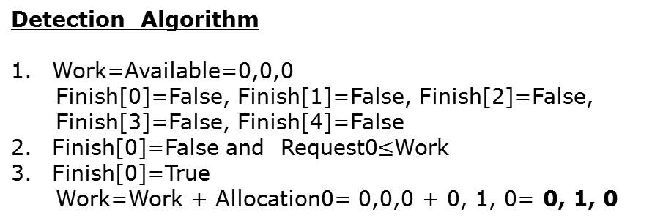
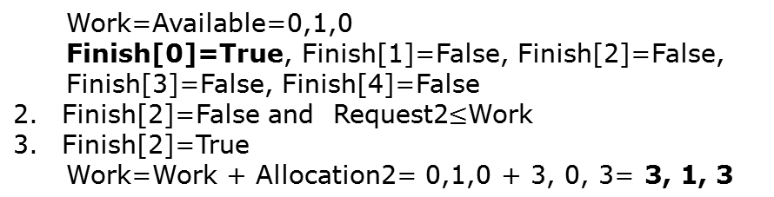
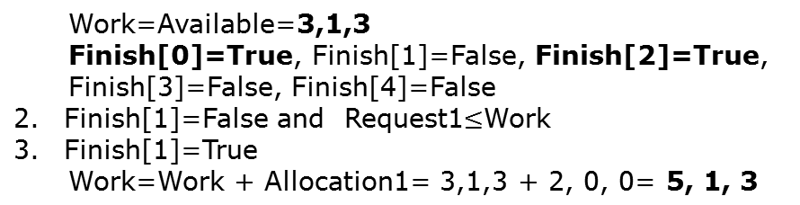
Example (Cont.)
Request
A B C
P₀ 0 0 0
P₁ 2 0 2
P₂ 0 0 0
P₃ 1 0 0
P₄ 0 0 2
Request of P0 is satisfied
Request of P2 is satisfied
Request of P1 is satisfied
<P0, P2, P1, P3, P4>

Slide 59
Recovery from Deadlock: Process Termination
Abort all deadlocked processes
Abort one process at a time until the deadlock cycle is eliminated
In which order should we choose to abort?
  Priority of the process
  How long process has computed, and how much longer to completion
  Resources the process has used
  Resources process needs to complete

Slide 60
Recovery from Deadlock: Resource Preemption
Selecting a victim – minimize cost
Rollback – return to some safe state, restart process for that state
Starvation – same process may always be picked as victim, include number of rollback in cost factor

Slide 61
End of Chapter 7

