Slide 1
Chapter 8: Main Memory

Slide 2
Chapter 8: Memory Management
Background
Swapping
Contiguous Memory Allocation
Segmentation
Paging
Structure of the Page Table
Example: The Intel 32 and 64-bit Architectures
Example: ARM Architecture

Slide 3
Objectives
To provide a detailed description of various ways of organizing memory hardware
To discuss various memory-management techniques, including paging and segmentation
To provide a detailed description of the Intel Pentium, which supports both pure segmentation and segmentation with paging

Slide 4
Background
Program must be brought (from disk) into memory and placed within a process for it to be run
Main memory and registers are only storage CPU can access directly
Memory unit only sees a stream of addresses + read requests, or address + data and write requests
Register access in one CPU clock (or less)
Main memory can take many cycles, causing a stall
Cache sits between main memory and CPU registers
Protection of memory required to ensure correct operation

Slide 5

Base and Limit Registers
A pair of base and limit registers define the logical address space
CPU must check every memory access generated in user mode to be sure it is between base and limit for that user

Slide 6

Hardware Address Protection

Slide 7
Address Binding
Programs on disk, ready to be brought into memory to execute form an input queue
  Without support, must be loaded into address 0000
Inconvenient to have first user process physical address always at 0000
  How can it not be?
Further, addresses represented in different ways at different stages of a program’s life
  Source code addresses usually symbolic
  Compiled code addresses bind to relocatable addresses
    i.e. “14 bytes from beginning of this module”
  Linker or loader will bind relocatable addresses to absolute addresses
    i.e. 74014
  Each binding maps one address space to another

Slide 8
Binding of Instructions and Data to Memory
Address binding of instructions and data to memory addresses can happen at three different stages
  Compile time: If memory location known a priori, absolute code can be generated; must recompile code if starting location changes
  Load time: Must generate relocatable code if memory location is not known at compile time
  Execution time: Binding delayed until run time if the process can be moved during its execution from one memory segment to another
    Need hardware support for address maps (e.g., base and limit registers)

Slide 9

Multistep Processing of a User Program

Slide 10
Logical vs. Physical Address Space
The concept of a logical address space that is bound to a separate physical address space is central to proper memory management
  Logical address – generated by the CPU; also referred to as virtual address
  Physical address – address seen by the memory unit
Logical and physical addresses are the same in compile-time and load-time address-binding schemes; logical (virtual) and physical addresses differ in execution-time address-binding scheme
Logical address space is the set of all logical addresses generated by a program
Physical address space is the set of all physical addresses generated by a program

Slide 11
Memory-Management Unit (MMU)
Hardware device that at run time maps virtual to physical address
Many methods possible, covered in the rest of this chapter
To start, consider simple scheme where the value in the relocation register is added to every address generated by a user process at the time it is sent to memory
  Base register now called relocation register
The user program deals with logical addresses; it never sees the real physical addresses
  Execution-time binding occurs when reference is made to location in memory
  Logical address bound to physical addresses

Slide 12

Dynamic relocation using a relocation register

Slide 13
Dynamic Loading
Routine is not loaded until it is called
Better memory-space utilization; unused routine is never loaded
All routines kept on disk in relocatable load format
Useful when large amounts of code are needed to handle infrequently occurring cases

Slide 14
Dynamic Linking
Static linking – system libraries and program code combined by the loader into the binary program image
Dynamic linking –linking postponed until execution time
Small piece of code, stub, used to locate the appropriate memory-resident library routine
Stub replaces itself with the address of the routine, and executes the routine
Operating system checks if routine is in processes’ memory address
  If not in address space, add to address space
Dynamic linking is particularly useful for libraries

Slide 15
Swapping
A process can be swapped temporarily out of memory to a backing store, and then brought back into memory for continued execution
  Total physical memory space of processes can exceed physical memory
Backing store – fast disk large enough to accommodate copies of all memory images for all users; must provide direct access to these memory images
Roll out, roll in – swapping variant used for priority-based scheduling algorithms; lower-priority process is swapped out so higher-priority process can be loaded and executed
Major part of swap time is transfer time; total transfer time is directly proportional to the amount of memory swapped
System maintains a ready queue of ready-to-run processes which have memory images on disk

Slide 16
Swapping (Cont.)
Does the swapped out process need to swap back in to same physical addresses?
  Depends on address binding method
Modified versions of swapping are found on many systems (i.e., UNIX, Linux, and Windows)
  Swapping normally disabled
  Started if more than threshold amount of memory allocated
  Disabled again once memory demand reduced below threshold

Slide 17

Schematic View of Swapping

Slide 18
Context Switch Time including Swapping
If next processes to be put on CPU is not in memory, need to swap out a process and swap in target process
Context switch time can then be very high
100MB process swapping to hard disk with transfer rate of 50MB/sec
  Swap out time of 2000 ms
  Plus swap in of same sized process
  Total context switch swapping component time of 4000ms (4 seconds)
Can reduce if reduce size of memory swapped – by knowing how much memory really being used

Slide 19
Contiguous Allocation
Main memory must support both OS and user processes
Limited resource, must allocate efficiently
Contiguous allocation is one early method
Main memory usually into two partitions:
  Resident operating system, usually held in low memory with interrupt vector
  User processes then held in high memory
  Each process contained in single contiguous section of memory

Slide 20
Contiguous Allocation (Cont.)
Relocation registers used to protect user processes from each other, and from changing operating-system code and data
  Base register contains value of smallest physical address
  Limit register contains range of logical addresses – each logical address must be less than the limit register
  MMU maps logical address dynamically

Slide 21

Hardware Support for Relocation and Limit Registers

Slide 22
Multiple-partition allocation
Multiple-partition allocation
  Degree of multiprogramming limited by number of partitions
  Fixed-size partitioning
    Program too big to fit
    Internal fragmentation
  Unequal-size partition sizes for efficiency (sized to a given process’ needs)
  Dynamic partitioning
  Hole – block of available memory; holes of various size are scattered throughout memory
  When a process arrives, it is allocated memory from a hole large enough to accommodate it
  Process exiting frees its partition, adjacent free partitions combined
  Operating system maintains information about:
  a) allocated partitions b) free partitions (hole)

Slide 23
Dynamic Storage-Allocation Problem
How to satisfy a request of size n from a list of free holes?
First-fit: Allocate the first hole that is big enough
Best-fit: Allocate the smallest hole that is big enough; must search entire list, unless ordered by size
  Produces the smallest leftover hole
Worst-fit: Allocate the largest hole; must also search entire list
  Produces the largest leftover hole
First-fit and best-fit better than worst-fit in terms of speed and storage utilization

Slide 24
Fragmentation
External Fragmentation – total memory space exists to satisfy a request, but it is not contiguous
Internal Fragmentation – allocated memory may be slightly larger than requested memory; this size difference is memory internal to a partition, but not being used
First fit analysis reveals that given N blocks allocated, 0.5 N blocks lost to fragmentation
  1/3 may be unusable -> 50-percent rule

Slide 25
Fragmentation
400K
1000K
2000K
2300K
2560K
OS
400K
1000K
P2 terminates
2000K
2300K
2560K
OS
400K
1000K
allocate P4
1700K
2000K
2300K
2560K
OS
P1
P1
P1
P2
P4
P3
P3
P3

Slide 26
Fragmentation (Cont.)
Reduce external fragmentation by compaction
  Shuffle memory contents to place all free memory together in one large block
300K
500K
600K
1000K
1200K
1500K
1900K
2100K
P1
P1
P1
P1
P2
P2
P2
P2
400K
P3
P4
900K
P4
P3
P3
300K
900K
900K
P4
P4
200K
P3
Original allocation
Moved 600K
Moved 400K
Moved 200K

Slide 27
Segmentation
Memory-management scheme that supports user view of memory
A program is a collection of segments
  A segment is a logical unit such as:
main program
procedure
function
method
object
local variables, global variables
common block
stack
symbol table
arrays

Slide 28

User’s View of a Program

Slide 29
Logical View of Segmentation
1
1
4
2
3
4
2
3
user space
physical memory space

Slide 30
Segmentation Architecture
Logical address consists of a two tuple:
<segment-number, offset>,
Segment table – maps two-dimensional physical addresses; each table entry has:
  base – contains the starting physical address where the segments reside in memory
  limit – specifies the length of the segment
Segment-table base register (STBR) points to the segment table’s location in memory
Segment-table length register (STLR) indicates number of segments used by a program;
segment number s is legal if s < STLR

Slide 31
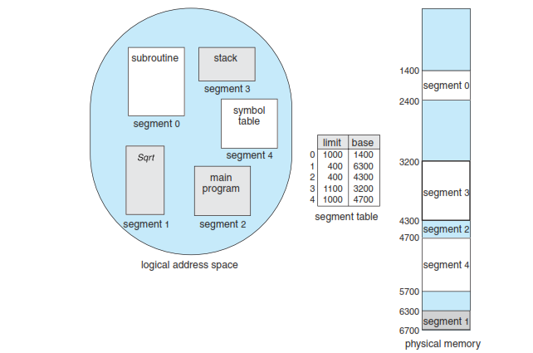
Segmentation Architecture (Cont.)

Slide 32

Segmentation Hardware

Slide 33

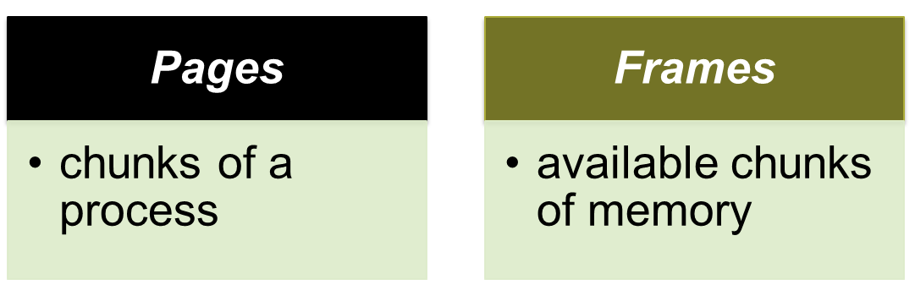
In paging, main memory is partitioned into equal fixed-size chunks that are relatively small, and each process is also divided into small fixed-size chunks of the same size.
Then the chunks of a process, known as pages , could be assigned to available chunks of memory, known as frames , or page frames.
Using this technique the wasted space in memory for each process is due to internal fragmentation consisting of only a fraction of the last page of a process. There is no external fragmentation.

Slide 34
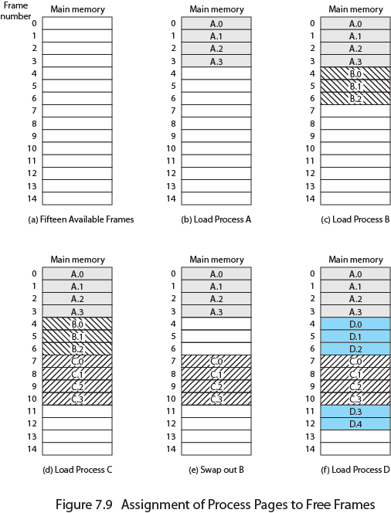
Assignment of Process to Free Frames
Figure 7.9 illustrates the use of pages and frames. At a given point in time, some of the frames in memory are in use and some are free. A list of free frames is maintained by the OS.
Process A, stored on disk, consists of four pages. When it is time to load this process, the OS finds four free frames and loads the four pages of process A into the four frames ( Figure 7.9b ).
Process B, consisting of three pages, and process C, consisting of four pages, are subsequently loaded. Then process B is suspended and is swapped out of main memory. Later, all of the processes in main memory are blocked, and the OS needs to bring in a new process, process D, which consists of five pages.
Now suppose, as in this example, that there are not sufficient unused contiguous frames to hold the process. Does this prevent the operating system from loading D? The answer is no, because we can once again use the concept of logical address.

Slide 35

Page Table
A simple base address register will no longer suffice. Rather, the operating system maintains a page table for each process.
The page table shows the frame location for each page of the process.
Within the program, each logical address consists of a page number and an offset within the page.

Slide 36
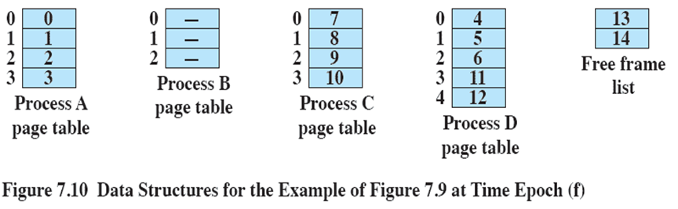
Data Structures
A page table contains one entry for each page of the process, so that the table is easily indexed by the page number (starting at page 0 ).
In addition, the OS maintains a single free-frame list of all the frames in main memory that are currently unoccupied/available for pages.

Slide 37

Paging Hardware

Slide 38
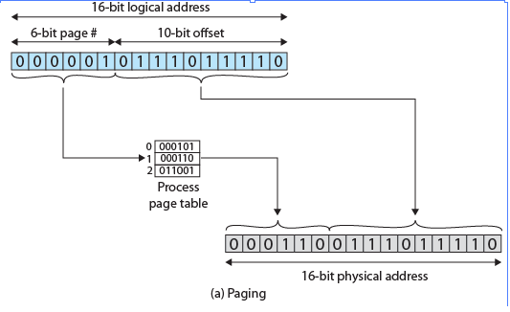
In our example, we have the logical address 0000010111011110, which is page number 1, offset 478. Suppose that this page is residing in main memory frame 6 binary 000110. Then the physical address is frame number 6, offset 478 0001100111011110 ( Figure 7.12a ).

Slide 39

Paging Example
n=2 and m=4 32-byte memory and 4-byte pages

Slide 40

Free Frames
Before allocation
After allocation

Slide 41
End of Chapter 8

