Slide 1


NRC Technical Document Query System
AI-Powered Semantic Search for Nuclear Regulatory Policymakers

Slide 2




Project Overview & Mission
NRC Technical Document Query System
AI-Powered Semantic Search for Nuclear Regulatory Compliance
Objective
The Problem
To streamline the retrieval of critical regulatory information from vast libraries of NRC Technical Letters.
Traditional keyword searches often fail to capture technical context, leading to "information overload" or missed regulatory requirements.
The Solution
Target Documents
A specialized RAG (Retrieval-Augmented Generation) dashboard that understands natural language queries and maps them to specific document sections.
Generic Letters (GL), Information Notices (IN), Bulletins (BL), and Regulatory Issue Summaries (RIS).

Slide 3
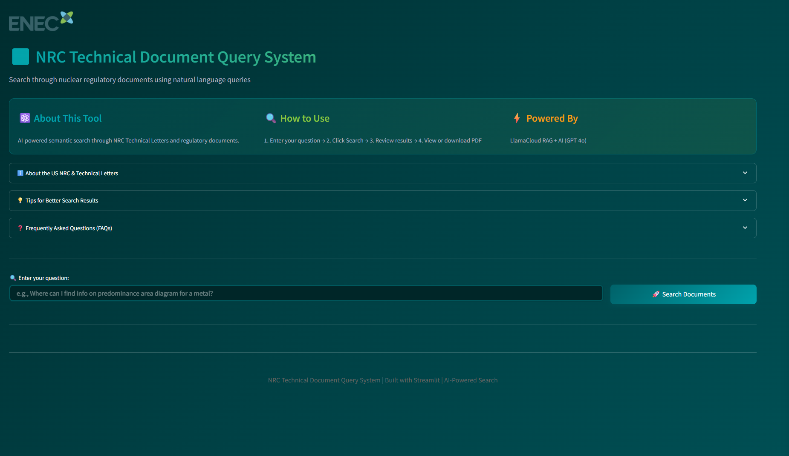

Slide 4



User Experience & UI Features
Semantic Search Input
Natural language processing that handles complex queries (e.g., "stress corrosion cracking in austenitic stainless steel").
Interactive Result Cards
Visual Hierarchy: Teal and Green color coding for document names and section headers.
Technical Context Banners: Gold-accented warnings to remind users to validate AI insights against the source text.
Integrated Document Access:
System Viewer Integration
Direct Download
Advanced Debugging
One-click "Open in System Viewer" for Windows environments.
Embedded PDF download functionality for offline review.
Expandable "Raw Chunks" section for power users to verify the RAG source data.

Slide 5
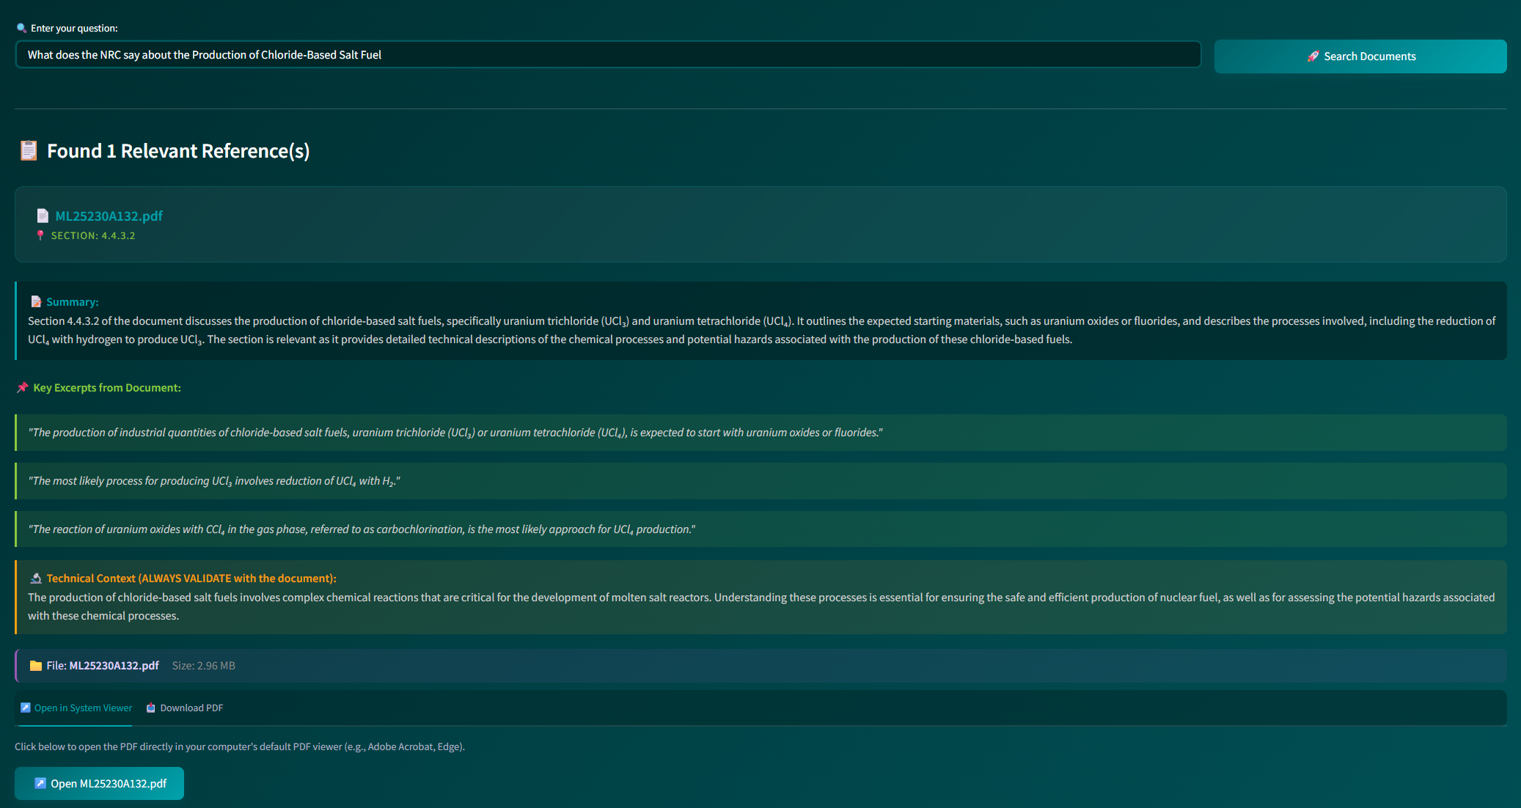

Slide 6



Intelligent Retrieval-Augmented Generation (RAG)
The AI Processing Pipeline
Enhanced System Prompting
Data Extraction & Structuring
JSON Enforcement
The engine is instructed to act as a technical nuclear regulatory assistant, prioritizing document names and section numbers.
Processing retrieved information into structured, actionable insights.
Strict output formatting ensures the UI can dynamically render cards, tabs, and download links without parsing errors.
Data Extraction & Structuring:
Detailed Relevance Summary
Key Excerpts
Technical Context
3-5 sentences explaining why a section matters to the specific user query.
Direct, verbatim quotes from the source PDF to ensure regulatory accuracy.
AI-generated insight into the broader significance of the found data.

Slide 7
System Architecture & Integration
Technical Architecture
Frontend & Interface
Configuration & Processing
Frontend Interface: Built with Streamlit, featuring a custom "Corporate Deep Teal" theme and high-contrast CSS for professional technical environments.
Temperature Setting: 0.1 – Set to a low value to prioritize factual accuracy and consistency while minimizing creative variance.
Vector Indexing: Powered by LlamaCloudIndex, managing document embeddings and metadata for precise similarity matching.
Retrieval Depth (Top K): 5 – The system retrieves the top 5 most relevant document nodes per query to ensure comprehensive context without exceeding the context window.
Core Model: GPT-4o – Selected for its reasoning capabilities and precision in structured JSON extraction.
Response Format: Strict JSON – Forced output schema to ensure seamless integration with the Streamlit frontend.
01
02
Similarity Engine
Contextual Grounding
LlamaCloudIndex – Utilized for semantic vector search across the "nrc" project and organization-specific indices.
System Prompt Engineering – Specific instructions used to force the identification of document names, section numbers, and technical excerpts from the retrieved metadata.

Slide 8
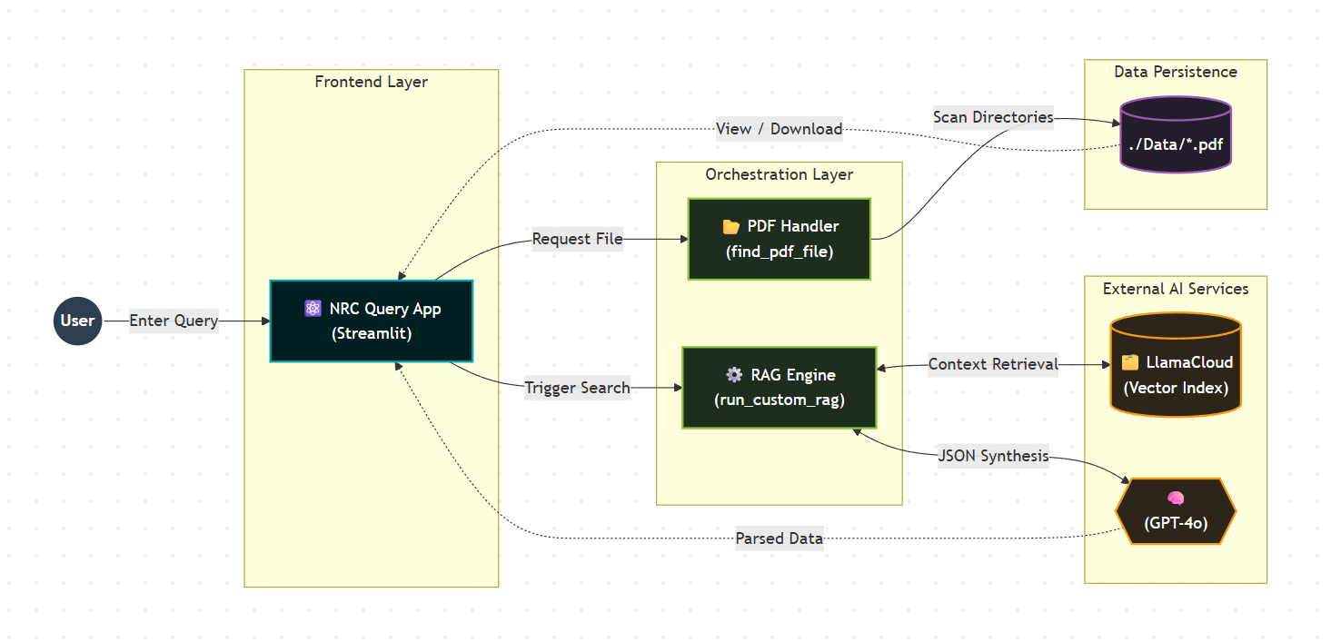
Technical
Architecture
High Level Flow Diagram

Slide 9
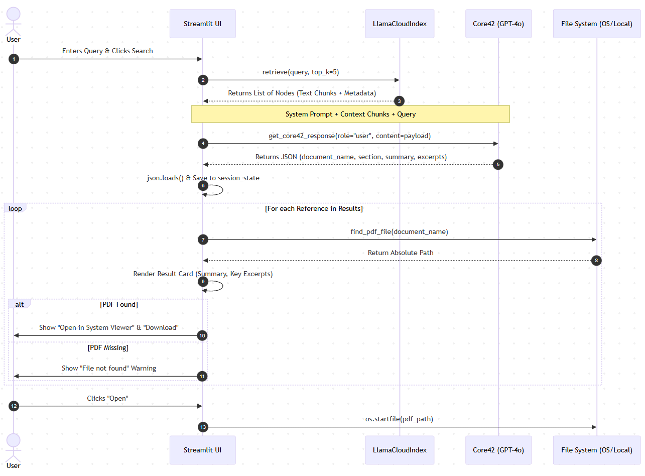
Technical
Architecture
Technical Flow
Diagram

