Slide 1
Level 4 Project Presentation Health Misinformation, Covid-19, and Search
Shahzeb Zafar, 2371704

Slide 2
Motivation
The project has two major objectives:
Understand how misinformation changes overtime when the quantity and quality of data increases.
Identify the main characteristics of misinformation to make it easier to identify and filter out fake news.

Slide 3
Methodology
The project was split into 5 distinct tasks:
Gathering Twitter Data
Binary Classification
Data Clustering
Sentiment & Emotion Classification
Analysis of Data

Slide 4
Gathering Twitter Data
Collected around 1M tweets from a large scientific dataset for Covid-19 tweets for 8 time periods.
The time periods are: January, April, July, October 2020/21

Slide 5
Binary Classification
Classified the tweets as either true or false.
Used a pre-trained BERT model (Covid-Twitter-Bert-v2)that was trained using over 1B tweets.
Finetuned the model using a training dataset of around 24,000 tweets.

Slide 6
Data Clustering
Grouped the tweets into 15 topics.
Used Jaccard Similarity as a substitute for clustering algorithms.

Slide 7
Sentiment & Emotion Classification
Classified the tweets as either positive, negative, or neutral.
For the emotions we have joy, sadness, anger, surprise, disgust, and fear.
Both were done using the pysentimiento package.

Slide 8
Analysis of Data
Calculated the Pearson Correlation Coefficient for sentiments and emotions for each topic.
Visualisation done using tables and line graphs.

Slide 9
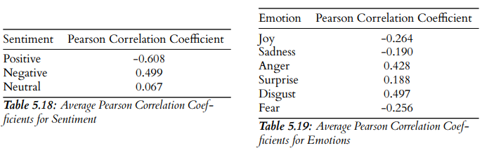
Results
Negative sentiment, anger, and disgust have a moderate positive correlation with misinformation (coefficient >= 0.4).

Slide 10
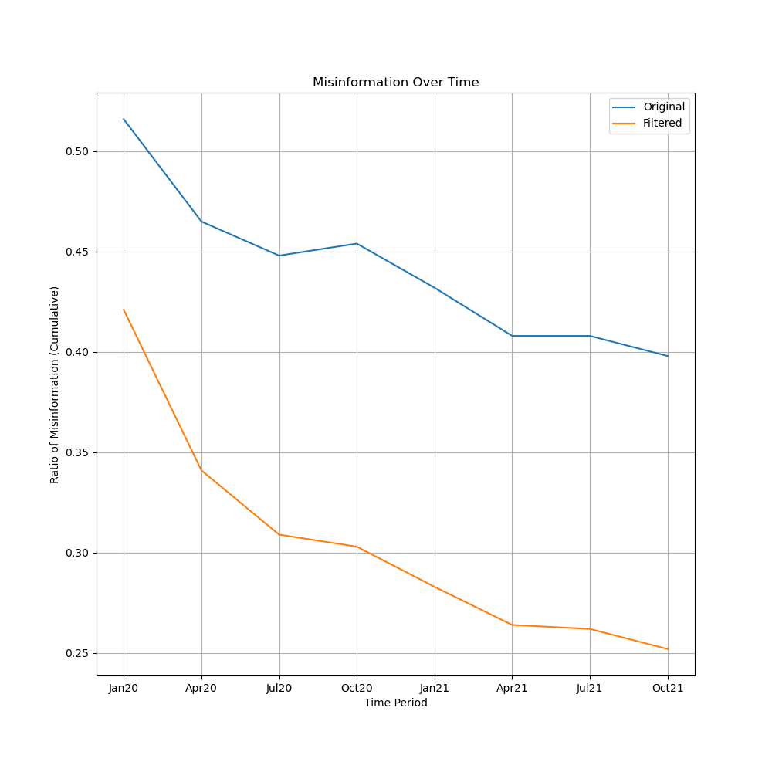
Results
Blue line represents original dataset without any alterations. We see misinformation naturally decrease as time passes.
Orange line represents filtered dataset after removing tweets with negative sentiment + anger/disgust. There’s a drastic decrease in misinformation.

Slide 11
Conclusion
Successfully identified key characteristics of misinformation.
Can use this to develop advanced deep learning models to detect information with such traits and remove/ignore it.

Slide 12
Acknowledgements
Dr Jesus Rodriguez Perez for being a great supervisor and helping me throughout the course of the project.
Dr Graham McDonald and Una Marie Darragh for helping me get an extension for medical reasons.

Slide 13
Thank You!

