Slide 1
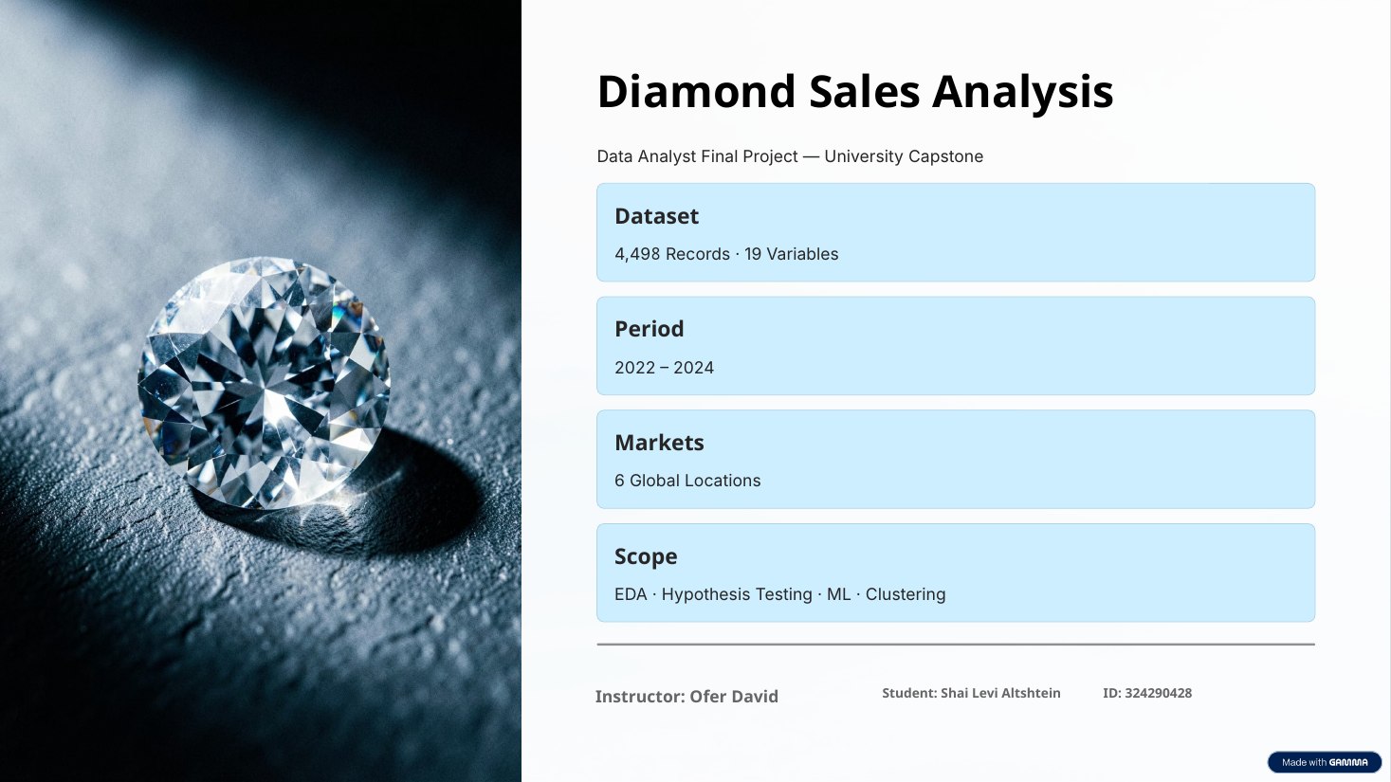

Slide 2
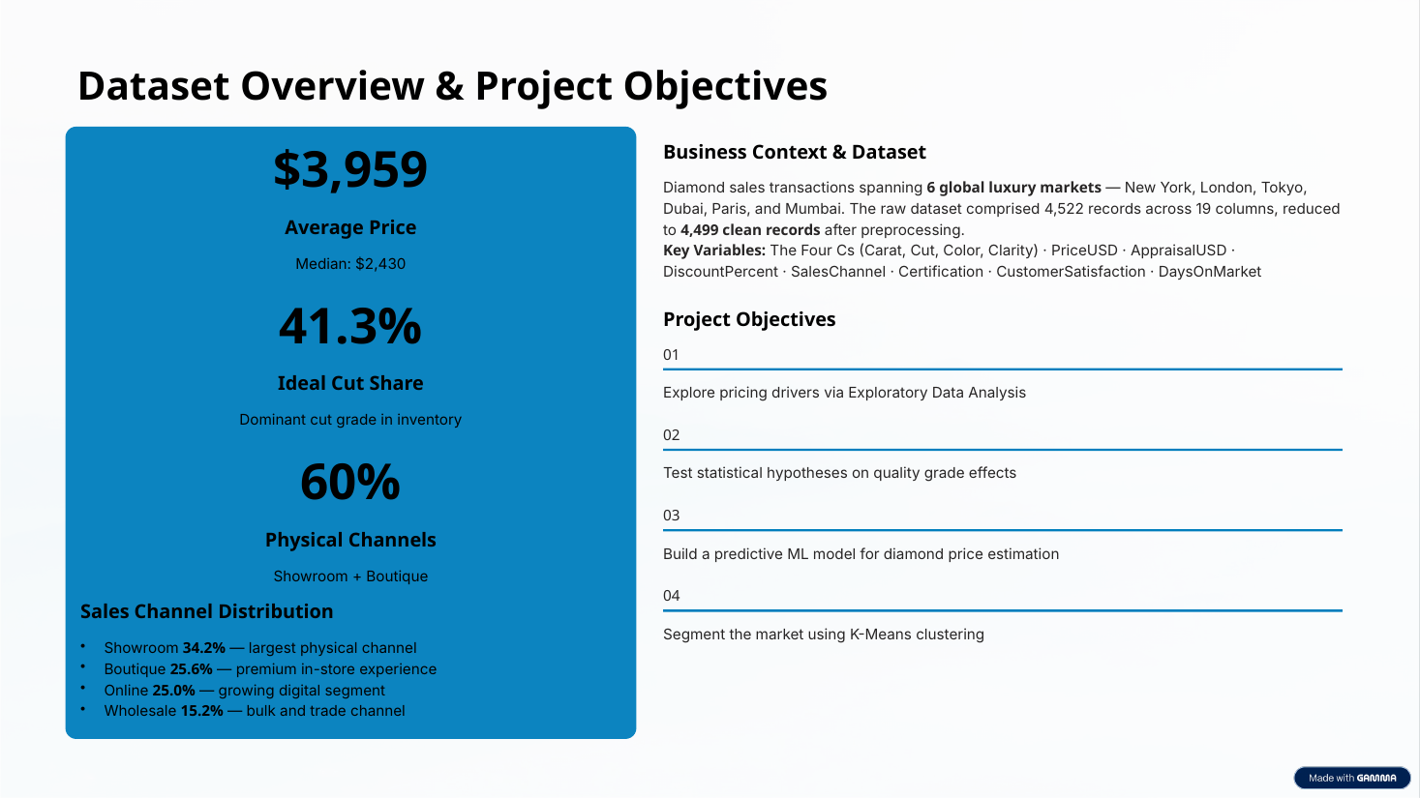
Sales Channel Distribution
• Showroom 34.2% — largest physical channel
• Boutique 25.6% — in-store channel
• Online 25.0% — digital sales channel
• Wholesale 15.2% — bulk and trade channel

Slide 3
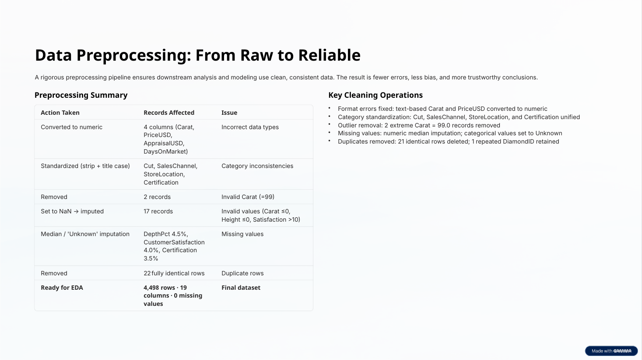
Key Cleaning Operations
• Format errors fixed: text-based Carat and PriceUSD converted to numeric
• Category standardization: Cut, SalesChannel, StoreLocation, and Certification unified
• Date processing: SaleDate converted to datetime format (dayfirst=True for DD/MM/YYYY values) and validated for time-based analysis
• Outlier removal: 2 invalid Carat = 99.0 records removed
• Missing values: numeric median imputation; categorical values set to Unknown
• Duplicates removed: 22 identical rows, including DIA62001 (same sale date written in two formats)

Slide 4
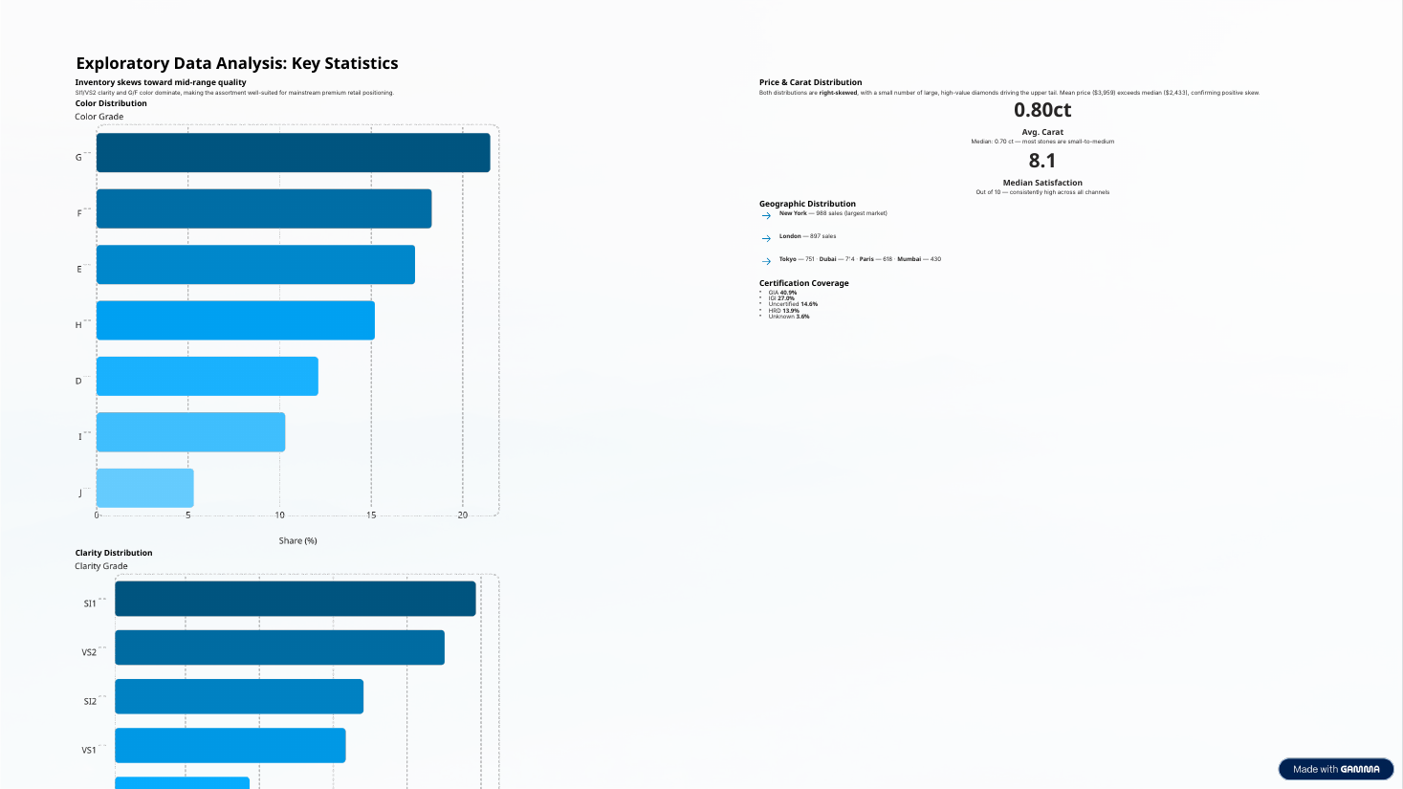

Slide 5
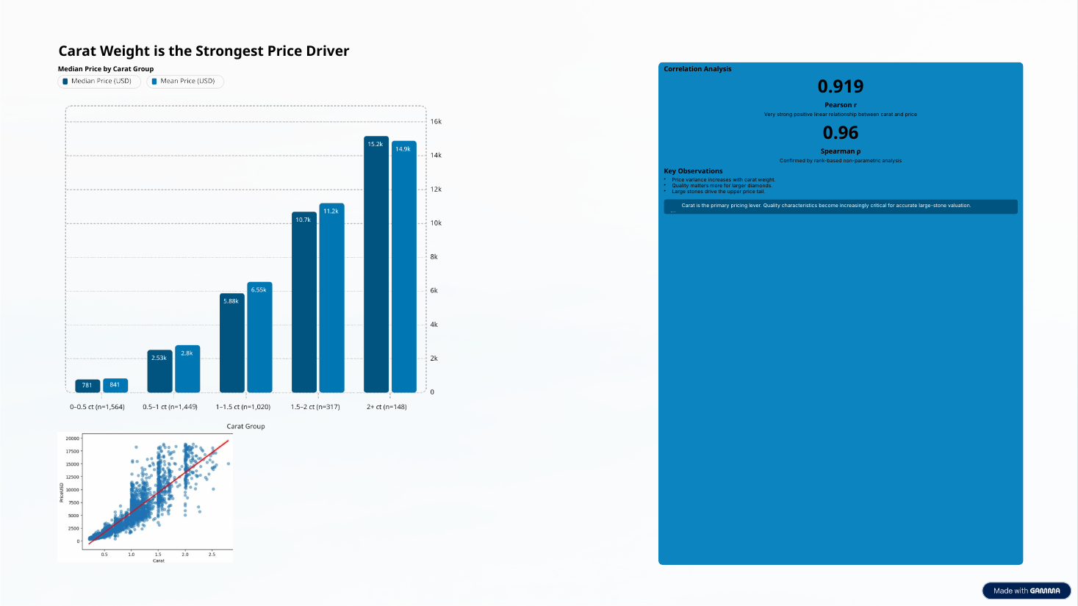

Slide 6
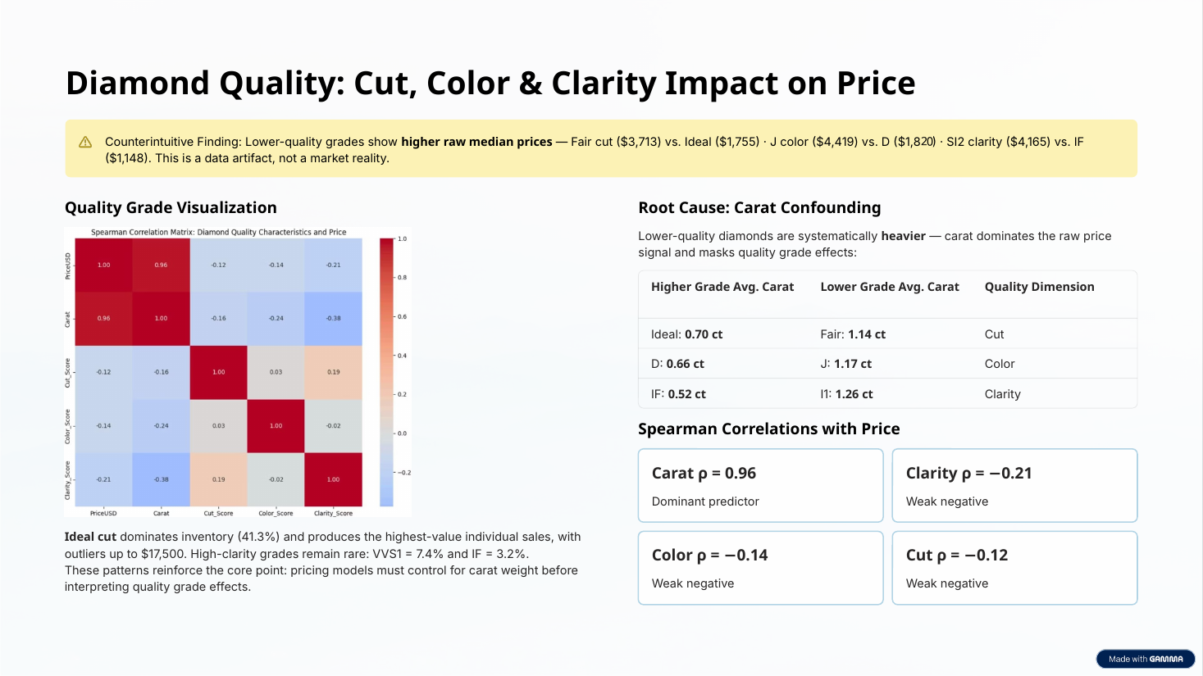
Counterintuitive finding: Lower-quality grades show higher raw median prices. This pattern is largely explained by carat confounding and should not be interpreted as an independent quality effect.
Ideal cut is the most common cut category (41.3%), while VVS1 and IF are relatively rare. Pricing analyses must account for carat weight before interpreting quality-grade effects.

Slide 7
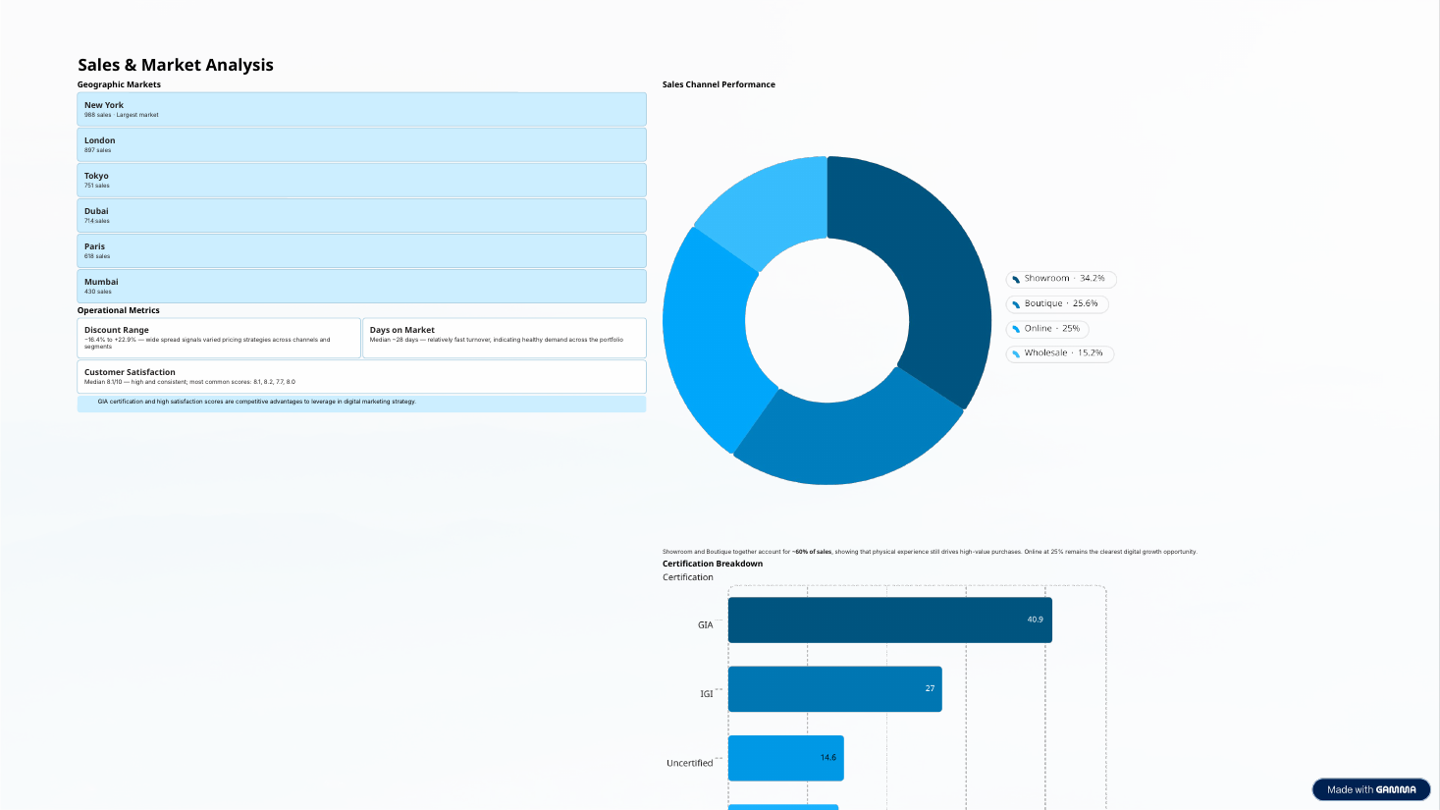
Satisfaction is high overall; causal marketing effects were not tested.
Physical channels represent 59.8% of sales; Online represents 25.0%. The dataset does not establish channel growth over time.

Slide 8
Statistical Hypothesis Testing
DECISION: Fail to Reject H₀
Welch’s t-test · Premium vs. Standard diamonds · 1–1.5 carats
Research Question
Test Design
Is the difference in mean selling price between Premium and Standard diamonds within the 1–1.5 carat range statistically significant?
Levene’s test: p = 0.358
Welch’s t-test: t = 1.908 · p = 0.0568
Significance level: α = 0.05
Cohen’s d = 0.126 (very small effect)
H₀: No statistically significant mean-price difference.
H₁: A statistically significant mean-price difference exists.
Observed Results
Premium
Standard
Difference
n = 675 · Mean = $6,652.72
n = 345 · Mean = $6,341.86
$310.87
Not significant at α = 0.05
Conclusion: Premium diamonds were slightly more expensive within this range, but the difference was not statistically significant and the effect size was very small. Pricing should consider multiple characteristics, not only this classification.

Slide 9
Machine Learning: Linear Regression Price Prediction
Final Selected Model: Log-Transformed Linear Regression
80/20 split · random_state = 42 · 4,498 cleaned records · 5-fold cross-validation
Baseline Linear Regression
Final Log-Transformed Model
R² 0.9253
MAE $743.78
RMSE $1,106.92
MAPE 41.98%
Negative predictions 76
Mean CV R² 0.9183
R² 0.9605
MAE $434.22
RMSE $804.81
MAPE 10.70%
Negative predictions 0
Mean CV R² 0.9505 · SD 0.0040
Model Inputs & Encoding
Interpretation & Future Work
Carat · Cut · Color · Clarity · DepthPct · TablePct
LengthMm · WidthMm · HeightMm · Certification
One-Hot Encoding produced 27 model features.
Permutation importance ranked Carat first, followed by LengthMm. Compare against Regularized Regression, Random Forest and Gradient Boosting; validate with external market data.
The final model improved every metric, reduced MAPE from 41.98% to 10.70%, and eliminated negative predictions. Use it to support—not replace—professional appraisal.

Slide 10
Diamond Market Segmentation: K-Means Clustering
K-Means Market Segmentation — k = 3
StandardScaler · 7 numerical features · 4,498 diamonds · Elbow Method
Entry-Level Diamonds
Mid-Value Diamonds
Premium Diamonds
2,079 · 46.22%
1,800 · 40.02%
619 · 13.76%
0.40 ct average
0.95 ct average
1.69 ct average
$1,056.45 average price
$4,582.40 average price
$11,895.39 average price
Small carat weights, low selling prices and smaller physical dimensions.
Moderate carat weights, intermediate selling prices and medium physical dimensions.
Large carat weights, high selling prices and larger physical dimensions.
Features: Carat · PriceUSD · DepthPct · TablePct · LengthMm · WidthMm · HeightMm
Silhouette 0.381 · Davies–Bouldin 1.042
K-Means identified three broad, interpretable market segments with moderate separation and some overlap. Treat them as decision-support categories—not strict classifications—and add profiling variables before assigning customer behavior or marketing strategies.

Slide 11
Key Findings & Business Recommendations
Core Analytical Findings
Evidence-Based Recommendations
1
Carat is the dominant price driver
Model
Use the final log model for pricing support; compare it with regularized and tree-based models.
Pearson r = 0.919; Spearman ρ = 0.96.
2
Quality comparisons require carat control
Inventory
Use clusters for product positioning and inventory organization, with caution near cluster boundaries.
Raw grade-price patterns are confounded by size.
3
Physical channels dominate
Profiling
Add discount, certification, channel and satisfaction before segment-specific campaigns.
Showroom + Boutique = 59.8%; Online = 25.0%.
4
Three broad diamond segments identified
Validation
Use external market data and cluster-stability analysis before operational deployment.
Moderate separation; clusters are not customer profiles.
KEY TAKEAWAY
Diamond pricing is primarily driven by carat and physical dimensions. Quality effects require controlled analysis; the final log-transformed model provides strong decision support; and the three K-Means clusters offer broad product categories rather than customer personas.

Slide 12
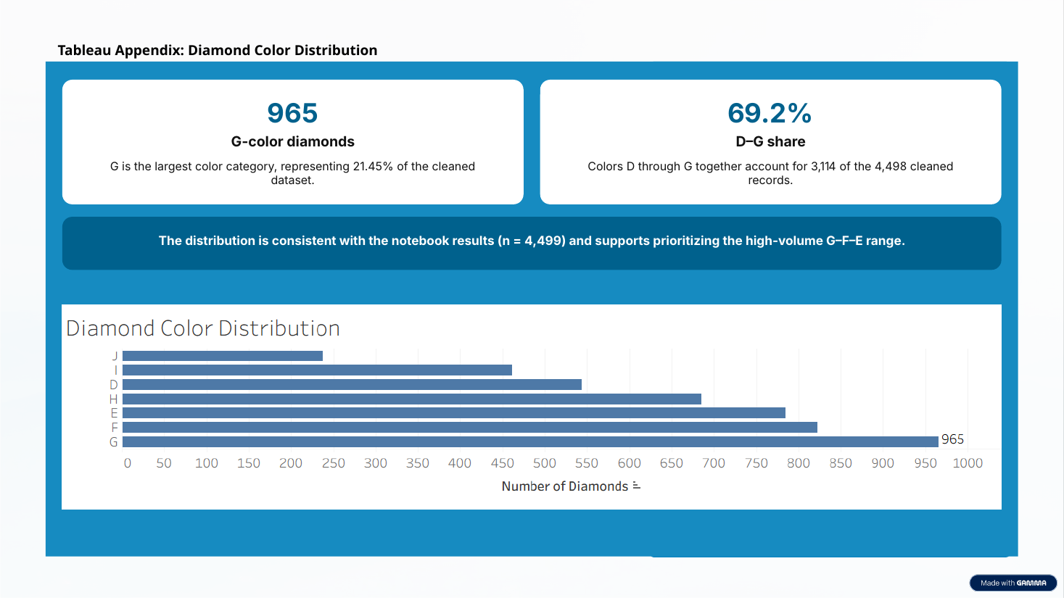
The Tableau ranking matches the notebook frequency table (n = 4,498) and describes the observed inventory mix.

Slide 13
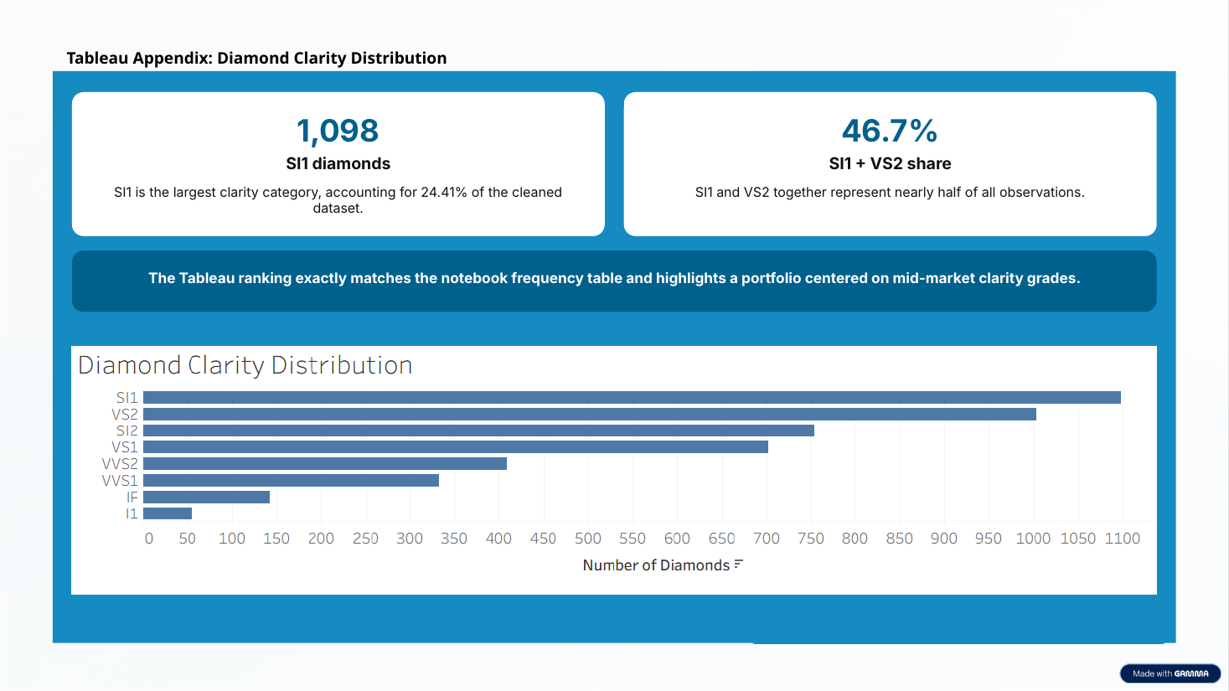

Slide 14
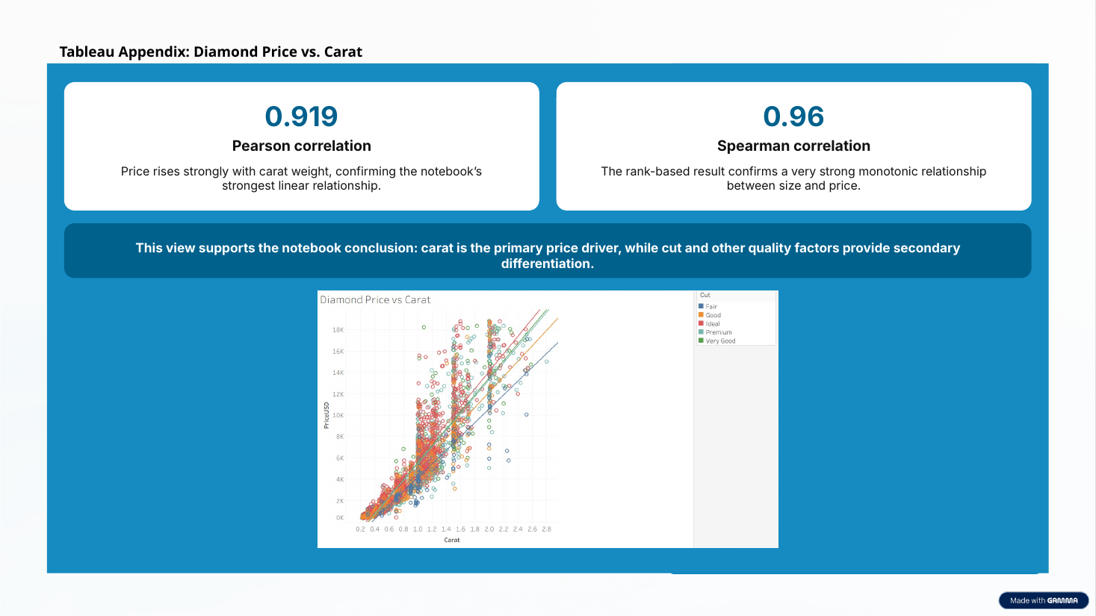

Slide 15
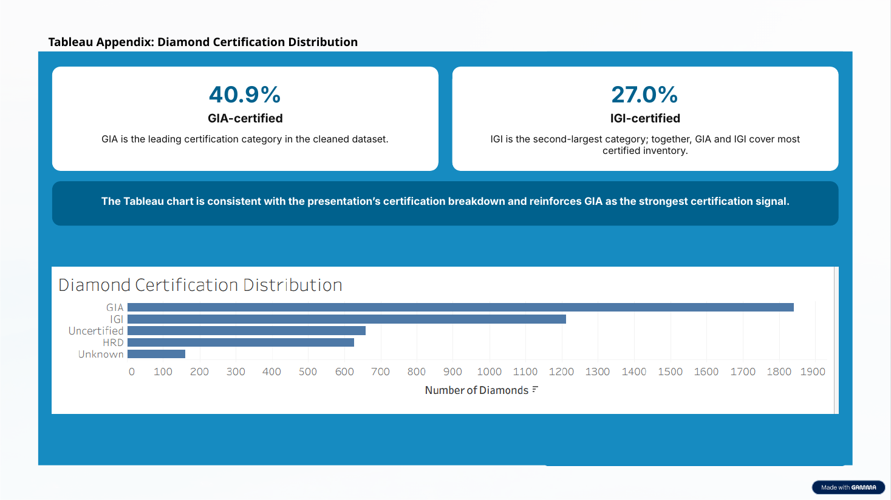
The chart matches the notebook certification breakdown. GIA is the most common category; this alone does not establish a price premium.

Slide 16
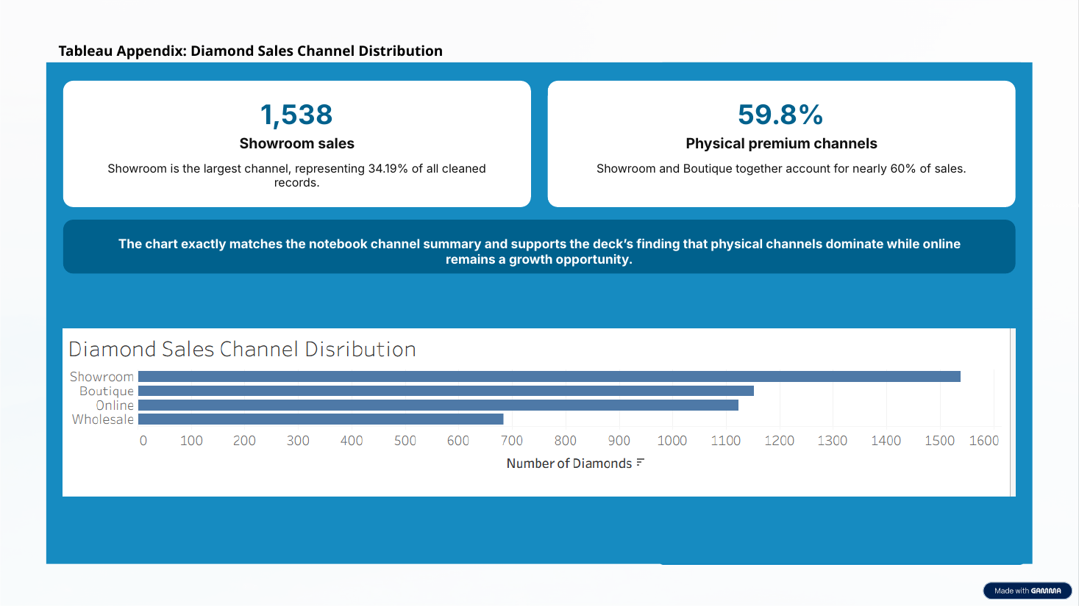
The chart matches the notebook channel summary: physical channels account for 59.8% of sales, while Online accounts for 25.0%.

