Slide 1


AGENTIC PRECISION AGRICULTURE
Irrigation & fertilisation decisions for any field on Earth,
by fusing satellite, weather and soil data.
Presented by :Shaima Bouslah
Sentinel-2 · Open-Meteo · ISMN · Chronos-2 / TimesFM · LangGraph · Streamlit

Slide 2




THE PROBLEM
Growers get data — not decisions
When to irrigate?
When to fertilise?
Data is scattered
Soil dries days before a plant shows stress. Acting late costs yield; acting early wastes water.
A weak canopy can mean thirst or hunger. Fertilising a thirsty crop wastes the input entirely.
Satellite, weather and soil live in separate tools — none of them tells the grower what to do.
The goal
One system that turns raw signals into a clear, explained irrigation and fertilisation call — for any field, anywhere.

Slide 3




SYSTEM OVERVIEW
One pipeline, five stages
The only geographic input is a field drawn on a map — the identical code runs anywhere on Earth.
01
02
03
04
05
Ingestion
Alignment
Forecasting
Fusion agent
Decision
Sentinel-2 · Open-Meteo · ISMN
Cloud-masked, daily, one table
Soil moisture, short horizon
Reason + decide + explain
Draw-a-field dashboard
Deterministic rule engine underneath the agent keeps every recommendation trustworthy.

Slide 4

STATE OF THE ART
Existing solutions — and their gaps
Threshold irrigation tools
Forecasting-only research
Agentic geospatial
Soil-sensor dashboards, FAO-56 ET₀ calculators, commercial controllers.
Deep-learning / time-series soil-moisture and ET prediction papers.
LLM geo-agents & RAG (GeoBenchX, GeoAgentic-RAG).
DOES
DOES
DOES
Fire an alert when one sensor drops below a set point.
Predict a variable accurately, often at one site.
Answer geospatial questions over data.
MISSES
MISSES
MISSES
Single point · reactive · no forecast, no vegetation, no fertilisation.
No decision layer, no agronomic action, not a usable tool.
Retrieval / Q&A · no forecasting · can hallucinate the answer.
AgriSat is the first to combine all three — fusion + forecasting + agentic reasoning — with a deterministic decision that cannot hallucinate.

Slide 5

STATE OF THE ART
How AgriSat compares
Capability
Threshold
tools
Forecasting
research
Agentic
geospatial
AgriSat
Multi-source fusion (satellite + weather + soil)
—
~
~
✓
Short-horizon forecasting (foundation models)
—
✓
—
✓
Agentic LLM reasoning (LangGraph / ReAct)
—
—
✓
✓
Explained, source-traceable recommendation
—
—
~
✓
Anti-hallucination (deterministic decision)
~
—
—
✓
Irrigation AND fertilisation advice
~
—
—
✓
Location-agnostic, free global data
~
~
✓
✓
Interactive map dashboard + per-pixel NDVI
—
—
~
✓
✓ provided ~ partial — absent

Slide 6



PHASE 1 · DATA ACQUISITION & FUSION
01
The datasets and how they combine
Sentinel-2 L2A
Open-Meteo
Multispectral, ~5-day, 10 m
Weather + multi-depth soil
NDVI / EVI / NDWI — free via STAC, no account
Rain & ET₀ timing; modelled soil = global fallback
ISMN
IoT simulator
Real in-situ probes
Synthetic, Open-Meteo-seeded
Ground truth for the validation fields
Stress-tests and offline fallback
Cloud-masked NDVI
Tiered soil moisture
The Sentinel-2 SCL band drops cloud, shadow and cirrus pixels before averaging — so the field NDVI is trustworthy.
Real ISMN where near → Open-Meteo modelled everywhere else → simulator. No field is ever left without soil data.

Slide 7

PHASE 1 · WHY THESE DATASETS
Justified against the alternatives
Need
Chosen
Alternatives considered
Why this one
Vegetation
(satellite)
Sentinel-2 L2A
Landsat 8/9 (30 m, 16-day) · MODIS (250–500 m, daily) · PlanetScope (3 m, paid)
10 m + ~5-day revisit, free, red-edge bands and an SCL cloud mask — the best free field-scale option.
Weather
+ soil
Open-Meteo
NASA POWER (~50 km, daily) · ERA5 / CDS (key + slow) · Meteomatics (paid)
One free, keyless API: global forecast, ET₀ and multi-depth modelled soil in a single call.
Soil ground
truth
ISMN
Single networks (SCAN, USCRN) · SMAP satellite soil (9–36 km)
70+ networks harmonised and quality-controlled; SMAP is far too coarse for one field.
All free. Access: earth-search.aws.element84.com · open-meteo.com · ismn.earth

Slide 8
PHASE 2 · FORECASTING & VALIDATION
02
Setup: target, fields and models
Target
Four models compared
Root-zone soil moisture, 14-day horizon (daily) — forecast so the agent can act before stress.
Chronos-2 Amazon foundation model — zero-shot, probabilistic, takes covariates
TimesFM Google foundation model — zero-shot
Validation fields (real ISMN)
N-HiTS Neural, supervised — trains on the field's own series
Iowa — Ames SCAN humid continental, corn · 213 days
Catalonia — Vilosell XMS-CAT Mediterranean dryland · 244 days
seasonal-naive Reference baseline (last season repeats)
Validation method
Sliding-origin backtest (6 windows) + covariate study · metrics: MASE · sMAPE · RMSE · CRPS (lower = better)
Foundation models forecast zero-shot — no training on farm data — which is why they fit a new field with only a few months of history.

Slide 9
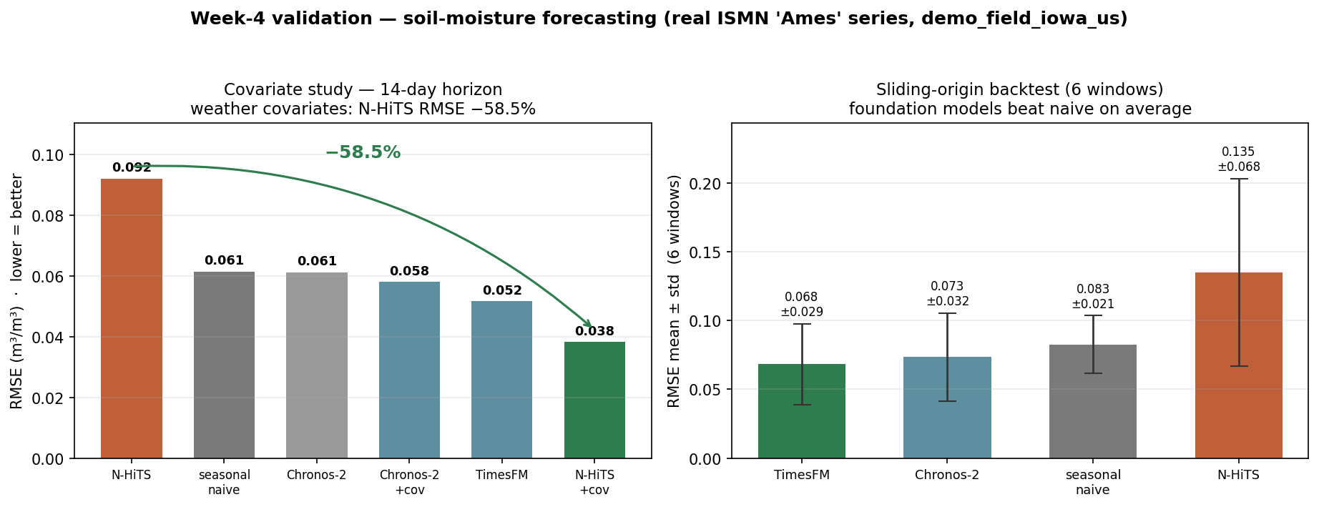

PHASE 2 · RESULTS
Accuracy — and where models fail
N-HiTS alone fails
Worst (RMSE 0.092) and most unstable — a supervised net starved of training data on a short series.
Foundation models win
TimesFM 0.052 and Chronos-2 beat the naïve baseline zero-shot, no training.
Iowa (Ames) · RMSE, m³/m³ · left: covariate study · right: sliding-origin backtest (6 windows)
Covariates: −58.5%
Feeding weather cuts N-HiTS RMSE 0.092 → 0.038 — soil follows rain and ET₀.

Slide 10

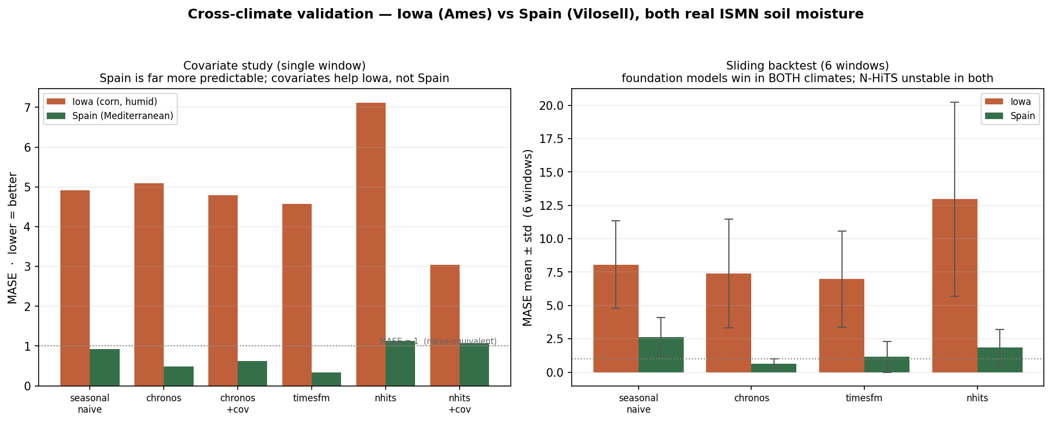
PHASE 2 · GENERALISATION
Does it hold across climates?
Same code, two climates
Only coordinates and dates changed — the pipeline is genuinely location-agnostic.
Foundation models win in both
TimesFM and Chronos-2 beat the baseline in Iowa and Spain alike.
MASE (lower = better) · Iowa (corn, humid) vs Spain (Mediterranean) · both real ISMN
Predictability is regime-dependent
Spain is far more predictable (best MASE 0.33); N-HiTS stays unstable in both.

Slide 11

PHASE 3 · THE FUSION AGENT
03
Why LangGraph — and the guardrail
A LangGraph ReAct agent
Why an agent at all?
A stateful graph that forces a fixed tool-use plan — it must call all four tools before it is allowed to decide:
Fuses four heterogeneous sources into one reasoned answer
Explains the decision in plain language, source-traceable
Field status (NDVI / EVI / NDWI)
Same graph runs any reasoning model — local or hosted
Weather outlook (rain, ET₀)
Soil-moisture forecast
Two recommendations
NDVI anomaly check
Irrigation and fertilisation are decided separately:
Weak canopy + dry soil → water stress → irrigate
Weak canopy + adequate soil → nitrogen limit → fertilise
Guardrail — why it can't hallucinate
The headline decision is computed by a deterministic agronomic rule engine, not the LLM. The model only writes the traceable explanation.

Slide 12
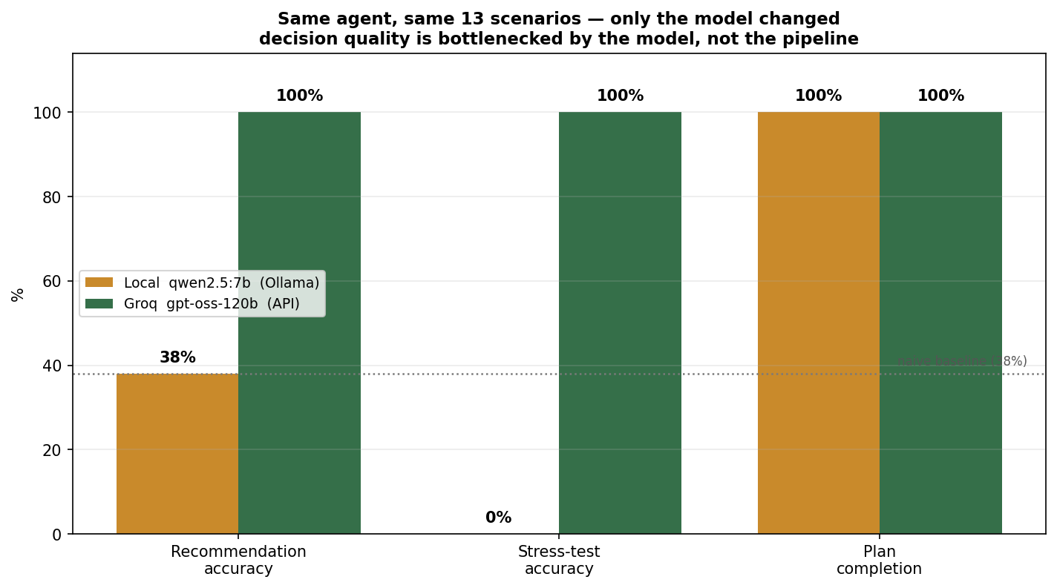

PHASE 3 · MODEL COMPARISON
Same agent, different reasoning model
38% → 100%
Local qwen2.5:7b vs Groq gpt-oss-120b — recommendation accuracy on 13 scenarios, same tools.
Where the 7B fails
0% on stress-tests; biased to “wait”, never picks “monitor”. Its tool-use is perfect — the judgment is not.
Both models complete the 4-tool plan 100% of the time
So the pipeline is never the bottleneck — decision quality is a pure function of the reasoning model. This motivates a two-tier design: the local model for an offline demo, the hosted model for real decisions, switchable with one flag.

Slide 13

PHASE 4 · DECISION SURFACE
04
Draw a field — get a recommendation
Draw-a-field
Two modes
Search any place, draw the parcel; its coordinates drive the analysis.
Rapid (global weather, instant) or full Sentinel-2 satellite with cloud masking.
Per-pixel NDVI map
Alerts & trend
Reveals within-field variability, cloud pixels masked out.
Severity-coded alerts and a forward-looking soil-drop warning.
Stack
Streamlit + Folium
The rule-engine card and the independent LLM explanation agree on the clear cases — and the system refuses to irrigate bare or harvested ground.

Slide 14
RESULTS AT A GLANCE
What the system achieves
100%
−58.5%
4
Global
agent accuracy
forecast RMSE
data sources fused
field coverage
13 / 13 labelled scenarios (hosted model)
with weather covariates
satellite · weather · soil · simulator
any parcel, drawn on a map
Both models complete the 4-tool plan 100% of the time — so decision quality is a pure function of the reasoning model, motivating a switchable two-tier design.

Slide 15

LIVE DEMONSTRATION
Four fields, four continents
Tunisia
Spain
Equatorial
Sahara
NDVI 0.40 · dry soil
NDVI weak · water OK
cloud cover
NDVI 0.07 · bare
Irrigate
Irrigate
Wait
Monitor
Fertilisation
Fertilisation
Fertilisation
Fertilisation
defer fertiliser
+ nitrogen
not evaluated
refuse to irrigate
The anti-hallucination proof
On bare desert every water signal says “irrigate” — but NDVI 0.07 means no crop, so the system refuses and asks to confirm a crop first.

Slide 16

REPRODUCIBILITY
Where the data comes from
Sentinel-2 L2A
Open-Meteo
earth-search.aws.element84.com/v1
open-meteo.com
Public STAC on AWS — no account. (also: dataspace.copernicus.eu)
Forecast + Soil-Moisture + Geocoding APIs — free, no key.
ISMN
Reasoning model
ismn.earth
console.groq.com · ollama.com
International Soil Moisture Network — one archive download per station.
Groq gpt-oss-120b (hosted) or qwen2.5:7b (local) — one flag.
One configuration file — bounding box, centroid, dates — is the only geographic input. The identical code reproduces every result on any field.
github.com/shiaimabouslah

Slide 17

AgriSat
From scattered signals to a decision you can trust
NEXT
Probabilistic forecast bands
scored by CRPS for risk-aware advice
Yield-impact estimation
turn moisture deficits into expected loss
What-if planning
test irrigation scenarios before acting
github.com/shaimabouslah · Shaima Bouslah · Project 12

