Slide 1
Real Time Operating Systems

Slide 2
Presentation Outline
Definition of real-time
Characteristics of RTOS’s
Components of an RTOS
Case Study
    Commercial RTOS
    OpenSource RTOS

Slide 3
What is Real Time ?
“ Real time in operating systems:
The ability of the operating system to provide a required level of service in a bounded response time.”
- POSIX Standard 1003.1

Slide 4
Soft RTOS…
In a soft real-time system, it is considered undesirable, but not catastrophic, if deadlines are occasionally missed.
Also known as “best effort” systems
Most modern operating systems can serve as the base for a soft real time systems.
Examples:
  multimedia transmission and reception,
  networking, telecom (cellular) networks,
  web sites and services
  computer games.

Slide 5
Hard RTOS…
A hard real-time system has time-critical deadlines that must be met; otherwise a catastrophic system failure can occur.
Absolutely, positively, first time every time
Requires formal verification/guarantees of being to always meet its hard deadlines (except for fatal errors).
Examples:
  air traffic control
  vehicle subsystems control
  Nuclear power plant control

Slide 6
Components of an RTOS
Process (task) management
  Scheduler
  Synchronization mechanism
    Interprocess communication (IPC)
    Semaphores
Memory management
Interrupt service mechanism
I/O management , H.A.Layer
Development Environments
Communication subsystems (Option)
Board Support Packages (BSP)

Slide 7
Commercial Real-time Operating Systems – An Introduction

Slide 8
Outline
Introduction
LynxOS
QNX/Neutrino
VRTX
VxWorks
Spring Kernel

Slide 9
Commercial RTOS
Commercial RTOSes different from traditional OS – gives more predictability
Used in the following areas such as:
  Embedded Systems or Industrial Control Systems
  Parallel and Distributed Systems
E.g. LynxOS, VxWorks, pSoS, QNX , bluecat
Traditionally these systems can be classified into a Uniprocessor, Multiprocessor or Distributed Real-Time OS

Slide 10
Lynx OS
Microkernel design
  Means the kernel footprint is small
  Only 28 KB in size
The small kernel provides essential services in scheduling, interrupt dispatching and synchronization
The other services are provided by kernel lightweight service modules, called Kernel Plug-Ins (KPIs)
New KPIs can be added to the microkernel and can be configured to support I/O, file systems, TCP/IP, streams and sockets
Can function as a multipurpose UNIX OS

Slide 11
Lynx OS (contd..)
Here KPIs are multi-threaded, which means each KPI can create as many threads as it want
There is no context switch when sending a message to a KPI
  For example, when a RFS (Request for Service) message is sent to a File System KPI, this does not request a context switch
  Hence run-time overhead is minimum
  Further, inter KPI communication incurs minimal overhead with it consuming only very few instructions
Lynx OS is a self hosted system – wherein development can be done in the same system

Slide 12
Lynx OS (contd..)
In such a system, there is a need for protecting the OS from such huge memory consuming applications (compilers, debuggers)
LynxOS offers memory protection through hardware MMUs
Applications make I/O requests to I/O system through system calls
Kernel directs I/O request to the device driver
Each device driver has an interrupt handler and kernel thread

Slide 13
Lynx OS (contd..)
The interrupt handler carries the first step of interrupt handling
If it does not complete the processing, it sets an asynchronous trap to the kernel
Later, when kernel can respond to the software interrupt, it schedules an instance of the kernel thread to complete the interrupt processing

Slide 14
QNX/ Neutrino
POSIX-compliant Unix-like real-time operating system.
Microkernel design – kernel provides essential threads and real-time services
use of a microkernel allows users (developers) to turn off any functionality they do not require without having to change the OS itself.
The system is quite small, fitting in a minimal fashion on a single floppy, and is considered to be both very fast and fairly "complete."
The footprint of microkernel is 12kb.

Slide 15
QNX/ Neutrino (contd..)
Every driver, application, protocol stack, and file system runs outside the kernel, in the safety of memory-protected user space.
As a result, virtually any component can fail - and be automatically restarted -without affecting other components or the kernel.
Maximize application portability with extensive support for the POSIX standard, which lets you quickly migrate Linux, Unix, and other open source programs

Slide 16
QNX/ Neutrino (contd..)
QNX is a message passing operating system
  Messages are basic means of interprocess communication among all threads
  Follows a message based priority tracking feature

Slide 17
VRTX ( Virtual Real-Time Executive )
VRTX has two multitasking kernels
  VRTXsa (scalable architecture )
    designed for performance
    Provides priority inheritance, POSIX compliant libraries
    Supports multiprocessing
    System calls fully preemptable and deterministic
  VRTXmc (micro-controller)
    Designed for low memory consumption
    Used for cellular phones and hand-held devices
Rather than providing optional components provides hooks for extensibility – application can add its own system calls

Slide 18
VxWorks
Created by Wind River.
Current Version: VxWorks 6.0 →
VxWorks is the most established and most widely deployed device software operating system.
Currently there are more than 300 million devices that are VxWorks enabled.
The core attributes of VxWorks, include high performance, reliability, determinism, low latency and scalability.

Slide 19
VxWorks (contd..)
Enhanced error management
Backward compatibility to previous verison features for exception handling and and template support
Extensive POSIX 1003.1, .1b, .1c compatibility (including pthreads )
Scheduling
  Uses preemptive priority with round robin scheduling to accommodate for both
    Real time processes
    Non-real time processes

Slide 20
VxWorks (contd..)
Memory Protection
  MMU based memory protection.
Reduced Context Switch time
  Saves only those register windows that are actually in use (on a Sparc)
  When a task’s context is restored, only the relevant register window is restored
  To increase response time, it saves the register windows in a register cache – useful for recurring tasks

Slide 21
VxWorks (contd..)
Distinguishing features
  efficient POSIX-compliant memory management
  multiprocessor facilities
  shell for user interface
  symbolic and source level debugging capabilities
  performance monitoring
Mars Exploration Rovers Spirit and Opportunity and the Mars Reconnaissance Orbiter use the VxWorks operating system

Slide 22
Open Source Real-time Operating Systems – An Introduction

Slide 23
Outline
Introduction
eCos
Free RTOS
RTLinux
RTAI
MicroC/OSII

Slide 24
eCos ( Embedded Configurable OS )
open source, royalty-free
Highly Configurable nature
  Small footprint
  Application specific
  Multiple implementation of kernel functions including scheduling, allocating memory and interrupt handling
Easily Portable
  Hardware Abstraction Language (HAL)
Native API, POSIX API, µITRON API, C API

Slide 25
eCos ( Contd …)
eCos is targeted at high-volume applications in consumer electronics, telecommunications, automotive, and other deeply embedded applications.
Ecos has kernel mode
  No user mode
Implemented using C++
GNU debugger (GDB) support

Slide 26
eCos ( Contd …)
Features
  Choice of scheduling algorithms
  Choice of memory-allocation strategies
  Timers and counters
  Support for interrupts and DSRs
  Exception handling
  ISO C library , Math library
  Rich set of synchronization primitives
  Host debug and communications support

Slide 27
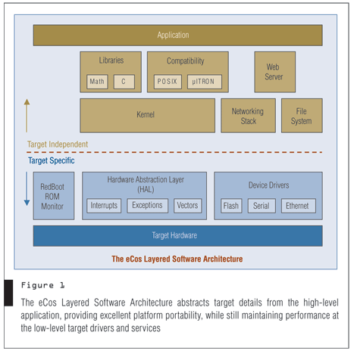
eCos ( Contd …)
http://www.cotsjournalonline.com/home/article.php?id=100164

Slide 28
FreeRTOS
Simple , Portable , Royalty free , Concise
Mini Realtime Kernel
Cross development from a standard Windows host
Choice of RTOS scheduling policy
  Pre-emptive: Always runs the highest available task. Tasks of identical priority share CPU time (fully pre-emptive with round robin time slicing).
  Cooperative: Context switches only occur if a task blocks, or explicitly calls taskYIELD().
Messages Queue

Slide 29
FreeRTOS ( Contd )
Semaphores [via macros]
Majority of source code common to all supported development tools
RTOS kernel uses multiple priority lists
FreeRTOS supports 8, 16 and 32bit microcontrollers including ARM7, AVR, 8051, MSP430 and x86.
It offers a smaller and easier real-time processing alternative for applications where eCos and embedded Linux (or Real Time Linux) won't fit, are not appropriate, or are not available.

Slide 30
FreeRTOS ( Contd )
Smaller than RTLinux or eCos but want to stick with software that protects your freedoms?
Ports are available for the Philips ARM7, TI MSP430, Renesas (Hitachi) H8/S, Atmel AVR, Motorola/Freescale HCS12, Motorola/Freescale ColdFire, and others.

Slide 31
RTLinux
Available as a patch to the regular Linux kernel
Provides an RT API for developers
RTLinux is a hybrid OS that runs a Linux kernel as an idle thread (lowest priority) of the real-time kernel.
Predictable delays.
  By its small size and limited operations.
Finer timer resolution.
RT kernel and RT applications are kept as simple as possible and non-time critical applications (GUIs, file systems) are handled by the standard Linux.

Slide 32
RTLinux ( Contd )
Real time threads and interrupt handlers never delayed by non-realtime operations
Preemptible kernel.
  Its routines are very small and fast, this does not cause big delays.
  Interrupts from Linux are disabled.
RT-Linux has many kinds of Schedulers.
  FIFO.
    Used to pass information between real-time process and ordinary Linux process.
    Designed to never block the real-time task.
  The “earliest deadline first” scheduler.
  Rate-monotonic scheduler.

Slide 33
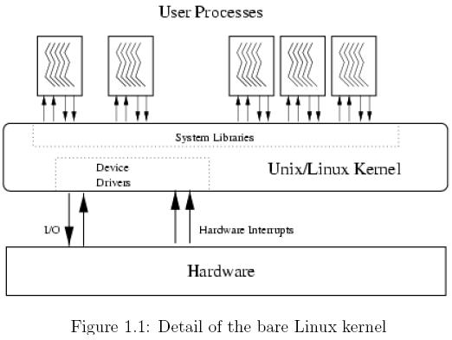
Linux Kernel

Slide 34
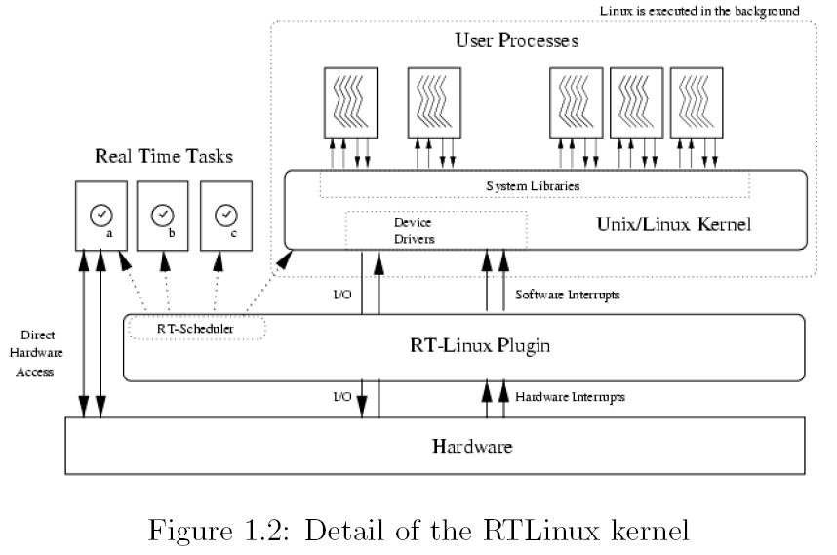
RTLinux Kernel

Slide 35
RTAI (Real Time Application Interface)
Hard real-time extension to the Linux kernel
A patch to the Linux kernel which introduces a hardware abstraction layer
A broad variety of services which make realtime programmers' lifes easier
RTAI provides deterministic response to interrupts, POSIX compliant and native RTAI realtime tasks.
Linux application is able to execute without any modification
RTAI considers Linux as a background task running when no real time activity occurs.

Slide 36
RTAI ( Contd )
RTAI is very much module oriented
real time scheduler module
  Task functions
  Timing functions
  Semaphore functions
  Mailbox functions
  Intertask communication functions
Fifo services
Shared memory
Posix pthread and pqueue(msg queue)

Slide 37
Comparison of Linux implementations RTLinux and RTAI
RTAI provides better real-time support than RTLinux
  soft real-time in user space along with hard real-time in kernel space
  excellent performance in terms of low jitter and low latency
  better C++ support and more complete feature set
  availability of LXRT which allows user space applications in kernel space
RTAI has the better open source approach with frequent feedback from developers

Slide 38
MicroC/OSII
Also known as µC/OS II or uC/OSII
MicroC/OS has been designed as a small footprint real time pre-emptive OS that was designed for embedded use on 8 bit platforms upwards
highly portable, ROMable, very scalable, preemptive real-time, multitasking kernel
has ports for most popular processors and boards in the market
suitable for use in safety critical embedded systems such as aviation, medical systems and nuclear installations
Over 100 microprocessors are supported
approved for use in a DO-178B aerospace system and is (apparently) MISRA-C compliant

Slide 39
MicroC/OSII ( Contd )
µC/OS II features
  reentrant functions and is portable to different processors
kernel is preemptive real time, managing up to 64 tasks, with up to 56 tasks for each application
Each task has a unique priority and its own stack
Round robin scheduling is not supported
operating system uses semaphores to restrict access to resources shared by multiple elements of the system
Memory management is performed using fixed size partitions.

Slide 40
MicroC/OSII ( Contd )
µC/OS II is a multitasking operating system
Each task is an infinite loop and can be in any one of the following 5 states
  Dormant, Ready, Running, Waiting, ISR
services such as mailboxes, queues, and semaphores

Slide 41
Other RTOS
* Opensource * Commercial
* Nut/OS [1] * BeOS * µnOS
* TRON Project * ChorusOS * RMX
* MicroC/OS-II * RSX-11
* OS-9 * RT-11
* OSEKtime * RTOS-UH
* pSOS * VRTX

Slide 42
Thank You

Slide 43
Comparison of RTOS
 | VXWorks | pSOS | eCos
Scheduler | Preemptive | Preemptive | Preemptive
Synchronization mechanism | No condition variable | Y | Y
POSIX support | Y | Y | Linux
Scalable | Y | Y | Y
Custom hw support | BSP | BSP | HAL, I/O package
Kernel size | - | 16KB | -
Multiprocessor support | VxMP/ VxFusion (accessories) | PSOS+m kernel | Y/only basic support (SMP)

Slide 44
Board Support Package
BSP = skeleton device driver code + code for lowlevel system functions each particular devices requires
http://bwrc.eecs.berkeley.edu/Classes/CS252/Notes/Lec26a-sw.pdf

