Slide 1
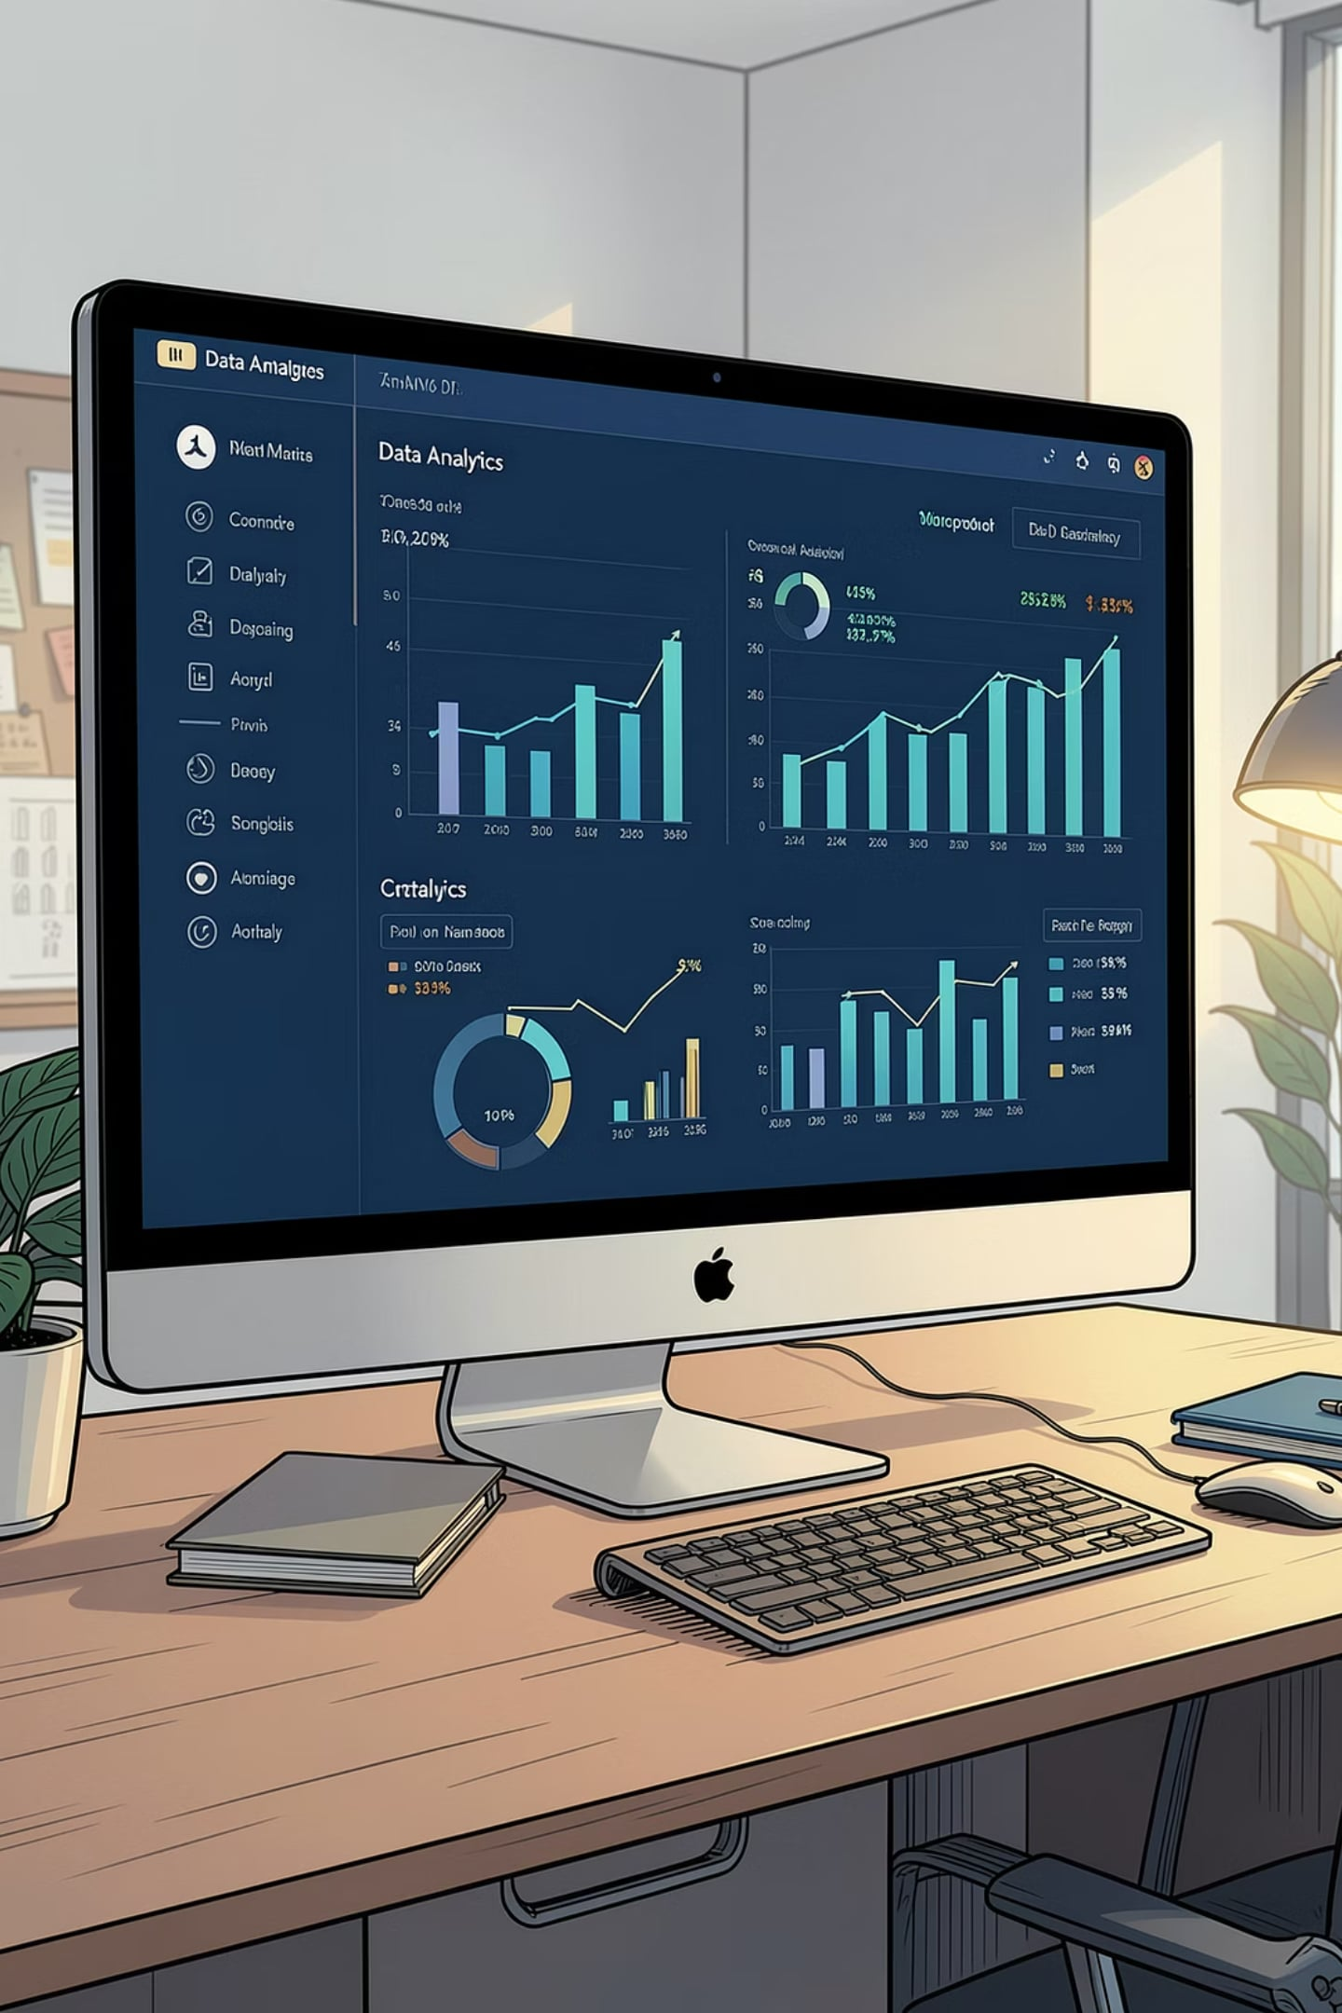
POWER BI PROJECT
BUSINESS INTELLIGENCE
Bengaluru Ola Executive Dashboard
Power BI Business Intelligence Project — Prepared by Shahabaz Khan

Slide 2
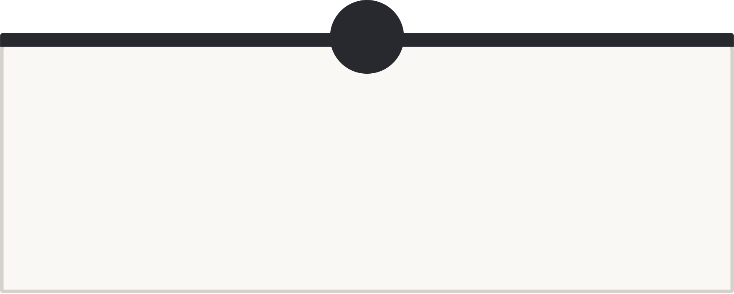
Project Overview
Turning Ride Data into Executive Decisions
1
2
Business Problem
Project Objective
Ola's Bengaluru operations lacked a centralized view of booking performance, payment trends, and customer satisfaction.
Build an interactive Power BI dashboard to monitor KPIs and surface actionable insights for stakeholders.
3
4
Why This Dashboard
Expected Impact
To replace manual reporting with a real-time, self-service BI solution for faster, data-driven decisions.
Improved operational efficiency, reduced incomplete rides, and better alignment of vehicle supply with demand.

Slide 3
Dataset Information
Foundation of the Analysis
The dashboard is built on a comprehensive Ola ride-booking dataset capturing every key dimension of each transaction.
Attribute
Description
Booking ID
Unique identifier for each ride booking
Customer ID
Unique identifier for each customer
Booking Status
Outcome of the ride — completed, cancelled, or incomplete
Vehicle Type
Category such as Prime Sedan, Prime Plus, Mini, Auto
Payment Method
Digital wallet, UPI, cash, or card transaction
Pickup Location
Origin zone within the Bengaluru metropolitan area
Drop Location
Destination zone within the Bengaluru metropolitan area
Customer Rating
Post-ride satisfaction score on a 1–5 scale
Booking Value
Fare amount in INR for each completed ride

Slide 4

Data Cleaning & Preparation
From Raw Data to Analysis-Ready Model
Remove Duplicates
Standardize Columns
Eliminate redundant rows for accuracy
Normalize names and formats
Handle Missing Values
Convert Data Types
Impute or remove gaps consistently
Ensure correct types for analysis
Each step ensures the dataset is accurate, consistent, and optimized for Power BI's in-memory analytics engine.

Slide 5
Dashboard KPIs
Key Metrics That Drive Decisions
₹1.2M+
10K+
75%
Total Booking Value
Total Rides
Successful Rides
Revenue scale across all rides
Volume of bookings analyzed
Completion rate indicator
25%
4.2★
Incomplete Rides
Customer Ratings
Cancellations and no-shows
Average satisfaction score
These KPIs give executives an at-a-glance view of revenue health, operational efficiency, and service quality.

Slide 6
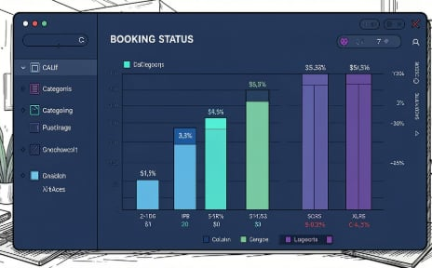
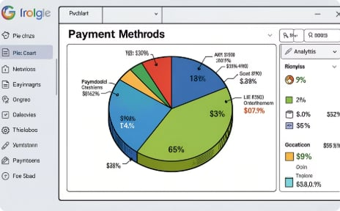
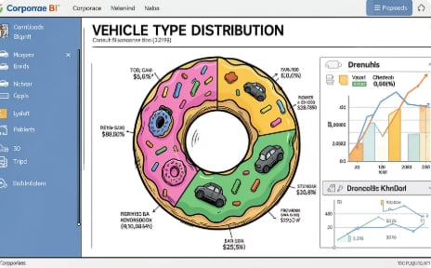
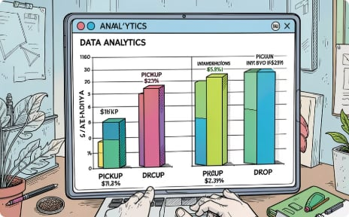
Dashboard Visualizations
Interactive Charts & Slicers
Booking Status Column Chart
Payment Method Pie Chart
Vehicle Type Donut Chart
Pickup & Drop Location Analysis
Tracks completed, cancelled, and incomplete rides over time.
Breaks down transactions by UPI, cash, card, and wallet.
Shows demand share across Prime Sedan, Prime Plus, Mini, and Auto.
Identifies high-traffic zones and underserved areas in Bengaluru.

Slide 7






Key Business Insights
What the Data Reveals
High Completion Rate
The majority of rides are successfully completed, reflecting strong operational reliability.
Digital Payments Dominate
UPI and wallet transactions account for most bookings, signaling a shift away from cash.
Premium Vehicle Demand
Prime Sedan and Prime Plus consistently show the highest booking volume.
Location Hotspots
Certain pickup and drop zones generate significantly more bookings than others.
Strong Satisfaction
Average customer ratings indicate overall positive service experience.

Slide 8




Business Recommendations
Strategic Actions for Growth
Optimize Low-Performing Zones
Reduce Incomplete Rides
Enhance Customer Experience
Promote Digital Payments
Target underserved pickup and drop locations with driver incentives and localized promotions.
Analyze cancellation patterns and implement driver accountability and ETA accuracy measures.
Use rating feedback to identify service gaps and reward high-performing drivers.
Offer cashback incentives for UPI and wallet transactions to further reduce cash dependency.
Expand Premium Supply
Monitor KPIs Continuously
Increase availability of Prime Sedan and Prime Plus during peak demand windows.
Leverage the dashboard for weekly performance reviews and agile decision-making.

Slide 9





Tools & Skills Used
The Technical Toolkit
95%
90%
Power BI
Power Query
Dashboard development & visualization
Data extraction and transformation
85%
90%
DAX
Excel
Calculated measures and KPIs
Data cleaning and preliminary analysis
88%
92%
Data Modeling
BI & Analytics
Star schema and relationship design
Insight generation and storytelling

Slide 10



Thank You
Questions?
Executive Insights Delivered
Data-Driven Decisions
Stakeholders can now monitor KPIs, identify trends, and act on insights in real time.
This project successfully transforms raw Ola booking data into a clear, interactive executive dashboard.
Skills Showcased
Power BI, DAX, data modeling, and business intelligence — interview-ready and portfolio-quality.
Prepared by Shahabaz Khan

