Slide 1
British Airways:Booking Prediction Analysis
Task 2: Predictive Modeling Rrsults

Slide 2
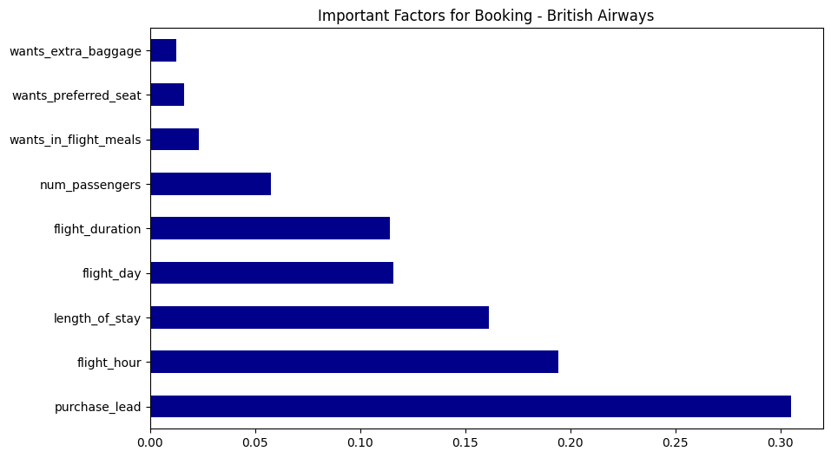
Key Findings and Model Performance
Model Accuracy:88.88%(High Reliability)
Top Predictor:Purchase Lead(Early planning is strong indicator of booking)
Secondary Drivers:Flight hour and Length of stay.

