Slide 1
Insurance Data — Key Insights
Insurance Customer Analysis – Overview & Insights"

Slide 2
Business Overview — Key Metrics
Total records: 99,951
Average Age: 39.03
Income categories: 86508
Distinct product types: 6

Slide 3
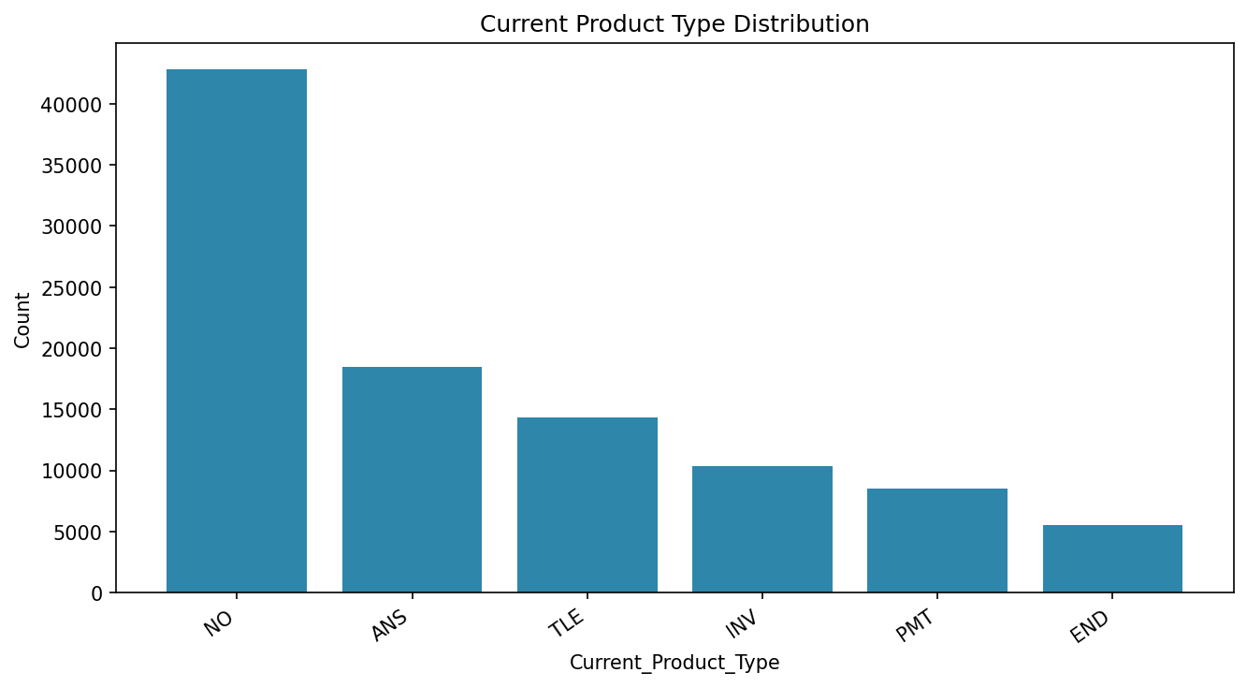
Product Adoption Analysis
What the chart shows: A bar chart showing how many customers currently own each product type.
Insights:
We can see that certain product types are significantly more popular than others. This means customers tend to prefer specific products, while some offerings may not be performing as well..
Business Suggestions:
High-volume product types → target for cross-sell (sell New_Product_Type).
Low-volume products → review messaging, pricing, or distribution channels.
Notes:
Shows distribution of currently-held product types. Suggestion: target cross-sell to dominant product segments.

Slide 4
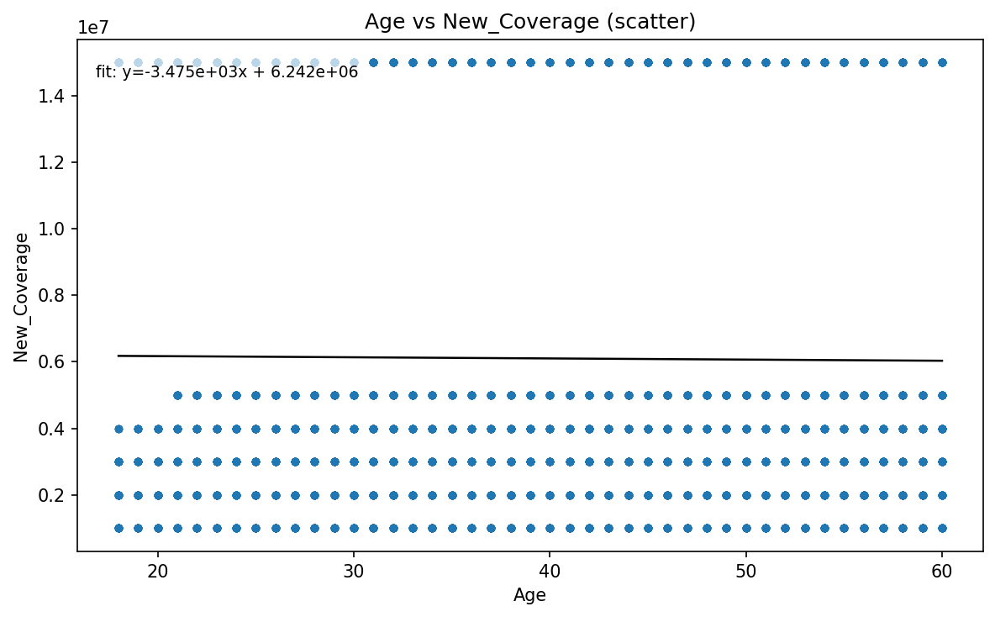
Relationship Analysis
"Premium vs New Coverage "
Description:
This scatter plot compares customer age with the new coverage amount. The points are widely scattered with no strong pattern, meaning age alone does not predict how much coverage a customer chooses. .”Suggestion:
Don’t rely on age alone for pricing or underwriting; test other predictors (income, occupation, product type) and build segment-level pricing models..
Notes:
Scatter shows relationship between premium (or proxy) and new coverage. Suggestion: test alternative predictors for pricing — age alone is weak.

Slide 5
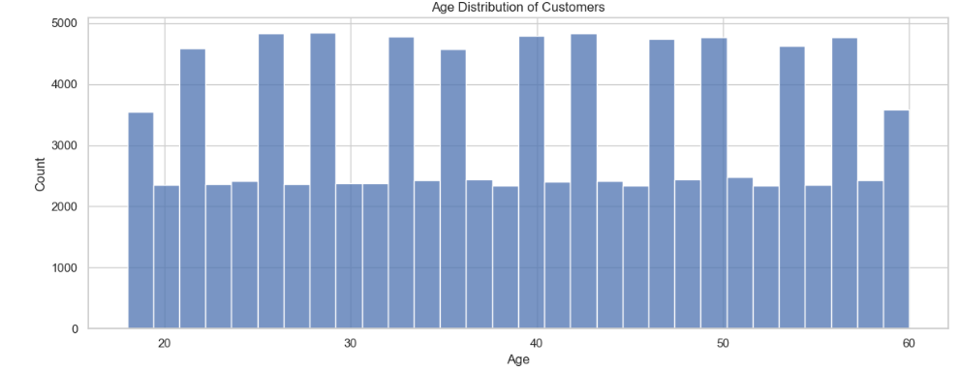
Customer Demographics
"Age Distribution of Customers"
What the chart shows: A histogram showing how customers are distributed across different age groups.
Insights:
If you see clustering between 25–40, these are your dominant working-age customers. Younger or older segments may be underrepresented.
Business Suggestions:
Focus marketing campaigns around the age segments with the highest density.
If older segments are small, design simplified or senior-friendly insurance bundles.
Notes:
Histogram showing customer age profile. Suggestion: tailor marketing and product features by cohort.

Slide 6
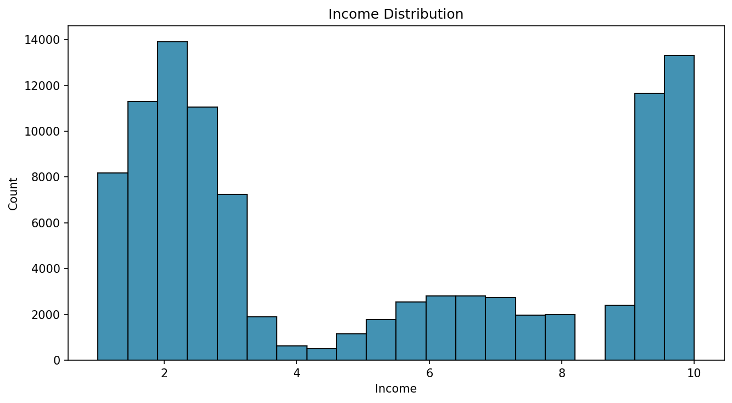
Income Segmentation
"Income Category Distribution"
What the chart shows: A histogram showing how customers fall into various income categories (1–10.).
Insights:
If income category 1 or 2 dominates → customer base is primarily lower-income.
If category 4–5 dominates → higher potential for selling investment or premium coverage plans.
Business Suggestions:
Align product pricing strategy with income clusters.
Create different “income-segmented” plans to increase conversion.
Notes:
Income band distribution among customers. Suggestion: offer segmented product tiers by income.

Slide 7
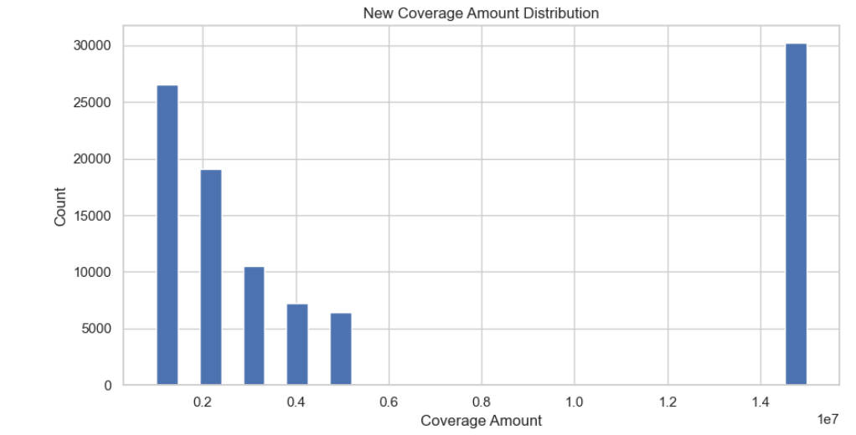
Coverage Distribution
What the chart shows: A histogram of the New Coverage Amount.
Insights:
Shows whether customers prefer low, mid, or extremely high coverage policies.
Can reveal skewness — e.g., few customers taking very high coverage.
Business Suggestions:
For high-coverage customers → consider enhanced risk assessment & underwriting.
For low-coverage groups → upsell to increase average policy value (APV).
Notes:
Distribution of requested coverage amounts; may be skewed. Suggestion: review underwriting for very large exposures.

Slide 8
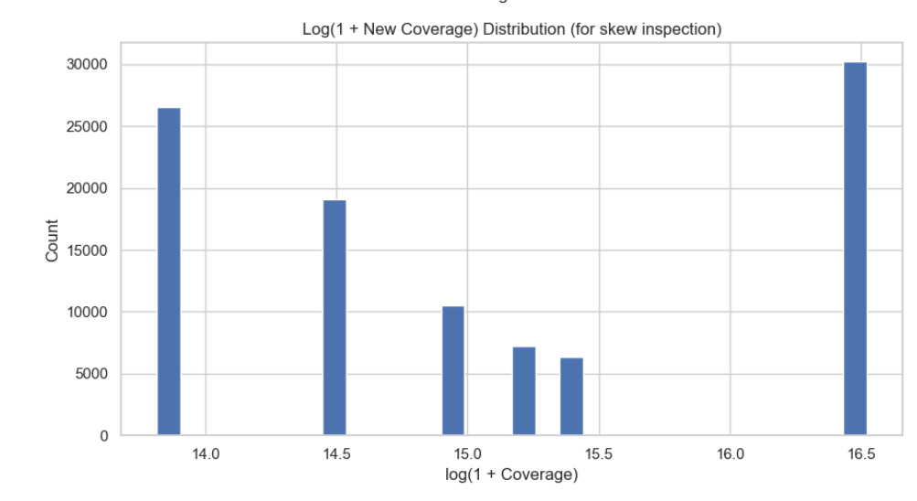
Coverage Skew Analysis
"Log(1 + Coverage) Transformation"
Insights:
Applying a log(1 + x) transformation shows that New Coverage values are highly right-skewed, meaning a few customers request very high coverage while most ask for lower or moderate levels.
Business Suggestions:
Create tiered insurance offerings: standard packages for the majority low-coverage customers and premium/high-value packages for the small high-coverage group
Notes:
Log-scale view to inspect skew in coverage amounts. Suggestion: consider segmenting by coverage brackets.

Slide 9
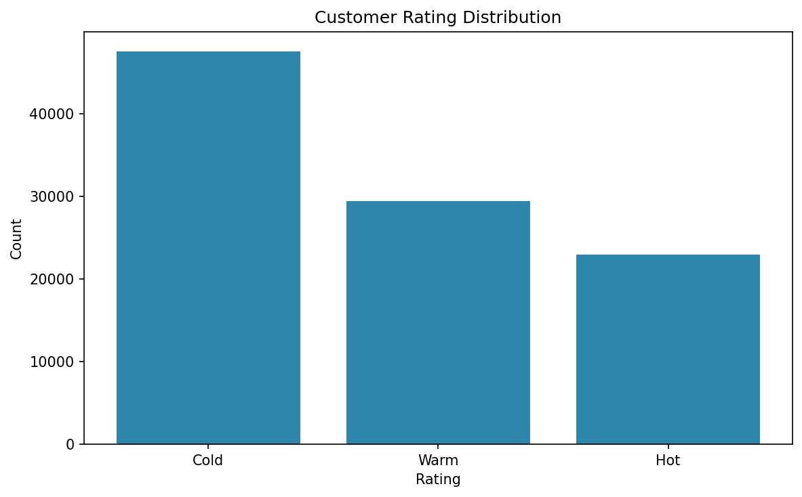
Lead Quality Analysis
"Customer Rating Distribution (Hot / Warm / Cold)"
What the chart shows: A bar chart of Rating segments (Hot, Warm, Cold).
Insights:
Shows the quality of leads (Hot/Warm/Cold).
If Cold leads dominate → conversion will be low unless re-engaged.
Business Suggestions:
Prioritize Hot and Warm leads in the upcoming campaign.
Build automated nurturing workflows for Cold leads to improve activation.
Notes:
Shows lead quality (Hot/Warm/Cold). Suggestion: prioritize Hot leads and nurture Cold leads.

Slide 10
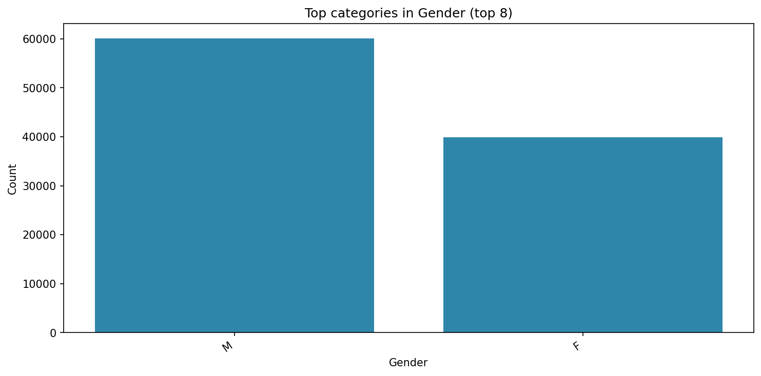
Gender Segmentation
"Top Gender Categories – Market Concentration"
What the chart shows :
Top buyers in gender.
Insights:
The dataset shows a strong concentration in specific gender categories, indicating that a majority of customers fall under one dominant gender group i.e ‘Male’.
Business Suggestions:
Develop targeted campaigns or product bundles that appeal more specifically to the smaller gender group.
Notes:
Top categories for an extra categorical field (e.g., Gender). Suggestion: deeper segmentation/targeting for top groups.

Slide 11
Key Insights and Business Recommendations“
Insights:
Customer base is dominated by ages 25–40, indicating strong representation of working professionals.
Coverage distribution is highly skewed, with most customers selecting low-to-mid coverage amounts.
Lead ratings show a healthy share of Hot and Warm leads, but Cold leads still represent churn risk.
Gender distribution reveals uneven segmentation, suggesting marketing imbalance.
Recommendations:
Develop tiered insurance products targeted at different income and coverage segments.
Increase cross-selling for the top product categories and redesign offerings for weaker ones.
Strengthen marketing for the underrepresented gender segment to diversify the customer base.

