Slide 1
Customer Churn Prediction
Brazilian E‑Commerce (Olist Dataset)
End‑to‑End Data Analytics project
Tools: SQL, Python, Pandas
Goal: Analyze customer transaction data to identify behavioral patterns that lead to customer churn and help businesses improve customer retention.

Slide 2
Project Objective
• Analyze customer purchase behavior
• Identify factors that lead to churn
• Build machine learning models to predict churn
• Provide actionable recommendations to reduce churn

Slide 3
Dataset Overview
Dataset: Brazilian E‑Commerce Public Dataset by Olist
Contains ~100k orders (2016–2018)
Multiple relational tables including:
• Customers
• Orders
• Order Items
• Payments
• Reviews
• Products

Slide 4
Project Workflow
1. Data Collection
2. Database Creation (SQLite)
3. SQL Exploratory Analysis
4. Data Cleaning & Preparation (Pandas)
5. Feature Engineering
6. Business Insights

Slide 5
SQL Exploratory Data Analysis
Key business questions answered using SQL:
• Monthly sales trends
• Top customers by revenue
• Payment method analysis
• Product category performance
• Customer purchase frequency

Slide 6
Data Cleaning & Preparation
Steps performed:
• Handling missing values
• Converting date columns
• Removing duplicates
• Creating aggregated customer metrics
• Preparing dataset for machine learning

Slide 7
Feature Engineering
Important features created:
• Total orders per customer
• Average order value
• Total amount spent
• Days since last purchase
• Payment behavior patterns

Slide 8
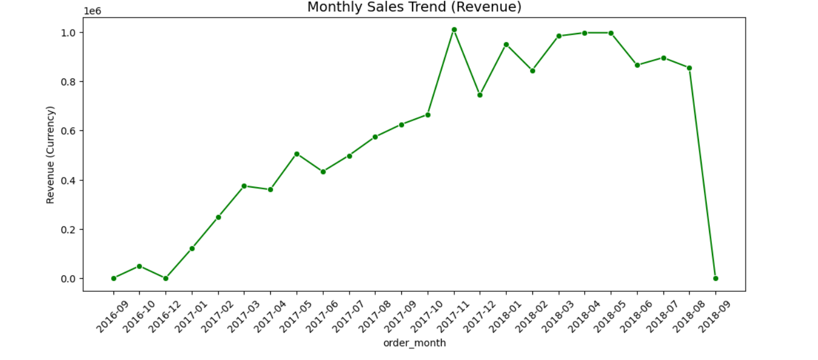
Monthly Sales Trend (Revenue)
Insight:
• Revenue trend shows how sales fluctuate month-to-month across the platform.
• Peaks indicate seasonal demand or successful promotional campaigns.
Recommendation:
• Run marketing campaigns before historically high‑performing months.
• Investigate low‑revenue months and introduce targeted discounts.

Slide 9
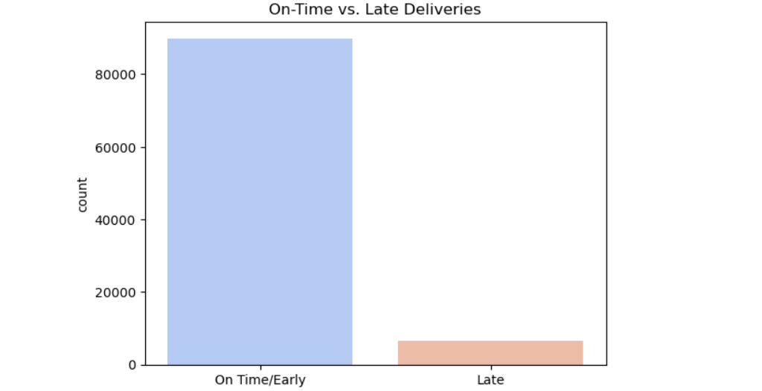
On‑Time vs Late Deliveries
Insight:
• Delivery performance distribution shows how often orders arrive late vs on time.
• Higher late deliveries may indicate logistics or courier inefficiencies.
Recommendation:
• Improve logistics coordination with delivery partners.
• Implement real‑time tracking and proactive delay notifications.

Slide 10
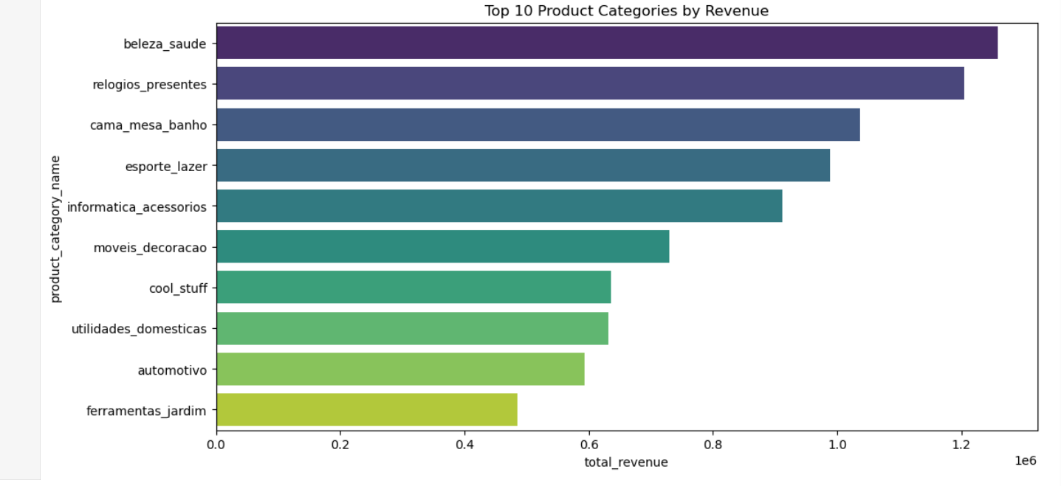
Top Product Categories by Revenue
Insight:
• Some product categories contribute disproportionately to total revenue.
• Identifies the most profitable segments of the marketplace.
Recommendation:
• Prioritize marketing for top‑performing categories.
• Expand inventory and supplier partnerships in high‑revenue segments.

Slide 11
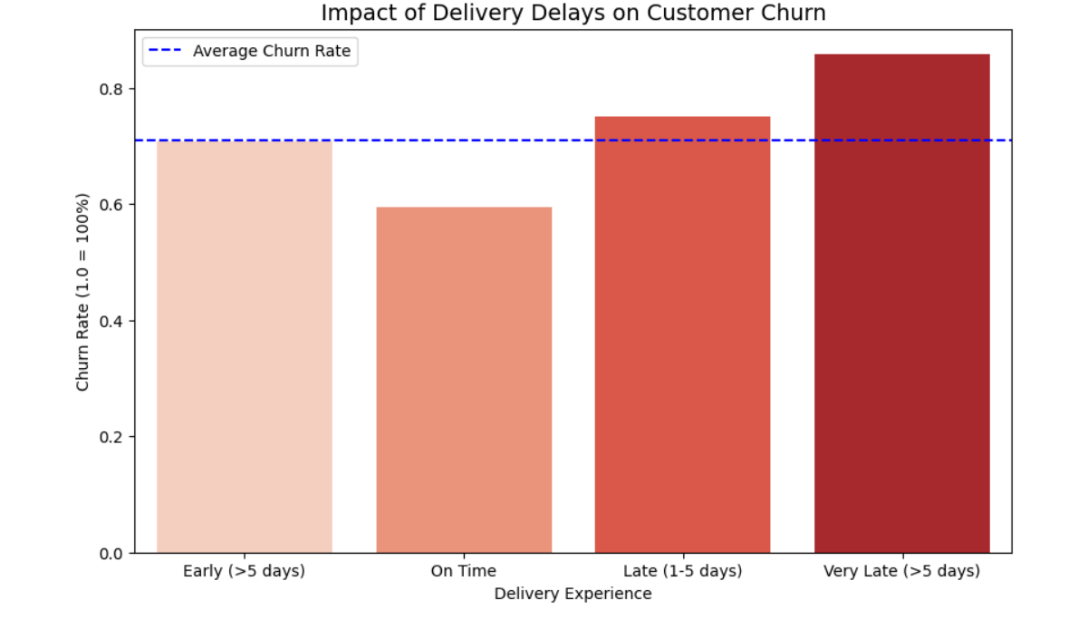
Impact of Delivery Delay on Customer Churn
Insight:
• Customers experiencing late deliveries show higher churn probability.
• Delivery experience is a strong driver of customer retention.
Recommendation:
• Prioritize faster fulfillment for repeat customers.
• Offer compensation or discounts when deliveries are significantly delayed.

Slide 12
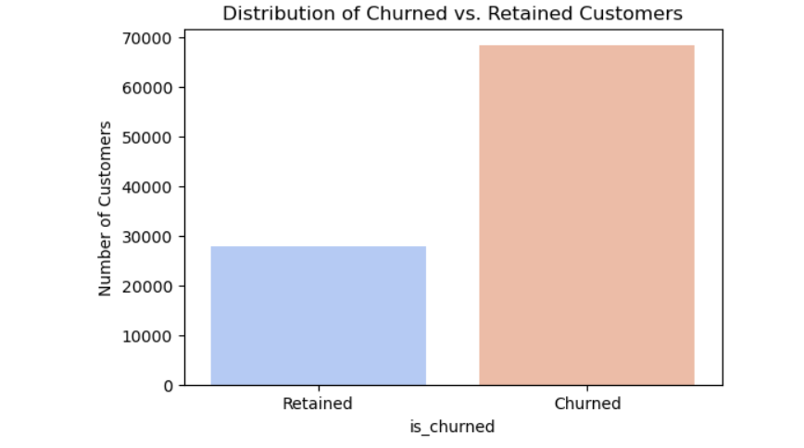
Customer Churn Distribution
Insight:
• Shows the proportion of customers who churned vs retained.
• Helps understand the overall churn severity in the dataset.
Recommendation:
• Launch retention campaigns for customers with declining purchase frequency.
• Introduce loyalty programs for repeat customers.

Slide 13
Business Recommendations
• Launch targeted retention campaigns
• Offer discounts to inactive customers
• Create loyalty programs for high‑value customers
• Improve customer support for negative review segments

Slide 14
THANK YOU

