Slide 1
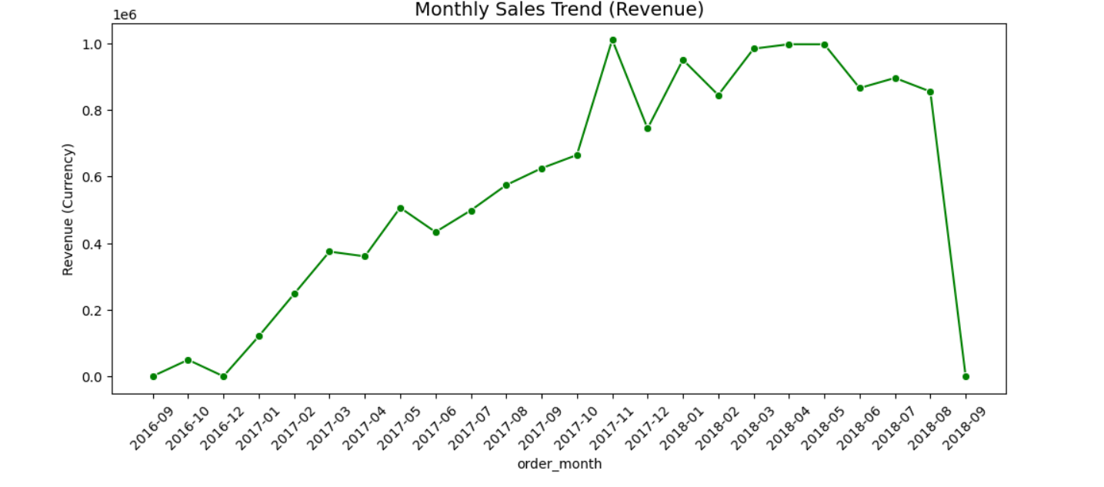
Monthly Sales Trend (Revenue)
Insight:
• Revenue trend shows how sales fluctuate month-to-month across the platform.
• Peaks indicate seasonal demand or successful promotional campaigns.
Recommendation:
• Run marketing campaigns before historically high‑performing months.
• Investigate low‑revenue months and introduce targeted discounts.

Slide 2
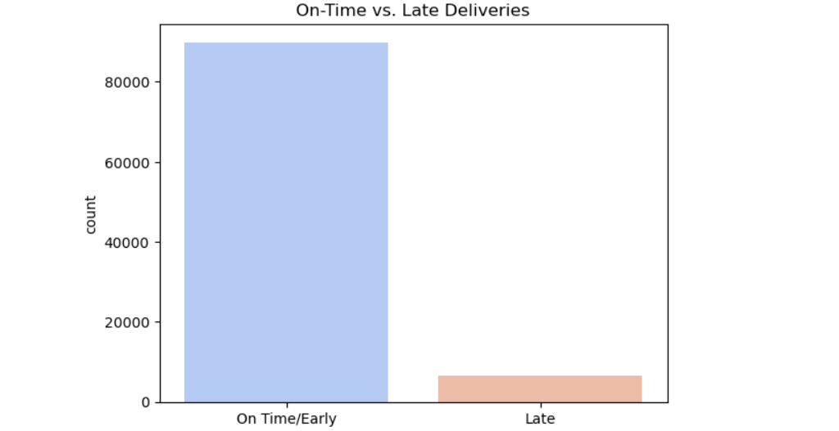
On‑Time vs Late Deliveries
Insight:
• Delivery performance distribution shows how often orders arrive late vs on time.
• Higher late deliveries may indicate logistics or courier inefficiencies.
Recommendation:
• Improve logistics coordination with delivery partners.
• Implement real‑time tracking and proactive delay notifications.

Slide 3
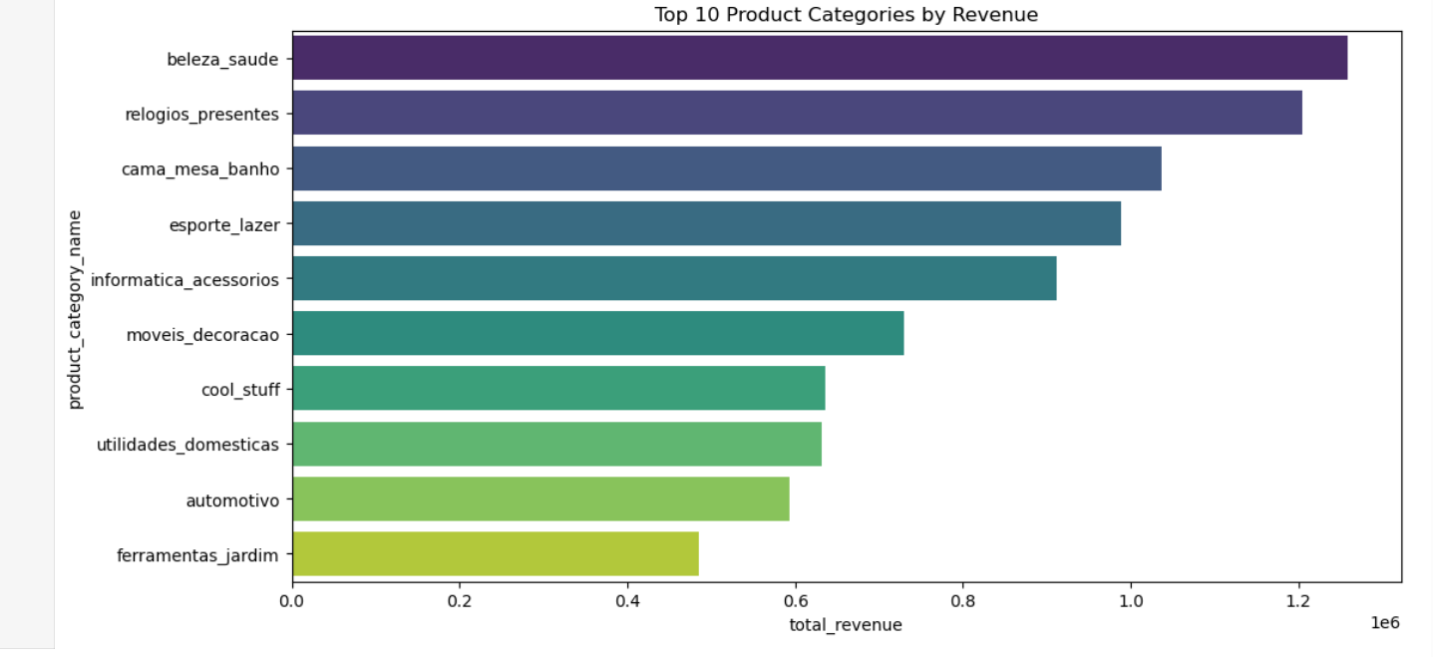
Top Product Categories by Revenue
Insight:
• Some product categories contribute disproportionately to total revenue.
• Identifies the most profitable segments of the marketplace.
Recommendation:
• Prioritize marketing for top‑performing categories.
• Expand inventory and supplier partnerships in high‑revenue segments.

Slide 4
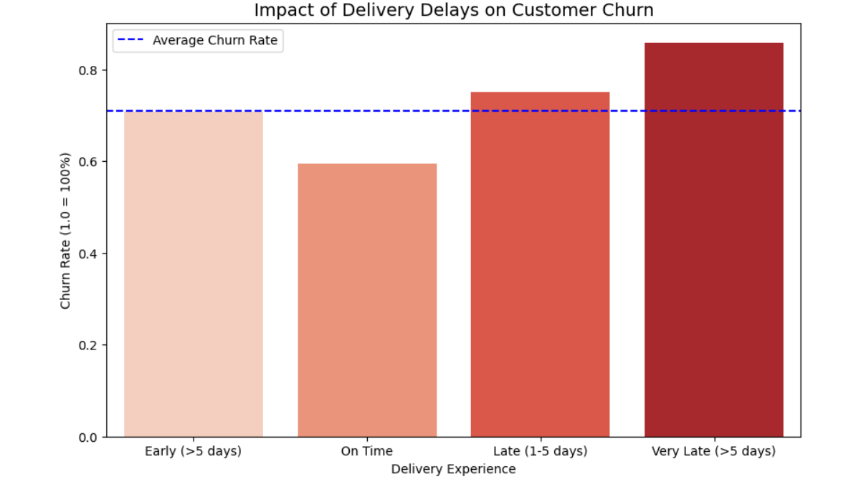
Impact of Delivery Delay on Customer Churn
Insight:
• Customers experiencing late deliveries show higher churn probability.
• Delivery experience is a strong driver of customer retention.
Recommendation:
• Prioritize faster fulfillment for repeat customers.
• Offer compensation or discounts when deliveries are significantly delayed.

Slide 5
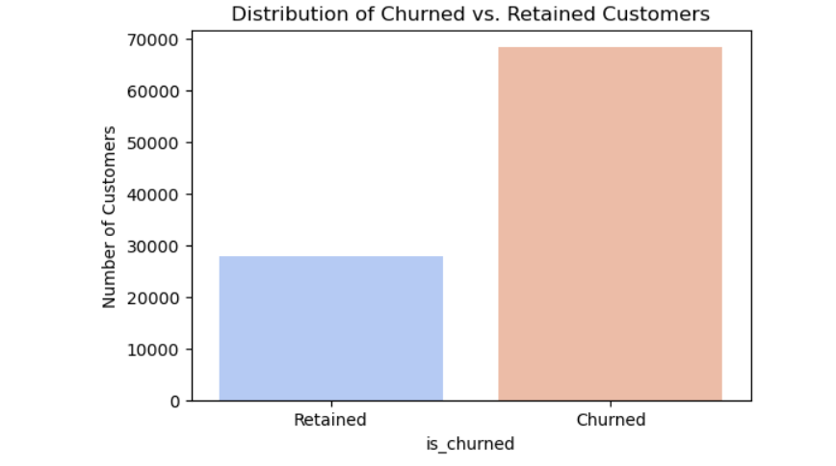
Customer Churn Distribution
Insight:
• Shows the proportion of customers who churned vs retained.
• Helps understand the overall churn severity in the dataset.
Recommendation:
• Launch retention campaigns for customers with declining purchase frequency.
• Introduce loyalty programs for repeat customers.

