Slide 1
HR Analytics -MOHD.SHAIFAN

Slide 2
Business Objective
To analyze employee performance, training, and KPI data
To identify factors that influence employee promotion
To predict whether an employee will be promoted or not
To help the organization make faster and data-driven promotion decisions

Slide 3
DATA OVERVIEW
We have employee information, like:
Which department they work in
Their education and gender
How many trainings they completed
Their previous year performance rating
Whether they met KPIs or won awards
Their training score

Slide 4
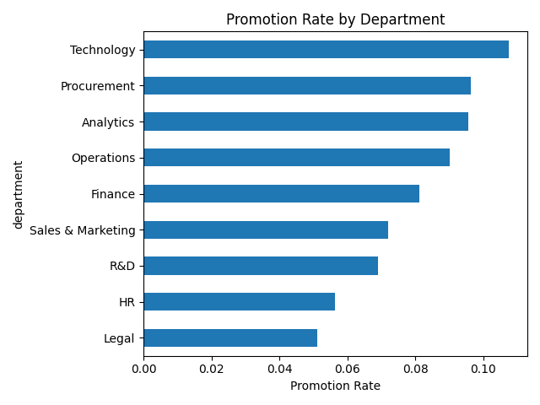
Promotion Rate by Department
“Technology and Procurement departments show the highest promotion rates, above 9.5%, indicating strong alignment between skills, training outcomes, and promotion criteria. On the other hand, HR and Legal have promotion rates close to 5%, suggesting either limited senior role availability or stricter promotion benchmarks.”
Business Action
Replicate training and evaluation practices from high-performing departments.
Review promotion readiness criteria in low-performing departments.

Slide 5
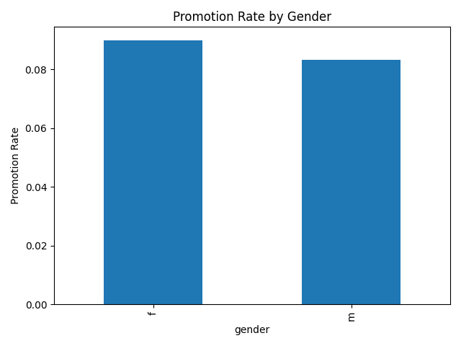
Promotion Rate by Gender
Insight
“Female employees show a slightly higher promotion rate than male employees, with 8.99% versus 8.32%. The difference is marginal, indicating that the promotion process is largely gender-neutral.”
Business Action
Maintain current evaluation standards.
Continue monitoring fairness metrics to avoid future bias

Slide 6
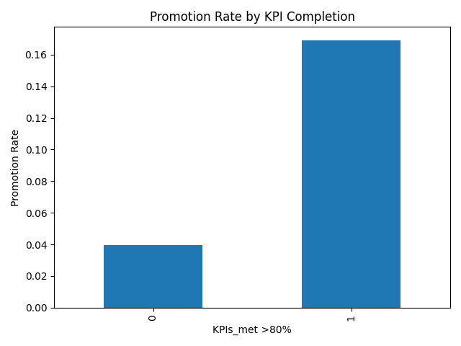
Impact of KPI Completion
Insight :
“Employees who meet KPI targets have a promotion rate of nearly 17%, compared to only 4% for those who do not. This means employees meeting KPIs are over 4 times more likely to be promoted.”
Business Action
Use KPI completion as a mandatory checkpoint filter.
Fast-track KPI-compliant employees into promotion preparation programs.

Slide 7
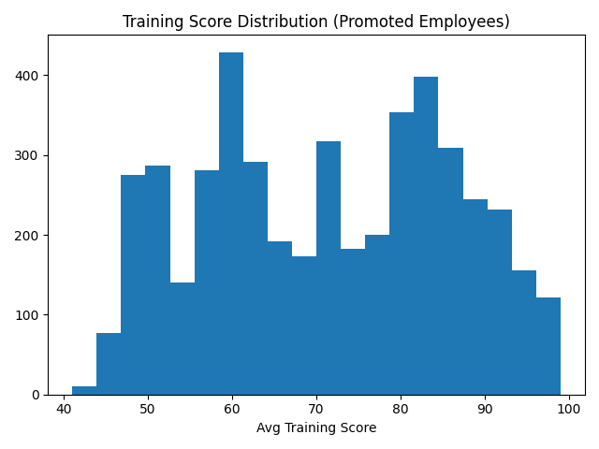
Training Score Distribution (Promoted)
Insight
“Most promoted employees score above 70 in training evaluations, clearly indicating that training performance is a major differentiator in promotion decisions.”
Business Action
Set 70+ training score as a promotion readiness benchmark.
Provide targeted coaching for employees scoring between 60–70.

Slide 8
Key Insights & Recommendations
“Out of 54,808 employees only 8.5% were promoted, showing a highly selective process.
Employees meeting KPI >80% and having previous year rating ≥3 are significantly more likely to be promoted.
Certain departments consistently outperform others in promotion rates, indicating skill alignment differences.
Training score is a strong differentiator; promoted employees cluster at higher scores.
Gender-wise promotion rates show minimal bias, suggesting a relatively fair evaluation process.

Slide 9
Actionable Next Steps
Prioritize checkpoint-eligible employees for fast-track promotion
Focus training investments on low-performing departments
Monitor fairness metrics continuously

Slide 10
THANK YOU

