Slide 1
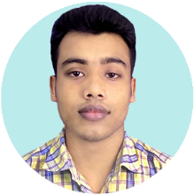

Welcome to my Website
GALLERY
My name is SHAIFUL ISLAM. Family, relatives, neighbours call me SHOHAG. I am studying BSc in Civil Engineering at Dhaka International University. As well as I am working for VCube as Junior Project QA(Quality Assurance) Engineer. Before working at VCube, I was worked for Fervid Structure Limited as a Site Engineer and Daulod Uddin Day-night Tutorial Home as a Teacher. I have completed my diploma-in-engineering degree in Civil Technology from Rangpur Polytechnic Institute in 2017.
I love to face adventure. Challenging work attract me.I like to smile others. And so much love to teach.
About
Education
Experience
Skills
Contacts

Slide 2

EDUCATION
HOME
GALLERY
BSc. In Civil Engineering
Dhaka International University.
Studying
Diploma in Engineering
Rangpur Polytechnic Institute, Rangpur.
Civil Technology
Passing Year : 2017
About
Education
Experience
Secondary School Certificate (SSC)
Kanthalbari High School, Kurigram.
Science
Passing Year : 2013
Skills
Contacts

Slide 3


EXPERIENCE
HOME
GALLERY
VCUBE | FERVID STRUCTURE LIMITED
I am working here from as a Junior Project QA(Quality Assurance) Engineer. I have joined here on 4 August, 2018 as a Trainee Jr. Project QA Engineer. At VCube we work for Insidemaps (Insidemaps.com) where we create stunning interactive Virtual Tour, 3D Models, Floor plans, 3D Tour videos and HDR photos of homes for customers in the Real Estate Industry and beyond. | I was working here as a Site Engineer from March – May, 2018. Here I was a project which one was two connecting bridge of 3 buildings. It was challenging project. While project was running every moment we faced unfavorable condition. It is hopeful that I finished my project successfully.
About
Education
Experience
Skills
Contacts

Slide 4



SKILLS
HOME
GALLERY
POWERPOINT
95%
About
PHOTOSHOP
65%
Education
MS WORD
90%
Experience
EXCEL
88%
Skills
Contacts
AUTOCAD
82%

Slide 5










CONTACTS
HOME
GALLERY
KEEP IN TOUCH
FACEBOOK
LINKEDIN
About
Education
TWITTER
INSTAGRAM
Experience
Skills
S_I_SHOHAG
+8801400031319
Contacts
sishohagce@gmail.com

Slide 6
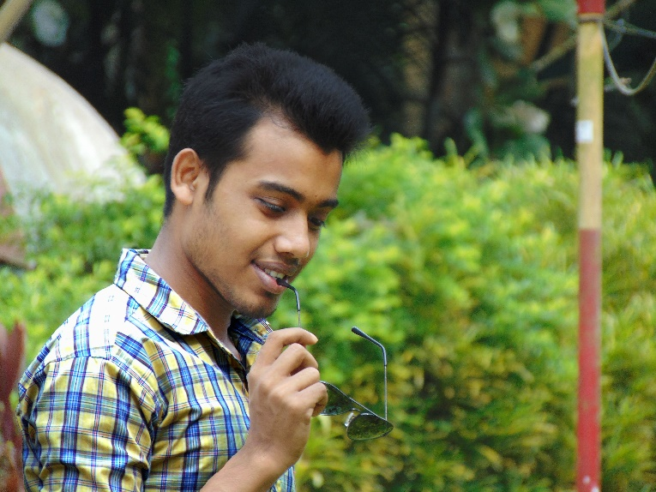
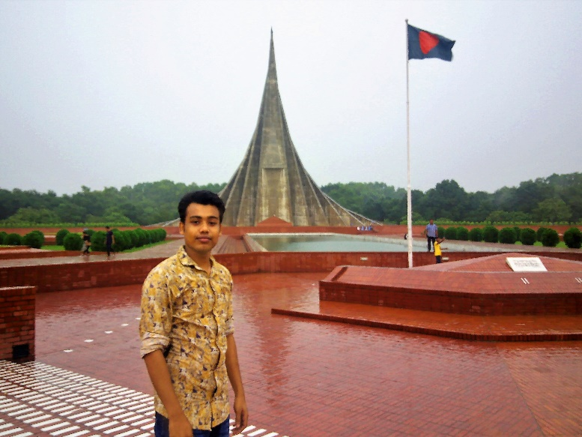
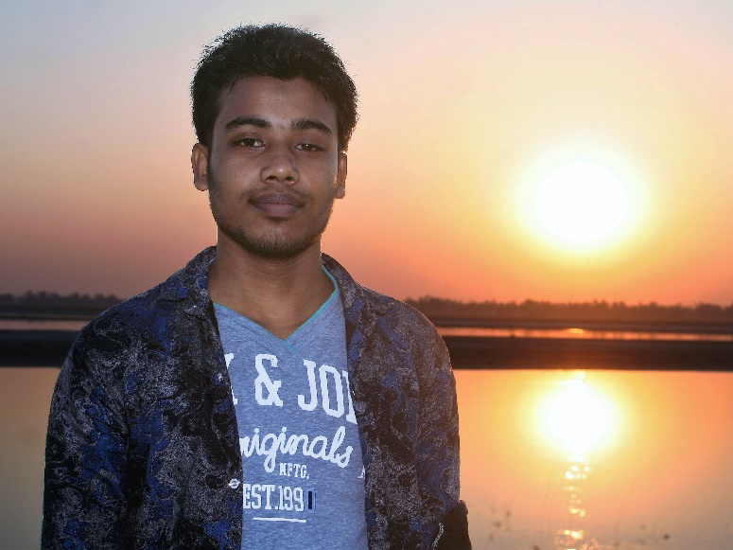
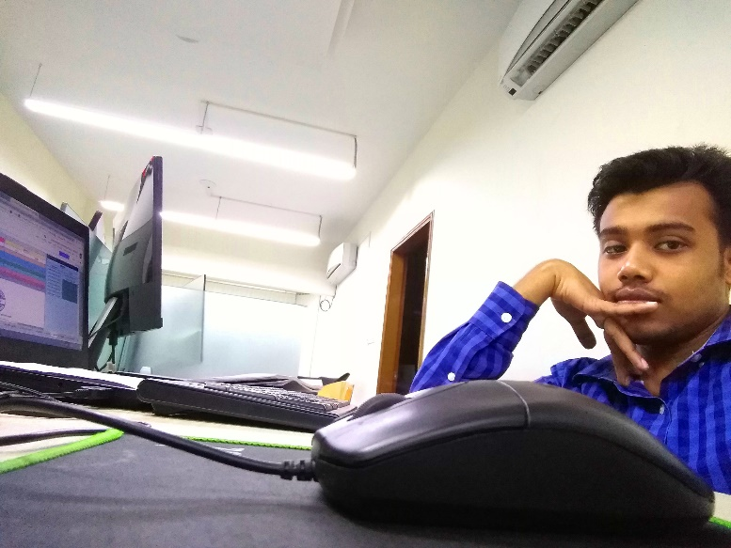
GALLERY
HOME
About
Education
Experience
Skills
Contacts

