Slide 1



Can a Blockchain Keep a Secret?
¹
²
³
Fabrice Benhamouda¹, Craig Gentry¹, Sergey Gorbunov², Shai Halevi¹, Hugo Krawczyk¹, Chengyu Lin³, Tal Rabin¹, Leonid Reyzin²
https://eprint.iacr.org/2020/464

Slide 2



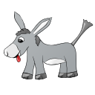
Can a Blockchain be a Trusted Party?
Public PoS
$$x_{1}$$
$${f(x}_{1}, x_{2}, x_{3})$$
$$x_{2}$$
$$x_{3}$$
This Photo by Unknown Author is licensed under CC BY-NC-ND
Meh…
Great for integrity/immutability
Not so much for secrecy

Slide 3
This Work: A Basic Secrecy Setting
A client deposits a secret at the blockchain
To be “revealed only when the time is right”
More generally “used only in the prescribed manner”
Example: publish a puzzle, deposit a solution
Reveal the solution if not found by next week
Can form the basis for many applications

Slide 4
Security and Efficiency
The secret must remain a secret
Unknown to the adversary, but still recoverable
As long as we have “honest majority” of stake
Even when the adversary is mobile
Efficiency: want a scalable solution
Communication/work does not increase as time go by, or as more nodes are joining the network
Plausible practicality: No obfuscation/witness-encryption
We seek solutions based on proactive secret-sharing

Slide 5




Proactive Secret-Sharing [OY91,CH93,…]
Periodic runs of a share-refresh protocol
The secret remains a secret as long as each committee separately has honest majority
Even if different parties are corrupted in different times
reshare
reshare
reshare
reshare
$$C_{1}$$
$$C_{2}$$
$$C_{3}$$
$$C_{4}$$

Slide 6
Why is it Hard on a Public Blockchain?
For scalability, communication only by a small committee
But then a mobile adversary can corrupt them all
Previous work assumed that committees have honest majority
We provide a mechanism to ensure it
Solution: keep committee members anonymous
So adversary cannot target them
Player replaceability: a committee member sends a single message, revealing its identity only after completing its job
How to (re)share a secret among an unknown committee?

Slide 7

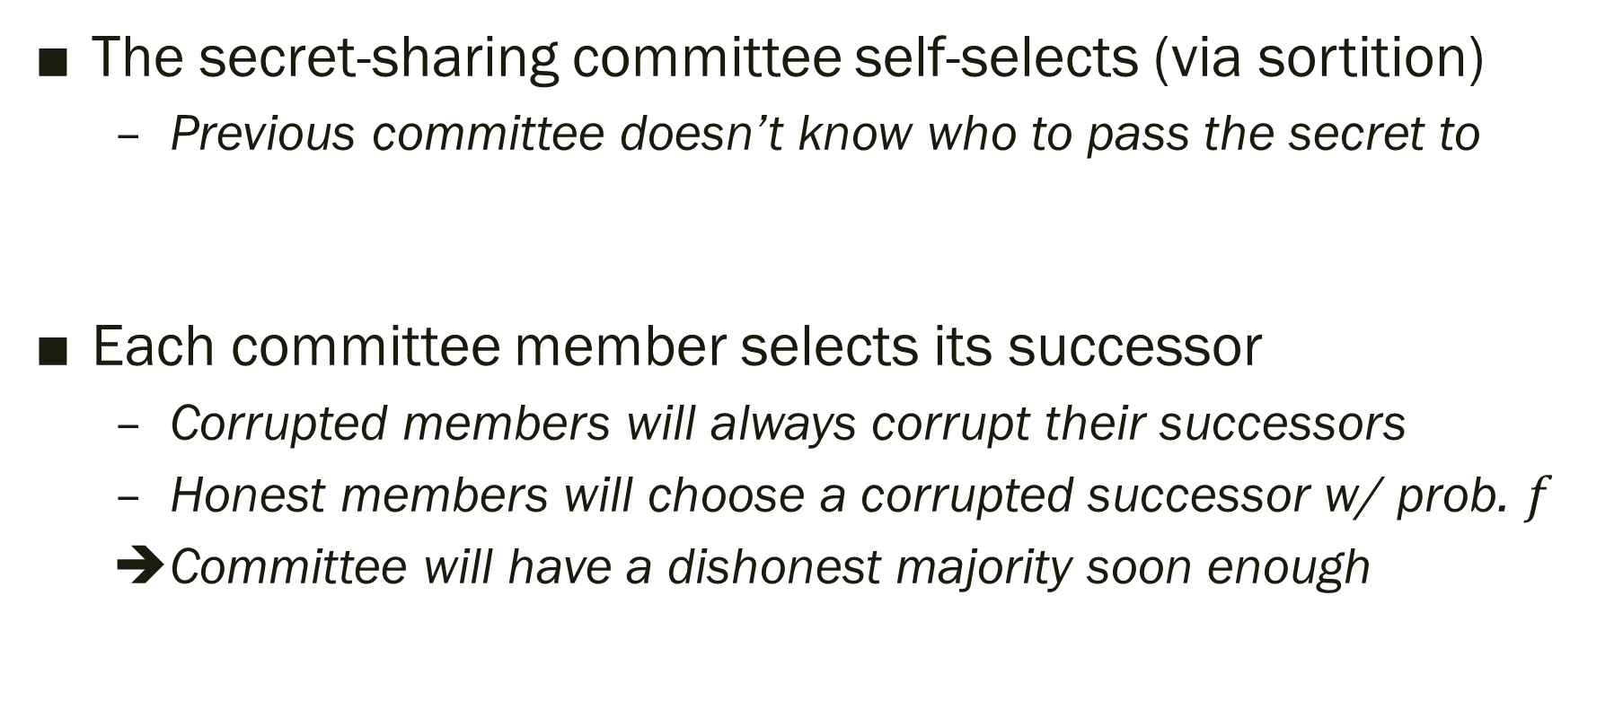



Some Directions that do not Work
The secret-sharing committee self-selects (via sortition)
Previous committee doesn’t know who to pass the secret to
Each committee member selects its successor
Corrupted members will always corrupt their successors
Honest members will choose a corrupted successor w/ prob. $f$
Committee will have a dishonest majority soon enough
?
reshare
reshare
reshare
reshare
reshare
$$C_{1}$$
$$C_{2}$$
$$C_{3}$$
$$C_{4}$$

Slide 8












Wouldn’t it be great if we had…
A target-anonymous channel functionality
$m$ visible input ports, $m$ hidden output ports
Random assignment of the output ports to an $m$-subset of the $N$ users
$$P_{1}$$
$$P_{2}$$
$$I_{1}$$
$$P_{3}$$
$$I_{2}$$
$$P_{4}$$
$$I_{3}$$
$$P_{5}$$
…
$$P_{6}$$
…
$$I_{m}$$
$$P_{N}$$

Slide 9
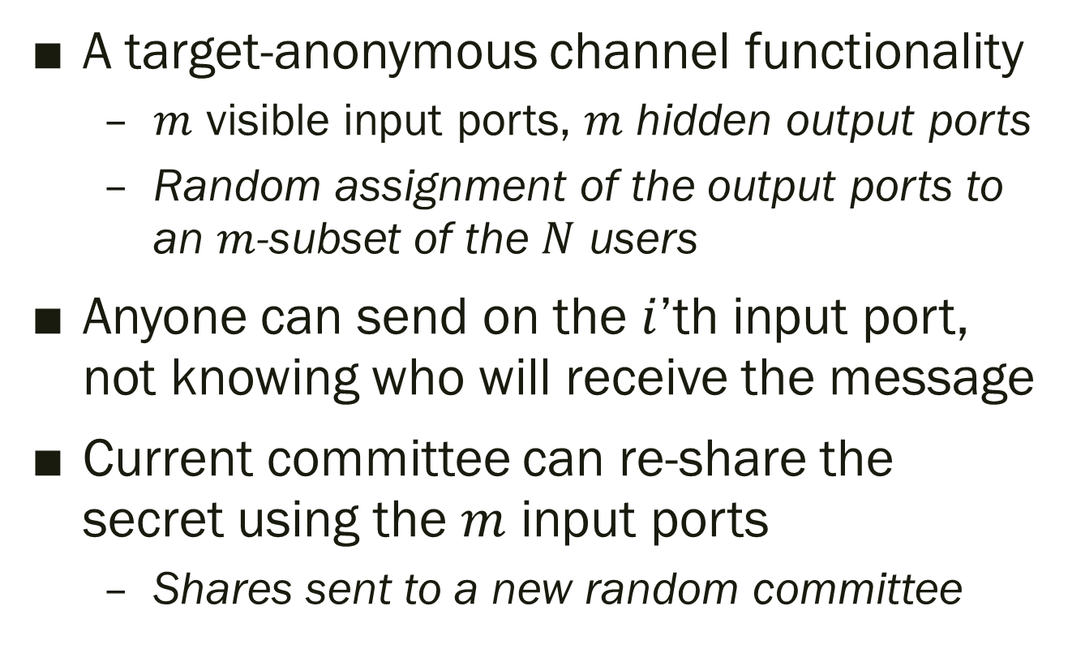
Wouldn’t it be great if we had…
A target-anonymous channel functionality
$m$ visible input ports, $m$ hidden output ports
Random assignment of the output ports to an $m$-subset of the $N$ users
Anyone can send on the $i$’th input port, not knowing who will receive the message
Current committee can re-share the secret using the $m$ input ports
Shares sent to a new random committee
$$P_{1}$$
$$P_{2}$$
$$I_{1}$$
$$P_{3}$$
$$I_{2}$$
$$P_{4}$$
$$I_{3}$$
$$P_{5}$$
…
$$P_{6}$$
…
$$I_{m}$$
$$P_{N}$$

Slide 10
Wouldn’t it be great if we had…
A target-anonymous channel functionality
$m$ visible input ports, $m$ hidden output ports
Random assignment of the output ports to an $m$-subset of the $N$ users
Anyone can send on the $i$’th input port, not knowing who will receive the message
Current committee can re-share the secret using the $m$ input ports
Shares sent to a new random committee
$$P_{1}$$
$$P_{2}$$
$$I_{1}$$
$$P_{3}$$
$$I_{2}$$
$$P_{4}$$
Doesn’t solve everything, but helps a lot
$$I_{3}$$
$$P_{5}$$
…
$$P_{6}$$
…
$$I_{m}$$
$$P_{N}$$

Slide 11
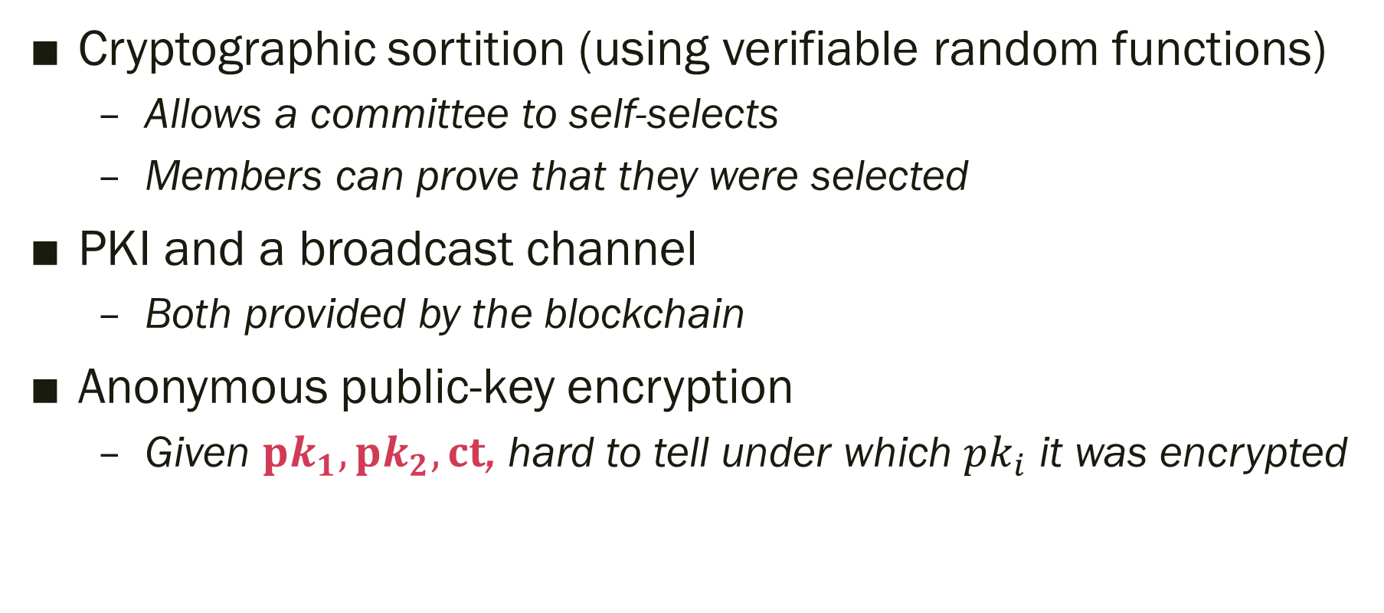
Tools
Cryptographic sortition (using verifiable random functions)
Allows a committee to self-selects
Members can prove that they were selected
PKI and a broadcast channel
Both provided by the blockchain
Anonymous public-key encryption
Given $pk_{1}, pk_{2}, ct$, hard to tell under which $pk_{i}$ it was encrypted

Slide 12
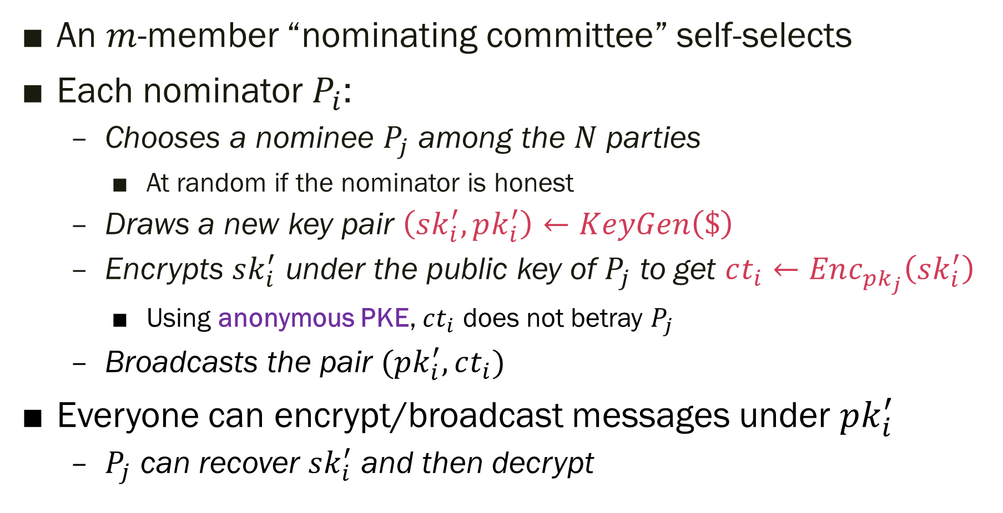
Approximating Target-Anonymous Channels
An $m$-member “nominating committee” self-selects
Each nominator $P_{i}$:
Chooses a nominee $P_{j}$ among the $N$ parties
At random if the nominator is honest
Draws a new key pair $\left(sk_{i}^{′}, pk_{i}^{′}\right)←KeyGen\left(\$\right)$
Encrypts $sk_{i}^{′}$ under the public key of $P_{j}$ to get $ct_{i}←Enc_{pk_{j}}\left(sk_{i}^{′}\right)$
Using anonymous PKE, $ct_{i}$ does not betray $P_{j}$
Broadcasts the pair $(pk_{i}^{′}, ct_{i})$
Everyone can encrypt/broadcast messages under $pk_{i}^{′}$
$P_{j}$ can recover $sk_{i}^{′}$ and then decrypt

Slide 13
Nominators Need Not Prove Anything
➔Corrupted nominators can (e.g.) nominate their friends
Proofs wouldn’t have worked anyways:
Even if forced to behave honestly, a corrupted nominator could turn around and corrupt its randomly-chosen nominee
Also: such proofs have “long statements”
Statements that include everyone’s public keys
So producing the proof is not scalable

Slide 14
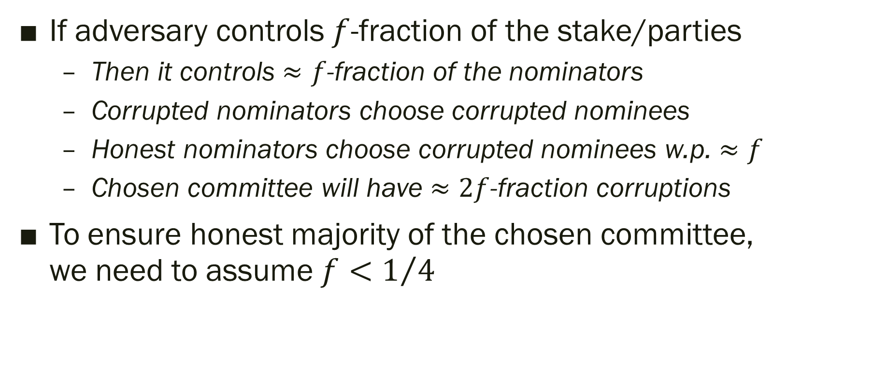
Resilience of Our Target-Anonymous Channels
If adversary controls $f$-fraction of the stake/parties
Then it controls $≈f$-fraction of the nominators
Corrupted nominators choose corrupted nominees
Honest nominators choose corrupted nominees w.p. $≈f$
Chosen committee will have $≈2f$-fraction corruptions
To ensure honest majority of the chosen committee, we need to assume $f<1/4$

Slide 15








The Overall Solution
$$C_{1}^{′}$$
$$C_{2}^{′}$$
$$C_{3}^{′}$$
$$C_{4}^{′}$$
Nominating committees
…
reshare
reshare
reshare
reshare
Secret-sharing committees
$$C_{1}$$
$$C_{2}$$
$$C_{3}$$
$$C_{4}$$
Re-sharing requires NIZK
Only for short statements with short witnesses
Depends only on the committee size
Hence solution is scalable

Slide 16
The End Result
A scalable proactive secret-sharing protocol
With “player replaceability”
Assuming that the adversary controls < ¼ of the stake
Room for improvement here
Can be implemented under DDH, DCR, LWE, …
Requires anonymous encryption under selective opening attacks
An open problem, see following slides
Can conceivably be made practical

Slide 17
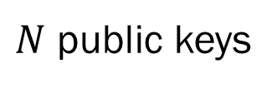

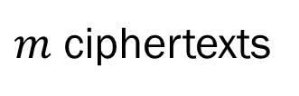
Anonymous PKE Under Selective Opening
Our solution broadcasts encryptions under anonymous PKE
Adversary sees pks, ctxts, then decides who to corrupt
Can an adversary that only corrupts $f$-fraction of keys, nonetheless manage to read $≫f$ fraction of the ctxts?
$m$ ciphertexts
$N$ public keys

Slide 18
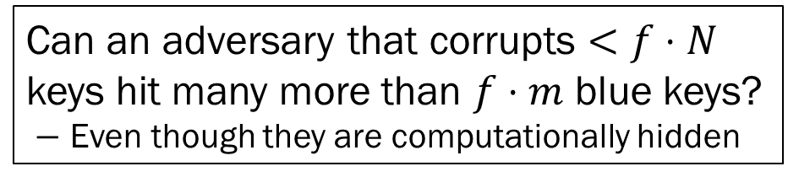
Anonymous PKE Under Selective Opening
Our solution broadcasts encryptions under anonymous PKE
Adversary sees pks, ctxts, then decides who to corrupt
Can an adversary that only corrupts $f$-fraction of keys, nonetheless manage to read $≫f$ fraction of the ctxts?
Can an adversary that corrupts $<f⋅N$ keys hit many more than $f⋅m$ blue keys?
$−$ Even though they are computationally hidden
$m$ ciphertexts
$N$ public keys

Slide 19
Anonymous PKE Under Selective Opening
An adaptive adversary sees keys, ciphertexts, then opens keys one at a time
“Semi adaptive” decides on the set of keys to open at once
Rather than one at a time
For secrecy, it is known that semantic security does not imply secrecy under selective opening
Even for semi-adaptive adversaries

Slide 20
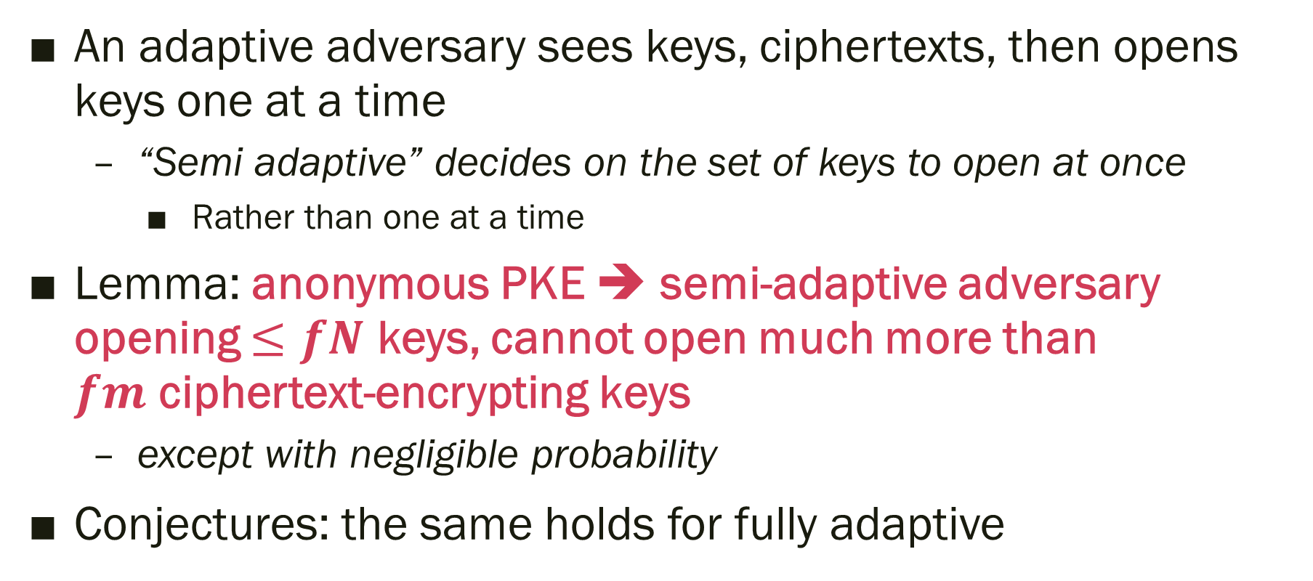
Anonymous PKE Under Selective Opening
An adaptive adversary sees keys, ciphertexts, then opens keys one at a time
“Semi adaptive” decides on the set of keys to open at once
Rather than one at a time
Lemma: anonymous PKE ➔ semi-adaptive adversary opening $≤fN$ keys, cannot open much more than $fm$ ciphertext-encrypting keys
except with negligible probability
Conjectures: the same holds for fully adaptive

Slide 21
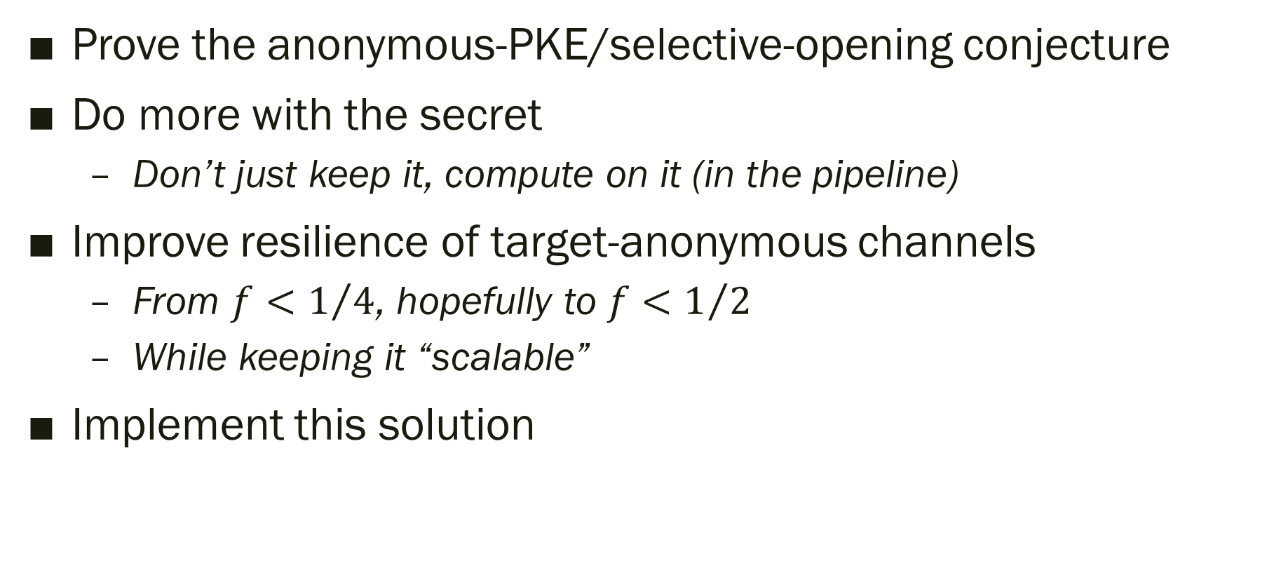
Some Open Problems and Future Work
Prove the anonymous-PKE/selective-opening conjecture
Do more with the secret
Don’t just keep it, compute on it (in the pipeline)
Improve resilience of target-anonymous channels
From $f<1/4$, hopefully to ${f<1}/2$
While keeping it “scalable”
Implement this solution

Slide 22


