Slide 1
Advanced Cryptography: Promise and Challenges
Shai Halevi, IBM Research
ACM-CCS, October 2018

Slide 2
What's "Advanced Cryptography"?
Cryptography beyond encryption, signatures
Protecting computation, not just data

Slide 3






What's "Advanced Cryptography"?
Cryptography beyond encryption, signatures
Protecting computation, not just data
I’ll mention three technologies:
Zero-Knowledge Proofs (ZKP)
Secure Multi-Party Computation (MPC)
Homomorphic Encryption (HE)
x₁
x₂
x₃
x₄

Slide 4
What's "Advanced Cryptography"?
Cryptography beyond encryption, signatures
Protecting computation, not just data
I’ll mention three technologies:
Zero-Knowledge Proofs (ZKP)
Secure Multi-Party Computation (MPC)
Homomorphic Encryption (HE)
Not in this talk:
Searchable Encryption
Oblivious RAM (ORAM)
Attribute-Based Encryption (ABE)
...

Slide 5

Advanced Cryptography is
Needed

Slide 6

Advanced Cryptography is
Needed
Fast enough to be useful

Slide 7

Advanced Cryptography is
Needed
Fast enough to be useful
Not "generally usable" yet

Slide 8
Advanced Crypto Tools
Zero-Knowledge (ZK)
Secure Multi-Party Computation (MPC)
Homomorphic Encryption (HE)

Slide 9
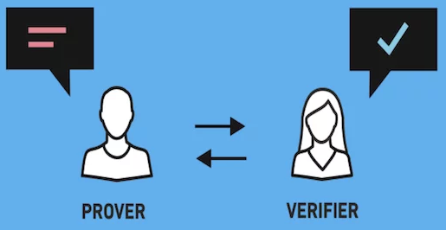
Zero Knowledge Proofs
I have a secret
I can convince you of some properties of my secret
Without revealing it
Available (in principle) since the 80’s [GMR’85]

Slide 10
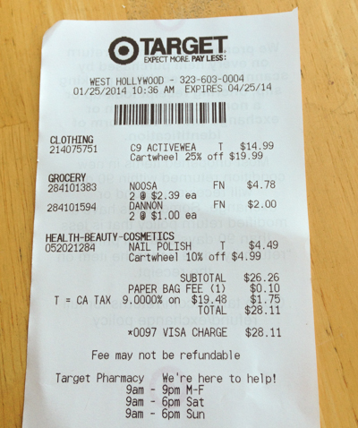
Zero Knowledge Proofs
I have a secret
I can convince you of some properties of my secret
Without revealing it
Example: my secret is my purchase history

Slide 11
Zero Knowledge Proofs
I have a secret
I can convince you of some properties of my secret
Without revealing it
Example: my secret is my purchase history
I can prove to Hood that I bought 10 gallons of milk this month
so I can get a coupon
Without revealing anything else

Slide 12
Secure Multi-Party Computation
We all have our individual secrets
We can compute a function of these secrets
Without revealing them to each other (or anyone else)
Available (in principle) since the 80’s [Yao’86, GMW’86]
x₁
x₂
Goal:
Correctness: Everyone computes y = f (x₁,…,x_{n})
Privacy: Nothing but the output is revealed
x₃
x₄

Slide 13
Secure Multi-Party Computation
We all have our individual secrets
We can compute a function of these secrets
Without revealing them to each other (or anyone else)
Example: medical data
Evaluating the effectivness of a treatment
f ( patient1Data, patient2Data, ...) = effective/not-effective
Data for different patients held by different clinics
Can compute this without revealing any private data

Slide 14

Homomorphic Encryption
Data can be processed in encrypted form
Result is also encrypted
Available (in principle) for <10 years [Gen’09]
Enc(x)
f
Enc[ f(x)]
Client
Server/Cloud
(Input: x)
(Function: f )

Slide 15

Homomorphic Encryption
Data can be processed in encrypted form
Result is also encrypted
Example: location services
I encrypt my location, send to Yelp
Yelp compute an encrypted table lookup
T[cityBlock#] = reviews for nearby coffee shops
I get back encrypted recommendation for coffee shops within two blocks

Slide 16
The Promise of Advanced Cryptography
Blindfold Computation
The ability to process data without ever seeing it

Slide 17
The Need for Advanced Cryptography

Slide 18
Your Privacy for Sale
We give up information in return for services
E.g., location for directions, restaurant recommendation, health data for "personalized medicine", financials for tax and investment services, purchace history for better ads and coupons, ...

Slide 19
Your Privacy for Sale
We give up information in return for services
E.g., location for directions, restaurant recommendation, health data for "personalized medicine", financials for tax and investment services, purchace history for better ads and coupons, ...
Personalized services require personal information
or so we are told

Slide 20
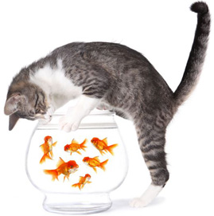
Your Privacy for Sale
We give up information in return for services
E.g., location for directions, restaurant recommendation, health data for "personalized medicine", financials for tax and investment services, purchace history for better ads and coupons, ...
Personalized services require personal information
or so we are told
What happens once we give away this information?

Slide 21
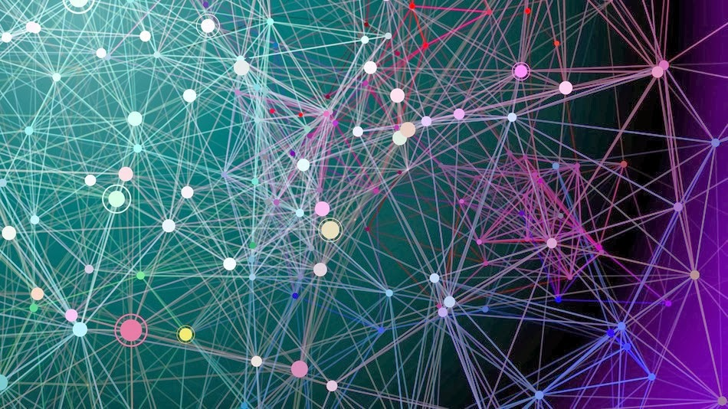
Data Abuse is the New Normal
The entire IT industry is busy making it easier
Larger collections, better ways to link, process them
Data abuse, not “data breach”
Overwhelming motivation to use whatever data can be found
If the data is available, it will be (ab)used

Slide 22
Data Abuse is the New Normal
The entire IT industry is busy making it easier
Larger collections, better ways to link, process them
It will only get worse
We cannot provide opportunity for easy abuse, seriously expect it not to happen

Slide 23
Data Abuse is the New Normal
The entire IT industry is busy making it easier
Larger collections, better ways to link, process them
We need all the tools we can get to push back
“Advanced Crypto” is an under-utilized tool in our box
IT, security professionals

Slide 24
The Promise of Advanced Cryptography
Blindfold Computation
The ability to process data without ever seeing it
Personalized services without access to private information
You cannot abuse data that’s not there

Slide 25
Example: Anonymous Credentials using ZK
sk
pk
Name: Stick Person
DoB: August 1, 1988
Eye color: Black
Digital Signature: D2A6B1..8F
Issuing a
certificate

Slide 26
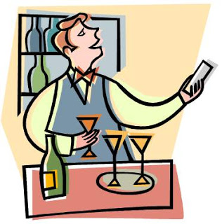
Example: Anonymous Credentials using ZK
pk
“D2A6B1..8F is a valid signature wrt pk on a statement that includes a birthdate before 2000 and the picture “
Prove in zero-knowledge

Slide 27



Example: No-Fly-List Using 2PC
This Photo by Unknown Author is licensed under CC BY-SA-NC
Airline has a list of passengers
Police has a list of suspects
This Photo by Unknown Author is licensed under CC BY-NC-ND
Output is the intersection of the two lists

Slide 28





HE for Medical Data in the Cloud
Anyone can deposit
encrypted data in silo
Recovering results in the clear requires secret key, only processed results should be decrypted
Data Silo
Processing Node
Encrypted genome
Encrypted lab results
Encrypted genome
Controlled Environment
processed data
encrypted model
Silo, processor are not exposed to sensitive data
“Silos” of encrypted data, each controlled by a key
Lots of stored data, small parts of it are in process at any time
Notes:
Cloud is not liable for information, cannot be subpoenaed for it, it cannot be stolen from it, etc.

Slide 29
The Promise of Advanced Cryptography
Blindfold Computation
Also useful for “more traditional” security issues
E.g., key and credential management, protecting commercial secrets, collaboration on sensitive data, ...

Slide 30
Fast Enough to be Useful

Slide 31

Performance of Advanced Cryptography
Improving performance has been a major research topic over the last 30 years
Tremendous progress, many orders of magnitude
For most tasks, there is a cryptographic solution with adequate performance
Although designing it may take a team of experts

Slide 32
Some Speed Examples
Lots of examples, meant to demonstrate feasibility of doing “many things” with reasonable performance
It’s okay to feel a little dizzy after example #17,352…
The point is not to compare them
They operate in very different settings: “general-purpose” vs. specific functions, different security guarantees, different performance profiles, etc.
My apologies if I didn’t include your awesome work in this list

Slide 33
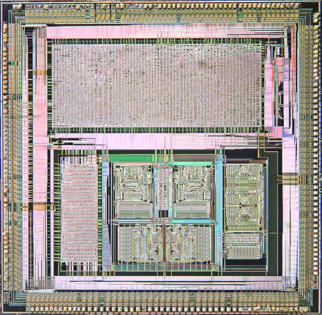
Some ZK Speed Examples
Proving a 100,000-gate predicate in 1.8sec
Improved Non-Interactive Zero Knowledge with Applications […] (KKW, CCS 2018)
From this conference
Notes:
Improved Non-Interactive Zero Knowledge with Applications to Post-Quantum Signatures
Jonathan Katz, Vladimir Kolesnikov, Xiao Wang, CCS 2018

Slide 34
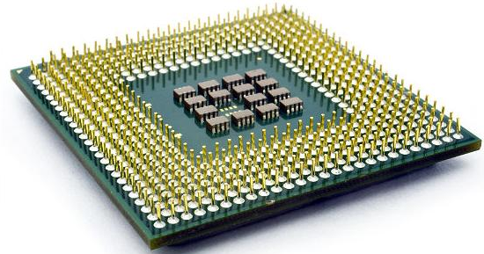
Some ZK Speed Examples
Proving a 2²⁷-gate predicate on a 64-cluster in ~1.5 hours
DIZK: A Distributed Zero Knowledge Proof System (WZCPS, USENIX Security 2018)
Notes:
DIZK: A Distributed Zero Knowledge Proof System, Howard Wu, Wenting Zheng, Alessandro Chiesa, Raluca Ada Popa, Ion Stoica, USENIX security 2018

Slide 35
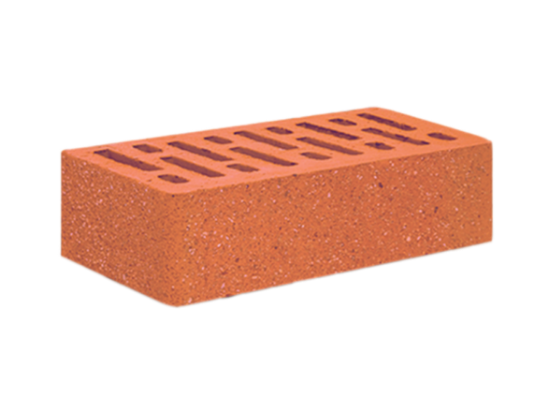

Some ZK Speed Examples
“I know a pre-image of 0xA4E…1 under SHA”
Proving at 100 pre-images/sec, verifying at 5000/sec
Ligero: Lightweight Sublinear Arguments Without a Trusted Setup (AHIV, CCS 2017)
Useful, e.g., for blockchains
Can prove things about the hash values in the blocks
Notes:
Ligero, Ames, Hazay, Ishai, Venkitasubramaniam, CCS 2017

Slide 36

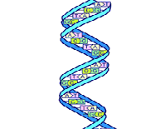
Some ZK Speed Examples
DNA match against a database (zk-STARK, [BBHR, 2018])
Size-100,000 DB, proving in ~1 hour, verifying in milliseconds
Police has a forensic DNA database
Presidential candidate has a DNA sample
This Photo by Unknown Author is licensed under CC BY-NC
“the sample whose hash is 0xe677d398 does not match anything in the database whose hash is 0x3b2a108a”
Public commitment 0x3b2a108a
Public commitment 0xe677d398
Notes:
Zk-STARK Ben-Sasson, Bentov, Horesh, Riabzev ePrint 2018/046

Slide 37
ZK Proofs in the Wild
Digital currencies (zCoin, Zcash, ...)
Proving that I have sufficiently many unspent coins on the ledger
Constructing proof in ~1min*, verification in a few msec
Anonymous credentials (e.g., idemix)
Proving that I possess a credential, takes 1-30 seconds
Private payments in the Brave browser (using Anonize)
Tax bracket proofs (Deloitte/QEDit)
Commitments to my financial data posted to ledger
Then I can prove that I belong to a certain tax bracket
…
* Soon to be much faster

Slide 38
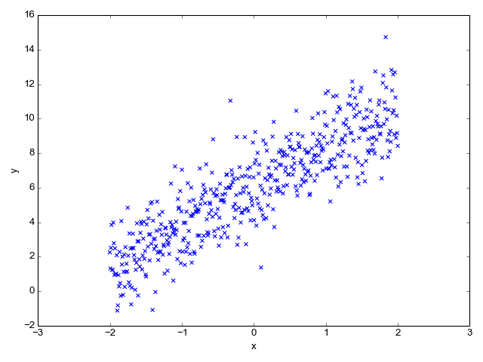
Some MPC Speed Examples
x₁
x₂
x₃
x₄
10-party linear regression with
For most protocols, the bottleneck is communication rather than computation
So performance is measures for LAN vs WAN
Data is shared among the parties, each holding 400,000 points

Slide 39
Some MPC Speed Examples
x₁
x₂
x₃
x₄
10-party linear regression with 4M inputs in 5sec over LAN
An End-to-End System for Large Scale P2P MPC-as-a-Service […] (BHKL, CCS 2018)
Data is shared among the parties, each holding 400,000 points
Cherry picked from this conference
Notes:
An End-to-End System for Large Scale P2P MPC-as-a-Service […] (Barak etal CCS 2018)

Slide 40
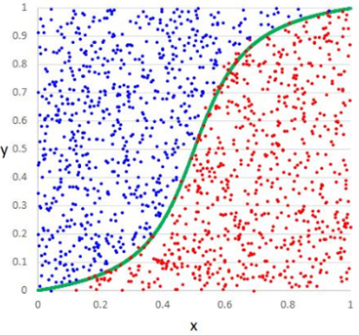

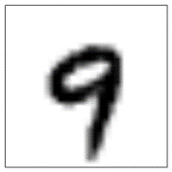
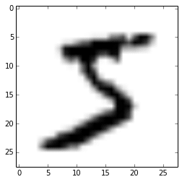
Some MPC Speed Examples
x₁
x₂
x₃
x₄
10-party regression with 4M inputs in 5sec over LAN
4-party logistic regression training in ~5 days over WAN
NANOPI: Extreme-Scale Actively-Secure Multi-Party Computation (ZCSH, CCS 2018)
Benchmarked on MNIST data: 1K rows x 784 columns
Cherry picked from this conference
Notes:
nanoPI: Extreme-Scale Actively-Secure Multi-Party Computation (Zhu etal, CCS 2018)

Slide 41
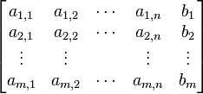
Some MPC Speed Examples
x₁
x₂
x₃
x₄
10-party regression with 4M inputs in 5sec over LAN
4-party logistic regression training in ~5 days over WAN
2-party 16x16 Gaussian elimination in 16sec over WAN
HyCC: Compilation of Hybrid Protocols for Practical Secure Computation (BDK, CCS 2018)
The matrix is shared between the two parties
Cherry picked from this conference
Notes:
HyCC: Compilation of hybrid protocols (Büscher etal, CCS 2018)

Slide 42
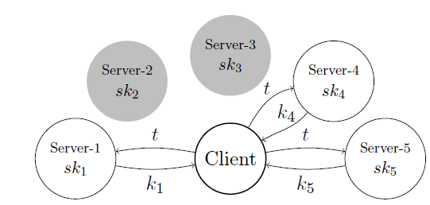
Some MPC Speed Examples
x₁
x₂
x₃
x₄
10-party regression with 4M inputs in 5sec over LAN
4-party logistic regression training in ~5 days over WAN
2-party 16x16 Gaussian elimination in 16sec over WAN
12-party distributed AES >50,000 enc/sec on WAN
DiSE: Distributed Symmetric-key Encryption (AMMP, CCS 2018)
Encryption key is secret-shared among the servers
Cherry picked from this conference
Notes:
DiSE: Distributed Symmetric-key Encryption (Agrawal etal CCS 2018)

Slide 43
More MPC Systems, Use-Cases
Tax Fraud Detection System (Sharemind)
Analyzing one month of the Estonian economy in ten days
“How the Estonian Tax and Customs Board Evaluated a Tax Fraud Detection System Based on Secure Multi-party Computation” (BJSV, FC 2015)
Virtual HSMs (Unbound), MPC replacing hardware
RSA, ECDSA, AES,…, comparable speed to hardware HSM

Slide 44
More MPC Systems, Use-Cases
Tax Fraud Detection System (Sharemind)
Analyzing one month of the Estonian economy in ten days
“How the Estonian Tax and Customs Board Evaluated a Tax Fraud Detection System Based on Secure Multi-party Computation” (BJSV, FC 2015)
Virtual HSMs (Unbound), MPC replacing hardware
RSA, ECDSA, AES,…, comparable speed to hardware HSM
Similar patients in a genomic database (iDASH 2016)
Best 5 matches against 4000 patients, 1000 markers, in ~30sec
“Privacy-Preserving Search of Similar Patients in Genomic Data” (AHLR, PoPETS 2018)
Clearing-price auction on Hyperledger Fabric, 10-20sec
“Initial Public Offering (IPO) on Permissioned Blockchain using Secure Multiparty Computation” (BDHHJMZ 2018)

Slide 45
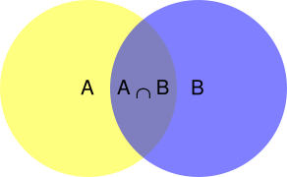
HE Speed Examples
Set intersection, size-2²⁰ by size-512 sets in 1 sec
Labeled PSI from Fully Homomorphic Encryption with Malicious Security (CHLR, CCS 2018)
From this conference
Notes:
Labeled PSI from FHE (Chen etal, CCS 2018)

Slide 46
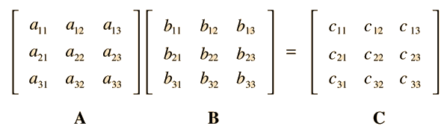
HE Speed Examples
Set intersection, size-2²⁰ by size-512 sets in 1 sec
Multiplying two 64x64 “real matrices” in ~9 seconds
Secure Outsourced Matrix Computation and Application to Neural Networks (JKLS, CCS 2018)
From this conference
Notes:
Secure Outsourced Matrix Computation and Application to Neural Networks (Jiang-Kim-Lauter-Song, CCS 2018)

Slide 47
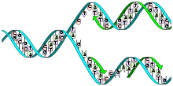
More HE Speed Examples
Computing similarity of two 1M-vectors in minutes
Similarity of encrypted genome sequences (iDASH 2015)
This Photo by Unknown Author is licensed under CC BY-SA

Slide 48
More HE Speed Examples
Computing similarity of two 1M-vectors in minutes
Inference of simple models on encrypted data
1000 perditions/minute, CNN on MNIST optical characters
“Crypto-Nets: Neural Networks over Encrypted Data” (DGLLNW, ICML 2016)
8000 predictions/second on 100-feature LR model

Slide 49
More HE Speed Examples
Computing similarity of two 1M-vectors in minutes
Inference of simple models on encrypted data
1000 perditions/minute, CNN on MNIST optical characters
8000 predictions/second on 100-feature LR model
Training a logistic-regression model on genome data
Under 10 minutes with 10-15 features, ~1000 rows (iDASH 2017)
“Logistic Regression Model Training based on the Approximate Homomorphic Encryption” (KSKLC, BMC Medical Genomics 2018)
15-30 minutes to train 30,000 models w/ 5 features (iDASH 2018)

Slide 50

Such awesome performance, how come we’re not seeing these tools everywhere?
This Photo by Unknown Author is licensed under CC BY-SA

Slide 51
Not “Generally Usable" Yet

Slide 52
Complexity of Advanced Cryptography
Distributed computing is already complex enough, “advanced crypto” adds secrecy considerations
Good performence requires extreme optimizations
Straightforward implementation will be exceedingly slow
Small application-level changes can make a big difference in how to best optimize for it
Tension between simplicity/usability and performance

Slide 53
Implementations
Many software libraries for ZKP / MPC / HE
Most of them open-source
Very hard to compare them, decide which technology/implementation to use for what purpose
Different tools, data models, computation models, performance profiles, security guarantees, ...
Hardly any accepted benchmarks
Many of the libraries are written for speed, not usability

Slide 54
Code Quality
Most code written in C/C++
By researchers with limited C/C++ experience
parts.push_back(CtxtPart(*ptr,handle));
if (negative) parts.back().Negate(); // not thread-safe??
ya think?

Slide 55
Example: Secure-MPC Communication
Communication between parties is a bottleneck in many protocols for secure multi-party computation
To optimize, many MPC libraries work with sockets
The library expects to be “in charge” of IP-address:port
int main(int argc, char** argv)
{
const char* addr = "127.0.0.1”;
int port = 7766;
if (m_nPID == SERVER_ID) { //Play as OT sender
InitSender(addr, port, glock);
OTExtSnd* sender = InitOTExtSnd(prot, m_nBaseOTs, m_nChecks, usemecr, ftype, crypt);
[...]
}
else { //Play as OT receiver
InitReceiver(addr, port, glock);
OTExtRec* receiver = InitOTExtRec(prot, m_nBaseOTs, m_nChecks, usemecr, ftype, crypt);
[...]
}
}

Slide 56
Example: Secure-MPC Communication
Communication between parties is a bottleneck in many protocols for secure multi-party computation
To optimize, many MPC libraries work with sockets
What if my system has its own communication layer?
E.g. working over https, gRPC, …
Retrofitting existing libraries to use “abstract channels” is a lot of work, may degrade performance
Your best option is to look for another library

Slide 57
Example: Data Encoding for HE
Ciphertext operations in contemporary HE are slow
“Ciphertext packing” to gain in performance
Each ciphertext encrypts a vector of plaintext element
Ciphertext operations effect element-wise operations
Vector-size is a parameter, depends on the algebra
a₁ a₂ a₃ a₄ a₅ a₆ a₇ a₈
⊗
c₁ c₂ c₃ c₄ c₅ c₆ c₇ c₈
b₁ b₂ b₃ b₄ b₅ b₆ b₇ b₈
c_{i} = a_{i} ⊗ b_{i} (mod p)

Slide 58
Example: Data Encoding for HE
Lots of flexibility in setting the parameters
Determine plaintext modulus, vector-size, more
Choosing the right parameters is an art form
Even with parameters set, where to put each piece of data requires a careful design
Could get orders-of-magnitude performance difference between different packing schemes
Almost no tool support for making these choices

Slide 59
Taming the Complexity
How to make advanced cryptography usable to non-expert programmers?
Usable “toolbox libraries” for common tasks
Low level: arithmetic, sorting, linear algebra, …
Mid level: graphs algorithms, set intersection, ML tools, …
Domain specific tasks (medical, financial, …)
Design libraries as “middleware”
One component in larger systems
Don’t assume that the library “owns” the relevant resources

Slide 60
Taming the Complexity
How to make advanced cryptography usable to non-expert programmers?
Frameworks, compiler support
Some work over last 10+years
e.g., Fairplay, Sharemind, Obliv-C, …
Considerable work reported in this conference
An End-to-End System for Large Scale P2P MPC-as-a-Service[…] (BHKL)
HyCC: Compilation of hybrid protocols for Practical Secure[…] (BDK)
Generalizing the SPDZ CompilerFor Other Protocols (ABFKLOT)
ALCHEMY: A Language and Compiler for HE […] (CPS)

Slide 61
Time to Put These Tools to Use
The need is acute
Push back against IT systems that put us in a fishbowl
Personalized services are possible without access to personal information
Don’t believe people telling you they’re too slow

Slide 62
Time to Put These Tools to Use
Cryptographers must put emphasis on usability and “mundane” software engineering aspects
Although improving performance is still important
System builders should try to use what tools exist
Complain bitterly to your fellow cryptographers if their tools are too hard to use
For now, keep designing one-off systems
Hopefully, some generalizations will emerge
These technologies are best suited for that type of applications

Slide 63
Time to Put These Tools to Use
Some starting points to access these technologies:
Zero-Knowledge: https://zkp.science/
Secure-MPC: https://github.com/rdragos/awesome-mpc and http://www.multipartycomputation.com
HE: http://homomorphicencryption.org/
We really need HOWTO documents
With application focus
Any volunteers to write them?

Slide 64
Incentives for Blindfold Computation?
Customer demand?
Seems unlikely
Government regulation?
Maybe, in some cases
Developers wanting to do the right thing?
That’s us, we have some choice in the systems that we build
Don’t build systems that require users to hand over their data
It will be abused

Slide 65
Summary: Advanced Cryptography is
Needed
Fast enough to be useful
Not "generally usable" yet
Can help prevent data abuse
An under-utilized tool
We are making some progress

Slide 66
Summary: Advanced Cryptography is
Needed
Fast enough to be useful
Not "generally usable" yet
Questions?
Can help prevent data abuse
Still an under-utilized tool
Thanks to many people for their input:
Eli Ben-Sasson, Alessandro Chiesa, Jonathan Katz,
Yehuda Lindell, Thomas Schneider, Elaine Shi,
Muthu Venkitasubaramaniam, Xiao Wang
We are making some progress

