Slide 1
2-round secure MPC from IndISTINGUISHABILITY Obfuscation
Sanjam Garg, Craig Gentry, Shai Halevi (IBM), Mariana Raykova (SRI)

Slide 2
Background: Secure Multi-Party Computation
Many slides borrowed from Yehuda Lindell

Slide 3
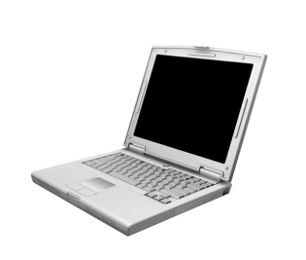



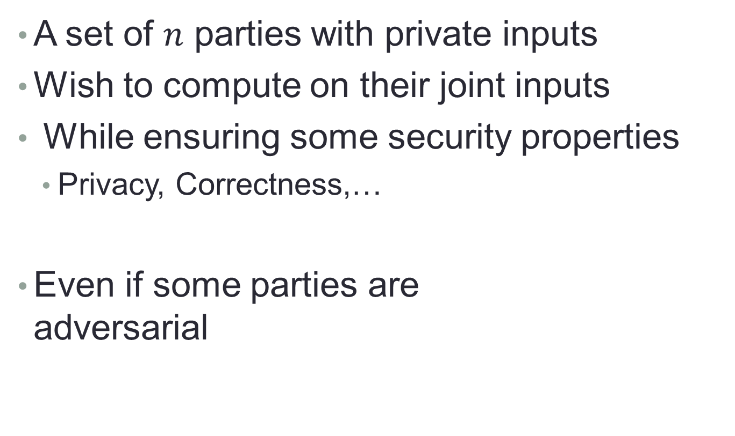



Secure Multiparty Computation
A set of $n$ parties with private inputs
Wish to compute on their joint inputs
While ensuring some security properties
Privacy, Correctness,…
Even if some parties are adversarial
$$x$$
$$y$$
$$f(x,y,z)$$
$$z$$

Slide 4


Adversarial behavior
Semi-honest: follows the protocol
Trying to learn more than what’s allowed by inspecting transcript
Malicious: deviates arbitrarily from protocol
Trying to compromise privacy, correctness, or both

Slide 5

Defining Security: the Ideal/Real Paradigm
What is the best we could hope for?
An incorruptible trusted party
All parties send inputs to trusted party
over perfectly secure communication lines
Trusted party computes output, sends to parties
This is an ideal world
What can an adversary do?
Just choose its input(s)…

Slide 6
Defining Security: the Ideal/Real Paradigm
A real-world protocol is secure if it emulates an ideal-world execution
Any damage that can happen in the real world can also happen in the ideal world
Ideal-world adversary cannot do much, so the same is true of the real-world adversary
Privacy, correctness, independence of inputs (and more), all hold in the real world

Slide 7


The Ideal/Real Paradigm
x
Real World
y
Ideal World
Protocol
Trusted Party
≈
x’
f(x’,y)
f(x’,y)
y
arbitrary
output
protocol
output
arbitrary
output
f(x’,y)

Slide 8
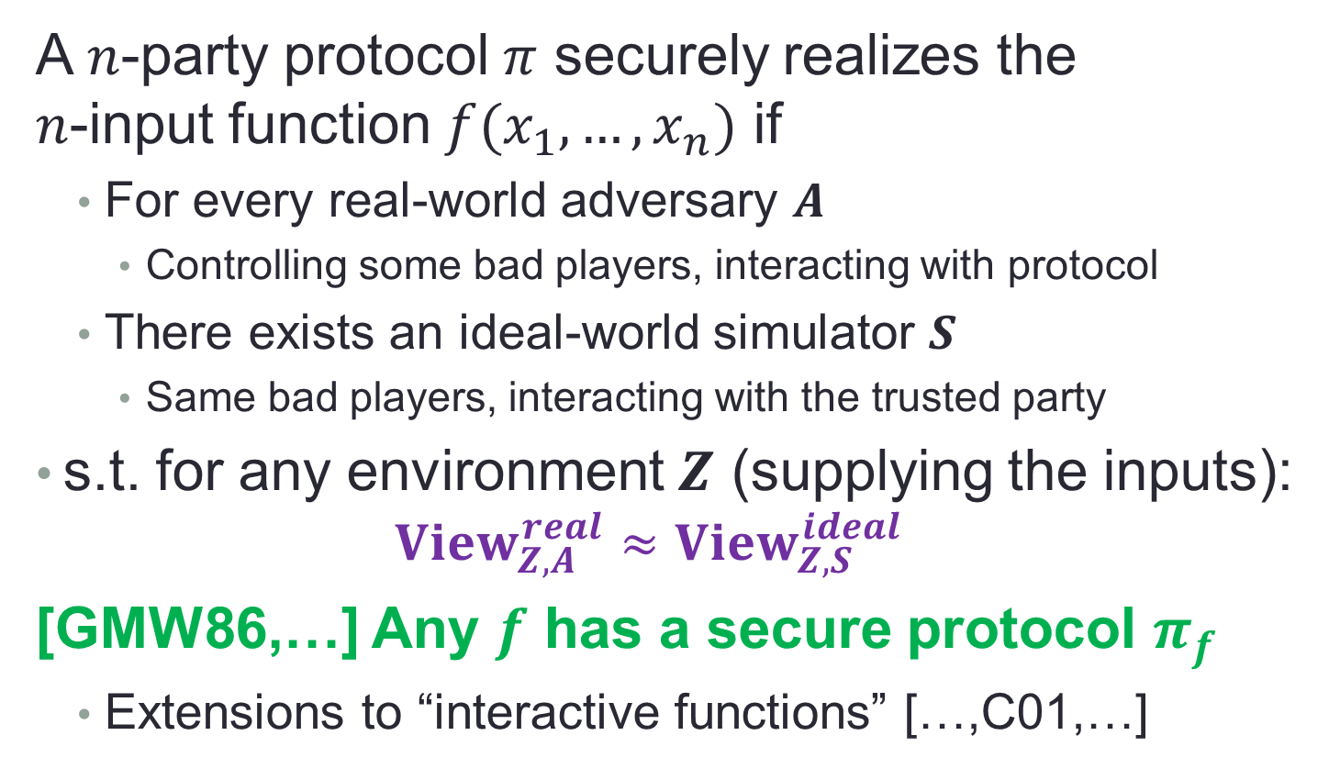
The Ideal/Real Paradigm
A $n$-party protocol $π$ securely realizes the $n$-input function $f(x_{1},…,x_{n})$ if
For every real-world adversary $A$
Controlling some bad players, interacting with protocol
There exists an ideal-world simulator $S$
Same bad players, interacting with the trusted party
s.t. for any environment $Z$ (supplying the inputs):
$$View_{Z,A}^{real}≈View_{Z,S}^{ideal}$$
[GMW86,…] Any $f$ has a secure protocol $π_{f}$
Extensions to “interactive functions” […,C01,…]

Slide 9
Some Specifics of Our “Real World”
We assume trusted setup (CRS)
A random common reference string is chosen honestly, made available to all the players
E.g., hard-wired into the protocol implementation
A broadcast channel is available
If I received msg, everyone received same msg
The set of bad players is determined before the protocol execution
Aka “static corruption model”

Slide 10
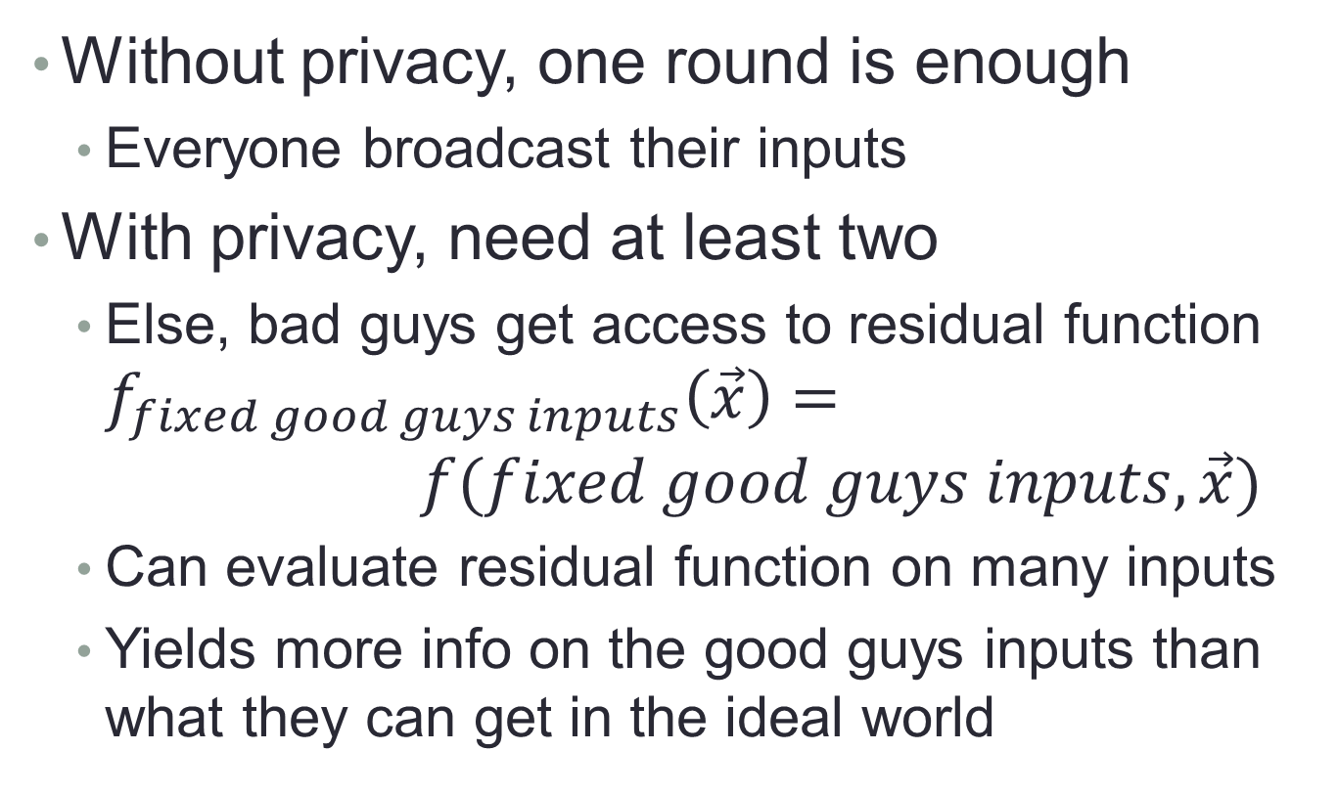
Round Complexity of Secure MPC
Without privacy, one round is enough
Everyone broadcast their inputs
With privacy, need at least two
Else, bad guys get access to residual function $f_{fixed good guys inputs}\left(\vec{x}\right)= f(fixed good guys inputs, \vec{x})$
Can evaluate residual function on many inputs
Yields more info on the good guys inputs than what they can get in the ideal world

Slide 11
Round Complexity of Secure MPC
Can we get 2-round secure computation?
Two broadcast rounds after seeing the CRS
Before this work, best result was 3 rounds
[Asharov, Jain, Lopez-Alt, Tromer, Vaikuntanathan, Wichs, Eurocrypt 2012], using threshold (multi-key) FHE
This work: doing it in two rounds
Using heavy tools (iO, NIZK)

Slide 12
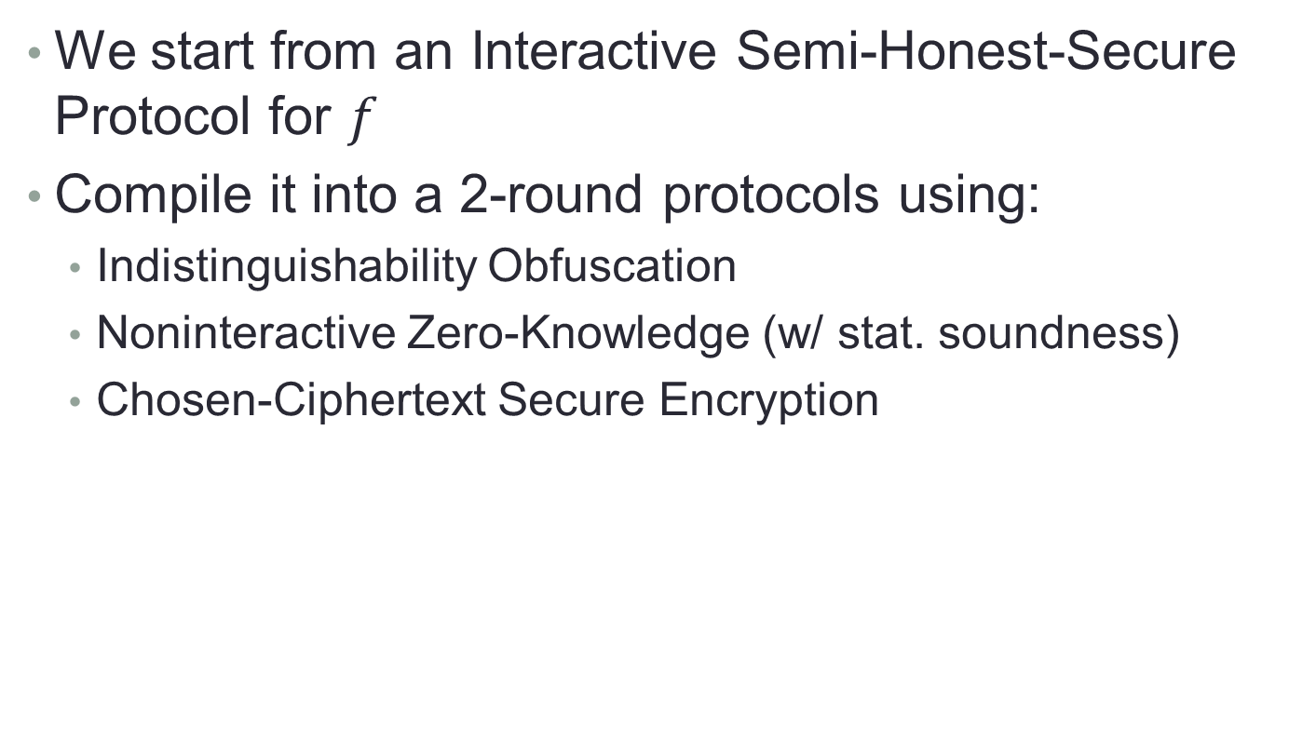
The Tools We Use
We start from an Interactive Semi-Honest-Secure Protocol for $f$
Compile it into a 2-round protocols using:
Indistinguishability Obfuscation
Noninteractive Zero-Knowledge (w/ stat. soundness)
Chosen-Ciphertext Secure Encryption

Slide 13
Main Tool: Obfuscation
Make programs “unintelligible” while maintaining their functionality
Example from Wikipedia:
Rigorous treatment [Hada’00, BGIRSVY’01,…]
Constructions [GGHRSW13,…]
@P=split//,".URRUU\c8R";@d=split//,"\nrekcah xinU / lreP rehtona tsuJ";sub p{ @p{"r$p","u$p"}=(P,P);pipe"r$p","u$p";++$p;($q*=2)+=$f=!fork;map{$P=$P[$f^ord ($p{$_})&6];$p{$_}=/ ^$P/ix?$P:close$_}keys%p}p;p;p;p;p;map{$p{$_}=~/^[P.]/&& close$_}%p;wait until$?;map{/^r/&&<$_>}%p;$_=$d[$q];sleep rand(2)if/\S/;print
Notes:
[B+01] Barak, Goldreich, Impagliazzo, Rudich, Sahai, Vadhan, Yang, “On the (im)possibility of obfuscating programs”

Slide 14
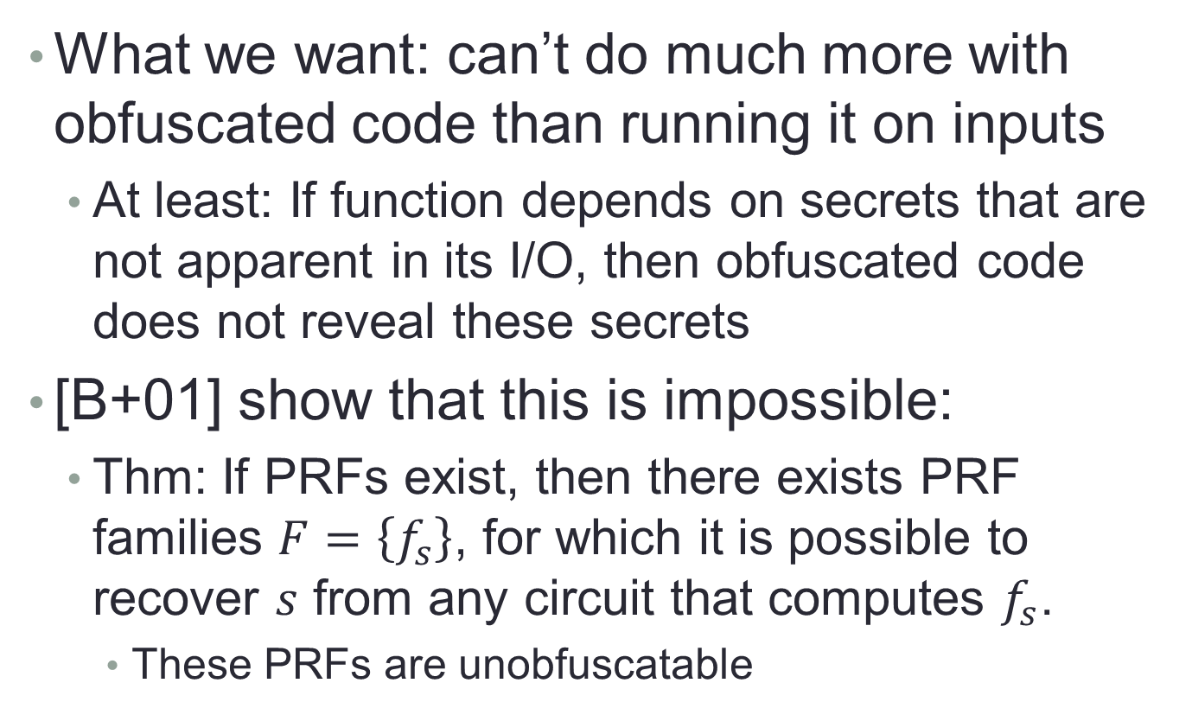
What’s “Unintelligible”?
What we want: can’t do much more with obfuscated code than running it on inputs
At least: If function depends on secrets that are not apparent in its I/O, then obfuscated code does not reveal these secrets
[B+01] show that this is impossible:
Thm: If PRFs exist, then there exists PRF families $F=\left\{f_{s}\right\}$, for which it is possible to recover $s$ from any circuit that computes $f_{s}$.
These PRFs are unobfuscatable

Slide 15
What’s “Unintelligible”?
Okay, some function are bad, but not all…
Can we get OBF() that does “as well as possible” on every function?
[B+01] suggested the weaker notion of “indistinguishability obfuscation” (iO)
Gives the “best-possible” guarantee [GR07]
Turns out to suffice for many applications, including ours
Notes:
[GR07] Goldwasser, Rothblum, “On best-possible obfuscation”

Slide 16
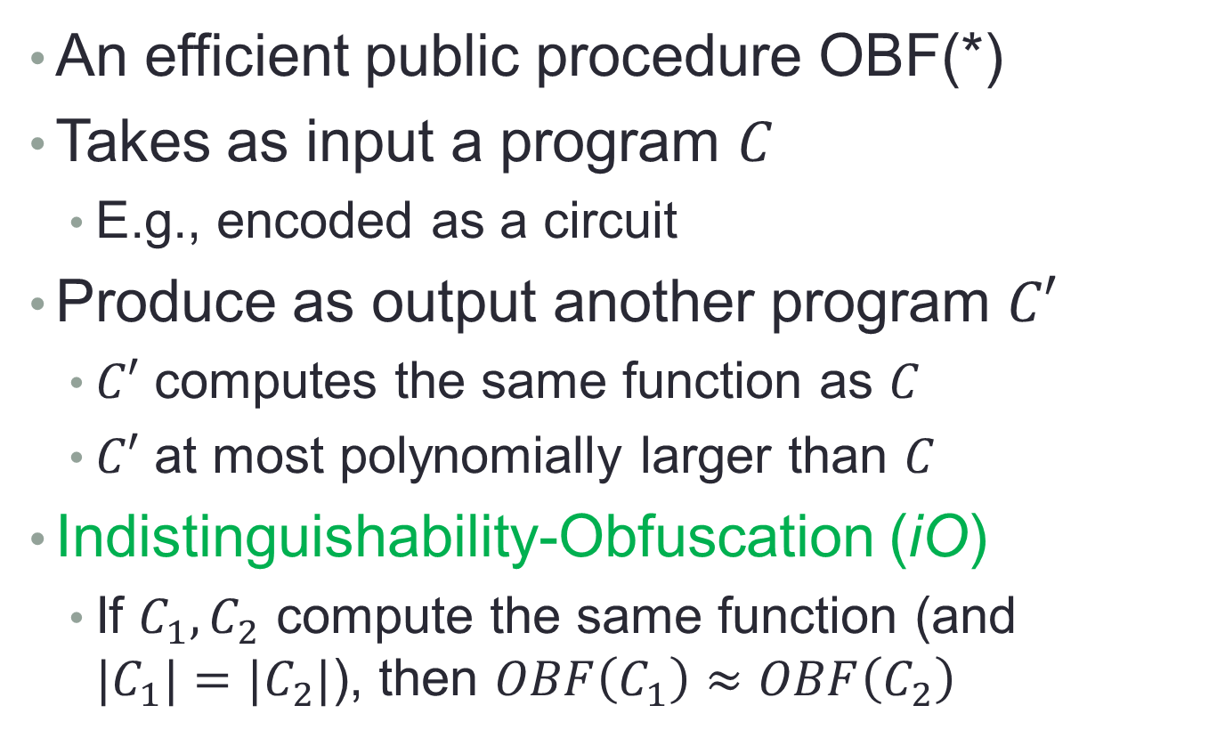
Defining Obfuscation
An efficient public procedure OBF(*)
Takes as input a program $C$
E.g., encoded as a circuit
Produce as output another program $C′$
$C′$ computes the same function as $C$
$C′$ at most polynomially larger than $C$
Indistinguishability-Obfuscation (iO)
If $C_{1},C_{2}$ compute the same function (and ${|C}_{1}|=|C_{2}|$), then $OBF\left(C_{1}\right)≈OBF\left(C_{2}\right)$

Slide 17
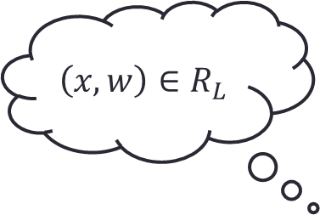

Another Tool: Noninteractive ZK (slide due to Jens Groth)
Common reference string: 0100…11010
$$\left(x,w\right)∈R_{L}$$
Statement: $x∈L$
Proof: π
Zero-knowledge:
Nothing but truth revealed
Soundness:
Statement is true
Prover Verifier

Slide 18
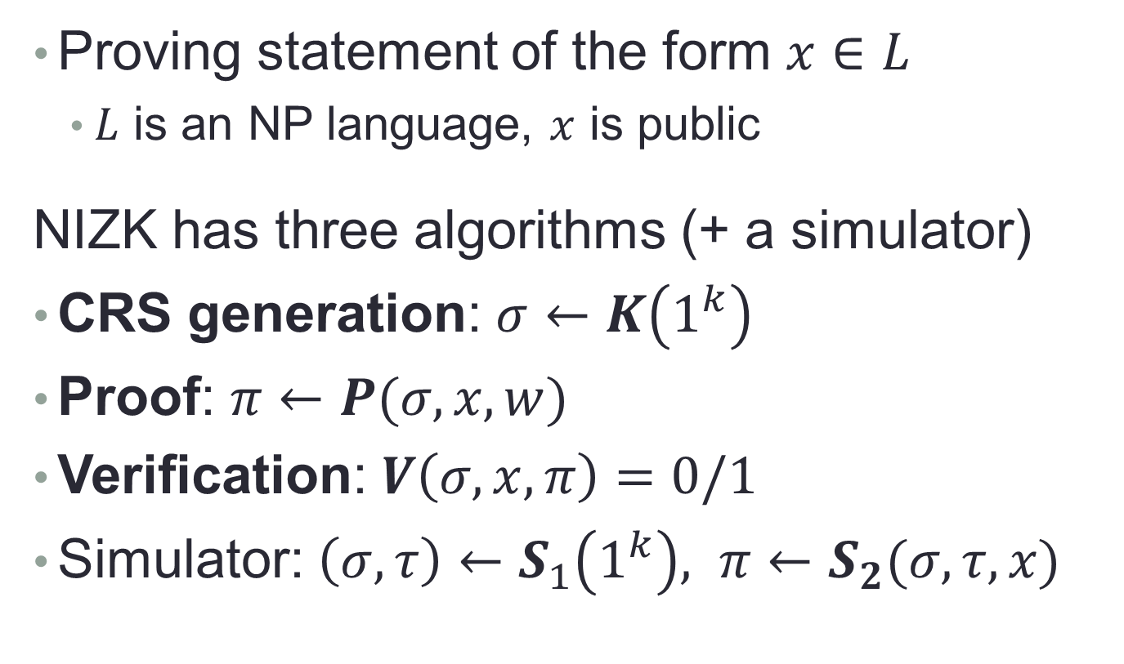
Non Interactive Zero Knowledge
Proving statement of the form $x∈L$
$L$ is an NP language, $x$ is public
NIZK has three algorithms (+ a simulator)
CRS generation: $σ←K\left(1^{k}\right)$
Proof: $π←P(σ, x, w)$
Verification: $V\left(σ, x, π\right)=0/1$
Simulator: $\left(σ,τ\right)←S_{1}\left(1^{k}\right), π←S_{2}(σ,τ,x)$

Slide 19
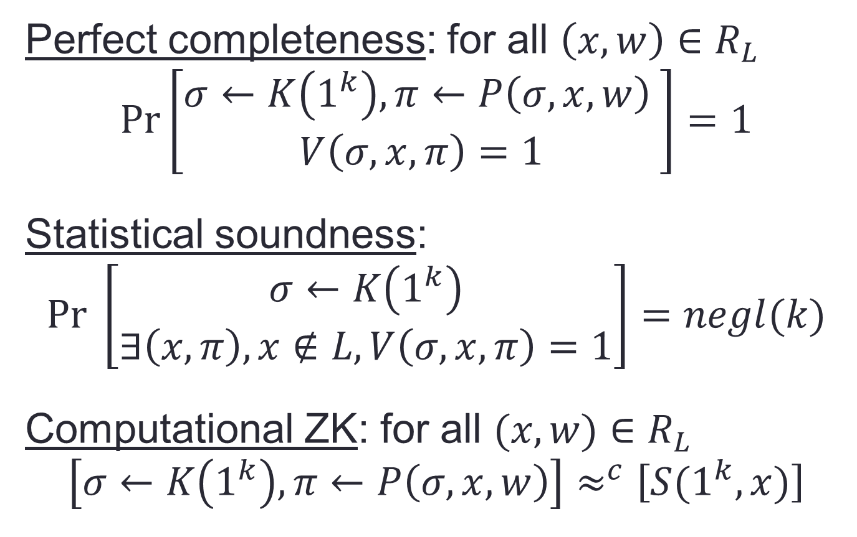
Non Interactive Zero Knowledge
Perfect completeness: for all $\left(x,w\right)∈R_{L}$ $$Pr\left[\begin{aligned}σ←K\left(1^{k}\right), π←P\left(σ,x,w\right) \\ V\left(σ,x,π\right)=1\end{aligned}\right]=1$$
Statistical soundness: $$Pr \left[\begin{aligned}σ←K\left(1^{k}\right) \\ ∃\left(x,π\right), x∉L, V\left(σ,x,π\right)=1\end{aligned}\right]=negl(k)$$
Computational ZK: for all $(x,w)∈R_{L}$ $$\left[σ←K\left(1^{k}\right), π←P\left(σ,x,w\right)\right]≈^{c}\left[S(1^{k},x)\right]$$

Slide 20










Last Tool: CCA-Secure Encryption
Public-key encryption $(KeyGen, Enc, Dec)$
Adversary wins if $c^{∗}$ not queries and $b^{′}=b$
Scheme is secure if $∀A,\operatorname{Pr}\left[A wins\right]≲1/2$
$$\left(sk,pk\right)←KeyGen\left(1^{k}\right)$$
$$Challenger\left(pk,sk\right)$$
$$c_{i}$$
$$Adversary\left(pk\right)$$
$${m_{i}=Dec_{sk}(c}_{i})$$
$$m_{0}^{∗}, m_{1}^{∗}$$
$$b←\{0,1\}$$
$$c^{∗}←Enc_{pk}\left(m_{b}^{∗}\right)$$
$$b^{′}$$

Slide 21
Our Protocol

Slide 22
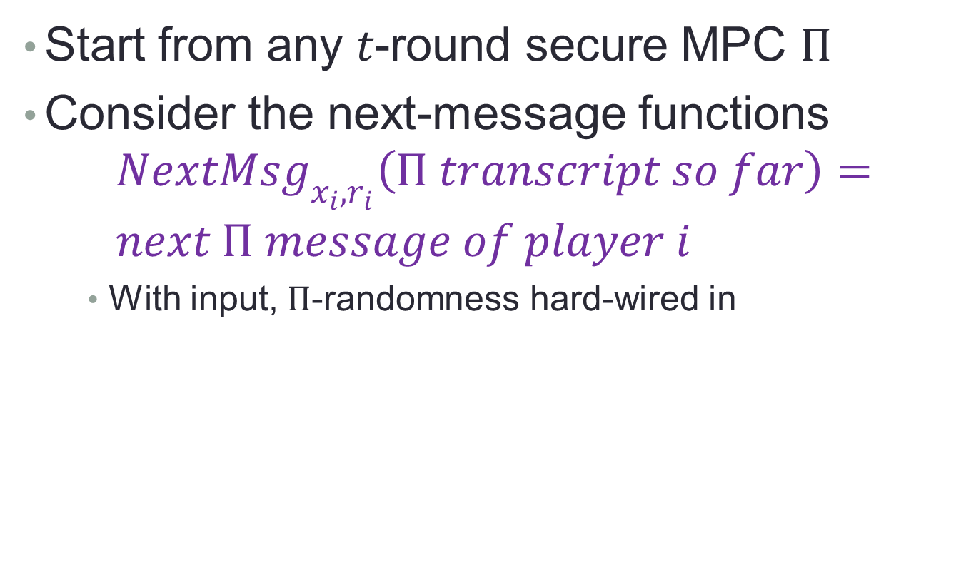
Starting Point: Use Obfuscation
Start from any $t$-round secure MPC $Π$
Consider the next-message functions $NextMsg_{x_{i},r_{i}}\left(Π transcript so far\right)=$ $next Π message of player i$
With input, $Π$-randomness hard-wired in

Slide 23
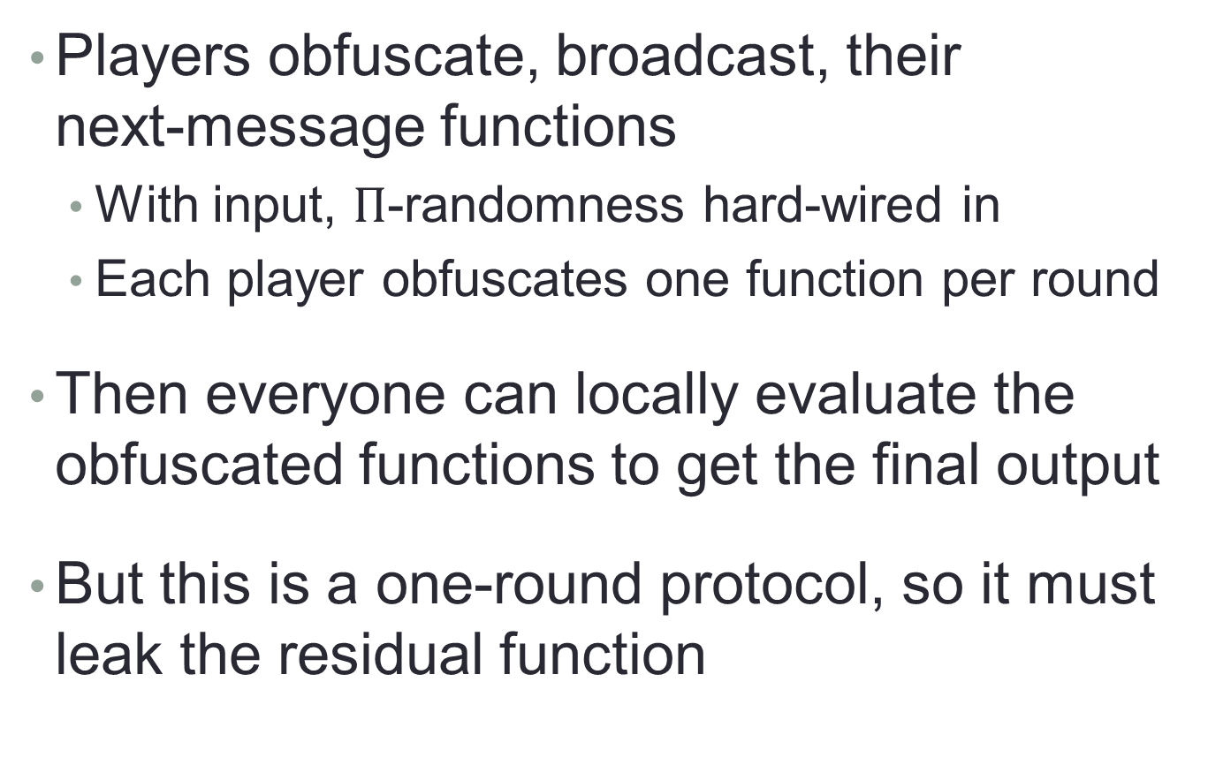
Starting Point: Use Obfuscation
Players obfuscate, broadcast, their next-message functions
With input, $Π$-randomness hard-wired in
Each player obfuscates one function per round
Then everyone can locally evaluate the obfuscated functions to get the final output
But this is a one-round protocol, so it must leak the residual function

Slide 24
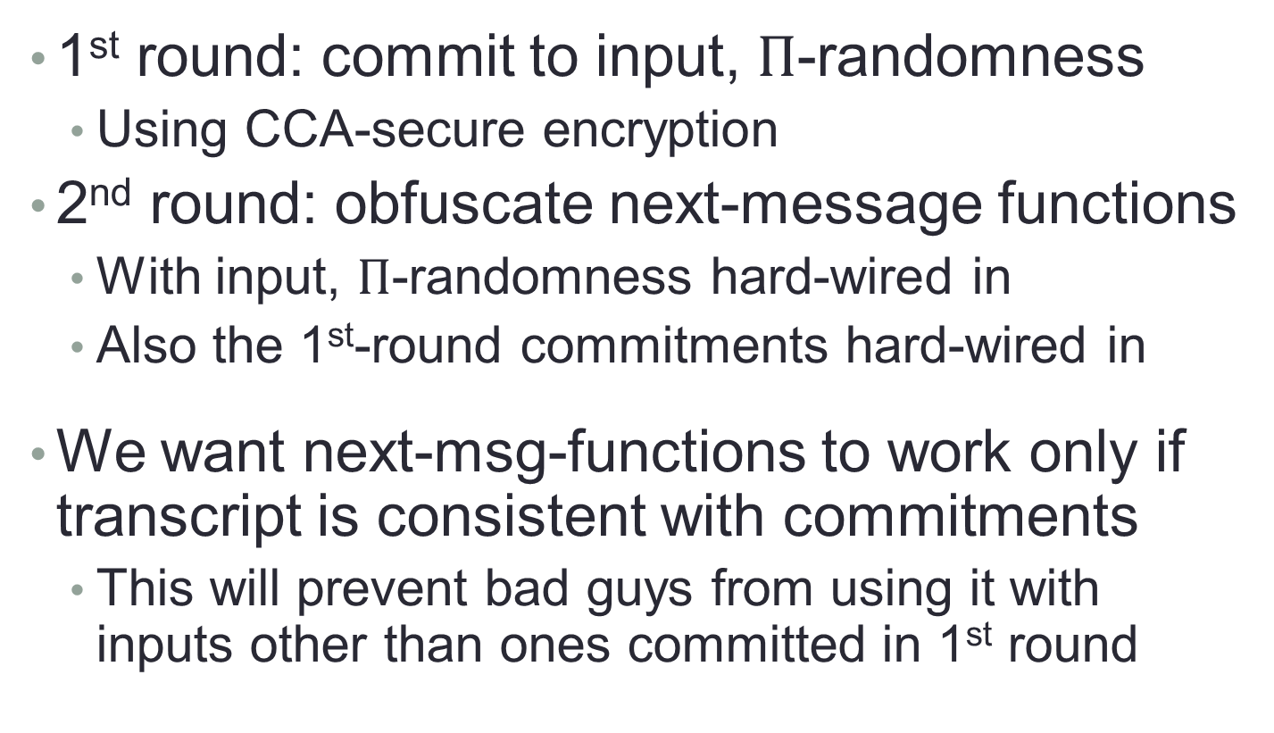
Add a Commitment Round
1st round: commit to input, $Π$-randomness
Using CCA-secure encryption
2nd round: obfuscate next-message functions
With input, $Π$-randomness hard-wired in
Also the 1st-round commitments hard-wired in
We want next-msg-functions to work only if transcript is consistent with commitments
This will prevent bad guys from using it with inputs other than ones committed in 1st round

Slide 25
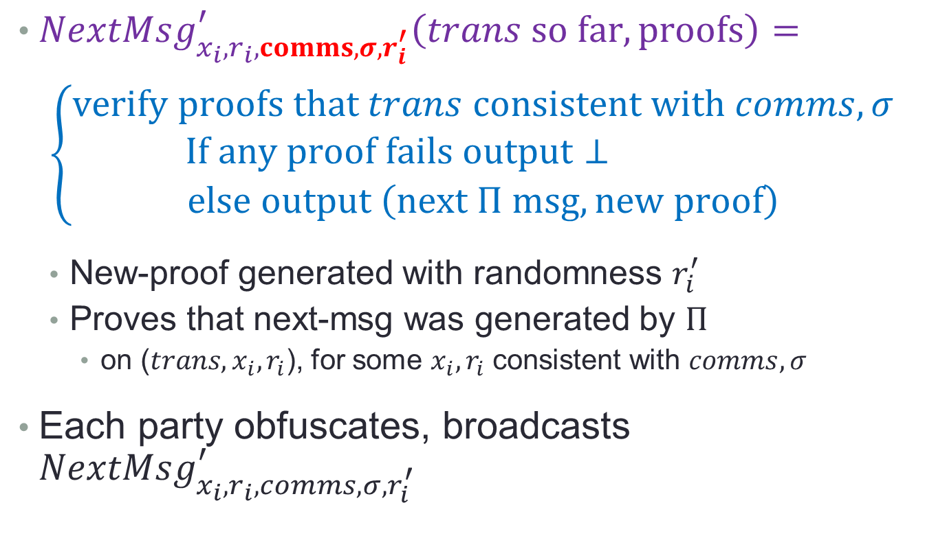
Proofs of Consistency
$NextMsg_{x_{i},r_{i},comms, σ,r_{i}^{′}}^{′}\left(trans so far, proofs\right)=$ $\left\{\begin{aligned}verify proofs that trans consistent with comms,σ \\ If any proof fails output⊥ \\ else output \left(next Π msg, new proof\right)\end{aligned}\right.$
New-proof generated with randomness $r_{i}^{′}$
Proves that next-msg was generated by $Π$
on ($trans, x_{i}, r_{i}$), for some $x_{i}, r_{i}$ consistent with $comms,σ$
Each party obfuscates, broadcasts $NextMsg_{x_{i},r_{i},comms,σ,r_{i}^{′}}^{′}$

Slide 26
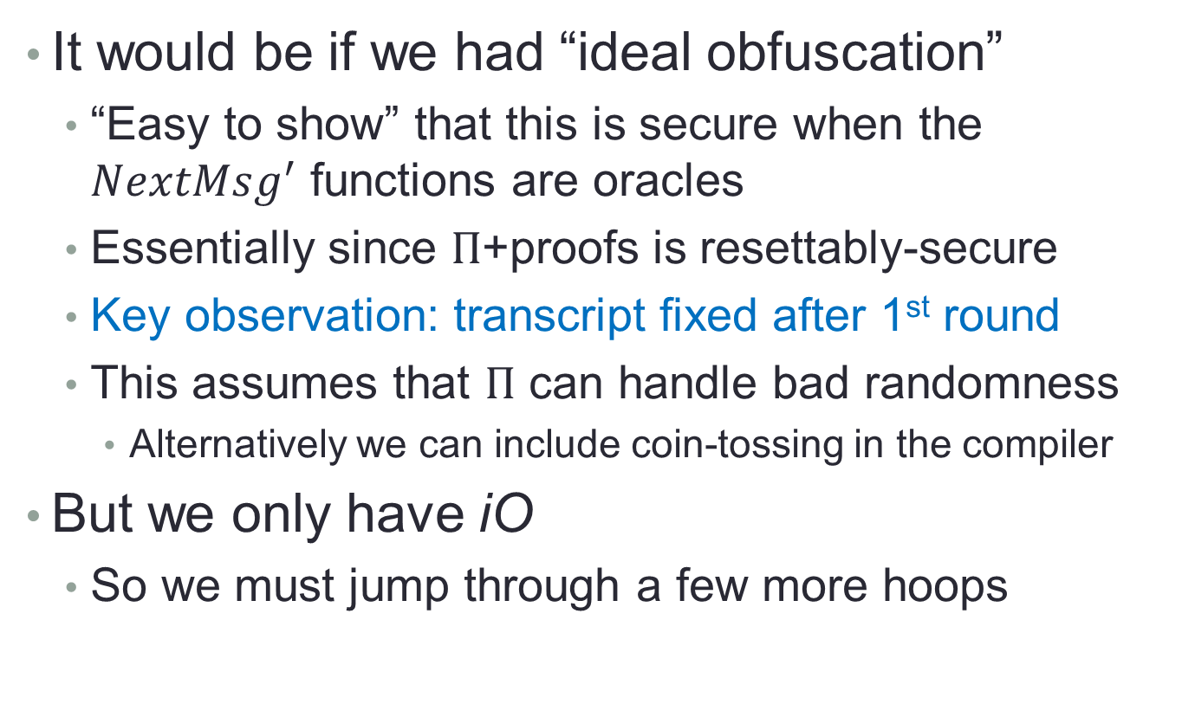
Is It Secure?
It would be if we had “ideal obfuscation”
“Easy to show” that this is secure when the $NextMsg^{′}$ functions are oracles
Essentially since $Π$+proofs is resettably-secure
Key observation: transcript fixed after 1st round
This assumes that $Π$ can handle bad randomness
Alternatively we can include coin-tossing in the compiler
But we only have iO
So we must jump through a few more hoops

Slide 27
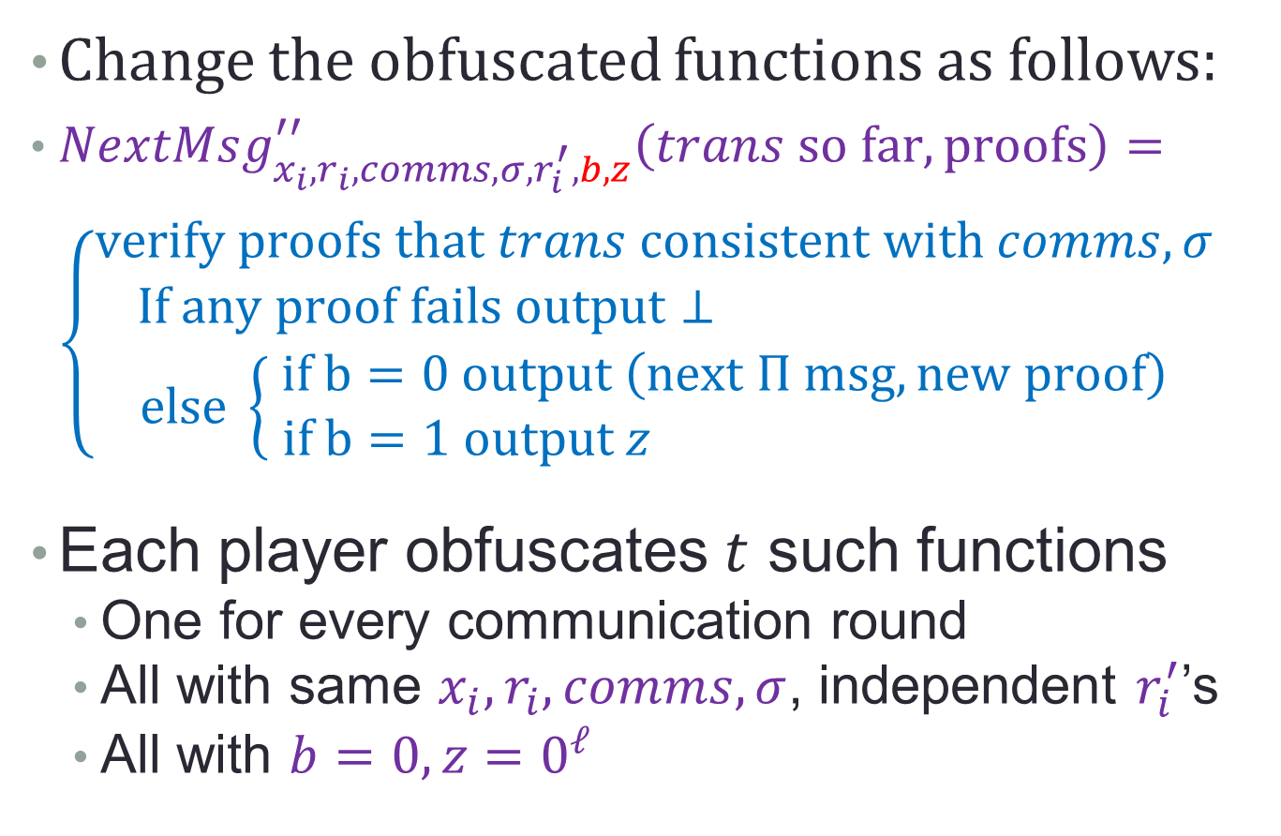
Dealing with iO
Change the obfuscated functions as follows:
$NextMsg_{x_{i},r_{i},comms, σ,r_{i}^{′},b,z}^{′′}\left(trans so far, proofs\right)=$ $\left\{\begin{aligned}verify proofs that trans consistent with comms,σ \\ If any proof fails output⊥ \\ \begin{matrix}else \left\{\begin{aligned} if b=0 output \left(next Π msg, new proof\right) \\ if b=1 output z \end{aligned}\right.\end{matrix}\end{aligned}\right.$
Each player obfuscates $t$ such functions
One for every communication round
All with same $x_{i},r_{i},comms, σ$, independent $r_{i}^{′}$’s
All with $b=0, z=0^{ℓ}$

Slide 28
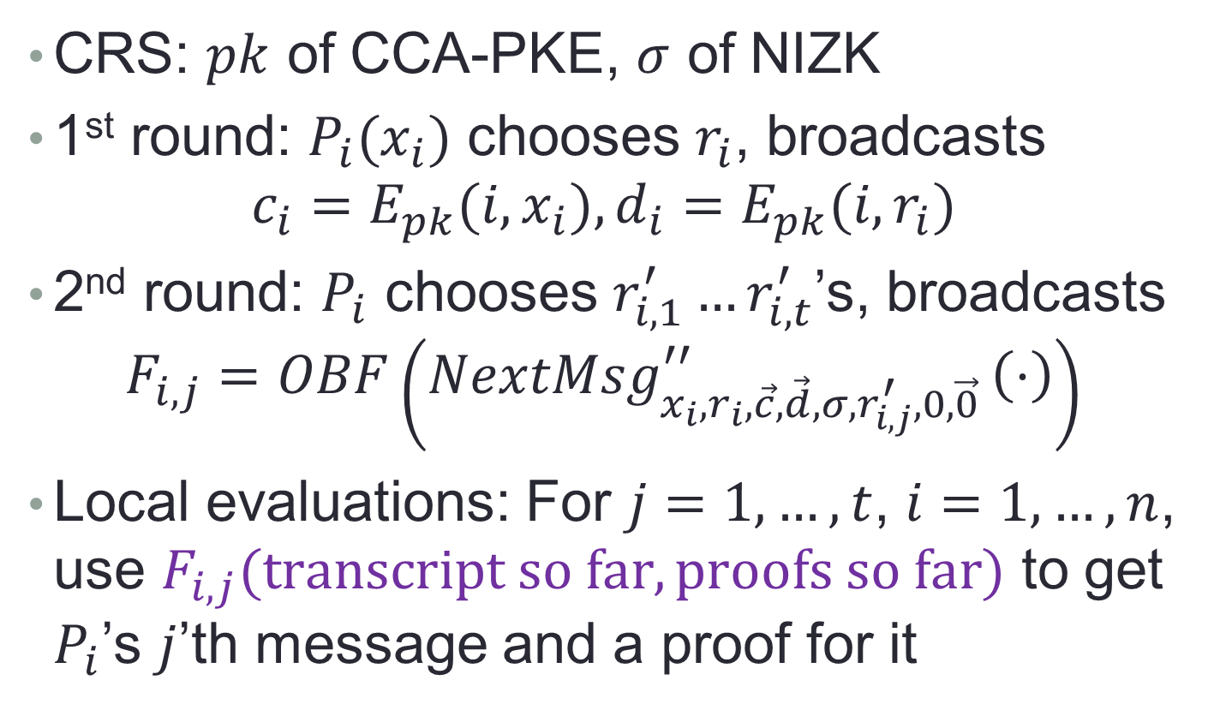
The Full* Compiler
CRS: $pk$ of CCA-PKE, $σ$ of NIZK
1st round: $P_{i}(x_{i})$ chooses $r_{i}$, broadcasts $c_{i}={E_{pk}(i,x}_{i}), {d_{i}=E_{pk}(i,r}_{i})$
2nd round: $P_{i}$ chooses $r_{i,1}^{′}…r_{i,t}^{′}$’s, broadcasts $F_{i,j}=OBF\left(NextMsg_{x_{i},r_{i},\vec{c},\vec{d},σ,r_{i,j}^{′},0,\vec{0} }^{′′}\left(⋅\right)\right)$
Local evaluations: For $j=1,…,t$, $i=1,…,n$, use $F_{i,j}(transcript so far, proofs so far)$ to get $P_{i}$’s $j$’th message and a proof for it

Slide 29
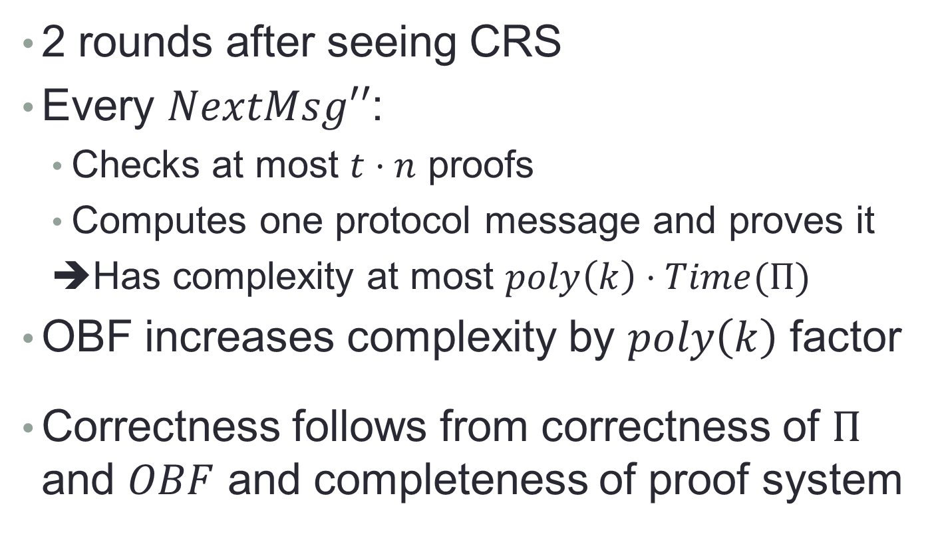
Complexity, Functionality
2 rounds after seeing CRS
Every $NextMsg′′$:
Checks at most $t⋅n$ proofs
Computes one protocol message and proves it
➔Has complexity at most $poly\left(k\right)⋅Time(Π)$
OBF increases complexity by $poly\left(k\right)$ factor
Correctness follows from correctness of $Π$ and $OBF$ and completeness of proof system

Slide 30
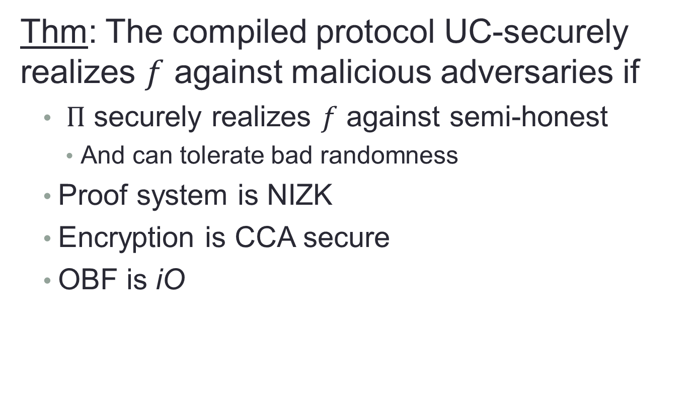
Security
Thm: The compiled protocol UC-securely realizes $f$ against malicious adversaries if
$Π$ securely realizes $f$ against semi-honest
And can tolerate bad randomness
Proof system is NIZK
Encryption is CCA secure
OBF is iO

Slide 31
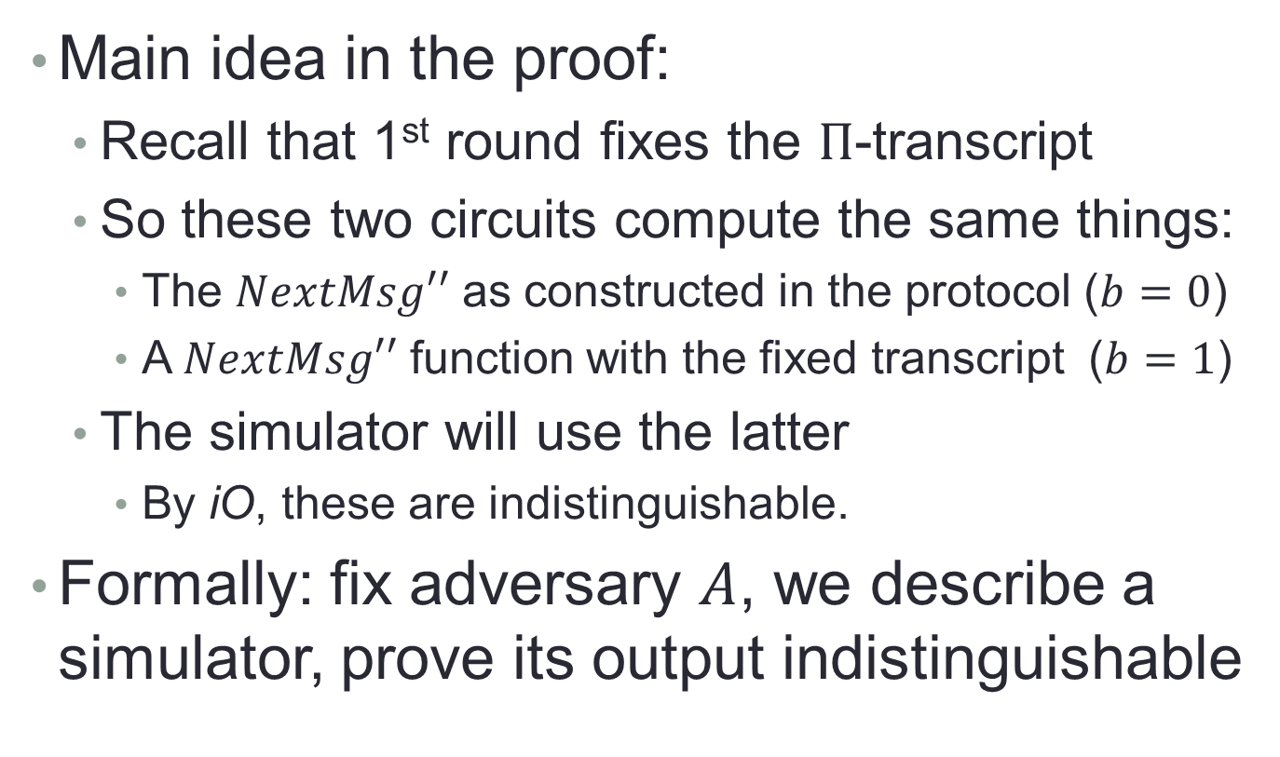
Proof Of Security
Main idea in the proof:
Recall that 1st round fixes the $Π$-transcript
So these two circuits compute the same things:
The $NextMsg′′$ as constructed in the protocol ($b=0$)
A $NextMsg′′$ function with the fixed transcript ($b=1$)
The simulator will use the latter
By iO, these are indistinguishable.
Formally: fix adversary $A$, we describe a simulator, prove its output indistinguishable

Slide 32
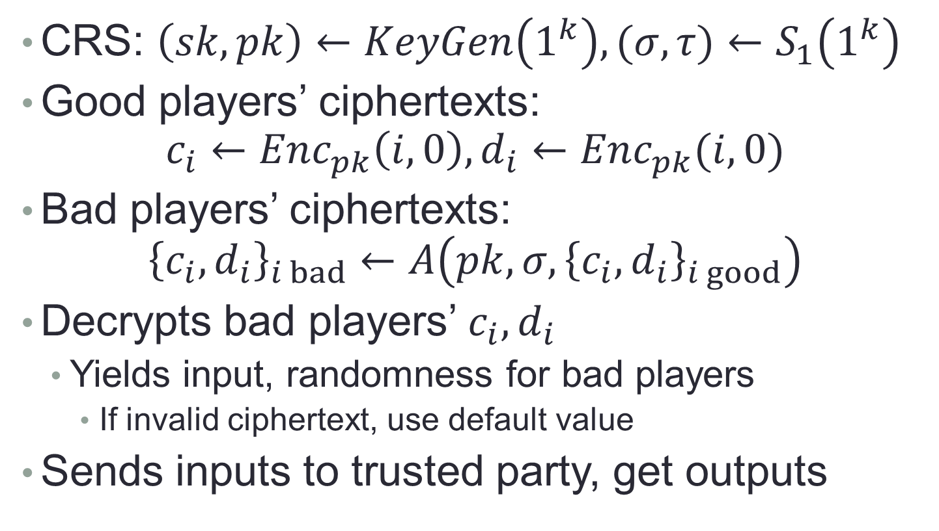
The Simulator (1)
CRS: $\left(sk,pk\right)←KeyGen\left(1^{k}\right), (σ,τ)←S_{1}\left(1^{k}\right)$
Good players’ ciphertexts: $c_{i}←Enc_{pk}\left(i,0\right), d_{i}←Enc_{pk}(i,0)$
Bad players’ ciphertexts: ${\left\{c_{i},d_{i}\right\}}_{i bad}←A\left(pk,σ,{\left\{c_{i},d_{i}\right\}}_{i good}\right)$
Decrypts bad players’ $c_{i},d_{i}$
Yields input, randomness for bad players
If invalid ciphertext, use default value
Sends inputs to trusted party, get outputs

Slide 33
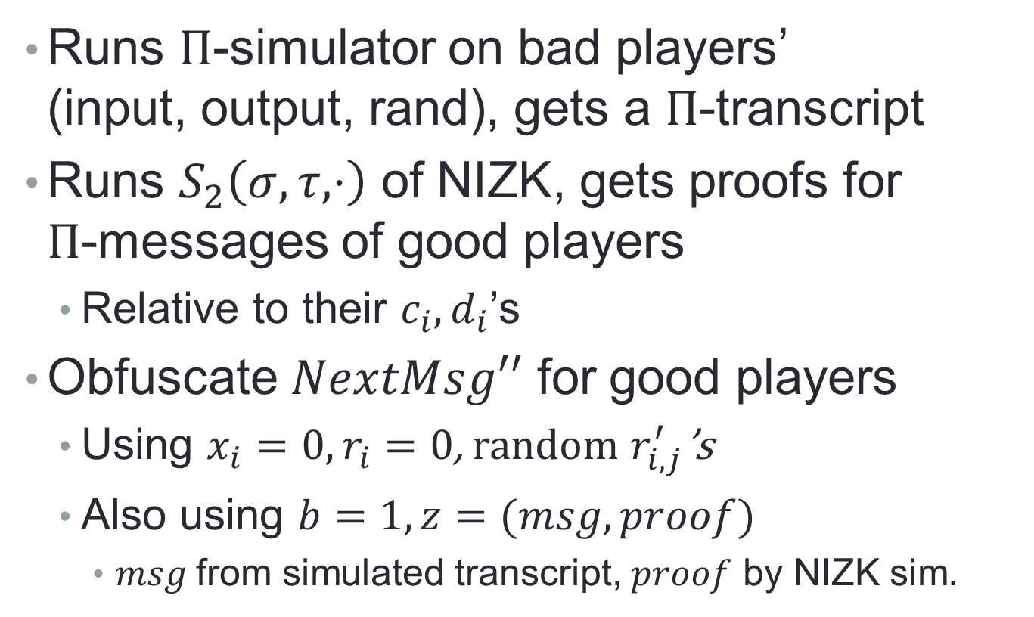
The Simulator (2)
Runs $Π$-simulator on bad players’ (input, output, rand), gets a $Π$-transcript
Runs $S_{2}\left(σ,τ,⋅\right)$ of NIZK, gets proofs for $Π$-messages of good players
Relative to their $c_{i},d_{i}$’s
Obfuscate $NextMsg′′$ for good players
Using $x_{i}=0, r_{i}=0$, random $r_{i,j}^{′}$’s
Also using $b=1, z=(msg, proof)$
$msg$from simulated transcript, $proof$ by NIZK sim.

Slide 34

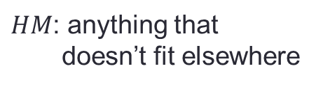


Real/Ideal Indistinguishability
We prove indistinguishability by going through several hybrids
Environment
This interface is indistinguishable
Between hybrids
Hybrid Manager
$HM$: anything that doesn’t fit elsewhere
Adversary
$$A$$
Honest Players
Trusted Party
$$T$$

Slide 35
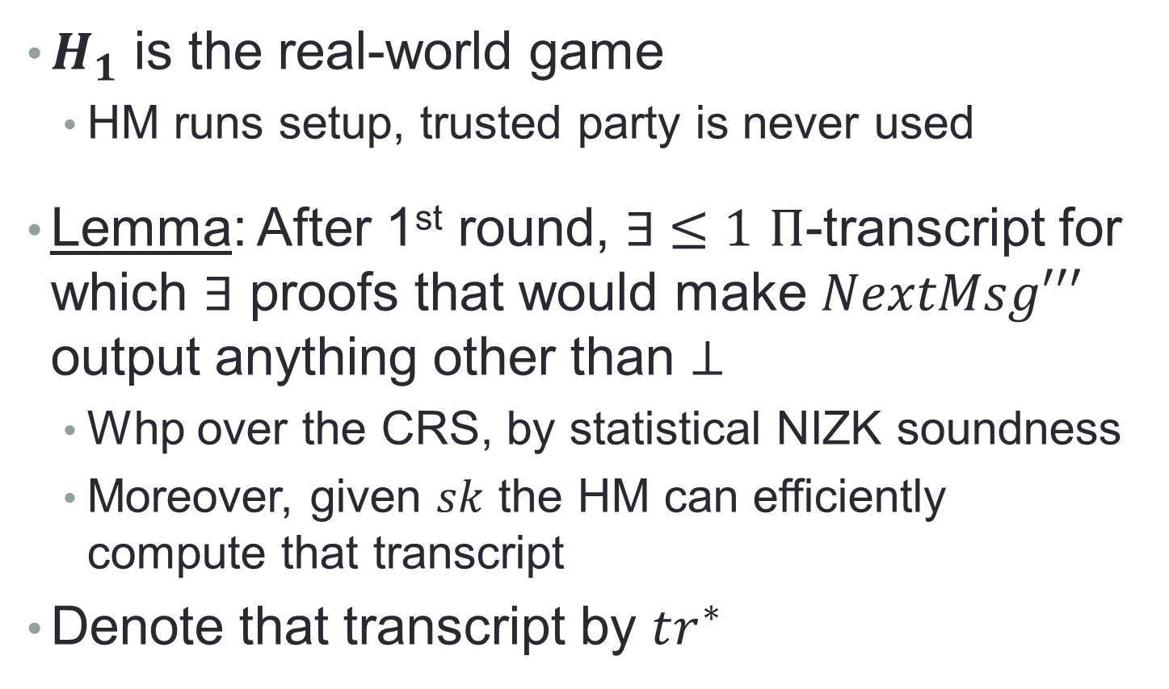
Real/Ideal Indistinguishability
$H_{1}$ is the real-world game
HM runs setup, trusted party is never used
Lemma: After 1st round, $∃ ≤1$ $Π$-transcript for which $∃$ proofs that would make $NextMsg′′′$ output anything other than $⊥$
Whp over the CRS, by statistical NIZK soundness
Moreover, given $sk$ the HM can efficiently compute that transcript
Denote that transcript by $tr^{∗}$

Slide 36
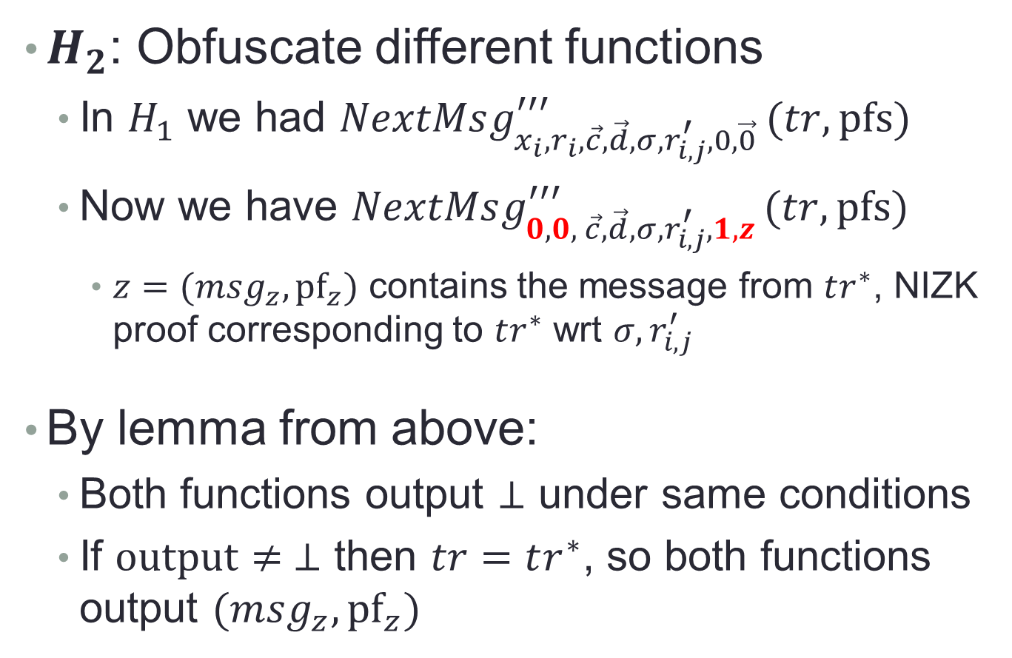
Real/Ideal Indistinguishability
$H_{2}$: Obfuscate different functions
In $H_{1}$ we had $NextMsg_{x_{i},r_{i},\vec{c},\vec{d},σ,r_{i,j}^{′},0,\vec{0} }^{′′′}(tr, pfs)$
Now we have $NextMsg_{0, 0, \vec{c},\vec{d},σ,r_{i,j}^{′},1,z }^{′′′}(tr,pfs)$
$z=(msg_{z},{pf}_{z})$ contains the message from $tr^{∗}$, NIZK proof corresponding to $tr^{∗}$ wrt $σ,r_{i,j}^{′}$
By lemma from above:
Both functions output $⊥$ under same conditions
If $output≠ ⊥$ then $tr=tr^{∗}$, so both functions output $(msg_{z},{pf}_{z})$

Slide 37
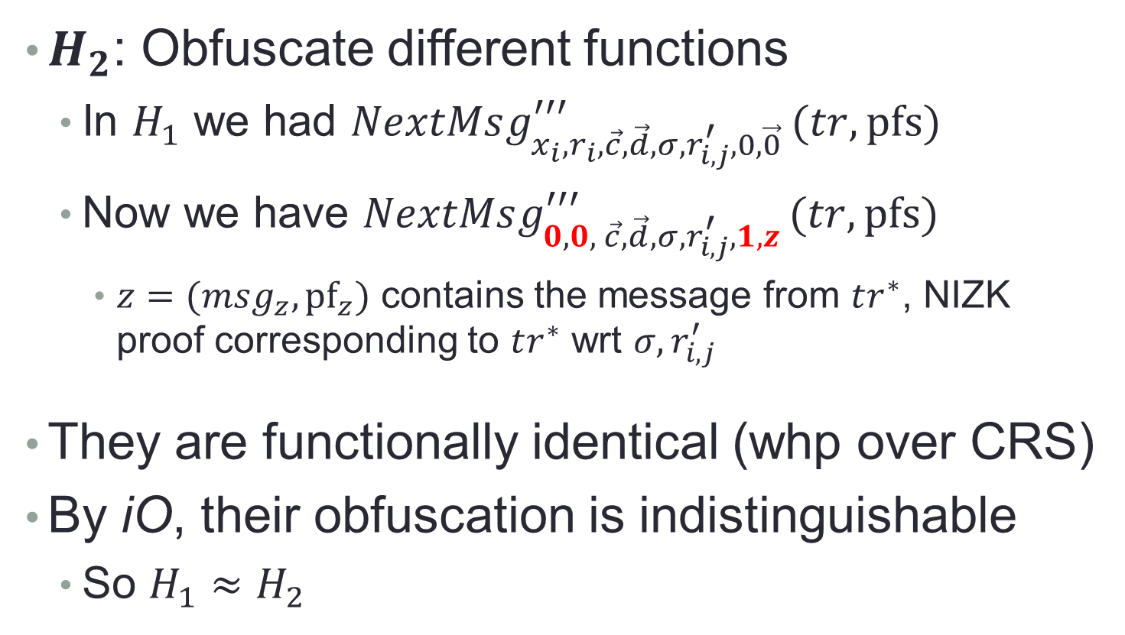
Real/Ideal Indistinguishability
$H_{2}$: Obfuscate different functions
In $H_{1}$ we had $NextMsg_{x_{i},r_{i},\vec{c},\vec{d},σ,r_{i,j}^{′},0,\vec{0} }^{′′′}(tr, pfs)$
Now we have $NextMsg_{0, 0, \vec{c},\vec{d},σ,r_{i,j}^{′},1,z }^{′′′}(tr,pfs)$
$z=(msg_{z},{pf}_{z})$ contains the message from $tr^{∗}$, NIZK proof corresponding to $tr^{∗}$ wrt $σ,r_{i,j}^{′}$
They are functionally identical (whp over CRS)
By iO, their obfuscation is indistinguishable
So $H_{1}≈H_{2}$

Slide 38
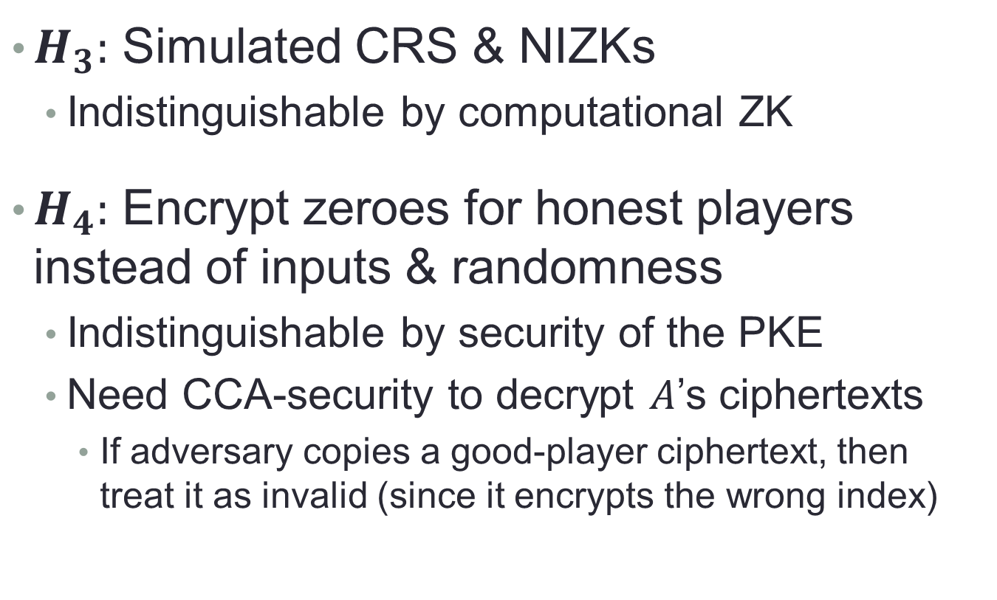
Real/Ideal Indistinguishability
$H_{3}:$ Simulated CRS & NIZKs
Indistinguishable by computational ZK
$H_{4}:$ Encrypt zeroes for honest players instead of inputs & randomness
Indistinguishable by security of the PKE
Need CCA-security to decrypt $A$’s ciphertexts
If adversary copies a good-player ciphertext, then treat it as invalid (since it encrypts the wrong index)

Slide 39

Real/Ideal Indistinguishability
$H_{5}:$ Use $Π$-simulator to generate $tr^{∗}$
Send inputs, get outputs from trusted party
Indistinguishable by security of $Π$
This is the ideal world, HM is the simulator

Slide 40
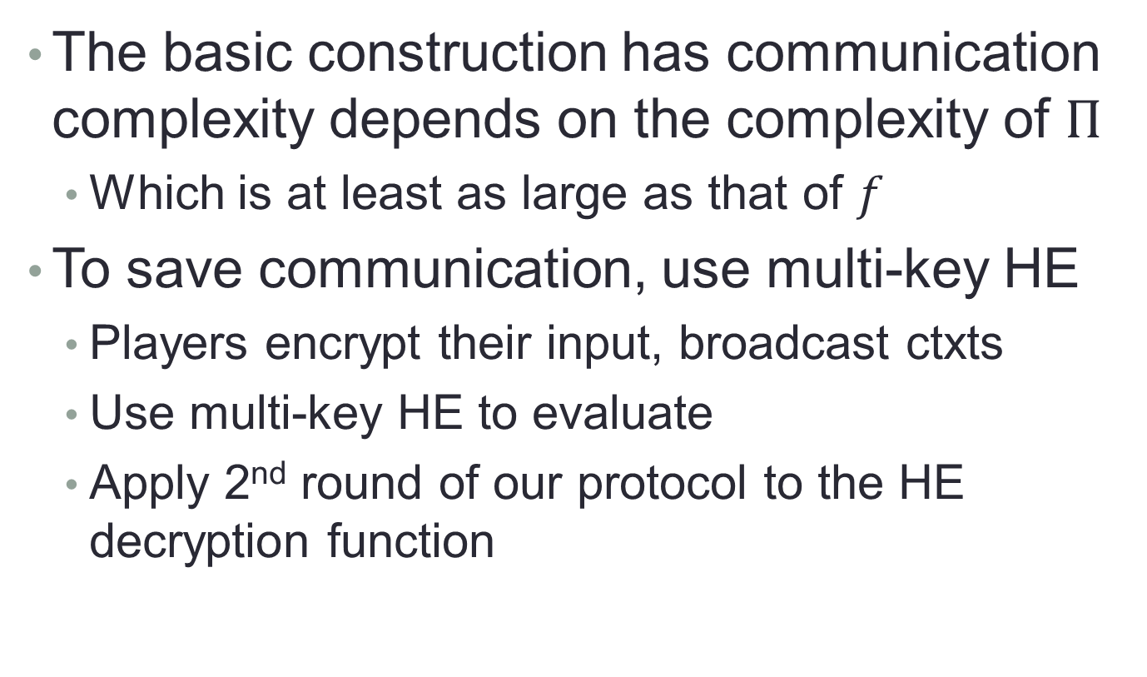
Reducing Communication Complexity
The basic construction has communication complexity depends on the complexity of $Π$
Which is at least as large as that of $f$
To save communication, use multi-key HE
Players encrypt their input, broadcast ctxts
Use multi-key HE to evaluate
Apply 2nd round of our protocol to the HE decryption function

Slide 41

Questions?

