Slide 1
Things that Cryptography Can Do
Shai Halevi – IBM Research
NYU Security Research Seminar
April 1, 2014

Slide 2
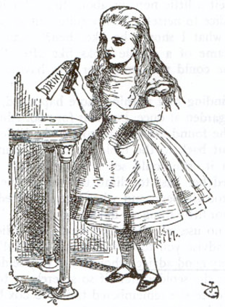
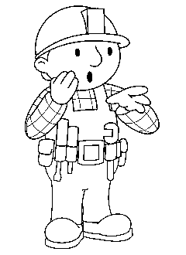

Cryptography
Traditional View: securing communication
Replicate in the digital world the functionality of sealed envelopes/Brinks cars
Bob
Alice
IHlBaf8ZK1i
l1xqqo1M4
0ZNAdMyV
Hello
there
Hello
there
Decrypt
Encrypt

Slide 3
Cryptography Today
Much more than communication
Public-key cryptography, Key-exchange, Signatures
Commitments, Oblivious-transfer, Zero-knowledge proofs, Secure computation, […]
Identity-based encryption, Attribute-based encryption, Functional encryption
Homomorphic encryption, Code obfuscation
Many of these concepts are digital-only
They have no analog in the physical world

Slide 4
Plan for Today
Cryptographic “magic tricks”
The classics
Zero-Knowledge [GMR84]
Secure Computation [GMW’86, Yao’86]
The modern & beyond
Homomorphic encryption [Gen’09]
Cryptographic code obfuscation [GGHRSW’13]
Applications to privacy in the digital society

Slide 5
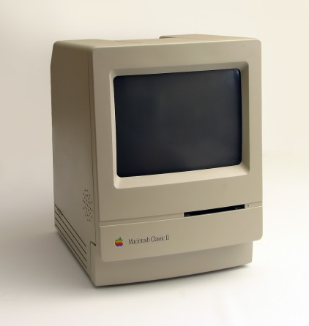
Classic Crypto Concepts

Slide 6

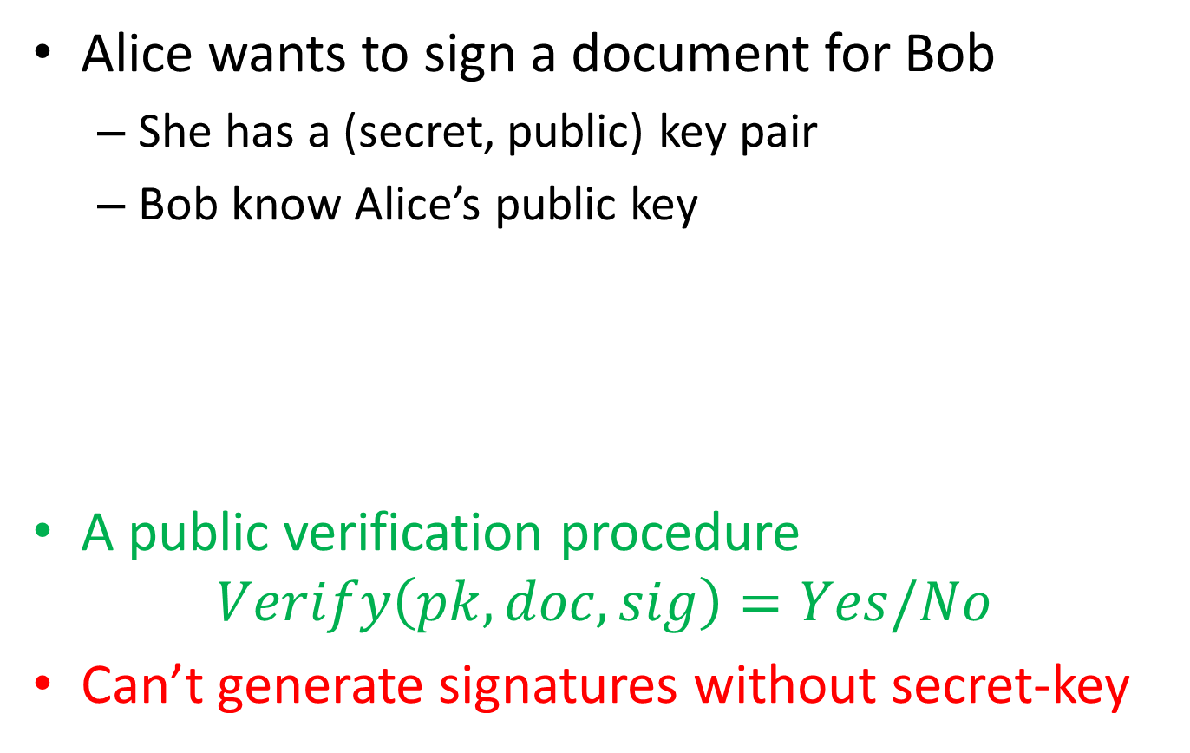
Digital Signatures
Alice wants to sign a document for Bob
She has a (secret, public) key pair
Bob know Alice’s public key
A public verification procedure $Verify\left(pk, doc, sig\right)=Yes/No$
Can’t generate signatures without secret-key
sign
verify
sk
pk

Slide 7


Zero-Knowledge Proofs [GoMiRa’84]
Alice proves to Bob that a statement is true
Without revealing anything about why it is true
Illustration: proving to a color-blind person that two balls have different colors

Slide 8
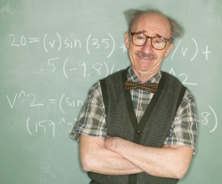
Zero-Knowledge Proofs
Theorem [GMW’86]: Every NP statement can be proven in zero-knowledge
The moral: anything that can be proven, can be proven in zero-knowledge
NP statement: of the form “problem XYZ has a solution” where the solution can be verified efficiently

Slide 9
Illustrative Application: Anonymous Credentials
sk
pk
Name: Stick Person
DoB: August 1, 1988
Eye color: Black
Digital Signature: D2A6B1..8F
Issuing a
certificate
wrt pk

Slide 10
Illustrative Application: Anonymous Credentials
pk
“D2A6B1..8F is a valid signature wrt pk on a statement that includes a birthdate later than 1993 and the picture “
NP statement de jour
Prove in zero-knowledge

Slide 11

Real-World Anonymous Credentials
A team in IBM Zurich Research Lab developed a suite of “anonymous identity management” crypto protocols along these lines
Joint work with Victor Shoup (NYU), Anna Lysyanskaya (Brown Univ.), others…
https://www.zurich.ibm.com/security/idemix/ https://idemix.wordpress.com/

Slide 12
Technical: An ZKP example from Number Theory

Slide 13

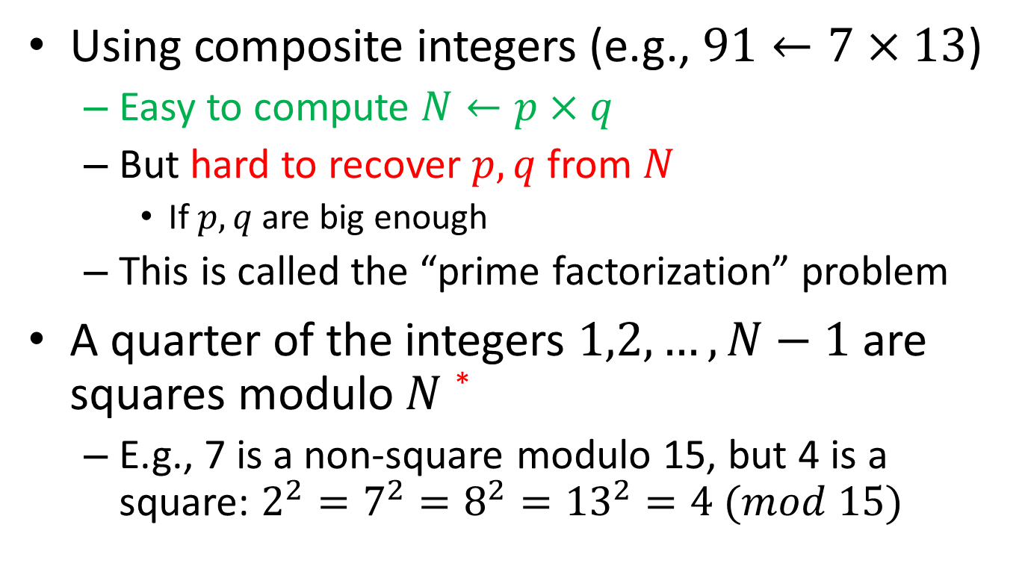
Some Number Theory
Using composite integers (e.g., $91←7×13$)
Easy to compute $N←p×q$
But hard to recover $p,q$ from $N$
If $p,q$ are big enough
This is called the “prime factorization” problem
A quarter of the integers $1,2,…,N−1$ are squares modulo $N$ *
E.g., 7 is a non-square modulo 15, but 4 is a square: $2^{2}=7^{2}=8^{2}={13}^{2}=4 (mod 15)$
* We only consider integers that are not divisible by p or q

Slide 14
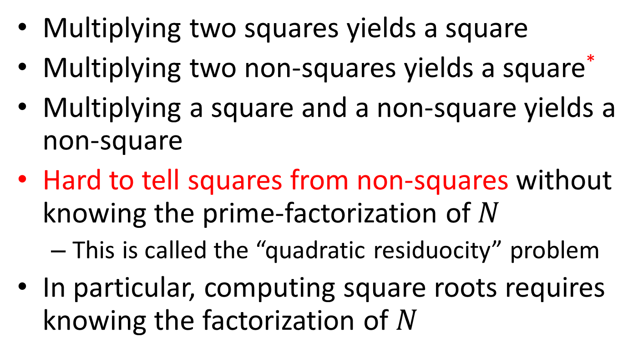
Squares vs. Non-Squares
Multiplying two squares yields a square
Multiplying two non-squares yields a square*
Multiplying a square and a non-square yields a non-square
Hard to tell squares from non-squares without knowing the prime-factorization of $N$
This is called the “quadratic residuocity” problem
In particular, computing square roots requires knowing the factorization of $N$
* Only true for integers with “Jacobi symbol 1”

Slide 15
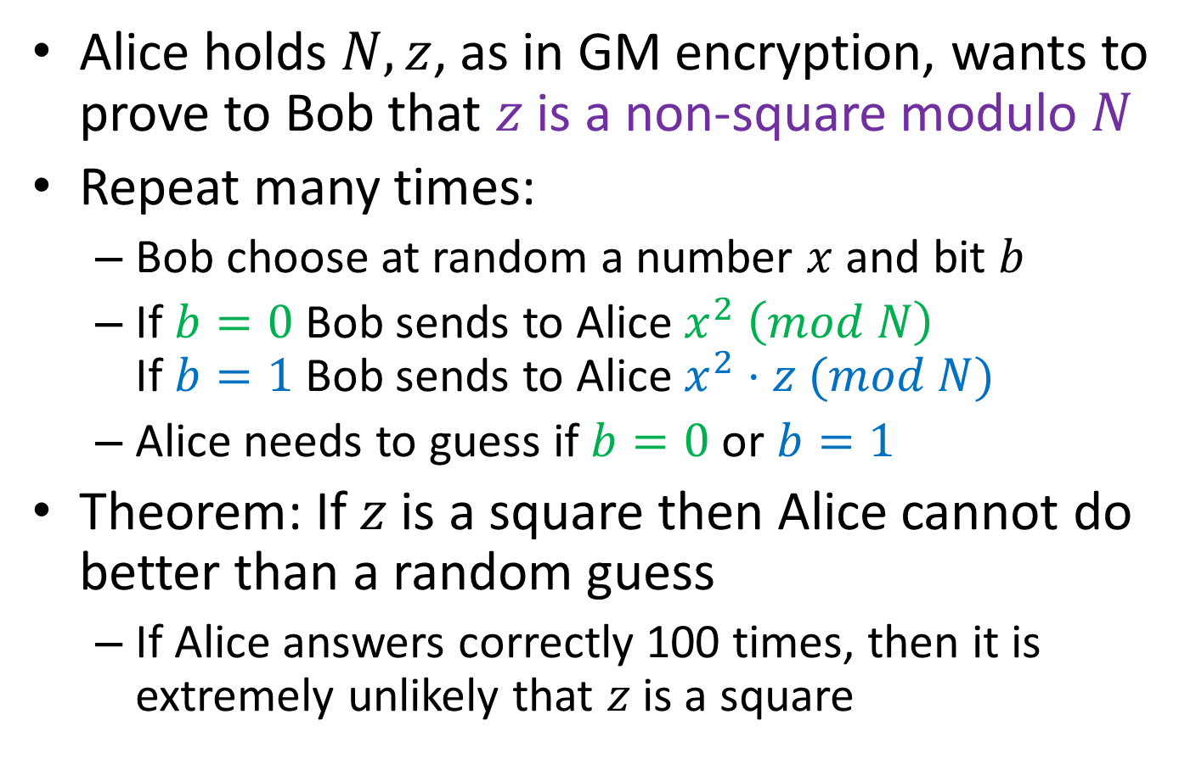
ZKP for Non-Squares
Alice holds $N,z$, as in GM encryption, wants to prove to Bob that $z$ is a non-square modulo $N$
Repeat many times:
Bob choose at random a number $x$ and bit $b$
If $b=0$ Bob sends to Alice $x^{2} \left(mod N\right)$ If $b=1$ Bob sends to Alice $x^{2}⋅z (mod N)$
Alice needs to guess if $b=0$ or $b=1$
Theorem: If $z$ is a square then Alice cannot do better than a random guess
If Alice answers correctly 100 times, then it is extremely unlikely that $z$ is a square

Slide 16
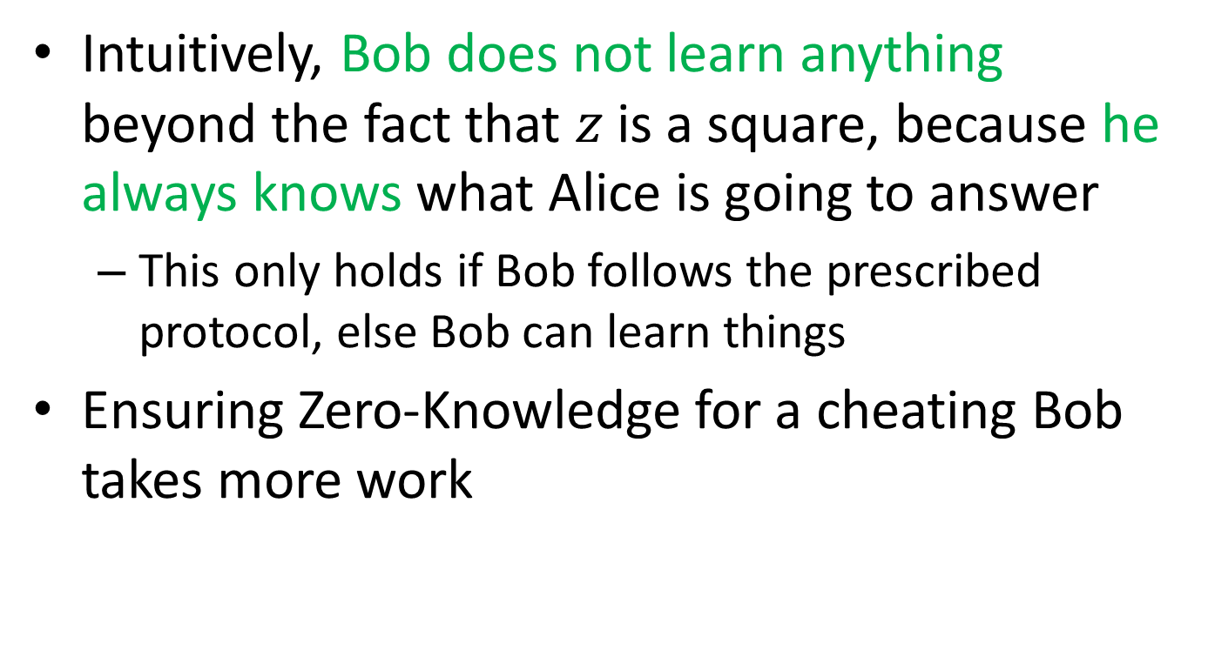
ZKP for Non-Squares
Intuitively, Bob does not learn anything beyond the fact that $z$ is a square, because he always knows what Alice is going to answer
This only holds if Bob follows the prescribed protocol, else Bob can learn things
Ensuring Zero-Knowledge for a cheating Bob takes more work

Slide 17
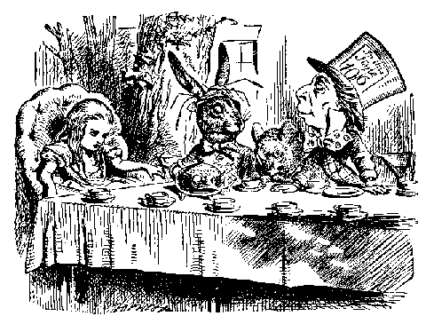
Secure Computation [Yao’86, GMW’86]
Very general setting:
A few parties: Alice, Bob, Charlie, Dora, …
Each with his/her own private input
Want to compute on their joint input
Without revealing their secrets
Computation should reveal the desired output and nothing more
Even if some parties misbehave

Slide 18
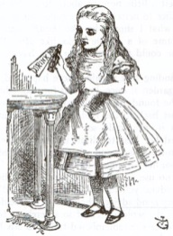
Illustration: Alice and Bob’s First Date
Alice & Bob plan their first date:
After the date
Alice will know whether or not she likes Bob
Bob will know whether or not he likes Alice
But neither will know (yet) what the other feels
Then they plan to play a game
Game only reveals if they both like each other
The logical-AND function
But if Alice doesn’t like Bob, then she does not learn whether Bob likes her (and vice versa)

Slide 19
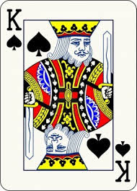
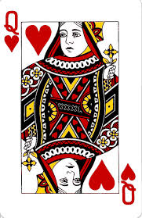
The “Game of Like” [dB’89]
Alice and Bob use five cards:
Two identical queen of hearts
Three identical king of spades
Each of then gets one queen and one king
Third king is left on the table, face down

Slide 20
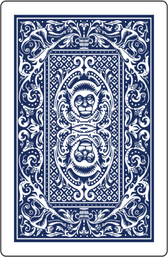
The “Game of Like”
Alice and Bob use five cards:
Two identical queen of hearts
Three identical king of spades
Each of then gets one queen and one king
Third king is left on the table, face down

Slide 21
The “Game of Like”
Bob puts his cards face down on top
Queen on top means he likes Alice, king on top means he does not
Alice puts her cards face down on top
King on top means she likes Bob, queen on top means she does not

Slide 22
The “Game of Like”
Alice and Bob take turn cutting the deck
Result is a cyclic shift of the deck

Slide 23
The “Game of Like”
Alice and Bob take turn cutting the deck
Result is a cyclic shift of the deck
Then they open the cards in order (on a circle)
If queens are adjacent they like each other

Slide 24
The “Game of Like”
Alice and Bob take turn cutting the deck
Result is a cyclic shift of the deck
Then they open the cards in order (on a circle)
If queens are adjacent they like each other
Theorem: nothing is revealed when the queens are not adjacent

Slide 25
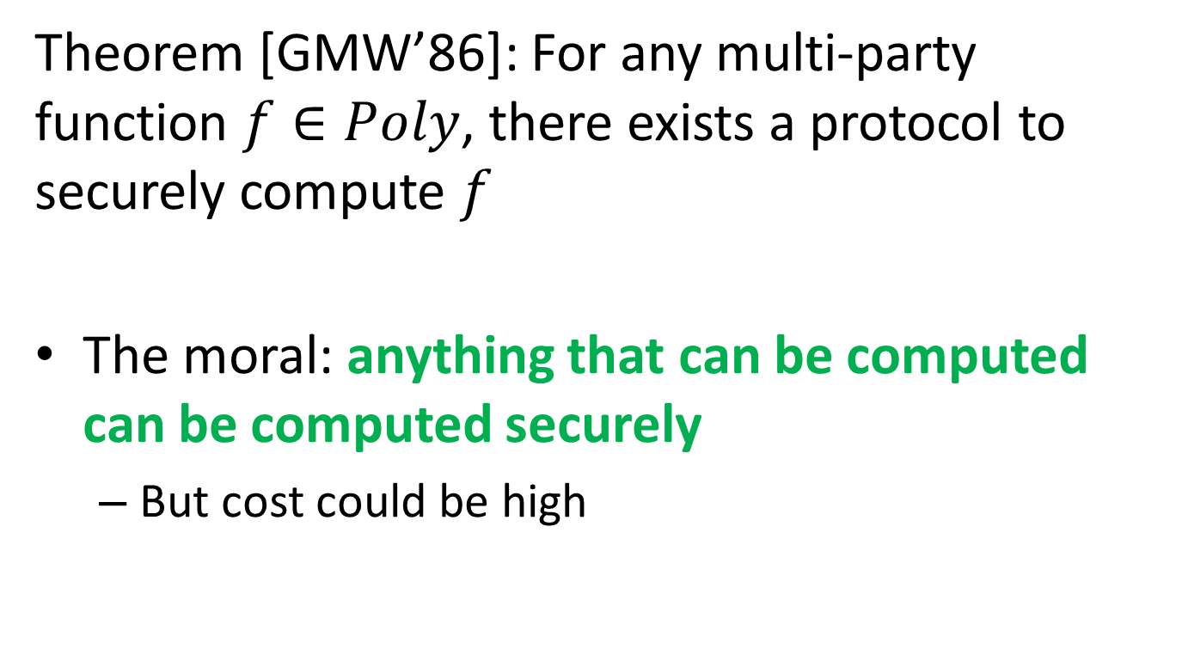
Secure Computation
Theorem [GMW’86]: For any multi-party function $f∈Poly$, there exists a protocol to securely compute $f$
The moral: anything that can be computed can be computed securely
But cost could be high

Slide 26
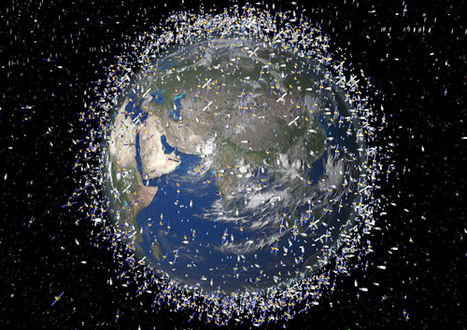
Applicability of Secure Computation
Avoiding collisions in space
Each government has course of its satellites, output is whether any two are on a collision course
An election protocol
Inputs are votes, output is tally
No-fly list
FBI has list of suspect, airline has list of passengers, output is the intersection of the two lists
Etc.

Slide 27
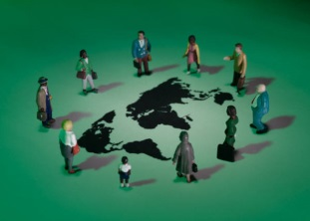
Real-World Secure Computation
Prices of Sugar Beets in Denmark are determined using secure computation
For over five years now
Some universities and other organizations are using cryptographic voting protocols
Extensive research over last decade into improving efficiency and usability
Some start-ups, code libraries, etc.

Slide 28
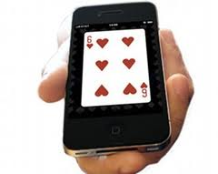
Modern-day magic

Slide 29
Beyond Secure Computation?
Secure-computation is not always applicable
Protocols often impose tough conditions
All parties must be online all the time
No “send and forget” or “loosely connected”
Often need to broadcast messages to everyone
All parties work equally hard
No clients-and-server
Processing is “data oblivious”
E.g., linear search rather than binary search
Current effort to address these issues

Slide 30

One Theme: Removing Interaction
Solutions for the “send and forget” setting (one-way communication)
Or the “send question, get answer” setting (e.g., client-server)
Most important advances along these lines:
Homomorphic encryption
Obfuscation

Slide 31

Homomorphic Encryption
“I want to delegate processing of my data, without giving away access to it”
“I want to delegate the computation to the cloud”
Enc(x)
f
Enc[f(x)]
Client
Server/Cloud
(Input: x)
(Function: f)

Slide 32
Applicability of HE
Encrypting data before storing to the cloud
The cloud can still search/sort/edit/… this data without shipping it back and forth to be decrypted
Encrypting queries to the cloud
Cloud can process them
Answer is encrypted, client can decrypt
Note: data, program have similar roles here
Can encrypt either (or both)

Slide 33
“Privacy Homomorphisms”
Rivest-Adelman-Dertouzos 1978
Plaintext space P
Ciphertext space C
x₁ x₂
c_{i} ← Enc(x_{i})
c₁ c₂
∗
#
y ← Dec(d)
y
d

Slide 34
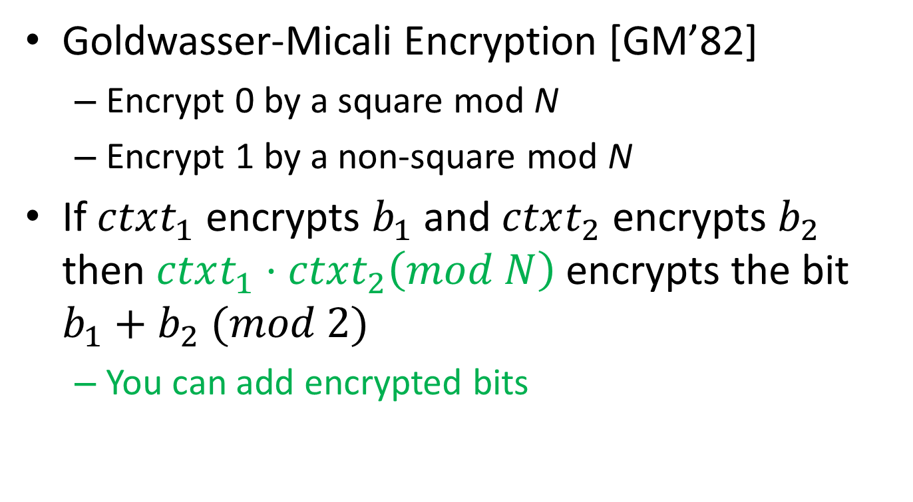
Example of Additive Homomorphism
Goldwasser-Micali Encryption [GM’82]
Encrypt 0 by a square mod N
Encrypt 1 by a non-square mod N
If $ctxt_{1}$ encrypts $b_{1}$ and $ctxt_{2}$ encrypts $b_{2}$ then $ctxt_{1}⋅ctxt_{2}\left(mod N\right)$ encrypts the bit $b_{1}+b_{2} (mod 2)$
You can add encrypted bits

Slide 35
“Fully Homomorphic” Encryption
Compute arbitrary functions f on encrypted data
An example: private information retrieval
Next: “FHE in two easy steps”
Enc(x)
Eval
f
Enc(f(x))
i
Enc(i)
A[1 … n]
Enc(A[i])

Slide 36
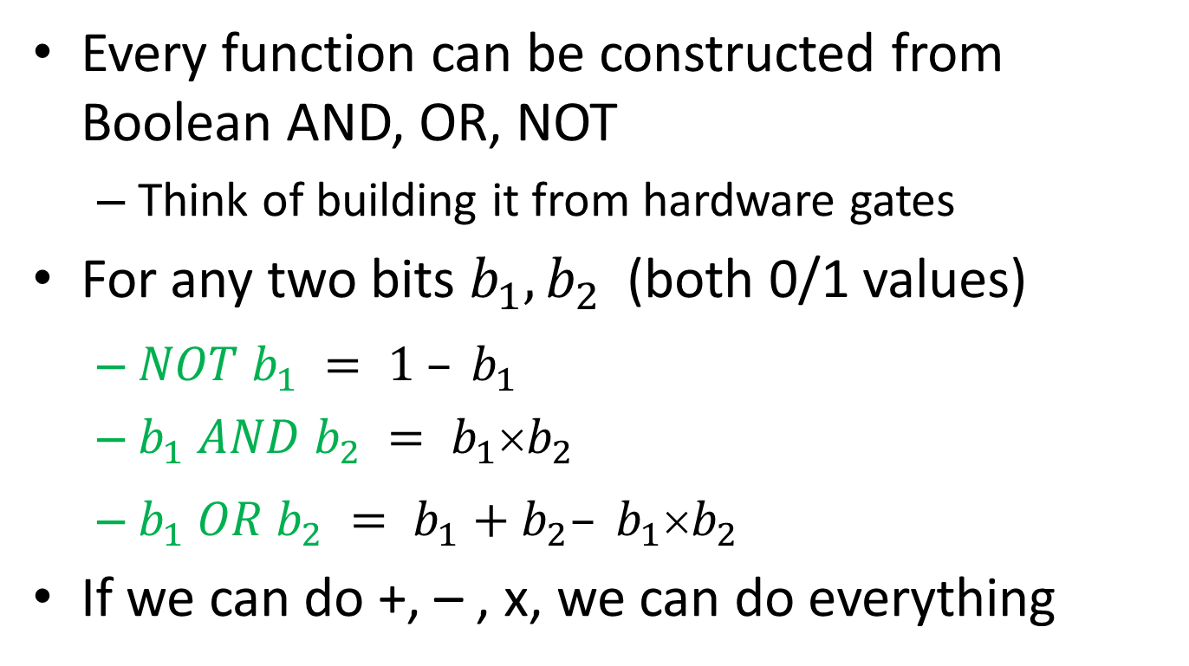
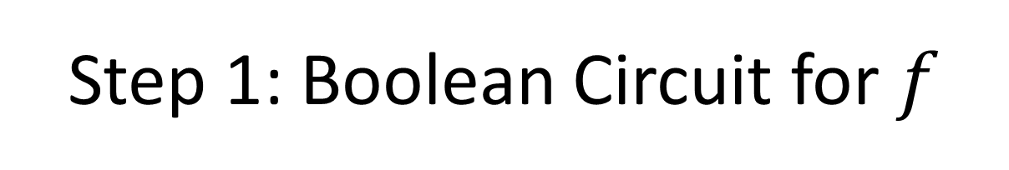
Step 1: Boolean Circuit for $f$
Every function can be constructed from Boolean AND, OR, NOT
Think of building it from hardware gates
For any two bits $b_{1}, b_{2}$(both 0/1 values)
$NOT b_{1} = 1 – b_{1}$
$b_{1} AND b_{2} = b_{1}b_{2}$
$b_{1} OR b_{2} = b_{1}+b_{2}– b_{1}b_{2}$
If we can do +, – , x, we can do everything

Slide 37
Step 2: Encryption Supporting ±, ×
Open Problem for over 30 years
Gentry 2009: first plausible scheme
Several other schemes in last few years
Moral: Fully homomorphic encryption is possible

Slide 38
Technical: A FHE Example from Linear-Algebra

Slide 39


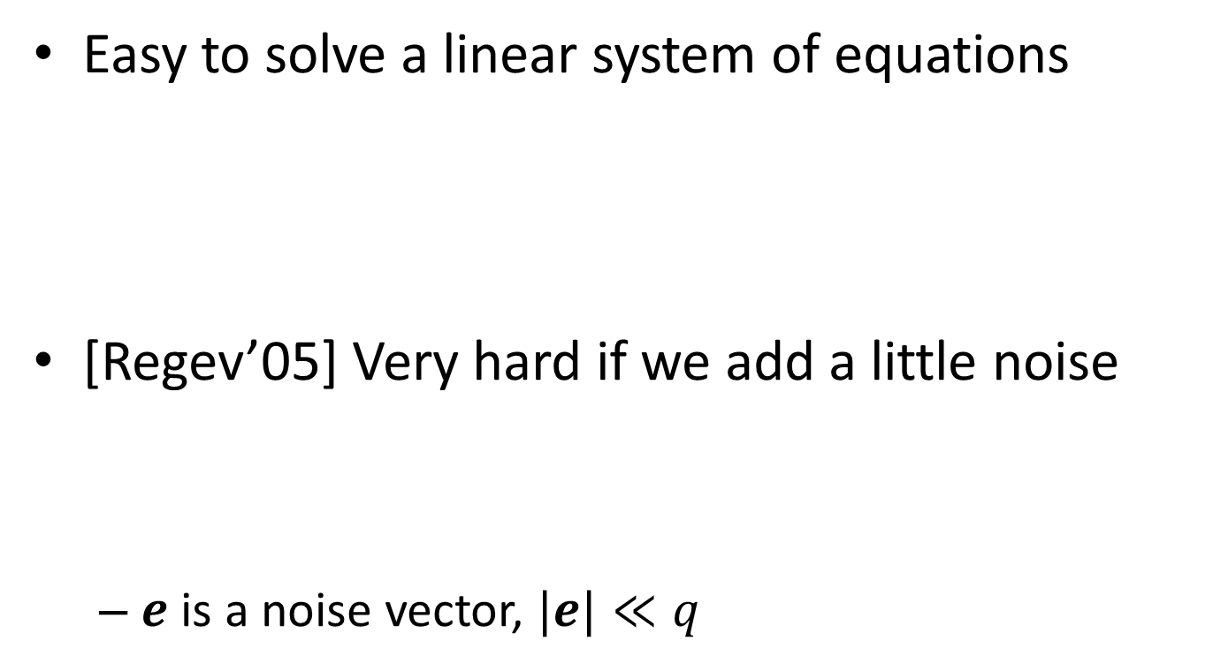



Main Tool: Learning with Errors
Easy to solve a linear system of equations
[Regev’05] Very hard if we add a little noise
$e$ is a noise vector, $|e|≪q$
A
x
b
$$=$$
$$(mod q)$$
A
x
e
b
$$+$$
$$=$$
$$(mod q)$$

Slide 40
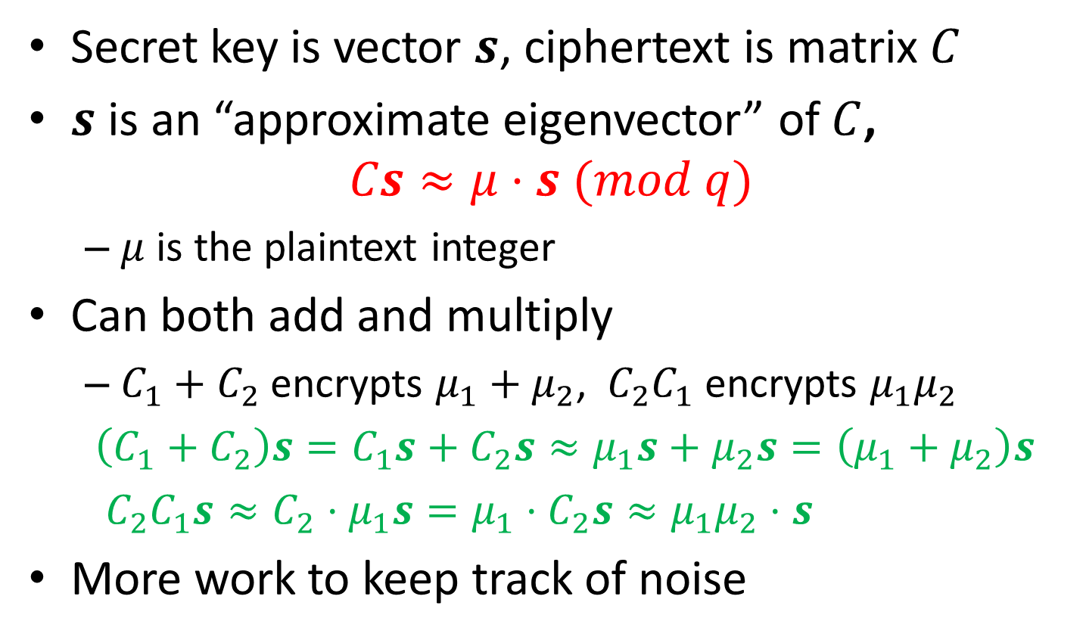
A Taste of [GSW’13] HE Scheme
Secret key is vector $s$, ciphertext is matrix $C$
$s$ is an “approximate eigenvector” of $C$, $Cs≈μ⋅s (mod q)$
$μ$ is the plaintext integer
Can both add and multiply
$C_{1}+C_{2}$ encrypts $μ_{1}+μ_{2}$, $C_{2}C_{1}$ encrypts $μ_{1}μ_{2}$
$\left(C_{1}+C_{2}\right)s=C_{1}s+C_{2}s≈μ_{1}s+μ_{2}s=\left(μ_{1}+μ_{2}\right)s$
$C_{2}C_{1}s≈C_{2}⋅μ_{1}s=μ_{1}⋅C_{2}s≈μ_{1}μ_{2}⋅s$
More work to keep track of noise

Slide 41
Status of Real-World HE
Still Experimental
Open-source HElib implementation on github
Performance improved by ~6 orders of magnitude since 2009, but still very costly
May be suitable for niche applications

Slide 42
Code Obfuscation
Encrypting programs, maintaining functionality
Only the functionality should remain “visible”
Example of recreational obfuscation:
-- Wikipedia, accessed Oct-2013
@P=split//,".URRUU\c8R";@d=split//,"\nrekcah xinU / lreP rehtona tsuJ";sub p{ @p{"r$p","u$p"}=(P,P);pipe"r$p","u$p";++$p;($q*=2)+=$f=!fork;map{$P=$P[$f^ord ($p{$_})&6];$p{$_}=/ ^$P/ix?$P:close$_}keys%p}p;p;p;p;p;map{$p{$_}=~/^[P.]/&& close$_}%p;wait until$?;map{/^r/&&<$_>}%p;$_=$d[$q];sleep rand(2)if/\S/;print

Slide 43
Why Obfuscation?
Hiding secrets in software
Distributing software patches
Vulnerable
program
1,2d0
< The Way that can be told of is not the eternal Way;
< The name that can be named is not the eternal name
4c2,3
< The Named is the mother of all things.
---
> The named is the mother of all things.
11a11,13
> They both may be called deep and profound.
> Deeper and more profound,
> The door of all subtleties!
Patched
program

Slide 44
Why Obfuscation?
Hiding secrets in software
Distributing software patches while hiding vulnerability
Vulnerable
program
@P=split//,".URRUU\c8R";@d=split//,"\nrekcah xinU / lreP rehtona tsuJ";sub p{ @p{"r$p","u$p"}=(P,P);pipe"r$p","u$p";++$p;($q*=2)+=$f=!fork;map{$P=$P[$f^ord ($p{$_})&6];$p{$_}=/ ^$P/ix?$P:close$_}keys%p}p;p;p;p;p;map{$p{$_}=~/^[P.]/&& close$_}%p;wait until$?;map{/^r/&&<$_>}%p;$_=$d[$q];sleep rand(2)if/\S/;print
Patched
program

Slide 45
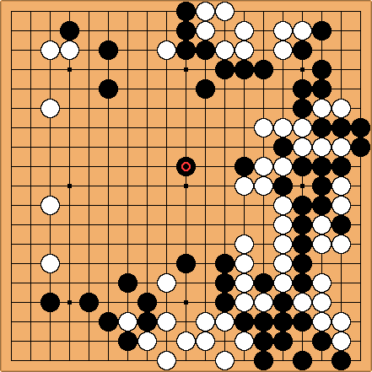
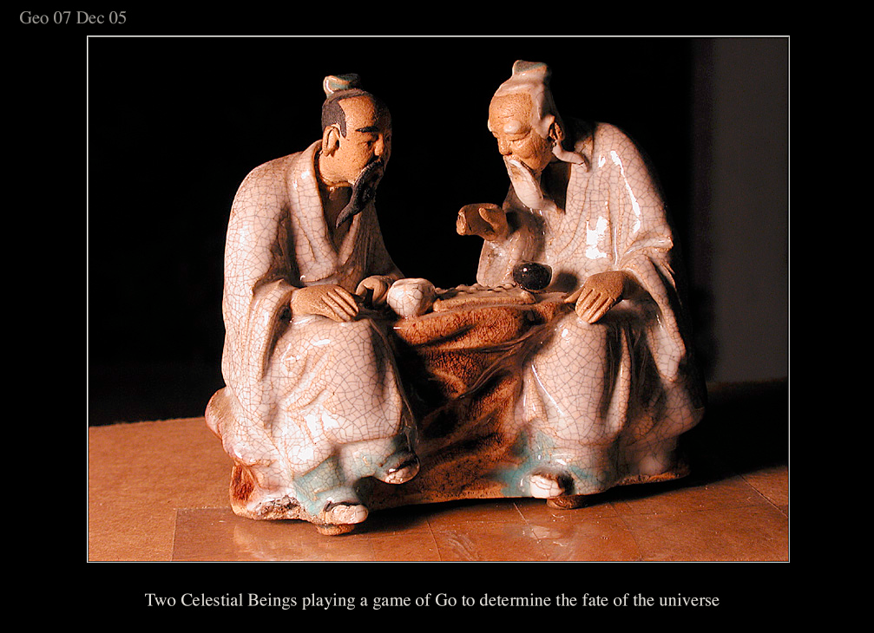
Why Obfuscation?
Hiding secrets in software
Uploading my expertise to the web
http://www.arco-iris.com/George/images/game_of_go.jpg
Game of Go
Next
move

Slide 46
Why Obfuscation?
Hiding secrets in software
Uploading my expertise to the web without revealing my strategies
@P=split//,".URRUU\c8R";@d=split//,"\nrekcah xinU / lreP rehtona tsuJ";sub p{ @p{"r$p","u$p"}=(P,P);pipe"r$p","u$p";++$p;($q*=2)+=$f=!fork;map{$P=$P[$f^ord ($p{$_})&6];$p{$_}=/ ^$P/ix?$P:close$_}keys%p}p;p;p;p;p;map{$p{$_}=~/^[P.]/&& close$_}%p;wait until$?;map{/^r/&&<$_>}%p;$_=$d[$q];sleep rand(2)if/\S/;print
Game of Go
Next
move

Slide 47
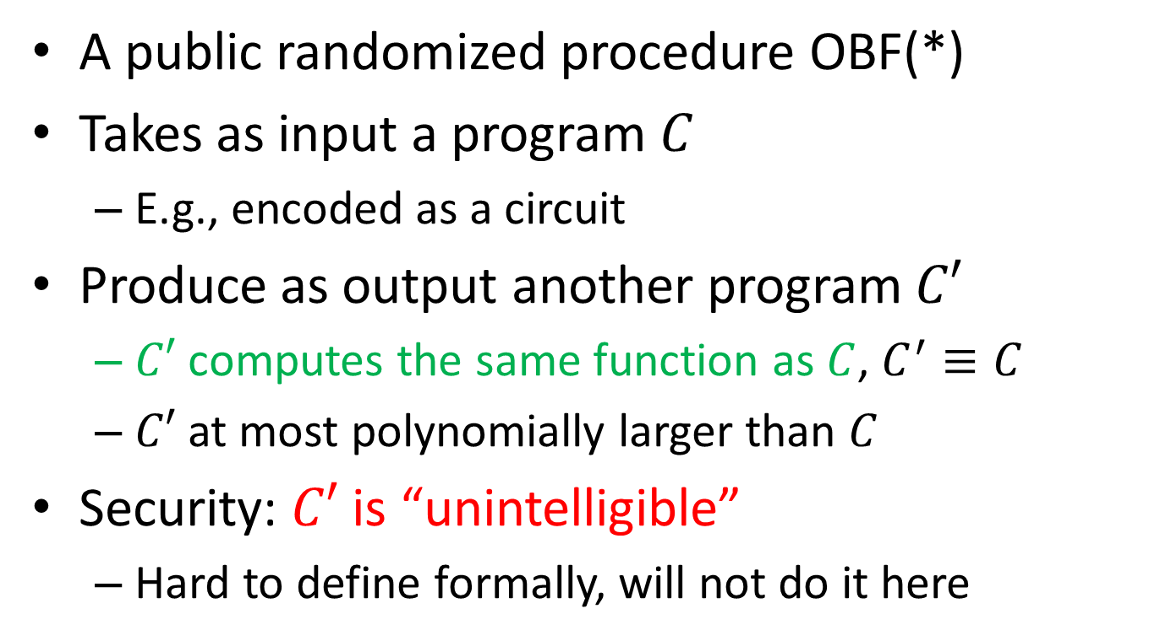
A Little More Formally
A public randomized procedure OBF(*)
Takes as input a program $C$
E.g., encoded as a circuit
Produce as output another program $C′$
$C′$ computes the same function as $C$, $C^{′}≡C$
$C′$ at most polynomially larger than $C$
Security: $C′$ is “unintelligible”
Hard to define formally, will not do it here

Slide 48
Obfuscation vs. HE
F
Encryption
F
+
➔
F(x)
x
or
x
Result encrypted
F
Obfuscation
F
+
➔
F(x)
x
Result in the clear

Slide 49
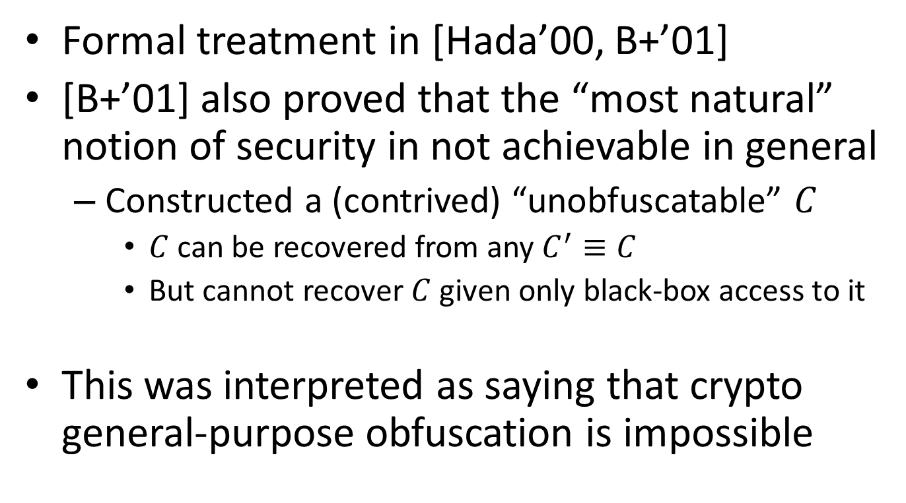
History of Crypto-Obfuscation
Formal treatment in [Hada’00, B+’01]
[B+’01] also proved that the “most natural” notion of security in not achievable in general
Constructed a (contrived) “unobfuscatable” $C$
$C$ can be recovered from any $C^{′}≡C$
But cannot recover $C$ given only black-box access to it
This was interpreted as saying that crypto general-purpose obfuscation is impossible
Notes:
Barak, Goldreich, Impagliazzo, Rudich, Sahai, Vadhan, Yang, “On the (im)possibility of obfuscating programs”

Slide 50
Crypto-Obfuscation is Plausible
Some progress before 2013 on obfuscating very simple functions
[GGHRSW’13] has an candidate obfuscator for general-purpose circuits
Satisfy weaker security notion (also from [B+’01])
Using recent “cryptographic multilinear maps” [GGH’13], and also HE
A few similar constructions since then

Slide 51
Crypto Obfuscation in the Real-World
Currently only a plausibility argument
Contemporary construction are polynomial time, but very inefficient
So much so that they cannot be implemented
This will probably change as we find better ways to obfuscate

Slide 52
Summary
Cryptography can do much more than secure communication
Today I briefly reviewed some examples:
Proofs in zero-knowledge
Computing on secret inputs w/o revealing them
Computing on encrypted data
Code obfuscation
Major challenge: leverage this power to solve privacy issues in todays’ digital society

Slide 53

Thank You
Questions?

