Slide 1

Cryptographic Hash Functions and their many applications
Shai Halevi – IBM Research
USENIX Security – August 2009
Thanks to Charanjit Jutla and Hugo Krawczyk

Slide 2
What are hash functions?
Just a method of compressing strings
  E.g., H : {0,1}* → {0,1}¹⁶⁰
  Input is called “message”, output is “digest”
Why would you want to do this?
  Short, fixed-size better than long, variable-size
    True also for non-crypto hash functions
  Digest can be added for redundancy
  Digest hides possible structure in message

Slide 3
How are they built?
But not always…
Typically using Merkle-Damgård iteration:
Start from a “compression function”
  h: {0,1}^{b+n}→{0,1}^{n}
Iterate it
|M|=b=512 bits
h
c =160 bits
d=h(c,M)=160 bits
M₁
M₂
M_{L-1}
M_{L}
IV=d₀
d₁
d₂
…
d_{L-1}
d_{L}
h
h
h
h
d=H(M)

Slide 4
What are they good for?
“Modern, collision resistant hash functions were designed to create
small, fixed size message digests so that a digest could act as a
proxy for a possibly very large variable length message in a digital
signature algorithm, such as RSA or DSA. These hash functions
have since been widely used for many other “ancillary” applications,
including hash-based message authentication codes, pseudo
random number generators, and key derivation functions.”
“Request for Candidate Algorithm Nominations”,
-- NIST, November 2007

Slide 5
Some examples
Signatures: sign(M) = RSA⁻¹( H(M) )
Message-authentication: tag=H(key,M)
Commitment: commit(M) = H(M,…)
Key derivation: AES-key = H(DH-value)
Removing interaction [Fiat-Shamir, 1987]
  Take interactive identification protocol
  Replace one side by a hash function
        Challenge = H(smthng, context)
  Get non-interactive signature scheme
A
B
smthng
challenge
response
smthng, response

Slide 6
Some things that we want
Collision resistance (commitment, signatures)
  Hard to find MM’ for which H(M)=H(M’)
One-way (commitment)
  Given d, hard to find M such that H(M)=d
Unpredictability (authentication)
  MH(R,M) unpredictable when R is secret
Extraction (key derivation)
  If M has high entropy then H(M) is ~ uniform
What’s needed for the Fiat-Shamir transformation?
  Some other form of “unpredictability” (?)

Slide 7
Part I: Random functions vs. hash functions

Slide 8

Random functions
What we really want is H that behaves
“just like a random function”:
  Digest d=H(M) chosen uniformly for each M
  Digest d=H(M) has no correlation with M
  For distinct M₁,M₂,…, digests d_{i}=H(M_{i}) are completely uncorrelated to each other
  Cannot find collisions, or even near-collisions
  Cannot find M to “hit” a specific d
  Cannot find fixed-points (d = H(d))
  etc.

Slide 9





The “Random-Oracle paradigm”
[Bellare-Rogaway, 1993]
Pretend hash function is really this good
Design a secure cryptosystem using it
  Prove security relative to a “random oracle”
Notes:
Paradigm for designing/proving crypto schemes

Slide 10
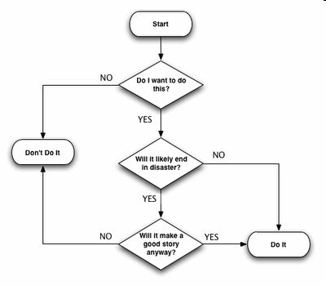
The “Random-Oracle paradigm”
[Bellare-Rogaway, 1993]
Pretend hash function is really this good
Design a secure cryptosystem using it
  Prove security relative to a “random oracle”
Replace oracle with a hash function
  Hope that it remains secure

Slide 11
The “Random-Oracle paradigm”
[Bellare-Rogaway, 1993]
Pretend hash function is really this good
Design a secure cryptosystem using it
  Prove security relative to a “random oracle”
Replace oracle with a hash function
  Hope that it remains secure
Very successful paradigm, many schemes
  E.g., OAEP encryption, FDH,PSS signatures
    Also all the examples from before…
  Schemes seem to “withstand test of time”

Slide 12
Random oracles: rationale
S is some crypto scheme (e.g., signatures), that uses a hash function H
S proven secure when H is random function
→ Any attack on real-world S must use
some “nonrandom property” of H
We should have chosen a better H
  without that “nonrandom property”
Caveat: how do we know what “nonrandom properties” are important?

Slide 13
This rationale isn’t sound
[Canetti-Goldreich-H 1997]
Exist signature schemes that are:
  1. Provably secure wrt a random function
  2. Easily broken for EVERY hash function
Idea: hash functions are computable
  This is a “nonrandom property” by itself
Exhibit a scheme which is secure only
for “non-computable H’s”
  Scheme is (very) “contrived”

Slide 14
Contrived example
Start from any secure signature scheme
  Denote signature algorithm by SIG1^{H}(key,msg)
Change SIG1 to SIG2 as follows:
  SIG2^{H}(key,msg): interprate msg as code Π
  If Π(i)=H(i) for i=1,2,3,…,|msg|, then output key
  Else output the same as SIG1^{H}(key,msg)
If H is random, always the “Else” case
If H is a hash function, attempting to sign
the code of H outputs the secret key
Some Technicalities

Slide 15
Cautionary note
ROM proofs may not mean what you think…
  Still they give valuable assurance, rule out “almost all realistic attacks”
What “nonrandom properties” are important for OAEP / FDH / PSS / …?
How would these scheme be affected by a weakness in the hash function in use?
ROM may lead to careless implementation

Slide 16
Merkle-Damgård vs. random functions
h
h
…
h
h
Recall: we often construct our hash functions from compression functions
  Even if compression is random, hash is not
    E.g., H(key|M) subject to extension attack
      H(key | M|M’) = h( H(key|M), M’)
  Minor changes to MD fix this
    But they come with a price (e.g. prefix-free encoding)
Compression also built from low-level blocks
  E.g., Davies-Meyer construction, h(c,M)=E_{M}(c)c
  Provide yet more structure, can lead to attacks
  on provable ROM schemes [H-Krawczyk 2007]

Slide 17
Part II: Using hash functions in applications

Slide 18
Using “imperfect” hash functions
Applications should rely only on “specific security properties” of hash functions
  Try to make these properties as “standard” and as weak as possible
Increases the odds of long-term security
  When weaknesses are found in hash function, application more likely to survive
  E.g., MD5 is badly broken, but HMAC-MD5 is barely scratched

Slide 19
Security requirements
Deterministic hashing
  Attacker chooses M, d=H(M)
Hashing with a random salt
  Attacker chooses M, then good guy
  chooses public salt, d=H(salt,M)
Hashing random messages
  M random, d=H(M)
Hashing with a secret key
  Attacker chooses M, d=H(key,M)
Stronger
Weaker

Slide 20
Deterministic hashing
Collision Resistance
  Attacker cannot find M,M’ such that H(M)=H(M’)
Also many other properties
  Hard to find fixed-points, near-collisions,
  M s.t. H(M) has low Hamming weight, etc.

Slide 21
Hashing with public salt
Target-Collision-Resistance (TCR)
  Attacker chooses M, then given random salt, cannot find M’ such that H(salt,M)=H(salt,M’)
enhanced TRC (eTCR)
  Attacker chooses M, then given random salt, cannot find M’,salt’ s.t. H(salt,M)=H(salt’,M’)

Slide 22
Hashing random messages
Second Preimage Resistance
  Given random M, attacker cannot find M’
  such that H(M)=H(M’)
One-wayness
  Given d=H(M) for random M, attacker cannot
  find M’ such that H(M’)=d
Extraction*
  For random salt, high-entropy M, the digest d=H(salt,M) is close to being uniform
* Combinatorial, not cryptographic

Slide 23
Hashing with a secret key
Pseudo-Random Functions
  The mapping MH(key,M) for secret key
  looks random to an attacker
Universal hashing*
  For all MM’, Pr_{key}[ H(key,M)=H(key,M’) ]<ε
* Combinatorial, not cryptographic

Slide 24
Application 1:
Digital signatures
Hash-then-sign paradigm
  First shorten the message, d = H(M)
  Then sign the digest, s = SIGN(d)
Relies on collision resistance
  If H(M)=H(M’) then s is a signature on both
→ Attacks on MD5, SHA-1 threaten current signatures
  MD5 attacks can be used to get bad CA cert
  [Stevens et al. 2009]

Slide 25
Collision resistance is hard
Attacker works off-line (find M,M’)
  Can use state-of-the-art cryptanalysis, as much computation power as it can gather, without being detected !!
Helped by birthday attack (e.g., 2⁸⁰ vs 2¹⁶⁰)
Well worth the effort
  One collision ➔ forgery for any signer

Slide 26

Signatures without CRHF
[Naor-Yung 1989, Bellare-Rogaway 1997]
Use randomized hashing
  To sign M, first choose fresh random salt
  Set d= H(salt, M), s= SIGN( salt || d )
Attack scenario (collision game):
  Attacker chooses M, M’
  Signer chooses random salt
  Attacker must find M' s.t. H(salt,M) = H(salt,M')
Attack is inherently on-line
  Only rely on target collision resistance
same salt (since salt is explicitly signed)

Slide 27
TCR hashing for signatures
Not every randomization works
  H(M|salt) may be subject to collision attacks
    when H is Merkle-Damgård
  Yet this is what PSS does (and it’s provable in the ROM)
Many constructions “in principle”
  From any one-way function
Some engineering challenges
  Most constructions use long/variable-size randomness, don’t preserve Merkle-Damgård
Also, signing salt means changing the underlying signature schemes

Slide 28
Signatures with enhanced TCR
[H-Krawczyk 2006]
Use “stronger randomized hashing”, eTCR
  To sign M, first choose fresh random salt
  Set d = H(salt, M), s = SIGN( d )
Attack scenario (collision game):
  Attacker chooses M
  Signer chooses random salt
  Attacker needs M‘,salt’ s.t. H(salt,M)=H(salt',M')
Attack is still inherently on-line
attacker can use different salt’

Slide 29
Randomized hashing with RMX
[H-Krawczyk 2006]
Use simple message-randomization
  RMX: M=(M₁,M₂,…,M_{L}), r 
  (r, M₁⊕r,M₂⊕r,…,M_{L}⊕r)
Hash( RMX(r,M) ) is eTCR when:
  Hash is Merkle-Damgård, and
  Compression function is ~ 2nd-preimage-resistant
Signature: [ r, SIGN( Hash( RMX(r,M) )) ]
  r fresh per signature, one block (e.g. 512 bits)
  No change in Hash, no signing of r

Slide 30
Preserving hash-then-sign
M =(M₁,…,M_{L})
M =(M₁,…,M_{L})
RMX
r
(r, M₁⊕r,,…,M_{L}⊕r(
HASH
HASH
TCR
X
SIGN
SIGN

Slide 31
Application 2:
Message authentication
Sender, Receiver, share a secret key
Compute an authentication tag
  tag = MAC(key, M)
Sender sends (M, tag)
Receiver verifies that tag matches M
Attacker cannot forge tags without key

Slide 32
Authentication with HMAC
[Bellare-Canetti-Krawczyk 1996]
Simple key-prepend/append have problems when used with a Merkle-Damgård hash
  tag=H(key | M) subject to extension attacks
  tag=H(M | key) relies on collision resistance
HMAC: Compute tag = H(key | H(key | M))
  About as fast as key-prepend for a MD hash
Relies only on PRF quality of hash
  MH(key|M) looks random when key is secret

Slide 33
Authentication with HMAC
[Bellare-Canetti-Krawczyk 1996]
Simple key-prepend/append have problems when used with a Merkle-Damgård hash
  tag=H(key | M) subject to extension attacks
  tag=H(M | key) relies on collision resistance
HMAC: Compute tag = H(key | H(key | M))
  About as fast as key-prepend for a MD hash
Relies only on PRF property of hash
  MH(key|M) looks random when key is secret
As a result, barely affected by collision attacks on MD5/SHA1

Slide 34
Carter-Wegman authentication
[Wegman-Carter 1981,…]
Compress message with hash, t=H(key₁,M)
Hide t using a PRF, tag = tPRF(key₂,nonce)
  PRF can be AES, HMAC, RC4, etc.
  Only applied to a short nonce, typically not a performance bottleneck
Secure if the PRF is good, H is “universal”
  For MM’,Δ, Pr_{key}[ H(key,M)H(key,M’)=Δ ]<ε)
  Not cryptographic, can be very fast

Slide 35
Fast Universal Hashing
“Universality” is combinatorial, provable
  → no need for “security margins” in design
Many works on fast implementations
  From inner-product, H_{k1,k2}(M₁,M₂)=(K₁+M₁)·(K₂+M₂)
    [H-Krawczyk’97, Black et al.’99, …]
  From polynomial evaluation H_{k}(M₁,…,M_{L})=Σ_{i} M_{i} k^{i}
    [Krawczyk’94, Shoup’96, Bernstein’05, McGrew-Viega’06,…]
As fast as 2-3 cycle-per-byte (for long M’s)
  Software implementation, contemporary CPUs

Slide 36
Part III:
Designing a hash function
Fugue: IBM’s candidate for the NIST hash competition

Slide 37
Design a compression function?
h
h
…
h
h
PROs: modular design, reduce to the “simpler problem” of compressing fixed-length strings
  Many things are known about transforming compression into hash
CONs: compression→hash has its problems
  It’s not free (e.g. message encoding)
  Some attacks based on the MD structure
    Extension attacks ( rely on H(x|y)=h(H(x),y) )
    “Birthday attacks” (herding, multicollisions, …)

Slide 38
Example attack: herding
[Kelsey-Kohno 2006]
M_{1,1}
Find many off-line collisions
  “Tree structure” with ~2^{n/3} d_{i,j}’s
  Takes ~ 2^{2n/3} time
Publish final d
Then for any prefix P
  Find “linking block” L s.t. H(P|L) in the tree
  Takes ~ 2^{2n/3} time
  Read off the tree the suffix S to get to d
→ Show an extension of P s.t. H(P|L|S) = d
d_{1,1}
h
M_{2,1}
M_{1,2}
d_{2,1}
h
d_{1,2}
h
M_{1,3}
d
d_{1,3}
h
M_{2,2}
M_{1,4}
d_{2,2}
h
d_{1,4}
h

Slide 39
The culprit: small intermediate state
With a compression function, we:
  Work hard on current message block
  Throw away this work, keep only n-bit state
Alternative: keep a large state
  Work hard on current message block/word
  Update some part of the big state
More flexible approach
  Also more opportunities to mess things up

Slide 40
The hash function Grindahl
[Knudsen-Rechberger-Thomsen 2007]
State is 13 words = 52 bytes
Process one 4-byte word at a time
  One AES-like mixing step per word of input
After some final processing, output 8 words
Collision attack by Peyrin (2007)
  Complexity ~ 2¹¹² (still better than brute-force)
    Recently improved to ~ 2¹⁰⁰ [Khovratovich 2009]
  “Start from a collision and go backwards”

Slide 41
The hash function “Fugue”
[H-Hall-Jutla 2008]
Proof-driven design
  Designed to enable analysis
  → Proofs that Peyrin-style attacks do not work
State of 30 4-byte words = 120 bytes
Two “super-mixing” rounds per word of input
  Each applied to only 16 bytes of the state
  With some extra linear diffusion
Super-mixing is AES-like
  But uses stronger MDS codes

Slide 42
Fugue-256
Initial State (30 words)
Process
M₁
New State
Iterate
M_{i}
State
Final Processing
Output 8 words = 256 bits

Slide 43
Collision attacks
Think of M₁, …,M_{L}
and M’₁,…,M’_{L}
Initial State (30 words)
Process
ΔM₁
Collision
means that
ΔM_{i}’s are
not all zero
New State
Iterate
ΔM_{i}
Δ State = 0?
State
Δ State = 0
→Internal collision
Δ State  0
→External collision
Final Processing
Δ = 0

Slide 44
Processing one input word
Initial State (30 words)
Process
Process
1. Input one word
M₁
2. Shift 3 columns to right
M₁
New State
3. XOR into columns 1-3

4. “super-mix” operation
on columns 1-4
SMIX
Repeat 2-4 once more
This is where the crypto happens
Iterate
State
Final Stage

Slide 45
SMIX in Fugue
Similar to one AES round
  Works on a 4x4 matrix of bytes
  Starts with S-box substitution
    Byte b, S[256] = {...};
    ...
    b = S[b];
  Does linear mixing
Stronger mixing than AES
  Diagonal bytes as in AES
  Other bytes are mixed into both column and row

Slide 46
SMIX in Fugue
In algebraic notation:
M generates a good linear code
  If all the b_{i}’ bytes but 4 are zero
  then ≥ 13 of the S[b_{i}] bytes must be nonzero
  And other such properties
'
b₁
S[b₁]
'
b₂
= M_{16x16}
S[b₂]
×


'
b₁₆
S[b₁₆]

Slide 47
Analyzing internal collisions*
now Δ₂₈₋₁0
 3 columns
still Δ₁₋₄0


before SMIX: Δ₁₋₄0
≤4 nonzero byte diffs
SMIX
before input word: Δ₁0
Δ
After last input word: ΔState=0
* a bit oversimplified

Slide 48
Analyzing internal collisions*
Δ₂₅₋₁0
 3 columns
Δ₂₈₋₄0


Δ₂₈₋₄0
≤4 nonzero byte diffs
SMIX
now Δ₂₈₋₁0
 3 columns
still Δ₁₋₄0

before SMIX: Δ₁₋₄0
SMIX
before input word: Δ₁0
Δ
after input word: ΔState=0
* a bit oversimplified

Slide 49
Analyzing internal collisions*
before input: Δ₁=?, Δ₂₅₋₃₀0
Δ’
Δ₂₅₋₁0
 3 columns
Δ₂₈₋₄0


Δ₂₈₋₄0
SMIX
now Δ₂₈₋₁0
 3 columns
still Δ₁₋₄0

before SMIX: Δ₁₋₄0
SMIX
before input word: Δ₁0
Δ
after input word: ΔState=0
* a bit oversimplified

Slide 50
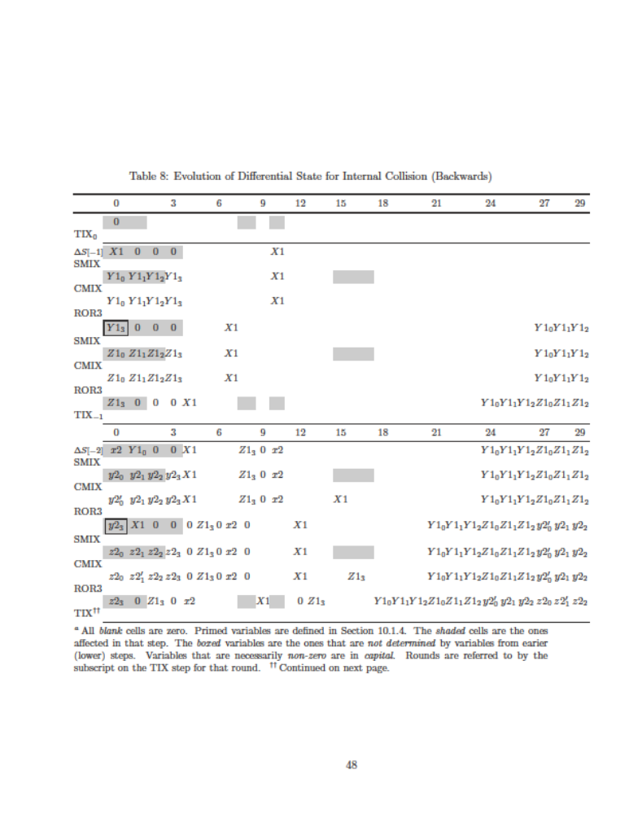
Many nonzero byte differences before the SMIX operations
The analysis
from previous
slides was
upto here

Slide 51
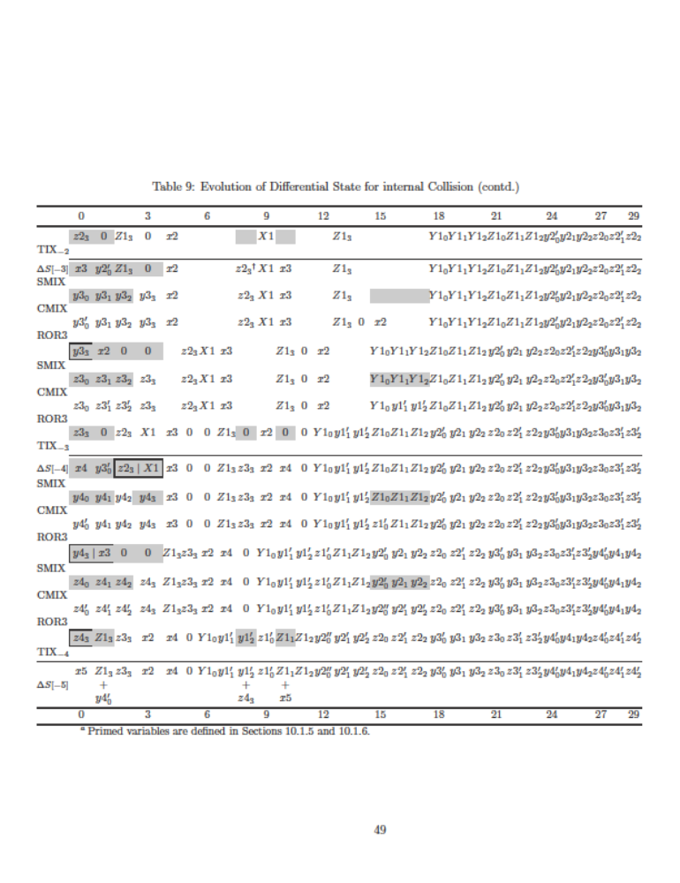

Slide 52
Analyzing internal collisions
What does this mean? Consider this attack:
  Attacker feeds in random M₁,M₂,… and M’₁,M’₂,…
  Until State_{L}  State’_{L} = some “good Δ”
  Then it searches for suffixed (M_{L+1},…,M_{L+4}), (M’_{L+1},…,M’_{L+4}) that will induce internal collision
Theorem*: For any fixed Δ,
Pr[ ∃ suffixes that induce collision ] < 2⁻¹⁵⁰
  * Relies on a very mild independence assumptions

Slide 53
Analyzing internal collisions
Why do we care about this analysis?
Peyrin’s attacks are of this type
All differential attacks can be seen as (optimizations of) this attack
  Entities that are not controlled by attack are always presumed random
A known “collision trace” is as close as we can get to understanding collision resistance

Slide 54
Fugue: concluding remarks
Similar analysis also for external collisions
  “Unusually thorough” level of analysis
Performance comparable to SHA-256
  But more amenable to parallelism
One of 14 submissions that were selected by NIST to advance to 2nd round of the SHA3 competition

Slide 55
Morals
Hash functions are very useful
We want them to behave “just like random functions”
  But they don’t really
Applications should be designed to rely on “as weak as practical” properties of hashing
  E.g., TCR/eTCR rather than collision-resistance
A taste of how a hash function is built

Slide 56
Thank you!

