Slide 1
Field-Switching in Homomorphic Encryption
Craig Gentry Shai Halevi Chris Peikert Nigel P. Smart

Slide 2
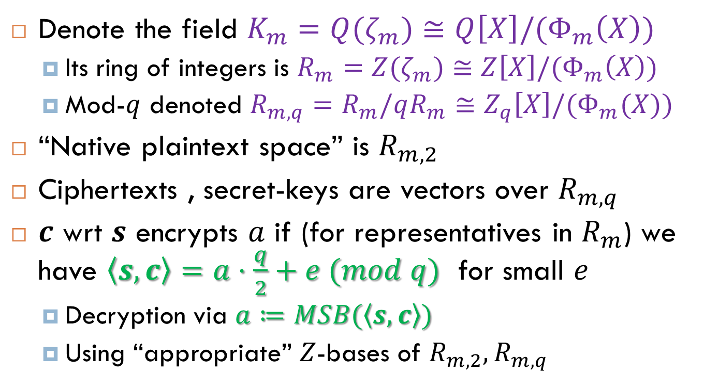
HE Over Cyclotomic Rings
Denote the field $K_{m}=Q(ζ_{m})≅Q\left[X\right]/(Φ_{m}\left(X\right))$
Its ring of integers is $R_{m}=Z(ζ_{m})≅Z\left[X\right]/(Φ_{m}\left(X\right))$
Mod-$q$ denoted $R_{m,q}{=R}_{m}/qR_{m}≅Z_{q}\left[X\right]/{(Φ}_{m}(X))$
“Native plaintext space” is $R_{m,2}$
Ciphertexts , secret-keys are vectors over $R_{m,q}$
$c$ wrt $s$ encrypts $a$ if (for representatives in $R_{m}$) we have $\left\langle s,c\right\rangle =a⋅\frac{q}{2}+e (mod q)$ for small $e$
Decryption via $a≔MSB(\left\langle s,c\right\rangle )$
Using “appropriate” $Z$-bases of $R_{m,2},R_{m,q}$
*
*
*
* Not exactly

Slide 3
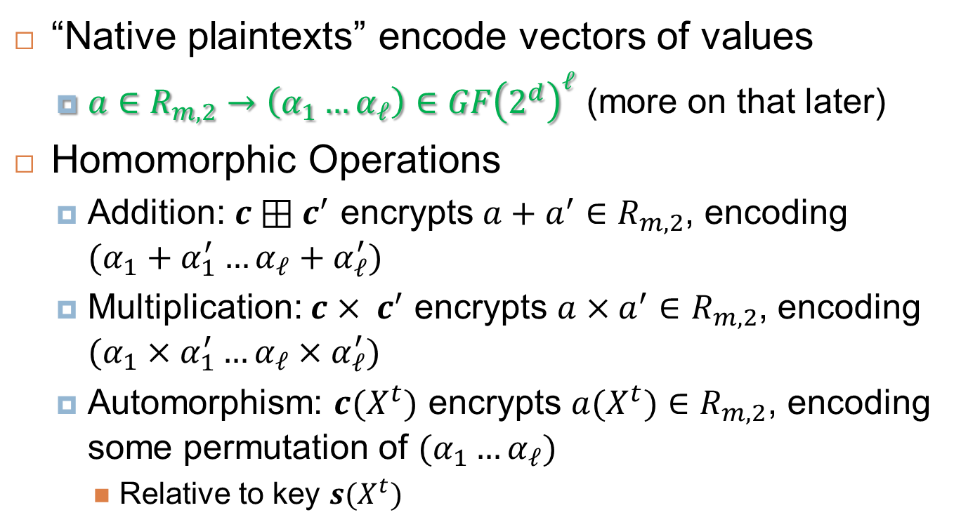
HE Over Cyclotomic Rings
“Native plaintexts” encode vectors of values
$a∈R_{m,2}→\left(α_{1}…α_{ℓ}\right)∈GF{\left(2^{d}\right)}^{ℓ}$ (more on that later)
Homomorphic Operations
Addition: $c⊞c^{′}$ encrypts $a+a^{′}∈R_{m,2}$, encoding $(α_{1}+α_{1}^{′}…α_{ℓ}+α_{ℓ}^{′})$
Multiplication: $c× c^{′}$ encrypts $a×a^{′}∈R_{m,2}$, encoding $(α_{1}×α_{1}^{′}…α_{ℓ}×α_{ℓ}^{′})$
Automorphism: $c(X^{t})$ encrypts $a(X^{t})∈R_{m,2}$, encoding some permutation of $(α_{1}…α_{ℓ})$
Relative to key $s(X^{t})$

Slide 4
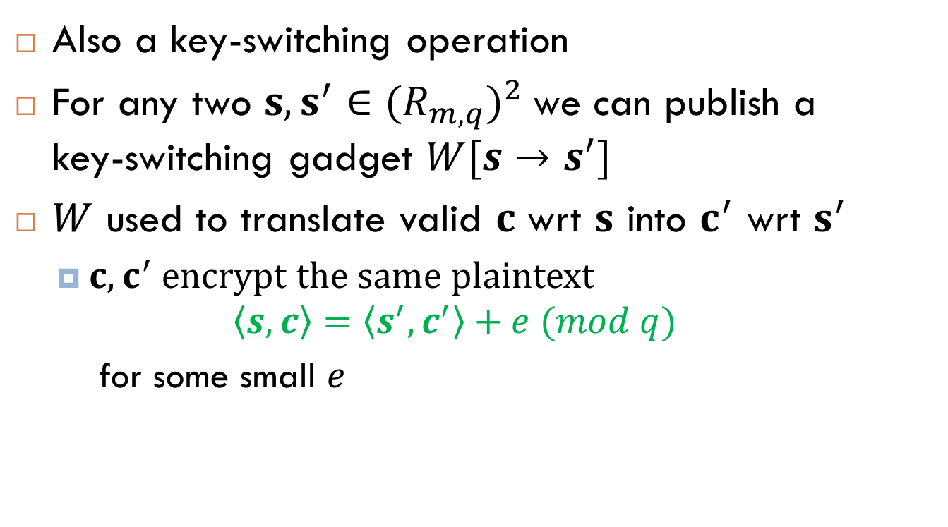
HE Over Cyclotomic Rings
Also a key-switching operation
For any two $s,s^{′}∈{(R_{m,q})}^{2}$we can publish a key-switching gadget $W[s→s^{′}]$
$W$ used to translate valid $c$ wrt $s$ into $c^{′}$ wrt $s^{′}$
${c,c}^{′}$ encrypt the same plaintext
$$\left\langle s,c\right\rangle =\left\langle s^{′},c^{′}\right\rangle +e (mod q)$$
for some small $e$

Slide 5
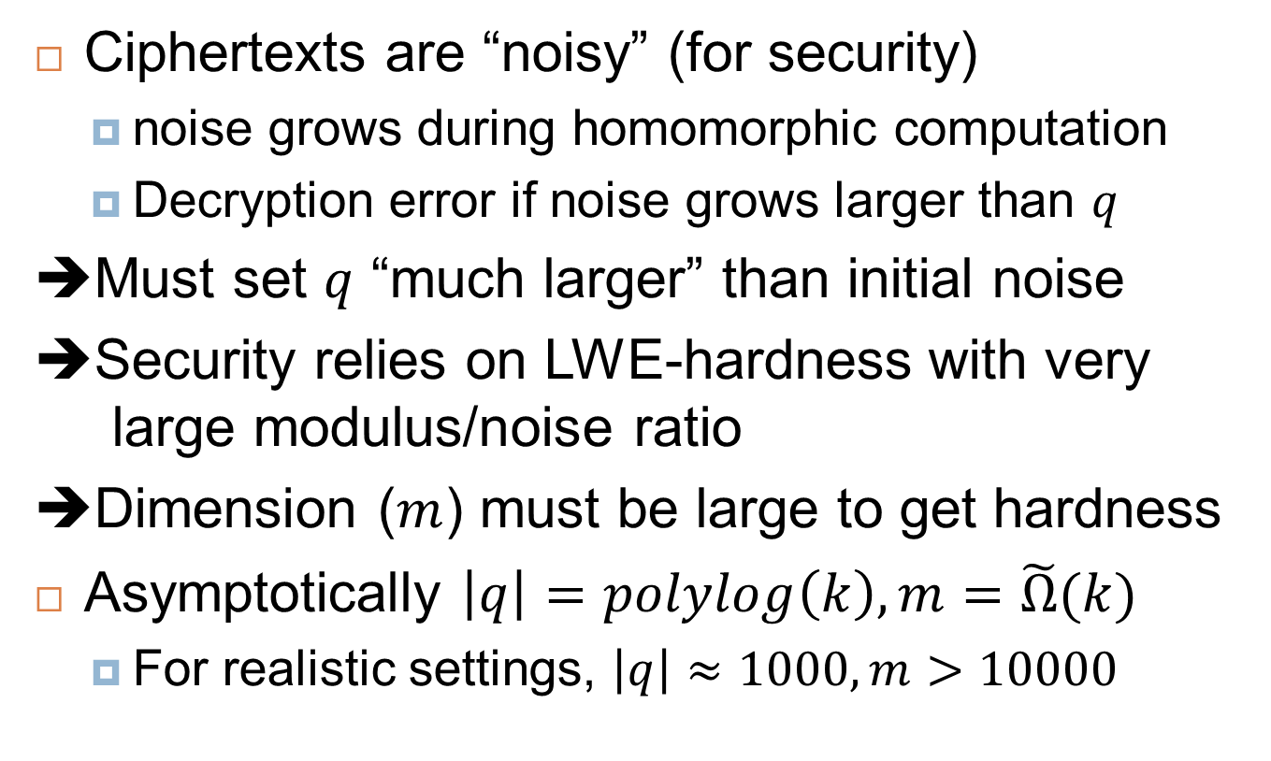

How Large are $m,q$?
Ciphertexts are “noisy” (for security)
noise grows during homomorphic computation
Decryption error if noise grows larger than $q$
➔Must set $q$ “much larger” than initial noise
➔Security relies on LWE-hardness with very large modulus/noise ratio
➔Dimension ($m$) must be large to get hardness
Asymptotically $\left|q\right|=polylog\left(k\right), m=\tilde{Ω}(k)$
For realistic settings, $\left|q\right|≈1000, m>10000$

Slide 6
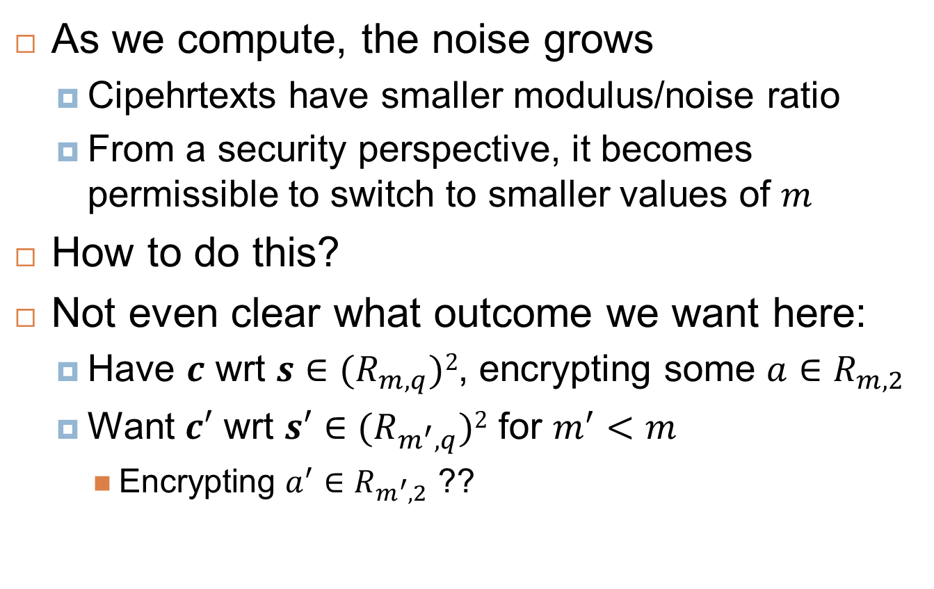

Switching to Smaller $m$?
As we compute, the noise grows
Cipehrtexts have smaller modulus/noise ratio
From a security perspective, it becomes permissible to switch to smaller values of $m$
How to do this?
Not even clear what outcome we want here:
Have $c$ wrt $s∈{(R}_{m,q})2$, encrypting some $a∈R_{m,2}$
Want $c′$ wrt $s′∈{(R}_{m^{′},q})2$ for $m^{′}<m$
Encrypting $a^{′}∈R_{m^{′},2}$ ??

Slide 7
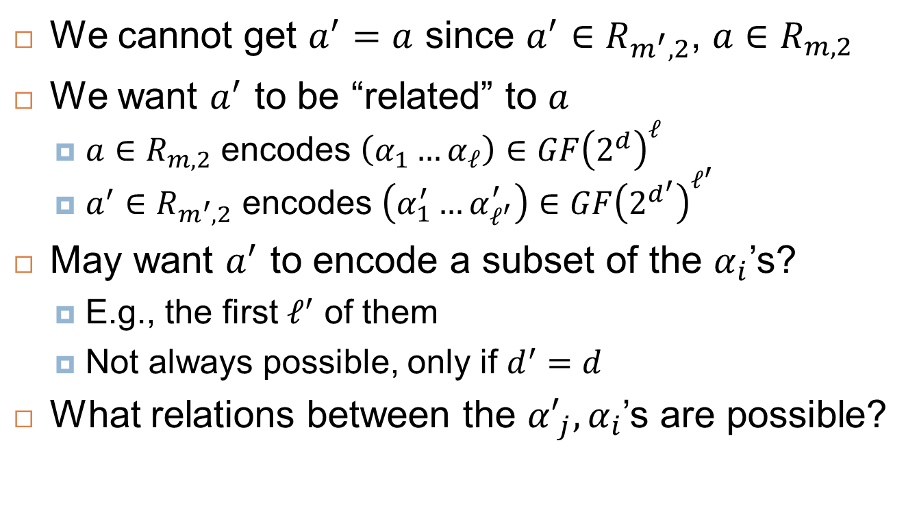
Ring-Switching: The Goal
We cannot get $a^{′}=a$ since $a^{′}∈R_{m^{′},2}$, $a∈R_{m,2}$
We want $a^{′}$ to be “related” to $a$
$a∈R_{m,2}$ encodes $\left(α_{1}…α_{ℓ}\right)∈GF{\left(2^{d}\right)}^{ℓ}$
$a^{′}∈R_{m^{′},2}$ encodes $\left(α_{1}^{′}…α_{ℓ^{′}}^{′}\right)∈GF{\left(2^{d^{′}}\right)}^{ℓ^{′}}$
May want $a^{′}$ to encode a subset of the $α_{i}$’s?
E.g., the first $ℓ^{′}$ of them
Not always possible, only if $d^{′}=d$
What relations between the ${α′}_{j}, α_{i}$’s are possible?

Slide 8
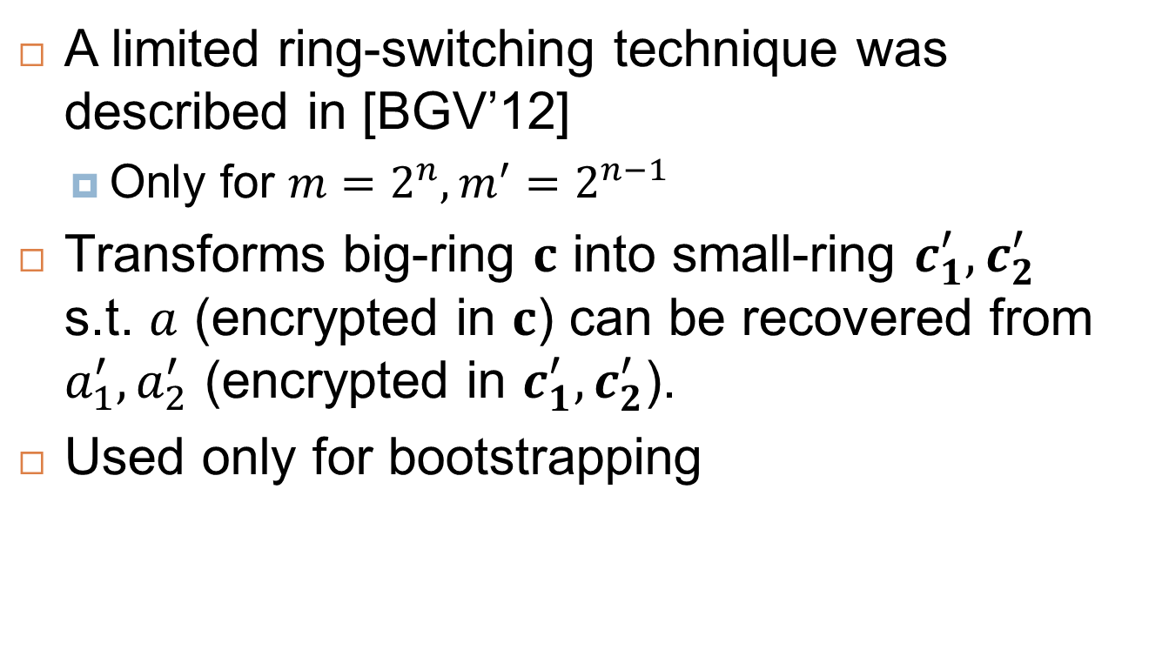
Prior Work
A limited ring-switching technique was described in [BGV’12]
Only for $m=2^{n}, m^{′}=2^{n−1}$
Transforms big-ring $c$ into small-ring $c_{1}^{′}, c_{2}^{′}$ s.t. $a$ (encrypted in $c$) can be recovered from $a_{1}^{′}, a_{2}^{′}$ (encrypted in $c_{1}^{′}, c_{2}^{′}$).
Used only for bootstrapping

Slide 9
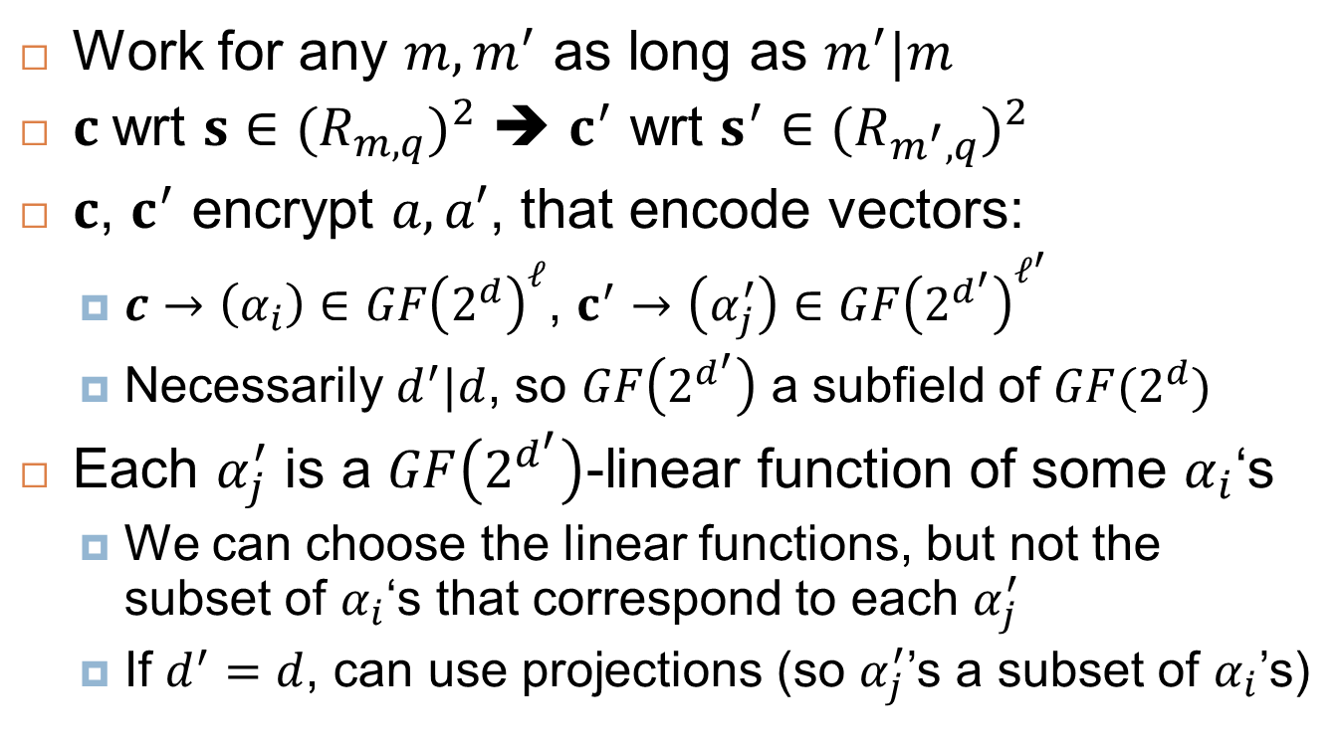
Our Transformation: Overview
Work for any $m,m^{′}$ as long as $m^{′}|m$
$c$wrt $s∈{(R_{m,q})}^{2}$ ➔ $c^{′}$ wrt $s^{′}∈{(R_{m^{′},q})}^{2}$
$c$, $c^{′}$ encrypt $a,a′$, that encode vectors:
$c→\left(α_{i}\right)∈{GF\left(2^{d}\right)}^{ℓ}$, $c^{′}→\left(α_{j}^{′}\right)∈GF{\left(2^{d^{′}}\right)}^{ℓ^{′}}$
Necessarily $d^{′}|d$, so $GF\left(2^{d^{′}}\right)$ a subfield of $GF(2^{d})$
Each $α_{j}^{′}$ is a $GF\left(2^{d^{′}}\right)$-linear function of some $α_{i}$‘s
We can choose the linear functions, but not the subset of $α_{i}$‘s that correspond to each $α_{j}^{′}$
If $d^{′}=d$, can use projections (so $α_{j}^{′}$’s a subset of $α_{i}$’s)

Slide 10
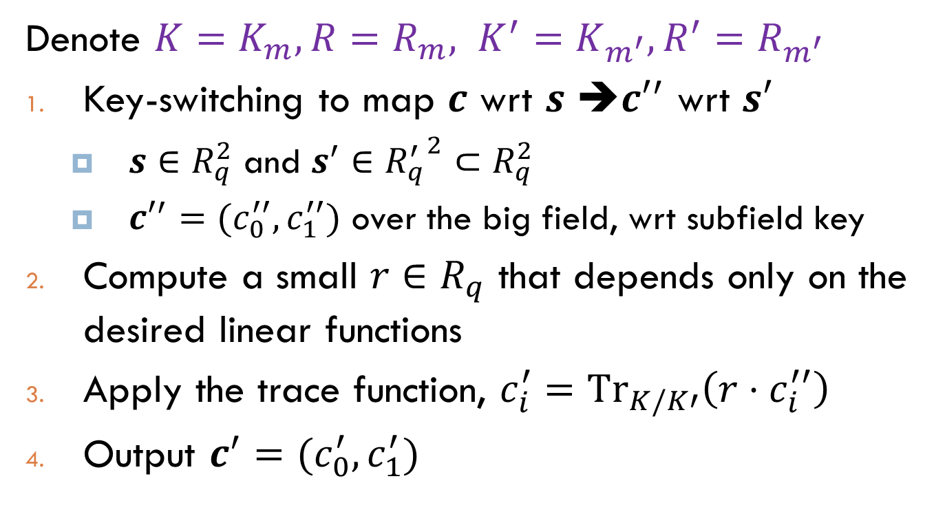
Our Transformation: Overview
Denote $K=K_{m},R=R_{m}, K^{′}=K_{m^{′}}, R^{′}=R_{m^{′}}$
Key-switching to map $c$ wrt $s$ ➔${c′}^{′}$ wrt $s′$
$s∈R_{q}^{2}$ and $s^{′}∈{R_{q}^{′}}^{2}⊂R_{q}^{2}$
${c′}^{′}=(c_{0}^{′′},c_{1}^{′′})$ over the big field, wrt subfield key
Compute a small $r∈R_{q}$ that depends only on the desired linear functions
Apply the trace function, $c_{i}^{′}=Tr_{K/K′}\left({r⋅c}_{i}^{′′}\right)$
Output $c^{′}=(c_{0}^{′},c_{1}^{′})$

Slide 11
Algebra

Slide 12
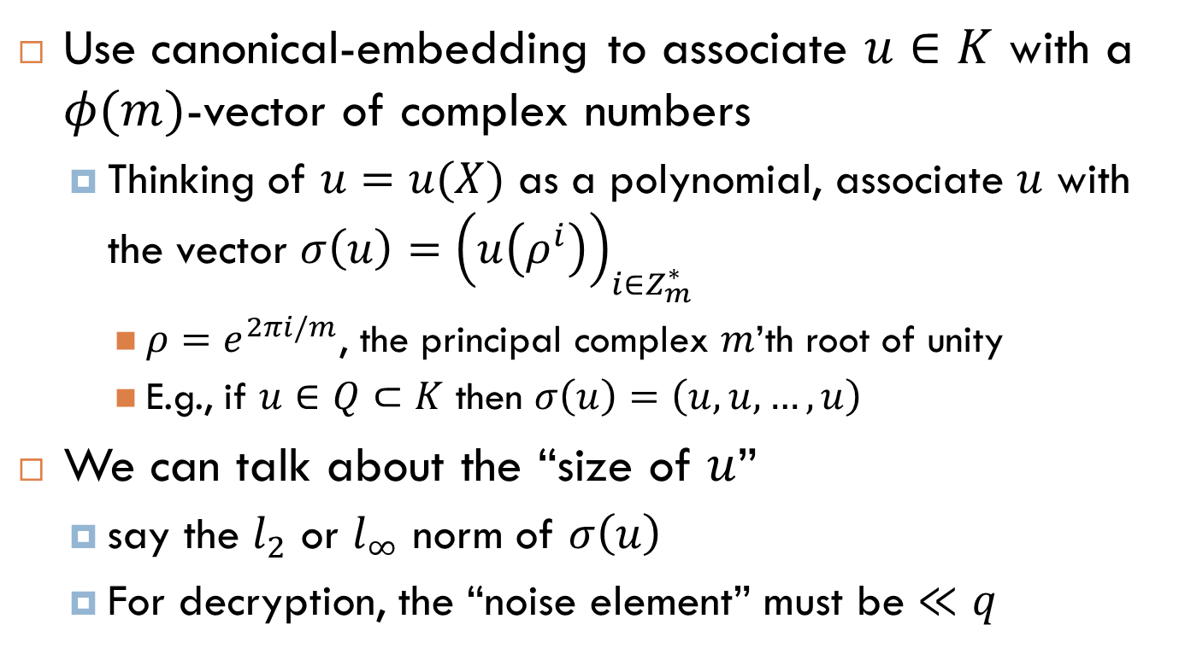

Geometry of $K$
Use canonical-embedding to associate $u∈K$ with a $φ(m)$-vector of complex numbers
Thinking of $u=u(X)$ as a polynomial, associate $u$ with the vector $σ\left(u\right)={\left(u\left(ρ^{i}\right)\right)}_{i∈Z_{m}^{∗}}$
$ρ=e^{2πi/m}$, the principal complex $m$’th root of unity
E.g., if $u∈Q⊂K$ then $σ\left(u\right)=\left(u,u,…,u\right)$
We can talk about the “size of $u$”
say the $l_{2}$ or $l_{∞}$ norm of $σ\left(u\right)$
For decryption, the “noise element” must be $≪q$

Slide 13
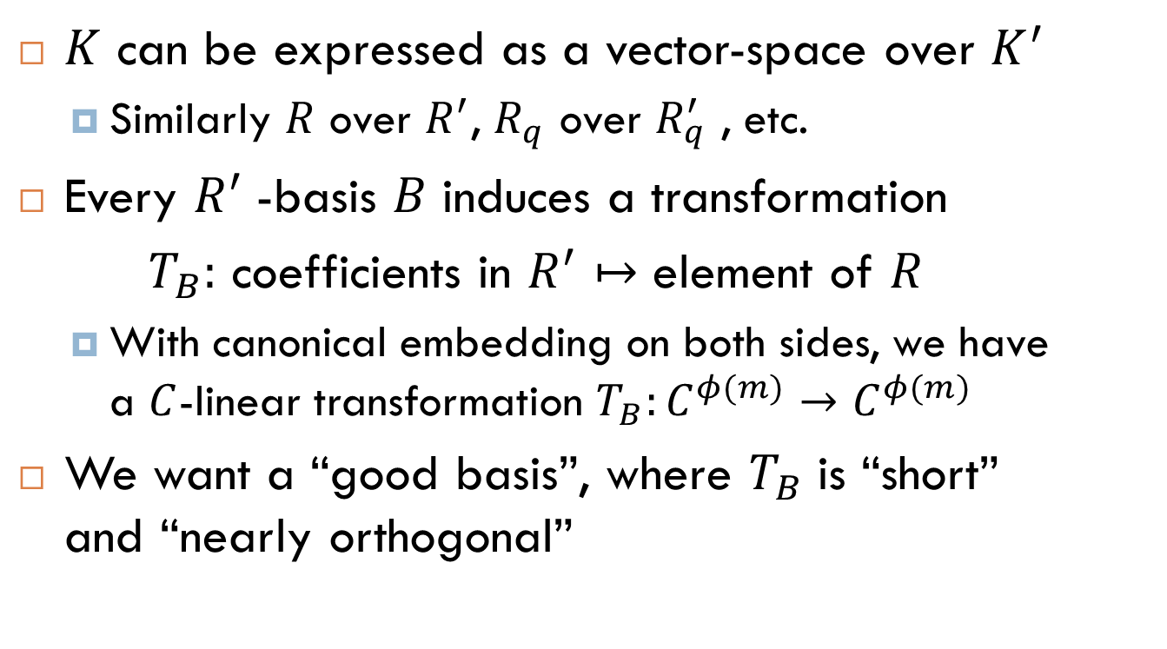

Geometry of $K,K^{′}$
$K$ can be expressed as a vector-space over $K^{′}$
Similarly $R$ over $R^{′}$, $R_{q}$ over $R_{q}^{′}$ , etc.
Every $R^{′}$-basis $B$ induces a transformation
$T_{B}:$ coefficients in $R^{′}↦$ element of $R$
With canonical embedding on both sides, we have a $C$-linear transformation $T_{B}:C^{φ(m)}→C^{φ(m)}$
We want a “good basis”, where $T_{B}$ is “short” and “nearly orthogonal”

Slide 14
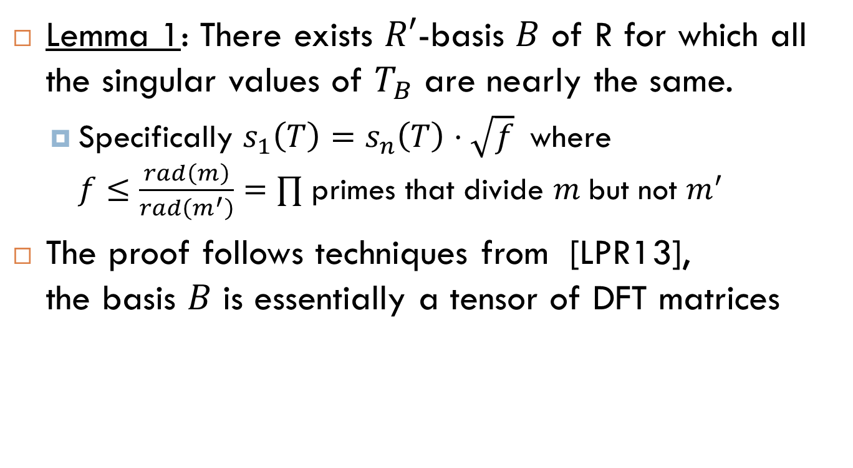
Geometry of $K,K^{′}$
Lemma 1: There exists $R′$-basis $B$ of R for which all the singular values of $T_{B}$ are nearly the same.
Specifically $s_{1}\left(T\right)=s_{n}\left(T\right)⋅\sqrt{f}$ where $f≤\frac{rad\left(m\right)}{rad\left(m^{′}\right)}=∏$ primes that divide $m$but not $m^{′}$
The proof follows techniques from [LPR13], the basis $B$ is essentially a tensor of DFT matrices

Slide 15
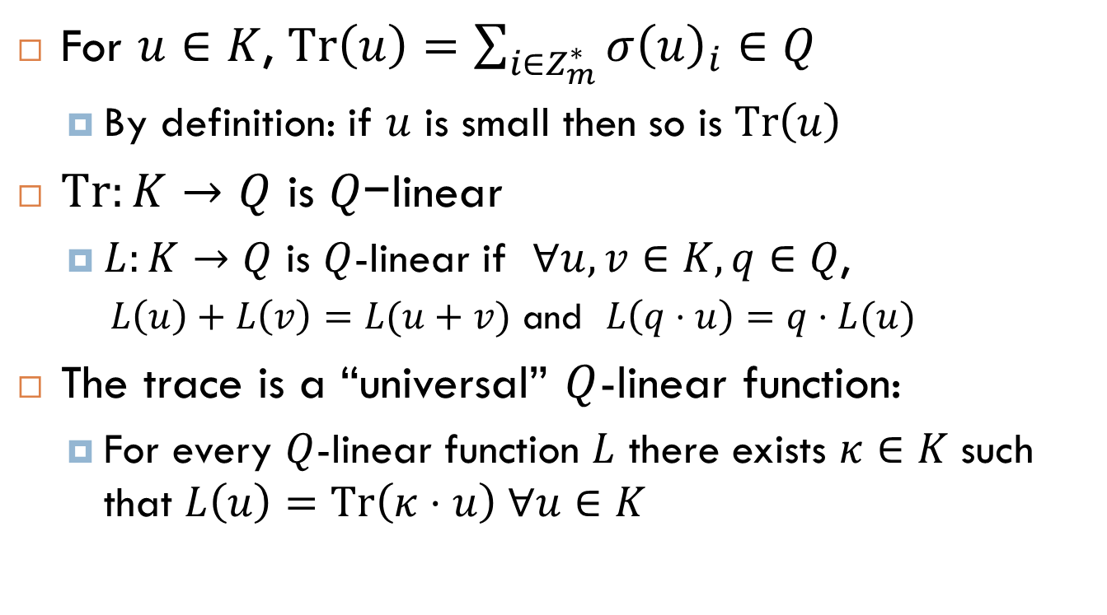
The Trace Function
For $u∈K$, $Tr\left(u\right)=\sum_{i∈Z_{m}^{∗}}{σ{\left(u\right)}_{i}}∈Q$
By definition: if $u$ is small then so is $Tr\left(u\right)$
$Tr:K→Q$ is $Q\text{−}\text{linear}$
$L:K→Q$ is $Q$-linear if $∀u,v∈K,q∈Q$,
$L\left(u\right)+L\left(v\right)=L(u+v)$ and $L\left(q⋅u\right)=q⋅L(u)$
The trace is a “universal” $Q$-linear function:
For every $Q$-linear function $L$ there exists $κ∈K$ such that $L\left(u\right)=Tr\left(κ⋅u\right) ∀u∈K$

Slide 16
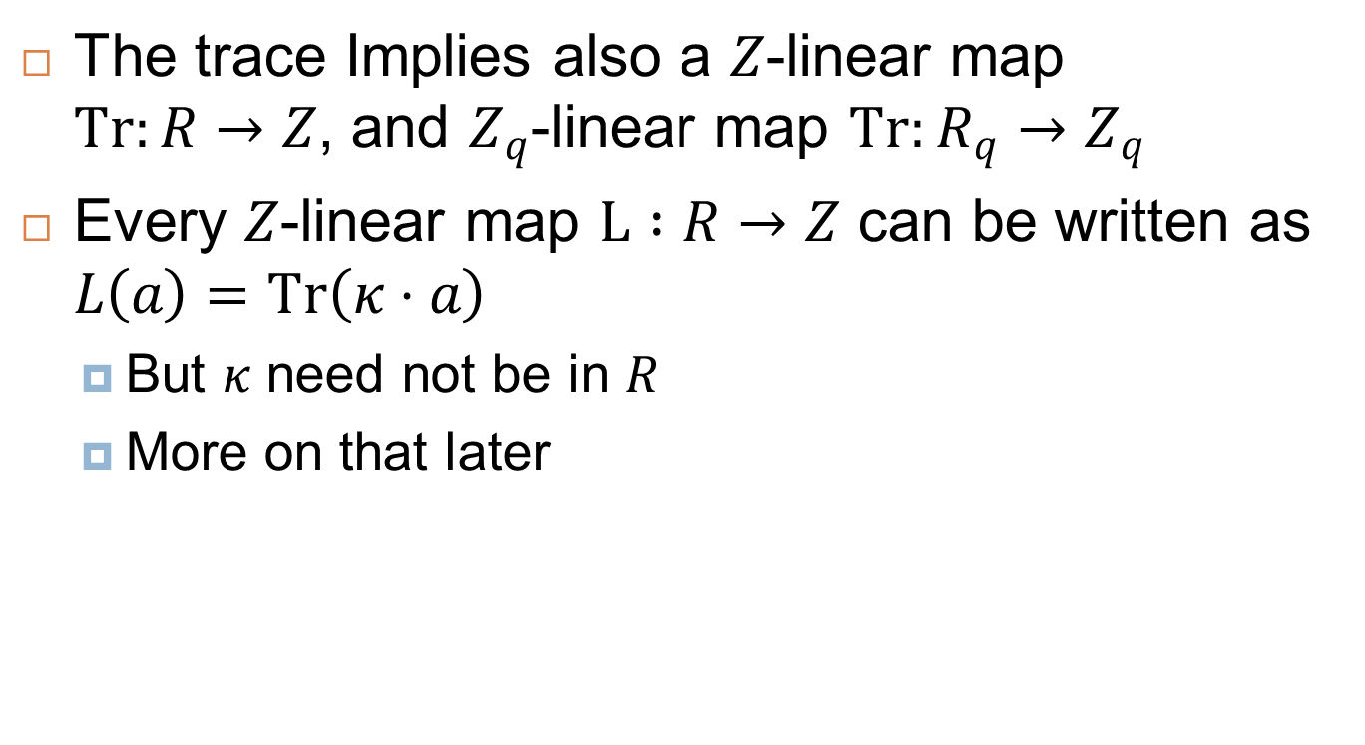
The Trace Function
The trace Implies also a $Z$-linear map $Tr:R→Z$, and $Z_{q}$-linear map $Tr:R_{q}→Z_{q}$
Every $Z$-linear map $L :R→Z$ can be written as $L\left(a\right)=Tr\left(κ⋅a\right)$
But $κ$ need not be in $R$
More on that later

Slide 17
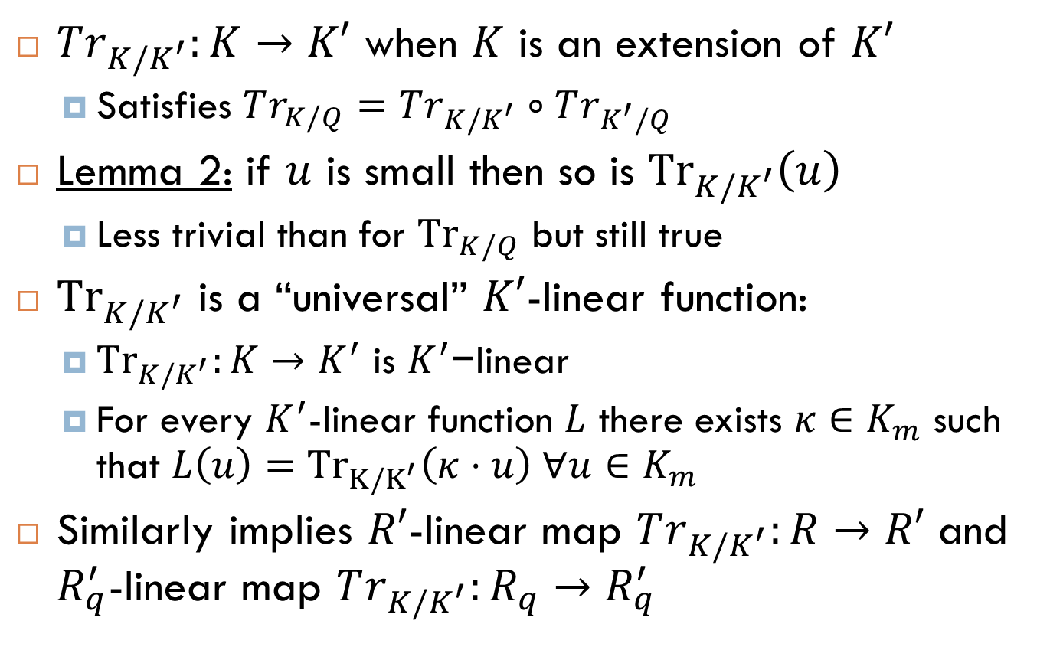
The Intermediate Trace Function
$Tr_{K/K^{′}}:K→K′$ when $K$ is an extension of $K′$
Satisfies $Tr_{K/Q}=Tr_{K/K^{′}}∘Tr_{K^{′}/Q}$
Lemma 2: if $u$ is small then so is ${Tr}_{K/K^{′}}\left(u\right)$
Less trivial than for ${Tr}_{K/Q}$ but still true
${Tr}_{K/K^{′}}$ is a “universal” $K′$-linear function:
${Tr}_{K/K^{′}}:K→K^{′}$ is $K^{′}\text{−}\text{linear}$
For every $K^{′}$-linear function $L$ there exists $κ∈K_{m}$ such that $L\left(u\right)={Tr}_{K/K^{′}}\left(κ⋅u\right) ∀u∈K_{m}$
Similarly implies $R′$-linear map $Tr_{K/K^{′}}:R→R′$ and $R_{q}^{′}$-linear map $Tr_{K/K^{′}}:R_{q}→R_{q}^{′}$

Slide 18
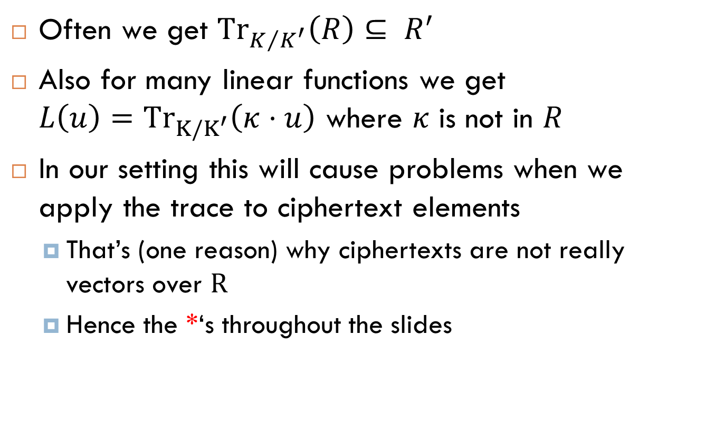
Some Complications
Often we get ${Tr}_{K/{K^{′}}}\left(R\right)⊆ R^{′}$
Also for many linear functions we get $L\left(u\right)={Tr}_{K/K^{′}}\left(κ⋅u\right)$ where $κ$ is not in $R$
In our setting this will cause problems when we apply the trace to ciphertext elements
That’s (one reason) why ciphertexts are not really vectors over $R$
Hence the *‘s throughout the slides

Slide 19
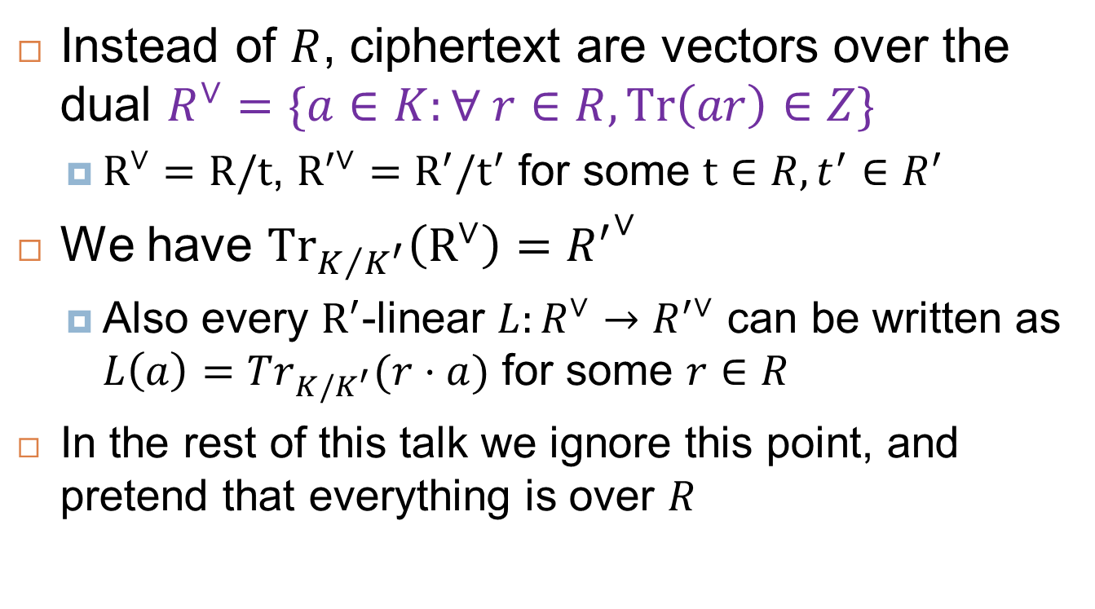

The Dual of $R$
Instead of $R$, ciphertext are vectors over the dual $R^{∨}=\{a∈K:∀ r∈R, Tr\left(ar\right)∈Z\}$
$R^{∨}=R/t$, $R^{′∨}=R^{′}/t^{′}$ for some $t∈R, t^{′}∈R^{′}$
We have ${Tr}_{K/{K^{′}}}\left(R^{∨}\right)={R^{′}}^{∨}$
Also every $R^{′}$-linear $L:R^{∨}→R^{′∨}$ can be written as $L\left(a\right)=Tr_{K/K^{′}}(r⋅a)$ for some $r∈R$
In the rest of this talk we ignore this point, and pretend that everything is over $R$

Slide 20
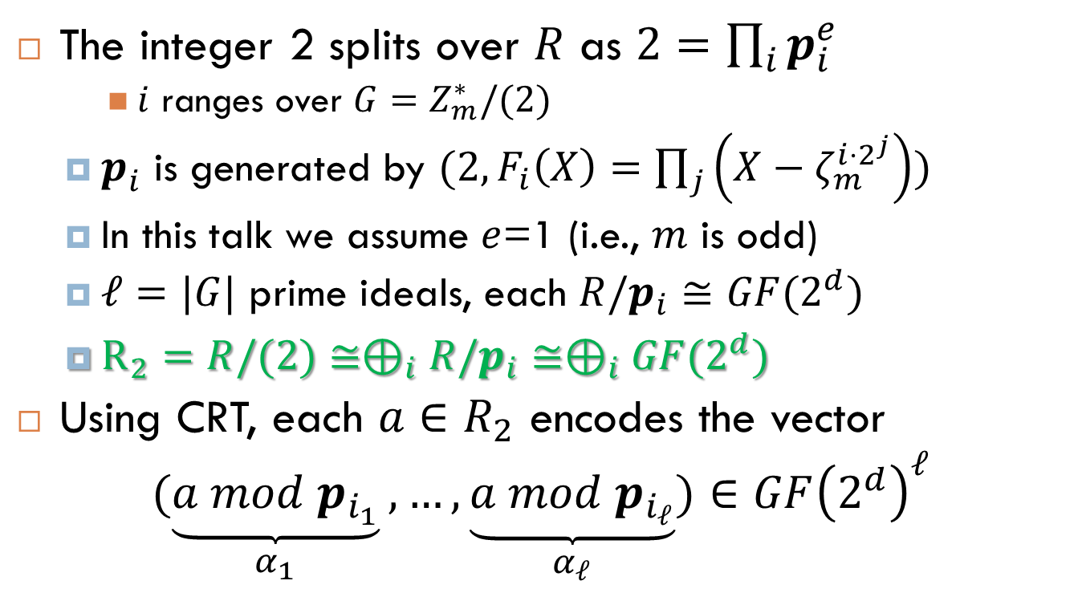
Prime Splitting
The integer 2 splits over $R$ as $2=\prod_{i}{p_{i}^{e}}$
$i$ ranges over $G=Z_{m}^{∗}/(2)$
$p_{i}^{}$ is generated by $(2, F_{i}\left(X\right)=\prod_{j}{\left(X−ζ_{m}^{i⋅2^{j}}\right)})$
In this talk we assume $e$=1 (i.e., $m$ is odd)
$ℓ=|G|$ prime ideals, each $R/p_{i}≅GF(2^{d})$
$R_{2}=R/(2)≅⊕_{i}R/p_{i}≅⊕_{i}GF(2^{d})$
Using CRT, each $a∈R_{2}$ encodes the vector
$$(\underset{α_{1}}{\underbrace{a mod p_{i_{1}}}},…,\underset{α_{ℓ}}{\underbrace{a mod p_{i_{ℓ}}}})∈GF{\left(2^{d}\right)}^{ℓ}$$

Slide 21
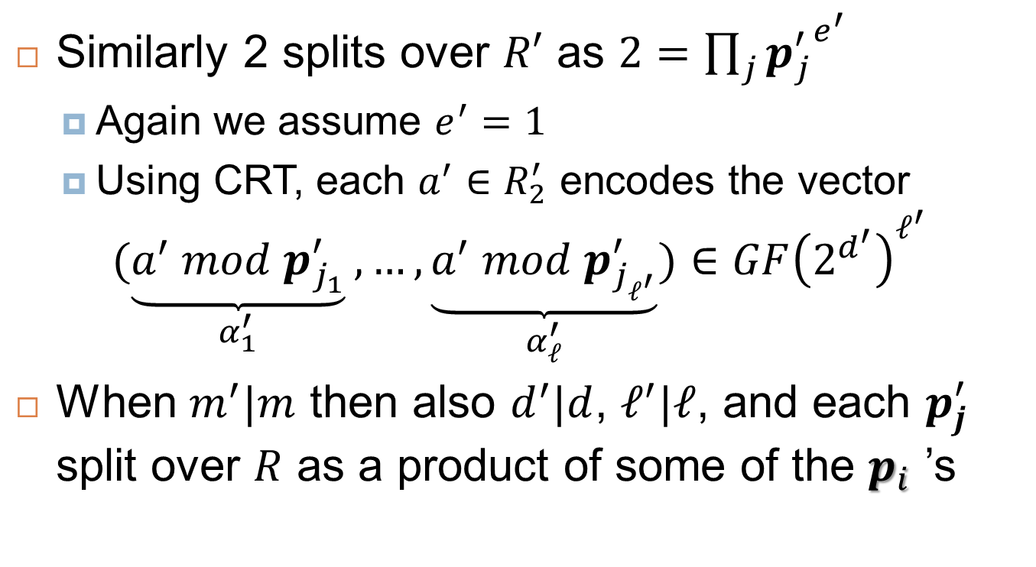
Prime Splitting
Similarly 2 splits over $R′$ as $2=\prod_{j}{{p_{j}^{′}}^{e^{′}}}$
Again we assume $e^{′}=1$
Using CRT, each $a^{′}∈R_{2}^{′}$ encodes the vector
$$(\underset{α_{1}^{′}}{\underbrace{a^{′} mod p_{j_{1}}^{′}}},…,\underset{α_{ℓ}^{′}}{\underbrace{a^{′} mod p_{j_{ℓ^{′}}}^{′}}})∈GF{\left(2^{d^{′}}\right)}^{ℓ^{′}}$$
When $m^{′}|m$ then also $d^{′}|d$, $ℓ^{′}|ℓ$, and each $p_{j}^{′}$ split over $R$ as a product of some of the $p_{i}$ ’s

Slide 22


















Prime Splitting
Example for $m=91, m^{′}=7$
Lie over $p_{1}^{′}$
Lie over $p_{3}^{′}$
$$p_{1}^{}$$
$$p_{15}^{}$$
$$p_{22}^{}$$
$$p_{3}^{}$$
$$p_{17}^{}$$
$$p_{31}^{}$$
$$R$$
$$d=12$$
$$ℓ=6$$
$$⊆$$
$$p_{1}^{′}$$
$$p_{3}^{′}$$
$$R^{′}$$
$$d^{′}=3$$
$$ℓ^{′}=2$$
Lie over 2
$$⊆$$
2
$$Z$$

Slide 23
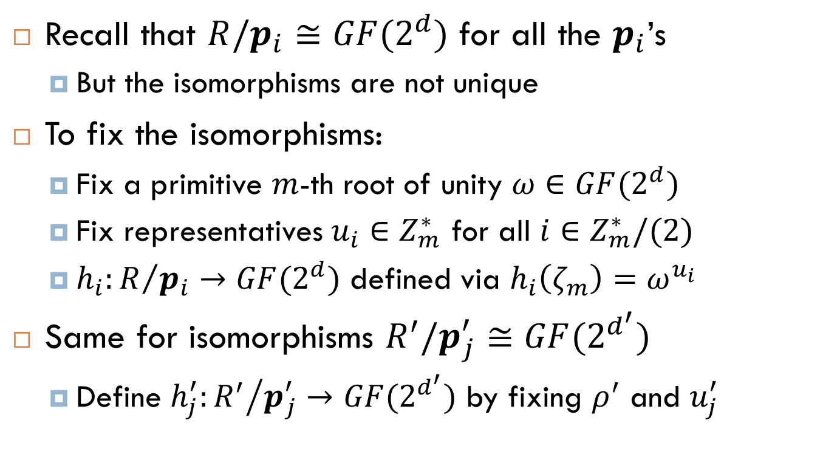
Plaintext-Slot Representation
Recall that $R/p_{i}≅GF(2^{d})$ for all the $p_{i}$’s
But the isomorphisms are not unique
To fix the isomorphisms:
Fix a primitive $m$-th root of unity $ω∈GF(2^{d})$
Fix representatives $u_{i}∈Z_{m}^{∗}$ for all $i∈Z_{m}^{∗}/(2)$
$h_{i}:R/{p_{i}}→GF(2^{d})$ defined via $h_{i}\left(ζ_{m}\right)=ω^{u_{i}}$
Same for isomorphisms $R^{′}/p_{j}^{′}≅GF(2^{d^{′}})$
Define $h_{j}^{′}:{R^{′}}/{p_{j}^{′}}→GF(2^{d^{′}})$ by fixing $ρ^{′}$ and $u_{j}^{′}$

Slide 24
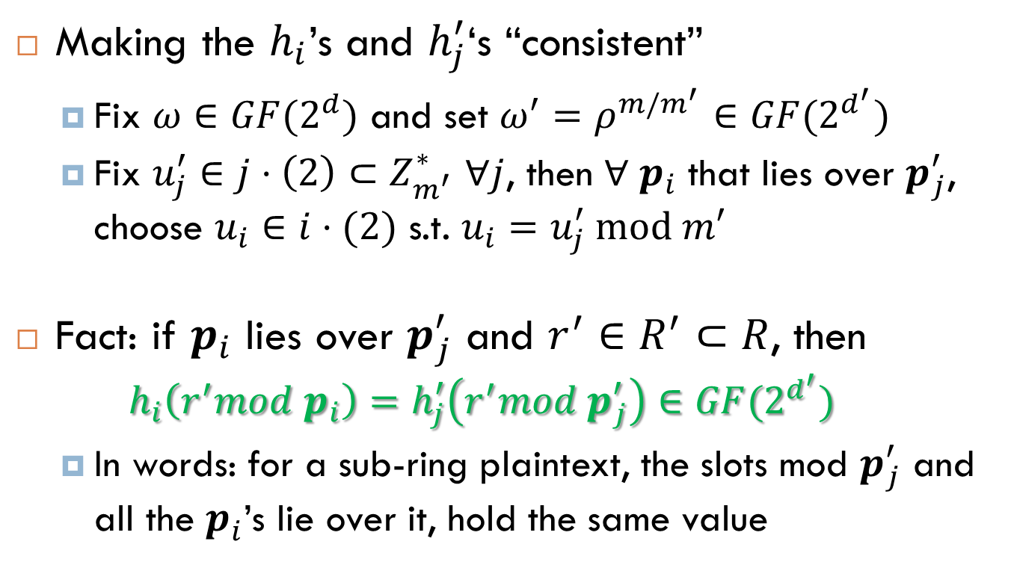
Plaintext-Slot Representation
Making the $h_{i}$’s and $h_{j}^{′}$‘s “consistent”
Fix $ω∈GF(2^{d})$ and set $ω^{′}=ρ^{m/m^{′}}∈GF(2^{d^{′}})$
Fix $u_{j}^{′}∈j⋅\left(2\right)⊂Z_{m^{′}}^{∗}$ $∀j$, then $∀ p_{i}$ that lies over $p_{j}^{′}$, choose $u_{i}∈i⋅(2)$ s.t. $u_{i}=u_{j}^{′} mod m′$
Fact: if $p_{i}$ lies over $p_{j}^{′}$ and $r^{′}∈R^{′}⊂R$, then
$$h_{i}\left(r^{′}mod p_{i}\right)=h_{j}^{′}\left(r^{′}mod p_{j}^{′}\right)∈GF(2^{d^{′}})$$
In words: for a sub-ring plaintext, the slots mod $p_{j}^{′}$ and all the $p_{i}^{}$’s lie over it, hold the same value

Slide 25
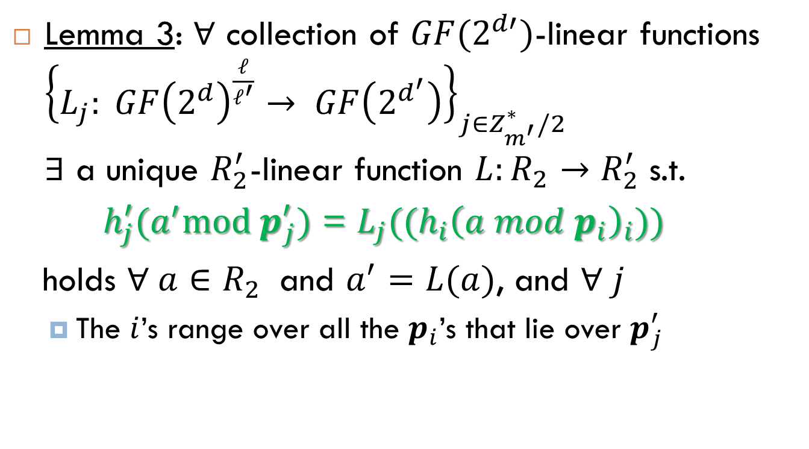
Plaintext-Slot Representation
Lemma 3: $∀$ collection of $GF(2^{d′})$-linear functions ${\left\{L_{j}: GF{\left(2^{d}\right)}^{\frac{ℓ}{ℓ^{′}}}→ GF\left(2^{d^{′}}\right)\right\}}_{j∈Z_{m^{′}}^{∗}/2}$ $∃$ a unique $R_{2}^{′}$-linear function $L:R_{2}→R_{2}^{′}$ s.t.
$h_{j}^{′}(a^{′}mod p_{j}^{′})$ = $L_{j}({(h_{i}\left(a mod p_{i}\right)}_{i}))$
holds $∀ a∈R_{2}$ and $a^{′}=L(a)$, and $∀ j$
The $i$’s range over all the $p_{i}$’s that lie over $p_{j}^{′}$

Slide 26
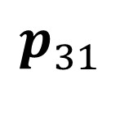

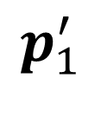
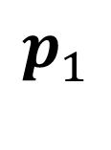


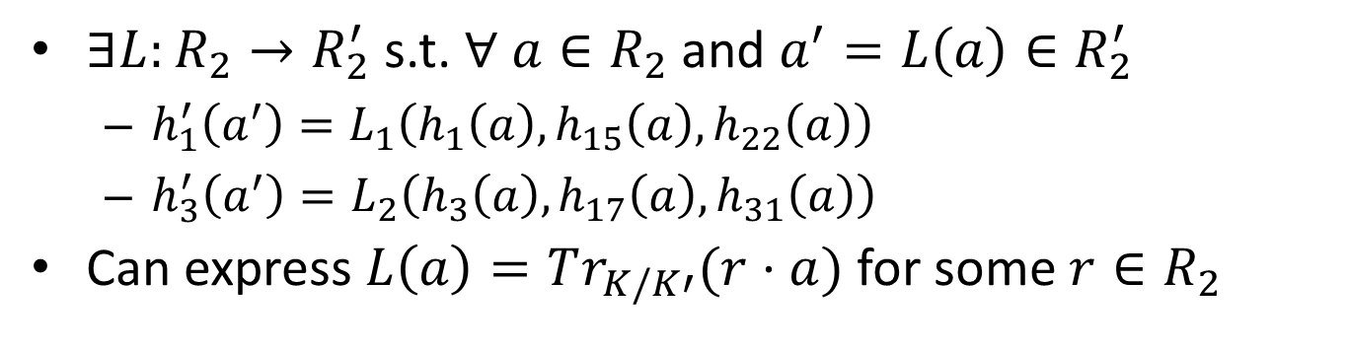

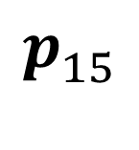

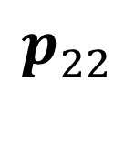

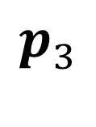
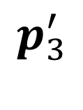
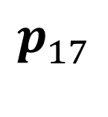

Illustration of Lemma 3
$$p_{1}^{}$$
$$p_{15}^{}$$
$$p_{22}^{}$$
$$p_{3}^{}$$
$$p_{17}^{}$$
$$p_{31}^{}$$
$$R$$
$$(d=12, ℓ=6)$$
$$L_{1}:GF{\left(2^{12}\right)}^{3}→GF(2^{3})$$
$$L_{3}:GF{\left(2^{12}\right)}^{3}→GF(2^{3})$$
$$⊆$$
$$p_{1}^{′}$$
$$p_{3}^{′}$$
$$R^{′}$$
$$(d^{′}=3, ℓ^{′}=2)$$
$∃L:R_{2}→R_{2}^{′}$ s.t. $∀ a∈R_{2}$ and $a^{′}=L\left(a\right)∈R_{2}^{′}$
$h_{1}^{′}\left(a^{′}\right)=L_{1}\left(h_{1}\left(a\right),h_{15}\left(a\right), h_{22}\left(a\right)\right)$
$h_{3}^{′}\left(a^{′}\right)=L_{2}\left(h_{3}\left(a\right),h_{17}\left(a\right), h_{31}\left(a\right)\right)$
Can express $L\left(a\right)=Tr_{K/K′}(r⋅a)$ for some $r∈R_{2}$
*
* Not exactly

Slide 27
The Transformation

Slide 28
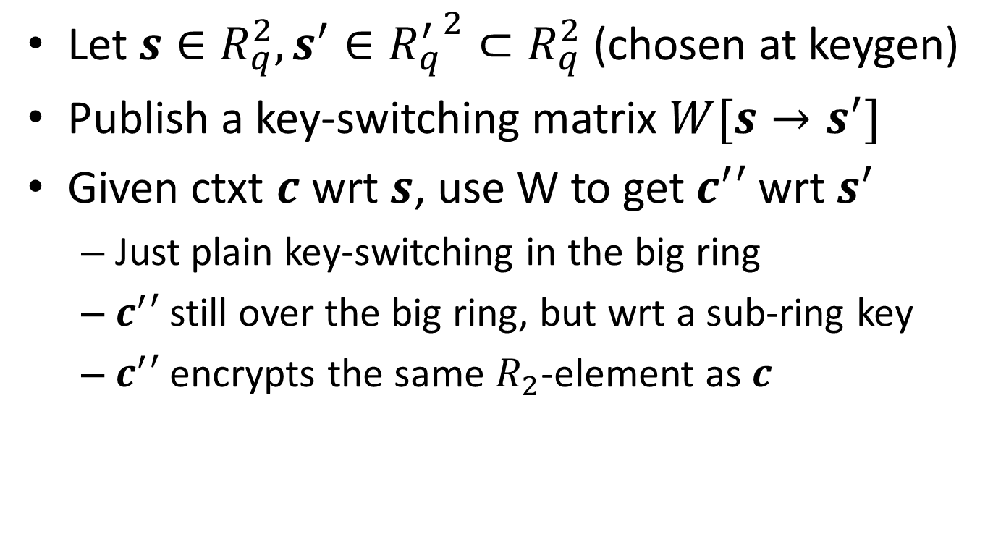
Step 1, Key Switching
Let $s∈R_{q}^{2}, s^{′}∈{R_{q}^{′}}^{2}⊂R_{q}^{2}$ (chosen at keygen)
Publish a key-switching matrix $W[s→s^{′}]$
Given ctxt $c$ wrt $s$, use W to get $c^{′}′$ wrt $s^{′}$
Just plain key-switching in the big ring
$c^{′}′$ still over the big ring, but wrt a sub-ring key
$c^{′}′$ encrypts the same $R_{2}$-element as $c$

Slide 29
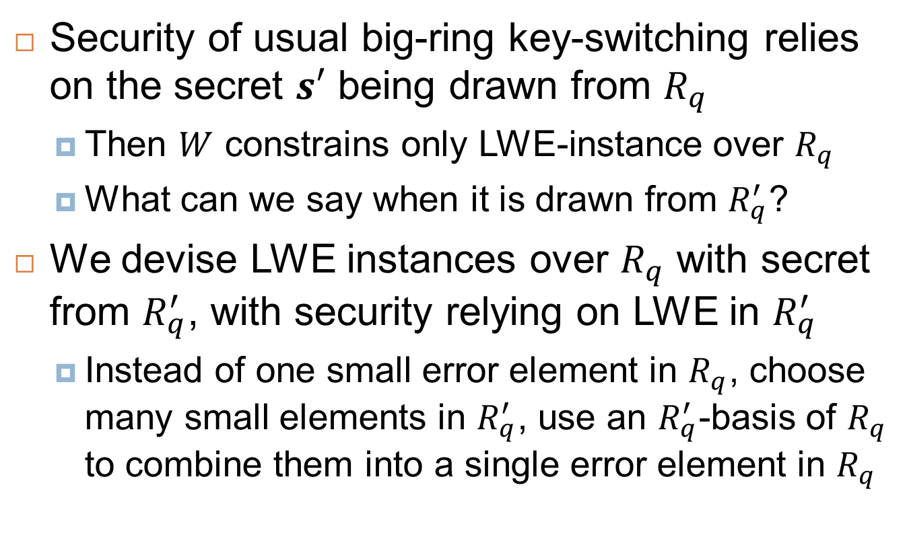
Security of Key-Swicthing
Security of usual big-ring key-switching relies on the secret $s′$ being drawn from $R_{q}$
Then $W$ constrains only LWE-instance over $R_{q}$
What can we say when it is drawn from $R_{q}^{′}$?
We devise LWE instances over $R_{q}$ with secret from $R_{q}^{′}$, with security relying on LWE in $R_{q}^{′}$
Instead of one small error element in $R_{q}$, choose many small elements in $R_{q}^{′}$, use an $R_{q}^{′}$-basis of $R_{q}$ to combine them into a single error element in $R_{q}$

Slide 30
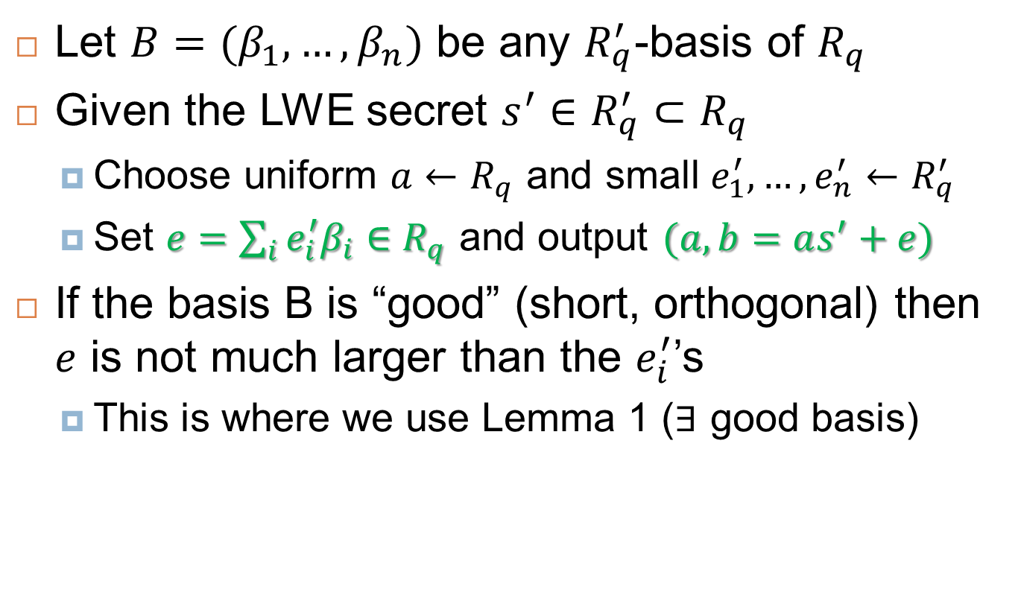

$R_{q}$-LWE With Secret in $R_{q}^{′}$
Let $B=(β_{1}, …, β_{n})$ be any $R_{q}^{′}$-basis of $R_{q}$
Given the LWE secret $s^{′}∈R_{q}^{′}⊂R_{q}$
Choose uniform $a←R_{q}$ and small $e_{1}^{′}, …, e_{n}^{′}←R_{q}^{′}$
Set $e=\sum_{i}{e_{i}^{′}β_{i}}∈R_{q}$ and output $(a, b=as^{′}+e)$
If the basis B is “good” (short, orthogonal) then $e$ is not much larger than the $e_{i}^{′}$’s
This is where we use Lemma 1 ($∃$ good basis)

Slide 31
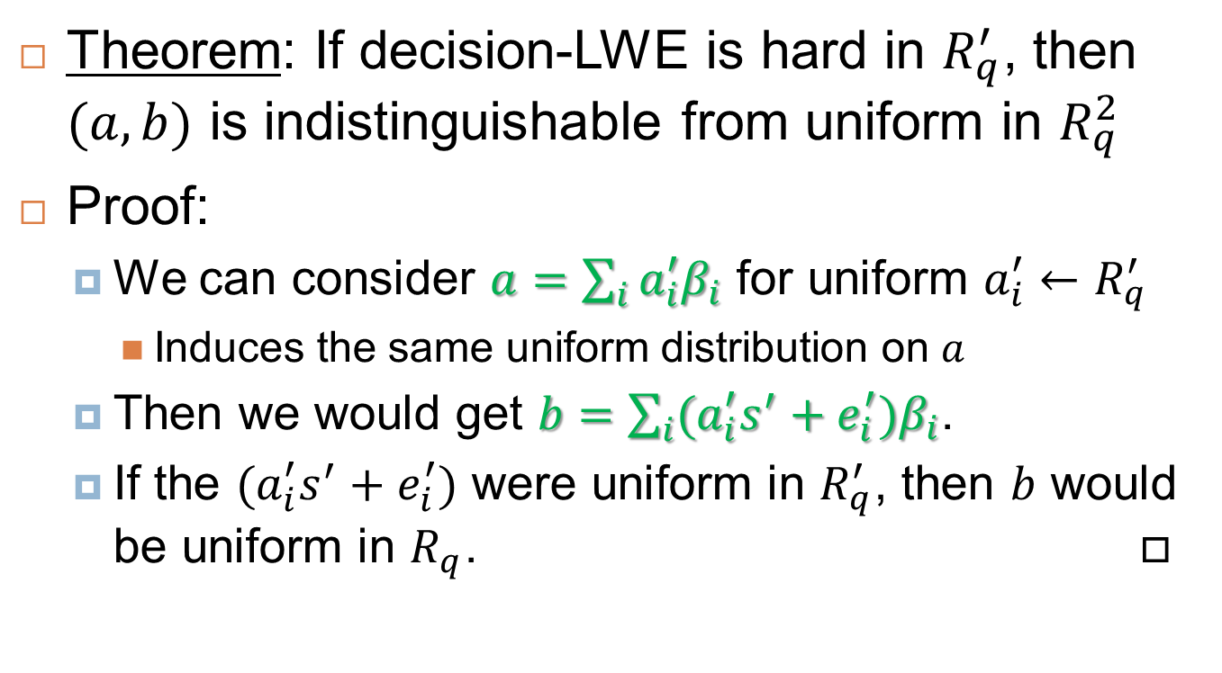
$R_{q}$-LWE With Secret in $R_{q}^{′}$
Theorem: If decision-LWE is hard in $R_{q}^{′}$, then $(a, b)$ is indistinguishable from uniform in $R_{q}^{2}$
Proof:
We can consider $a=\sum_{i}{a_{i}^{′}β_{i}}$ for uniform $a_{i}^{′}←R_{q}^{′}$
Induces the same uniform distribution on $a$
Then we would get $b=\sum_{i}{(a_{i}^{′}s^{′}+e_{i}^{′})β_{i}}$.
If the $(a_{i}^{′}s^{′}+e_{i}^{′})$ were uniform in $R_{q}^{′}$, then $b$ would be uniform in $R_{q}$. $□$

Slide 32
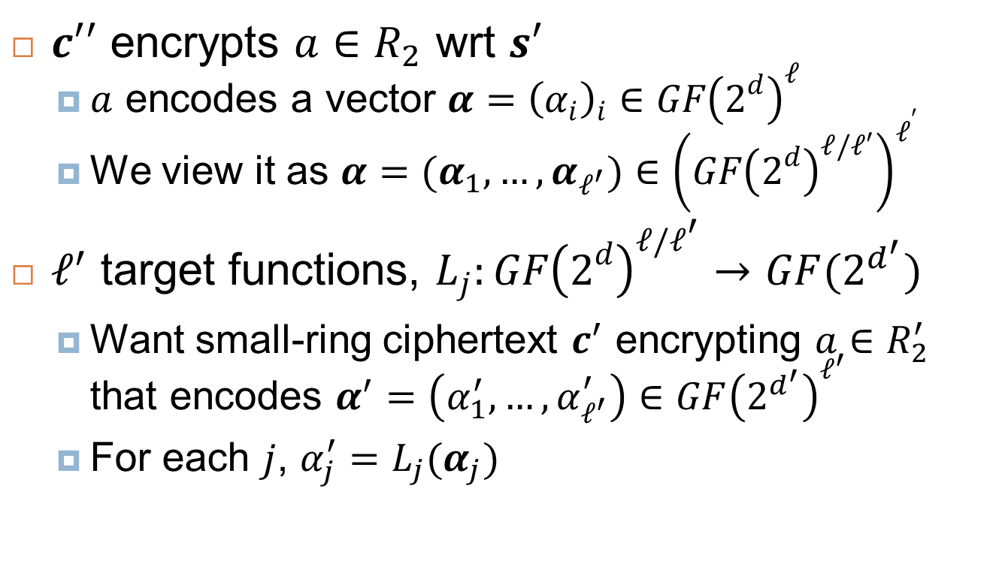
Steps 2,3: Ring Switching
$c′′$ encrypts $a∈R_{2}$ wrt $s′$
$a$ encodes a vector ${α=\left(α_{i}\right)}_{i}∈GF{\left(2^{d}\right)}^{ℓ}$
We view it as $α=(α_{1}, …,α_{ℓ^{′}})∈{\left(GF{\left(2^{d}\right)}^{ℓ/ℓ′}\right)}^{ℓ^{′}}$
$ℓ^{′}$ target functions, $L_{j}:GF{\left(2^{d}\right)}^{ℓ/ℓ^{′}}→GF(2^{d^{′}})$
Want small-ring ciphertext $c^{′}$ encrypting $a∈R_{2}^{′}$ that encodes $α^{′}=\left(α_{1}^{′}, …,α_{ℓ^{′}}^{′}\right)∈GF{\left(2^{d^{′}}\right)}^{ℓ^{′}}$
For each $j$, $α_{j}^{′}=L_{j}(α_{j})$

Slide 33
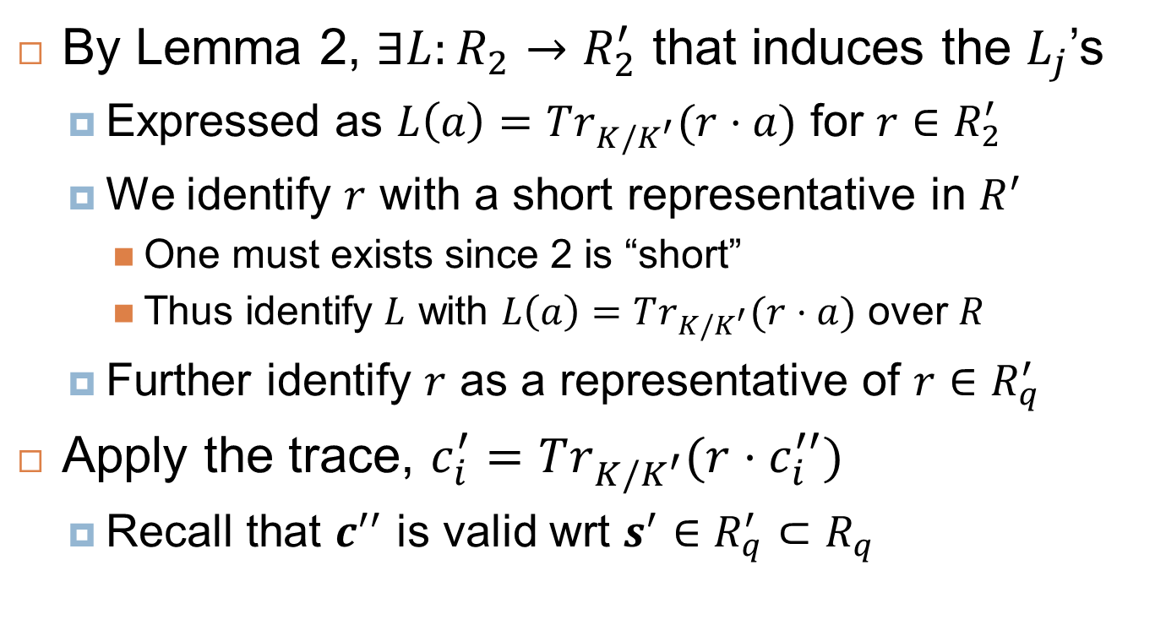
Steps 2,3: Ring Switching
By Lemma 2, $∃L:R_{2}→R_{2}^{′}$ that induces the $L_{j}$’s
Expressed as $L\left(a\right)=Tr_{K/K^{′}}(r⋅a)$ for $r∈R_{2}^{′}$
We identify $r$ with a short representative in $R^{′}$
One must exists since 2 is “short”
Thus identify $L$ with $L\left(a\right)=Tr_{K/K^{′}}(r⋅a)$ over $R$
Further identify $r$ as a representative of $r∈R_{q}^{′}$
Apply the trace, $c_{i}^{′}=Tr_{K/K^{′}}(r⋅c_{i}^{′′})$
Recall that $c^{′′}$ is valid wrt $s^{′}∈R_{q}^{′}⊂R_{q}$
*
* Not exactly

Slide 34
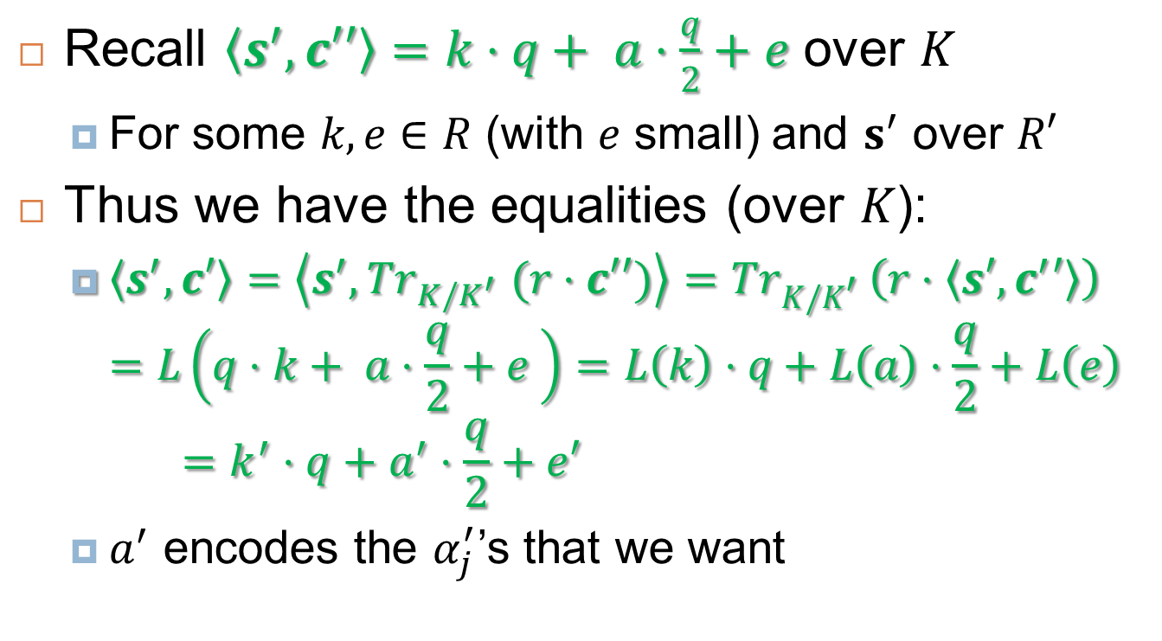
Correctness
Recall $\left\langle s^{′},c′′\right\rangle =k⋅q+ a⋅\frac{q}{2}+e$ over $K$
For some $k,e∈R$ (with $e$ small) and $s^{′}$ over $R′$
Thus we have the equalities (over $K$):
$\left\langle s^{′},c′\right\rangle =\left\langle s^{′},Tr_{K/K^{′}} (r⋅c′′)\right\rangle =Tr_{K/K^{′} }\left(r⋅\left\langle s′,c^{′}′\right\rangle \right)$ $=L\left(q⋅k+ a⋅\frac{q}{2}+e \right)=L\left(k\right)⋅q+L\left(a\right)⋅\frac{q}{2}+L\left(e\right)=k^{′}⋅q+a^{′}⋅\frac{q}{2}+e′$
$a^{′}$ encodes the $α_{j}^{′}$’s that we want

Slide 35
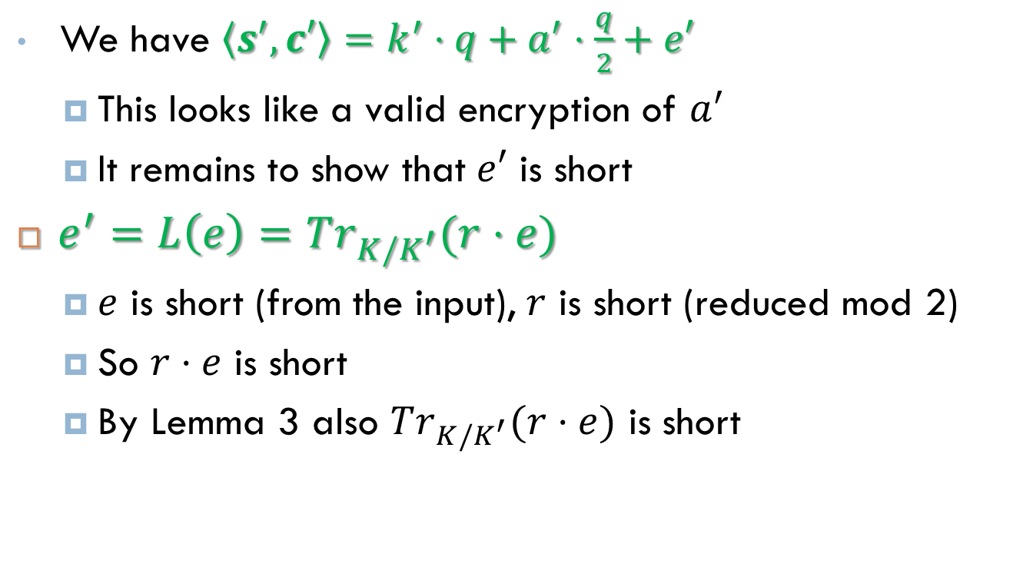
Correctness
We have $\left\langle s^{′},c′\right\rangle =k^{′}⋅q+a^{′}⋅\frac{q}{2}+e′$
This looks like a valid encryption of $a^{′}$
It remains to show that $e′$ is short
$e^{′}=L\left(e\right)=Tr_{K/K^{′}}(r⋅e)$
$e$ is short (from the input), $r$ is short (reduced mod 2)
So $r⋅e$ is short
By Lemma 3 also $Tr_{K/K^{′}}(r⋅e)$ is short

Slide 36
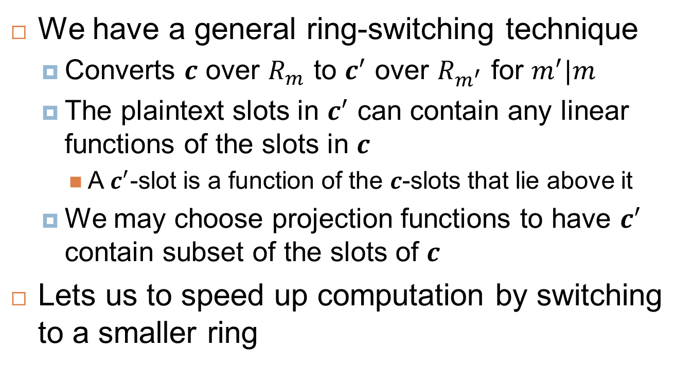
Conclusions
We have a general ring-switching technique
Converts $c$ over $R_{m}$ to $c^{′}$ over $R_{m^{′}}$ for $m^{′}|m$
The plaintext slots in $c^{′}$ can contain any linear functions of the slots in $c$
A $c^{′}$-slot is a function of the $c$-slots that lie above it
We may choose projection functions to have $c^{′}$ contain subset of the slots of $c$
Lets us to speed up computation by switching to a smaller ring

Slide 37
Epilog: The [AP13] Work
Alperin-Sheriff & Peikert described a clever use of ring-switching for efficient homomorphic computation of DFT-like transformations:
Decompose it to an FFT-like network of “local” linear functions
Use ring-switching for each level
Then switch back up before the next level
Yields fastest bootstrapping procedure to date

