Slide 1
Homomorphic Encryption Tutorial
Shai Halevi ― IBM
August 2013

Slide 2
I want to delegate processing of my data, without giving away access to it.
Computing on Encrypted Data

Slide 3

Outsourcing Computation
“I want to delegate the computation to the cloud,
but the cloud shouldn’t see my input”
“I want to delegate the computation to the cloud”
Enc(x)
f
Enc[f(x)]
Client
Server/Cloud
(Input: x)
(Function: f)

Slide 4
Privacy Homomorphisms
Rivest-Adelman-Dertouzos 1978
Plaintext space P
Ciphertext space C
x₁ x₂
c_{i} ← Enc(x_{i})
c₁ c₂
∗
#
y ← Dec(d)
y
d
Example: RSA_encrypt_{(e,N)}(x) = x^{e} mod N
x₁e x x₂e = (x₁ x x₂) ^{e} mod N
“Somewhat Homomorphic”: can compute some functions on encrypted data, but not all

Slide 5
“Fully Homomorphic” Encryption
Encryption for which we can compute arbitrary functions on the encrypted data
Enc(x)
Eval
f
Enc(f(x))

Slide 6
Some Notations
An encryption scheme: (KeyGen, Enc, Dec)
Plaintext-space = {0,1}
(pk,sk) ←KeyGen($), c←Enc_{pk}(b), b←Dec_{sk}(c)
Semantic security [GM’84]: (pk, Enc_{pk}(0)) ≈ (pk, Enc_{pk}(1))
≈ means indistinguishable by efficient algorithms

Slide 7
Homomorphic Encryption (HE)
H = {KeyGen, Enc, Dec, Eval}
c* ← Eval_{pk}(f, c)
Homomorphic: Dec_{sk}(Eval_{pk}( f, Enc_{pk}(x))) = f(x)
c* may not look like a “fresh” ciphertext
As long as it decrypts to f(x)
Compact: Decrypting c* easier than computing f
Otherwise we could use Eval_{pk} (f, c)=(f, c) and Dec_{sk}(f, c) = f(Dec_{sk}(c))
Technically, |c*| independent of the complexity of f
c*

Slide 8
Fully Homomorphic Encryption
First plausible candidate in [Gen’09]
Security from hard problems in ideal lattices
Polynomially slower than computing in the clear
Big polynomial though
Many advances since
Other hardness assumptions
LWE, RLWE, NTRU, approximate-GCD
More efficient
Other “Advanced properties”
Multi-key, Identity-based, …

Slide 9
This Talk
Regev-like somewhat-homomorphic encryption
Adding homomorphism to [Reg’05] cryptosystem
Security based on LWE, Ring-LWE
Based on [BV’11, BGV’12, B’12]
Bootstrapping to get FHE [Gen’09]
Packed ciphertexts for efficiency
Based on [SV’11, BGV’12, GHS’12]
Not in this talk: a new LWE-based scheme
[Gentry-Sahai-Waters CRYPTO 2013]

Slide 10
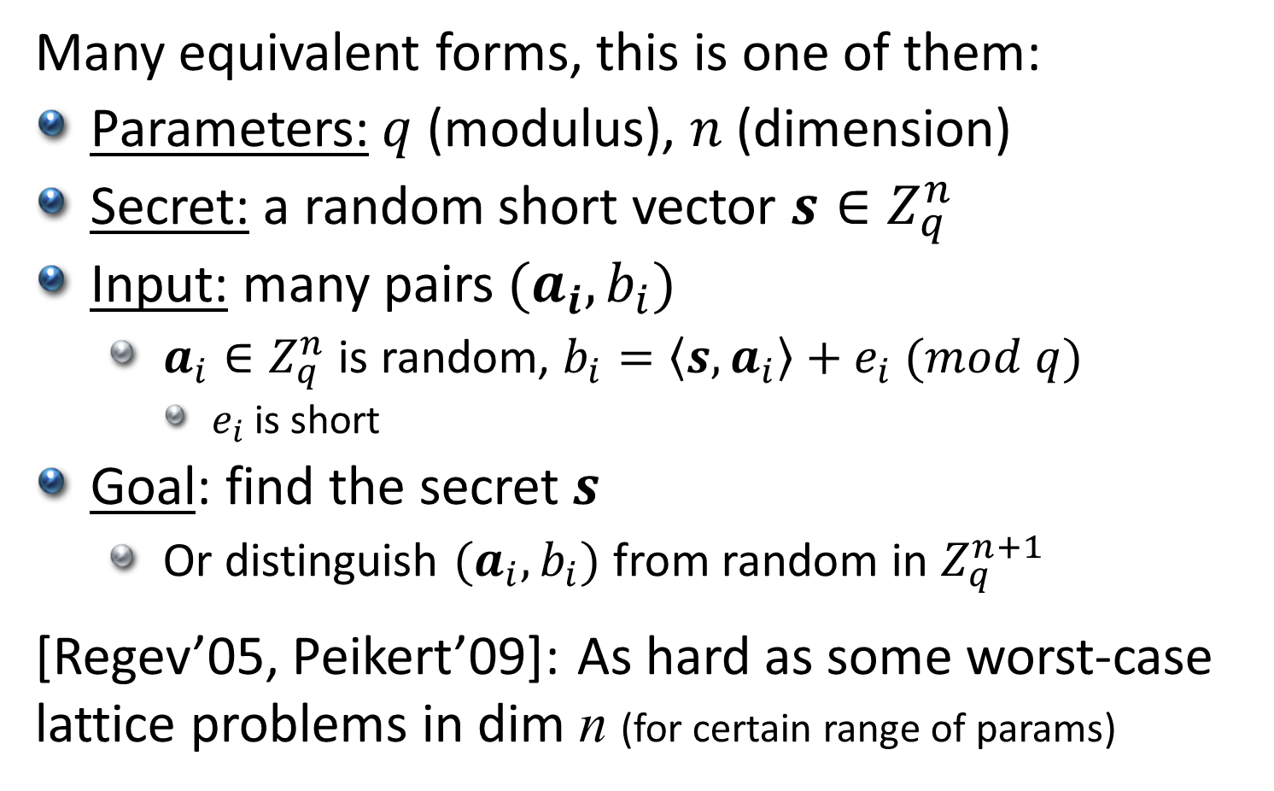
Learning with Errors [Reg’05]
Many equivalent forms, this is one of them:
Parameters: $q$ (modulus), $n$ (dimension)
Secret: a random short vector $s∈Z_{q}^{n}$
Input: many pairs $(a_{i},b_{i})$
$a_{i}∈Z_{q}^{n}$ is random, $b_{i}=\left\langle s,a_{i}\right\rangle +e_{i} (mod q)$
$e_{i}$ is short
Goal: find the secret $s$
Or distinguish $(a_{i},b_{i})$ from random in $Z_{q}^{n+1}$
[Regev’05, Peikert’09]: As hard as some worst-case lattice problems in dim n (for certain range of params)

Slide 11
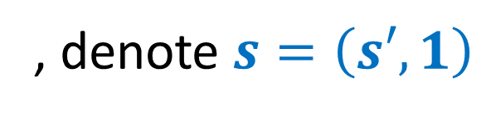
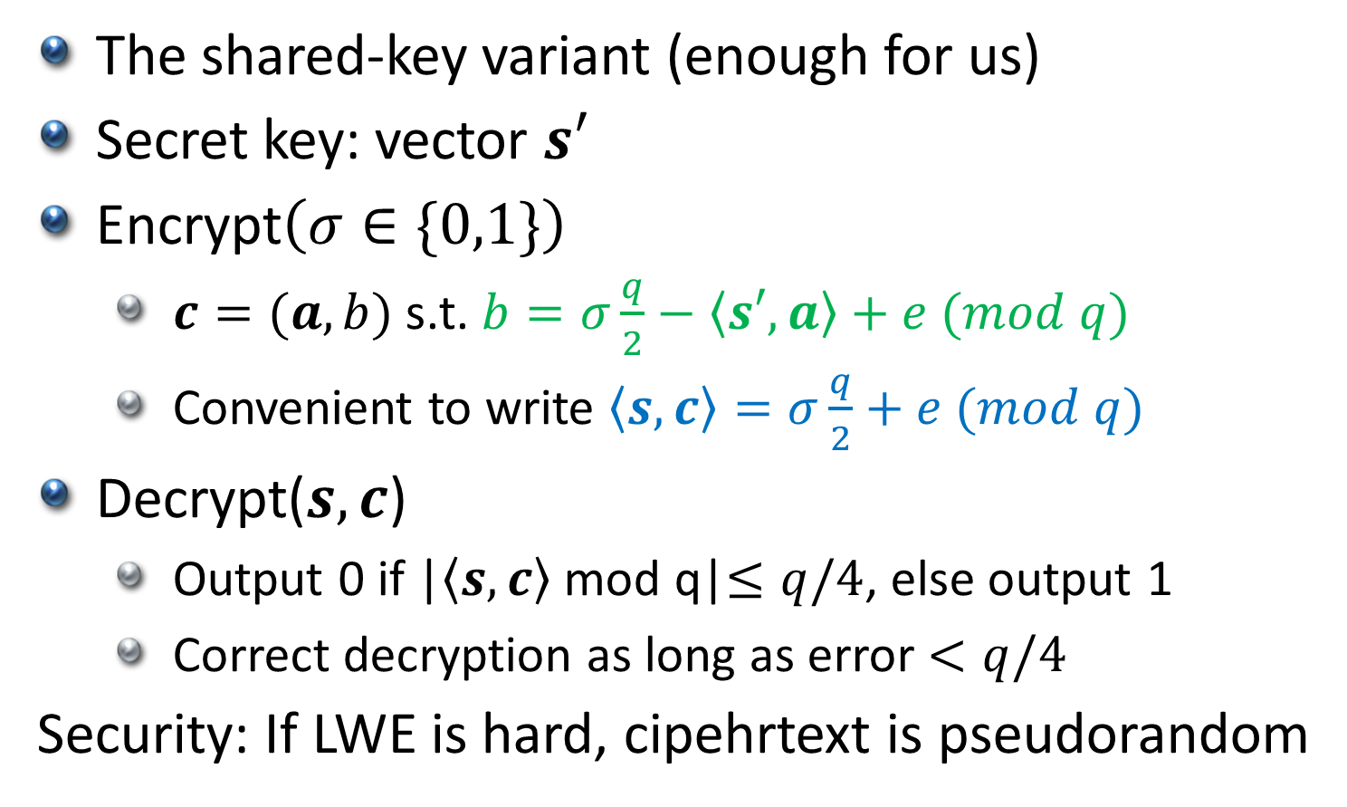
Regev’s Cryptosystem [Reg’05]
The shared-key variant (enough for us)
Secret key: vector $s′$
Encrypt$\left(σ∈\{0,1\}\right)$
$c=(a,b)$s.t. $b=σ\frac{q}{2}−\left\langle s′,a\right\rangle +e (mod q)$
Convenient to write $\left\langle s,c\right\rangle =σ\frac{q}{2}+e (mod q)$
Decrypt($s,c$)
Output 0 if |$\left\langle s,c\right\rangle$ mod q|$≤q/4$, else output 1
Correct decryption as long as error $<q/4$
Security: If LWE is hard, cipehrtext is pseudorandom
, denote $s=\left(s′, 1\right)$

Slide 12

Additive Homomorphism
If $\left\langle s,c_{i}\right\rangle ≈σ_{i}\frac{q}{2}$ (mod q) then $\left\langle s,{c_{1}+c}_{2}\right\rangle ≈{(σ}_{1}⊕σ_{2})\frac{q}{2}$ (mod q)
Error doubles on addition
Correct decryption as long as the error $<q/4$

Slide 13
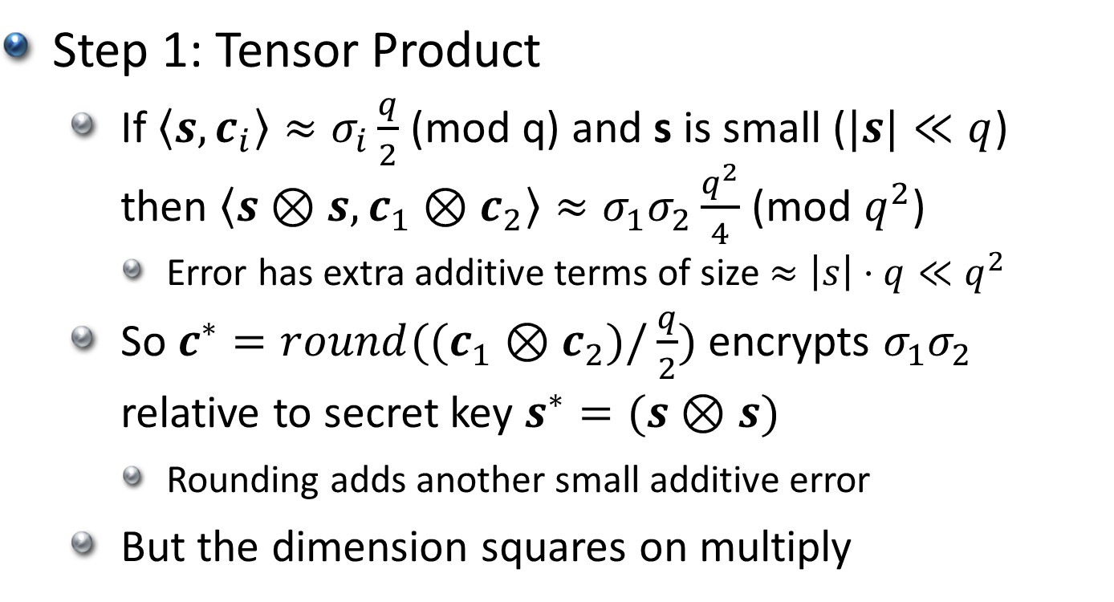
How to Multiply [BV’11, B’12]
Step 1: Tensor Product
If $\left\langle s,c_{i}\right\rangle ≈σ_{i}\frac{q}{2}$ (mod q) and s is small ($|s|≪q$) then $\left\langle s⊗s,c_{1}⊗c_{2}\right\rangle ≈σ_{1}σ_{2}\frac{q^{2}}{4}$ (mod $q^{2}$)
Error has extra additive terms of size $≈\left|s\right|⋅q≪q^{2}$
So ${c^{∗}=round((c}_{1}⊗c_{2})/\frac{q}{2})$ encrypts $σ_{1}σ_{2}$
relative to secret key $s^{∗}=(s⊗s)$
Rounding adds another small additive error
But the dimension squares on multiply

Slide 14
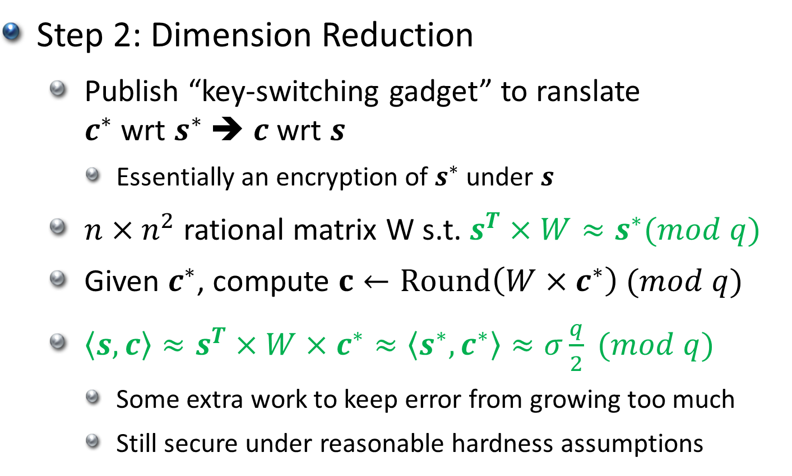
How to Multiply [BV’11, B’12]
Step 2: Dimension Reduction
Publish “key-switching gadget” to ranslate $c^{∗}$ wrt $s^{∗}$ ➔ $c$ wrt $s$
Essentially an encryption of $s^{∗}$ under $s$
$n×n^{2}$ rational matrix W s.t. $s^{T}×W≈s^{∗}(mod q)$
Given $c^{∗}$, compute $c←Round\left({W×c}^{∗}\right) (mod q)$
$\left\langle s,c\right\rangle ≈s^{T}×W×c^{∗}≈\left\langle s^{∗},c^{∗}\right\rangle ≈σ\frac{q}{2} (mod q)$
Some extra work to keep error from growing too much
Still secure under reasonable hardness assumptions

Slide 15
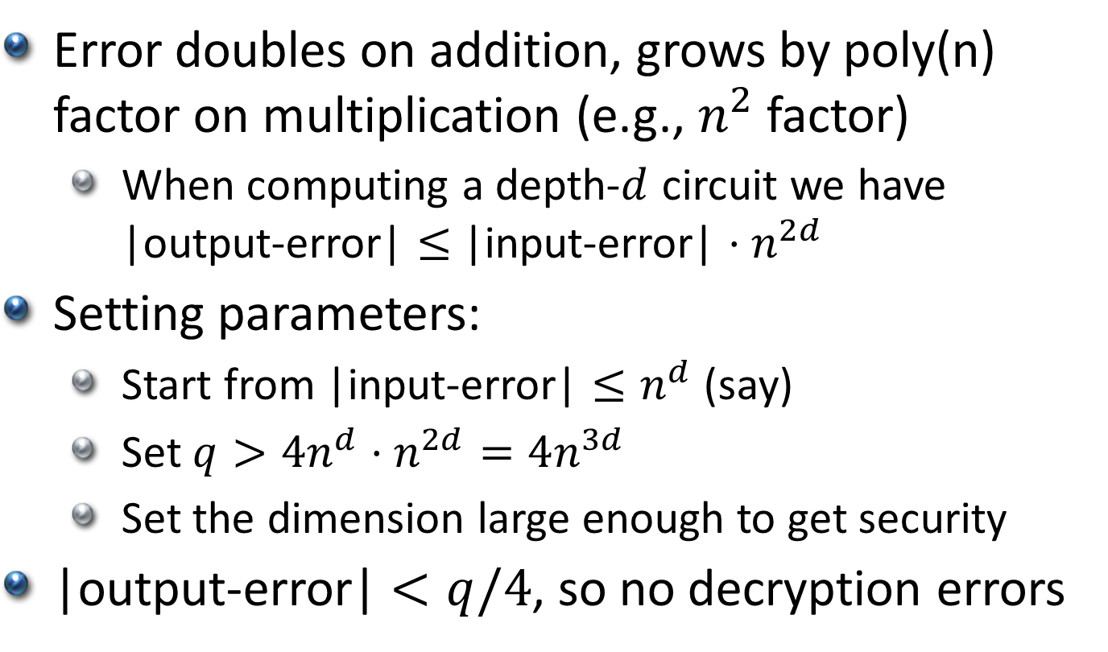
Somewhat Homomorphic Encryption
Error doubles on addition, grows by poly(n) factor on multiplication (e.g., $n^{2}$ factor)
When computing a depth-$d$ circuit we have |output-error| $≤$ |input-error| $⋅n^{2d}$
Setting parameters:
Start from |input-error| $≤n^{d}$ (say)
Set $q>{4n^{d}⋅n}^{2d}=4n^{3d}$
Set the dimension large enough to get security
|output-error| $<q/4$, so no decryption errors

Slide 16
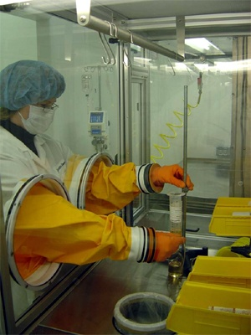
FHE via Bootstrapping [Gen’09]
So far, circuits of pre-determined depth
x₁
C
x₂
…
C(x₁, x₂ ,…, x_{t})
x_{t}
Notes:
Explain “fresh” vs “evaluated” cipehrtexts

Slide 17
FHE via Bootstrapping [Gen’09]
So far, circuits of pre-determined depth
Can eval y=C(x₁,x₂…,x_{n}) when x_{i}’s are “fresh”
But y is an “evaluated ciphertext”
Can still be decrypted
But eval C’(y) will increase noise too much
x₁
C
x₂
…
C(x₁, x₂ ,…, x_{t})
x_{t}
Notes:
Explain “fresh” vs “evaluated” cipehrtexts

Slide 18
FHE via Bootstrapping [Gen’09]
So far, circuits of pre-determined depth
Bootstrapping to handle deeper circuits
We have a noisy evaluated ciphertext y
Want to get another y with less noise
x₁
C
x₂
…
C(x₁, x₂ ,…, x_{t})
x_{t}
Notes:
Explain “fresh” vs “evaluated” cipehrtexts

Slide 19
FHE via Bootstrapping [Gen’09]
For ciphertext c, consider D_{c}(sk) = Dec_{sk}(c)
Hope: D_{c}(∗) is a low-depth circuit (on input sk)
Include in the public key also Enc_{pk}(sk)
Homomorphic computation applied only to the “fresh” encryption of sk
c
y
Requires “circular security”
sk₁
Dc
sk₁
sk₂
sk₂
c’
…
Dc(sk)
…
= Dec_{sk}(c) = y
sk_{n}
sk_{n}

Slide 20
FHE via Bootstrapping [Gen’09]
Similarly define Mc₁,c₂(sk) = Dec_{sk}(c₁)∙Dec_{sk}(c₁)
Homomorphic computation applied only to the “fresh” encryption of sk
y₁
y₂
c₁
c₂
sk₁
Mc₁,c₂
sk₁
c’
sk₂
sk₂
…
Mc₁,c₂(sk)
…
= Dec_{sk}(c₁) x Dec_{sk}(c₂) = y₁ x y₂
sk_{n}
sk_{n}

Slide 21
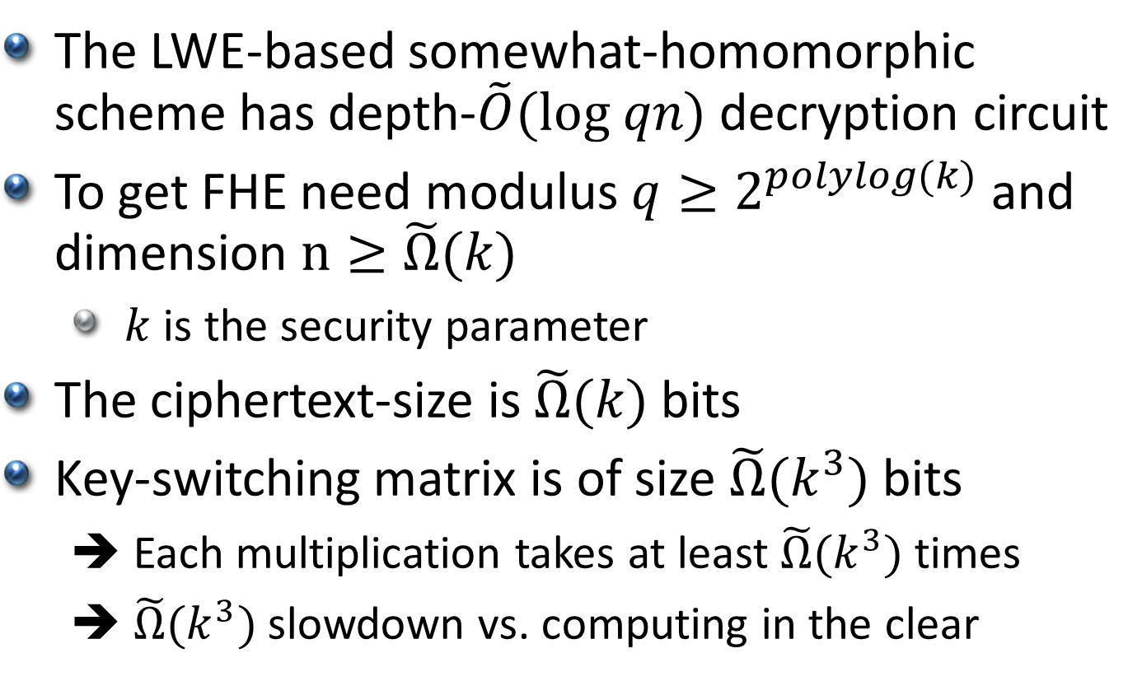
(In)Efficiency of This Scheme
The LWE-based somewhat-homomorphic scheme has depth-$\tilde{O}(log qn)$ decryption circuit
To get FHE need modulus ${q≥2}^{polylog(k)}$ and dimension $n≥\tilde{Ω}(k)$
$k$ is the security parameter
The ciphertext-size is $\tilde{Ω}(k)$ bits
Key-switching matrix is of size $\tilde{Ω}(k^{3})$ bits
➔ Each multiplication takes at least $\tilde{Ω}(k^{3})$ times
➔ $\tilde{Ω}(k^{3})$ slowdown vs. computing in the clear

Slide 22
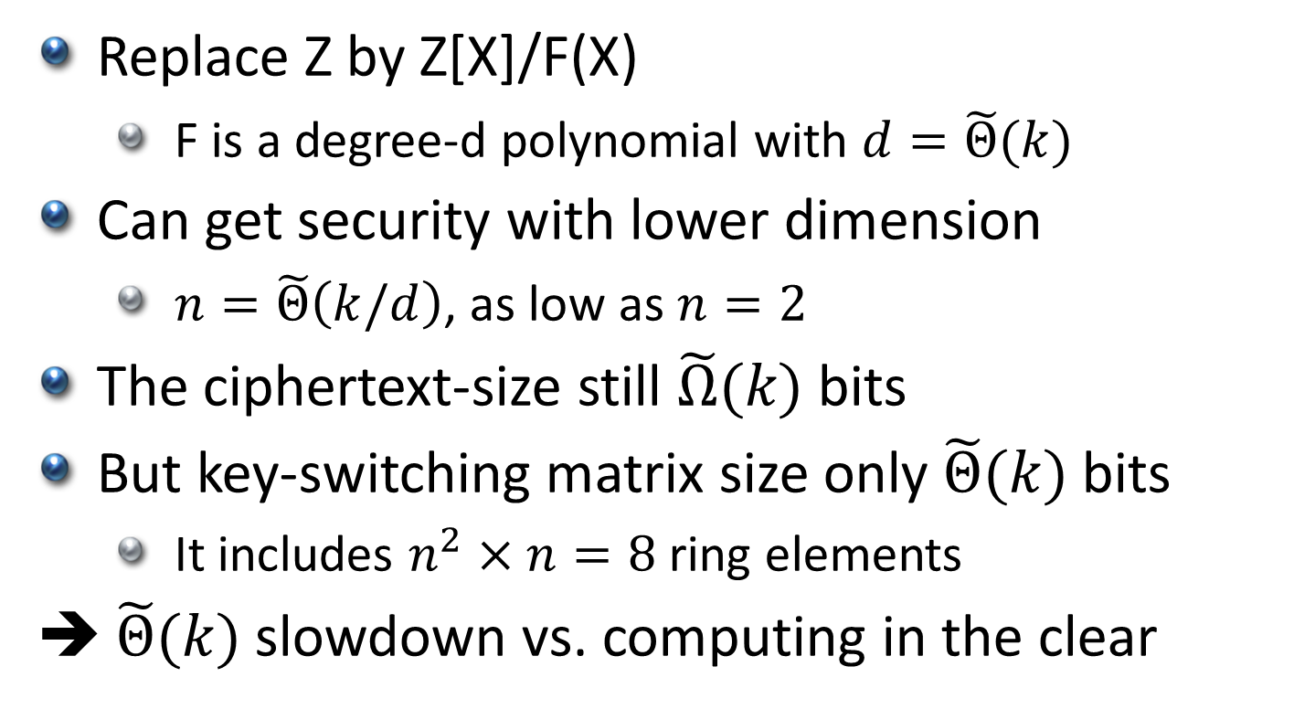
Better Efficiency with Ring-LWE
Replace Z by Z[X]/F(X)
F is a degree-d polynomial with $d=\tilde{Θ}(k)$
Can get security with lower dimension
$n=\tilde{Θ}\left(k/d\right)$, as low as $n=2$
The ciphertext-size still $\tilde{Ω}(k)$ bits
But key-switching matrix size only $\tilde{Θ}(k)$ bits
It includes $n^{2}×n=8$ ring elements
➔ $\tilde{Θ}(k)$ slowdown vs. computing in the clear

Slide 23
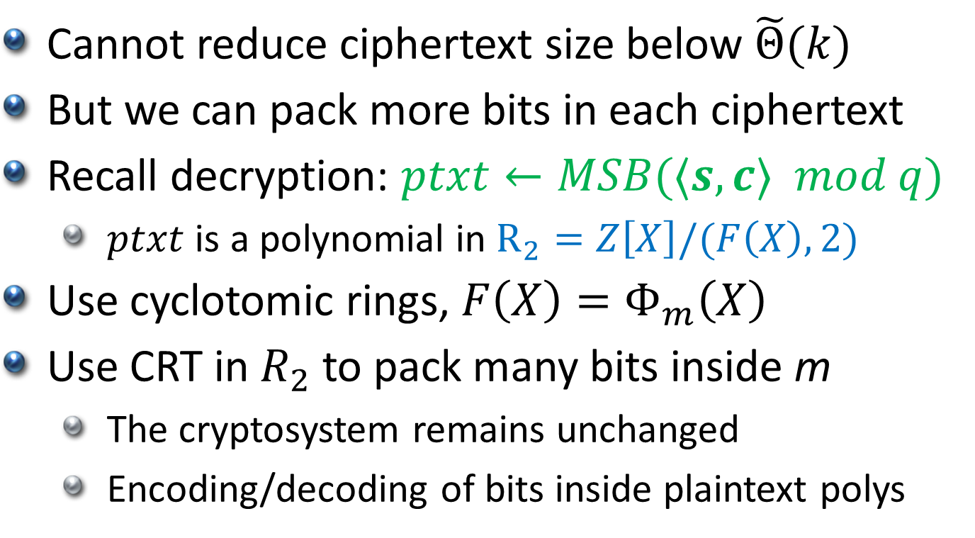
Ciphertext Packing
Cannot reduce ciphertext size below $\tilde{Θ}(k)$
But we can pack more bits in each ciphertext
Recall decryption: $ptxt←MSB(⟨s,c⟩ mod q)$
$ptxt$ is a polynomial in $R_{2}=Z\left[X\right]/(F\left(X\right),2)$
Use cyclotomic rings, $F\left(X\right)=Φ_{m}\left(X\right)$
Use CRT in $R_{2}$ to pack many bits inside m
The cryptosystem remains unchanged
Encoding/decoding of bits inside plaintext polys

Slide 24
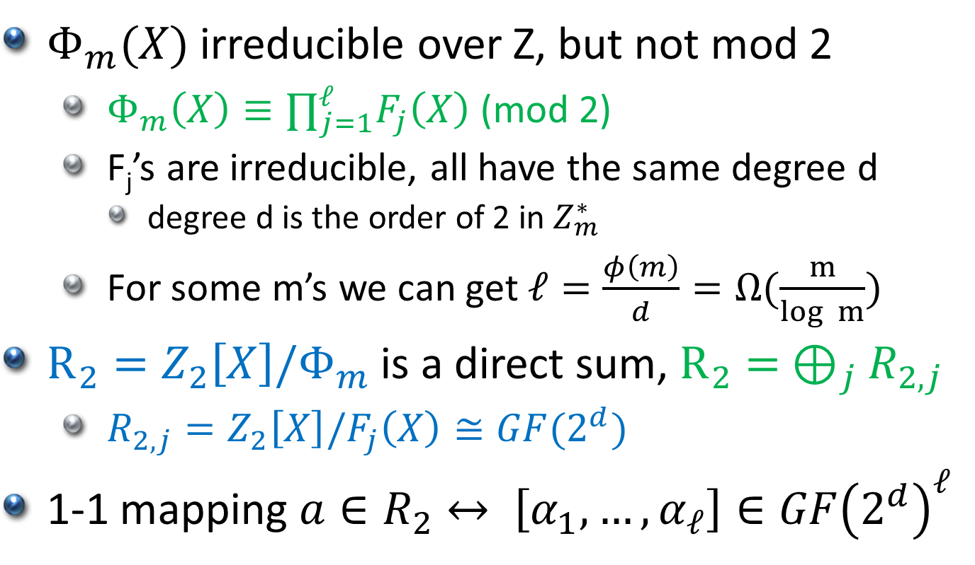
Plaintext Algebra
$Φ_{m}(X)$ irreducible over Z, but not mod 2
$Φ_{m}\left(X\right)≡∏_{j=1}^{ℓ}F_{j}\left(X\right)$ (mod 2)
F_{j}’s are irreducible, all have the same degree d
degree d is the order of 2 in $Z_{m}^{∗}$
For some m’s we can get $ℓ=\frac{φ\left(m\right)}{d}=Ω(\frac{m}{log m})$
$R_{2}=Z_{2}\left[X\right]/Φ_{m}$ is a direct sum, $R_{2}= ⊕_{j}R_{2,j}$
$R_{2,j}=Z_{2}\left[X\right]/F_{j}\left(X\right)≅GF(2^{d})$
1-1 mapping $a∈R_{2}↔ \left[α_{1}, …, α_{ℓ}\right]∈GF{\left(2^{d}\right)}^{ℓ}$

Slide 25
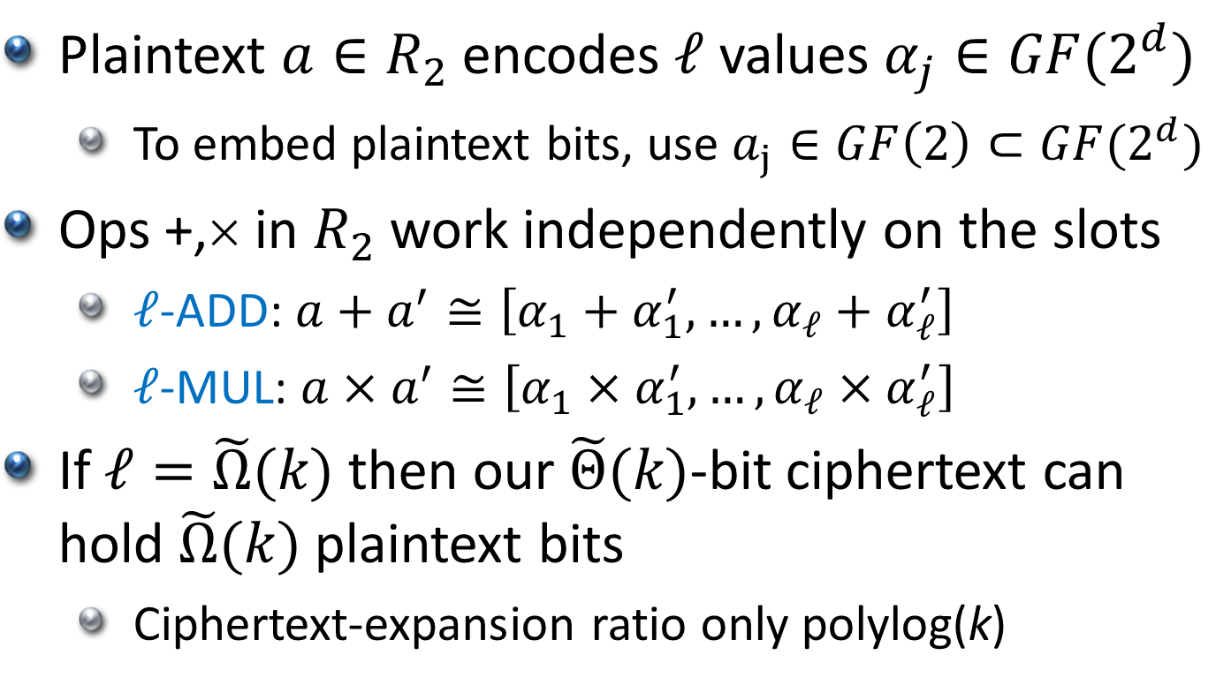
Plaintext Slots
Plaintext $a∈R_{2}$ encodes $ℓ$ values $α_{j}∈GF(2^{d})$
To embed plaintext bits, use $a_{j}∈GF\left(2\right)⊂GF(2^{d})$
Ops +,× in $R_{2}$work independently on the slots
$ℓ$-ADD: $a+a^{′}≅\left[α_{1}+α_{1}^{′}, …, α_{ℓ}+α_{ℓ}^{′}\right]$
$ℓ$-MUL: $a×a^{′}≅\left[α_{1}×α_{1}^{′}, …, α_{ℓ}×α_{ℓ}^{′}\right]$
If $ℓ=\tilde{Ω}(k)$ then our $\tilde{Θ}(k)$-bit ciphertext can hold $\tilde{Ω}(k)$ plaintext bits
Ciphertext-expansion ratio only polylog(k)

Slide 26

Aside: an $ℓ$-SELECT Operation
x₁ | x₂ | x₃ | x₄ | x₅ | x₆ | x₇
=
x₁ | 0 | 0 | x₄ | 0 | x₆ | 0
x
1 | 0 | 0 | 1 | 0 | 1 | 0
+
x₈ | x₉ | x₁₀ | x₁₁ | x₁₂ | x₁₃ | x₁₄
=
0 | x₉ | x₁₀ | 0 | x₁₂ | 0 | x₁₄
x
0 | 1 | 1 | 0 | 1 | 0 | 1
x₁ | x₉ | x₁₀ | x₄ | x₁₂ | x₆ | x₁₄
We will use this later

Slide 27
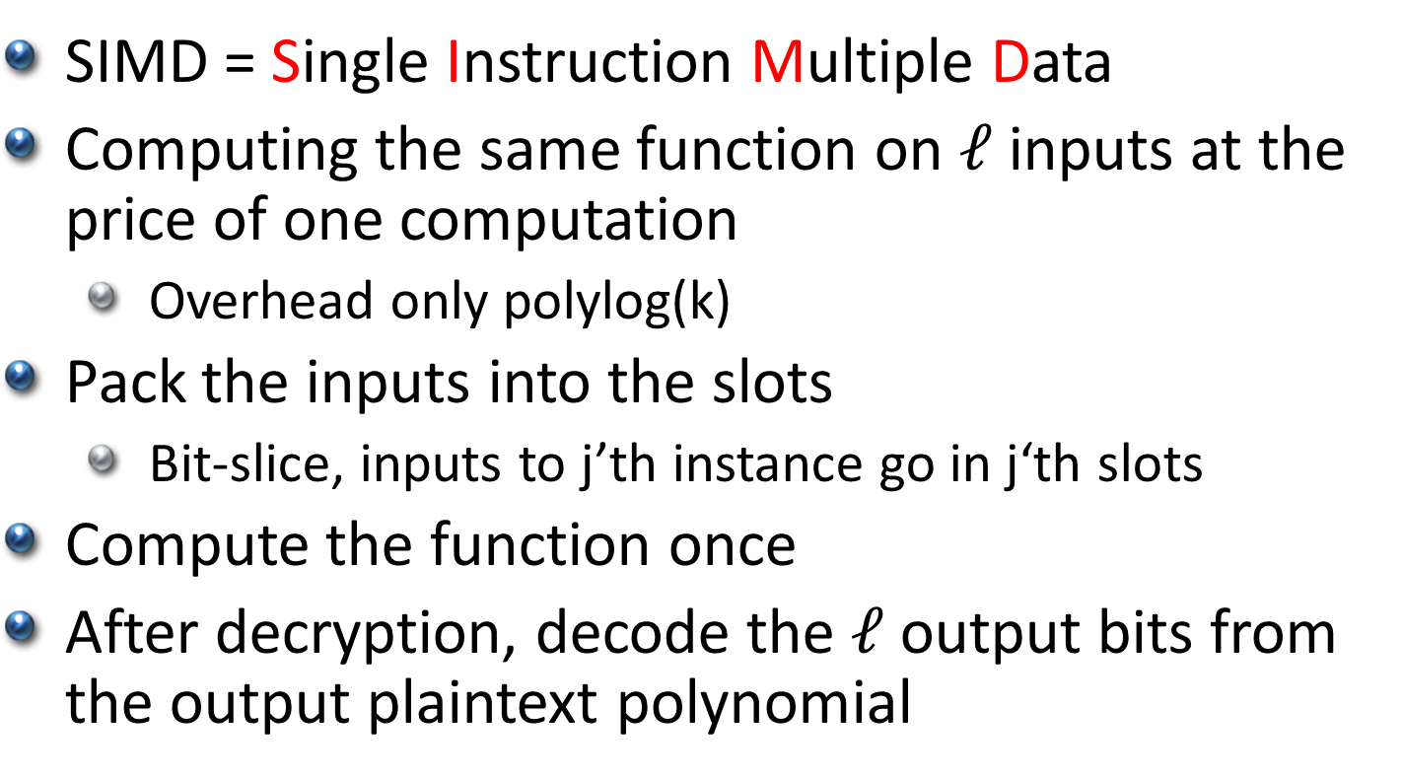
Homomorphic SIMD [SV’11]
SIMD = Single Instruction Multiple Data
Computing the same function on $ℓ$ inputs at the price of one computation
Overhead only polylog(k)
Pack the inputs into the slots
Bit-slice, inputs to j’th instance go in j‘th slots
Compute the function once
After decryption, decode the $ℓ$ output bits from the output plaintext polynomial

Slide 28
Beyond SIMD Computation
To reduce overhead for a single computation:
Pack all input bits in just a few ciphertexts
Compute while keeping everything packed
How to do this?

Slide 29
So you want to compute some function…
+
+
+
+
+
+
+
+
+
1
×
×
×
×
×
×
×
×
×
×
×
1
+
+
+
+
+
+
+
+
+
+
+
+
+
0
1
1
Input bits
x₁
x₂
x₃
x₄
x₅
x₇
x₈
x₉
x₁₀
x₁₁
x₁₂
x₁₄
x₁₅
x₁₆
x₁₇
x₁₈
x₁₉
x₂₁
x₂₂
x₂₃
x₂₄
x₂₅
x₂₆

Slide 30
So you want to compute some function using SIMD…
+
+
+
+
+
+
+
+
+
1
×
×
×
×
×
×
×
×
×
×
×
1
+
+
+
+
+
+
+
+
+
+
+
+
+
0
1
1
Input bits
x₁
x₂
x₃
x₄
x₅
x₇
x₈
x₉
x₁₀
x₁₁
x₁₂
x₁₄
x₁₅
x₁₆
x₁₇
x₁₈
x₁₉
x₂₁
x₂₂
x₂₃
x₂₄
x₂₅
x₂₆
x₁ | x₂ | x₃ | x₄ | x₅ |  | x₇
x₈ | x₉ | x₁₀ | x₁₁ | x₁₂ |  | x₁₄
x₁₅ | x₁₆ | x₁₇ | x₁₈ | x₁₉ |  | x₂₁
x₂₂ | x₂₃ | x₂₄ | x₂₅ | x₂₆

Slide 31

Routing Values Between Levels
We need to map this
Into that
Is there a natural operation on polynomials that moves values between slots?
x₁ | x₂ | x₃ | x₄ | x₅ | 0 | x₇
x₈ | x₉ | x₁₀ | x₁₁ | x₁₂ | 1 | x₁₄
x₁₅ | x₁₆ | x₁₇ | x₁₈ | x₁₉ | 1 | x₂₁
x₂₂ | x₂₃ | x₂₄ | x₂₅ | x₂₆
… so we can use $ℓ$-add
+
+
+
+
+
+
+
+
+
+
+
+
+
x₁ | x₃ | x₅ | x₇ | x₉ | x₁₁ | 1
x₁₅ | x₁₇ | x₁₉ | x₂₁ | x₂₃ | x₂₅
x₂ | x₄ | 0 | x₈ | x₁₀ | x₁₂ | x₁₄
x₁₆ | x₁₈ | 1 | x₂₂ | x₂₄ | x₂₆

Slide 32
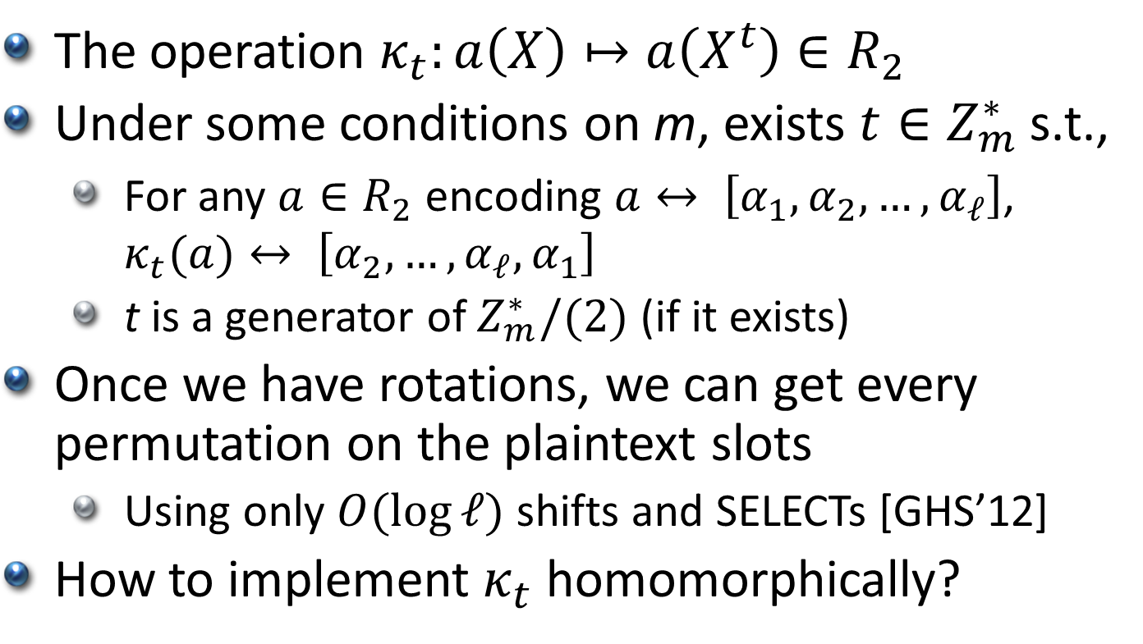
Using Automorphisms
The operation $κ_{t}:a\left(X\right)↦a\left(X^{t}\right)∈R_{2}$
Under some conditions on m, exists $t∈Z_{m}^{∗}$ s.t.,
For any $a∈R_{2}$ encoding $a↔ \left[α_{1}, α_{2},…, α_{ℓ}\right]$, $κ_{t}(a)↔ \left[α_{2}, …, α_{ℓ},α_{1}\right]$
t is a generator of $Z_{m}^{∗}/(2)$ (if it exists)
Once we have rotations, we can get every permutation on the plaintext slots
Using only $O(\log{ℓ})$ shifts and SELECTs [GHS’12]
How to implement $κ_{t}$ homomorphically?

Slide 33
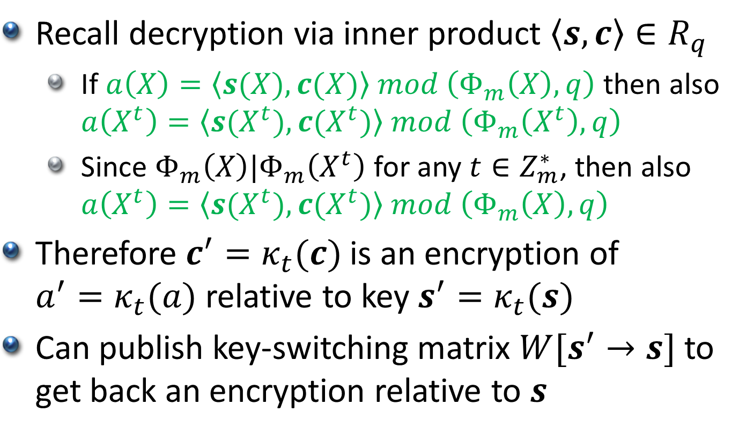
Homomorphic Automorphism
Recall decryption via inner product $\left\langle s,c\right\rangle ∈R_{q}$
If $a\left(X\right)=\left\langle s(X),c(X)\right\rangle mod \left(Φ_{m}\left(X\right), q\right)$ then also $a\left(X^{t}\right)=\left\langle s(X^{t}),c(X^{t})\right\rangle mod \left(Φ_{m}\left(X^{t}\right), q\right)$
Since $Φ_{m}\left(X\right)|Φ_{m}\left(X^{t}\right)$ for any $t∈Z_{m}^{∗}$, then also $a\left(X^{t}\right)=\left\langle s(X^{t}),c(X^{t})\right\rangle mod \left(Φ_{m}\left(X\right), q\right)$
Therefore $c^{′}=κ_{t}(c)$ is an encryption of $a^{′}=κ_{t}(a)$ relative to key $s^{′}=κ_{t}(s)$
Can publish key-switching matrix $W[s^{′}→s]$ to get back an encryption relative to $s$

Slide 34
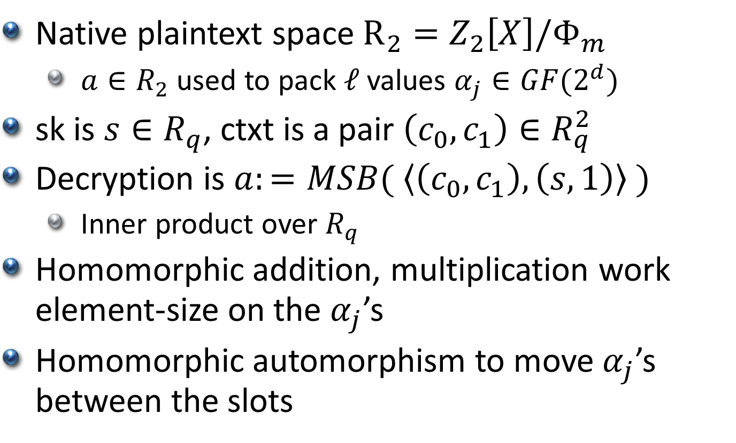
Summary of RLWE HE encryption
Native plaintext space $R_{2}=Z_{2}\left[X\right]/Φ_{m}$
$a∈R_{2}$ used to pack $ℓ$ values $α_{j}∈GF(2^{d})$
sk is $s∈R_{q}$, ctxt is a pair $\left(c_{0},c_{1}\right)∈R_{q}^{2}$
Decryption is $a:=MSB( \left\langle \left(c_{0},c_{1}\right),\left(s,1\right)\right\rangle )$
Inner product over $R_{q}$
Homomorphic addition, multiplication work element-size on the $α_{j}$’s
Homomorphic automorphism to move $α_{j}$’s between the slots

