Slide 1
Fully Homomorphic Encryption over the Integers
Many slides borrowed from Craig
Marten van Dijk¹, Craig Gentry², Shai Halevi², Vinod Vaikuntanathan²
1 – MIT, 2 – IBM Research

Slide 2
The Goal
I want to delegate processing of my data, without giving away access to it.

Slide 3
Application: Cloud Computing
I want to delegate processing of my data, without giving away access to it.
Storing my files on the cloud
  Encrypt them to protect my information
  Later, I want to retrieve the files containing “cloud” within 5 words of “computing”.
    Cloud should return only these (encrypted) files, without knowing the key

Slide 4
Computing on Encrypted Data
Separating processing from access via encryption:
  I will encrypt my stuff before sending it to the cloud
  They will apply their processing on the encrypted data, send me back the processed result
  I will decrypt the result and get my answer

Slide 5
Application: Private Google Search
I want to delegate processing of my data, without giving away access to it.
Private Internet search
  Encrypt my query, send to Google
    Google cannot “see” my query, since it does not know my key
  I still want to get the same results
    Results would be encrypted too
Privacy combo: Encrypted query on encrypted data

Slide 6
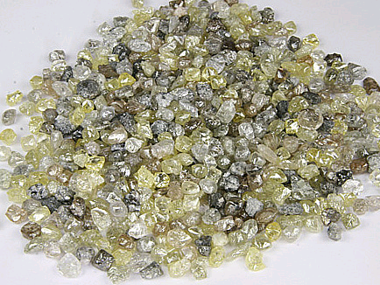


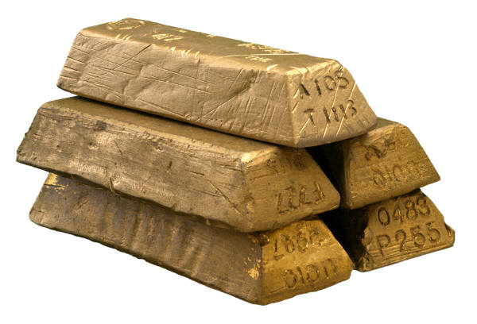

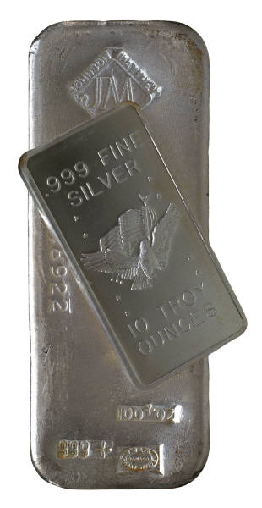
An Analogy: Alice’s Jewelry Store
Alice’s workers need to assemble raw materials into jewelry
But Alice is worried about theft
  How can the workers process the raw materials without having access to them?

Slide 7



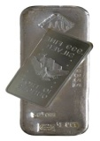

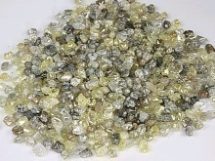
An Analogy: Alice’s Jewelry Store
Alice puts materials in locked glove box
  For which only she has the key
Workers assemble jewelry in the box
Alice unlocks box to get “results”

Slide 8
The Analogy
Encrypt: putting things inside the box
  Anyone can do this (imagine a mail-drop)
  c_{i} ← Enc(m_{i})
Decrypt: Taking things out of the box
  Only Alice can do it, requires the key
  m* ← Dec(c*)
Process: Assembling the jewelry
  Anyone can do it, computing on ciphertext
  c* ← Process(c₁,…,c_{n})
m* = Dec(c*) is “the ring”, made from “raw materials” m_{i}

Slide 9
Public-key Encryption
Three procedures: KeyGen, Enc, Dec
  (sk,pk) ← KeyGen($)
    Generate random public/secret key-pair
  c ← Enc_{pk}(m)
    Encrypt a message with the public key
  m ← Dec_{sk}(c)
    Decrypt a ciphertext with the secret key
E.g., RSA: c←m^{e} mod N, m←c^{d} mod N
  (N,e) public key, d secret key

Slide 10
Homomorphic Public-key Encryption
Another procedure: Eval (for Evaluate)
  c* ← Eval(pk, f, c₁,…,c_{t})
  No info about m₁, …, m_{t}, f(m₁, …m_{t}) is leaked
  f(m₁, …m_{t}) is the “ring” made from raw materials m₁, …, m_{t} inside the encryption box
function
Encryptions of inputs m₁,…,m_{t} to f
  Encryption of f(m₁,…,m_{t}). I.e., Dec(sk, c) = f(m₁, …m_{t})

Slide 11
Can we do it?
As described so far, sure..
  (Π, c₁,…,c_{n}) = c* ←Eval_{pk}(Π, c₁,…,c_{n})
  Dec_{sk}(c*) decrypts individual c_{i}’s, apply Π
(the workers do nothing, Alice assembles
the jewelry by herself)
Of course, this is cheating:
We want c* to remain small
  independent of the size of Π
  “Compact” homomorphic encryption
We may also want Π to remain secret
This is the main challenge
Can be done with “generic tools” (Yao’s garbled circuits)

Slide 12
Previous Schemes
  c ← Eval(pk, f, c₁,…,c_{t}), Dec(sk, c) = f(m₁, …, m_{t})
Only “somewhat homomorphic”
  Can only handle some functions f
RSA works for MULT function (mod N)
  c = c₁ x … x c_{t} =(m₁ x … x m_{t})^{e} (mod N)
X
c₁ = m₁e
c₂ = m₂e
c_{t} = m_{t}^{e}
Notes:
Maybe use pictures here?

Slide 13
“Somewhat Homomorphic” Schemes
RSA, ElGamal work for MULT mod N
GoMi, Paillier work for XOR, ADD
BGN05 works for quadratic formulas

Slide 14
Schemes with large ciphertext
SYY99 works for shallow fan-in-2 circuits
  c* grows exponentially with the depth of f
IsPe07 works for branching program
  c* grows with length of program
AMGH08 for low-degree polynomials
  c* grows exponentially with degree

Slide 15
Connection with 2-party computation
Can get “homomorphic encryption” from certain protocols for 2-party secure function evaluation
  E.g., Yao86
But size of c*, complexity of decryption, more than complexity of the function f
  Think of Alice assembling the ring herself
These are solving a different problem

Slide 16
A Recent Breakthrough
Genrty09: A bootstrapping technique
Gentry also described a candidate “bootstrappable” scheme
  Based on ideal lattices
Scheme E can handle its own decryption function
Scheme E* can handle any function

Slide 17
The Current Work
A second “bootstrappable” scheme
  Very simple: using only modular arithmetic
Security is based on the hardness of finding “approximate-GCD”

Slide 18
Outline
Homomorphic symmetric encryption
  Very simple
Turning it into public-key encryption
  Result is “almost bootstrappable”
Making it bootstrappable
  Similar to Gentry’09
Security
Gentry’s bootstrapping technique
As much as
we have time
Not today

Slide 19
A homomorphic symmetric encryption
Shared secret key: odd number p
To encrypt a bit m:
  Choose at random small r, large q
  Output c = m + 2r + pq
    Ciphertext is close to a multiple of p
    m = LSB of distance to nearest multiple of p
To decrypt c:
  Output m = (c mod p) mod 2
    m = c – p • [c/p] mod 2
    = c – [c/p] mod 2
    = LSB(c) XOR LSB([c/p])
The “noise”
Noise much smaller than p

Slide 20
Homomorphic Public-Key Encryption
Secret key is an odd p as before
Public key is many “encryptions of 0”
  x_{i} = q_{i}p + 2r_{i}
Enc_{pk}(m) = subset-sum(x_{i}’s)+m
Dec_{sk}(c) = (c mod p) mod 2
[ ]_{x0} for i=1,2,…,t
[ ]_{x0}

Slide 21
Why is this homomorphic?
Basically because:
  If you add or multiply two near-multiples
  of p, you get another near multiple of p…

Slide 22
Why is this homomorphic?
c₁=q₁p+2r₁+m₁, c₂=q₂p+2r₂+m₂
c₁+c₂ = (q₁+q₂)p + 2(r₁+r₂) + (m₁+m₂)
  2(r₁+r₂)+(m₁+m₂) still much smaller than p
  ➔c₁+c₂ mod p = 2(r₁+r₂) + (m₁+m₂)
c₁ x c₂ = (c₁q₂+q₁c₂−q₁q₂)p
+ 2(2r₁r₂+r₁m₂+m₁r₂) + m₁m₂
  2(2r₁r₂+…) still much smaller than p
  ➔c₁xc₂ mod p = 2(2r₁r₂+…) + m₁m₂
Distance to nearest multiple of p

Slide 23
Why is this homomorphic?
c₁=m₁+2r₁+q₁p, …, c_{t}=m_{t}+2r_{t}+q_{t}p
Let f be a multivariate poly with integer coefficients (sequence of +’s and x’s)
Let c = Eval_{pk}(f, c₁, …, c_{t}) = f(c₁, …, c_{t})
  f(c₁, …, c_{t}) = f(m₁+2r₁, …, m_{t}+2r_{t}) + qp
  = f(m₁, …, m_{t}) + 2r + qp
  Then (c mod p) mod 2 = f(m₁, …, m_{t}) mod 2
Suppose this noise is much smaller than p
That’s what we want!

Slide 24
How homomorphic is this?
Can keep adding and multiplying until the “noise term” grows larger than p/2
  Noise doubles on addition, squares on multiplication
  Multiplying d ciphertexts ➔ noise of size ~2^{dn}
We choose r ~ 2^{n}, p ~ 2^{n} (and q ~ 2^{n} )
  Can compute polynomials of degree n before the noise grows too large
2
5

Slide 25
Keeping it small
The ciphertext’s bit-length doubles with every multiplication
  The original ciphertext already has n⁶ bits
  After ~log n multiplications we get ~n⁷ bits
We can keep the bit-length at n⁶ by adding more “encryption of zero”
  |y₁|=n⁶+1, |y₂|=n⁶+2, …, |y_{m}|=2n⁶
  Whenever the ciphertext length grows,
  set c’ = c mod y_{m} mod y_{m-1} … mod y₁

Slide 26
Bootstrappable yet?
c/p, rounded to nearest integer
Almost, but not quite:
Decryption is m = LSB(c)  LSB([c/p])
  Computing [c/p] takes degree O(n)
  But O() is more than one (maybe 7??)
    Integer c has ~n⁵ bits
  Our scheme only supports degree ≤ n
To get a bootstrappable scheme, use Gentry09 technique to “squash the decryption circuit”
Notes:
With n=80, n⁵~2³² bits, ~400 MByte

Slide 27
How do we “simplify” decryption?
m
Old decryption algorithm
Dec_{E}
sk
c
Idea: Add to public key another “hint” about sk
  Of course, hint should not break secrecy of encryption
With hint, anyone can post-process the ciphertext, leaving less work for Dec_{E*} to do
This idea is used in server-aided cryptography.

Slide 28
How do we “simplify” decryption?
m
New approach
Old decryption algorithm
Dec_{E*}
Processed ciphertext c*
m
The hint about sk in pub key
sk*
c*
Dec_{E}
Post-Process
sk
c
f(sk, r)
c
Hint in pub key lets anyone post-process the ciphertext, leaving less work for Dec_{E*} to do.

Slide 29
Squashing the decryption circuit
Add to public key many real numbers
  d₁,d₂, …, d_{t} ∈ [0,2] (with “sufficient precision”)
  ∃ sparse set S for which Σ_{i∈S} d_{i} = 1/p mod 2
Enc, Eval output ψ_{i}=c x d_{i} mod 2, i=1,…,t
  Together with c itself
New secret key is bit-vector σ₁,…,σ_{t}
  σ_{i}=1 if i∈S, σ_{i}=0 otherwise
New Dec(c) is c – [Σ_{i} σ_{i}Ψ_{i}] mod 2
  Can be computed with a “low-degree circuit” because S is sparse

Slide 30
A Different Way to Add Numbers
a_{i}
Dec_{E*}(s,c)= LSB(c) XOR LSB([Σ_{i} σ_{i}ψ_{i}])
  Our problem: t is large (e.g. n⁶)
a_{1,0} | a_{1,-1} | … | a_{1,-log t}
a_{2,0} | a_{2,-1} | … | a_{2,-log t}
a_{3,0} | a_{3,-1} | … | a_{3,-log t}
a_{4,0} | a_{4,-1} | … | a_{4,-log t}
a_{5,0} | a_{5,-1} | … | a_{5,-log t}
… | … | … | …
a_{t,0} | a_{t,-1} | … | a_{t,-log t}
a_{i}‘s in binary representation

Slide 31
A Different Way to Add Numbers
a_{1,0} | a_{1,-1} | … | a_{1,-log t}
a_{2,0} | a_{2,-1} | … | a_{2,-log t}
a_{3,0} | a_{3,-1} | … | a_{3,-log t}
a_{4,0} | a_{4,-1} | … | a_{4,-log t}
a_{5,0} | a_{5,-1} | … | a_{5,-log t}
… | … | … | …
a_{t,0} | a_{t,-1} | … | a_{t,-log t}
Let b₀ be the binary rep of Hamming weight
b_{0,log t} | … | b_{0,1} | b_{0,0}

Slide 32
A Different Way to Add Numbers
a_{1,0} | a_{1,-1} | … | a_{1,-log t}
a_{2,0} | a_{2,-1} | … | a_{2,-log t}
a_{3,0} | a_{3,-1} | … | a_{3,-log t}
a_{4,0} | a_{4,-1} | … | a_{4,-log t}
a_{5,0} | a_{5,-1} | … | a_{5,-log t}
… | … | … | …
a_{t,0} | a_{t,-1} | … | a_{n,-log t}
Let b₋₁ be the binary rep of Hamming weight
b_{0,log t} | … | b_{0,1} | b_{0,0}
 | b_{-1,log t} | … | b_{-1,1} | b_{-1,0}

Slide 33
A Different Way to Add Numbers
a_{1,0} | a_{1,-1} | … | a_{1,-log t}
a_{2,0} | a_{2,-1} | … | a_{2,-log t}
a_{3,0} | a_{3,-1} | … | a_{3,-log t}
a_{4,0} | a_{4,-1} | … | a_{4,-log t}
a_{5,0} | a_{5,-1} | … | a_{5,-log t}
… | … | … | …
a_{t,0} | a_{t,-1} | … | a_{t,-log t}
Let b_{-log t} be the binary rep of Hamming weight
b_{0,log t} | … | b_{0,1} | b_{0,0}
 | b_{-1,log t} | … | b_{-1,1} | b_{-1,0}
 |  | … | … | … | …
 |  |  | b_{-log t,log t} | … | b_{-log t,1} | b_{-log t,0}

Slide 34
A Different Way to Add Numbers
a_{1,0} | a_{1,-1} | … | a_{1,-log t}
a_{2,0} | a_{2,-1} | … | a_{2,-log t}
a_{3,0} | a_{3,-1} | … | a_{3,-log t}
a_{4,0} | a_{4,-1} | … | a_{4,-log t}
a_{5,0} | a_{5,-1} | … | a_{5,-log t}
… | … | … | …
a_{t,0} | a_{t,-1} | … | a_{n,-log t}
Only log t numbers with log t bits of precision. Easy to handle.
b_{0,log t} | … | b_{0,1} | b_{0,0}
 | b_{-1,log t} | … | b_{-1,1} | b_{-1,0}
 |  | … | … | … | …
 |  |  | b_{-log n,log t} | … | b_{-log t,1} | b_{-log t,0}

Slide 35
Computing Sparse Hamming Wgt.
a_{1,0} | a_{1,-1} | … | a_{1,-log n}
a_{2,0} | a_{2,-1} | … | a_{2,-log n}
a_{3,0} | a_{3,-1} | … | a_{3,-log n}
a_{4,0} | a_{4,-1} | … | a_{4,-log n}
a_{5,0} | a_{5,-1} | … | a_{5,-log n}
… | … | … | …
a_{t,0} | a_{t,-1} | … | a_{t,-log t}

Slide 36
Computing Sparse Hamming Wgt.
a_{1,0} | a_{1,-1} | … | a_{1,-log t}
0 | 0 | … | 0
0 | 0 | … | 0
a_{4,0} | a_{4,-1} | … | a_{4,-log t}
0 | 0 | … | 0
… | … | … | …
a_{t,0} | a_{t,-1} | … | a_{t,-log t}

Slide 37
Computing Sparse Hamming Wgt.
Binary representation of the Hamming weight of a = (a₁, …, a_{t})∈{0,1}^{t}
  The i’th bit of HW(a) is e₂i(a) mod2
  e_{k} is elementary symmetric poly of degree k
    Sum of all products of k bits
We know a priori that weight ≤ |S|
  ➔ Only need upto e_{2^[log |S|]}(a)
  ➔ Polynomials of degree upto |S|
Set |S| ~ n, then E* is bootstrappable.

Slide 38
Security
The approximate-GCD problem:
  Input: integers w₀, w₁,…, w_{t,}
    Chosen as w_{i} = q_{i}p + r_{i} for a secret odd p
    p∈$[0,P], q_{i}∈$[0,Q], r_{i}∈$[0,R] (with R  P  Q)
  Task: find p
Thm: If we can distinguish Enc(0)/Enc(1) for some p, then we can find that p
  Roughly: the LSB of r_{i} is a “hard core bit”
  ➔ Scheme is secure if approx-GCD is hard
Is approx-GCD really a hard problem?

Slide 39
Hard-core-bit theorem
A. The approximate-GCD problem:
  Input: w_{i} = q_{i}p + r_{i} (i=0,…,t)
    p∈$[0,P], q_{i}∈$[0,Q], r_{i}∈$[0,R’] (with R’  P  Q)
  Task: find p
B. The cryptosystem
  Input: x_{i} = q_{i}p + 2r_{i} (i=0,…,t), c=qp+2r+m
    p∈$[0,P], q_{i}∈$[0,Q], r_{i}∈$[0,R] (with R  P  Q)
  Task: distinguish m=0 from m=1
Thm: Solution to B ➔ solution to A
  small caveat: R’ smaller than R

Slide 40
Proof outline
Input: w_{i} = q_{i}p + r_{i} (i=1,…,t)
Use the w_{i}’s to form a public key
  This is where we need R’>R
Amplify the distinguishing advantage
  From any noticeable ε to almost 1
Use reliable distinguisher to learn q_{t}
  Using the binary GCD procedure
Finally p = round(w_{t}/q_{t})

Slide 41
Use the w_{i}’s to form a public key
We have w_{i}=q_{i}p+r_{i}, need x_{i}=q_{i}’p+2r_{i}’
  Setting x_{i} = 2w_{i} yields wrong distribution
Reorder w_{i}’s so w₀ is the largest one
  Check that w₀ is odd, else abort
  Also hope that q₀ is odd (else may fail to find p)
    w₀ odd, q₀ odd → r₀ is even
x₀=w₀+2ρ₀, x_{i}=(2w_{i} +2ρ_{i}) mod w₀ for i>0
  The ρ_{i}’s are random < R
Correctness:
  r_{i}+ρ_{i} distributed almost identically to ρ_{i}
    Since R>R’ by a super-polynomial factor
  2q_{i} mod q₀ is random in [q₀]

Slide 42
Amplify the distinguishing advantage
Given an integer z=qp+r, with r<R’:
  Set c = [z+ m+2ρ + subset-sum(x_{i}’s)] mod x₀
  For random ρ<R, random bit m
c is a random ciphertext wrt the x_{i}’s
  ρ>r_{i}’s, so ρ+r_{i}’s distributed like ρ
  (subset-sum(q_{i})’s mod q₀) random in [q₀]
c mod p mod 2 = r+m mod 2
  A guess for c mod p mod 2 ➔ vote for r mod 2
Choose many random c’s, take majority
  Noticeable advantage ➔ Reliable r mod 2

Slide 43
Use reliable distinguisher to learn q_{t’}
From z=qp+r, can get r mod 2
  Note: z = q+r mod 2 (since p is odd)
  So (q mod 2) = (r mod 2)  (z mod 2)
Given z₁, z₂, both near multiples of p
  Get b_{i} := q_{i} mod 2, if z₁<z₂ swap them
  If b₁=b₂=1, set z₁:=z₁−z₂, b₁:=b₁−b₂
    At least one of the b_{i}’s must be zero now
  For any b_{i}=0 set z_{i} := floor(z_{i}/2)
    new-q_{i} = old-q_{i}/2
  Repeat until one z_{i} is zero, output the other
Binary-GCD
z = (2s)p + r ➔ z/2 = sp + r/2
➔ floor(z/2) = sp + floor(r/2)

Slide 44
Use reliable distinguisher to learn q_{t}
z_{i}=q_{i}p+r_{i}, i=1,2, z’:=Binary-GCD(z₁,z₂)
  Then z’ = GCD*(q₁,q₂)·p + r’
  For random q₁,q₂, Pr[GCD(q₁,q₂)=1] ~ 0.6
Try (say) z’:=Binary-GCD(w_{t},w_{t-1})
  Hope that z’=1·p+r
    Else try again with Binary-GCD(z’,w_{t-2}), etc.
Run Binary-GCD(w_{t},z’)
  The b₂ bits spell out the bits of q_{t}
Once you learn q_{t} then
  round(w_{t}/q_{t}) = p+round(r_{t}/q_{t}) = p
The odd part of the GCD

Slide 45
Hardness of Approximate-GCD
Several lattice-based approaches for solving approximate-GCD
  Related to Simultaneous Diophantine Approximation (SDA)
  Studied in [Hawgrave-Graham01]
    We considered some extensions of his attacks
All run out of steam when |q_{i}|>|p|²
  In our case |p|~n², |q_{i}|~n⁵  |p|²

Slide 46
Relation to SDA
x_{i} = q_{i}p + r_{i} (r_{i}  p  q_{i}), i = 0,1,2,…
  y_{i} = x_{i}/x₀ = (q_{i}p + r_{i})/(q₀p + r₀)
  = (q_{i} + (r_{i}/p))/(q₀ + (r₀/p))
    = (q_{i}+s_{i})/q₀, with s_{i} ~ r_{i}/p  1
  y1, y2, … is an instance of SDA
    q₀ is a denominator that approximates all y_{i}’s
Use Lagarias’es algorithm to try and solve this SDA instance
  Find q₀, then p=round(x₀/q₀)

Slide 47
Lagarias’es SDA algorithm
Consider the rows of this matrix B:
  They span dim-(t+1) lattice
<q₀,q₁,…,q_{t}>·B is short
  1st entry: q₀R < Q·R
  i^{th} entry (i>1): q₀(q_{i}p+r_{i})-q_{i}(q₀p+r₀)=q₀r_{i}-q_{i}r₀
    Less than Q·R in absolute value
  ➔ Total size less than Q·R·t
    vs. size ~Q·P (or more) for the basis vectors
Hopefully we will find it with a lattice-reduction algorithm (LLL or variants)
  R x₁ x₂ … x_{t}
  -x₀
  -x₀
  …
  -x₀
B=

Slide 48
Will this algorithm succeed?
  R x₁ x₂…x_{t}
  -x₀
  -x₀
  …
  -x₀
Is <q₀,q₁,…,q_{t}>·B shortest in lattice?
  Is it shorter than t·det(B)^{1/t+1} ?
    det(B) is small-ish (due to R in the corner)
  Need ((QP)^{t}R)^{1/t+1} > QR
     t+1 > (log Q + log P – log R) / (log P – log R)
    ~ log Q/log P
log Q = ω(log²P) ➔ need t=ω(log P)
Quality of LLL & co. degrades with t
  Only finds vectors of size ~ 2^{t/2}·shortest
    or 2^{t/2}→2^{εt} for any constant ε>0
  t=ω(log P) ➔ 2^{εt}·QR > det(B)^{1/t+1}
  Contemporary lattice reduction is not strong enough
Minkowski bound

Slide 49
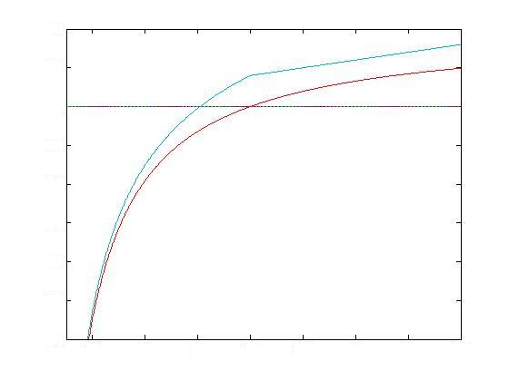
Why this algorithm fails
What LLL can find
min(blue,purple)+εt
size (log scale)
log Q
auxiliary solutions
(Minkowski’s bound)
converges to ~ logQ+logP
the solution we
are seeking
blue line
remains above
purple line
t
logQ/logP

Slide 50
Conclusions
Fully Homomorphic Encryption is a very powerful tool
Gentry09 gives first feasibility result
  Showing that it can be done “in principle”
We describe a “conceptually simpler” scheme, using only modular arithmetic
What about efficiency?
  Computation, ciphertext-expansion are polynomial, but a rather large one…
Improving efficiency is an open problem

Slide 51
Extra credit
The hard-core-bit theorem
Connection between approximate-GCD and simultaneous Diophantine approx.
Gentry’s technique for “squashing” the decryption circuit

Slide 52
Thank you

