Slide 1
Fully Homomorphic Encryption over the Integers
Many slides borrowed from Craig
Marten van Dijk¹, Craig Gentry², Shai Halevi², Vinod Vaikuntanathan²
1 – MIT, 2 – IBM Research

Slide 2
Computing on Encrypted Data
Storing my files on the cloud
  Encrypt them to protect my information
  Search through them for emails with “homomorphic” in the subject line
    Cloud should return only these (encrypted) messages, w/o knowing the key
Private Internet search
  Encrypt my query, send to Google
  I still want to get the same results
    Results would be encrypted too

Slide 3
Public-key Encryption
Three procedures: KeyGen, Enc, Dec
  (sk,pk) ← KeyGen($)
    Generate random public/secret key-pair
  c ← Enc_{pk}(m)
    Encrypt a message with the public key
  m ← Dec_{sk}(c)
    Decrypt a ciphertext with the secret key
E.g., RSA: c←m^{e} mod N, m←c^{d} mod N
  (N,e) public key, d secret key

Slide 4
Homomorphic Public-key Encryption
Also another procedure: Eval
  c* ← Eval_{pk}(Π, c₁,…,c_{n})
  Π a Boolean circuit with ADD, MULT mod 2
Circuit
Encryption of inputs m₁,…,m_{n} to Π
Encryption of output value m*=Π(m₁,…,m_{n})

Slide 5
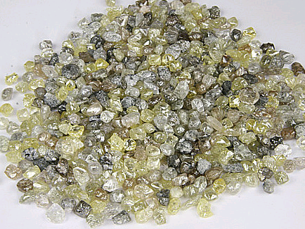


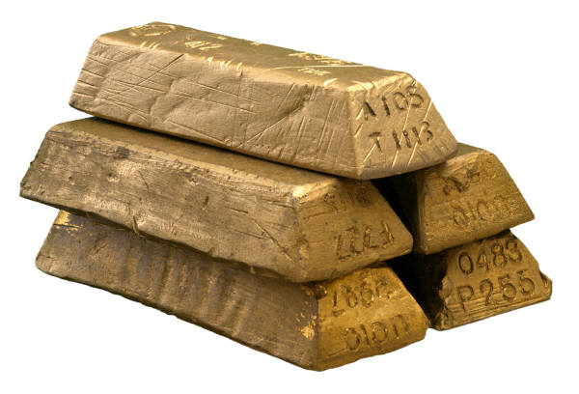

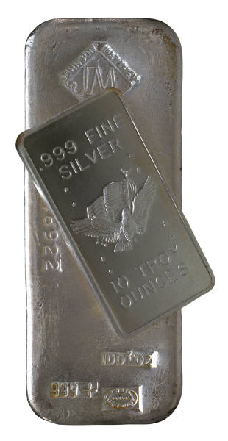
An Analogy: Alice’s Jewelry Store
Alice’s workers need to assemble raw materials into jewelry
But Alice is worried about theft
  How can the workers process the raw materials without having access to them?

Slide 6



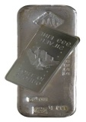

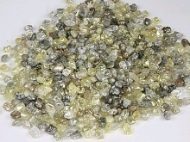
An Analogy: Alice’s Jewelry Store
Alice puts materials in locked glove box
  For which only she has the key
Workers assemble jewelry in the box
Alice unlocks box to get “results”

Slide 7
The Analogy
Enc: putting things inside the box
  Anyone can do this (imagine a mail-drop)
  c_{i} ← Enc_{pk}(m_{i})
Dec: Taking things out of the box
  Only Alice can do it, requires the key
  m* ← Dec_{sk}(c*)
Eval: Assembling the jewelry
  Anyone can do it, computing on ciphertext
  c* ← Eval_{pk}(Π, c₁,…,c_{n})
m* = Π(m₁,…,m_{n}) is “the ring”, made from “raw materials” m₁,…,m_{n}

Slide 8
Can we do it?
As described so far, sure..
  (Π, c₁,…,c_{n}) = c* ←Eval_{pk}(Π, c₁,…,c_{n})
  Dec_{sk}(c*) decrypts individual c_{i}’s, apply Π
(the workers do nothing, Alice assembles
the jewelry by herself)
Of course, this is cheating:
We want c* to remain small
  independent of the size of Π
  “Compact” homomorphic encryption
We may also want Π to remain secret
This is the main challenge
Can be done with “generic tools” (Yao’s garbled circuits)

Slide 9
What was known?
“Somewhat homomorphic” schemes:
  Only work for some circuits
E.g., RSA works for MULT gates (mod N)
  c*= c₁ x c₂ … x c_{n} =(m₁ x m₂ … x m_{n})^{e} (mod N)
X
c₁ = m₁e
c₂ = m₂e
c_{n} = m_{n}^{e}

Slide 10
“Somewhat Homomorphic” Schemes
RSA, ElGamal work for MULT mod N
GoMi, Paillier work for XOR, ADD
BGN05 works for quadratic formulas
SYY99 works for shallow fan-in-2 circuits
  c* grows exponentially with the depth of Π
IP07 works for branching program
MGH08 works for low-degree polynomials
  c* grows exponentially with degree

Slide 11
A Recent Breakthrough
Genrty09: A bootstrapping technique
  Somewhat homomorphic → Fully homomorphic
Gentry also described a candidate “bootstrappable” scheme
  Based on ideal lattices
Scheme E can evaluate its own decryption circuit
Scheme E* can evaluate any circuit

Slide 12
The Current Work
A second “bootstrappable” scheme
  Very simple: using only modular arithmetic
Security is based on the hardness of finding “approximate-GCD”

Slide 13
Outline
A homomorphic symmetric encryption
Turning it into public-key encryption
  Result is “almost bootstrappable”
Making it bootstrappable
  Similar to Gentry’09
Security
Gentry’s bootstrapping technique
Time permitting
Not today

Slide 14
A homomorphic symmetric encryption
Shared secret key: odd number p
To encrypt a bit m:
  Choose at random large q, small r
  Output c = pq + 2r + m
    Ciphertext is close to a multiple of p
    m = LSB of distance to nearest multiple of p
To decrypt c:
  Output m = (c mod p) mod 2
2r+m much smaller than p

Slide 15
Why is this homomorphic?
c₁=q₁p+2r₁+m₁, c₂=q₂p+2r₂+m₂
c₁+c₂ = (q₁+q₂)p + 2(r₁+r₂) + (m₁+m₂)
  2(r₁+r₂)+(m₁+m₂) still much smaller than p
  ➔c₁+c₂ mod p = 2(r₁+r₂) + (m₁+m₂)
c₁ x c₂ = (c₁q₂+q₁c₂−q₁q₂)p
+ 2(2r₁r₂+r₁m₂+m₁r₂) + m₁m₂
  2(2r₁r₂+…) still much smaller than p
  ➔c₁xc₂ mod p = 2(2r₁r₂+…) + m₁m₂
Distance to nearest multiple of p

Slide 16
How homomorphic is this?
Can keep adding and multiplying until the “noise term” grows larger than q/2
  Noise doubles on addition, squares on multiplication
We choose r ~ 2^{n}, p ~ 2^{n} (and q ~ 2^{n} )
  Can compute polynomials of degree ~n before the noise grows too large
2
5

Slide 17
Homomorphic Public-Key Encryption
Secret key is an odd p as before
Public key is many “encryptions of 0”
  x_{i} = q_{i}p + 2r_{i}
Enc_{pk}(m) = subset-sum(x_{i}’s)+m
Dec_{sk}(c) = (c mod p) mod 2
Eval as before
[ ]_{x0} for i=1,2,…,n
[ +2r]_{x0}

Slide 18
Keeping it small
The ciphertext’s bit-length doubles with every multiplication
  The original ciphertext already has n⁶ bits
  After ~log n multiplications we get ~n⁷ bits
We can keep the bit-length at n⁶ by adding more “encryption of zero”
  |y₁|=n⁶+1, |y₂|=n⁶+2, …, |y_{m}|=2n⁶
  Whenever the ciphertext length grows,
  set c’ = c mod y_{m} mod y_{m-1} … mod y₁

Slide 19
Bootstrappable yet?
c/p, rounded to nearest integer
Almost, but not quite:
Decryption is m = c – (p x [c/p]) mod 2
  Same as c–[c/p] mod 2, since p is odd
  Computing [c/p] mod 2 takes degree O(n)
  But O() has constant bigger than one
    Our scheme only supports degree < n
To get a bootstrappable scheme, use Gentry09 technique to “squash the decryption circuit”

Slide 20
Squashing the decryption circuit
Add to public key many real numbers
  r₁,r₂, …, r_{t} ∈ [0,2]
  ∃ sparse set S for which Σ_{i∈S} r_{i} = 1/p mod 2
Enc, Eval output ψ_{i}=c x r_{i} mod 2, i=1,…,t
  Together with c itself
New secret key is bit-vector σ₁,…,σ_{t}
  σ_{i}=1 if i∈S, σ_{i}=0 otherwise
New Dec(c) is c – [Σ_{i} σ_{i}Ψ_{i}] mod 2
  Can be computed with a “low-degree circuit” because S is sparse

Slide 21
Security
The approximate-GCD problem:
  Input: integers x₁, x₂, x_{3,} …
    Chosen as x_{i} = q_{i}p + r_{i} for a secret odd p
    p∈$[0,P], q_{i}∈$[0,Q], r_{i}∈$[0,R] (with R  P  Q)
  Task: find p
Thm: If we can distinguish Enc(0)/Enc(1) for some p, then we can find that p
  Roughly: the LSB of r_{i} is a “hard core bit”
  ➔ Scheme is secure if approx-GCD is hard
Is approx-GCD really a hard problem?

Slide 22
Hardness of Approximate-GCD
Several lattice-based approaches for solving approximate-GCD
  Related to Simultaneous Diophantine Approximation (SDA)
  Studied in [Hawgrave-Graham01]
    We considered some extensions of his attacks
All run out of steam when |q_{i}|>|p|²
  In our case |p|~n², |q_{i}|~n⁵  |p|²

Slide 23
Relation to SDA
x_{i} = q_{i}p + r_{i} (r_{i}  p  q_{i}), i = 0,1,2,…
  y_{i} = x_{i}/x₀ = (q_{i}+s_{i})/q₀, s_{i} ~ r_{i}/p  1
  y1, y2, … is an instance of SDA
    q₀ is a denominator that approximates all y_{i}’s
Use Lagarias’es algorithm:
  Consider the rows of this matrix:
  Find a short vector in the
  lattice that they span
  <q₀,q₁,…,q_{t}>·L is short
  Hopefully we will find it
  R x₁ x₂ … x_{t}
  -x₀
  -x₀
  …
  -x₀
L=

Slide 24
Relation to SDA (cont.)
When will Lagarias’es algorithm succeed?
  <q₀,q₁,…,q_{t}>·L should be shortest in lattice
    In particular shorter than ~det(L)^{1/t+1}
  This only holds for t > log Q/log P
  The dimension of the lattice is t+1
  Quality of lattice-reduction deteriorates exponentially with t
  When log Q > (log P)² (so t>log P),
  LLL-type reduction isn’t good enough anymore
Minkowski bound

Slide 25
Conclusions
Fully Homomorphic Encryption is a very powerful tool
Gentry09 gives first feasibility result
  Showing that it can be done “in principle”
We describe a “conceptually simpler” scheme, using only modular arithmetic
What about efficiency?
  Computation, ciphertext-expansion are polynomial, but a rather large one…

Slide 26
Thank you

